Slide 1

TLE Roster Verification Import
Webinar – FAQ Session

Slide 2
Participation
TLE Steps for Success
TLE Roster Verification Import Video
  http://vimeo.com/87904409
Questions from Districts

Slide 3
Participation
TLE Steps for Success
TLE Roster Verification Import Video
  http://vimeo.com/87904409
Questions from Districts

Slide 4
Participation
Tested Grades and Subjects Only
  Grades 4 – 12
  Subjects Elementary
    Reading/ELA and Math
  Subjects High School
    English III, Algebra I, Algebra II, Geometry.

Slide 5
Participation
1044 Transitional Fourth Grade(3 to 4) (Math/Reading)
1054 Fourth Grade (Math/Reading)
1055 Fifth Grade (Math/Reading)
1056 Sixth Grade (Math/Reading)
1057 Seventh Grade (Math/Reading)
1058 Eighth Grade (Math/Reading)
1114 Language Arts
1115 Spelling/Vocabulary
1116 Title I Language Arts
1132 Reading
1134 ACE Remediation Reading
1139 Title I Reading
1313 English as a Second Language
2204 Mathematics
2217 Pre Algebra
2227 Algebra I (NOT FOR HIGH SCHOOL CREDIT)
2230 Geometry (NOT FOR HIGH SCHOOL CREDIT)
2231 Title I Math
2232 Combined Geometry (not FOR HIGH SCHOOL CREDIT)
2234 ACE Math Remediation
2510 Advanced Programming (For Math Credit)
2537 AP Computer Science Course A (For Math Credit)
2538 Computer Science Course AB (For Math Credit)
4010 AP English Lit. & Comp.
4051 English III (Amer. Lit)
4057 AP English Language & Composition
4058 ACE Reading remediation
4060 ACE English III remediation
4063 English As A 2nd Language — Grades 9-12
4064 International English Language
4065 IB Language Arts
4210 Reading
4215 Title I Reading
4230 World Literature
4404 Title I Math
4405 ACE Math Remediation
4411 Algebra I
4412 Algebra II
4414 ACE Algebra I Remediation
4415 ACE Algebra II Remediation
4418 Intermediate Algebra
4420 Algebra Matrix
4421 Contextual Algebra
4431 Pre Algebra (Elective Credit Only)
4432 Algebra I A (1/2 Unit Credit)
4433 Algebra I B (1/2 Unit Credit)
4520 Combined Geometry
4521 Contextual Geometry
4524 ACE Geometry Remediation
4530 Plane Geometry
4540 Solid Geometry
4630 General Mathematics (For Elective Credit Only)
4640 High School Arithmetic (For Elective Credit Only)
4811 Applied Math I (For Elective Credit Only)
4812 Applied Math II (For Elective Credit Only)
4820 IB Math

Slide 6
Participation
TLE Steps for Success
TLE Roster Verification Import Video
  http://vimeo.com/87904409
Questions from Districts

Slide 7
Goal 1 – Data Clean Up in the Wave TLE Roster Verification Import Application (March 4 – March 31)
Goal 2 – Every “participating” teacher a Single Sign On Account with Certificate Number
Goal 3 – Every “participating” teacher a Single Sign On Account with Certificate Number; associated with your district.
Goal 4 – Final Data Clean Up in the Battelle For Kids application April TBD – April TBD.
Goal 5 – Every “participating” teacher a Single Sign On Account with Certificate Number; associated with your district; with the Battelle for Kids role assigned to their account.
Goal 6 – Teachers Begin Roster Verification by logging into Single Sign On and Clicking on the Battelle for Kids application. (approximately April 15 to approximately May 31)
Goal 7 – Principals/Administrators review and approve rosters in the Battelle for Kids application (completed by June 12)

Slide 8
March 4 – March 31
  Goals 1, 2, & 3
April TBD to June 12
  Goals 4, 5, 6 & 7

Slide 9
March 4th – March 31st
Goal 1 - Data Clean Up in the Wave TLE Roster Verification Import Application (March 4 – March 31)

Slide 10
March 4th to March 31st
Goal 2 - Every “Participating” Teacher A Single Sign On Account with Certificate Number
  1 – Determine if your teachers already have an SSO account. If they do, Goal 1 is complete.
  2 – If the teacher does NOT have an SSO account, have them go to the home page and create a user account on their own.
  Show example of How to Go to the SSO and create an account.

Slide 11
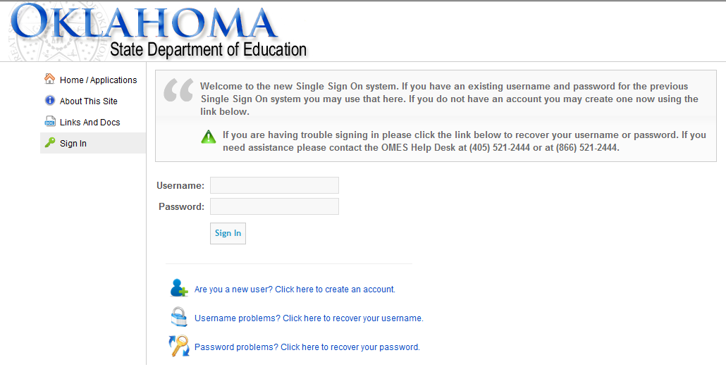

Slide 12
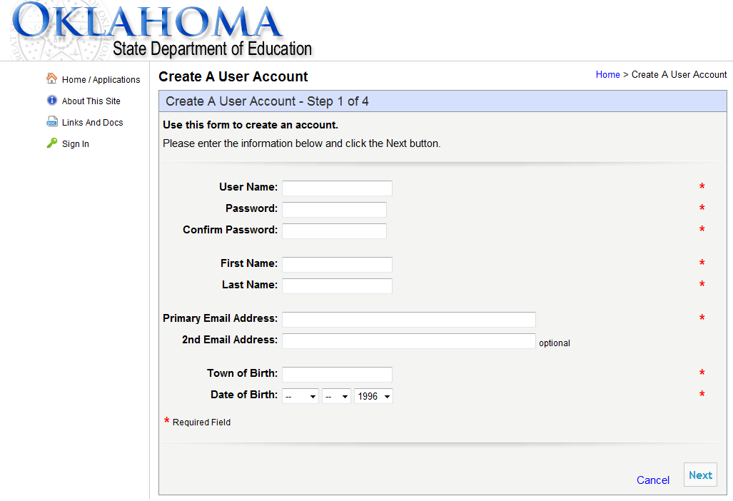

Slide 13
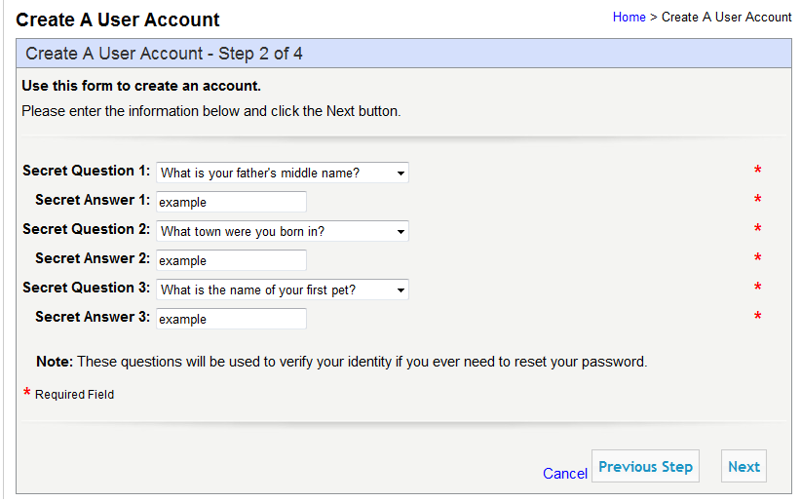

Slide 14
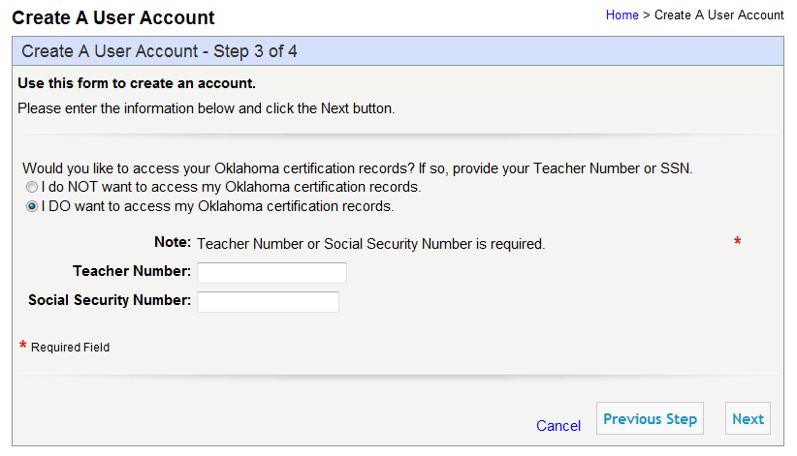

Slide 15
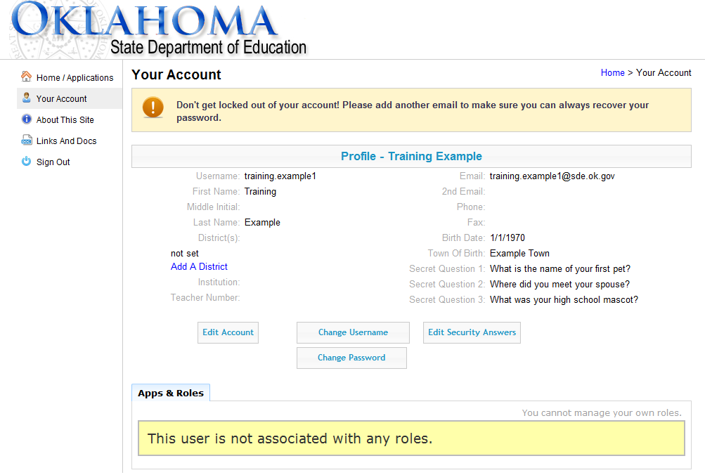

Slide 17
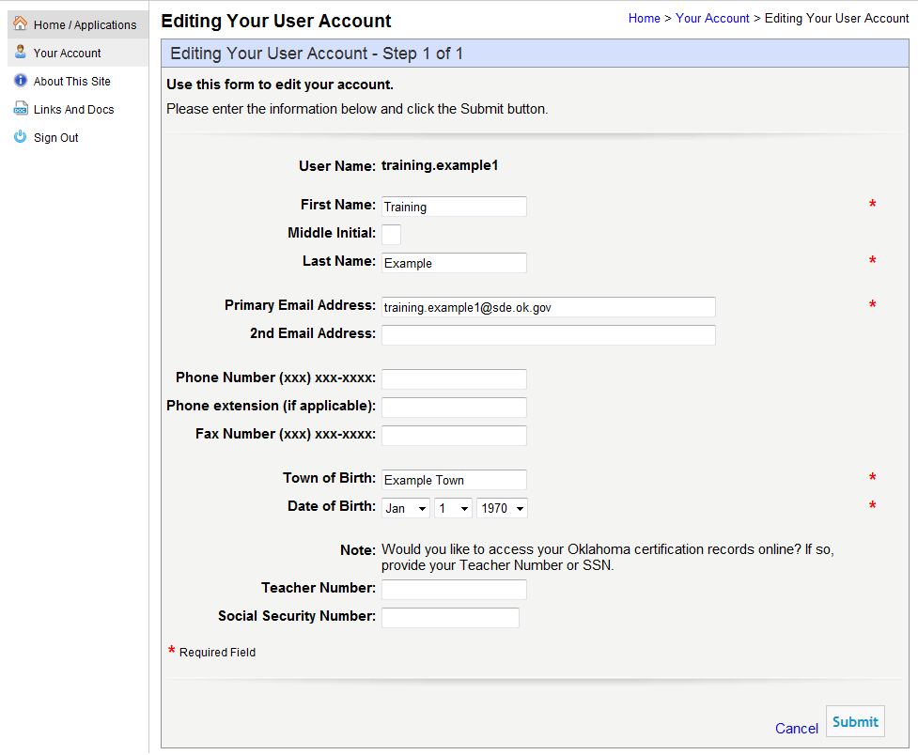

Slide 18
March 4th to March 31st
Goal 3 - Every “Participating” Teacher A Single Sign On Account with Certificate Number; associated with your district
  Inside of the SSO, a teacher has the option to select to “Add a District” to their account which will allow the Superintendent or District Logon Administrator the ability to assign roles (Battelle) to the account.
  If you, as an Admin, can see the teacher in SSO they are associated and Goal 2 is complete. If not they are not associated.
  Automated association is also taking place when the user logs in using the School Personnel report.

Slide 19


Slide 20
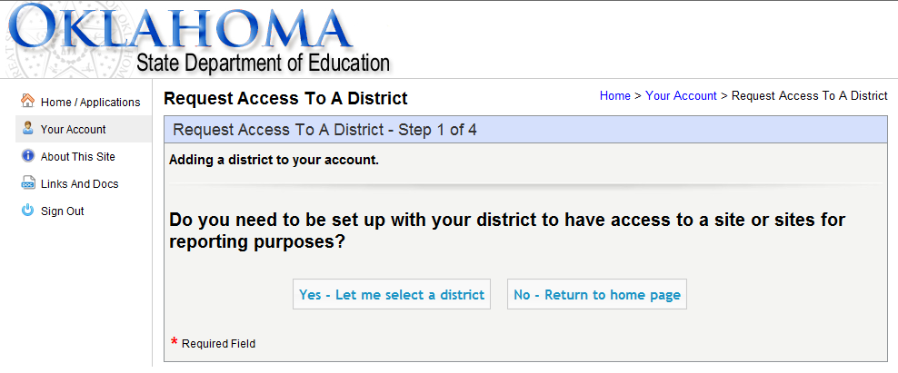

Slide 21
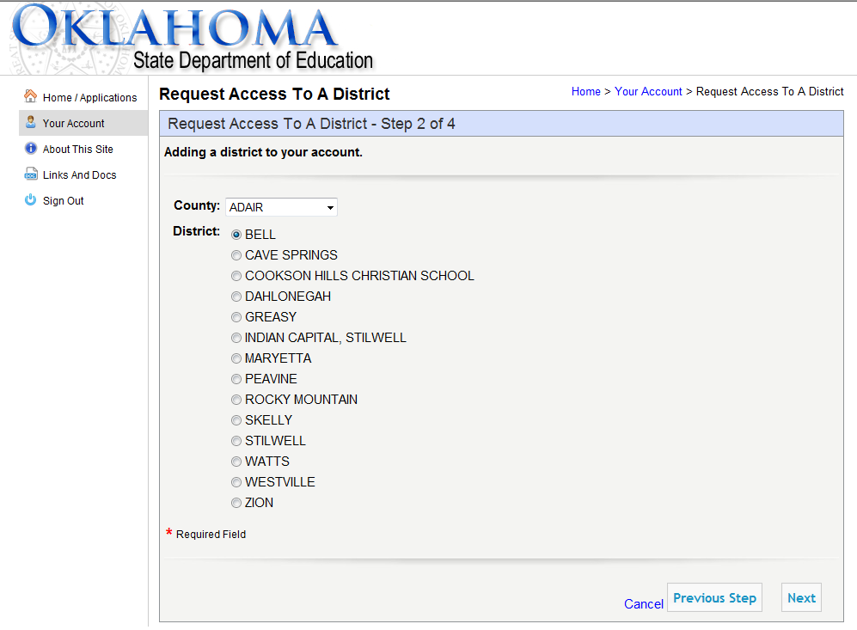

Slide 22
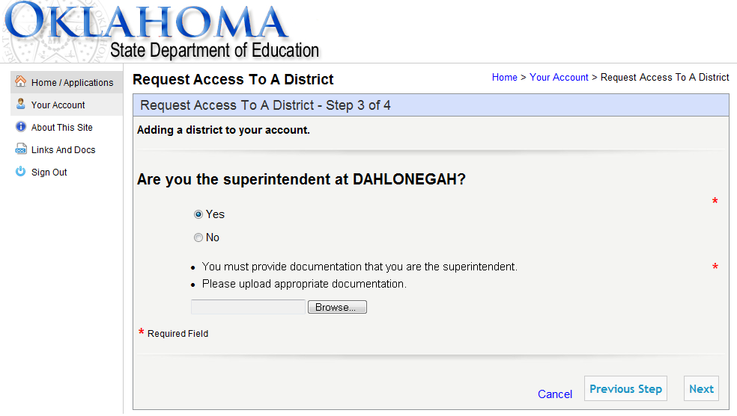

Slide 23
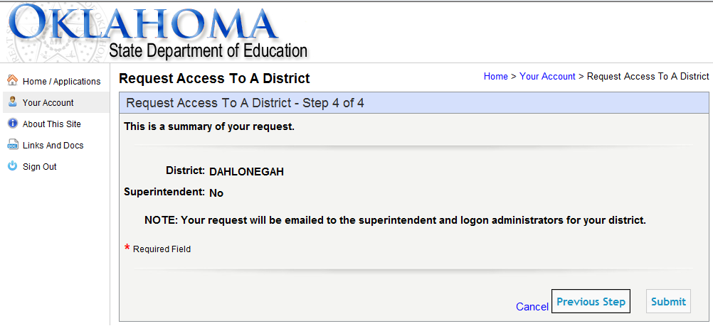

Slide 24
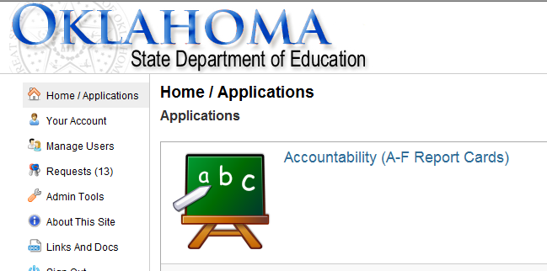

Slide 25
April TBD – June 13th
Goal 4 – Final Data Clean Up in the Battelle For Kids application April TBD – approximately April 15.
Goal 5 – Every “Participating” teacher a single sign on account with Certificate Number; associated with your district; and with the appropriate Battelle for Kids role assigned to their account.
Goal 6 – Teachers Begin Roster Verification by logging into Single Sign On and clicking on the Battelle for Kids application. (approximately April 15 to approximately May 31)
Goal 7 – Principals/Administrators review and approve rosters in the Battelle for Kids application (completed by June 12)
We will discuss the Battelle for Kids application shortly

Slide 26
Participation
TLE Steps for Success
TLE Roster Verification Import Video
  http://vimeo.com/87904409
Questions from Districts

Slide 27
Participation
TLE Steps for Success
TLE Roster Verification Import Video
  http://vimeo.com/87904409
Questions from Districts

Slide 28
TLE Roster Verification Import
SDE Help Desk: 405-521-3301
Webinar – FAQ Session

