Slide 1
Oklahoma State Department of Education

Slide 2
Universal Design for Learning: Introduction
Notes:
Universal Design for Learning is a great strategy for all teachers to engage learners in their classroom. Students perceive lesson content and demonstrate their understanding in multiple ways including means that are intrinsically motivated.

Slide 3
Learning Objectives
Explain the history and purpose of Universal Design
Recognize the 3 principles of Universal Design for Learning in practice
Identify valuable resources available for UDL implementation in the classroom
Notes:
The focus of the presentation will be the following objectives. 1. Explain the history and purpose of Universal Design, 2. Recognize the three principles of Universal Design for Learning (UDL) in practice 3. Identify valuable resources available for UDL implementation in the classroom.

Slide 4
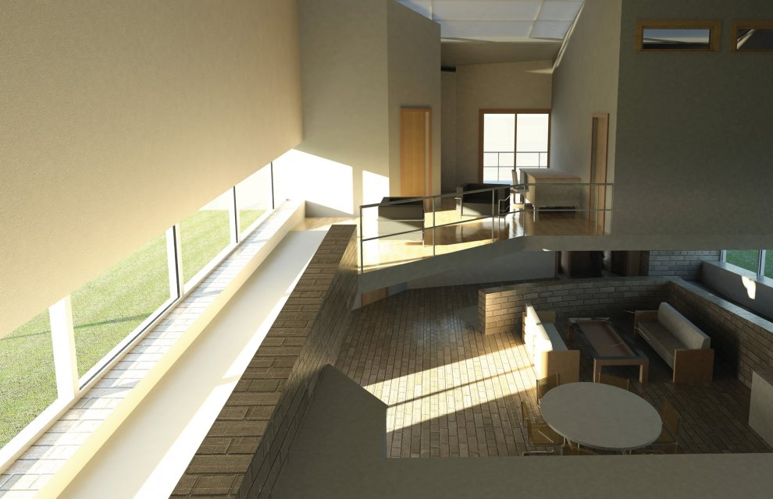
Universal Design (UD)
UD originated in architecture and urban planning, as part of a movement to begin designing building and other structures that would accommodate the widest spectrum of users, including those with disabilities, right from the start.
Notes:
The first origins of Universal Design started in building architecture and thinking of the widest range of users that may need accessibility in and around the facility of the structure. The pictures here represent several designs that incorporate individuals accessibility around the structure.

Slide 5
UD Assumptions
Not one size fits all – but alternatives for everyone.
Not added on later – but designed from the beginning.
Not access for some – but access for everyone.
Notes:
The theory of Universal Design has several basic assumptions. 1. Offering variety benefits everyone.
2. Although retrofit may be a necessity, design with thoughtful execution from the very beginning.
3. Be mindful not to limit the access for certain individuals, access should be offered for the widest variety of individuals possible.

Slide 6
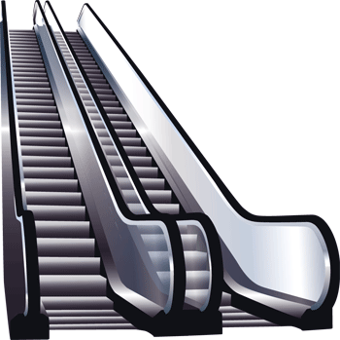
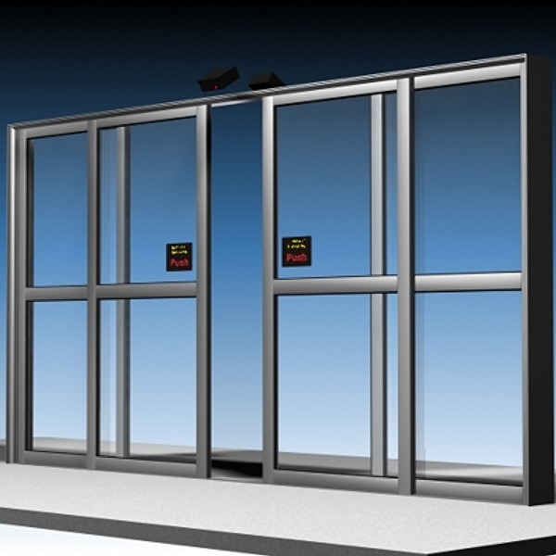
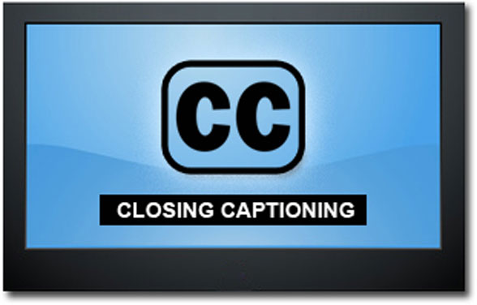
Choose one & discuss
How does the item address a specific need?
How can designing for specific individuals benefit others?
Notes:
Pictured on this screen are several different items. Choose one item and discuss the consideration of user variability.
How does the item address a specific need?
How does designing for specific individuals benefit others?
Take a moment to discuss these questions with an elbow partner.

Slide 7
Learner Variability
https://www.youtube.com/watch?v=8WClnVjCEVM 1:04-7:56
Notes:
This is a video I found to emphasize learner variability and the unique needs that all individuals may have. Let’s take a moment to watch this excerpt from Todd Rose in a presentation he did on Learner variability.

Slide 8
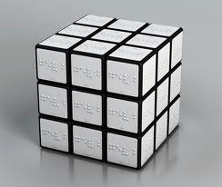
Reflect
What resonated?
Why is the design of a Rubik cube important for engagement and mastery?
How do ideas of variability & context relate to your practice (curriculum or classroom)?
Notes:
With an elbow partner take a moment to reflect on the video clip we just saw. Some guiding questions for your discussion are listed on this screen.

Slide 9
Definition (HEOA)
Universal Design for Learning (UDL) is a scientifically valid framework for guiding educational practice that:
(a) provides flexibility in the way information is presented, in the ways students respond or demonstrate knowledge and skills, and in the ways students are engaged; and
(b) reduces barriers in instruction, provides appropriate accommodations, supports, and challenges, and maintains high achievement expectations for all students, including students with disabilities and students who are limited English proficient.
Higher Education Opportunity Act of 2008
Notes:
The official definition of Universal Design for Learning is provided by the Higher Education Opportunity Act of 2008.
Key highlights emphasize UDL as a framework for guiding education practice that:
1. Is scientifically valid
2. Provides flexible presentation, response and engagement
3. Reduces barriers to instruction, provides accommodations/supports, maintains high achievement expectations
4. Benefits students with disabilities and English Language Learners
The new law, Every Student Succeeds Act (ESSA) of 2015 includes the definition and endorsement of UDL. ESSA is the 7th reauthorization of the Elementary and Secondary Education Act of 1965, which was originally passed to address the need for greater equity and opportunity in public schools.

Slide 10
Definition (CAST)
Universal Design for Learning is a proactive design of curricula (educational goals, methods, materials, and assessments) that enable all individuals to gain knowledge, skills, and enthusiasm for learning.
Center for Applied Special Technology (CAST)
Notes:
A definition of Universal Design for Learning provided from the Center for Applied Special Technology (CAST) is “a proactive design of curricula that enable all individuals to gain knowledge, skills, and enthusiasm for learning.”

Slide 11
Differentiation: For specific learners in the classroom based on knowledge of who those learners are.
Differentiation & UDL
UDL: Planning for all students at the beginning, even though future students are unknown.
Notes:
UDL and differentiated instruction have commonalities, but distinct differences. The visual representation of moose road signs identify the differences. As shown on left side of the slide, “Beware of Moose,” is provided in four different languages. This would be a representation of differentiation. However, rather than planning instruction based on the specific learner types in the classroom, i.e. differentiating for them based on need, UDL provides representation for the widest variety of users from the very beginning. The picture of a moose damaging a car is more explicit to all learners, even non-readers that there is a danger of moose causing harm your car. UDL is the most ideal instruction format because it is planning for all students from the beginning, even if you may not even know who the learners might be.
Even though the picture sign of the moose damaging a car reaches a wide spectrum of users, it is still not accessible for those that are visually impaired. There are circumstances where differentiation is still a valuable tool and shouldn’t be omitted from practice. Differentiation is an important consideration based on the specific needs of the learners. Differentiated instruction is a type of instructional practice where tools are provided to specific learners in the classroom based on a knowledge of what needs those are.
http://www.gpb.org/education/common-core/udl-part-1

Slide 12
What is Universal Design for Learning?
Uses multiple delivery methods for instruction
Designing quality instruction from the onset of the lesson.
Providing multiple opportunities for students to learn, acquire and demonstrate understanding of the material presented.
Creating experiences for students regardless of disability to participate in the lesson through a variety of mediums.
Notes:
UDL goes beyond the lecture format, it provides quality design from the very beginning, offers multiple opportunities to learn and allows for participation through a variety of mediums.

Slide 13
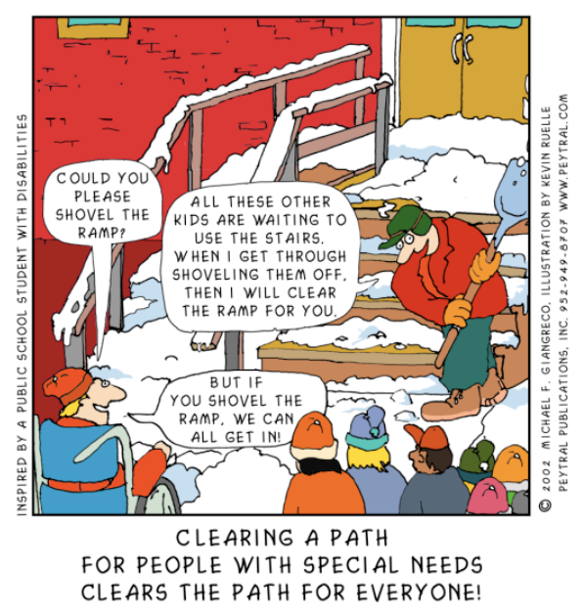
UDL Cartoon
Notes:
As you think in terms of Universal Design for Learning, think of providing instruction benefitting the widest range of learners possible. Lessons design is not intended to be double the amount of work, but smarter so more learners benefit from the efforts of the teacher.
Image source: https://www.google.com/url?sa=i&rct=j&q=&esrc=s&source=images&cd=&cad=rja&docid=pkIDBxOnUqXlRM&tbnid=m8kZrpcc3NbIrM:&ved=0CAUQjRw&url=http%3A%2F%2Fbergman-udl.blogspot.com%2F2011_09_01_archive.html&ei=jyW2UeG7K9O1qQGe-oGoCg&bvm=bv.47534661,d.aWM&psig=AFQjCNFM9DaecqIDeEFJssrBKI-2jAQ1AA&ust=1370978044735105

Slide 14
Why encourage UDL?
Benefit to all learners (ELL, gifted, special ed).
Healthy learning environment (respect).
Positive experiences conducive to learning.
Learners acquire skills in a medium of their strength/interest.
Lessons are designed with integrity from the onset. Long term benefit. Purposeful planning for all rather than consideration of a few for short term.
Notes:
Now that we know what UDL is, why is it important in the classroom?
UDL benefits multiple learners, creates a healthy learning environment, provides students access to areas of learning related to their strengths/interests, and there is evidence of the long term benefits of well designed lessons.

Slide 15
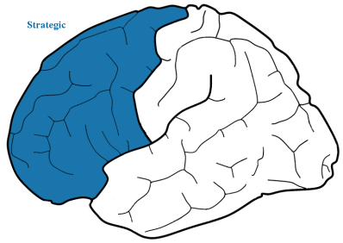
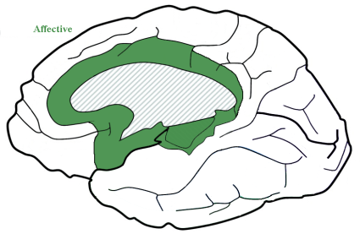
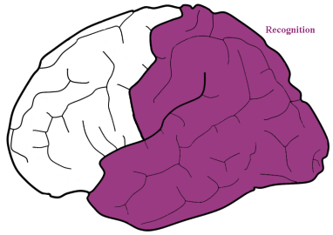
Brain Research
Recognition
Strategic
Affective
What of learning
See, hear, read
How of learning
Task performance
Why of learning
Motivation to learn
Center for Applied Special Technology (CAST)
Notes:
UDL is based on brain research. The research began at the Center for Applied Special Technology (CAST).
The brain is divided into three different regions; recognition, strategic and affective.
The recognition network accesses how information received is represented. It is the “what” of learning; what we see, hear or read.
The strategic network accesses information that is received through action or expression. It is the “how” of learning.
Finally, the middle of the brain is the affective region. This region acquires information through means of engagement. It is the why of learning and acknowledges our motivation to learn.

Slide 16
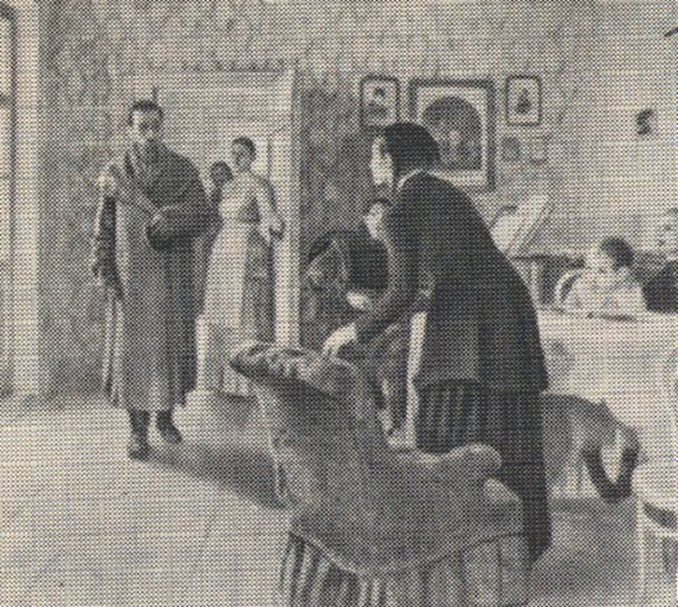
Recognition Network
List the objects you recognize in this picture.
http://www.cast.org
“Unexpected Visitor” Ilya Repin
Notes:
One of the ways to see how each region of the brain is activated, is through a learning activity that utilizes the three networks of the brain.
The recognition network of the brain can be activated by listing objects you recognize in this picture.
Conclusion: You probably identified lots of objects including people, pictures, furniture, doorways, tables and chairs. Many of these objects have poor resolution or only partially shown, yet your powerful recognition network recognized them instantly.

Slide 17
Strategic Network
1. What are the ages of the people in the picture?
2. What were the people doing before the visitor arrived?
http://www.cast.org
“Unexpected Visitor” Ilya Repin
Notes:
The strategic network can be activated by looking at an image for a specific purpose. First, identify the ages of the people in the image. Second, determine what the people were doing before the visitor arrived.
Conclusion: The brain is doing more than recognizing objects, but making generalizations and inferences.

Slide 18
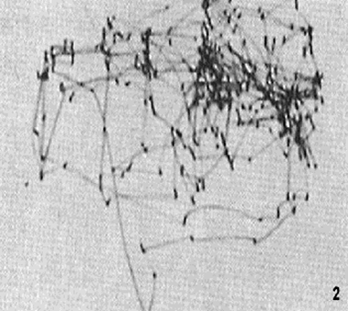
Eye Movements
Identifying the ages of the people
l
Determining what the people were doing before the visitor arrived
http://www.cast.org
Notes:
Look at these two images. They show the eye movements of the same person looking at the same image, the “Unexpected Visitor,” yet each one is different. Why? Like you, this viewer inspected the image with different goals each time. First, he was instructed to identify the ages of the people in the image. Second, he was asked to determine what the people were doing before the visitor arrived. Each new strategy resulted in a different pattern of eye movements.
When you looked at the picture with different goals, you probably looked at the parts of the picture in different orders and focused on different elements of the picture. Where did you look for each question? Because you used different strategies to reach different goals, you looked at different parts of the picture each time.

Slide 19
Affective Network
What grabs your attention?
http://www.cast.org
“Unexpected Visitor” Ilya Repin
Notes:
Finally, the affective network can be activated by looking at an image for something that is personally relevant to you. What grabs your attention?
Conclusion: Each individual’s response is different because what you see in the picture depends on your interests, background, and current mood.
A psychologist might attend to the expressions on the people's faces, while an interior designer might take note of the room's decor. The mother of a toddler may be drawn to the child seated at the table, whereas a musician may notice the piano.

Slide 20
Activity Summary
All three brain networks are working when you do something as simple as view an image.
Each network contributes something vital to the task.
This is true of everything we do and everything we learn.
Notes:
The activity we just participated in activates all three different regions of the brain. They were activated for different purposes. Even something as simple as viewing an image allows us to utilize each of the three brain networks. Each area of the brain complete a specific task and is activated not just for viewing images, but flows over into everything we do and everything we learn.

Slide 21
Three Principles of UDL
http://www.udlcenter.org/resource_library/videos/udlcenter/guidelines#video1 0:00-6:22
Notes:
The Center for Applied Special Technology, (CAST) put together a very clear description of the three learning networks and how the research evolved into the three principles of UDL. The video describes the areas of learning in more detail.
Let’s take a moment to watch the video together. It is approximately 6 minutes in length.

Slide 22
UDL Principles
Provide Multiple Means of Representation
Options for Perception
Options for Language/Symbols
Options for Comprehension
Provide Multiple Means of Action and Expression
Options for Physical Action
Options for Expression/Communication
Options for Executive Functions
Provide Multiple Means of Engagement
Options for Recruiting Interest
Options for Sustaining Effort
Options for Self-Regulation
http://www.cast.org
Notes:
The foundation of the UDL principles acknowledge that learning is acquired through:
Multiple means of representation
Multiple means of action and expression
Multiple means of engagement
Examples of each are listed on the right. The components of each principle will be discussed in more detail on the following slides.

Slide 23
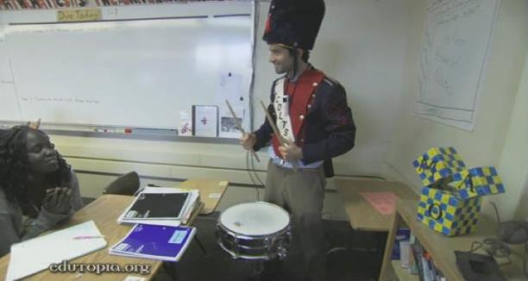
Options for Representation Video
Provide Multiple Means of Representation
Options for Perception
Options for Language/Symbols
Options for Comprehension
http://www.edutopia.org/masterful-teacher-jonathan-winn-calculus-video 0:00-6:33
Notes:
Here is a second video demonstrating multiple means of representation with an excerpt specific to a high school classroom. As you watch this video, look closely at the multiple means of representation the teacher tries to convey to his students. Write down all forms that you see.

Slide 24
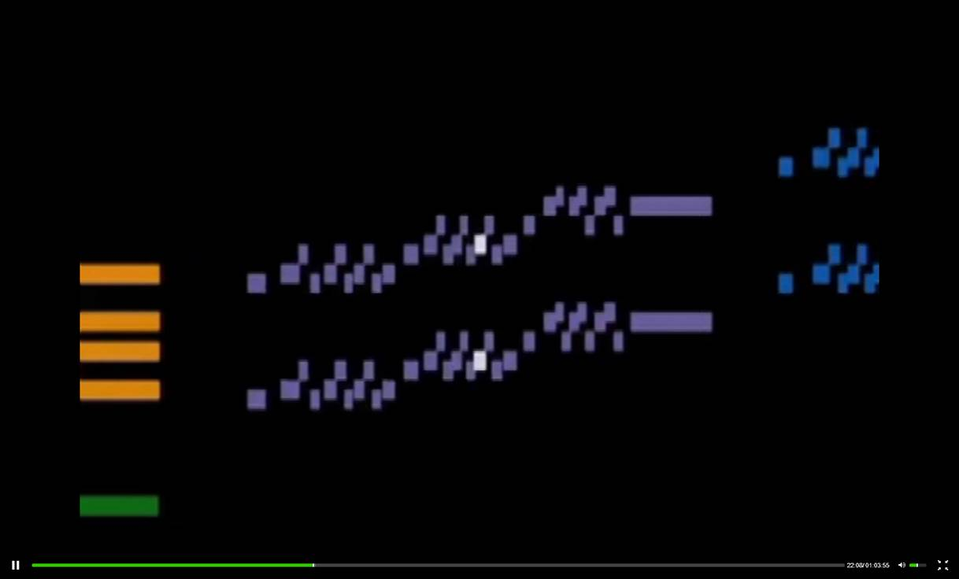
Representation Video 2
Provide Multiple Means of Representation
Options for Perception
Options for Language/Symbols
Options for Comprehension
http://udlseries.udlcenter.org/presentations/bach_to_gaga.html 21:11-25:00
Notes:
The next several slides provides video of each of three representations of UDL. This first video was an excerpt of a presentation by Dr. David Rose from CAST and the OSEP Project Directors Meeting in 2011. Although it is content specific I chose to include this excerpt because it does a good job of providing a graphic representation of music to help listeners make sense of the musical design of the selected piece.

Slide 25
Recognition Learning
Provide Multiple Means of Representation
Provide alternative formats for presenting information.
Provide multiple examples
Highlight critical features
Provide multiple media and formats
Support background context
http://www.cast.org
Notes:
The recognition network supports how material is represented for learners.
Alternative formats for presenting information and its purpose include:
Multiple examples
Highlights key terms or critical elements
Provides multiple media
Supports student background knowledge

Slide 26
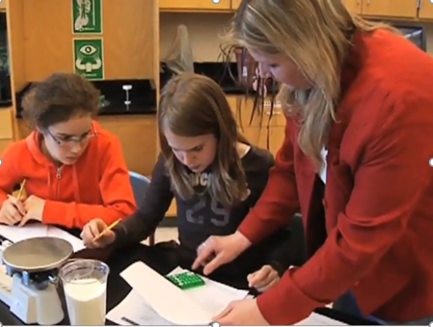
Action and Expression Video
Provide Multiple Means of Action and Expression
Options for Physical Action
Options for Expression/Communication
Options for Executive Functions
http://www.youtube.com/watch?v=dTxFYf50l-4 0:00-6:58
Notes:
The organization of CAST produced a video of a middle school science classroom. This video highlights the strategic network of the brain, information acquired through multiple means of action and expression. As you watch this excerpt, think of your own classroom. How can students utilize different tools to acquire new skills and information?

Slide 27
Strategic Learning
Provide Multiple Means of Action and Expression
Provide alternative means for action and expression.
Provide flexible models of skilled performance
Provide opportunities to practice with supports
Provide ongoing, relevant feedback
Offer flexible opportunities for demonstrating skill
Notes:
Multiple means of action and expression address the “how” of learning including:
Provide flexible models of skilled performance
Provide opportunities to practice with supports
Provide ongoing, relevant feedback
Offer flexible opportunities for demonstrating a skill

Slide 28
Options for Recruiting Interest 1
Provide Multiple Means of Engagement
Options for Recruiting Interest
Options for Sustaining Effort
Options for Self-Regulation
Notes:
Multiple means of engagement recruits and sustains student’s interest in the content of the lesson based on the learner’s strengths/interests. On this slide is a picture of elementary students engaged in a lesson on classification and object attributes. Students have options for self-regulation, demonstrating their knowledge of the lesson through a variety of work stations.
http://2.bp.blogspot.com/_6iyyhNHJjtI/TVBiBAuXp6I/AAAAAAAABPc/iWdgoYbMUck/s1600/montessori_elementary_lg.jpg

Slide 29
Options for Engagement Video
Provide Multiple Means of Engagement
Options for Recruiting Interest
Options for Sustaining Effort
Options for Self-Regulation
https://www.teachingchannel.org/videos/increase-engagement-and-understanding 0:00-4:44
Notes:
This video clip represents a teacher providing multiple means of engagement in an English Language Arts high school classroom. As you watch this video make a comparison chart with the first column representing the specific examples you see in the video and the second column examples you offer or would like to offer in your own classroom of student engagement.

Slide 30
Affective Learning
Provide Multiple Means of Engagement
Provide alternative means for engagement.
Offer choices of content and tools
Offer adjustable levels of challenge
Offer choices of rewards
Offer choices of learning context
http://www.cast.org
Notes:
Multiple means of engagement address the “why” of learning including:
Offer choices of content and tools
Offer adjustable levels of challenge
Offer choices of rewards
Offer choices of learning context

Slide 31
UDL Wrap Up
All 3 UDL principles are not intended to be incorporated into every lesson plan. Rather, they guide instruction over time.
Some students may need additional support to meet an individual needs. Accommodations are still appropriate (i.e. Braille text).
Notes:
Two important points require emphasis in regards to UDL.
First, all three UDL principles are not intended to be incorporated into every lesson plan.
Second, accommodations are still appropriate to offer students with specific needs. For example, even though a lesson may have been well designed from the beginning there may be specific needs of the learners that need to be addressed. A student who is blind may need Braille text, a consideration that is an accommodation for that specific student based on his/her needs.

Slide 32
http://ok.gov/sde/universal-design
Notes:
Additional resources through the Oklahoma State Department website are located at the following URL address listed at the top of the screen.

Slide 33
UDL Guidelines Handout
http://www.udlcenter.org/sites/udlcenter.org/files/updateguidelines2_0.pdf
Notes:
A resource tool for educators is the learning guidelines template produced by CAST. The chart lists several examples of learning guidelines for each of the three learning principles.
http://www.udlcenter.org/sites/udlcenter.org/files/updateguidelines2_0.pdf

Slide 34
Educator Worksheet
http://ok.gov/sde/sites/ok.gov.sde/files/Guidelines_2.0_Educator_Worksheet_0-2.pdf
Notes:
Here is a document of the UDL guidelines in a template format with space for a teacher to write notes when preparing or reflecting upon a lesson.

Slide 35
Interactive Wheel
http://udlwheel.mdonlinegrants.org/
Notes:
One resource produced by CAST in conjunction with the Maryland department of Education is an interactive wheel that spins to provide specific examples of each of the learning guidelines.
http://udlwheel.mdonlinegrants.org/

Slide 36
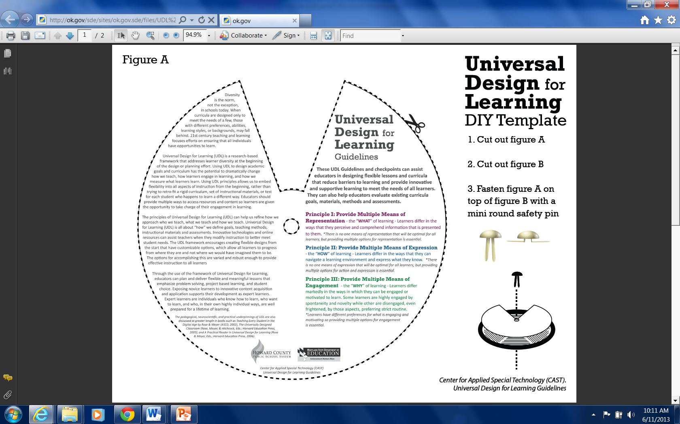
Paper Wheel
http://ok.gov/sde/sites/ok.gov.sde/files/UDL%20Wheel.pdf
Notes:
The interactive wheel on the previous slide is also available in paper format. The URL is listed below the picture.
http://ok.gov/sde/sites/ok.gov.sde/files/UDL%20Wheel.pdf

Slide 37
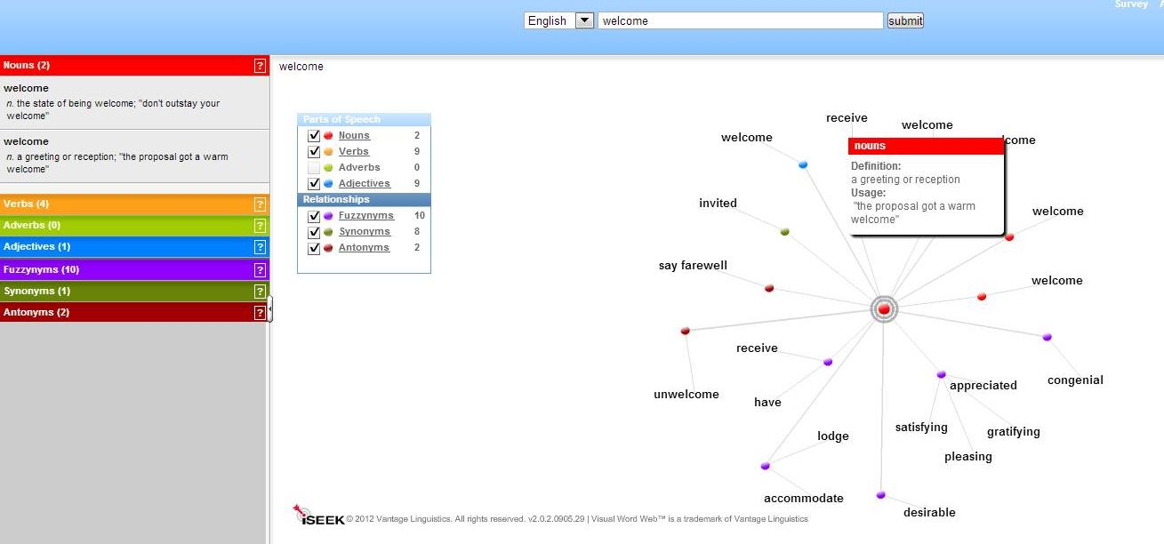
On-Line Graphic Dictionary/Thesaurus
http://lexipedia.com/
Notes:
One example of the resources available through the CAST resources includes helpful links and resources such as lexipedia.com. Lexipedia is a great tool serving as a graphic dictionary/thesaurus. The student types in the word and then the word is linked to other similar words (synonym/antonym) or click on the word and the definition appears.

Slide 38
Questions/Comments
Notes:
I will pause a moment to ask you if you have any questions or comments over the information that was presented today.
-Pause-
Let me conclude today’s presentation by thanking you for your time, your commitment to help Oklahoma students and to have had the opportunity to share with you a little bit about special education.

Slide 39
Contact Information
Oklahoma State Department of Education
Special Education Services
2500 N. Lincoln Blvd.
Oklahoma City, OK 73105
405-521-3351
Notes:
Contact information at the State Department of Education is available on this slide. Please feel free to contact us at any time with any questions or clarification needed.

