Slide 1
Accreditation
Regional Accreditation Officers
Jason Pittenger—Executive Director of Accreditation

Slide 2
Regional Accreditation Officers
Shellie Gammill Don Gray
Kim Hale Leslie Janis
Mat Luse Ryan Pieper
Brent Meeks LeGay Riggs
Larry Stogner Kirk Warnick
Mike Teel Mike Lemon

Slide 3
Purpose of the RAO’s
Educate!
Act as liaison between the SDE and the schools.
Resource for information.
Provide guidance and make recommendations.
Conduct audits to gather information for other departments.
Work to facilitate communication between community members and the school district.
We are here to help you be the best leader you can be!

Slide 4
Resources
Standards for Accreditation Guide*
http://sde.ok.gov/sde/documents/2015-09-21/2014-15-accreditation-standards
Certification Guide for School Staff Assignments (when available)*
Law Book*
http://www.oscn.net/applications/oscn/Index.asp?ftdb=STOKST70&level=1
RAO
http://sde.ok.gov/sde/documents/rao-contact-information-list
*Download to IBook on Iphone/Ipad and search

Slide 5
Annual Audits—August/September
1. The district has and follows a policy on felony record searches. 70 O.S. § 5-142
Documentation: provide felony record search policy for review, a list of names of all new employees, and a letter signed by the superintendent that felony searches have been conducted on all new employees.
2. All bus drivers have the required current health examination form, CDL, Oklahoma bus driving certificate, and the Motor Vehicle Record from the DMV? OAC 210:30-5-8
Documentation: provide copy of health cert., CDL, Oklahoma bus cert., & motor vehicle record for review
3. The district is in compliance with the federal requirements for drug testing for school bus drivers. CFR Part 382.
Documentation: provide contract with drug testing facility for review and a list of all drivers that are on the list for random testing

Slide 6
Annual Audits—August/September Continued
4. Daily pre-trip bus inspections are being made and reported. OAC 210:30-5-6
Documentation: Provide pre-trip inspections for review.
5. All school buses are inspected annually, by a certified inspector in accordance with state law. OAC 210 :30-5-6 Documentation: provide school bus inspections available for review
6. Annual in-service forms for all bus drivers are on file at the district office. OAC 210:35-5-8
Documentation: provide in-service forms for all bus drivers for review

Slide 7
Annual Audits—August/September, continued
7. All 7th graders have received one dose of Tdap vaccine. OAC:535-1-2
Documentation: Access to student shot records or a list of Tdap immunizations for each 7th grader
8. Athletic coaches have completed a course in Care and Prevention of Athletic Injuries. OAC 210:35-9-44; OAC 210:35-5-45; OAC 210: 35-7-44
Documentation: Copy of college transcript with course highlighted or certificate from a SDE approved program.

Slide 8
Annual Audits—August/September, continued
9. All students participating in or desiring to participate in an athletic activity and the student’s. Parent or guardian shall, prior to participation in an athletic activity, sign and return the School Acknowledgment of Receipt and Review of a Sudden Cardiac Arrest Symptoms and Warning Signs. 70 O.S. 24-156
10. Certificate of Completion of Sudden Cardiac Arrest Training offered by a provider approved by the State Department of Heath prior to first practice with students. 70 O.S. 24-156
Documentation: Provide a copy of certificate. ANNUAL
11. Are handbooks provided for students, parents, and teachers as required by State Department of Education regulation? OAC 210:35-3-69
Documentation: Provide copy of handbooks

Slide 9
Annual Audits—October/November
1. Does the district have specific procedures to be followed in regard to administration of medicines, accidents, emergencies disasters, as well as the reporting of child abuse and child neglect including recognition of child sexual abuse? OAC 210:35-3-107, 70 O.S. § 1210.160.
Documentation: Copy of school policy
2. Is a program offered annually to all teachers (certified personnel) which includes a component of training on recognition and reporting of child abuse and neglect including child sexual abuse?
Documentation: Provide copy of sign-in sheet for training
3. Are the Standards of Performance and Conduct for Teachers distributed to all certified personnel annually? 70 O.S. § 6-101.21 Provide documentation on how this is distributed

Slide 10
Annual Audits—October/November
4. Does the district have a written plan with procedures in place to protect students, faculty, administration and visitors from natural and man-made disasters? (i.e., tornados, and other disasters. The plan is on file in each district AND with the local emergency management organization within the district). 63 O.S. § 681
https://www.ok.gov/schoolsecurity/
Documentation: Provide plan and verify on file with local organization
5. The school’s graduation policy requires the minimum 23 units or sets of competencies. Documentation: Copy of the policy
6. Did the district distribute information on Meningococcal Meningitis at the beginning of the year? 70 O.S. § 1210.195
Documentation: Provide verification of distribution.

Slide 11
Accreditation
YOUR GOAL AS AN EFFECTIVE LEADER
Every Site Accredited With…
NO DEFICIENCIES

Slide 12
Accreditation
Accredited schools are meeting state requirements.
State aid is paid ONLY to accredited schools
A deficiency indicates the school is not in compliance with a requirement, but is still accredited. (For this year deficiencies are not tied to designations: focus, priority, etc.)
Deficiencies typically move from one, to with warning, to on probation then to non-accredited for the same deficiency

Slide 13
2018-2019 Accreditation Application
Fill out the application correctly!
Administrators can delegate job tasks but cannot delegate responsibility!
The application will change and there will be new questions. Answer them correctly.
Some information will be uploaded for immediate viewing instead of being required during Accreditation visit.
Do not use co-teacher, unless there is a true co-teaching situation.
Make sure to put Career Tech information in the system correctly.
If you have questions call for clarification! – 405.521.3335

Slide 14
Preparing For Your Audit
Organize your supporting evidence in the order requested (Without a paper trail it didn’t happen).
Use a file box or binder to organize materials.
Do not use plastic sleeves.
Use this opportunity to demonstrate the great things going on in your school district.

Slide 15
Exception Reports
Personnel Report Accreditation Application
Your Student Information System
District Exceptions

Slide 16
Accreditation Audits - UPLOADS
Uploads
PLEASE—Have your district, site, date and document in the title you save your uploads to before uploading.
To upload documents sign on to SSO
Click the Accreditation Tab
From the Summary Tab scroll down to document upload and click upload document
There, listed in red, you will find a list of things that need to be uploaded.
Scrolling down from there you will find a browse button
From there you will select the item you are uploading that has been saved with your district and site, date and document in the title.

Slide 17
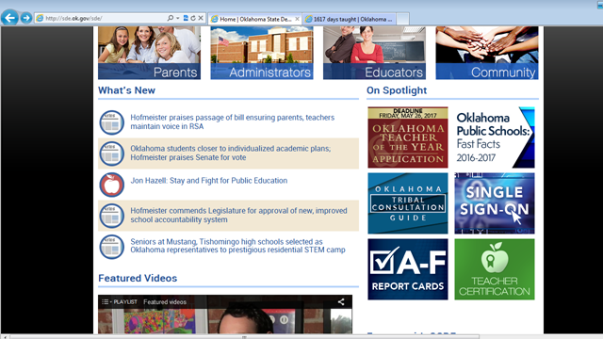

Slide 18
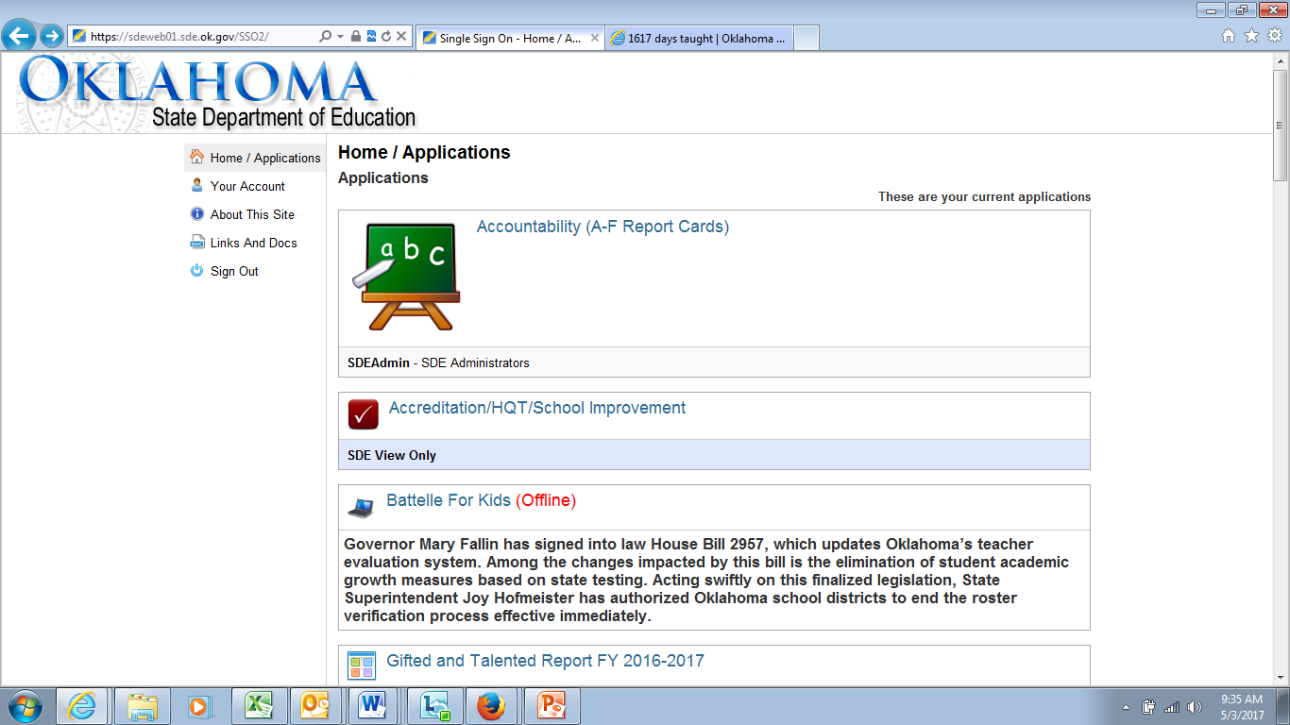

Slide 19
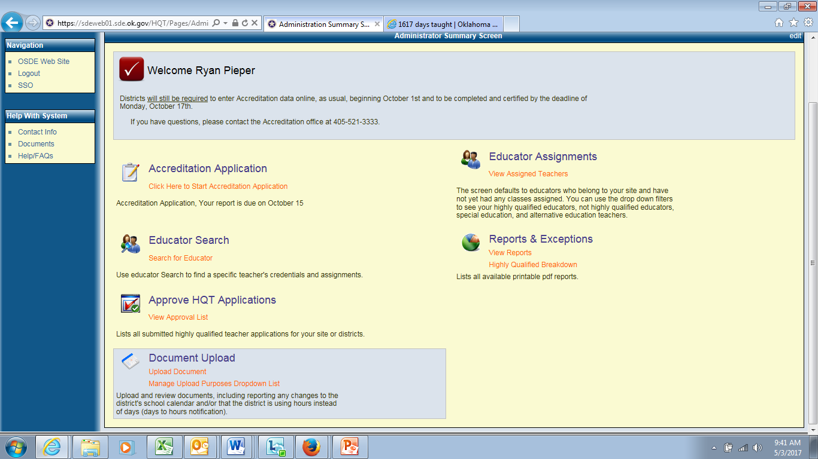

Slide 20
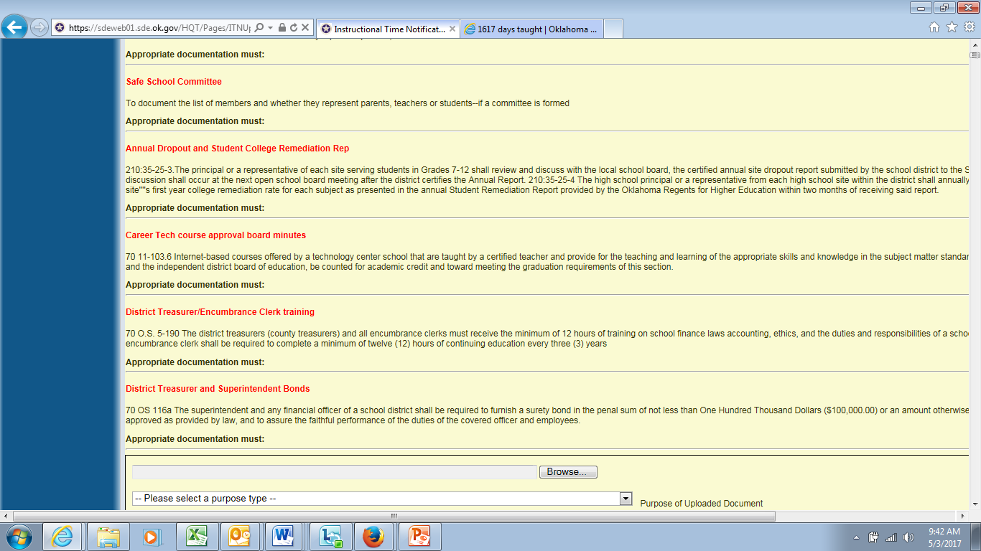

Slide 21
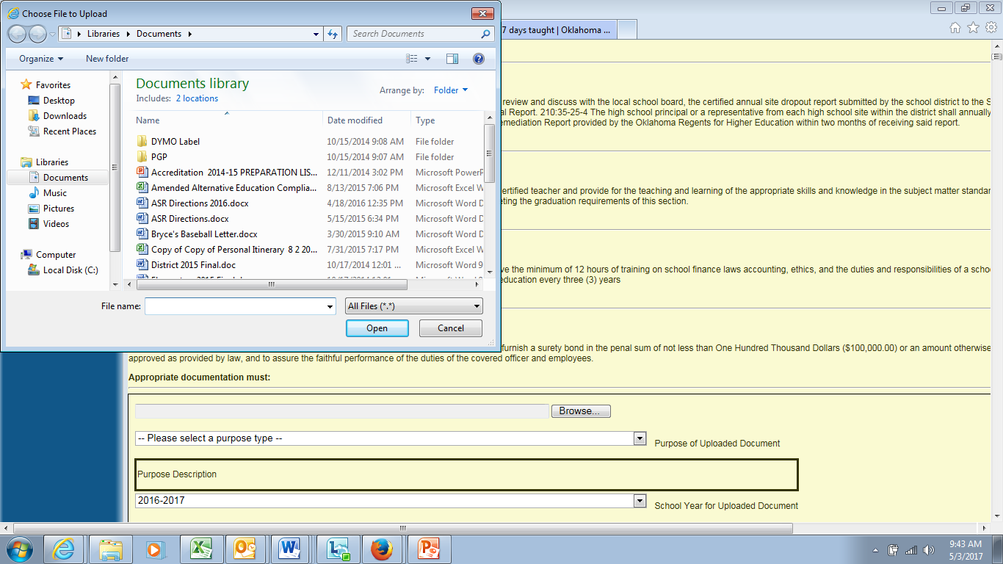

Slide 22
Accreditation Uploads
Select the purpose of the upload. (example: CPR)
Select the year of the documentation.
Write a short file description
Click upload file

Slide 23
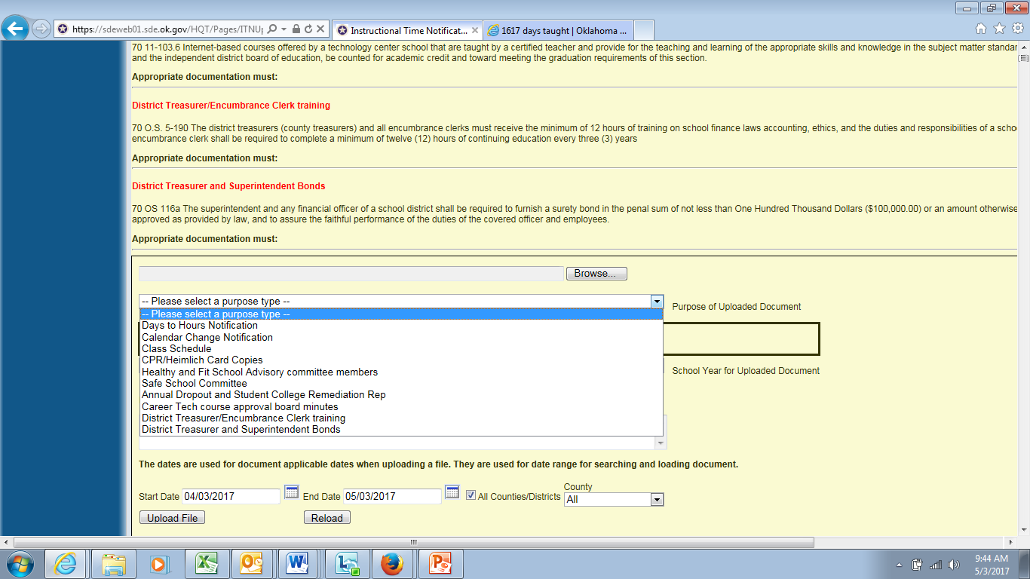

Slide 24
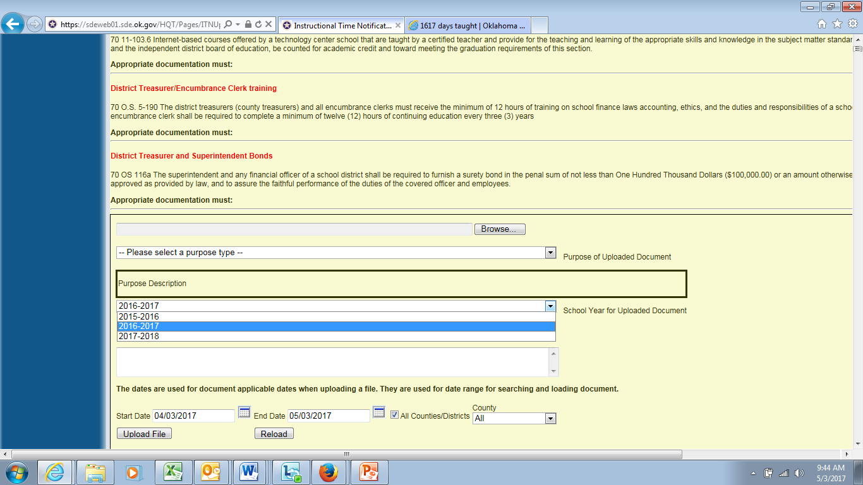

Slide 25
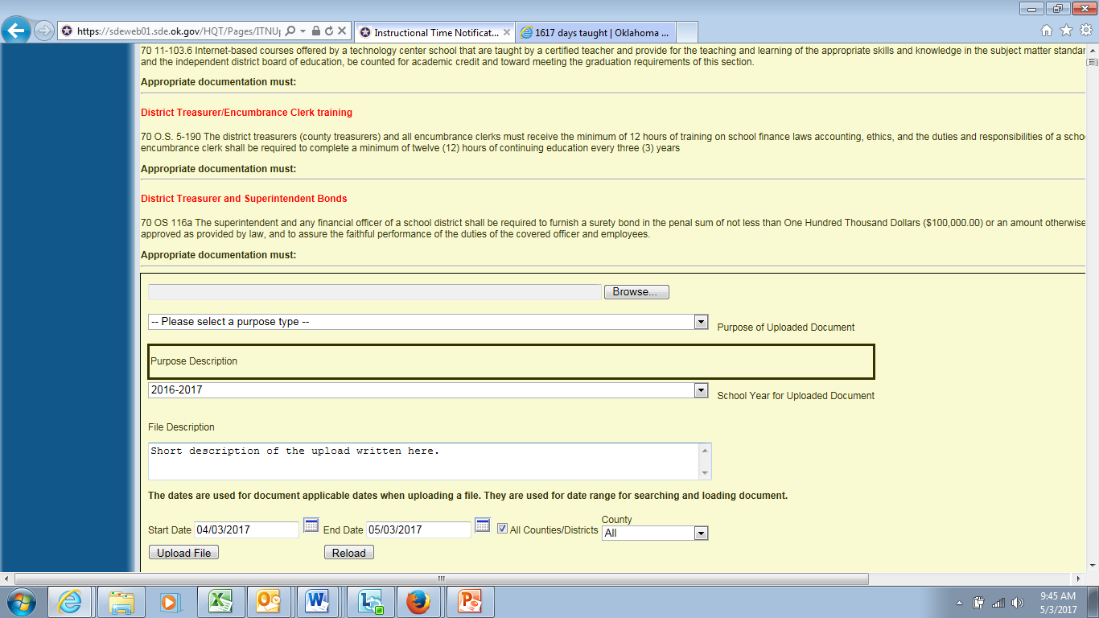

Slide 26
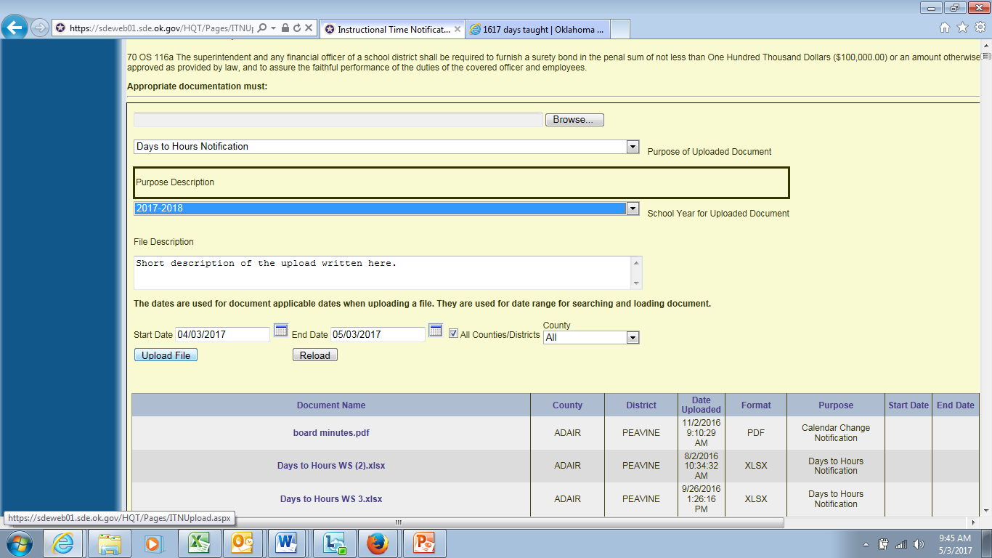

Slide 27
District Treasurers/Encumbrance Clerks
12 hours of school finance laws.
12 hours of continuing education in last three years.
As of fall 2014 trainings must have approved stamp.
Please put the most recent training in front of the file.
Provide documentation. $100,000 for superintendent and $1,000
for treasurer bonds.
Superintendent cannot be treasurer or encumbrance clerk.

Slide 28
Site Code and Grade Span Changes
Site code and grade span change requests must be into the accreditation office by September 1, 2018 for the 2018-2019 school year.

Slide 29
Tdap: 7th Grade Students
Not the same as DTaP
Brand Names: Adacel (Tdap), Boostrix (Tdap)
Most Dr. Offices and Health Departments are connected to the same system.
Contact the State Health Department to get access.
If a large majority of students are not inoculated contact health department or local tribal office.
If parents choose to not get inoculations they must have an approved form from the State Department of Health in your files.

Slide 30
Care and Prevention and Cardiac Arrest
Every Certified, Head/Assistant or Adjunct / Lay Coach Must Have Care and Prevention And Cardiac Arrest Certification. Have the Transcript With Care and Prevention Highlighted.
Class must be taught by a certified athletic trainer and include a lab. Make sure the certificate has all of the necessary information
You can look up certified trainers online on the site Oklahoma Board of Medical Licensure and Supervision to make sure they are certified. http://www.okmedicalboard.org/search
A Certificate of Completion from an approved provider will serve as documentation for the Cardiac Arrest Certification. Each coach must have their own certificate.

Slide 31
Safety Committee
This committee is back in law. We recommend that districts have the meetings and document the discussions. Districts want to let the stakeholders know that the leaders of the district/sites are doing everything possible to keep students safe. HB 1684 requires districts to include suicide prevention in the discussions.
Active Shooter – Following Parkland, it would be wise to have a documented plan for an Active shooter that can be shared with the local school board. The Oklahoma School Security Institute can assist

Slide 32
Required Members for Safety Committee
Teachers
Parents of enrolled students
Students
School official who participates in investigations regarding bullying
HB 1684 requires districts to include a counselor or mental health provider

Slide 33
Hours/Days
Do not mail/email documents to the Accreditation office or the RAO
Get board approval for school calendar if 1080 hours. Upload the information on the single sign on. Unofficial board minutes will work.
Documentation due October 15th
Board Minutes
Board Memo (Letter written on school letterhead)
To upload go in to Single Sign-On:
Accreditation
Upload documents *Please Name Indicating District, Site, ETC* Refer To Slide 16
Your RAO will take a signed copy with them during ASR.
SY 18-19 will use WAVE data for instructional minutes and calendar days!

Slide 34
Drills 2018-2019
2 Tornado drills (September and March)
2 Fire drills (within 15 days at the start of each semester)
4 Security drills (one within 15 days of the start of each semester)
2 Bus evacuation drills (one within 15 days of the start of each semester--recommended)
2 Other drills (selected after evaluation of local safety issues) This may be an additional two bus evacuations, but it must be in addition to the two required bus evacuation drills. Change the type of drill frequently, so that your district has documentation that they are well prepared.
Report drills to www.schoolsecurity.ok.gov

Slide 35
Questions? Leslie Janis, Accreditation Officer or Jason Pittenger, Executive Director Accreditation 405.521.3335

