Slide 1
2017 End of Year Reporting
Special Education
OSDE
Erik Friend & Ginger Elliott-Teague
Directors of Data Analysis/Part B Data Managers

Slide 2
Why This Data?
Federal reporting requirements dictate which data elements states must collect.
Oklahoma is judged and scored for its compliance with data submission mandate: is it timely, accurate and complete?
By mandate, OSDE-SES must also ensure districts are compliant.
Timely, accurate and complete DISTRICT DATA is good for all of us!

Slide 3
2017 Critical Deadlines
June 30
  Data pulled from OK EdPlan
Now until Midnight, June 30
  Data clean-up and final entry
June 30 – July 14
  Superintendent Certification open in Single Sign-On
ALL DATA ENTERED BY JUNE 30!
Notes:
OSDE-SES personnel will be contacting some districts as needed and available about data clean-up. We are going to be reviewing data state-wide to help guide districts in their clean-up, identifying problem areas and any technical assistance required.
We will be using the Data Test “student” at times to transfer information back and forth between us and your district—please be aware of how to use this function.

Slide 4
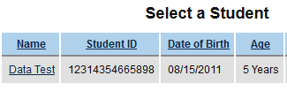
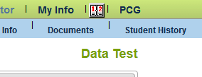
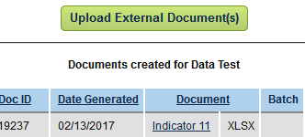
“Data Test” Doc Sharing Tool
Last name = Test
First name = Data
Search for the “student” and select.
Open “Documents” section.
Upload / download relevant documents.
Notes:
Because we cannot email personally identifiable information to districts, OSDE has created a private document sharing mechanism in EdPlan. We created a fake student named “Data Test” where documents can be uploaded for sharing between the state and districts. Each district must have a “Data Test” student. If you do not, check your Inactives and re-activate the student. The record will not affect any of your counts in any way.

Slide 5
Data Reporting Topics Today
45-day Timeline/“Child Find”
Early Childhood Transition
Personnel
CEIS Participation
Exiting
Secondary Transition
Early Childhood Outcomes
Discipline
Certification
District Summary Data Page
Student-level Data Entry
Notes:
Focus on reporting the following data sets

Slide 6
District summary data

Slide 7
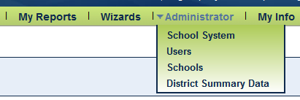
District Summary Data Page
Administrator access only.
Access through the green menu bar.
Page may be saved and updated multiple times.
Zeroes required in empty boxes.
This year: new requirement to upload names of students whose evaluations/transition did not meet timeline. Use “Data Test” doc sharing tool.
Notes:
New requirement is to check compliance with federal and state policy mandates.
Some data is currently reported at the district level, without reference to individual students. This data is submitted through the district summary data page. If you were involved in data submissions through Single Sign-On in the past, the method and format are similar to that.

Slide 8
45-day Timeline/“Child Find”
Purpose: To report a count of delays and the reasons for delay in completing evaluations once parental consent is given.
Two broad categories of delay:
  Family reasons
  Other reasons
    District
    Calendar
    Late referrals

Slide 9
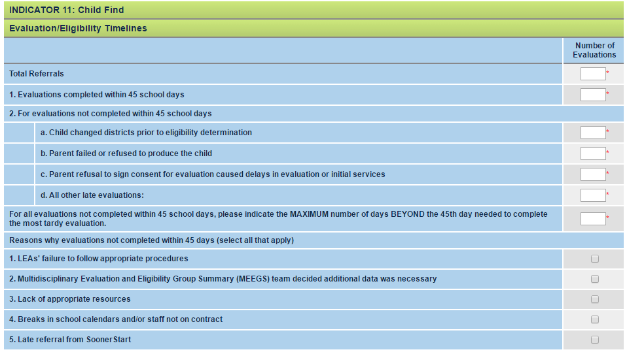
Family Reasons
Why was the evaluation delayed?
Other Reasons
= Sum of counts of 1 and 2 just below
Provide COUNT of each
Mark ALL that apply
Notes:
--Each element must be reported to OSEP annually for the state as a whole. They also want to know the max days beyond third b-day for the state: how long did the worst case take?
Other reasons: if you have one or more students for whom a reason applies, check the box.
Total referrals = sum of timely evaluations plus sum of delayed evaluations

Slide 10
Notes on 45-day Timeline
Only count initial evaluations
Include SoonerStart referrals in all counts
Include all disabilities
Special Note: “All other late evaluations”
  Districts must create a separate Excel file that lists the specific names and STNs of students whose evaluations were late for a non-family reason.
  Upload this “45Timeline-DistrictName” file to EdPlan in the “Data Test” external documents.
Notes:
All other late evaluations are considered compliance issues. We must report on non-compliance and check that correct procedure has been followed. We will be checking these students’ records in EdPlan.

Slide 11
Early Childhood Transition
Purpose: to report the counts of eligibility outcomes for children transitioning from SoonerStart and the reasons for delay in completing evaluations and IEPs.
Two broad categories of delay:
  Family refusal/declined services
  Other reasons
    District
    Calendar
    Late referrals

Slide 12
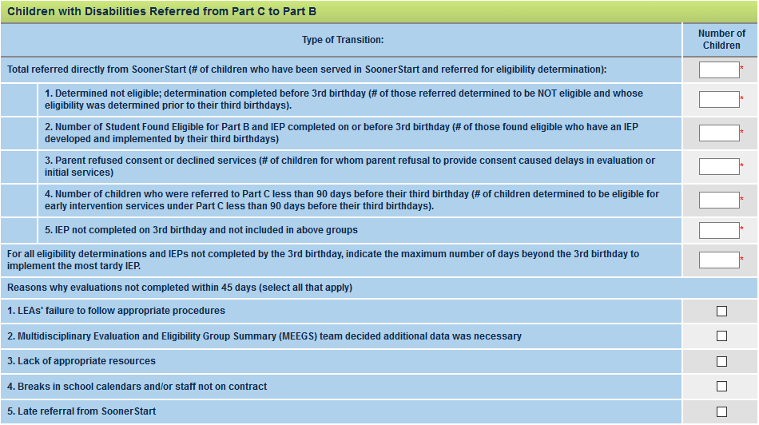
What was the transition outcome, and why was it delayed?
Family Reason
Other Reasons
Sum of counts 1 to 5 just below
Provide COUNT of each
Mark ALL that apply
Notes:
Total referrals MUST = sum of all outcomes of referral from SoonerStart
--Each element must be reported to OSEP annually for the state as a whole. They also want to know the max days beyond third b-day for the state: how long did the worst case take?
Other reasons for delays beyond the third birthday (here described as “not completed within 45 days”, but refers to post-3rd b-day evaluation and IEP decisions): if you have one or more students for whom a reason applies, check the box.

Slide 13
Notes on EC Transition
Reasons for “not completed within 45 days” should reflect why evaluation and/or IEP not completed prior to 3rd birthday.
Special Note: “IEP not completed on 3rd b-day and not included in above groups”
  Districts must create a separate Excel file that lists the specific names and STNs of students whose evaluations/IEPs were late for a non-family reason.
  Upload this “EC_Trans-DistrictName” file to EdPlan in the “Data Test” external documents.
Notes:
All other late evaluations are considered compliance issues. We must report on non-compliance and check that correct procedure has been followed. We will be checking these students’ records in EdPlan.
here described as “not completed within 45 days”, but refers to post-3rd b-day evaluation and IEP decisions

Slide 14
Personnel
Purpose: To report a count of FTEs of related services personnel and paraprofessionals working in schools who serve students on IEPs for any amount of time during the week.
Related services: fully certified and not
  11 discipline categories
Paras: qualified and not
  By age group
Notes:
As of Oct 1.

Slide 15
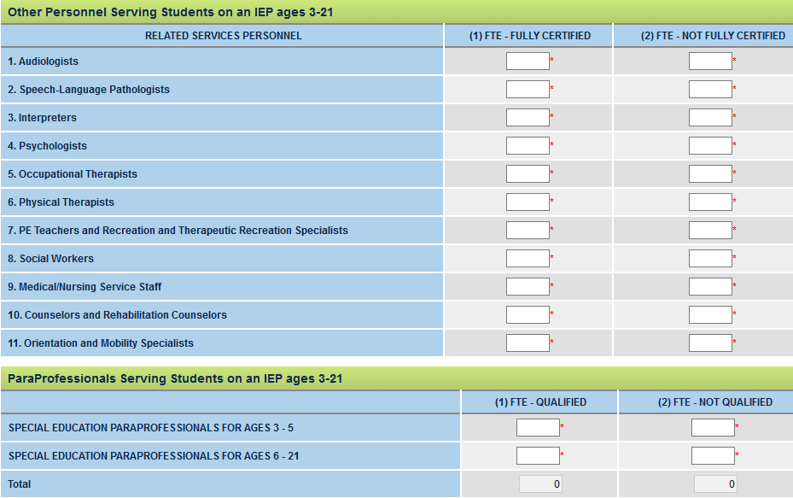

Slide 16
Notes on Calculating FTEs
Consider only personnel employed or on contract as of child count (October 1, 2016).
Count average hours served with students on IEPs divided by school week, by category.
Round to the hundredth decimal (0.00).
If a service provider works even 1 hr/wk with students on IEPs, count the hour as a % of FTE.
See guidance document for an auto-calculator.
Notes:
sde.ok.gov/sde/sites/ok.gov.sde/files/documents/files/End%20of%20Year%20Reporting%20Guidance%20without%20Notes.docx

Slide 17
CEIS Student Reporting
Purpose: To report the count of students receiving “Coordinated Early Intervening Services” across the state during the current fiscal year AND the count of students who received early intervening services and subsequently received special education and related services during the preceding 2-year period.
Notes:
Subsequent=during the two years immediately following the receipt of CEIS.

Slide 18
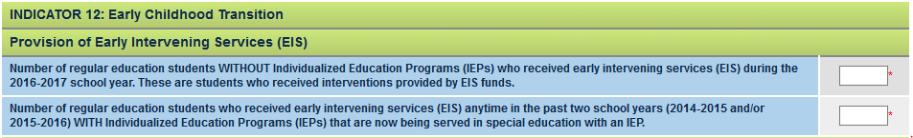
CEIS Reporting in EdPlan
This applies to the data below this section; CEIS is not part of Indicator 12.
NOTE: Count children from either year who have moved from EIS to special education with an IEP.

Slide 19
Notes on CEIS
Which students can receive CEIS?
  Voluntary CEIS: Kindergarten through Grade 12, not currently identified as needing special education of related services.
  Comprehensive CEIS: Ages 3 – Grade 12, not currently identified as needing special education or related services but who need additional academic and behavioral support to succeed in a general education environment and children currently identified as needing special education or related services.
Notes:
Funds can be used primarily, but not exclusively, for SPED kids.
Only include kids receiving CEIS in the counts.

Slide 20
Student-level data

Slide 21
Student-level Data
Data entered for students individually via various processes/pages in OK EdPlan
  Exiting reasons
  Secondary transition
  Early childhood data: environments and outcomes
  Discipline information

Slide 22
Exiting
Purpose: To report the count of students who exited districts by reason.
Reasons for exit that must be counted:
  Dropped Out of School (Incl. Unknown & Homeschooled)
  Deceased
  Exceeded Maximum Age
  Graduated with Diploma
  Transferred to Another School System
  Returned to Regular Ed (Non-Eligibility, LNH)

Slide 23
Notes on Exits
To exit a student from your district, you must “inactivate” the student on his/her personal page.
Ensure exit reasons and dates are entered correctly; you cannot forward date an exit.
If a student leaves your district suddenly, check whether he/she has moved to another district or private school to prevent reporting a drop-out.
Exit graduates prior to June 30, 2017.
Notes:
VIRTUALS!!!

Slide 24
Secondary Transition
Purpose: To report the percentage of students whose IEPs meet the eight secondary transition requirements:
  1. Includes post-secondary goals
    2. Goals are updated annually
    3. Goals based on age-appropriate transition assessment
  4. Includes transition services that will reasonably enable the achievement of post-secondary goals
    5. Services include courses of study relevant to goals
  6. Includes IEP goals related to transition services needs
  7. Student was invited to the IEP Team meeting
  8. Relevant related agency representatives invited with consent

Slide 25
Notes on Secondary Transition
OSDE-SES has determined that IEPs finalized within the reporting fiscal year are considered compliant with all IDEA requirements for secondary transition.
  All eligible students age 16+ or grade 9+ must have finalized IEPs.
    Not finalized = not compliant!
  This does not preclude a change in determination if monitoring finds non-compliance at a later time.

Slide 26
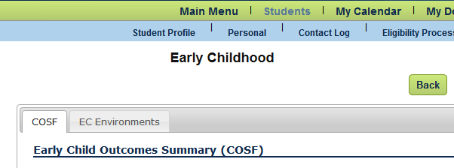
Early Childhood Data
Purpose: To report the specific learned skills’ outcomes of very young students.
OK EdPlan: Early Childhood Data Collection
  COSF (EC Environments)

Slide 27
Content: Child Outcomes Summary Form
Dates of preschool entry/exit VERSUS dates of ECO entrance & exit ratings
  The rating dates should match the dates of assessment.
Rate all three outcomes as compared to typical peers at entrance to program and at exit:
  Social & emotional skills
  Acquiring and using knowledge and skills (cognitive and language)
  Taking appropriate action to meet needs (physical)
Record whether progress was made (Y/N).

Slide 28
COSF Criteria for Data Entry
All students ages 3 to 5½ must have ENTRANCE ratings.
EXIT ratings:
  Student must have had at least six months of service by the age of 6 to receive an exit rating.
  If student has turned or will turn 6 (or exited the program) prior to June 30, enter exit ratings.
  If student will turn 6 after June 30, enter exit ratings at the start of the new school year.
http://ectacenter.org/~pdfs/eco/Decision_Tree.pdf

Slide 29
EC Environments
Collected at child count in October.
At end of year, verify that all young students have environment data entered in EdPlan.
  Must describe current learning environment that includes whether child is in day care or other classes outside of your school.
  Environment may change at any time without re-finalizing the IEP. Update when new information is received.
Notes:
Checking now will avoid some work later.

Slide 30
Discipline
Purpose: To report ALL disciplinary removals for students with IEPs (ages 3-21) according to OSEP reporting requirements.
Types of Disciplinary Removals to Report:
  In-School Suspension (ISS)
  Out-of-School Suspension (OSS)
  Unilateral Removal to Interim Alternative Educational Setting (IAES) for Drugs/Weapon/Serious Bodily Injury
  Removal by hearing officer to prevent likely injury to the student or others

Slide 31
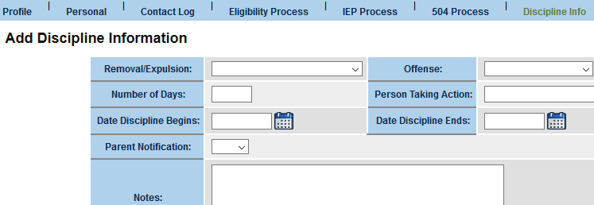
Entering Discipline
Enter each discipline incident via the “Discipline Info” tab in OK EdPlan.
You will also be asked to report whether services were provided during the removal.
Notes:
Link to the Discipline Guidance

Slide 32
Discipline
OSDE-SES just issued a guidance document to clarify reporting requirements to ensure Oklahoma is compliant with the federal reporting mandate on discipline.
  Please follow this guidance when reporting ALL incidents of disciplinary removal.
  Removals must be reported in a specific way, regardless of district policies and practice.
Guidance can be found here: http://sde.ok.gov/sde/documents/2012-10-01/special-education-data-and-reporting-part-b-children-ages-3-through-21

Slide 33
Certification
Superintendents must certify between June 30 and July 14 in Single Sign-On on the Special Education-Child Count system.
  Choose the District Profile tab to certify End of Year. Select district and “Certify End of Year.”
  Data does not freeze, nor is it visible in Single Sign-On.
Notes:
Select…

Slide 34
Summary: Data to Certify
Superintendents certify the accuracy of the following data elements, as discussed in this webinar:
From student IEPs:
  Exit reasons;
  Early childhood outcome completion;
  Secondary transition compliance; and
  All disciplinary removals for each special education student, as needed.
From the District Summary Data page:
  Personnel;
  Timeline/evaluation causes for delay; and
  Referral count and early childhood transition causes for delay.
Notes:
NOTE: Gen Ed Long-term Discipline Count not needed…enter zero here.

Slide 35
Questions and Contacts
Special Education Services | OSDE
Directors of Data Analysis
Erik Friend
405-521-2198
erik.friend@sde.ok.gov
Ginger L. Elliott-Teague, PhD
405-521-4871 •
ginger.elliott-teague@sde.ok.gov •

