Slide 2
Notes:
This graph represents the national workforce trends of the jobs created since the Great Recession. The bottom teal line indicates new jobs for those with a high school diploma or less. The middle orange line shows jobs being created for those with an associates degree or some college. The top two blue lines represent new jobs for those who have a bachelor’s or master’s degree. These trends indicate a significant shift in workforce expectations and reinforce the need to ensure our students are adequately prepared to continue on after high school.
I think Cory will need to recreate this slide. It needs editing, I don’t have access to the text, and it doesn’t have the OSDE “look.”

Slide 3
Notes:
This graph is specific to Oklahoma and mirrors the trends evident in the national data from the previous slide. Between 2015 and 2025, there will be a 50% reduction in the number of jobs available for those with a high school diploma or less. It is obvious we must rethink what it means for our students to be academically proficient and college and career ready in this changing workforce. You notice that the biggest transition in need includes those with some kind of post-secondary training or education: industry credential or certification and/or an Associate’s degree.
If we want to give our students a competitive edge for success after high school, we first must know our starting point and how we compare nationally. In order to do this, we use data from national benchmarks. In high school, we use SAT and ACT as our national comparisons, and in grades 3-8 we use the National Assessment for Educational Progress, known a NAEP. The next slide displays Oklahoma’s proficiency standards compared to other states. This data is from 2015, prior to the implementation of the new Oklahoma Academic Standards.

Slide 5
Notes:
The classroom teachers are the most important factor for getting our students ready for successful life based on the demands of the 21st century workforce. It is proven that the classroom teacher is STILL the single most significant contributor to student achievement and even more important to students who do not have a loving parent at home. Additionally, highly effective teachers can completely erase the academic effects of poverty within five years. (Jensen, E. 2017. Poor students, rich teaching: Mindsets for change. Bloomington, IN: Solution Tree.)
As you are thinking about these changes and the impact they will have on your students and communities, look beyond to the outcomes of our students being highly prepared and equipped to enter our evolving workforce.

Slide 6
Notes:
The classroom teachers are the most important factor for getting our students ready for successful life based on the demands of the 21st century workforce. It is proven that the classroom teacher is STILL the single most significant contributor to student achievement and even more important to students who do not have a loving parent at home. Additionally, highly effective teachers can completely erase the academic effects of poverty within five years. (Jensen, E. 2017. Poor students, rich teaching: Mindsets for change. Bloomington, IN: Solution Tree.)
As you are thinking about these changes and the impact they will have on your students and communities, look beyond to the outcomes of our students being highly prepared and equipped to enter our evolving workforce.

Slide 7
Notes:
In keeping with the task force recommendation, Oklahoma is moving forward with SAT and ACT for our state high school assessment. The next step is to evaluate how Oklahoma compares nationally within this benchmark system. To better understand and prepare our students as we move toward the goal of college and career readiness, we need to ensure our 3-8 assessments also provide indicators that students are on track to be college and career ready.

Slide 8
Notes:
This table displays the results from OSDE’s spring 2017 administration of the SAT and ACT to high school juniors in Oklahoma. 79% of our students opted to participate in one of the college- and career-readiness assessments provided by the state.
46% of our students met the national benchmark for English; 25% met the national benchmark for math, and 37% met the national benchmark for reading on the ACT.
Similar results were found on the SAT, where 45% of students met national benchmarks for reading and writing, and only 23% of students met the national benchmark in mathematics.
It is safe to assume that those who chose not to take the assessment would not have met the national benchmark. 21% of our students did not participate last year. In spring 2018, it will all students in grade 11 will be required to participate in the SAT or ACT. As a result, we anticipate fewer students will meet benchmark next year.

Slide 9
Notes:
As indicated by the SAT and ACT, students are entering college underprepared. Of the students who go to college, 39% must take remedial courses before they can began taking classes for credit.

Slide 10
Notes:
These remediation rates are significantly impacting our students and your pocketbooks. (read slide)
http://newsok.com/article/5538665

Slide 11
Notes:
These remediation rates are significantly impacting our students and your pocketbooks. (read slide)
http://newsok.com/article/5538665

Slide 12
Notes:
CORY CHANGE: Commercial off-the-shelf should be replaced with Nationally-esteemed (or any other word that Steffie thinks works better).
After careful consideration and in keeping with legal requirements, the task force recommended following the overwhelming stakeholder request of using a nationally recognizable indicator of college and career readiness as a state assessment in high school. This would ensure the assessment is relevant to students, parents and community members and provide a valid and reliable indicator of college and career readiness as we work to ensure students will be successful in the evolving workforce.
In keeping with the task force recommendation, Oklahoma is moving forward with SAT and ACT for our state high school assessment. The next step is to evaluate how Oklahoma compares nationally within this benchmark system. To better understand and prepare our students as we move toward the goal of college and career readiness, we need to ensure our 3-8 assessments also provide indicators that students are on track to be college and career ready.

Slide 13
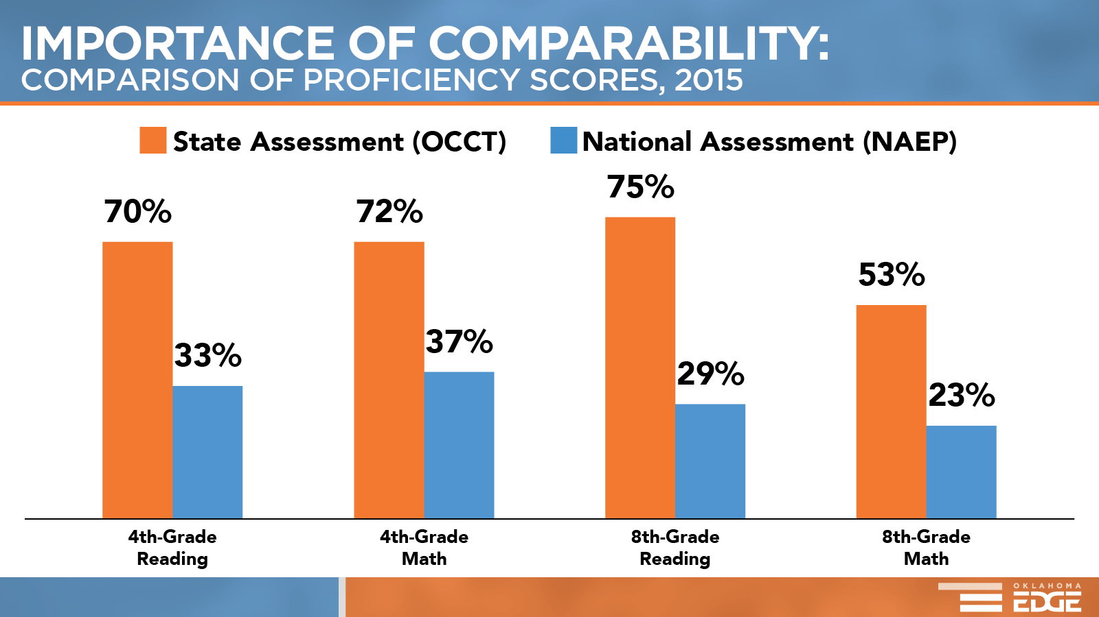
Notes:
This graph is specific to Oklahoma and mirrors the trends evident in the national data from the previous slide. Between 2015 and 2025, there will be a 50% reduction in the number of jobs available for those with a high school diploma or less. It is obvious we must rethink what it means for our students to be academically proficient and college and career ready in this changing workforce.
Again, Cory will need to rebuild and I will need to make a couple of text changes
If we want to give our students a competitive edge for success after high school, we first must know our starting point and how we compare nationally. In order to do this, we use data from national benchmarks. In high school, we use SAT and ACT as our national comparisons, and in grades 3-8 we use the National Assessment for Educational Progress, known a NAEP. The next slide displays Oklahoma’s proficiency standards compared to other states. This data is from 2015, prior to the implementation of the new Oklahoma Academic Standards.

Slide 14
Notes:
This graph is specific to Oklahoma and mirrors the trends evident in the national data from the previous slide. Between 2015 and 2025, there will be a 50% reduction in the number of jobs available for those with a high school diploma or less. It is obvious we must rethink what it means for our students to be academically proficient and college and career ready in this changing workforce.
Again, Cory will need to rebuild and I will need to make a couple of text changes
If we want to give our students a competitive edge for success after high school, we first must know our starting point and how we compare nationally. In order to do this, we use data from national benchmarks. In high school, we use SAT and ACT as our national comparisons, and in grades 3-8 we use the National Assessment for Educational Progress, known a NAEP. The next slide displays Oklahoma’s proficiency standards compared to other states. This data is from 2015, prior to the implementation of the new Oklahoma Academic Standards.

Slide 15
Notes:
This graph is specific to Oklahoma and mirrors the trends evident in the national data from the previous slide. Between 2015 and 2025, there will be a 50% reduction in the number of jobs available for those with a high school diploma or less. It is obvious we must rethink what it means for our students to be academically proficient and college and career ready in this changing workforce.
Again, Cory will need to rebuild and I will need to make a couple of text changes
If we want to give our students a competitive edge for success after high school, we first must know our starting point and how we compare nationally. In order to do this, we use data from national benchmarks. In high school, we use SAT and ACT as our national comparisons, and in grades 3-8 we use the National Assessment for Educational Progress, known a NAEP. The next slide displays Oklahoma’s proficiency standards compared to other states. This data is from 2015, prior to the implementation of the new Oklahoma Academic Standards.

Slide 16
Notes:
Read slide. Because of the changes we have made with new, more challenging academic standards, we expect Oklahoma to improve when compared to NAEP’s proficiency standards in future reports.

Slide 17
Notes:
Utah and Arizona are two states that have raised their proficiency standards and implemented new assessments with more challenging expectations of student performance. This data shows the outcome of those changes. REVEAL CHANGES. Although reports will be final on October 11, we expect to see similar patterns in Oklahoma. The important thing to focus on is that we are increasing our expectations of our students, not decreasing our percent proficient.
I don’t see the reveal but would sure like to.
Maria: You have to have it in the slide show format to see the animation.

Slide 18
Notes:
This timeline represents the different steps in this transition process. They bring us to 2017, where we are now looking at the results of our redefined proficiency expectations.

Slide 19
Notes:
In 2014, the Oklahoma State Department of Education implemented new, three-dimensional Oklahoma Academic Standards for Science – the first content area to be revised with the national expectations of preparation for college and career readiness. In 2016, we implemented our new college- and career-ready standards for both math and English language arts. All three content areas went through a comprehensive development and revision process that involved Pre-K-12 and postsecondary educators from around the state, community members and feedback from the Oklahoma business community.
These changes are happening as a result of the Federal Every Student Succeeds Act, state legislation which eliminated EOI assessments, and national and state workforce trends. Oklahoma’s testing program is federally required to administer assessments aligned to our Oklahoma Academic Standards. New standards, therefore, necessitated new assessments.
New standards and new assessments led to the need to revise performance-level language.
National workforce trends are reflected in Oklahoma, where we expect a 50% reduction in careers available for students with only a high school diploma by 2025. That is fewer than 8 years from now. The time to prepare our students is now.

Slide 20
Notes:
Read slide.
This needs to be styled the same way the other guiding questions are.

Slide 21
Notes:
Read slide. For example, a level-one DOK could be defining a vocabulary word. If that word is familiar to a student, it is an easy question. However, if that word is not familiar, it would be difficult for a student to answer. Because this is simple memorization and recall task, it is not a complex question, even if a student finds answering the question difficult.

Slide 22
Notes:
Remember, DOK is not about difficulty, but it is about complexity. DOK Level 1 requires students to use simple skills or abilities.
DOK Level 2 includes the engagement of some mental processing beyond recalling. For example, comparing or contrasting.
DOK Level 3 requires some higher-level mental processing like reasoning, planning, and using evidence.
A DOK Level 4 requires complex reasoning, planning, developing, and thinking over an extended period of time.
Let’s look at how the distribution has changed from our old standards to our new, more challenging Oklahoma academic standards.

Slide 23
Notes:
This represents the significant changes in our DOK distributions in English language arts. Blue represents DOK Level 3, which has changed from 14% in our previous standards to 26% in our new Oklahoma academic standards for ELA. More significantly, in our new standards, almost 10% of the assessed standards in ELA represent DOK level 4, whereas in our previous standards, level 4 was absent.

Slide 24
Notes:
This bar graph shows the changes in DOK distribution for all assessed standards in science, math and ELA. The left represents the overall percent increase of DOK 3, where it doubled, and the right shows the addition of DOK 4 with our new standards and assessments.
These changes have caused us to reevaluate our expectations of student performance.
I would cut this slide and add the above sentence to notes for the previous slide.
Maria: This slide displays the significant changes in all of our content standards and not just the ELA standards that are in the previous slide.

Slide 28
Notes:
ELA, math, and science have all developed specific toolboxes of resources tailored to the needs of teachers. When evaluating your options, these resources are an excellent place to start. Math has a well-developed set of resources; science also has many resources and will be adding formative assessment tools this year. ELA is in the process of developing resources and will be adding more tools as they are developed.

Slide 29
Notes:
In addition to Oklahoma needs, the task force had to keep in mind federal guidelines that required us to…READ SLIDE. .

Slide 31
Notes:
Stakeholders demanded a national college- and career-readiness assessment. Coupled with this, HB3218 required assessments aligned to national expectations of performance.
This resulted in the task force recommending that districts having the choice of the SAT or the ACT for their high school assessment. In order to ensure our students have the competitive edge with these new assessments, we’ve had to shift to higher levels of DOK which are driven by our more complex Oklahoma Academic Standards.
More challenging standards measured by more rigorous assessments require Oklahoma to rethink Performance Level Descriptors. These performance level descriptors are used to classify our students’ performances on state assessments.

Slide 32
Notes:
With the significant shifts in our assessments that reflect our more challenging standards, we expect fewer students to meet proficiency or advanced performance levels. As we rethink these new expectations, it is important to carefully consider how we communicate with students, families, and community members.
While your student reports will still contain terminology required by statute, when talking with students and parents, it may be more helpful and productive to use the terminology on the right hand side of the slide. This terminology reflects the knowledge, skills, and abilities that students possess as a true reflection of learning, as opposed to a label that may not reflect their progress and accomplishments.
NAEP uses Proficient and ACT uses Met Benchmark to describe student performance at the Proficient level. In this area, Oklahoma uses similar terminology; however, by using the old terminology of Limited Knowledge and unsatisfactory as categories, we are outside of nationally used terminology, such as Basic.
By utilizing the terms developing, beginning or emerging, we acknowledge the achievements students have already made and acknowledge that they are still progressing toward college and career readiness.
Moving to this type of terminology reflects the research on growth mindset by Dr. Carol Dweck.

Slide 33
Notes:
With the significant shifts in our assessments that reflect our more challenging standards, we expect fewer students to meet proficiency or advanced performance levels. As we rethink these new expectations, it is important to carefully consider how we communicate with students, families, and community members.
While your student reports will still contain terminology required by statute, when talking with students and parents, it may be more helpful and productive to use the terminology on the right hand side of the slide. This terminology reflects the knowledge, skills, and abilities that students possess as a true reflection of learning, as opposed to a label that may not reflect their progress and accomplishments.
NAEP uses Proficient and ACT uses Met Benchmark to describe student performance at the Proficient level. In this area, Oklahoma uses similar terminology; however, by using the old terminology of Limited Knowledge and unsatisfactory as categories, we are outside of nationally used terminology, such as Basic.
By utilizing the terms developing, beginning or emerging, we acknowledge the achievements students have already made and acknowledge that they are still progressing toward college and career readiness.
Moving to this type of terminology reflects the research on growth mindset by Dr. Carol Dweck.

Slide 34
Notes:
The pieces necessary to improve Oklahoma’s economy are complex, but many hinge around students receiving a high-quality education that translates to better careers, a stronger workforce, national competitiveness, and finally, a stronger state economy.
Shouldn’t this look more like a progression?
Maria: Yes we could display it that way. Below would be the progression:
Goal: Improved OK Economy
Students equipped to solve 21st century problems, Students prepared for high-demand, high-skill, wealth-generating jobs,
2) Students become great thinkers, problem-solvers, and innovators, Students better prepared for careers and college
3) Cognitively complex standards and assessments, Educational expectations equal to nationally accepted levels of performance

Slide 35
Notes:
The pieces necessary to improve Oklahoma’s economy are complex, but many hinge around students receiving a high-quality education that translates to better careers, a stronger workforce, national competitiveness, and finally, a stronger state economy.
Shouldn’t this look more like a progression?
Maria: Yes we could display it that way. Below would be the progression:
Goal: Improved OK Economy
Students equipped to solve 21st century problems, Students prepared for high-demand, high-skill, wealth-generating jobs,
2) Students become great thinkers, problem-solvers, and innovators, Students better prepared for careers and college
3) Cognitively complex standards and assessments, Educational expectations equal to nationally accepted levels of performance

Slide 36
Notes:
The pieces necessary to improve Oklahoma’s economy are complex, but many hinge around students receiving a high-quality education that translates to better careers, a stronger workforce, national competitiveness, and finally, a stronger state economy.
Shouldn’t this look more like a progression?
Maria: Yes we could display it that way. Below would be the progression:
Goal: Improved OK Economy
Students equipped to solve 21st century problems, Students prepared for high-demand, high-skill, wealth-generating jobs,
2) Students become great thinkers, problem-solvers, and innovators, Students better prepared for careers and college
3) Cognitively complex standards and assessments, Educational expectations equal to nationally accepted levels of performance

Slide 37
Notes:
The pieces necessary to improve Oklahoma’s economy are complex, but many hinge around students receiving a high-quality education that translates to better careers, a stronger workforce, national competitiveness, and finally, a stronger state economy.
Shouldn’t this look more like a progression?
Maria: Yes we could display it that way. Below would be the progression:
Goal: Improved OK Economy
Students equipped to solve 21st century problems, Students prepared for high-demand, high-skill, wealth-generating jobs,
2) Students become great thinkers, problem-solvers, and innovators, Students better prepared for careers and college
3) Cognitively complex standards and assessments, Educational expectations equal to nationally accepted levels of performance

Slide 38
Notes:
The pieces necessary to improve Oklahoma’s economy are complex, but many hinge around students receiving a high-quality education that translates to better careers, a stronger workforce, national competitiveness, and finally, a stronger state economy.
Shouldn’t this look more like a progression?
Maria: Yes we could display it that way. Below would be the progression:
Goal: Improved OK Economy
Students equipped to solve 21st century problems, Students prepared for high-demand, high-skill, wealth-generating jobs,
2) Students become great thinkers, problem-solvers, and innovators, Students better prepared for careers and college
3) Cognitively complex standards and assessments, Educational expectations equal to nationally accepted levels of performance

Slide 39
Notes:
The pieces necessary to improve Oklahoma’s economy are complex, but many hinge around students receiving a high-quality education that translates to better careers, a stronger workforce, national competitiveness, and finally, a stronger state economy.
Shouldn’t this look more like a progression?
Maria: Yes we could display it that way. Below would be the progression:
Goal: Improved OK Economy
Students equipped to solve 21st century problems, Students prepared for high-demand, high-skill, wealth-generating jobs,
2) Students become great thinkers, problem-solvers, and innovators, Students better prepared for careers and college
3) Cognitively complex standards and assessments, Educational expectations equal to nationally accepted levels of performance

Slide 40
Notes:
The pieces necessary to improve Oklahoma’s economy are complex, but many hinge around students receiving a high-quality education that translates to better careers, a stronger workforce, national competitiveness, and finally, a stronger state economy.
Shouldn’t this look more like a progression?
Maria: Yes we could display it that way. Below would be the progression:
Goal: Improved OK Economy
Students equipped to solve 21st century problems, Students prepared for high-demand, high-skill, wealth-generating jobs,
2) Students become great thinkers, problem-solvers, and innovators, Students better prepared for careers and college
3) Cognitively complex standards and assessments, Educational expectations equal to nationally accepted levels of performance

Slide 41
Notes:
Read slide.

Slide 42
Notes:
As you are thinking about assessment results, it is important to remember that comparisons to prior years are not relevant. Specifically, our standards have changed from our previous standards called PASS to our new Oklahoma Academic Standards. You will remember the Depth of Knowledge has significantly changed; therefore, students are no longer being assessed at the same level as they were in prior years. We are now instructing and assessing at nationally comparable levels and expectations of performance levels. This is Year One of a total reset!!

Slide 43
Notes:
As you are thinking about assessment results, it is important to remember that comparisons to prior years are not relevant. Specifically, our standards have changed from our previous standards called PASS to our new Oklahoma Academic Standards. You will remember the Depth of Knowledge has significantly changed; therefore, students are no longer being assessed at the same level as they were in prior years. We are now instructing and assessing at nationally comparable levels and expectations of performance levels. This is Year One of a total reset!!

Slide 44
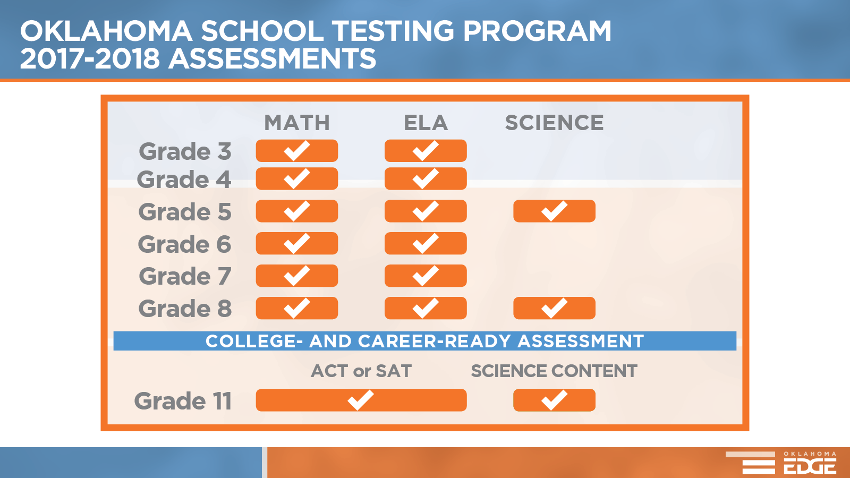
Notes:
This graphic displays content and grade level being assessed this academic year. For further information about any of these assessments, please see the assessment page on the Oklahoma State Department of Education web page.
Need to make an edit on this.

Slide 45
Notes:
This graphic displays content and grade level being assessed this academic year. For further information about any of these assessments, please see the assessment page on the Oklahoma State Department of Education web page.
Need to make an edit on this.

Slide 46
Notes:
C. McCreary is the ELA/SS Assessment Specialist; I would prefer that you switch her and Cora James on the placement of the slide.

