Slide 1
Moving Oklahoma
Education Forward
Budget Hearing
FY 2016
Notes:
Honorable Senators and guests, thank you for this opportunity to share my vision for the FY 2016 Department of Education Budget.
You will note that the budget request I am presenting to you is a $70 million decrease from that which the Oklahoma State Department of Education proposed last October.

Slide 2
Recurring Revenue
Notes:
This slide shows all new revenue that was available to schools at the beginning of FY 2014. This reflects all recurring revenue sources and all new monies that schools receive on an annual basis.
This is the only money schools can count on to budget for operations. This graph excludes bonds, sinking funds, activity funds, endowments, MAPs, municipal taxes and child care funds.
Dollar amounts in the blue and orange sections here are in the state funding formula for schools.

Slide 3
Seven Sources of
Formula Revenue
LOCAL AND COUNTY REVENUES:
AD VALOREM TAXES
COUNTY 4-MILL
STATE – DEDICATED REVENUES:
STATE SCHOOL LAND EARNINGS
GROSS PRODUCTION
MOTOR VEHICLE COLLECTIONS
RURAL ELECTRIFICATION ASSOCIATION (REA) TAX
STATE APPROPRIATED:
FINANCIAL SUPPORT OF SCHOOLS (FORMULA FUNDING)
Notes:
There are seven state revenue streams in the funding formula.
The county 4-mill in statute originally was set in place for minority schools. After desegregation, however, it applied to all districts. It is collected locally.
Dedicated revenues are those which are set in statute, voted on and approved by the people to go to schools. They are collected at state level and sent back to schools.
What is traditionally known as "financial support of schools" is what the Legislature puts into the formula each year via the appropriations process.
The REA tax refers to Rural Electric Cooperatives. They generate revenue for their counties.
Activity money is not chargeable (bake sales, concessions, band, etc).

Slide 4
Seven Formula Sources of Revenue
Seven Sources of
State Formula Revenue
.5
1.0
1.5
2.0
2.5
3.0
3.5
4.0
In Billions
Notes:
Here you can see the breakdown of how much each source contributes to the school funding formula and how it has changed over time.
When we talk about the “school funding formula,” we are talking about state and local revenues supporting Oklahoma schools.
Financial Support of Schools refers to the money that the Legislature appropriates to the formula.

Slide 5
Formula Revenue
Seven Rev. Sources | FY2015 | FY2014 | FY2013 | FY2012 | FY2011 | FY2010
Ad Valorem (35 Mills) | $1,058,635,853 | $ 1,013,534,728 | $ 975,794,215 | $ 943,606,637 | $ 905,082,205 | $ 878,567,004
County 4-Mill | $ 116,348,712 | $ 112,653,312 | $ 109,665,459 | $ 104,564,406 | $ 100,620,495 | $ 93,896,685
School Land | $ 93,626,801 | $ 93,000,002 | $ 102,144,987 | $ 93,160,723 | $ 83,212,992 | $ 60,341,458
Gross Production | $ 79,370,145 | $ 60,196,841 | $ 72,199,149 | $ 66,528,645 | $ 57,919,963 | $ 86,216,531
Motor Vehicle | $261,396,364 | $ 238,717,326 | $ 229,663,512 | $ 219,919,668 | $ 219,312,126 | $ 219,313,333
REA Tax | $ 39,049,624 | $ 35,001,277 | $ 33,642,861 | $ 31,213,972 | $ 28,930,479 | $ 30,453,465
Fin. Support of Sch. (Formula) - State Approp. Funds | $ 1,852,438,034 | $ 1,835,981,870 | $ 1,814,199,862 | $ 1,815,185,159 | $ 1,755,855,588 | $ 1,758,161,965
American Recovery and Reinvestment Act (ARRA) |  |  |  |  | $ 139,772,164 | $ 204,671,526
Government Services Fund (GSF) of the ARRA |  |  |  |  |  | $ 14,990,952
TOTAL | $3,500,865,533 | $ 3,389,085,356 | $ 3,337,310,045 | $ 3,274,179,210 | $ 3,290,706,012 | $ 3,346,612,919
Notes:
The last two lines here refer to stimulus money — not funds that schools can necessarily depend on in the future.

Slide 6
Percent Breakdown of Common Education Funding FY 2008 – FY 2014
Source: Office of Management and Enterprise Services
Notes:
This data is provided by the Office of Management and Enterprise Services up to FY 2014.
The red line is the percentage of the appropriated budget that goes to common education pre-K through 12th grade. In FY 14, that amounted to 34 percent of the budget.
The blue line is the percentage of total general revenue, or General Revenue Fund (GRF), that went to common education pre-K through 12. In FY 14, that was 16.6 percent available for public schools.
The percentage of funding from the GRF has continued to drop due to increased exemptions and off-the-top funding streams.

Slide 7
Ad Valorem Exemption
Tax Year | 5 yr. Exemption Wind Energy | 5 yr. Exemption Non-Wind | Total 5 yr. Exemptions
2013 | $32,270,226 | $32,086,050 | $64,356,276
2014 | $28,854,496 | $37,602,306 | $66,456,802
2015 | $38,207,891 | $43,009,873 | $81,217,764
2016 | $44,976,588 | $44,230,619 | $89,207,207
2017 | $50,440,944 | $43,191,938 | $93,632,882
2018 | $47,794,663 | $42,808,325 | $90,602,988
Oklahoma Tax Commission
Notes:
This material is from the Oklahoma Tax Commission.
The Ad Valorem (property tax) exemption was granted to certain manufacturing facilities by a vote of the people in 1985. The state constitution enables the Legislature to decide which entities quality for the exemption. The Legislature amended the law in the mid-2000s to include wind energy facilities in the property tax exemption.
The state’s Ad Valorem Reimbursement Fund is funded by 1 percent.
The amount of non-taxed money continues to grow. The state has to make up this amount by constitutional obligation. Under the Ad Valorem Reimbursement, the state is required to make up that property tax loss to schools, county government and libraries.

Slide 8
Ad Valorem Reimbursement
For 2014 tax year the Manufacturing Exemption will cost the state $66,456,802.
Of that amount, the amount due to common schools is $44.3 million.
Estimated revenues available to fund this obligation range between $7.5 to $12.5 million.
Projected Additional Appropriation to Oklahoma Tax Commission to make common schools whole by June 30, 2015 is $35 - $40 million!
Notes:
The revenue fund available to cover Ad Valorem Reimbursement is short almost $54 million.
Right now, the state will owe schools approximately, $35-$40 million due to the exemptions.
OSDE urges that this appropriation be made earlier than the final budget negotiations in May, so that schools can have the funds needed to close their books by June 30 as required by the constitution. Additionally, schools’ non-payable warrants must be paid back by June 30.
Every school benefits from this being addressed early because it is chargeable against the funding formula.

Slide 9
Notes:
Total state appropriations have declined and are gradually coming back up.
Enrollment, meanwhile, has continued to increase. Our educators are continuing to do more with less. Oklahoma public schools have 40,000 more children since 2010, and less money.
And this is only the last five years. 2009 was even higher — so one can understand the education community’s desire to see funding returned to 2010, or even 2009, levels.

Slide 10
Notes:
This graph shows all state funds flowing through the OSDE, including activity funds.

Slide 11
Financial Support of Public
Schools
FY2015 Appropriation | FY2016 Budget Request
$1,876,284,000 | $2,081,284,000
Increase of
$205,000,000
formula dollars
Notes:
How do we fix it?
OSDE is requesting an additional $205 million into the funding formula.

Slide 12
Securing Education Excellence
(Details of Budget Request)
$205,000,0000
$150,000,000
$2,000 Increase in Teacher Salary and Associated Costs
Two Additional Days of Instruction
$55,000,000
Two Additional Days of Instruction (non-teacher costs)
Address Increase Costs Due to Student Growth
Notes:
Here is the breakdown of where that $205 million would go:
$150 million for $2,000 increase in teacher salaries and two additional days of instruction.
$55 million for non-teacher costs for two additional days of instruction.
More students don’t simply mean more teachers. It means more desks, more buses, materials and the like.

Slide 13
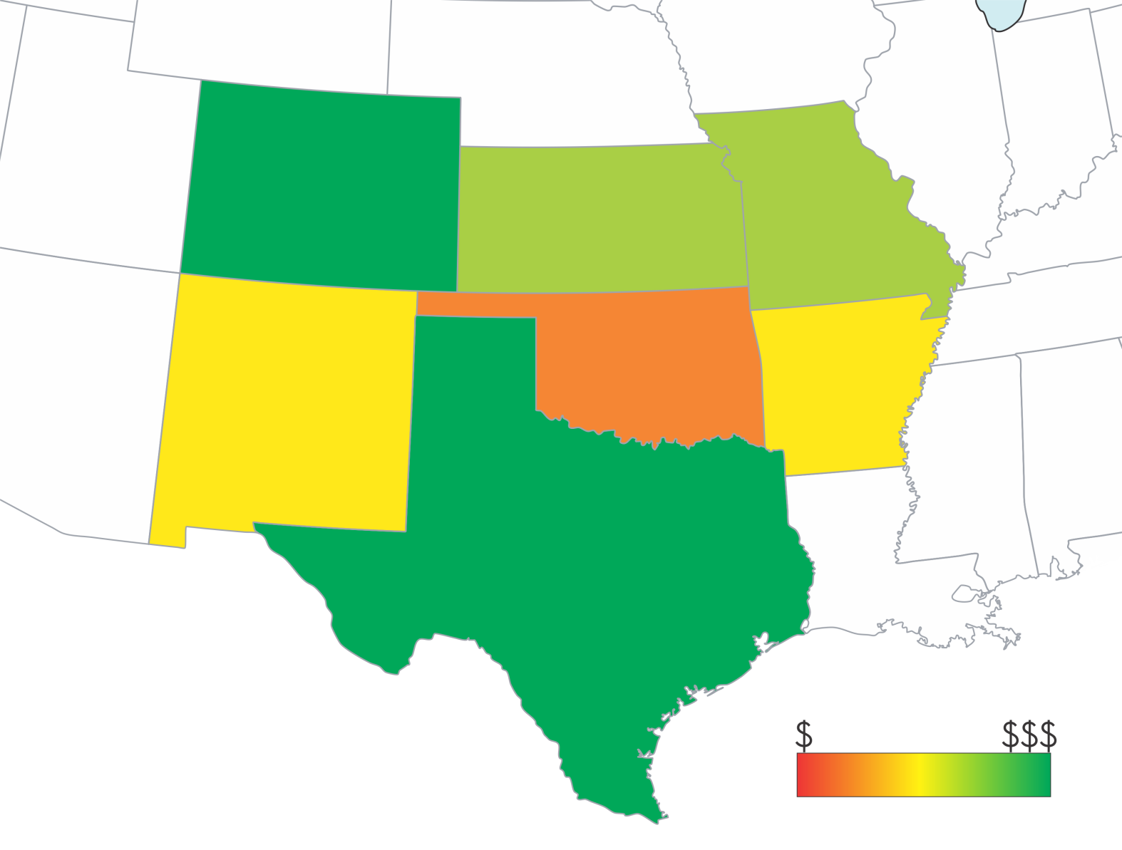
Average Teacher Salary and Number of Instructional Days in Surrounding States
$49,393
160 Days
$47,464186 Days
$47,517174 Days
$44,128175 Days
$46,632178 Days
$46,573
180 Days
$48,110180 Days
Source: Education Commission of the States http://www.ecs.org/clearinghouse/01/06/6810668.pdf
http://nces.ed.gov/programs/digest/d13/tables/dt13_211.60.asp
http://highereddatastories.blogspot.com/2013/12/how-much-do-we-pay-public-school.html
Notes:
Oklahoma lags In its number of instruction days. The average of neighboring states is 176 days. Our state should exceed that.
The national average for instructional days is 180. Our neighbors to the north exceed 180 days. If we expect to get out of the bottom tier of states when it comes to education, we must have a plan for success.
Under our proposal, Oklahoma would reach the national average in days of instruction.

Slide 14
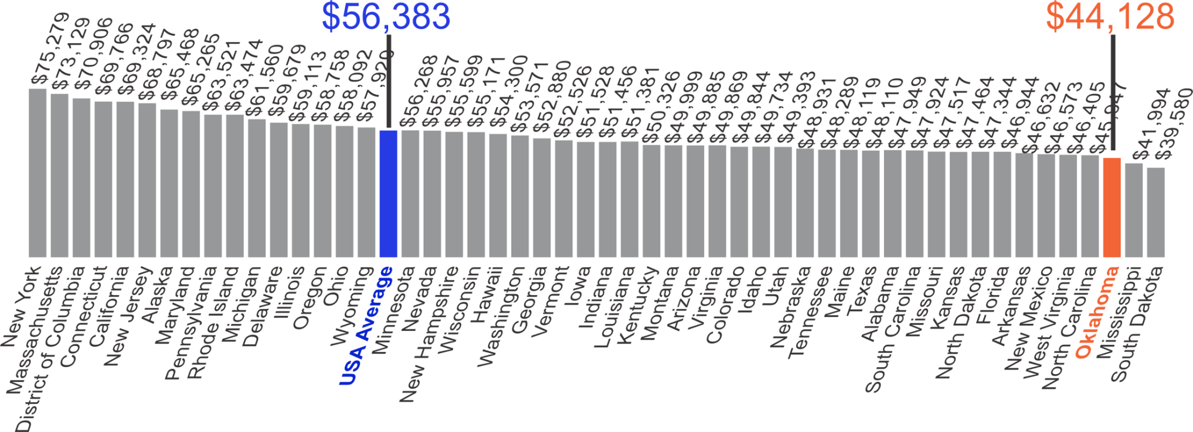
National Average of
Teachers’ Salaries
http://nces.ed.gov/programs/digest/d13/tables/dt13_211.60.asp
http://highereddatastories.blogspot.com/2013/12/how-much-do-we-pay-public-school.html
Notes:
In terms of teacher pay, the national average is $56,000. Only Mississippi and South Dakota (as well as the District of Columbia) keep Oklahoma from being ranked 49th in the nation.
Consequently, Oklahoma is losing teachers to almost every other state.

Slide 15
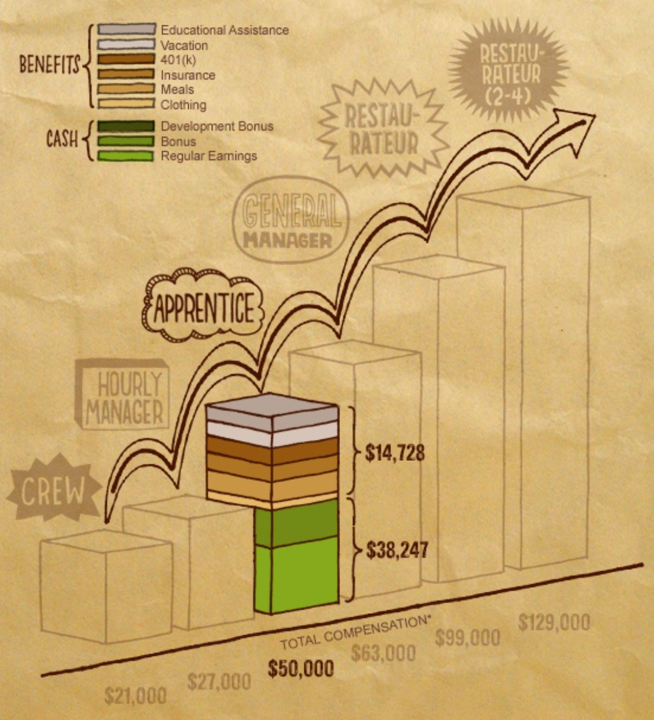
We are not only competing with industries like oil and gas, we are competing with fast food chains.
http://www.chipotle.com/en-US/careers/path_and_compensation/path_and_compensation.aspx
Notes:
To attract and retain top talent in the classroom, Oklahoma is not only competing with the oil and gas industry — it is competing with fast food.
For example, a Chipotle employee at the apprentice level can earn more than an Oklahoma teacher with a Ph. D and 25 years of experience (which is the top of Oklahoma’s minimum teacher salary schedule at $46,000 per year).

Slide 16
5 Year Plan to Secure
Education Excellence
Oklahoma teachers currently make $3,248.33 less per year than teachers from other states in our region.
In order to recruit and retain top teaching talent in Oklahoma, we must have a plan to extend our school year while raising teacher pay.
+5 Instructional Days
+$5,000 in Teacher Compensation
Over the next 5 years
#OKHigh5
Notes:
To increase educational attainment, we must have quality teacher in every classroom.
That is why Superintendent Hofmeister wants to increase both instructional days and teacher compensation.
She is advocating for a 5-year phasing in of 5 additional days of instruction and a $5,000 across-the-board increase in teacher compensation.

Slide 17
Investing in Our Future
Raising Teacher Compensation and Instructional Days
YEAR | RAISE | ADDED INSTRUCTIONAL DAY | AVERAGE DAILY RATE | TOTAL RAISE (Increase over 2012-13 Pay)
2014-15 | $0.00 | +0 days | N/A | $0.00
2015-16 | $2,000.00 | +2 days | $257.63 | $2,516.26
2016-17 | $500.00 | +1 day | $260.38 | $760.38
2017-18 | $500.00 | +1 day | $263.11 | $763.11
2018-19 | $500.00 | +1 day | $265.82 | $765.82
2019-20 | $500.00 | +0 days | N/A | $500.00
TOTALS | $4,000.00 | 5 DAYS (180) | $1,304.57 | $5,304.57
Salary Schedule Increase + (Added Day x Average Daily Rate) = Total Raise
YEAR | RAISE | AVERAGE TEACHER SALARY | AVERAGE DAILY RATE | ADDED DAY | TOTAL AVERAGE TEACHER COMPENSATION | TOTAL COST FOR TEACHER PAY & ADDING DAYS
2014-15 | $0.00 | $44,373.00 | $246.52 | N/A | $44,373.00 | N/A
2015-16 | $2,000.00 | $46,373.00 | $257.63 | Yes 2 days (182) | $46,888.26 | $150,000,000.00
2016-17 | $500.00 | $47,388.26 | $260.38 | Yes (183) | $47,648.64 | $60,000,000.00
2017-18 | $500.00 | $48,148.64 | $263.11 | Yes (184) | $48,411.75 | $60,000,000.00
2018-19 | $500.00 | $48,911.75 | $265.82 | Yes (185) | $49,177.57 | $60,000,000.00
2019-20 | $500.00 | $49,677.57 | $268.53 | No (185) | $49,677.57 | $32,000,000.00
TOTALS | $4,000.00 | $49,677.57 | $268.53 | 5 DAYS (185) | $5,304.57 INCREASE OVER 2012-13 PAY | $362,000,000.00
Notes:
Taking action now is a way to get ahead so we don't keep chasing the problem. We need to make a bold commitment for future success of Oklahoma schoolchildren.
This is a total $5,000 increase in compensation including pay for additional days.

Slide 18
Investing in Our Future
Total Cost of Investment
YEAR | TOTAL AVERAGE TEACHER COMPENSATION | TOTAL COST FOR TEACHER PAY & ADDING DAYS
2014-15 | $44,373.00 | N/A
2015-16 | $46,888.26 | $150,000,000
2016-17 | $47,648.64 | $60,000,000
2017-18 | $48,411.75 | $60,000,000
2018-19 | $49,177.57 | $60,000,000
2019-20 | $49,677.57 | $32,000,000
TOTALS | $5,304.57 INCREASE OVER 2012-13 PAY | $362,000,000
Notes:
So what is it going to cost to do this?
We put these dollars through the funding formula because it provides an equitable distribution of funds to all districts. We ensure through state statute that each teacher receives a guaranteed raise as well as by amending the minimum teacher salary schedule.

Slide 19
District Revenues & Expenditures
Notes:
Now, let’s go into a little more detail on school revenues and expenditures.

Slide 20
Statewide District New Revenue
Notes:
This is a repeat of the first slide you saw just to refresh your memory. This is all the money districts receive new each year from recurring sources.

Slide 21
New Revenue with Fund Balance
Notes:
This is the same slide as you just saw, but we are adding in cash forward and balancing accounts. The purple is old money that is available to schools to operate.
This is the money that we use to open school in the fall because we don't get it when we need it. There is a statutory cap on what schools can carry forward.
Money that districts carry over, money that has lapsed, and Estopped Warrants — warrants that were written but never cashed, so they stopped payment.

Slide 22
Statewide District Expenditures
Facilities Acquisition & Construction
$69,514,988
1%
Notes:
Now let’s look at how schools spend their money:
55 percent goes directly to in-classroom instruction.
38 percent is used for support services for the child, including food, transportation, nurses, counseling, principals and librarians, among other services.
93 cents of every $1 we spend supports individual student instruction.
The green “Administration” section on this chart includes the central office, superintendents, board of education and other staff. Using a definition of administrative costs defined in state statute, it is actually less than 4 percent of overall district expenditures statewide.
These expenses, at just over $5 billion, represent more than the amount of new revenue coming in, which is $4.96 million. Currently, schools use their carry-forward funds to fill that hole. This is unsustainable.

Slide 23
School District General Fund Beginning Balance
FY 2010 – 2015
Reported by Districts though OCAS
In Millions
Notes:
The first large state aid payments are not made until September. Districts use money from their emergency fund accounts to open schools until they receive funding for the new year. If a school doesn't get state aid, they may not get any new money until November or December. Ad valorem reimbursement districts won't get their money until June — a year later.
Based on what we know about how schools are dipping into their savings, we project that they will have drawn down to $601 million in their emergency fund accounts in FY2015.
Schools rely on this money.
In two years, schools have burned through more than $150 million in savings, or 22 percent. So we either have to stop growing and start turning away kids, or our schools are going to start closing.
Again this is unsustainable. We must be funded at a higher level.

Slide 24
Support of
Public School Activities
(Line Items)
Notes:
Next, let’s talk more about our proposed budget. This section is about Support of Public School Activities or what are more commonly known as the “line items.”

Slide 25
Percentage of Flexible Benefit Allowance
$139,918,158
25% of Public
School Activities
16% of
Total State
Appropriation
$407,283,633
75% of Public
School Activities
Total State Appropriation 2,477,885,086.00
Support of Public School Activities 546,201,791.00
Flexible benefit Allowance 407,283,633.00
FBA as a % of PSA 75%
FBA as a % of Total State Appropriation 16%
Notes:
The school activities account, reflected here in light blue, is the second biggest account OSDE receives from the Legislature. Seventy-five percent of funds from the activities account are already spent on health insurance through the Flexible Benefit Allowance (FBA), as required by state law.
Only 25 percent of monies allocated for “public school activities” actually serve that purpose.
The FBA claims 16 percent of total state appropriations for schools.

Slide 26
Flexible Benefit Allowance
Flexible Benefit Allowance Appropriation Total for Fiscal Year 2015 = $407,283,633
Flexible Benefit Allowance Appropriation Request for Fiscal Year 2016 = $422,588,036
Increase of
$15,304,403
Notes:
This is our estimate for how much money we will need in the FBA for FY 2016. It allows for a small insurance premium rate increase and a modest 3 percent growth in personnel.
We will need $15.3 million more to cover medical insurance costs in FY 2016 than in FY 2015.

Slide 27
Flexible Benefit Allowance Allocation
(Providing Health Insurance to over 83,000 Oklahoma Educators)
(In Millions)
Final count for FY 2015 will be available in mid February
Notes:
As this slide demonstrates, the cost of providing medical insurance to our educators, as required by law, increases steadily every year.
From FY 2010 through the estimated appropriation for FY 2016, the allocation for the FBA has increased by $132 million.

Slide 28
Reform Implementation
Budget Highlights
Most line item requests for FY 16 will simply return funding to the FY 15 original appropriation.
The $5.5 million previously budgeted for the NCLB transition is no longer needed.
Other than teacher compensation, staff development is one of the few areas where an increase is requested = $1.3 million.
Line items for RSA and Reading Readiness were combined for a total $9 million request.
Notes:
There are several areas of major change between the line items in the previous budget approved by the State Board of Education (SBE) in October 2014 and those in the new budget request, which the SBE approved in January 2015:
In the current budget request, most items were returned to their original appropriations in FY 2015.
Because Oklahoma’s waiver from the No Child Left Behind (NCLB) act was restored, the $5.5 million initially budgeted for a transition to NCLB rules is not needed. That item was removed from the new budget request.
Other than teacher compensation, one of our greatest needs is professional development. You will note an increase of $1.3 million in that category, one of only a few to request an increase.
Finally, the line items for reading readiness and the Reading Sufficiency Act were combined for clarity.

Slide 29
Performance Update
Finding opportunities to increase time for instruction by decreasing testing, while continuing to strive for excellence and transparency through valid and reliable measures.
29

Slide 30
OCCT General Assessments for Grades 3-8
Grade | Math | Reading | Science | Geography | Social Studies/ U.S. History | Writing
Grade 3
Grade 4
Grade 5
Grade 6
Grade 7
Grade 8
Federal and State mandated tests
State mandated tests
Notes:
This graph shows which tests are mandated by the federal and state governments in grades 3-8, and which are solely mandated by the state.

Slide 31
OCCT General Assessments
End-of-Instruction
ACE Algebra I | ACE English II | ACE Biology I | ACE U.S. History | ACE Algebra II | ACE Geometry | ACE English III
Federal and State mandated tests
State mandated tests
Notes:
This graph shows which end-of instruction (EOI) exams are mandated by the federal government and state governments, and which are solely state-mandated.
While the federal government mandates that Algebra I, English II and Biology I are tested, it does not have to be in the form of three separate tests. If Oklahoma chose to do so, it could meet the federal requirements with a single test.

Slide 32
FY 2015 Testing Costs
Grades 3-8 | $6,882,608
Grades 5 & 8 Science | $2,915,154
EOIs | $7,976,850
Total | $17,774,612
Federal Funds | $4,248,671
State Funds | $13,525,941
Total | $17,774,612
Notes:
These are the contracted costs for state tests in FY 2015. This is typically included as part of the agency budget, but here we break out specific numbers to give you a better idea of the price tag on testing.
The state does receive some money from the federal government for testing, but state funds cover most of it. Note the request for $14 million in the budget proposal to cover these costs.

Slide 33
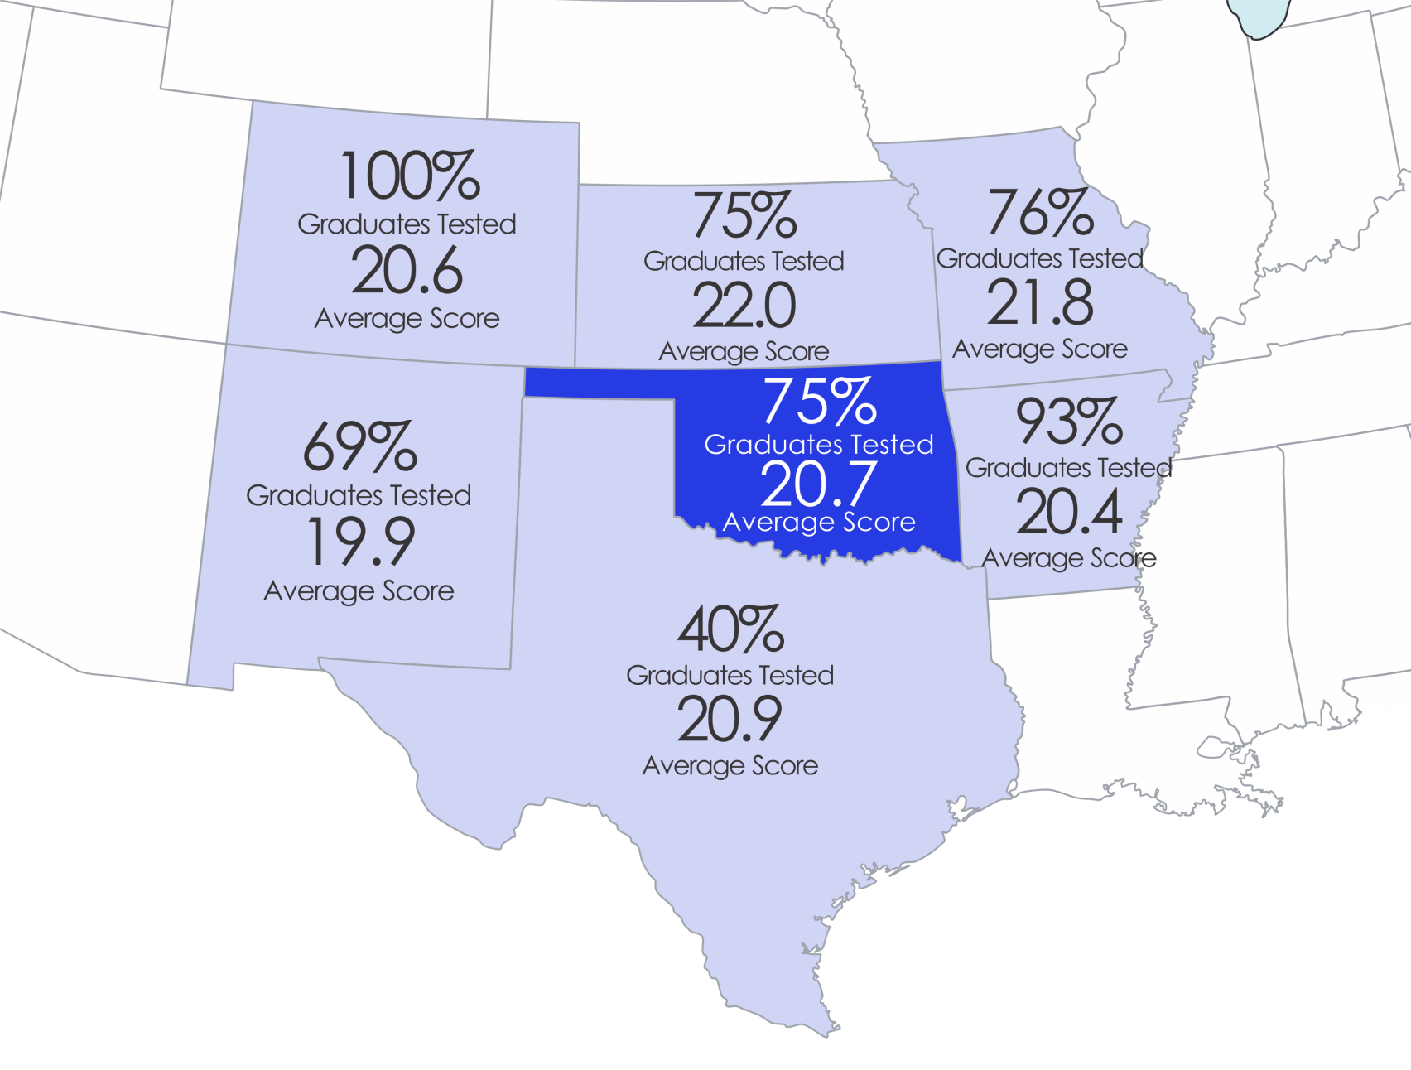
ACT Regional Comparison
www.act.org/readiness/2014
Notes:
Superintendent Hofmeister supports an ACT-based model for state testing. Here you can see that we already administer the ACT to 75 percent of our students, and our scores are competitive with our surrounding states.

Slide 34
ACT Cost Savings over EOI
$6,949,129
-$1,547,070
$5,402,059
EOI Cost
Estimated
ACT Cost
Savings
Notes:
If we administered the ACT to all high school juniors, it would cost an estimated $1.6 million. Replacing EOIs with the ACT produces a potential savings of $5.4 million, according to figures provided by the Oklahoma State Regents for Higher Education.

Slide 35
2014 OCCT EOI Results
Subject | % Proficient 2014 | Number Tested 2014 | % Proficient 2013 | Number Tested 2013
Algebra I | 75% | 46,141 | 84% | 40,608
Algebra II | 76% | 30,592 | 77% | 31,824
Biology I | 50% | 44,104 | 54% | 37,496
English II | 81% | 43,643 | 88% | 37,889
English III | 87% | 34,721 | 90% | 38,091
Geometry | 81% | 40,595 | 83% | 38,396
U.S. History | 77% | 39,057 | *
*2014 U.S. History test is aligned to new standards.
2014 was the first year OMAAP was not offered as a first option as assessment for students on an IEP
Notes:
Moving on to statewide academic performance as measured by current policies, here are the results from the 2013 and 2014 high school end-of-instruction (EOI) exams.
Our percentage proficient scores dropped on all tests between the two years. The primary reason for this is because our state dropped the Oklahoma Modified Alternative Assessment Program (OMAAP) in 2014, and students on Individualized Education Plans (IEP) were administered standard assessments without modification for the first time.

Slide 36
RSA Performance
45,356 3rd Grade Students Enrolled
41%
24%
35%
Notes:
Now let’s look at results under Oklahoma’s Reading Sufficiency Act (RSA).
In the first year of RSA’s mandatory retention policy (school year 2014-15), more students were retained than were promoted by their site-level literacy teams. For those who count success by the number of students retained this year was more successful than any previous year.

Slide 37
RSA Performance
Percent of Students Scoring Below Grade Level
Notes:
We are successfully addressing illiteracy earlier. Note the 3 percent decrease of kindergarten students scoring below grade level from school year 2013-14 to 2014-15.

Slide 38
ACE Remediation
38
Notes:
Looking again at results from higher grades, here are the results under the Achieving Classroom Excellence (ACE) graduation requirements.
Though there is always room for improvement, we can see from this graph that a majority of students are scoring either proficient or advanced on their tests.

Slide 39
Cost to Fully Fund
ACE Remediation & RSA
ACE Remediation:
$180 x 82,682
+ $240 x 79,856
$34,048,200
limited knowledge students
unsatisfactory students
Total if Fully Funded
Currently Funding at 23.5%
Reading Sufficiency Act:
$150
x 87,121
$13,068,150
per student
students
Total if Fully Funded
Currently Funding at 50%
Notes:
As outlined by statute and based on the results from the previous slides, it would cost $34 million to fully fund ACE remediation and $13 million to fully fund the RSA. Compared to last year’s appropriation, we are only funding ACE remediation at 23.5 percent and the RSA at 50 percent.

Slide 40
Advanced Placement
40 AP trainings were held in 8 regions across the state this fall with 750 teachers in attendance.
Advanced Placement Summer Institutes will be held in multiple locations this summer for all Oklahoma educators
49 schools in the state now offer AVID – Advancement Via Individual Determination, a proven program for increasing College and Career Readiness
15,001 students are taking AP exams
11,933 or 80% of these students are passing exams with a college-ready score of 3, 4, or 5
Notes:
Of the 15,000 students who took AP exams in Oklahoma, 80 percent are potentially eligible for college credit because they scored a three, four or five.

Slide 41
Teacher and Leader Effectiveness
100% of districts are using the qualitative component of TLE with a high level of fidelity to improve educator effectiveness and student learning outcomes.
‪More than 615 district leaders representing 523 districts attended the VAM trainings, and more than 815 district leaders representing 434 districts attended the SLO/SOO trainings held this fall.‬
Future Vision for TLE Implementation:
Collaborate with external stakeholders to continue training on both the qualitative and quantitative portions of TLE.
Further study is needed to ensure that the quantitative portion is valid, reliable and useful to teachers in order to improve instruction.
Notes:
Superintendent Hofmeister is committed to means of evaluating Oklahoma teachers and administrators. That method, however, must be valid and reliable. That’s why the superintendent is initiating a partnership with researchers at the University of Oklahoma and Oklahoma State University to study this issue and design a method that is transparent and holds teachers and administrators accountable.
Our hope and goal is that our method can be a model for the nation.

Slide 42
FY 16 Budget Increase Request
Teacher Compensation & Extended School Year | $150,000,000
Financial Support of Schools | $55,000,000
Flexible Benefit Allowance | $15,304,403
Staff Development for Schools | $1,320,961
Other School Activities | $350,921
Administration & Support | $4,363
TOTAL | $221,980,648
Notes:
To summarize our budget request increase:
OSDE is asking for an additional $205 million to support teachers and the costs that come with adding instructional days to the calendar.
We will need an additional $15 million for the Flexible Benefit Allowance (medial insurance) and $1.3 million for professional development.
We are only asking for a $4,300 increase for agency operations, which includes testing. That would bring our agency budget to a total of $25.4 million.
Our total increase is $222 million, which is $70 million less than what was requested in the October 2014 budget proposed by the previous state superintendent.

