Slide 1
Certificates of Eligibility (COE) Recertification Process
Oklahoma state
department of education
Migrant education program
May 27, 2015

Slide 2

DISTRICTS CANNOT RECERTIFY STUDENTS AFTER 36 MONTHS.
Students are eligible for the Migrant Education Program (MEP) for 36 months from their last Qualifying Date of Arrival (QAD).
The “clock” starts over with every QAD.

Slide 3
Terminology
The term “enrollment” means enrolled in your school district.
The term “withdrawn” means the student is no longer enrolled in your school district.
  Examples: Students moves or Student is out of school for Summer.
  Student would not be withdrawn for Fall Break, Winter Break, or Spring Break.
Students are not enrolled in the MEP (they are eligible for the MEP).

Slide 4

MIS2000
MIS2000 requires enrollment to be indicated on the original COE.
In order for Student Counts and Reports to run correctly, enrollment must be indicated annually for a student who did NOT make a new move.

Slide 5

Paper Recertification

Slide 6
Paper Recertification
If you filled out a paper COE for the student and submitted that paper COE to the OSDE MEP, then you will do a Paper Recertification on that student.
QAD that exceed 36 months will not be recertified/Recruiter will be notified.
Paper Recertification should be completed and submitted to OSDE MEP by October 1, 2015.

Slide 7
Paper Recertification
Step 1: Locate the original paper COE
  If you do not have the original paper COE, please contact the OSDE MEP Office.
    An unsigned electronic COE can be printed for any student in the system.
Step 2: Make a copy of the original paper COE
  OR use the unsigned electronic COE.

Slide 8
Paper Recertification
Step 3: Using RED INK, update the following:
  School Year
  Grade
  School Site Code (if applicable)
  Enrollment Date
  You may update address & phone number, but it is not mandatory
  Please do NOT change Parent/Guardian/Worker names
DO NOT UPDATE
Section III. Qualifying Move & Work
OR
Section IV. Comments

Slide 9
Paper Recertification
Step 3: Using RED INK, update the following:
  School Year
    Change from “14/15” to “15/16.”
  Grade
    Verify that the student changed grades.
    If the student did NOT change grades, please indicate.
    If the student dropped out or is no longer enrolled (OSY), please indicate.
  School Site Code (if applicable)
  Enrollment Date
    1st day of your school year
  If a sibling has graduated, simply draw a line through their name; the student will be removed from the recertification.
  Do not ADD siblings to a recertification; Complete a new COE.

Slide 10

Paper Recertification
Step 4: Parent/Guardian sign and date
  It does not have to be the same person that signed the original.
  The recruiter needs to ensure that the date is current.
Step 5: Recruiter sign and date

Slide 11
Paper Recertification
Step 6: Submit Paper Recertification to OSDE.
  It is RECOMMENDED that you scan the paper recertification and email it to OSDE MEP.
    Scan in color.
    This ensures receipt of delivery AND you have the paper recertification in case of an audit.
    It also protects everyone from items being “lost in the mail.”
  If you choose to mail the paper certifications, please make copies of the documents before you send them.
  If you choose to fax the paper certifications, please contact the OSDE MEP office and let them know that the fax is coming.
  You can submit paper recertification all at one time or as you collect them.

Slide 12

Electronic Recertification

Slide 13
Electronic Recertification
If you completed an electronic COE for the student and it was “Accepted” by OSDE MEP, then you will do an electronic Recertification on that student.
MIS2000 will not allow QADs that exceed 36 months to be recertified.
Electronic Recertifications should be completed and submitted to OSDE MEP by October 1, 2015.

Slide 14
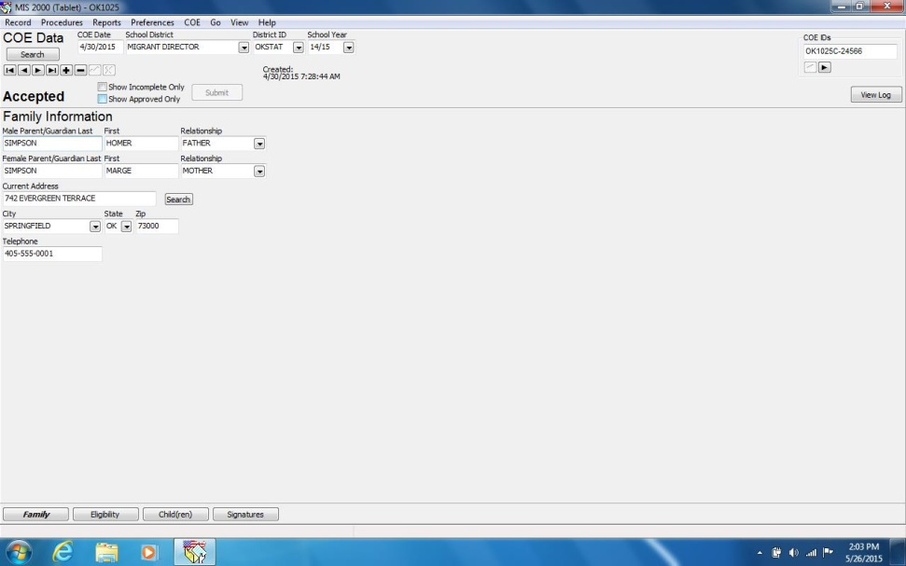
Electronic Recertification
Step 1: In MIS2000, find the original COE

Slide 15
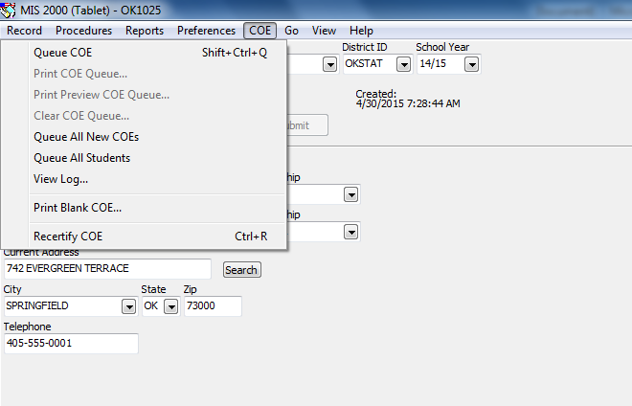
Electronic Recertification
Step 2: Click “COE”, select “Recertify”

Slide 16
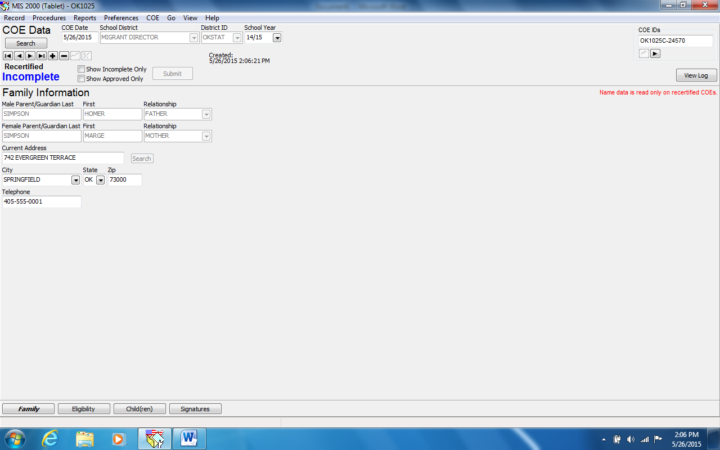
Electronic Recertification
“Accepted” will change to “Recertified Incomplete.”
COE IDs will change.

Slide 17
Electronic Recertification
Step 3: Update tabs – Family Tab
Only certain fields will be open for editing.
Mandatory: Update School Year (Top Panel).
Optional: Update address and phone number.

Slide 18
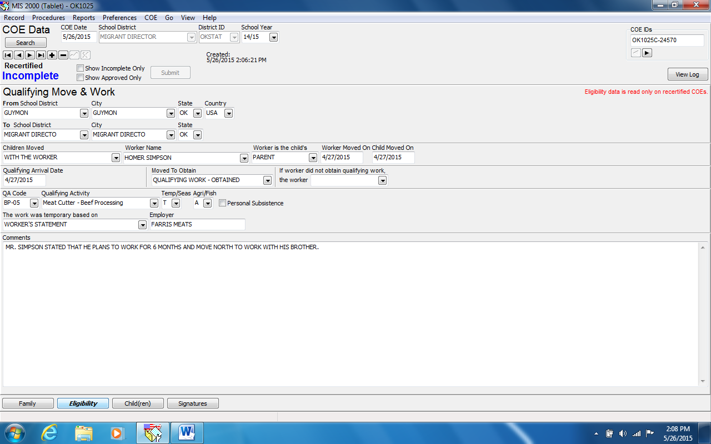
Electronic Recertification
Step 3: Update tabs – Eligibility Tab
No Editing Allowed

Slide 19
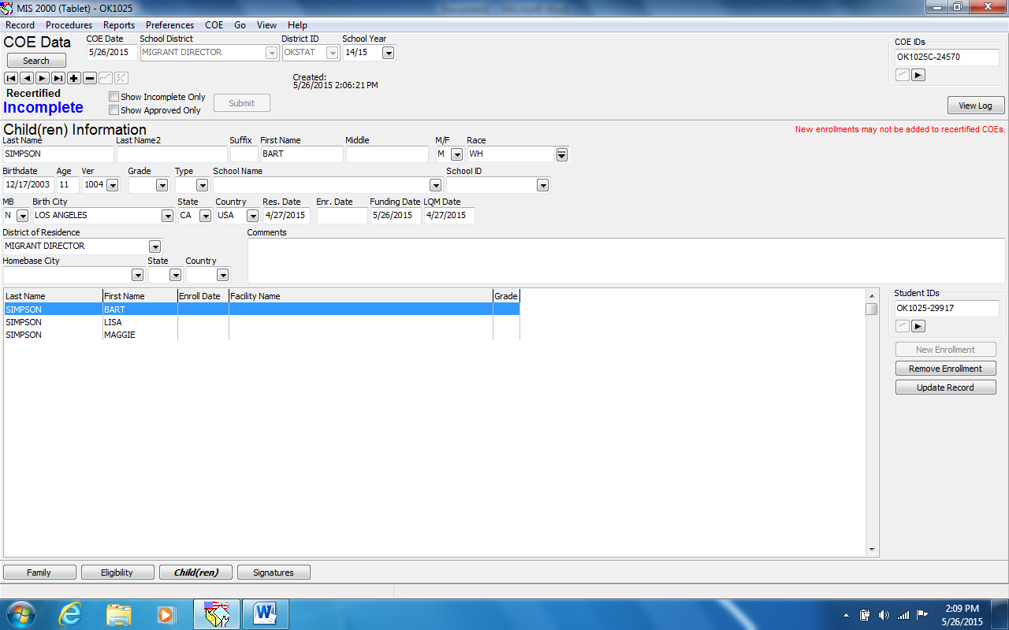
Electronic Recertification
Step 3: Update tabs – Child(ren) Tab
Grade
School Name
Enrollment Date
Update Record
Remove graduates
No new enrollments
Add Comments

Slide 20
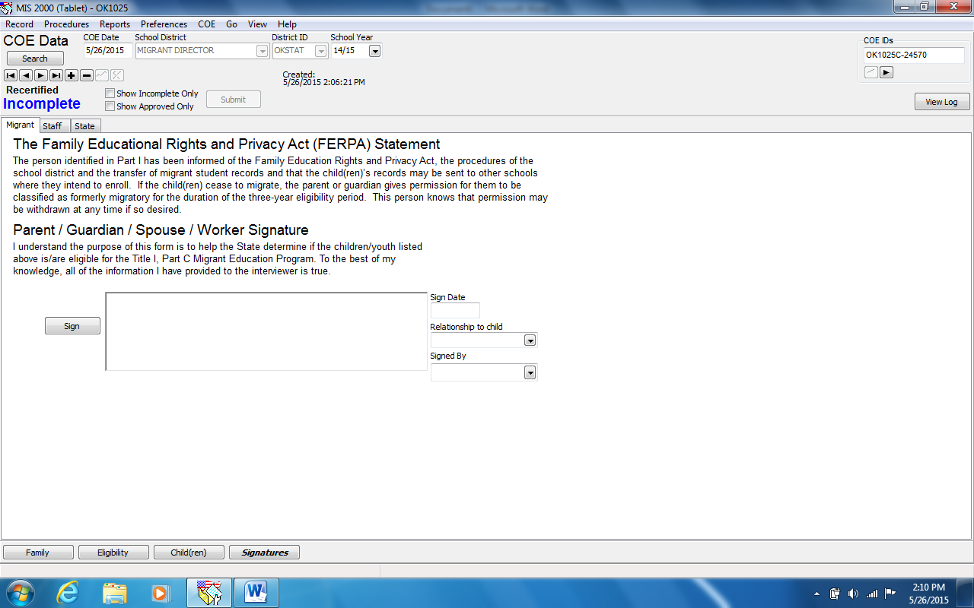
Electronic Recertification
Step 4: Parents/Guardian Sign and date

Slide 21
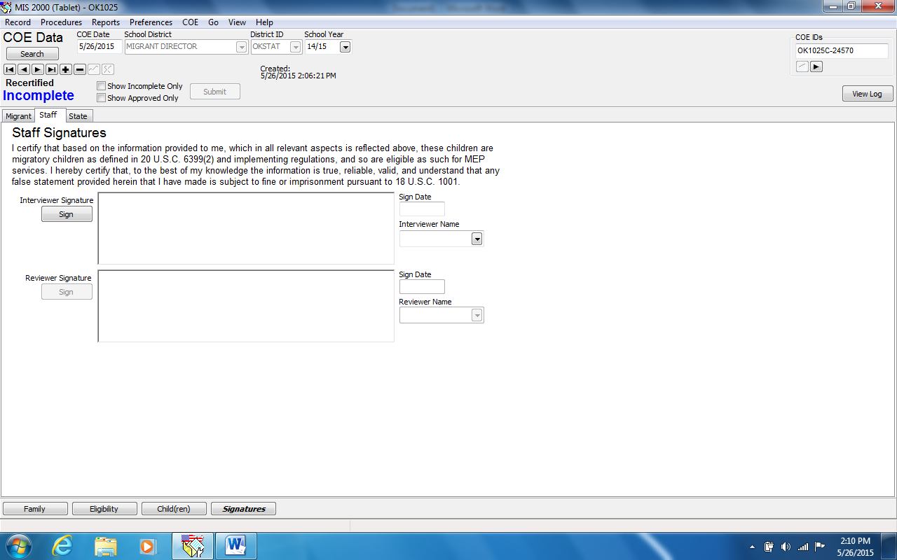
Electronic Recertification
Step 5: Recruiter/Reviewer Sign and date
After Recruiter signs and submits the eCOE, Reviewer will go to “View” > “COE Draft” to complete the process.

Slide 22
Electronic Recertification
Step 6: Upload to OSDE MEP
  Electronic COEs will upload along with any new COEs.
  OSDE MEP staff will review and accept the Electronic Recertification.
  Status will change to “Recertified Accepted.”

Slide 23

http://ok.gov/sde/title-i-part-c
Questions?
Oklahoma State Department of Education
Migrant Education Office
(405)522-3218
Fax (405)521-2361

