Slide 1
Data Reporting: APR/DDP Indicator 13
Erik Friend & Ginger Elliott-Teague
Directors of Data Analysis
April/May 2016
Notes:
This brief presentation discusses Indicator 13, which reflects the quality of transition services provided to secondary school students.

Slide 2
Data Collection Notes
Source: June 30 EOY collection through OK EdPlan
Question addressed:
Are students in secondary school properly transitioning to life after graduation?

Slide 3
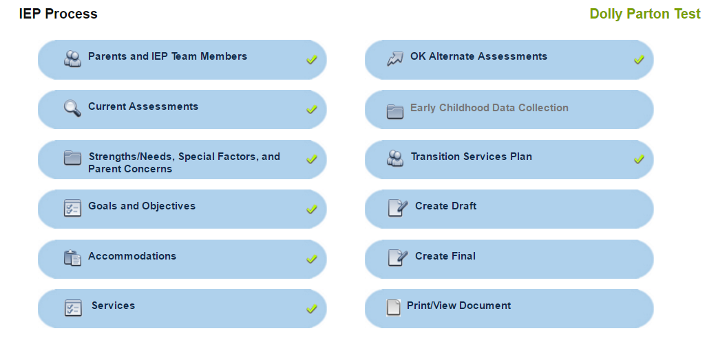
Indicator 13: Secondary Transition
All students with completed IEPs in OK EdPlan are in compliance.
Source:
Notes:
Previously, there was a section within Single Sign-On to validate the eight secondary transition requirements for each student. In OK EdPlan, for students age 16 and above, the first six requirements are met due to rules of completion (cells required before an IEP is finalized), but the last two questions are of concern this year only.
1. Was the student invited to the meeting? Students must be invited to the meeting when transition services are discussed.
2. Was an authorized representative invited to the meeting, if appropriate?
Right now you can uncheck these areas and create a final IEP. Next year for 16 year olds and above, the checkmarks will be automatic. You must invite those individuals.
If it is determined that a student or an authorized representative was not invited to the meeting, then the calculation for Indicator 13 will not be 100 percent. Also, through monitoring, if transition plans are found to be incomplete, haphazard, or not of sufficient quality, the data for this indicator may reflect those problems.

Slide 4
OSDE Contact
Need more detail?
Contact:
Erik Friend
405-521-2198
erik.friend@sde.ok.gov
Ginger Elliott-Teague
405-521-4871
ginger.elliott-teague@sde.ok.gov

