Slide 1
Oklahoma Educator Equity Plan Update to State Board of Education May 28, 2015

Slide 2
Challenge Statements
Eight Stakeholder Focus Groups worked through an exercise of brainstorming equity gaps and narrowing to one that could be analyzed for root causes. Once the causes were identified, a challenge statement was crafted to capture each group’s priority.

Slide 3
Two Equity Gaps
Gap #1 - Fewer effective teachers in high poverty and high minority schools
GAP #2 Fewer experienced teachers in high poverty and high minority schools.

Slide 4
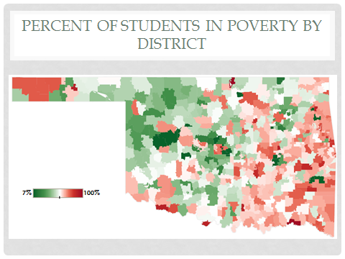

Slide 5
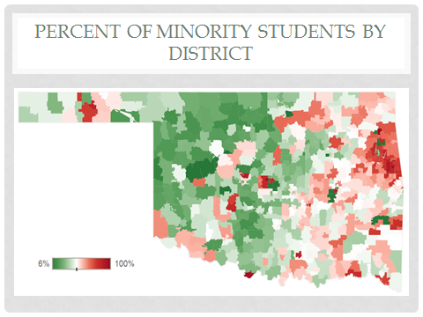

Slide 6
SAMPLING PARAMETERS
Student Body Characteristics
Minority Percent
Low-Income Percent
Teacher Characteristics
Level of Experience
Subject
School-Level Characteristics
Location (Rural/Urban)
Size
Certification Route
Grade Span

Slide 7
Guidance
April 20, 2015 - On site coaching from EASN (Equitable Access Support Network) representative, Phil Gonring
May 6, 2015 - Virtual Review of Draft Plan

Slide 8
Review Stage
Advisory Board
Stakeholder Groups
Public review on website
*Due Date – June 1, 2015

