Slide 2
Individual Health Plans
Sherry Fisher, RN, BSN
Director of Health and Physical Education

Slide 3
What is an Individual Health Plan?
Individual Health Plans are written plans used in the school setting to communicate a student’s health condition and their care/accommodations.

Slide 4
Who Writes an IHP?
The Nurse
Development of a IHP is a nurse responsibility and is based on standards of care regulated by the state nurses practice acts. IHP’s cannot be delegated to unlicensed individuals. It is the responsibility of the nurse to evaluate the IHP’s annually.

Slide 5
Which Students Should Have an IHP?
The student has a condition that requires scheduled daily medication, cares/accommodations during the school day.
The student has a potentially life threatening condition that requires as needed medication, cares/accommodations.
The student has a condition that requires as needed mediation, cares/accommodations.

Slide 6
Who is involved in developing an IHP?
Input from parents/guardians, physician, school nurse, school staff and as appropriate the student may be included.

Slide 7
Assessment
Does the health problem require:
Special training of school personnel
Modifications in school environment
Self-care assistance
Treatments
Special Diet
Orders from a doctor for care needs

Slide 8
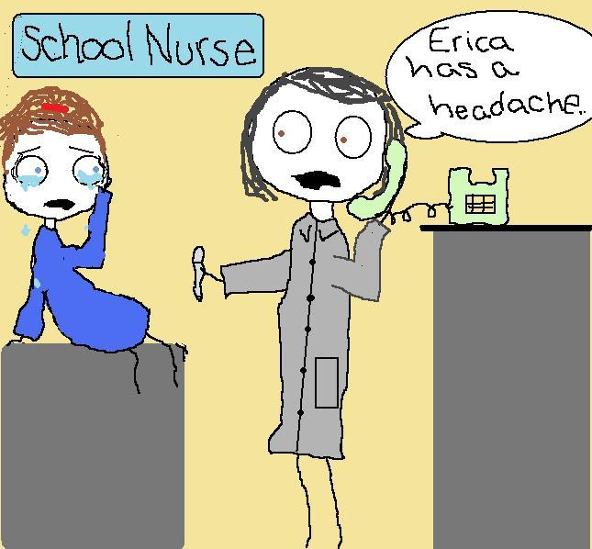
What Should be Included in an IHP?
Health Condition
Student’s Demographics
Nursing Diagnosis
Goals for Care
Assessment/Signs and Symptoms of Condition
Interventions/Plan of Action

Slide 9
Who Should Utilize an IHP?
Any staff member who is responsible for the care of the student.

Slide 10
Implementing the IHP
The administrator and nurse should identify a point person to oversee the implementation process.
Set up a meeting to inform/train staff.
Distribute the IHP.
Nurse and staff will monitor effectiveness of the plan.

Slide 14
Contact Information
Sherry Fisher, RN, BSN
Director of Health and Physical Education
Sherry.Fisher@sde.ok.gov
(918)289-6599 (cell phone)
(405)522-4499 (office)

