Slide 1
Academic Assessment Monitoring Program (Narrated Version)
Desk Monitoring

Slide 2
Purpose
To meet federal requirements, Oklahoma’s AAMP evaluates school district implementation of both federal- and state-required academic assessments.
All public school districts will be monitored at least once during the established five-year cycle.
An electronic version of the five-year monitoring cycle is updated on an annual basis and posted to the Test Security and Assessment Monitoring page at the following link https://sde.ok.gov/test-support-teachers-and-administrators
The Desk and On-site Monitoring Checklists has been revised
All monitoring types require districts/sites to submit information contained in the desk monitoring checklist
Districts will be notified of on-site monitoring at least 10 working days before the opening of the testing window.

Slide 3
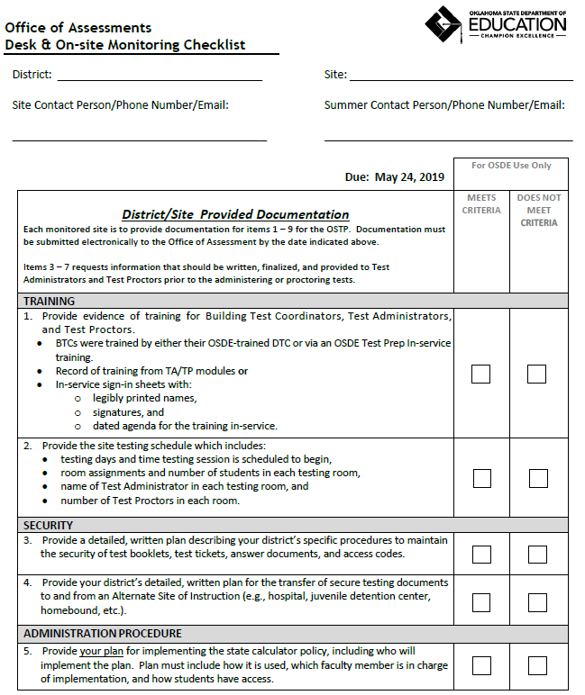
Required Documentation

Slide 4
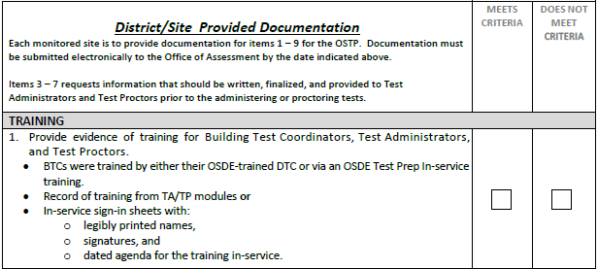
Desk Monitoring
2 types of documentation
District/site provided documentation
Line items 1 – 9
State collected documentation
Line items 10 – 16

Slide 5
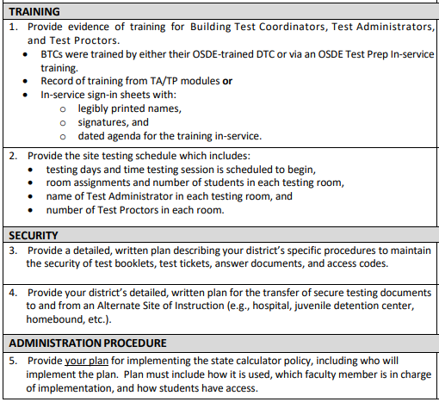
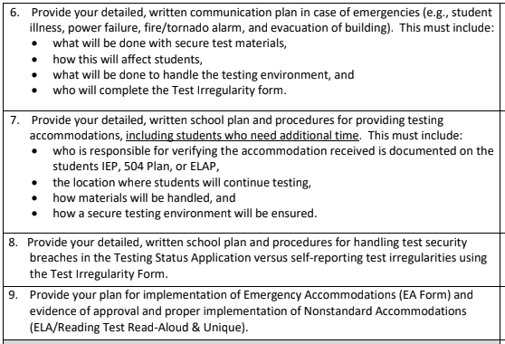
District and Site Provided Documentation

Slide 6
Line Item 1 – Training Evidence
Provide evidence of training for Building Test Coordinators, Test Administrators, and Test Proctors.
BTCs were trained by either their OSDE-trained DTC or via an OSDE Test Prep In-service training.
Record of training from TA/TP modules or
In-service sign-in sheets with:
legibly printed names,
signatures, and
dated agenda for the training in-service.

Slide 7
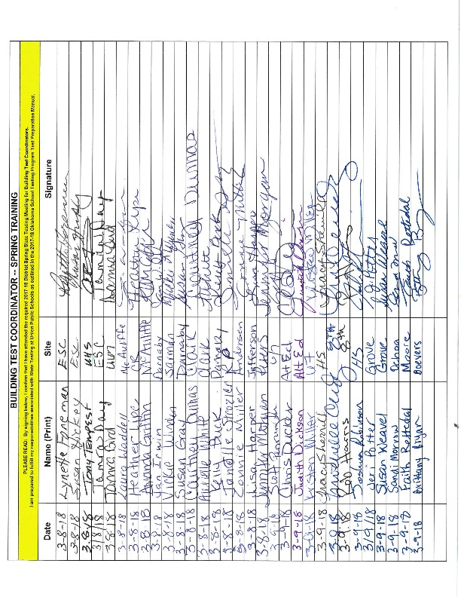
Provide evidence of training for Building Test Coordinators BTCs were trained by either their OSDE-trained DTC or via an OSDE Test Prep In-service training.

Slide 8
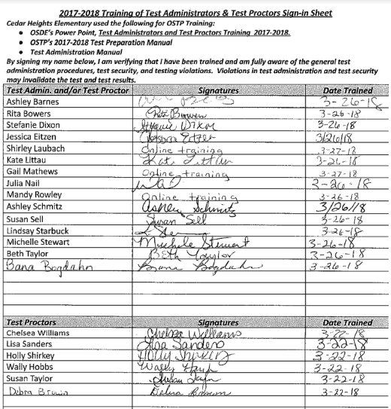
Provide evidence of training for Test Administrators/Test Proctors Record of training from TA/TP modules OR In-service sign-in sheets

Slide 9
Line Item 2 – Testing Schedule(s)
Provide the site testing schedule which includes:
testing days and time testing session is scheduled to begin,
room assignments and number of students in each testing room,
name of Test Administrator in each testing room, and
number of Test Proctors in each room.

Slide 10
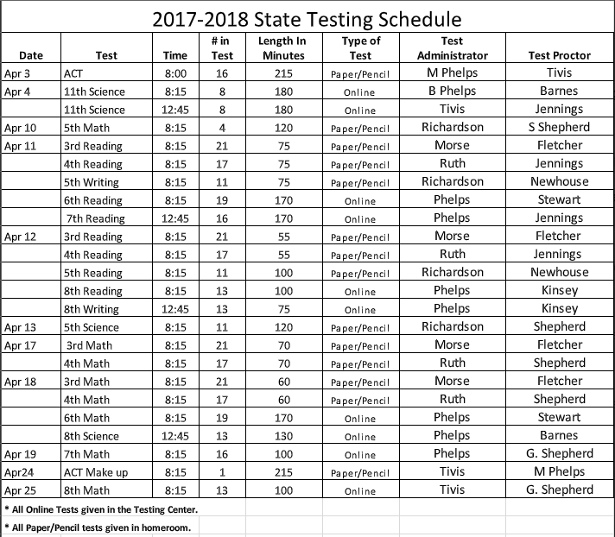
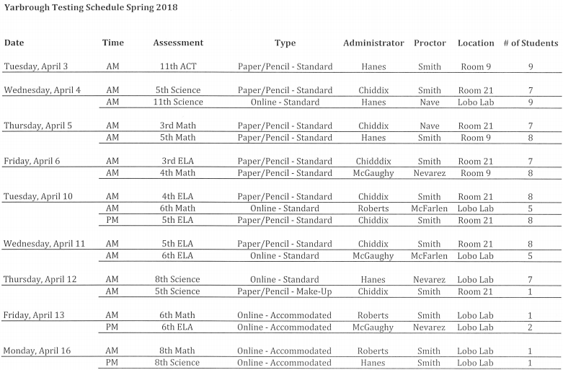
Test Schedules

Slide 11
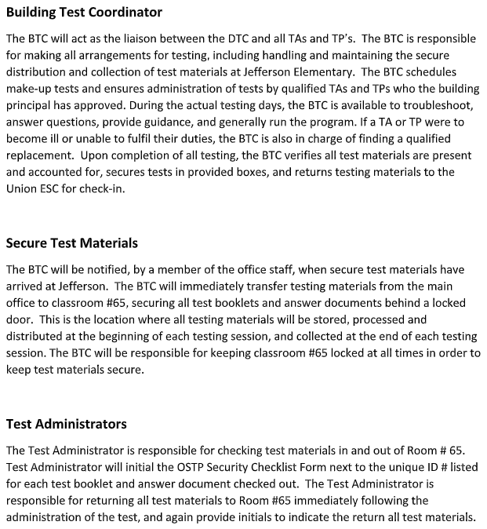
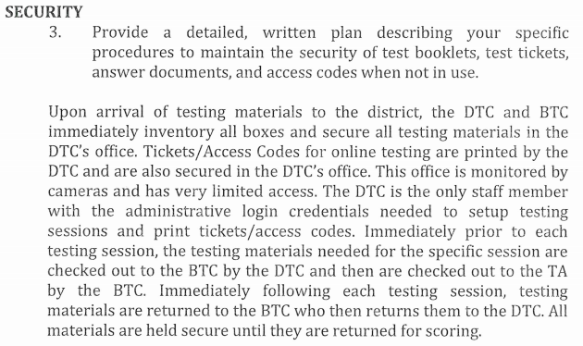
Line Item 3 – Test Security Provide a detailed, written plan describing your district’s specific procedures to maintain the security of test booklets, test tickets, answer documents, and access codes.

Slide 12
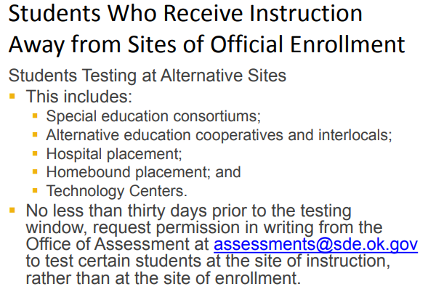
Line Item 4 – Test Security Provide your district’s detailed, written plan for the transfer of secure testing documents to and from an Alternate Site of Instruction (e.g., hospital, juvenile detention center, homebound, etc.).

Slide 13
Line Item 5 – Calculator Use Implementation
Provide your plan for implementing the state calculator policy, including who will implement the plan. Plan must include how it is used, which faculty member is in charge of implementation, and how students have access.

Slide 14
Line Item 6 – Emergency Plan
Provide your detailed, written communication plan in case of emergencies (e.g., student illness, power failure, fire/tornado alarm, and evacuation of building). This must include:
what will be done with secure test materials,
how this will affect students,
what will be done to handle the testing environment, and
who will complete the Test Irregularity form.

Slide 15
Line Item 7 – Accommodations
Provide your detailed, written school plan and procedures for providing testing accommodations, including students who need additional time. This must include:
who is responsible for verifying the accommodation received is documented on the students IEP, 504 Plan, or ELAP,
the location where students will continue testing,
how materials will be handled, and
how a secure testing environment will be ensured.

Slide 16
Line Item 8 – Security Breaches
Provide your detailed, written school plan and procedures for handling test security breaches in the Testing Status Application versus self-reporting test irregularities using the Test Irregularity Form.

Slide 17
Line Item 8 – Security Breaches Provide your detailed, written school plan and procedures for handling test security breaches in the Testing Status Application

Slide 18
Line Item 8 – Security Breaches Provide your detailed, written school plan and procedures for handling self-reporting test irregularities using the Test Irregularity Form

Slide 19
Line Item 9 – Emergency & Nonstandard Accommodations
Provide your plan for implementation of Emergency Accommodations (EA Form) and evidence of approval and proper implementation of Nonstandard Accommodations(ELA/Reading Test Read-Aloud & Unique).

Slide 20
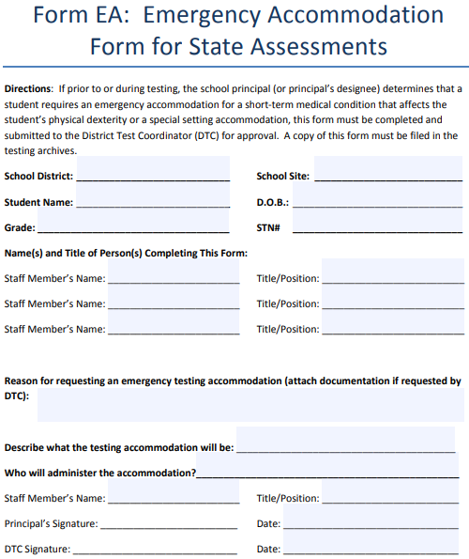
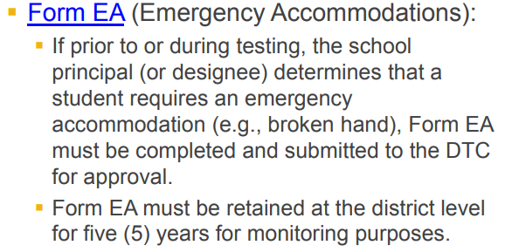
Line Item 9 – Nonstandard Accommodations Provide your plan for implementation of Emergency Accommodations (EA Form)

Slide 21
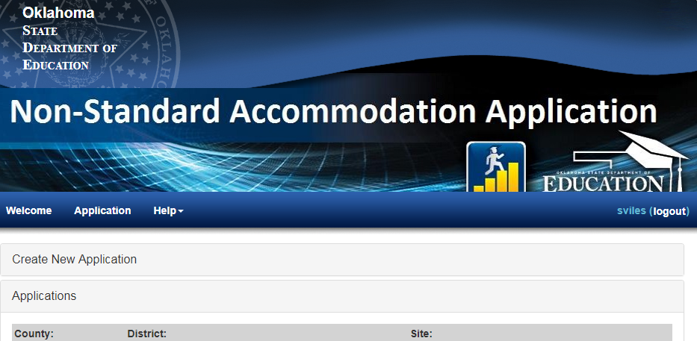
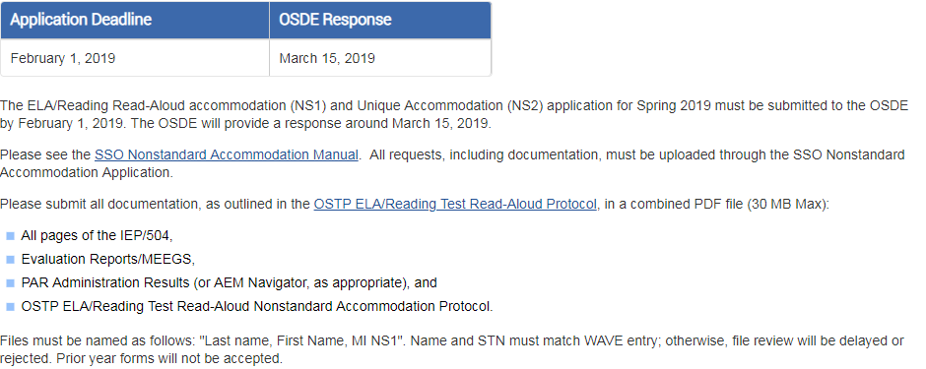
Line Item 9 – Nonstandard Accommodations proper implementation of Nonstandard Accommodations(ELA/Reading Test Read-Aloud & Unique)

Slide 22
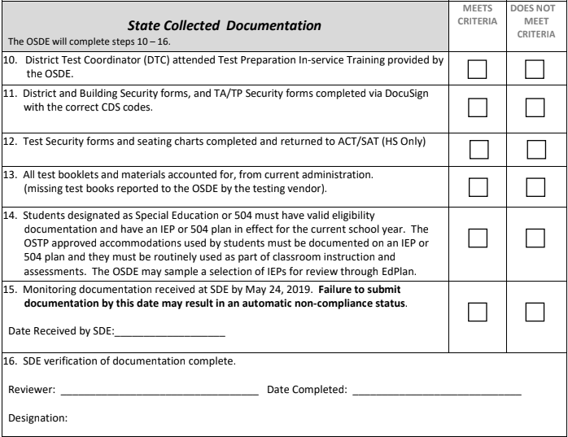
State Collected Documentation

Slide 23
Line Items 10-13 – Vendor Supplied Information
District Test Coordinator (DTC) attended Test Preparation In-service Training provided by the OSDE.
District and Building Security forms, and TA/TP Security forms completed via DocuSign with the correct CDS codes.
Test Security forms and seating charts completed and returned to ACT/SAT (HS Only)
All test booklets and materials accounted for, from current administration. (missing test books reported to the OSDE by the testing vendor).

Slide 24
Line Item 14 – IEP/504 Plans
Students designated as Special Education or 504 must have valid eligibility documentation and have an IEP or 504 plan in effect for the current school year. The OSTP approved accommodations used by students must be documented on an IEP or 504 plan and they must be routinely used as part of classroom instruction and assessments. The OSDE may sample a selection of IEPs for review through EdPlan.

Slide 25
Submitting Documentation
Monitoring documentation received at SDE by May 24, 2019. Failure to submit documentation by this date may result in an automatic non-compliance status.
Submitting Documentation
Email to Assessments@sde.ok.gov (15 MB max file size)with subject line: Desk Monitoring
Mail flash-drive to:
Office of Assessments
2500 N Lincoln Blvd, Suite 214
Oklahoma City, OK 73105-4599

Slide 26
Oklahoma State Department of Education
Office of Assessments
Academic Assessment Monitoring Program
Please contact the Office of Assessments with any questions or concerns you may have regarding the Academic Assessment Monitoring Program.
Email: Assessments@sde.ok.gov
Phone: 405-521-3341

