Slide 2
Assessment Correction Window
Office of Accountability
Oklahoma State Department of Education
May 24, 2019
Notes:
House Keeping
We will be hosting a monthly webinar on upcoming reports, report card indicators and other topics that you have submitted in the survey we sent out last month
The webinars will be held on the 3rd Thursday of each month and prior to those we will send out a reminder with the topic and times.
Also, this webinar will be recorded and posted to the accountability webpage on the state departments webpage along with any other resources that you will need when reviewing the assessment data.

Slide 3
What is the Assessment Correction Window?
The purpose of the Assessment Correction Window is for districts to be able to view the preliminary data that the vendors sent to the Office of Accountability. During this time, districts are able to send Data Verification Request (DVRs)

Slide 4
Assessment Correction Window Timeline
Report Window: June
Districts will be able to review student assessment data and submit Data Verification Requests (DVR) for a minimum of 15 days.
Notes:
We anticpate that the window will open the week of June 10th..

Slide 5
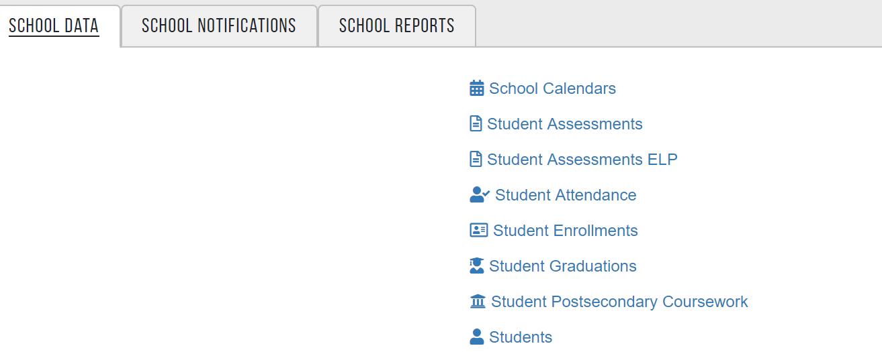
How do you access the assessment data
This report is located in Single Sign On (SSO)
School-School Data- Student Assessment

Slide 6
Where does the data come from?
The data that populates the report is from Spring testing
OSTP/OAAP (Grades 3-8 )
WIDA ACCESS/ALT ACESS (English Learners)
SAT/ACT (Grades 11-12)
Notes:
After testing is completed in a district those tests are reviewed and raw files are sent over the office accountability. We are provided the student data from multiple vendors depending on the test type. We review and start the pre auditing review of the data. This consists of our department making sure all the tests are in line with the correct STN, that the demographics for the student are showing correctly, etc.
you might mention that the high school science test was an operational test but individual scores have not been determined since they have not gone through the cut score setting process( or standard setting)

Slide 7
Why it is important to review assessment data
Academic Growth Indicator
Each individual student’s academic growth is recognized by comparing test results in the same subject from one year to the next. Growth is achieved when a student moves within a performance level (from Basic Low to Basic High, for example) or across performance levels (from Basic to Proficient, for example).
Academic Achievement Indicator
Oklahoma’s Academic Achievement indicator uses individual student performance on annual state tests. Points are earned based on meeting or exceeding state-level targets used to ensure all students have the opportunity to improve.
Notes:
Oklahoma is examining academic performance in multiple ways. The Academic Growth indicator recognizes schools that are working hard to meet students where they are and help them get – or stay – on track. In the new accountability system, Academic Achievement in ELA and math is balanced with Academic Growth; the same number of points is awarded under each subject for each indicator. This indicator captures the growth of students at all levels of performance and provides a more nuanced view of student performance over time.
This indicator provides a more complete look at student performance by using two measures – achievable and challenging targets and proficiency. Looking at academic performance in this way will help reveal previously hidden gaps in student achievement.

Slide 8
How to review the assessment data
What you should be looking for when reviewing test data
Missing students
Students who left prior to the assessment window and mark them NLE
Recently arrived English Learners and mark accordingly
Make sure the student took the correct test and correct grade level
Review the students NFAY status
Notes:
Our office frequently conduct reviews (audits) of the data to identify inconsistencies, invalid values, unexpected data, etc. If, upon review, your district has students or assessment records that were identified during one of these reviews, an email will be sent to navigate to the “Audits” screen. Here, there will be a description of the audit, affected STN(s), and impact of the audit. Depending on the nature of the audit, this may be to inform the district of required update to their SIS, or to request additional information. Although an email notification will be sent as audits appear on this screen, we recommend regular review to ensure that all appropriate parties are aware of updates and/or information requests

Slide 9
What is NFAY
NFAY stands for Non-Full Academic Year. It is determined via enrollment records certified in the Annual Statistical Report(ASR). NFAY is calculated by the entry and exit dates in the ASR report.
A student is considered FAY for an indicator if he/she enrolls within the first 20 instructional days of the school year, and does not have a gap of 10 or more consecutive instructional days of enrollment prior to applicable FAY end date.

Slide 10
NFAY Continued
Assessment | FAY End Date
Access/Access Alt | January 22 (Beginning of WIDA Testing)
OSTP/OAAP | April 1 (Beginning of OSTP Testing)
ACT/SAT | April 1 (Beginning of ACT/SAT Testing)
Notes:
NFAY status is displayed during the Assessment Correction window and it is not a part of the Demographic Overlay report. It is determined via enrollment records certified in the Annual Statistical Report(ASR). NFAY calculation is dependent on the entry and exits in that report.

Slide 11
NFAY Continued
NFAY | Definition
0 | The student is FAY. The student is FAY when he/she is enrolled within the first 20 days, and did not have an instructional gap of 10 or more consecutive days. This record will be used in school, district and state accountability.
1 | The student is NFAY at the school level only. This happens when the student is not enrolled within the first 20 instructional days at a site (or LEA) or they have a gap of 10 or more days at the school level. For instance, a student may have switched schools but stayed within the district. This student’s record will be used in district and state accountability.
Notes:
NFAY status is determined via enrollment records certified in the Annual Statistical Report(ASR). NFAY calculation is dependent on the entry and exits in that report.
A student may be Non-Full Academic Year (NFAY) at different levels. Please note that a blank NFAY value means that FAY cannot be calculated due to missing or invalid enrollment or calendar dates.

Slide 12
NFAY Continued
NFAY | Definition
2 | The student is NFAY at the school and district level. This happens when the student is not enrolled within the first 20 instructional days or the student had a gap of 10 or more days at the school and district level. For instance, a student may have transferred to another school in another district. This student’s record will be used in state accountability.
3 | The student is NFAY at the school, district and state level. This happens when the student was either : Enrolled in an Oklahoma public school for the first time AFTER the first 20 instructional days of the school year. Enrolled within the first 20 instructional days but has a lapse of 10 or more consecutive instructional days with no enrollment in any Oklahoma public school. This student’s records are excluded from school, district and state accountability.
Notes:
NFAY status is determined via enrollment records certified in the Annual Statistical Report(ASR). NFAY calculation is dependent on the entry and exits in that report.
A student may be Non-Full Academic Year (NFAY) at different levels. Please note that a blank NFAY value means that FAY cannot be calculated due to missing or invalid enrollment or calendar dates.

Slide 13
When to submit a DVR
Missing student
Incorrect NFAY status (refer to the NFAY chart)
Incorrect ‘no score code’ ( DNR, NLE, DNA, INV)
DNR= Do Not Report
NLE= No Longer Enrolled
DNA= Did Not Attempt
INV= Invalidated
DNR-D = Do Not Report Duplicate
SPD=student was not able to take the domain due to disability (WIDA)

Slide 14
Trouble Shooting
Students who took the CCRA
A student will not get a composite score if a student did not complete both sections (Reading and Writing) of the ELA test portion. This would end with a DNA.
This situation would not require a DVR

Slide 15
Trouble Shooting Continued
Student has OAAP record with valid score but is also showing a OSTP with a DNA
Solution: For Accountability purposes SDE will only include the records that have valid score. The record with a DNA will be updated to a DNR-D
A DVR is not required for these situations

Slide 16
Trouble Shooting Continued
Student has a blank NFAY status.
Solution: NFAY is calculated by using school calendar and student enrollment
Ex:
Entry or exit date is not a instructional day in the school calendar. The student enrollment would need to be adjusted
Entry or exit date is not in the school calendar. You would need to adjust the school calendar

Slide 17
Trouble Shooting Continued
A student is not showing up as Recently Arrived English Learner (RAEL)
Solution: check the entry code and EL Flag
As a reminder a student is marked RAEL if they marked EL and entry code is 1838,1839,1840

Slide 18
Resources
Next Reporting Webinar will be June 20th at 1:00pm
Department of Education Website
Recently Arrived English Learner (RAEL) Frequently Asked Questions
Data Verification Request (DVR) How-To
Assessment Correction Window (OSTP, OAAP, CCRA) Guide

Slide 19
Where can I get help?
The Office of Accountability is here to assist you in verifying and certifying your data.
Should you have any questions please contact accountability@sde.ok.gov or call (405) 522-5169

