Slide 1
Idea B State Advisory Panel
September 15th, 1-4pm
OSDE-Special Education Services

Slide 2
Agenda
Prior year Due Process
SSIP/Indicator Information
General Supervision System
District Determinations
Child Count
ESSA/IDEA
CADRE
Membership and Terms
Future Meeting Dates/Location
Subcommittees
Panel Priorities

Slide 3
General Supervision System
States are accountable for enforcing the requirements of the IDEA and ensuring continuous improvement.
OSEP oversees these general supervision activities by each State, and the State’s progress in a State Performance Plan which shows its overall efforts in implementing the IDEA.
Main Purpose: Monitor the implementation of the Individuals with Disabilities Education Act (IDEA).

Slide 4
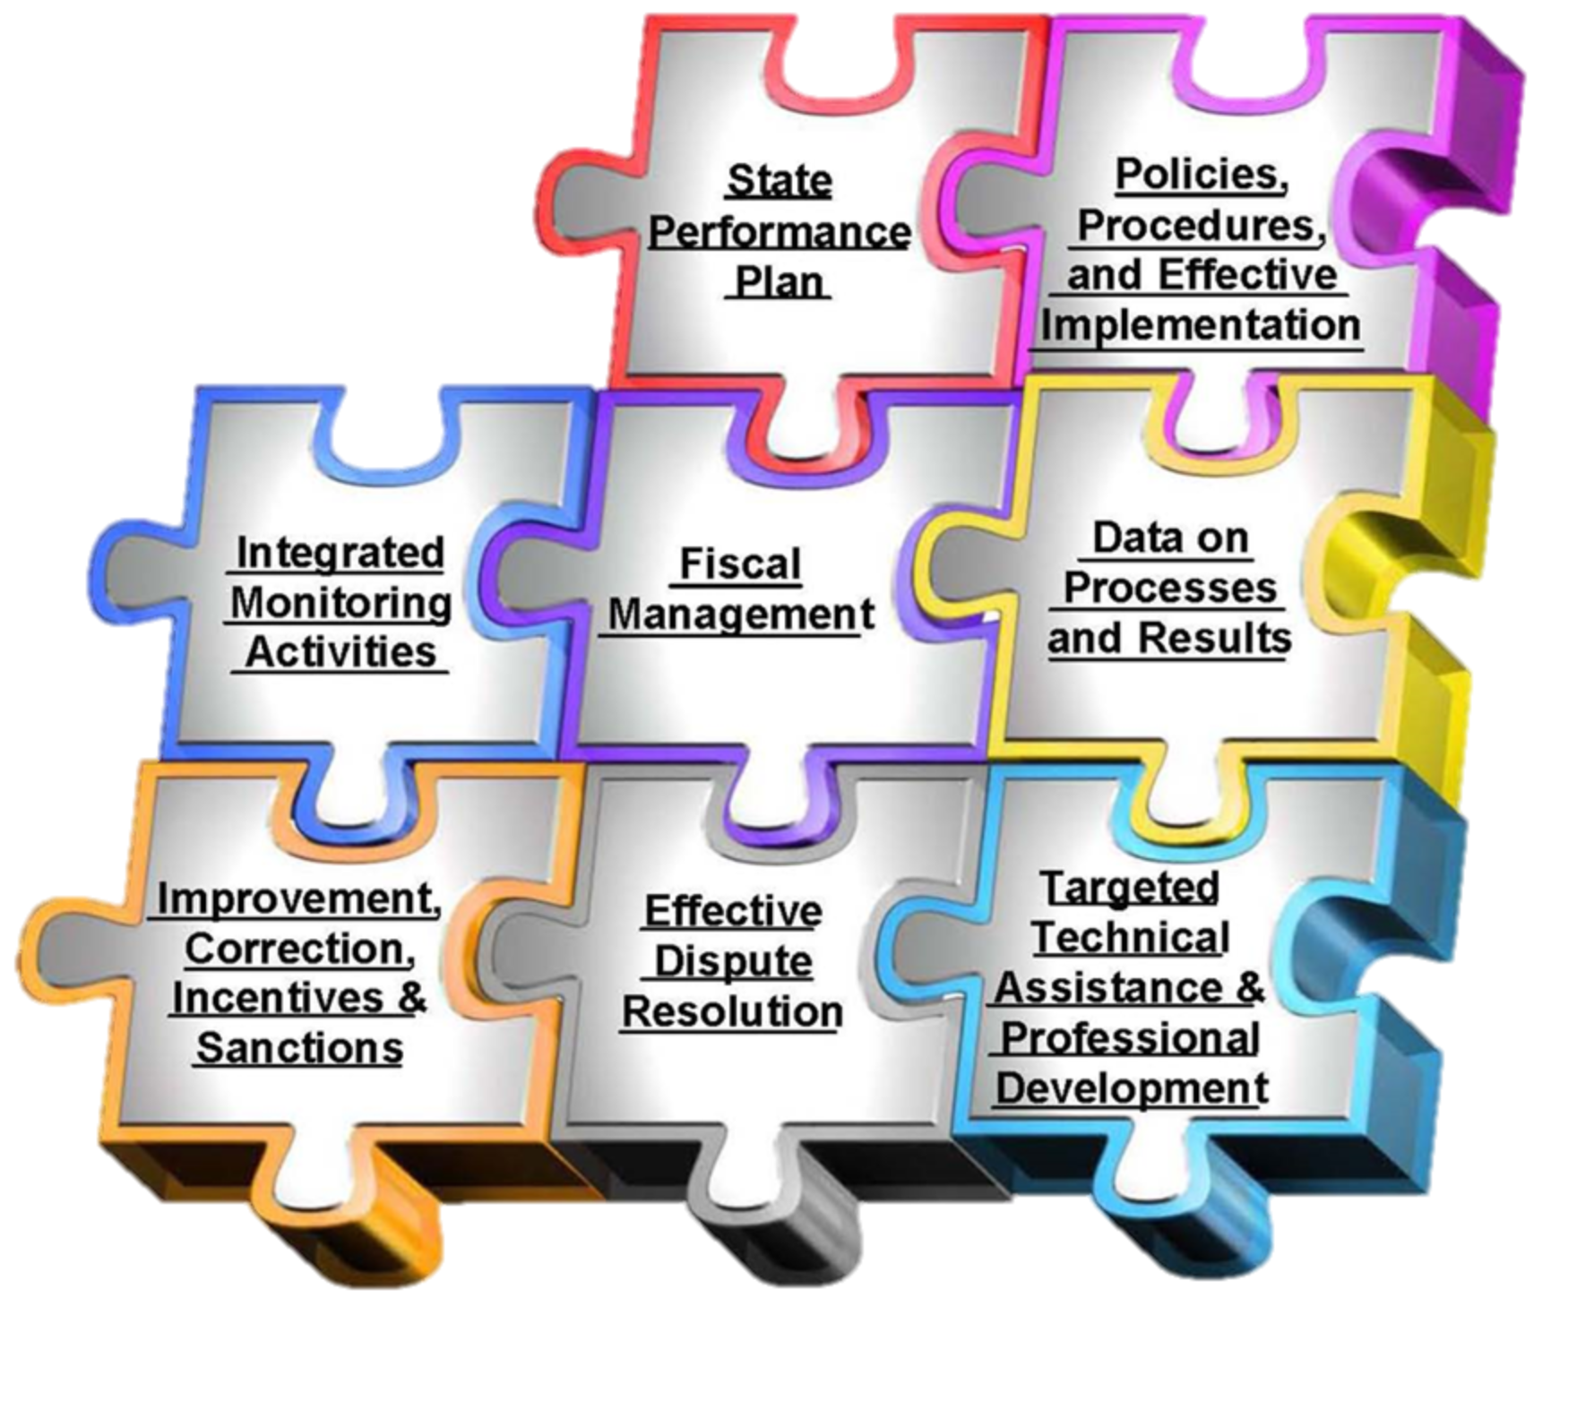
8 Components of the General Supervision System
Notes:
State Performance Plan
Policies, Procedures, and Effective Implementation
Integrated Monitoring Activities
Fiscal Management
Data on Processes and Results
Improvement, Correction, Incentives and Sanctions
Effective Dispute Resolution
Targeted Technical Assistance and Professional Development

Slide 5
8 Components
State Performance Plan
Policies, Procedures, and Effective Implementation
Integrated Monitoring Activities
Fiscal Management
Data on Processes and Results
Improvement, Correction, Incentives and Sanctions
Effective Dispute Resolution
Targeted Technical Assistance and Professional Development

Slide 6
General Supervision System
Monitoring
Tiered Compliance Review
Selective Review
Engage & Develop Review

Slide 7
Tiered Compliance
The OSDE-SES monitors every LEA in the state each year using the data available for each of the compliance indicators identified in the State Performance Plan (SPP).
For each LEA, data submitted through the Oklahoma Special Education Child Count System (i.e., Child Count and End of Year Report) are compared to the targets for each compliance indicator identified in the State Performance Plan.

Slide 8
Tiered Compliance
District Determinations (available early Fall) now include both compliance and performance elements.
Districts will participate in various activities based on our Tiered Compliance Review.
Meets Requirements
Needs Assistance
Needs Intervention
Needs Substantial Intervention

Slide 9
Tiered Compliance
Activities required based on District Determinations could include:
Front-loaded Technical Assistance
Professional Development
Improvement Plan
Self-Assessment
Targeted Technical Assistance
On-site Compliance Review
Corrective Action Plan

Slide 10
Selective Reviews
This process is used to identify districts who need assistance and/or intervention.
Phone calls or emails of concern
Referrals from other sections in the agency.
Referrals from outside agency/advocacy groups.
Complaint data
Other sources
Selective Reviews occur throughout the year.

Slide 11
Engage and Develop
The OSDE-SES will also be selecting districts for monitoring activities based on their performance in 3 areas:
Early Childhood
Equal Educational Opportunity
Secondary Transition
This process directly relates to the State Systemic Improvement Plan (SSIP) and our goal of implementing this initiative into our monitoring process.
Critical Questions Framework

Slide 12
Critical Questions Framework
Are young children with disabilities entering kindergarten ready to learn?
Are children with disabilities afforded equal educational opportunity?
Are youth with disabilities prepared for life, work and postsecondary education?
Do districts implement IDEA with fidelity?
Early
Childhood
Equal Educational Opportunity
Secondary Transition
Compliance

Slide 13
Child Count
October 1 annually
Collects the following for State and Federal reporting:
Count of children currently served (snapshot)
Primary, secondary and suspected disabilities, as appropriate
Child-level LRE (least restrictive environments)
Child-level ECE (early childhood environments)
Demographics, including race and ethnicity
Why?
Funding! Both State and Federal aid are determined by the child count.

Slide 14
ESSA and Special Education
Assessment – 1% Cap
1% Cap - Places a cap of one percent of the total number of all students in the state that can be assessed using alternative assessments aligned to alternative academic achievement standards for students with significant cognitive disabilities. Previously, the one percent cap was applied to performance (advanced and proficient) levels and used for accountability purposes. Now, states will need to examine school districts that are putting too many students in alternative assessment plans.

Slide 15
ESSA and Special Education
Seclusion and Restraint
States must include new information in their plan indicating how they will support districts to improve school conditions for student learning, including through reducing—‘‘(i) incidences of bullying and harassment;‘‘(ii) the overuse of discipline practices that remove students from the classroom; and‘‘(iii) the use of aversive behavioral interventions that compromise student health and safety. The conference report clarifies that the term aversive means seclusion and restraint.

Slide 16
ESSA and Special Education
Graduation Cohort
The graduation cohort issue is a disconnect between the ESEA and IDEA. But, the new ESEA (ESSA) allows for some flexibility in this regard.
NASDSE’s (the National Association of State Directors of Special Education) public comment on proposed ESSA accountability rules that discusses it some (question 5, page 3) - http://www.nasdse.org/LinkClick.aspx?fileticket=KULEcTwzudI%3d&tabid=36
OSDE’s public comment (see page 4, 2nd paragraph) - http://sde.ok.gov/sde/sites/ok.gov.sde/files/OSDEFinalCommentsNoticeofProposedRulemakingESSA.pdf

Slide 17
ESSA and Special Education
Highly Qualified
Amended the Individuals with Disabilities Education Act (IDEA) by removing the definition of “highly qualified” in section 602(10) and the requirement in section 612(a)(14)(C) that special education teachers be “highly qualified” by the deadline established in section 1119(a)(2) of the ESEA, as amended by NCLB.

Slide 18
ESSA Consolidated State Plan
In order to receive federal funds, state educational agencies must submit a plan to the U.S. Secretary of Education.
The purposes of a consolidated plan are to
improve teaching and learning by encouraging greater cross-program coordination, planning, and service delivery;
provide greater flexibility to State and local authorities through consolidated plans, applications, and reporting; and
enhance the integration of State and local programs.

Slide 19
ESSA Consolidated State Plan
Consolidated State plans will address five areas:
Consultation and Coordination (ESSA section 1111(a))
Challenging Academic Standards and Academic Assessments (ESSA section 1111(b))
Accountability, Support, and Improvement for Schools (ESSA sections 1111(c) and 1111(d))
Supporting Excellent Educators (ESSA section 111(g))
Supporting All Students (ESSA section 1111(g))

Slide 20
OSDE-SES Activities
First-Year Special Education Academy
First-Year Special Education Directors Project
Special Education Regional Professional Development (In the Loop)
Engage and Develop (Monitoring Activity)
Project 613: Special Education Professional Development Grant
OSAT Reimbursements
Non-Traditional Route to Special Education Teacher Certification
Participation in Oklahoma Transition Institute (OTI)
OAAP Advisory Council
Post School Outcomes data (OSEP Indicator 14: Post School Outcomes)
Parent Survey data (OSEP Indicator 8: Parent Involvement)
Universal Design for Learning (UDL) PD Module and Teacher Self-Assessment
UDL implemented through design of Dynamic Learning Maps
Accommodations Manual, Guide, Self-Assessments, and PD Modules
State Personnel Development Grant (SPDG)/Oklahoma Tiered Intervention System of Support (OTISS)
Collaboration with the Oklahoma Parents Center (funded through the IDEA Part D)
IDEA B State Advisory Panel
Handbook Review Committee

Slide 21
Membership and Terms
Section 3: Term
Members of IDEA B Advisory Panel shall be appointed for a 2-3 year term, commencing with the corresponding month of their initial appointment. However, in order to maintain a reasonable balance in expiration of terms, or to maintain an appropriate and adequate representation, the State Superintendent of Public Instruction may establish shorter or longer terms of membership, at the discretion of the Executive Director of Special Education.
Exceptions to this rule, as determined by the Executive Committee, may allow a member to be appointed by the State Board for a 4th year.
In unexpected circumstances, events may occur during a 3 year membership term prohibiting the appointed member from fulfilling his/her responsibilities and/or disqualifying the member from representing the assigned constituency. Should this situation occur, the Executive Committee will recommend to the Department of Education the removal of the member.

Slide 22
Meeting Times
Section 1: Meeting Schedule
The Panel shall meet at least 4 times during each school year.
The meeting dates shall be established as a matter of Panel business at the first meeting each year with the exception of the first meeting date which shall be established as a matter of Panel business at the last meeting of the previous year
Additional meetings necessary to transact the business of the Panel may be called by the OSDE Special Education Services Division upon the recommendation of the Executive Committee
In the event of forecasted inclement weather, the Executive Committee shall decide the day before the meeting if the Panel will meet. The Executive Committee will notify the Panel members of this decision, and will re-schedule the meeting
Panel meetings shall begin at 9:00 a.m. and end at 11:45 a.m. unless a Panel consensus decision or majority vote of the Panel or Executive Committee changes this time frame for a particular meeting

Slide 23
Subcommittees/Panel Priorities
Subcommittees
Work groups/facilitated by OSDE SES staff and at least one panel member.
Panel Priorities
2-3

