Slide 1
Creating a new Accountability System
Marianne Perie, University of Kansas
November 09, 2016

Slide 2
Since our last Meeting
We have simplified the indicators and reduced the number, allowing us to develop tables with the same point values for all schools.
OSDE has chosen value tables for the growth model.
We are ready to finalize the design decisions for combining indicators into a judgment.

Slide 3
Today’s agenda
Focus on accountability
Review final indicators
Discuss design decisions
Combining indicators
Including participation
Review report cards designs

Slide 4
Goals for Oklahoma Schools
Focus on college and career readiness:
College and career ready means that students graduate from high school prepared to enter and succeed in postsecondary opportunities whether college or career.

Slide 5
Indicators
Elementary and Middle Schools
High Schools
ELA status
Math status
Science status
ELA growth
Math growth
ELPA progress
Chronic absenteeism
ELA status
Math status
Science status
Graduation rate
Postsecondary opportunities
ELPA progress
Chronic absenteeism

Slide 6
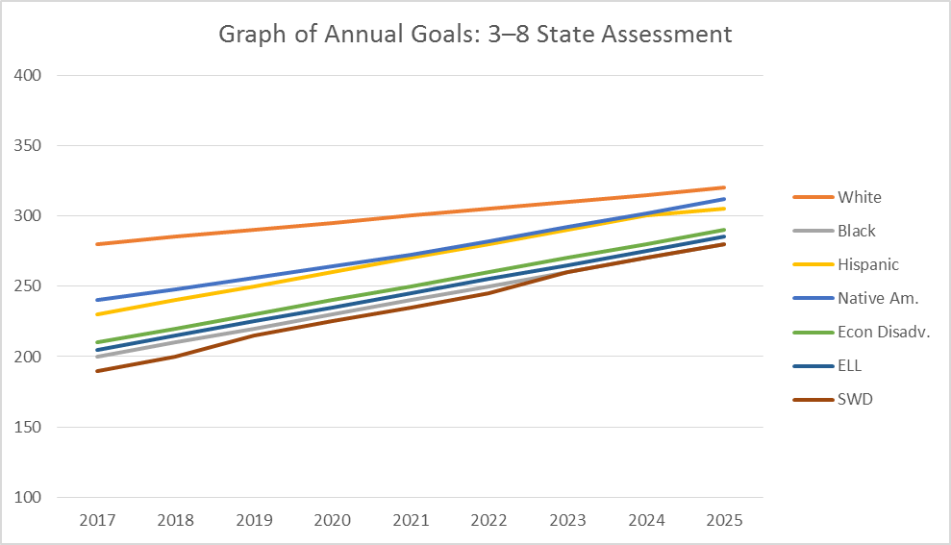
Sample Status measure for Grades 3–8
Assumed a scale of 100 – 400 with the “target” cut score set at 300.
Goals are set based on where the 40th percentile school scored on average.
Goals increase by X points each year.
Goals must increase more for lower performing groups.

Slide 7
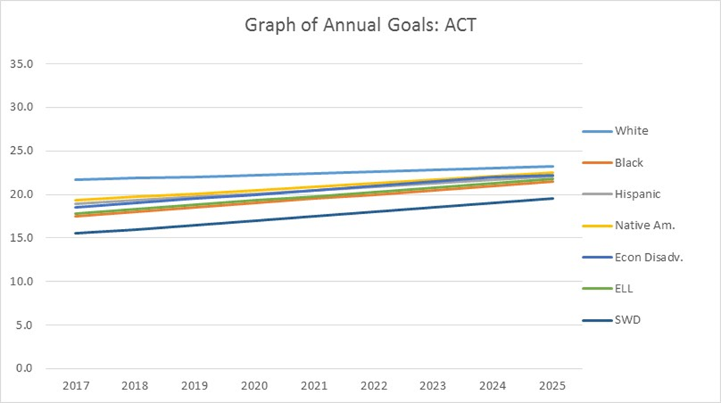
Sample Status measure for High School with ACT
Started with state averages from 2014.
22 is the college-ready goal for reading and math.
Goals increase by X points each year.
Goals must increase more for lower performing groups.

Slide 8
Growth: Value tables
Based solely on performance categories, but performance categories can be split.
Each student earns a different amount of points depending on how their performance category changed from one year to the next.
Points are averaged across all students to give a score for the school or district.
Point values should reflect system goals.

Slide 9
Sample Value Table 1
 |  | 2018
 |  | Level 1—Low | Level 1—High | Level 2—Low | Level 2—High | Level 3 | Level 4
2017 | Level 1—Low | 0 | 25 | 50 | 75 | 100 | 125
 | Level 1—High | 0 | 25 | 50 | 75 | 100 | 125
 | Level 2—Low | 0 | 0 | 25 | 50 | 100 | 125
 | Level 2—High | 0 | 0 | 25 | 50 | 100 | 125
 | Level 3 | 0 | 0 | 0 | 50 | 100 | 125
 | Level 4 | 0 | 0 | 0 | 25 | 100 | 125
Long-term goal is 100 points per school.
Interim goal could be increasing average by 25 points every two years.
Focus on giving credit to schools with students below Level 3 but moving up.
Also, give incentive for continuing to move students beyond the goal level of Level 3.

Slide 10
Sample Value Table 2
 |  | 2018
 |  | 1L | 1H | 2L | 2H | 3L | 3H | 4L | 4H
2017 | Level 1—Low | 0 | 120 | 160 | 185 | 200 | 200 | 200 | 200
 | Level 1—High | 0 | 90 | 130 | 150 | 195 | 200 | 200 | 200
 | Level 2—Low | 0 | 50 | 95 | 130 | 165 | 175 | 195 | 195
 | Level 2—High | 0 | 30 | 55 | 95 | 130 | 160 | 185 | 195
 | Level 3--Low | 0 | 0 | 30 | 80 | 100 | 130 | 150 | 175
 | Level 3—High | 0 | 0 | 0 | 30 | 70 | 105 | 135 | 160
 | Level 4—Low | 0 | 0 | 0 | 0 | 40 | 75 | 115 | 145
 | Level 4—High | 0 | 0 | 0 | 0 | 25 | 50 | 95 | 125
The long-term goal is an average of 100.
More emphasis is placed on the movement: Greater reward for positive growth, greater deficit for negative growth.
Because the long-term goal can be met more easily in this model, the interim goal would be 25 points per year.

Slide 11
ELPA Progress
Make long-term goal that all students should achieve English proficiency within 5 years of entering school. For students currently in system:
Level 1 student has 5 years to exit.
Level 2 student has 4 years to exit
Level 3 student has 3 years to exit
Level 4 student has 2 years to exit
Determine current proficiency levels and set goals for each student to be proficient in five years
Use interim benchmarks to measure progress

Slide 12
Other Indicators
Elementary/Middle
High School
Chronic absenteeism
Typically defined as missing 15+ days a year or 10% or more of school days.
(No growth measure)
Chronic absenteeism
Graduation rate (4 yr/5 yr/6 yr)
Participation in AP/IB/dual (concurrent) enrollment/internship/apprenticeship/ industry certification

Slide 13
Sample Elementary or Secondary Table
No. | Indicator | Points possible | Points earned | Percentage | Weight | Total
1a. | ELA status (with progress targets) | # students with ELA score | # students meeting goal | 0.65 | 15 | 13.00
1b. | Math status (with progress targets) | # students with math score | # students meeting goal | 0.59 | 15 | 11.80
1c. | Science status (with progress targets) | # students with science score | # students meeting goal | 0.62 | 5 | 6.20
2a. | ELA growth | Highest value on table | Value table average | 0.67 | 15 | 16.75
2b. | Math growth | Highest value on table | Value table average | 0.71 | 15 | 17.75
3. | ELPA progress | # of ELLs in US for more than one year | # of ELLs meeting goal | 0.68 | 15 | 10.20
4. | Chronic Absenteeism | #students enrolled | #students NOT missing 18+ days of school | 0.96 | 10 | 9.60
With ELL Without ELL
A > 70 >60
B 57–70.00 47–60.00
C 43–56.99 38–46.99
D 30–42.99 25–37.99
F <30 <25
or lowest 5% in achievement
Sum = 52.60 C

Slide 14
Sample Elementary or Secondary Table (with no ElL)
No. | Indicator | Points possible | Points earned | Percentage | Weight | Total
1a. | ELA status (with progress targets) | # students with ELA score | # students meeting goal | 0.72 | 15 | 14.40
1b. | Math status (with progress targets) | # students with math score | # students meeting goal | 0.54 | 15 | 10.80
1c. | Science status (with progress targets) | # students with science score | # students meeting goal | 0.59 | 5 | 5.90
2a. | ELA growth | Highest value on table | Value table average | 0.68 | 15 | 17.00
2b. | Math growth | Highest value on table | Value table average | 0.53 | 15 | 13.25
3. | ELPA progress | # of ELLs in US for more than one year | # of ELLs meeting goal | N/A | 15 | N/A
4. | Chronic Absenteeism | #students enrolled | #students NOT missing 18+ days of school | 0.96 | 10 | 9.60
With ELL Without ELL
A > 70 >60
B 57–70.00 47–60.00
C 43–56.99 38–46.99
D 30–42.99 25–37.99
F <30 <25
or lowest 5% in achievement
Sum = 49.60 B

Slide 15
Sample High School Table
Sum = 54.60 C
No. | Indicator | Points possible | Points earned | Percentage | Weight | Total
1a. | ELA status (with progress targets) | # students with ELA score | # students meeting goal | .55 | 20 | 11.00
1b. | Math status(with progress targets) | # students with math score | # students meeting goal | .42 | 20 | 8.40
1c. | Science status(with progress targets) | # students with science score | # students meeting goal | .52 | 10 | 5.20
2. | ELPA progress | # of ELLs in US for more than one year | # of ELLs meeting goal | .75 | 15 | 11.25
3. | Graduation rate | Use state grad formula to determine percentage |  | .92 | 10 | 9.20
4. | Chronic Absenteeism | #students enrolled | #students NOT missing 18+ days of school | .96 | 10 | 9.60
5. | Postsecondary opportunity (AP/IB/dual enrollment/ internship/apprenticeship) | 10% of enrollment | # enrolled in one program | .35 | 5 | 1.75
With ELL Without ELL
A > 70 >60
B 57–70.00 47–60.00
C 43–56.99 38–46.99
D 30–42.99 25–37.99
F <30 <25
or lowest 5% in achievement or graduation rate <67%

Slide 16
Design Decisions
Base comprehensive support schools on those who are in the lowest category, lowest 5% on overall points, and/or graduation rate below 67%
Base targeted support schools on those with large achievement gaps (first year) and little change or increases in gaps (subsequent years)
Identify reward schools
Highest category schools
Top 5% in points
Must show some growth (accounting for ceiling affect)
No large achievement gaps/progress for all student groups
Graduation rate above 80%, no student group below 70%
Participation rate of 95% or higher

Slide 17
Exiting Targeted and Comprehensive Support Categories
More than just no longer in bottom 5%
Must show continued progress on multiple indicators
Must have plan for continued success

Slide 18
Sample Report—Dashboard + Index

Slide 19
Changes to Sample report
Present number lines to show where on the continuum the school falls on each of the indicators
Include district and state comparison
Or possibly a peer school/group of schools
Online, reports should be dynamic, allowing users to dive deeper to see student group comparisons, data tables, graphs, and contextual information.

Slide 20
Example Alternate Graphic
Target = 85%

Slide 21
Questions?
These will all go into final recommendations.
Presentation to the State Board of Education is December 15th.

