Slide 1
Oklahoma’s English Learner Updates for 2018-2019
Changes to Serving ELs Under ESSA
+ WIDA Updates

Slide 2
Topic Overview
1. Important WIDA Reminders
2. WIDA Screener
3. New Entry/Exit Criteria
4. ACCESS ELP Band Rubrics
5. Changes Under ESSA
6. Trainings and Resources

Slide 3
EL/WIDA Glossary
ELPA=English Language Proficiency Assessment
WIDA=Language consortium
HLS=Home Language Survey
WIDA AMS=WIDA’s Assessment Management system, run by DRC
Kindergarten W-APT (K-WAPT)=EL placement test (Kindergarten-1st semester 1st grade)
WIDA Screener=EL placement test (2nd semester 1st grade-12th grade)
ACCESS tests=Spring ELPAs
NMAR=No Measurable Academic Response Criteria
Notes:
Also Kindergarten MODEL and WIDA MODEL, but these are less widely used.

Slide 4
Important Steps for New WIDA DTCs
Contact the Office of Assessments to:
  Identify yourself as the new WIDA DTC
  Get added to WIDA/EL listserv
  Get WIDA and WIDA AMS accounts (or get existing accounts updated)*
**NOTE: If a former DTC is still in district, or if you will be taking on DTC role and there is an existing DTC, they can create your accounts.

Slide 5
Important Steps for WIDA DTCs:
Fall Semester
August-September:
  Create accounts for any other district staff who will assist in EL testing
  Ensure staff who will administer ELPAs complete mandatory trainings and quizzes
  Ensure potential ELs identified and placement tested and parents informed of outcome**
  Ensure parents informed of existing ELs’ ACCESS performance and any changes to programming
Notes:
**NOTE: Districts have 30 calendar days to placement test ELs who are enrolled on or before the start date of school. Districts have 15 calendar days to test any potential EL students who enroll after the start date of school.

Slide 6
Important Steps for WIDA DTCs:
Fall Semester
October-December:
  Order ACCESS testing in WIDA AMS (Friday, 10/26/18-Thursday, 11/29/18
  Make sure all ELs accurately coded in district’s student information system in advance of OSDE performing the PreID student data upload to WIDA AMS on Thursday, 11/29/18
  Set up ACCESS test sessions in WIDA AMS (Function available from Wednesday, 12/19/18 through Friday, 3/22/18)
Notes:
**NOTE: Districts have 30 calendar days to placement test ELs who are enrolled on or before the start date of school. Districts have 15 calendar days to test any potential EL students who enroll after the start date of school.

Slide 7
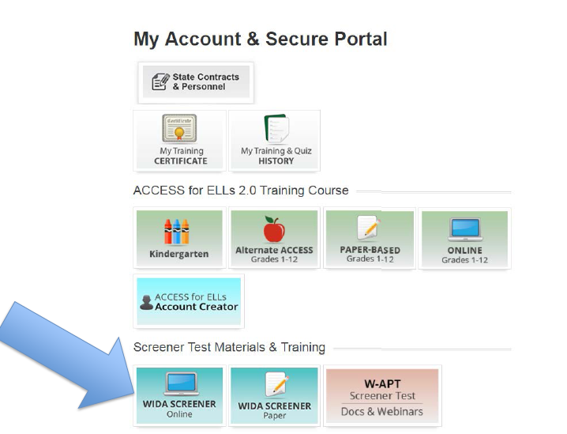
Locating WIDA Training Courses

Slide 8
Important Steps for WIDA DTCs:
Spring Semester
January-March:
  Manage checkout/check-in of secure materials
  Schedule, create, and manage test sessions
  Monitor and distribute test overage as needed
  Place any Additional Materials orders
  Oversee shipping of completed/secure test materials to DRC
April-May:
  Complete Data Validation in WIDA AMS

Slide 9
Changes to ACCESS Additional Material Ordering for 2018-2019
Only the district DTC should place Additional Materials orders.*
DTCs should make as few orders as possible.
Additional materials should NOT be ordered at site level.
DTCs should compile a list of needed materials for all sites and place a single, district-level order.
Notes:
*NOTE: In districts with very high numbers of ELs, it is acceptable to appoint more than one DTC, but most districts should appoint one person to be DTC and have all Additional Materials orders placed by that person.
NOTE: Please note that financial penalties will result from excessive additional materials orders.

Slide 10
What is the WIDA Screener?
New placement test for potential ELs. Available in Online and Paper versions.
All second semester 1st graders-12th graders must be tested with WIDA Screener. The W-APT is no longer supported and should not be used.
Flexible, on-demand, and locally-scored; designed to be administered to a group and scored within 24 hours.
Notes:
NOTE: WIDA Screener is not a diagnostic or interim progress test. WIDA MODEL is the only WIDA assessment designed to be used as an interim progress test.

Slide 11
WIDA Screener:
Who Can Administer?
Both versions of WIDA Screener may be scored by certified teachers or certified paraprofessionals*; OSDE strongly recommends certified teachers score whenever possible.
Staff members who administer and score WIDA Screener must complete required training and pass the Speaking and Writing certification quizzes with scores of 80% or above.
Notes:
*Certfied paras=AA degree, passed the PRAXIS, etc…

Slide 12
WIDA Screener Online
Always free to administer.
Same TSM/test platform as ACCESS 2.0.
Allows for group testing of all domains, including Speaking.
Allows for group testing for students in different grade levels.

Slide 13
WIDA Screener Online: Scoring
Listening and Reading scores auto-calculated.
Local rater scores Speaking and Writing responses in WIDA AMS; may review responses multiple times.
Responses available to score within two hours of test completion.
Notes:
Please report to WIDA and DRC if student responses or score reports are not due within two hours (responses) or almost immediately (Score Reports after Speaking and Writing responses are scored).

Slide 14
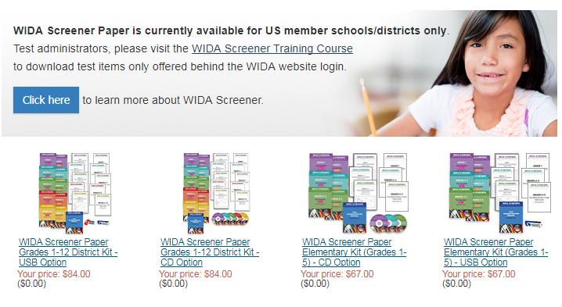
WIDA Screener Paper
Materials can be purchased in WIDA Store: https://www.wceps.org/Store/WIDA
Notes:
1st-5th grade kit (USB or CDs): $69
6th-12th grade kit: $69
1st-12th grade kit: $89

Slide 15
WIDA Screener Paper: Materials
Districts must purchase materials once-nominal fee for printing/shipping.
USB or CDs for audio files.*
Copies can be made as often as needed.
Listening, Reading, and Writing tests may be given in grade level groups.
Notes:
NOTE:*Same cost for USB or CD versions

Slide 16
Scoring WIDA Screener Paper
All domains hand scored locally.
Speaking must be administered individually and scored as given; test administrators will only hear responses once.
Score reports are filled out by hand and hard copies must be kept.

Slide 17
WIDA Screener: Recorded
Oklahoma-Specific Webinar
On 1/30/18, WIDA Screener Overview live webinar for OSDE aired and was recorded.
Available for free viewing in WIDA’s Download Library under State/District webinars menu.
Notes:
NOTE: WIDA Professional Learning Outreach Specialist Melissa Paton presented.

Slide 18
Other Recorded
WIDA Screener Webinars
By visiting the WIDA Screener webpage, anyone with a WIDA login can access:
  WIDA Screener Online Administration (recorded 4/24/2018)
  WIDA Screener Paper Administration (recorded 5/10/2018)

Slide 19
Upcoming
WIDA Screener Webinars
WIDA Screener Online:
  Thursday, August 9, 2018, 11 a.m.-12 p.m. CST
  Wednesday, September 12, 2018 3-4 p.m. CST
WIDA Screener Paper:
  Wednesday, August 22, 2018, 11 a.m.-12 p.m. CST

Slide 20
2018-2019 WIDA Screener:
Live Trainings for Oklahoma
OSDE will host the following in-person WIDA Screener trainings:
OKC (OSDE Room 215)-September 11-12, 2018:
  WIDA AMS for Screener (mornings)
  WIDA Screener Online (afternoons)
Broken Arrow (Central on Main-Ballroom/Conference Room)-September 13-14, 2018:
  WIDA AMS for Screener (mornings)
  WIDA Screener Online (afternoons)
Notes:
NOTE: Due to poor attendance in recent years, OSDE will not be hosting WIDA Screener Paper or ACCESS 2.0 Paper trainings in 2018-2019.

Slide 21
What About Screening Kindergartners and 1st-Semester 1st Graders?
Kindergartners and 1st semester 1st graders are still screened with Kindergarten W-APT and cannot currently placement test as proficient.
These ELs have the opportunity to test as proficient on K ACCESS or ACCESS for ELLs 2.0.
Notes:
NOTE: This is because both placement tests available for kindergarteners and first-semester first graders have not been updated to the new scoring standards.

Slide 22
In Development:
Kindergarten WIDA Screener
New paper-based kindergarten WIDA Screener in development; will replace K W-APT and serve as alternative to K MODEL.
Will be similar in design to Kindergarten ACCESS and K MODEL, but shorter.

Slide 23
In Development:
Kindergarten WIDA Screener
Kindergarten WIDA Screener will be released in fall 2019.
Will share same (or equivalent) 4.8 or higher Overall automatic exit score as WIDA Screener; potential ELs will be able to test as not needing EL services.
Notes:
NOTE: Students with disabilities that preclude them from taking all domains will need to score 4.8 or higher (or equivalent scores) on all domains taken.

Slide 24
ELPA Updates: District EL Stakeholder Team (November 2017)
OSDE convened a team of 13 district stakeholders to reevaluate OK’s EL entry and exit criteria. All participants:
  Selected by application.
  From districts with high per capita EL populations
  Have extensive experience working with ELs and/or WIDA assessments.
Most regions of OK represented.

Slide 25
ELPA Updates:
Entry & Exit Criteria
EL stakeholder team made recommendations regarding:
  WIDA Screener cut score (UPDATED)
  Kindergarten ACCESS & ACCESS for ELLs 2.0 exit criteria (UPDATED)
  Alternate ACCESS for ELLs exit criteria (NEW)
  Domain-level exit criteria for ELs with disabilities that preclude taking all ELPA domains (NEW)
  No Measurable Academic Response Criteria (NMAR) (NEW)

Slide 26
WIDA Screener:
Updated Cut Score
Updated cut score for potential ELs in 2nd semester 1st grade-12th grade
Students scoring 4.8 or above on Overall are not EL and do not need services.
Students scoring 4.7 or below on Overall are EL and should be placed in EL services.
Notes:
As of 1/19/18, when guidance was released via the WIDA listserv.

Slide 27
WIDA Screener:
New Domain Cut Scores for ELs with Disabilities
New domain cut scores for ELs with disabilities that preclude them from taking all domains of WIDA Screener even with accommodations.
Please review WIDA’s Accessibility and Accommodations Supplement for info on available accommodations for ELs.
Notes:
REMINDER: All K W-APT scores qualify. Students who have disabilities that preclude them from participating in all K W-APT domains will qualify for EL services, as all K W-APT scores qualify.

Slide 28
WIDA Screener:
New Domain Cut Scores for ELs with Disabilities
Students scoring 4.8 or above on all domains taken are not EL and do not need services.
Students scoring 4.7 or below on any domains taken are EL and should be placed in EL services.

Slide 29
GRADE LEVEL(S) | PLACEMENT TEST | CUT SCORE and EL STATUS
Pre-K | PKST (10-question oral screener) | 7 or more correct=Not EL for PK year* *All PK students rescreened with K W-APT in kindergarten
Kindergarten and 1st Semester 1st Grade | Kindergarten W-APT or K MODEL | ALL SCORES QUALIFY AS EL
2nd Semester 1st Grade-12th Grade | WIDA Screener (Online or Paper) | 4.8 or above Overall=Not EL

Slide 30
ACCESS Testing:
Who Can Administer?
All ACCESS tests must be scored by certified teachers. Districts may hire retired teachers who are still certified to administer testing.*
Staff members who administer and/or score ACCESS testing must complete required training and pass certification quizzes with scores of 80% or above for any version of ACCESS they will administer.
Notes:
*NOTE: This differs from WIDA Screener and K W-APT, which may be administered by certified paraprofessionals.

Slide 31
Kindergarten ACCESS and ACCESS 2.0: Updated Auto Exit Scores
K ACCESS and ACCESS for ELLs 2.0 have updated automatic exit scores.
ELs in K-12 scoring 4.8 or above on Overall are English proficient and exit EL services.
ELs in K-2 scoring 4.7 or below on Overall are still EL and remain in EL services.

Slide 32
Kindergarten ACCESS and ACCESS 2.0 Updated Auto Exit Scores:
ELs with Disabilities (Grades K-12)
ELs in K-12 scoring 4.8 or above after Overall score is calculated are English proficient and should exit services.
ELs in K-2 scoring 4.7 or below after Overall score is calculated are still EL and should remain in EL services.

Slide 33
ACCESS for ELLs 2.0:
New ELP Band (Grades 3-12)
ACCESS for ELLs 2.0 also has a new ELP band for ELs in grades 3-12.
ELs in grades 3-12 scoring in the ELP band of 4.3-4.7 on Overall may qualify for reclassification and exit.
ELs scoring 4.2 or below on Overall will not be eligible for reclassification and exit.

Slide 34
ACCESS for ELLs 2.0:
New ELP Band for ELs with Disabilities (3-12)
ELs in 3-12 scoring in the ELP band of 4.3-4.7 after Overall scores are calculated may qualify for reclassification and exit.
ELs in 1-12 scoring 4.2 or below after Overall scores are calculated are EL and should remain in EL services.

Slide 35
ACCESS for ELLs 2.0:
New ELP Band (Grades 3-12)
ELs scoring within the ELP band will potentially be evaluated for exit by a district academic committee.
OSDE-created rubrics provided on the OSDE ELPA page will be used to determine if ELs are eligible for committee.*
Notes:
The ELP band rubrics and guidance are contained in the EL/WIDA FAQ on the ELPA page of the OSDE website.

Slide 36
Why an ELP Band?
Setting an ELP band will allow more nuanced criteria to be considered when exiting ELs.
It will also help ensure ELs:
  Do not exit before English proficient, and
  Are not retained in programming longer than necessary.

Slide 37
ACCESS for ELLs 2.0:
ELP Band Eligibility Requirements
To be eligible for an ELP band committee, ELs in grades 3-12 must:
  Score 4.3-4.7 on their most recent ACCESS Overall score, AND
  Score Basic or above on their most recent OSTP ELA assessment*(see next slide)
Notes:
Any of the following render ELs ineligible, even if they have met other criteria:
Student is in grades K-2
Student scored 4.2 or below on ACCESS Composite score (or on any domain taken if disability precludes taking all domains)
Student scored Unsatisfactory or Limited Knowledge on current OSTP ELA test

Slide 38
ACCESS for ELLs ELP Band Rubric:
OSTP Requirement Substitution for 3rd Graders
For 3rd graders, districts may use the following in place of OSTP ELA score requirement (#2 on ACCESS rubric):
  A score above the 35th percentile on any of the NRTs listed on the OSDE Approved List for Norm-Reference Tests (NRT) ELP Band Decisions, or
  A score above the 35th percentile on any of the approved RSA Screeners

Slide 39
ACCESS for ELLs ELP Band Rubric:
OSTP Requirement Substitution for Secondary Students Not OSTP-Tested
For secondary students not in OSTP-tested grades, districts may use either of the following in place of OSTP ELA score requirement (#2 on ACCESS rubric):
  Scores above the 35th percentile on assessments listed on Approved Substitutions for OSTP ELA Score Requirement doc linked on OSDE’s ELPA page, or
  A Proficient score (33 or above) on the Alternative Grade 8 Reading Test available on Single Sign On

Slide 40
ACCESS 2.0 Rubric:
Additional Criteria
In addition to required OSTP and ACCESS scores, ACCESS 2.0 rubric includes the following criteria:
  ELA Class Grades
  Norm-reference Reading or ELA test score(s) from OSDE approved assessment list
  Student Oral Language Observation Matrix (SOLOM)

Slide 41
ACCESS 2.0 Rubric:
Using Additional Criteria
Districts may choose to use any/all of the 5 remaining non-required criteria in making decisions, but must ensure there is adequate data available to make reclassification and exit decisions for students.

Slide 42
ACCESS 2.0 Rubric:
Using Additional Criteria
To be declared English proficient and exited from EL services, students must:
  Meet a minimum of 3 of the 7 rubric criteria, AND
  Be recommended for reclassification and exit by a district EL representative
  AND if EL is dually identified:
  IEP representative must participate in committee, but his or her recommendation is not mandatory for reclassification/exit.

Slide 43
ACCESS 2.0 Rubric:
ELA Class Grades
To meet the ELA Class Grades criteria, students must:
  Have achieved passing grades in their ELA classes in the same year they scored within the ELP band, AND
  Be found to demonstrate mastery over appropriate grade-level subject matter and readiness for the next grade level.

Slide 44
ACCESS 2.0 Rubric:
NRT Reading and/or ELA Scores
To meet the NRT criteria, students must have scored above the 35th percentile on an OSDE-approved NRT Reading or ELA Test:
  In the spring semester of the year they scored within the ELP band on ACCESS, OR
  In the same semester as the committee is making their reclassification/exit decision

Slide 45
ACCESS 2.0 Rubric:
Student Oral Language Observation Matrix (SOLOM)
To meet the SOLOM criteria, students must have scored Advanced Fluency (21-25 points):
  In the spring semester of the year they scored within the ELP band on ACCESS, OR
  In the same semester as the committee is making their reclassification/exit decision

Slide 46
Suggested Additional Data for Committee Consideration
Student writing samples:
  Include work from throughout year
  Include works of varying lengths/complexity
  Include samples of works from multiple content areas-RL
  Show all elements of writing process

Slide 47
Suggested Additional Data for Committee Consideration
Language inventories (in addition to SOLOM) should be:
  Completed over extended period (at least 2-4 months)
  Completed by EL teacher and one classroom teacher at minimum (Best if multiple content area teachers participate)
  Conducted in English and student’s native language(s) whenever possible

Slide 48
Suggested Additional Data for Committee Consideration
Videos or notes recorded during student language use in classroom.
Example situations:
  Oral presentations (individual and group)
  Discussions during group work
  Communication while participating in labs or other hands-on activities

Slide 49
Suggested Additional Data for Committee Consideration
Portfolios of student work samples should:
  Include work from throughout school year
  Highlight student’s English language development throughout year leading up to student scoring within ELP band
  Include examples from all core content areas
  Include work showcasing both informal/social and academic/technical language use

Slide 50
ELP Band Committee Member Requirements
At minimum, committee must include:
  District EL representative (EL Coordinator or teacher most familiar with EL whenever possible)
  Classroom teacher who works closely with EL
  Administrator or counselor familiar with EL
AND if EL is dually identified,
  SpEd Coordinator or teacher most familiar with EL)

Slide 51
ELP Band Committee Timing Guidelines
ELP band committees begin fall 2018; committees meet once yearly.
Districts have 30 calendar days from start date of school to convene committees and make decisions.
Districts have 15 calendar days from committee meeting to notify parents or guardians of any change to EL classification or services.
Notes:
NOTE: ELP band committees are not something that should happen on a rolling basis throughout the year.

Slide 52
2018-2019 ACCESS for ELLs 2.0
Live Trainings for Oklahoma
OSDE will host the following in-person ACCESS 2.0 trainings:
OKC: December 4, 2018 (OSDE-Room 215)-
  ACCESS 2.0 for Testing Coordinators (morning)
  ACCESS 2.0 Online for Test Administrators (afternoon)
Broken Arrow: December 5, 2018 (Central On Main-Ballroom/Conference Room)-
  ACCESS 2.0 for Testing Coordinators (morning)
  ACCESS 2.0 Online for Test Administrators (afternoon)
Notes:
NOTE: Due to low demand and poor attendance in recent years, OSDE will not be supporting ACCESS 2.0 Paper or offering in-person trainings for ACCESS for ELLs 2.0 Paper. Districts may petition the state board of education to be allowed to use Paper. The process for doing so is still in development.

Slide 53
Who Takes Alternate ACCESS for ELLs?
Most dually identified ELs take ACCESS 2.0 with accommodations
Alternate ACCESS for ELLs is for dually identified ELs:
  Who have significant cognitive disabilities, AND
  Take the alternate state content assessment, AND
  Meet the criteria set forth by WIDA in the Accessibility and Accommodations Supplement

Slide 54
Alternate ACCESS for ELLs:
New Automatic Exit Scores
Alternate ACCESS for ELLs has new automatic exit scores for ELs in grades 1-12.
ELs in grades 1-12 scoring P2 on Overall for two consecutive years are English proficient and should exit services.
ELs in grades 1-2 scoring P1 or below on Overall are still EL and should remain in EL services.

Slide 55
Alternate ACCESS for ELLs:
New ELP Band (Grades 3-12)
Alternate ACCESS also has a new ELP band for ELs in grades 3-12.
ELs in grades 3-12 scoring in the ELP band of A3-P1 (or above) on Overall for two consecutive years may be eligible for reclassification and exit.
ELs scoring A2 or below on Overall are not eligible for reclassification and exit.

Slide 56
Alternate ACCESS:
ELs with Disabilities (1-12)
ELs in 1-12 scoring P2 or above after Overall scores are calculated for two consecutive years are English proficient and exit services.
ELs in 1-12 scoring A2 or below after Overall scores are calculated are EL and should be remain in EL services.

Slide 57
Alternate ACCESS: New ELP Band for ELs with Disabilities (3-12)
ELs in 3-12 scoring A3-P1 or above after Overall scores are calculated may qualify for reclassification and exit.
ELs in 1-12 scoring A2 or below after Overall scores are calculated are EL and should remain in EL services.

Slide 58
Alternate ACCESS:
ELP Band Committee Rubric
In addition to required Alternate ACCESS scores, Alternate ACCESS rubric includes the following criteria:
  DLM Reading Assessment-EL must have demonstrated growth at Essential Element level
  ELA class grades-Progress in ELA content must be evidenced through IEP documentation

Slide 59
Alternate ACCESS:
Exit Via ELP Band (Grades 3-12)
For ELs scoring in ELP Band to exit, they must:
  Meet all 3 criteria on rubric, AND
  Be recommended for exit by EL Representative, AND
  Be recommended for exit by IEP Representative.

Slide 60
Alternate ACCESS: New Auto Exit Score for ELs with Disabilities (1-12)
ELs scoring P2 or above after Overall scores are calculated for two consecutive years are English proficient and exit services.
ELs scoring A2 or below after Overall scores are calculated are still EL and should remain in EL services.

Slide 61
Alternate ACCESS for ELLs:
Alternate Exit Criteria (Grades 1-12)
If Overall scores of ELs taking Alternate ACCESS for ELLs do not improve, even incrementally, for three consecutive years, ELs may be reclassified and exited if:
  An EL representative recommends reclassification and exit, AND
  An IEP representative recommends reclassification and exit.

Slide 62
ESSA: Changes to Placement
Testing Guidelines
All students whose HLS responses indicate a language other than English on any 1 of the first 3 HLS questions must be placement tested.
“More often” and “less often” HLS designations will apply only to bilingual status. “Less often” potential ELs will not be eligible to be exempted from placement testing based on state or norm-referenced reading test scores.

Slide 63
ESSA: Changes to Placement
Testing Guidelines
If a new potential EL student enters a district during the ACCESS testing window:
  Placement test student using the appropriate screener.
  If student tests as EL, code, serve, and ACCESS test student, unless student enters during last two weeks of ACCESS window.*
    *Administer appropriate ACCESS test to new ELs who enter in last two weeks of window the following spring.

Slide 64
ESSA: Changes to EL Monitoring/Accountability Period
Under NCLB, ELs were to be monitored by districts for 2 years, and were part of district accountability calculations for 2 years, following testing as proficient and exiting services.
Under ESSA, ELs will still need to be actively monitored for 2 years, but will be included in district accountability for 4 years following testing as proficient and exiting services.

Slide 65
ESSA:
Changes to EL OSTP Accommodations
ELs who do not test Proficient on OSTP ELA exam the same year they test English proficient on ACCESS will be eligible for EL accommodations on following year’s OSTP testing during first monitor year.
For grades not tested, NRT Reading test score can determine eligibility. If unavailable, use prior year’s OSTP ELA score.
Notes:
Under NCLB, ELs who had tested as proficient could no longer receive EL accommodations on state testing.

Slide 66
ESSA:
Changes to EL OSTP Accommodations
If monitored EL does not test Proficient on OSTP ELA test during his or her first monitor year, OSTP EL accommodations must be offered during second monitor year.
If monitored EL tests Proficient on OSTP ELA test during his or her first monitor year, OSTP EL accommodations may be offered during second monitor year at district discretion.

Slide 67
ESSA: Additional EL OSTP Accommodations Changes
No monitored EL will be offered EL state testing accommodations beyond their second monitor year.
If any monitored EL does not test Proficient on OSTP ELA test in either of the two monitor years, he or she may be retested for EL services at district discretion.

Slide 68
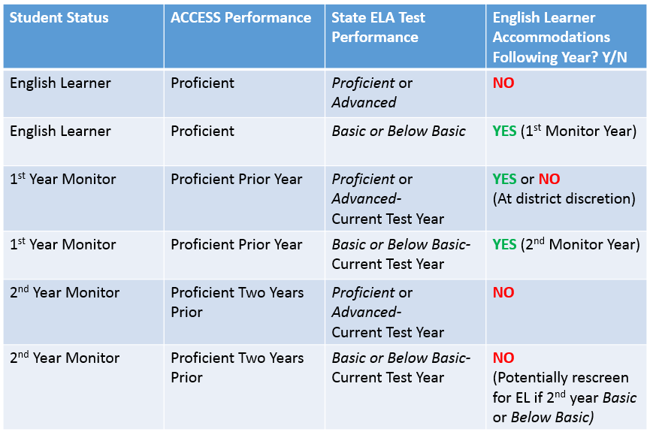

Slide 69
ESSA: Changes to EL Alternate Assessment
Potential or existing ELs with severe cognitive disabilities can be evaluated for No Measurable Academic Response (NMAR) status by their IEP team each year.
Students found to meet NMAR criteria will not be designated or served as EL, nor will they be given the Alternate ACCESS for ELLs.

Slide 70
No Measurable Academic Response (NMAR) Criteria
To qualify as NMAR, student must be found to:
  Be unable to demonstrate any observable reaction to a specific stimulus,
  Exhibit only startle responses,
  Track or fixate on objects at random and not for a purpose,
  Move or respond only to internal stimuli, AND
  Vocalize intermittently regardless of changes in environment.

Slide 71
NMAR Evaluation Process
Student’s academic team must agree that he or she meets all five of the criteria.
The decision to classify a potential EL, or reclassify an existing EL, as NMAR must be revisited at the beginning of each academic year by the student’s IEP team, with input from an EL representative.
Notes:
NOTE: Students should be thoroughly evaluated and given every opportunity to demonstrate communication skills. Students MUST be assessed in any domain in which they are able to participate. For example, a student that does not have expressive language skills, but does have receptive skills such as Listening, should be assessed in the receptive domains of Listening and Reading.

Slide 72
New WIDA Website
New site, wida.wisc.edu, will offer improved navigability and user-friendliness.
Please consult the WIDA Public Website-Key Changes Guide for additional info.
Users can navigate to new site via www.wida.us for 1 year after new site goes live.

Slide 73
Upcoming Trainings:
WIDA eLearning Modules
Oklahoma is 1 of 5 states piloting WIDA’s eLearning modules in 2018-2019.
September 1, 2018-June 30, 2019: All Oklahoma educators with a WIDA login will have access to 4 self-paced eLearning modules.
Platform for modules is Canvas. Users can print training certificates upon module completion.
Notes:
NOTE: More information will be made available through the EL/WIDA website once it is made available to OSDE.

Slide 74
Upcoming Trainings:
WIDA eLearning Module #1
Foundational Concepts eWorkshop for K-12 Educators:
  Designed for Teacher Leaders, Facilitators, Coaches, and EL/Bilingual Teachers
  Includes learning interactivities, handouts, worksheets, and videos
  Contains enough content and materials for facilitators to do two full days of training with PLCs

Slide 75
Upcoming Trainings:
WIDA eLearning Module #2
Doing and Talking STEM eWorkshop:
  For K-12 Science Teachers, Math Teachers, and EL Teachers
  Supports teachers as module takes them through series of reflections, video exercises, and resources on the Doing and Talking Math and Science website.
  Users can access additional education pathways and resources upon module completion.
Notes:
NOTE: At the end of the eWorkshop, teachers have an opportunity to select a pathway for further learning and corresponding resources focused on discourse–centered instruction and collaborative meaning–making in the STEM classroom.

Slide 76
Upcoming Trainings:
WIDA eLearning Module #3
Using the WIDA Writing Rubric eWorkshop:
  For 1st-12th grade classroom & EL teachers
  May be used individually or with PLCs; PLC Collaborative Protocol Template handout provided
  Two module sections with corresponding videos:
    Video 1: Using the WIDA Writing Rubric for Instructional Purposes
    Video 2: Using the WIDA Writing Rubric to Analyze Student Writing

Slide 77
Upcoming Trainings:
WIDA eLearning Module #4
Leading for Equity: Classroom Walkthrough eWorkshop:
  For K-12 leaders who engage in classroom walkthroughs
  Provides walkthrough resource to help leaders identify best practices/procedures for ELs
  Participants will learn to use/adapt resource for their current walkthrough practice

Slide 78
Upcoming Trainings: Live Webinars
OSDE will also host two live WIDA webinars in 2018-2019:
  “Collaboration for ELLs” (October 11, 2018, 2-3 p.m. CST)
  “Providing Supports for ELLs” (October 16, 2018, 3-4:30 p.m. CST)
  Both webinars designed for K-12 classroom and EL teachers
Notes:
NOTE: Additional info and registration links will go out through EL/WIDA listserv as soon as they are made available to OSDE.

Slide 79
Important WIDA Resources:
Oklahoma’s WIDA Membership Page
EL Identification and Placement Guide
State Specific Directions for ACCESS Materials Management and Return
Oklahoma’s ACCESS Testing Calendar
Info on upcoming WIDA PD for OK
Contact info for OSDE, WIDA Client Services, and the WIDA Store

Slide 80
Important WIDA Resources:
WIDA’s ELPA Pages
WIDA website pages for WIDA Screener, K W-APT, ACCESS for ELLs 2.0, Kindergarten ACCESS, WIDA MODEL, & Alternate ACCESS for ELLs contain:
  Key resource documents needed to administer assessments
  Technology specifications
  Tools for preparing students for testing
  Info on scores and reports
  Updates to assessments and testing procedures

Slide 81
***NEW*** OSDE Resources
English Learner Acquisition Plan (ELAP):
  Replaces LIEP as individual EL instruction plan
Approved Word-to-Word Dictionary List:
  Checklists for OSTP, ACT, and SAT
2017-2018 OSTP EL Accommodations Manual*:
  3-8 Math and Science tests now offered in Spanish
  Spanish audio files available for 3-8 Math and Science and grade 11 Science
Notes:
*NOTE: Only 3rd grade math tests will be offered in a paper Spanish translated form this year. All other grades/tests that are offered in Spanish translated forms will be online with an accompanying test-to-speech pack. This is due to VERY low demand for the paper forms.

Slide 82
***NEW*** OSDE ELPA Resources
ELP Band Rubrics for ACCESS 2.0 and Alternate ACCESS for ELLs
OSDE English Learner/WIDA FAQ
2018-2019 Language Instruction Education Plan (LIEP):
  District-level plan for EL instruction
  Replaces LIPDP
  Managed by Federal Programs

Slide 83
~Question Time~
Please let me know:
If there is anything I did not address that you would like to ask, or
If you need further clarification about anything I discussed today.
I am happy to answer any questions you may have!

Slide 84
Thank you for your time and attention!
Elizabeth Warren, Director of ELPA, Office of Assessments: elizabeth.warren@sde.ok.gov ; (405) 522-5073

