Slide 1
Weekly Wave
Data & Information Systems

Slide 2
WAVE Affiliates Expired Accounts
To ensure the safety and security of student data in WAVE Reporting, WAVE Affiliate users must have signed into their WAVE account at least one time since May 1, 2023. Users who do not meet the following conditions will lose access to WAVE on January 2, 2024.
Accounts that have not been used to sign into the WAVE since May 1, 2023, will be inactivated and removed.
Users with WAVE access must provide at least one school email address using the domain of their current district assignment in their SSO account profile.

Slide 3
WAVE Affiliates Expired Accounts
Users who lose access to WAVE by not meeting the requirements defined above will have to apply to OMES for a new WAVE Affiliate account if access is required.
Thank you for helping to protect our student’s data privacy. You play a valuable role!!

Slide 4
Civil Right Data Collection (CRDC)
Districts may begin submitting data for school year 2021-2022 on Monday, December 11, 2023.
The data submission period will end on Monday, February 26, 2024.
As in previous years, the 2021–22 CRDC will be a universal collection in which every public school district and school in the country that receives federal financial assistance from the Department is required to participate.

Slide 5
Civil Right Data Collection (CRDC)
Click here to download and review the detailed data element matrix, with a column (OSDE Provided) that indicates whether or not the element has been submitted.
Click here for more guidance on the CRDC from USDE, including a general guide to this report and answers to common questions.
For specific questions related to the collection tools, file layouts, and timelines, contact the CRDC Partner Support Center at crdc@aemcorp.com or 855-255-6901.

Slide 6
Need assistance or have questions
Send an email
Data & Information Systems – studentdatainfo@sde.ok.gov
Accountability Reporting – accountability@sde.ok.gov
State Aid – state.aid@sde.ok.gov

Slide 7
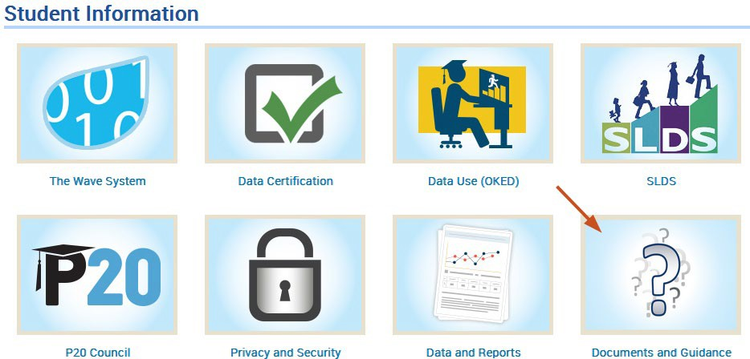
SDE Resources
TEAMs Channel - Files
OSDE Website >
Resources>Student Information

Slide 8
Connect with Us
Weekly Wave Meetings
Teams Channel
Student Accounting Consortium Data & Student Information Listserv

