Slide 1
Weekly Wave
Data & Information Systems

Slide 2
Civil Right Data Collection (CRDC)
Districts may begin submitting data for school year 2021-2022 on Monday, December 11, 2023.
The data submission period will end on Monday, February 26, 2024.
As in previous years, the 2021–22 CRDC will be a universal collection in which every public school district and school in the country that receives federal financial assistance from the Department is required to participate.

Slide 3
Civil Right Data Collection (CRDC)
Click here to download and review the detailed data element matrix, with a column (OSDE Provided) that indicates whether or not the element has been submitted.
Click here for more guidance on the CRDC from USDE, including a general guide to this report and answers to common questions.
For specific questions related to the collection tools, file layouts, and timelines, contact the CRDC Partner Support Center at crdc@aemcorp.com or 855-255-6901.

Slide 4
Civil Right Data Collection (CRDC)
We are providing CRDC training for those who are new to CRDC reporting. Please select one session below to register.
CRDC Introduction Session
Jan 11, 2024, 11:00 AM
Click here to register
CRDC Introduction Session
Jan 12, 2024, 09:00 AM
Click here to register

Slide 5
Postsecondary Coursework Review
Now is the time to review postsecondary coursework as final 1st semester grades should have been entered in your Student Information System. Check the following:
AP coursework should display 1 grade, no PS credit will be earned until the end of the 2nd semester and 2 grades are entered.
Concurrent College coursework should display 1st semester grades and PS credit should display a Y.
Career Tech program coursework should display 1 grade, no PS credit will be earned until the end of the 2nd semester and 2 grades are entered.
Internship coursework should display the 1st semester grades and PS credit should display as Y.
Reach out to accountability@sde.ok.gov or studentdatainfo@sde.ok.gov immediately if postsecondary is not displaying as expected.

Slide 6
Graduation Part-time Report
The Graduation Part-time Report is now open and closes on February 2, 2024. All students who meet the criteria must be entered in the report by the end of the day on February 2nd. Districts will not be able to add students to the report after February 2nd. Please make sure that responsible staff are notified and have planned sufficient time to complete the report and the superintendent has certified by the due date.

Slide 7
Things you should know
Audit exit date and codes for withdrawn or dropped students- helps prevent them from appearing in the dropout list.
Alt Ed Student Participation – many schools still do not have student participation set up for the Alt Ed students. If you are one of those districts you can expect to hear from the Alt Ed Department.
We are currently performing Data Quality Checks on the October 1st Consolidated Report. These checks will not affect your October 1st numbers reported but we will be reaching out for you to make corrections in your SIS. We have completed Special Ed. We are currently working on Gifted and Talented and Economic Disadvantaged. El is coming soon!

Slide 8
Need assistance or have questions
Send an email
Data & Information Systems – studentdatainfo@sde.ok.gov
Accountability Reporting – accountability@sde.ok.gov
State Aid – state.aid@sde.ok.gov

Slide 9
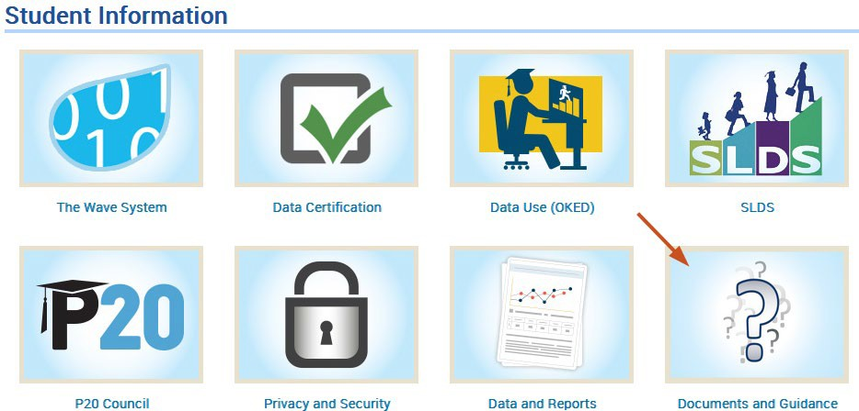
SDE Resources
TEAMs Channel - Files
OSDE Website >
Resources>Student Information

Slide 10
Connect with Us
Weekly Wave Meetings
Teams Channel
Student Accounting Consortium Data & Student Information Listserv

