Slide 1
Director Update
October 14, 2024
Sherri Coats
Program Director,
Special Education Services

Slide 2
Welcome

Slide 3


Slide 4
Director Call Schedule
Director Update
  2nd Monday of every month 3:00-3:30
Director Deep Dive
  4th Monday of every month 3:00-4:00 (except Nov. & Dec.)

Slide 5
Fall/Winter Director Call Schedule

Slide 6
August Deep Dive Director Call
Monday, October 28, 2024, 3:00-4:00
Travis Thompson & Tina Spence
  District Data Packet – November 15, 2024
  Significant Disproportionality

Slide 7
Good To Know

Slide 8
OAAP 1% Participation Waiver
Open for public comment Oct. 17
OSEP requires comments from the public for our waiver to be approved.
Watch for this notice on the listserv and please respond!!
Tiered Monitoring System
Great progress over time

Slide 9
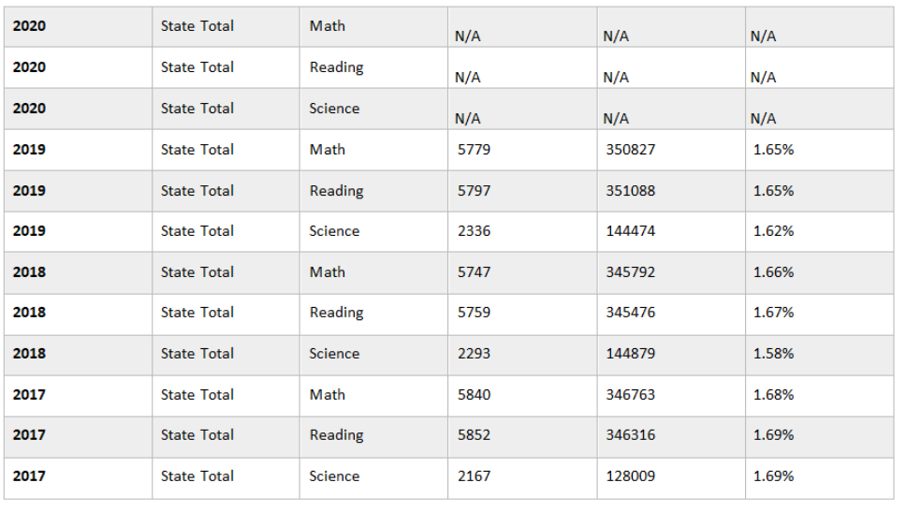
Historical 1% Waiver Data

Slide 10
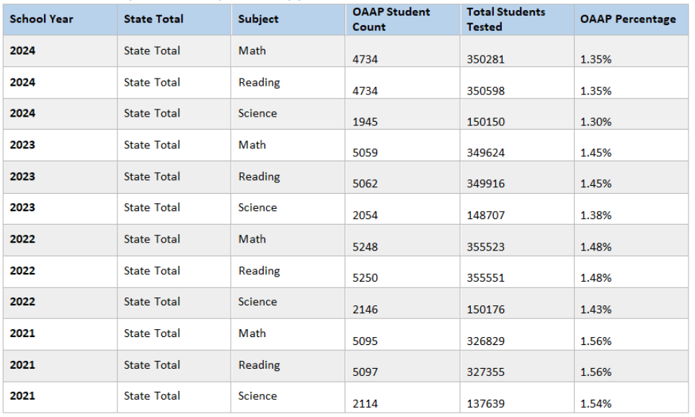
Historical 1% Waiver Data

Slide 11
State Aid Funding Weights Memo
Federal Funding
State Aid Funding (Two Weights Max)
  Primary Disability
  Secondary Disability, OR Related Services (whichever is higher)
The OSDE-SES is providing information regarding the Special Education weights in the 2024-2025 State Aid Funding Formula.
Primary and Secondary Disability and Related Services should NEVER be driven by weights. They MUST be determined by a group of qualified professionals based on data from a comprehensive evaluation that determines the disability related needs of a student.

Slide 12
Due Dates
October 31 Superintendent Certification of Child Count

Slide 13
School Based Medicaid Services
PCG – Medicaid Billing Partner
jrobison@pcgus.com

Slide 14
School Psych Support from OSDE
Questions about this process, please contact Cami Dotson, 405-522-1706.

Slide 15
Oklahoma School-Based Therapist Network
In partnership with the Lee Mitchener Tolbert Center for Developmental Disabilities, Oklahoma Autism Network, and OU Health Science Center
Providing:
  Continuing Education (Conferences, Webinars, Lunch & Learn 1st year School Therapist Training Series)
  Technical Support/Consultation
  Online Resource Library
Megan.Salisbury@sde.ok.gov to be added to the SB Therapist listserv
michele-deberry@oushc.edu for any questions

Slide 16
Paraprofessional Asynchronous Training Modules – Direct Step (LRP)
1500 paraprofessionals (openings for about 1300 more)
Each receive a bundle of 10 modules (not required to complete all of the modules)
Self paced
Results in a certificate of completion
Great way to earn the required 6 professional development points!
Carolyn.Thomas@sde.ok.gov

Slide 17
Engaging Support Conference
Paraprofessionals and other Support Staff
November 1, 2024: Stillwater, Oklahoma
For questions about the Oklahoma's Engaging Support Conference, please email Megan Salisbury or Abby Johnson.

Slide 18
Early Childhood Transition Training
From SoonerStart to LEA
Tuesday, October 15, 2024, 9:00 AM - 12:00 PM:
  Enid
Monday, October 21, 2024, 9:00 AM - 12:00 PM:
  Lawton
Tuesday, November 12, 2024, 12:30 PM - 3:30 PM
  McAlester
Wednesday, November 13, 2024, 9:00 AM - 12:00 PM:
  Tulsa

Slide 19
Early Childhood Data Digging
Join us for a chance to discuss early childhood data, as well as available tools & resources. This will be an ongoing group to discuss all topics related to early childhood data. This is an opportunity to ask any of your early childhood data questions. Please use this form to suggest questions or topics.
Join us on November 14, January 9, March 6, and May 8 from 2:00 PM - 3:00 PM.

Slide 20
Alternate Diploma Collaboratives and Q&A
Join via this Teams link for all ADC and Open Q & A Sessions
ADC – November 21, 2024 (3rd Thurs.)
Open Q & A – October 24, 2024 (4th Thurs.)

Slide 21
Using Assessment Results to Develop Effective Transition Plans (OAAP)
November 20, 2024 from 9:00AM -3:30PM Idabel, OK
December 3, 2024 from 9:00AM -3:30PM Oklahoma City, OK
December 5, 2024 from 9:00AM -3:30PMDuncan, OK
Questions can be directed to Claudia Beckner

Slide 22
OSDE Connect
PEPPER modules have transitioned to OSDE Connect
  Paraprofessional Training Modules
  Long Term Substitute Modules
Districts will not be able to self-enroll participants in these modules. The process for enrolling participants can be printed here

Slide 23
OSDE Connect
ECO Module
Dyslexia/Dysgraphia Module

Slide 24
504 Accommodation Plan Webinars
Registration is now open
October 23, 2024, at 12PM
October 23, 2024, at 3:30PM
Questions can be directed to Elana Grissom.

Slide 25
Data Literacy Retreat
School districts and sites in the state will be able to participate in the two day, in-person data literacy training that focuses on school system data analysis.
Participants who are receiving additional supports with OSDE groups will be prioritized for attendance. Please send a minimum of 2 participants per school site/district team. Participants will also need access to their school's data management system and a device that can connect to the internet during the professional development.
For more information and to register for this event please view the OK Multi-Tiered System of Supports | Oklahoma State Department of Education flyer.

Slide 26
Oklahoma Autism Center Trainings
Please see the Oklahoma Autism Center PD Opportunities flyer for more information.
Please see the OAC Professional Development Opportunities for more information.

Slide 27
Diabetes Management Training (DMT)
Meets the requirements of 70 O.S. § 1210.196.5
Live Virtual
  November 7, 2024- Register Here
On-Demand Virtual OSDE Connect
  Find Classes

Slide 28
Vision Screening Provider Training
This course fulfills the requirements listed in 70 O.S § 1210.284:
Live Class Options-
Vision Screening Provider Training- 9:00 AM - 12:00 PM
  OKC October 24, 2024 9AM-12PM
  OKC October 24, 2024 1PM-4PM
  OKC November 7, 2024 9AM-12PM
Vision Screening Trainer of Provider (only available to those who are certified in Vision Screening Provider Training) - 1:00 PM - 4:00 PM
OKC November 7, 2024 1PM - 4PM

Slide 29
School Based Medicaid Grant Award
Awarded July 1 to OHCA and OSDE as a sub-grantee
2 additional staff members to assist districts in School Based Medicaid Billing (Kimberly and Donita)
Kellie.carter@sde.ok.gov for more information

Slide 30
Educational Interpreter Registry
If your district employes educational interpreters, please verify that they are on the OSDE Educational Interpreter Registry. All interpreters in the educational setting are required to be on the registry and obtain yearly CEUs.
Educational Interpreter Registry - Oklahoma State Department of Education

Slide 31
Residential Facility Students
Free online curriculum (seat/license)
Contact Elana.Grissom@sde.ok.gov

Slide 32
Cyclical Monitoring Process
Announcement – December 13, 2024
Training – January 14, 2025
Program Self-Assessment (Protocols) beginning January 15, 2025
Document Submission Beginning May 2, 2025
Engagement – Beginning July 2025 (Monitoring, may be in person or virtual and results in a Written Report)
Close Out (1 year Correction window for any findings of noncompliance)

Slide 33
Looking Ahead – Watch the Listserv for:
Early Career School Psych Training and Mentorship
Early Career Special Education Teacher Training

