Slide 1
Director Update May 13, 2024
Sherri Coats
Program Director,
Special Education Services

Slide 2
Welcome

Slide 3
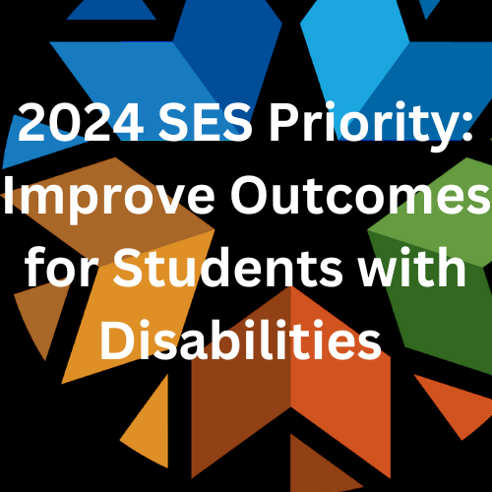

Slide 4
Director Call Schedule
Director Update
2nd Monday of every month 3:00-3:30
Director Deep Dive
4th Monday of every month 3:00-4:00 (except May)

Slide 5
May Deep Dive Director Call
Tuesday, May 28, 2024, 3:00-4:00
Alexa Hudak
Intervention Library
Carolyn Thomas
CPI Training Update
Paraprofessional Training Update

Slide 6
Public Comment Part B Grant Application
https://sde.ok.gov/special-education
Comments received no later than May 15, 2024
Send comments to abby.johnson@sde.ok.gov
"Public Comment" in the subject line

Slide 7
Public Comment Revised Policies & Procedures
https://sde.ok.gov/special-education
Comments received no later than May 31, 2024
Send comments to abby.johnson@sde.ok.gov
"Public Comment" in the subject line
Public Hearing @ OSDE State Board Room
May 17, 1:30-3:30 pm
May 20, 1:30-3:30 pm

Slide 8
Due Dates
June 1 SSIP Participation Application
June 30 Submit End of Year Data
July 1 Assurances
July 16 Certify EOY Data
July 22 High Needs Application
September 27 Bonus Point Submission

Slide 9
Upcoming Training Dates
May 15 – Duncan DRS/Pre-ETS Alternate Diploma and OP2P Grant
May 16 – EOY Open Door Assistance
May 17 – EOY Open Door Assistance
May 23 – Alternate Diploma & 18-22 Extended Transition Programs: Lessons Learned & Future Focus

Slide 10
Eligibility Report in AR
The Eligibility Timeline Report is currently not pulling initial eligibilities prior to January 2024. We are actively working to resolve the issues as quickly as possible and will let you know as soon as we have this corrected. We apologize for any inconvenience.

Slide 11
Oklahoma Deaf Education Conference
June 3-4 Pre-Conference
June 5-6 Conference
Registration is now open.

Slide 12
MTSS Fidelity of Implementation Self-Assessment
Registration Open Now
June 10 – Tulsa Technology Center, Owasso Campus
June 11 – Woodward Conference Center
June 17 – Easter Oklahoma State College, McAlester
June 18 – Cameron University, Lawton
In partnership with the National Center for Intensive Intervention
https://content.govdelivery.com/attachments/OKSDE/2024/03/19/file_attachments/2819142/MTSS%20Training%20Flyer.pdf

Slide 13
Picture Exchange Communication System (PECS)
June 11-12
Provided by Oklahoma Autism Center
Register by May 31
For more information and registration, please see the PECS Level 1 Flyer.

Slide 14
OKMTSS Conference
June 24th 12:30-4:30 Pre-Conference
June 25-26 Main Conference
June 25-26 Optional Virtual Conference
Register your MTSS teams today!

Slide 15
BeST (Behavioral Science for Teachers)
Requires a team
2-day Regional Training
July 15 &16 OKC
July 17&18 Sapulpa
July 22&23 Woodward
If you are interested in the BeST Training, please see the Behavioral Science for Teachers (BeST) Flyer and submit the Behavioral Science for Teachers (BeST) Form.

Slide 16
Funding with IDEA Funds
State Level Activities
“To support capacity building activities and improve the delivery of services by local education agencies to improve results for children with disabilities”
Almost $6M budgeted to this category for FY 25

Slide 17
Project 615 (Allocation)
District Provided Professional Development
Bring in PD providers
Send staff to PD opportunities
Allocation made per special education pupil (minimum of $500)
Must budget by December 1 or the funds will be redistributed
Districts can pool funds to bring in a PD provider

Slide 18
Project 613 (Until project funds are depleted)
Reimbursement for state identified, state provided professional development opportunities
PD must be on the approved 613 list
Covers registration, if any
Covers reimbursement of travel expenses
Covers reimbursement of substitutes while staff is attending the PD

Slide 19
Project 619
Provides funds to be used for stipends for staff who are
Attending MTSS Professional Development
Working toward district-wide MTSS implementation
Districts may distribute the stipends at their own discretion
Teams must complete required activities and submit evidence in order to make a claim
Refer to the Project 619 Memo

Slide 20
FY 25 Project Applications
Open for budget applications July 1
619 – Stipends for MTSS implementation
Application for FY24 open now until June 1
618 – Extended Transition Services
616 – Reimbursement for certification exams passed (must be related to special education)
615 – District provided Professional Development
613 – Reimbursement for state approved Professional Development reimbursement for registration, substitutes, and travel
Memos with specific information for each project can be found here. https://sde.ok.gov/finance Scroll to the bottom of the page.

Slide 21
Residential Students
Free online curriculum (seat/license)
Contact Elana.Grissom@sde.ok.gov

Slide 22
Looking Ahead – Watch the Listserv for
Related Service Provider Training and Mentorship
Early Career School Psych Training and Mentorship
Early Career Special Education Teacher Training
Paraprofessional Asynchronous Training Modules

