Slide 1
Director Update June 10, 2024
Sherri Coats
Program Director,
Special Education Services

Slide 2
Welcome

Slide 3
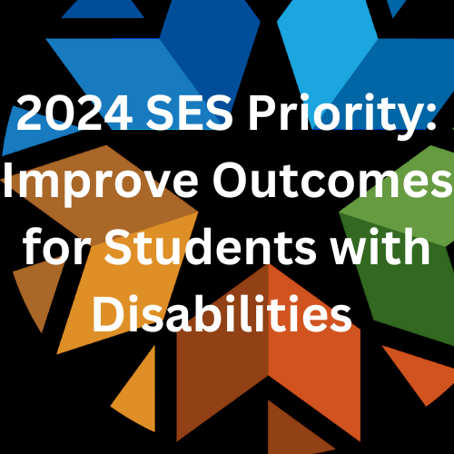

Slide 4
Director Call Schedule
Director Update
2nd Monday of every month 3:00-3:30
Director Deep Dive
4th Monday of every month 3:00-4:00 (except May)

Slide 5
June Deep Dive Director Call
Monday, June 24, 2024, 3:00-4:00
Lori Chesnut
Oklahoma Pathways to Partnership Grant (OP2P)
Kellie Carter
School Based Medicaid Billing

Slide 6
Staffing Changes
Brooks Sawyer – Data team – No longer with SES
Kristen Coleman – Formerly Project Manager of Professional Development – Now Program Manager of Differentiated Monitoring
School Psych replacing Kim Oliver – Cami Dotson
Cami.Dotson@sde.ok.gov
405-522-1706

Slide 7
Revised Policies & Procedures
https://sde.ok.gov/special-education
Currently developing responses to public comment and any necessary changes to the draft P&P
July 25, 2024, Presentation to Oklahoma State Board of Education
August 22, 2024, Request for approval by Oklahoma State Board of Education

Slide 8
Due Dates
June 10 – Open to perform close outs for 23-24 budgets (only if all claims have been approved) This action will roll forward any unspent funds as carry-over.
June 14 LEA Vision Screening Report Due
June 30 Submit End of Year Data
July 1 Assurances & LEA Agreements
July 16 Certify EOY Data
July 26 High Needs Application
August 1 All 23-24 Claims due
September 27 Bonus Point Submission

Slide 9
MTSS Fidelity of Implementation Self-Assessment
Registration Open Now
June 10 – Tulsa Technology Center, Owasso Campus
June 11 – Woodward Conference Center
June 17 – Eastern Oklahoma State College, McAlester
June 18 – Cameron University, Lawton
In partnership with the National Center for Intensive Intervention
https://content.govdelivery.com/attachments/OKSDE/2024/03/19/file_attachments/2819142/MTSS%20Training%20Flyer.pdf

Slide 10
OKMTSS Conference
June 24th 12:30-4:30 Pre-Conference
June 25-26 Main Conference
June 25-26 Optional Virtual Conference
Register your MTSS teams today!

Slide 11
BeST (Behavioral Science for Teachers)
Requires a team
2-day Regional Training
July 15 &16 OKC
July 17&18 Sapulpa
July 22&23 Woodward
If you are interested in the BeST Training, please see the Behavioral Science for Teachers (BeST) Flyer and submit the Behavioral Science for Teachers (BeST) Form.

Slide 12
Other Training
Inspire OK 2024
July 15
Cox Center in Tulsa
CPI (final full CPI Training)
July 25-26
*NEW* CPI Verbal Intervention (only)
August 29 Stillwater

Slide 13
IDEA B Panel Quarterly Meeting
Thursday, June 27, 2024
Francis-Tuttle Rockwell Campus
1:00-4:00
Open to the public and allows for Public Comment

Slide 14
Funding with IDEA Funds
State Level Activities
“To support capacity building activities and improve the delivery of services by local education agencies to improve results for children with disabilities”
Almost $6M budgeted to this category for FY 25

Slide 15
Oklahoma School-Based Therapist Network
In partnership with the Lee Mitchener Tolbert Center for Developmental Disabilities, Oklahoma Autism Network, and OU Health Science Center
Providing:
Continuing Education (Conferences, Webinars, Lunch & Learn 1st year School Therapist Training Series)
Technical Support/Consultation
Online Resource Library
Megan.Salisbury@sde.ok.gov to be added to the SB Therapist listserv
michele-deberry@oushc.edu for any questions

Slide 16
Project 615 (Allocation)
District Provided Professional Development
Bring in PD providers
Send staff to PD opportunities
Allocation made per special education pupil (minimum of $500)
Must budget by December 1 or the funds will be redistributed
Districts can pool funds to bring in a PD provider

Slide 17
Project 613 (Until project funds are depleted)
Reimbursement for state identified, state provided professional development opportunities
PD must be on the approved 613 list
Covers registration, if any
Covers reimbursement of travel expenses
Covers reimbursement of substitutes while staff is attending the PD

Slide 18
Project 619 (Allocation for 100 Specific Districts)
Provides funds to be used for stipends for staff who are
Attending MTSS Professional Development
Working toward district-wide MTSS implementation
Districts may distribute the stipends at their own discretion
Teams must complete required activities and submit evidence in order to make a claim
Refer to the Project 619 Memo

Slide 19
Project 618 (Allocation)
Provides funds to be used for developing or expanding 18-22 secondary transition program
Allocations based on Oct 1, 2023, enrollment of 17-21 year- old students who are eligible for OAAP
Refer to the Project 618 Memo

Slide 20
FY 25 Project Applications
Open for budget applications July 1
619 – Stipends for MTSS implementation
618 – Develop or Expand Extended Transition Services
616 – Reimbursement for certification exams passed (must be related to special education)
615 – District provided Professional Development
613 – Reimbursement for state approved Professional Development reimbursement for registration, substitutes, and travel
Memos with specific information for each project can be found here. https://sde.ok.gov/finance Scroll to the bottom of the page.

Slide 21
Residential Students
Free online curriculum (seat/license)
Contact Elana.Grissom@sde.ok.gov

Slide 22
Looking Ahead – Watch the Listserv for
Fall Training September 2024 – Two-day Regional Training
Day 1 P&P Updates
Day 2 Targeted Compliance
Early Career School Psych Training and Mentorship
Early Career Special Education Teacher Training
Paraprofessional Asynchronous Training Modules
Cyclical Monitoring Processes & Timelines

