Slide 1
Director Update August 12, 2024
Tina Spence
Assistant Program Director,
Special Education Services

Slide 2
Welcome

Slide 4
Director Call Schedule
Director Update
2nd Monday of every month 3:00-3:30
Director Deep Dive
4th Monday of every month 3:00-4:00 (except May)

Slide 5
Fall/Winter Director Call Schedule

Slide 6
August Deep Dive Director Call
Monday, August 26, 2024, 3:00-4:00
Melissa Ahlgrim/Deann Jones
SB 362 Strong Readers Act (replaces Reading Sufficiency Act (RSA)
LRP to give an overview to directors regarding the DirectSTEP training for paraprofessionals

Slide 7
Who’s Who in SES
Megan will send a email/phone directory to directors only

Slide 8
Office of Special Education Organization
Leadership
Director – Sherri Coats
Assistant Director – Tina Spence
Five Teams
Finance Team – Karen Howard
Data Team – Travis Thompson
Monitoring Team – Kristen Coleman
Dispute Resolution Team – Shea Stark
Policies & Procedures Team – Nancy Goosen

Slide 9
Office of Special Education Organization-2
Three Grants
State Personnel Development Grant – Alexa Hudak
Oklahoma Pathways to Partnership – Lori Chesnut
School Based Medicaid – Kellie Carter

Slide 10
SES Finance Team
Karen Howard
Carole Tomlin
Janet Felton
Mitchell Kern

Slide 11
SES Data Team
Travis Thompson
Tanis Thompson (8/19/24)

Slide 12
SES Monitoring Team
Kristen Coleman
Felica Denton
Megan Withers
(.5 monitoring/.5 Preschool-619 coordinator)

Slide 13
SES Dispute Resolution Team
Shea Stark
Keaton Oberst (State Complaints)
Abby Johnson (Awareity)

Slide 14
SES Policies & Procedures Team
Nancy Goosen
Carolyn Thomas (Staffing)
Elana Grissom (Alternate Placements)
Vacant (Professional Development)
Cami Dotson (Evaluation/Eligibility)
Tracy Prince (Deaf Education) (8/26/24)

Slide 15
SPDG Grant
Alexa Hudak (.5 SPDG/.5 SSIP)
Jasmine Brown (.5 SPDG/.5 SSIP)
Nicole Herron (SSIP Instructional Coach)
Wendy Hardwick (SPDG Instructional Coach)
Vacant (SPDG Instructional Coach)
Benjamin Taylor (Digital Content Specialist)

Slide 16
OP2P Grant
Lori Chesnut
Donna Tye-Lewis
Claudia Beckner
Erin Berry (8/5/24)
April Bowden (8/19/24)
Vacant

Slide 17
School Based Medicaid Grant
Kellie Carter
Vacant (School-based Medicaid Specialist)
Vacant (School-based Medicaid Specialist)

Slide 18
Administrative Support
Megan Salisbury
Maria Baca (8/19/24)
Heather Hancock

Slide 19
Good To Know

Slide 20
WAVE Rollover Update
The WAVE is now online but will only receive your district data if your vendor is sending the new SIF version 2.7 with updated codes as defined in the published mapping document. SIS vendors are working to address WAVE errors.
If you are not seeing data in WAVE beginning August 7th, reach out to your vendor. There may be needed updates that you must schedule in order to send the updated codes to WAVE.

Slide 21
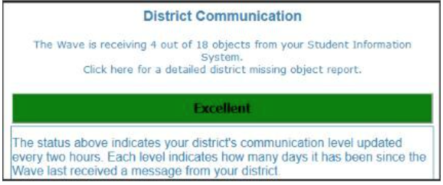
WAVE Rollover Update
On the WAVE homepage, you can see the number of objects your vendor is sending. You should expect to at least 8 objects sent last week. This is the minimum number of objects needed to process STNs and get students to EdPlan. Your vendor knows which objects meet the minimum requirement.

Slide 22
WAVE Rollover Update
You may also access the data validation wizard in WAVE and see any errors in data that have come into the WAVE.
Communication with the SIS Administrator in your district as they should know how to work with the SIS vendor to get your data flowing.

Slide 23
Revised Policies & Procedures
Request for SBE Approval Aug. 22
In effect Aug. 22

Slide 24
Director Summit
OSDE-Office of Special Education Services is offering a two-day Directors' Summit. The 2-day Directors' Summit will be in-person, offered at six different regional locations across Oklahoma during the first two weeks in September.
Day One: The first day aims to build the knowledge of the "new" 2024 amendments to the Oklahoma Special Education Policies and Procedures.
Day Two: The second day aims to provide updates to the U.S. Department of Education, Office of Special Education Programs (OSEP) requirements for monitoring and compliance, and targeted guidance regarding common compliance errors in Oklahoma.

Slide 25
Director Summit Dates
Duncan, Oklahoma: September 3-4, 2024
Burns Flat, Oklahoma: September 4-5, 2024
McAlester, Oklahoma: September 5-6, 2024
Oklahoma City, Oklahoma: September 6 and September 9, 2024
Owasso, Oklahoma: September 9-10, 2024
Enid, Oklahoma: September 10-11, 2024

Slide 26
Due Dates
August 30 SPARK applications due for sped teacher coaching through SPDG, includes a stipend for participation
September 1 FY 24 Close Outs in GMS due
September 27 Professional Development Bonus Point Submission due for the 2023-2024 school year.

Slide 27
Training
*NEW* CPI Verbal Intervention (only)
August 29 Stillwater
September 5 Ardmore
Prong II Training
September 13 Sapulpa
September 20 El Reno
Early Childhood Data Open Door
September 19 Virtual

Slide 28
Oklahoma School-Based Therapist Network
In partnership with the Lee Mitchener Tolbert Center for Developmental Disabilities, Oklahoma Autism Network, and OU Health Science Center
Providing:
Continuing Education (Conferences, Webinars, Lunch & Learn 1st year School Therapist Training Series)
Technical Support/Consultation
Online Resource Library
Megan.Salisbury@sde.ok.gov to be added to the SB Therapist listserv
michele-deberry@oushc.edu for any questions

Slide 29
Oklahoma’s Engaging Support Conference
The Oklahoma State Department of Education, Office of Special Education Services will be hosting our Annual Conference for Support Staff for the 2024-2025 School Year.
September 6, 2024: Ardmore, Oklahoma
November 1, 2024: Stillwater, Oklahoma
January 30, 2025: Lawton, Oklahoma
February 6, 2025: Guymon, Oklahoma
If you have any questions about the Oklahoma's Engaging Support Conference, please email Megan Salisbury or Abby Johnson.

Slide 30
Paraprofessional Asynchronous Training Modules – Direct Step (LRP)
1500 paraprofessionals
Each receive a bundle of 10 modules (not required to complete all of the modules)
Self paced
Results in a certificate of completion
Opens August 12

Slide 31
Early Childhood Transition Training From SoonerStart to LEA
Wednesday, October 2, 2024, 9:00 AM - 12:00 PM:
Oklahoma City
Tuesday, October 15, 2024, 9:00 AM - 12:00 PM:
Enid
Monday, October 21, 2024, 9:00 AM - 12:00 PM:
Lawton
Tuesday, November 12, 2024, 12:30 PM - 3:30 PM
McAlester
Wednesday, November 13, 2024, 9:00 AM - 12:00 PM:
Tulsa

Slide 32
Diabetes Management Training (DMT)
Meets the requirements of 70 O.S. § 1210.196.5
Live In Person
OKC Area: September 4, 2024- Register Here
Live Virtual
August 27, 2024- Register Here
September 24, 2024- Register Here
November 7, 2024- Register Here
On-Demand Virtual OSDE Connect
Find Classes

Slide 33
Vision Screening Provider Training
This course fulfills the requirements listed in 70 O.S § 1210.284:
Live Class Options-
Vision Screening Provider Training- 9:00 AM - 12:00 PM
Oklahoma City: September 19, 2024 - Register Here
Tulsa: October 3, 2024 - Register Here
Vision Screening Trainer of Provider (only available to those who are certified in Vision Screening Provider Training) - 1:00 PM - 4:00 PM
Oklahoma City: September 19, 2024 - Register Here
Tulsa: October 3, 2024 - Register Here

Slide 34
FY 25 Project Applications
Open for budget applications now
619 – Stipends for MTSS implementation
618 – Develop or Expand Extended Transition Services
616 – Reimbursement for certification exams passed (must be related to special education)
615 – District provided Professional Development
(Due Date December 31st)
613 – Reimbursement for state approved Professional Development reimbursement for registration, substitutes, and travel
Memos with specific information for each project can be found here. https://sde.ok.gov/finance Scroll to the bottom of the page.

Slide 35
Residential Facility Students
Free online curriculum (seat/license)
Contact Elana.Grissom@sde.ok.gov

Slide 36
School Based Medicaid Grant Award
Awarded July 1 to OHCA and OSDE as a sub-grantee
2 additional staff members to assist districts in School Based Medicaid Billing
Kellie.carter@sde.ok.gov for more information

Slide 37
Cyclical Monitoring
Is separate from other forms of monitoring such as Differentiated Monitoring Results (DMR) and Selective Reviews.
Occurs once every six years for each district.
554 Districts, including Charters, Co-ops, OJA, and OSD/OSB
6 Cohorts (92+/-)
4 Quarters per Cohort (23+/-)

Slide 38
Cyclical Monitoring Types
Districts will participate in one of two types of monitoring. The monitoring type will be assigned by the SES.
1) Comprehensive Monitoring- inclusive of all IDEA program areas
2) Targeted Monitoring – May include one or more
Indicator(s) Examples:
Child Find * Secondary Transition, * Early Childhood * Discipline * Assessment
Fiscal
The 6 year monitoring cycle will always include a sampling of student-level file review (e.g. RED, Consent, MEEGS, IEP, Written Notice, Invitation for Meeting, MD, Seclusion/Restraint, Counseling, Compliance dates) as well as a review of district policies and procedures.
*

Slide 39
Cyclical Monitoring Process
Announcement
Training
Self-Assessment (Protocols)
Document Submission (Varies by Monitoring Type)
Engagement – (Monitoring, may be in person or virtual and results in a Written Report)
Close Out (1 year Correction window for any findings of noncompliance)

Slide 40
Cyclical Monitoring Cohort 1
Cohort 1 Announcement – December 2024
Cohort 1 Training – January 2025
Cohort 1 Qtr 1 Submit Document Review – May 2025
Cohort 1 Qtr 1 Engagement- July-September 2025
Cohort 1 Qtr 2 Submit Document Review – August 2025
Cohort 1 Qtr 2 Engagement- October-December 2025
Cohort 1 Qtr 3 Submit Document Review – November 2025
Cohort 1 Qtr 3 Engagement- January – March 2026
Cohort 1 Qtr 4 Submit Document Review – February 2026
Cohort 1 Qtr 4 Engagement- April – June 2026

Slide 41
Looking Ahead – Watch the Listserv for:
Early Career School Psych Training and Mentorship
Early Career Special Education Teacher Training
Change for Long Term Sub modules and Para modules moving to OSDE connect and will no longer be on Pepper. Transition date to be announced. Currently continue to use modules on Pepper.

Slide 42
New Caseload Report
EdPlan will rerelease a “User Caseload Report” in Advanced Reporting System
There will be several tabs:
Data Analysis Guide – answer common questions about the report
Caseload FTE – FTE calculations for special education teachers
Caseload Student Summary – how caseload weights for each student
Caseload Details - types of services and LRE
Speech Caseload Summary – caseload for speech providers
Additional information will be sent out through the ListServ this week.

Slide 43
Caseload vs Workload
There are now two options for requesting an exception to caseload of teachers, including contract speech.
You must select one of the two options for all teachers for the school year.
The forms will be posted on the Compliance tab.
2025-2026 SY – LEA Agreements you will identify which you will use.

Slide 44
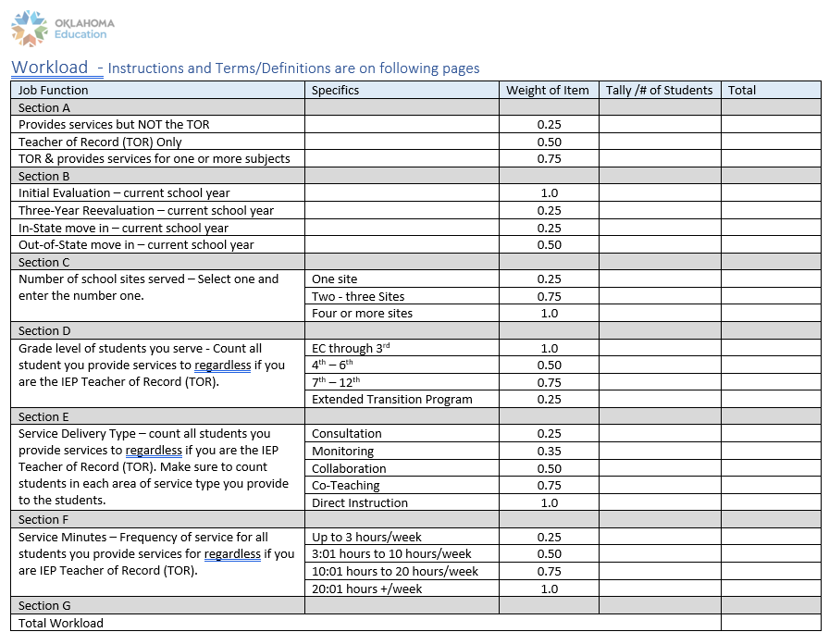
Caseload vs Workload

Slide 45
New Directors
Contact Megan.Salisbury@sde.ok.gov to:
Notify our office that you are a new director
Gain EdPlan access as an administrator
Be added to the special education Listserv

