Slide 1
Director’s Update
OKMTSS and Micro Crediential

Slide 2
Terms to Know
PCG, Public Consulting Group, is the company behind EDPlan.
EDPlan is our statewide system that houses many platforms including;
EasyIEP (Special Education paperwork)
Behavioral threat assessment
Pepper training modules, and
Soon to be much more!
Special education is often synonymous with EDPlan because of its robust usage for IEPs but EDPlan houses much more.

Slide 3
More Terms to Know
OKMTSS, is Oklahoma’s Multi-Tiered System of Supports Framework, that comprises the components that are aligned with state level activities related to MTSS.
OKMTSS on EDPlan is the data management system that is available to schools:
Intervention Management for all students (for all students, not only students on an Individualized Educational Program (IEP)).
Early Warning Dashboard for all students.
Advanced Reporting capabilities for sites, districts, and the state

Slide 4
Intervention Management System
Early Warning Dashboard
Advanced Reporting

Slide 5
Intervention Management System
Intervention Management System trainings have been ongoing since February.
Last Spring Training, April 14th, 3pm-4pm
Repeated sessions at OKMTSS Summer Conference (June 24, 25-26)
Ongoing sessions and support for next school year

Slide 6
Early Warning Dashboard
Early Warning Dashboard populates your student data into a one-stop-shop to best support next steps for student level decisions.
The state is working to pull data from the SIS system, WAVE system, and screening vendors to support your decisions.
At risk scores will be set for the state to help your district to know your student’s proficiency rates.
Stay tuned for more training regarding how to use the tool and what to expect.

Slide 7
Early Warning Dashboard: Data
Literacy
Phonemic Awareness
Phonics
Fluency
Vocabulary
Comprehension
Spelling
Written Expression
Math
Early Numeracy
Number/Operations
Algebraic Thinking
Computational Fluency
Geometry
Measurement
Data
Behavior
Disruptive Behavior
Social Skills
Attention/Engagement
Executive Function
Self-Regulation
Compliance
Attendance

Slide 8
Early Warning Dashboard: Data Sources
Literacy
RSA screeners
Behavior
Out of school suspensions (OSS)
In school suspensions (ISS)
Office discipline referrals (ODR)
Attendance
Math
Math Screeners

Slide 9
Frequently Asked Questions:

Slide 10
What is the purpose of OKMTSS on EDPlan?
OKMTSS on EDPlan is intended to support a student level data dashboard free to schools to implement an effective decision-making process.
It is not intended to supersede the decisions that teams make specifically for student level needs.
However, it supports district and site understanding of the complexities of student outcomes and provides insight to support effective intervention and progress monitoring tools

Slide 11
Why would a district use OKMTSS on EDPlan?
Schools seeking to have a singular data dashboard for student level data tracking.
Schools seeking to track intervention management in a seamless tool.
Schools seeking to create and improve a robust MTSS system at their site/district.

Slide 12
Is it required?
At this time, April 2024, the platform is not required for use. However, there are many benefits to using this tool.
Some specific projects may be tied to the participation of using this tool. Please follow up with your project manager to be sure that you have not elected to be required to use the platform.

Slide 13
Is it only for special education students?
No, this is for all students and all student data will be indicated in the tool.

Slide 14
I can’t log on or when I log on, I do not see anything?
Users were pulled into the system August 2023. If your user permission has been changed since then that could be a reason.
The data piece is in the process of being uploaded. As we are inputting more data, we are correcting issues with data and issues with uploads. You might not see everything all at once today.

Slide 15
I made my own progress monitoring tools but I can’t seem to add them into the platform.
There will be a process to request to add evidence-based interventions and progress monitoring tools but be sure that there is adequate rationale for the justification of the tool.

Slide 16
This is great but I think I will need a lot of help getting started. What kind of help can I get?
Ongoing next year, we will host with PCG several training sessions, provide guidance documents, and ongoing support. You will never be alone in your implementation of the tool.

Slide 17
AIM: Pathways to Proficient Reading
General Track and Micro-Credential Track

Slide 18
What is AIM Pathways to Proficient Reading?
Pathways to Proficient Reading is an online professional development experience introducing the Science of Reading to educators.
Explores practical strategies to enhance instructional practices that are program and curriculum agnostic.
An engaging variety of interactive creative content, with real-life situations and downloadable resources—so much more than instructional videos.
24/7 asynchronous learning, allowing participants to advance at their own pace and convenience, without compromising instructional time.
Expert AIM facilitators support participants in live sessions focused on classroom application of course content.

Slide 19
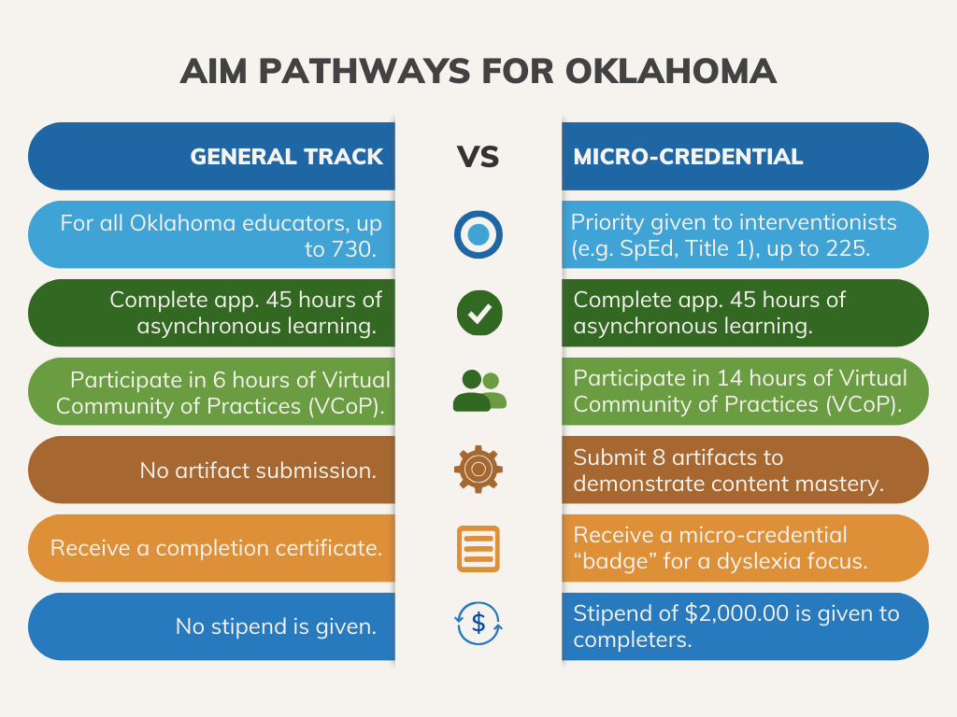
Two Options for Participation

Slide 20
Investment of Participation
There is no cost to participants.
Participants in the General Track are an investment of $836/participant.
Participants in the Micro-Credential Track are an investment of $886/participant.
Because this is a state-investment in educator learning, there are expectations for completion.

Slide 21
Virtual Communities of Practice (VCoPs)
VCoPs are opportunities to improve understanding with AIM trained facilitators.
Participants must attend 6 VCoPs.
Standard Track VCoP Cohorts are one (1) hour each.
Micro-Credential Track VCoP Cohorts are one (1) hour for sessions #1 and #4 and three (3) hours for sessions #2, #3, #5, and #6
Cohorts and VCoP session information can be found here.

Slide 22
Attendance Expectations
It is expected that participants will follow their Pacing Guide to complete asynchronous coursework prior to the VCoPs.
VCoP attendance is essential to course success and is required.

Slide 23
Timeline
Applications: Summer 2024
Kickoff for AIM: August 7th
Oklahoma State Department of Education (In-person)

Slide 24
OSDE Staff Contacts
Carolyn Thomas
Carolyn.Thomas@sde.ok.gov
405-522-0452
Elana Grissom
elana.grissom@sde.ok.gov
405-522-3246

