Slide 1
District Data Packet
Special Education Services

Slide 2
Draft Data District Profile (DDP)
The draft DDP is the first look at district’s indicator related results and the score received for each indicator and if the target was met.
A draft DDP will be emailed to SPED directors by October 31st
Some data may not be finalized at the time draft DDPs are issued. Data not available will be flagged as “TBD”
Districts have a two-week window to review the draft DDP and respond with questions or concerns
A finalized version of the DDP will be included with the November 15th data packet
Notes:
Send any questions or corrections to Travis Thompson at Travis.Thompson@sde.ok.gov or Tanis Thompson at Tanis.Thompson@sde.ok.gov
You may also reach out via phone at 405-521-3351

Slide 3
Data Sources for the DDP
Indicator No. | Indicator Description | Relevant Report
1 | SWDs exited by Graduation with a Regular Diploma | Exiting Report (EOY)
2 | SWDs exited by Drop-Out from School | Exiting Report (EOY)
3 | Participation/Performance for SWDs on Assessments | A-F Report Card
4 | Discrepancy in Suspension/Expulsion | Discipline Report (EOY)
5 | School Age Least Restrictive Environment | Child Count (2023)
6 | Early Childhood Environment | Child Count (2023)
7 | Early Childhood Outcomes | ECO Report (EOY)
8 | Parent Involvement | Parent Surveys (2023-2024)
9 | Disproportionality of Racial/Ethnic Representation | Child Count (2023)
10 | Disproportionality – Specific Disabilities | Child Count (2023)
11 | Child Find | Eligibility Timeline Report (EOY)

Slide 4
Data Sources for the DDP Continued
Indicator No. | Indicator Description | Relevant Report
12 | Early Childhood Transition | ECT Report (EOY)
13 | Secondary Transition | Secondary Transition Report (EOY)
14 | Post-School Outcomes | 2022-2023 Exiters
15 | Resolution Sessions | SPED Monitoring (2023-2024)
16 | Mediation | SPED Monitoring (2023-2024)
18 | General Supervision | Monitoring (2023-2024)
October 1 Child Count 2023 Submitted on time and accurate |  | Child Count (2023)
End of Year Data Report 2024 submitted on time and accurate |  | EOY Submission
2023-24 Assurances and LEA Agreements submitted timely and accurate |  | LEA Agreement Submission

Slide 5

Topics
District Data Profile
Determination Letter
Determination Table
Risk Table
Significant Disproportionate Notification
Notes:
Now we are going to discuss the information that will be provided in your November Data Packet.
We will cover the DDP, Determination Letter, Determination Table, Risk Table, and Signification Disproportionate Notification.

Slide 6
November Data Packet
Every November, Local Education Agencies (LEAs) receive a data packet from the Oklahoma State Department of Education Office of Special Education Services (OSDE-SES).
This data packet includes the following documents:
  District Data Profile
  District Monitoring Result (DMR) district Determination letter
    Determination Table
    Risk Table
  Significant Disproportionate Notification
Notes:
This packet includes several documents with special education compliance information and results for individual LEAs.
We provide all of a district's data/reports at once. In the past, we used to provide information throughout the school year. This was difficult for all directors to remember what information was sent out and when and to make sure it was received. We have now moved significant disproportionate data into this same packet.

Slide 7
District Data Profile

Slide 8
District Data Profile (DDP)
The DDP provides information about the district’s indicator related results with additional details (e.g., what the state target is, data source information, and additional notes).
Many LEAs find it helpful to look at the DDP and the determination table together.

Slide 9
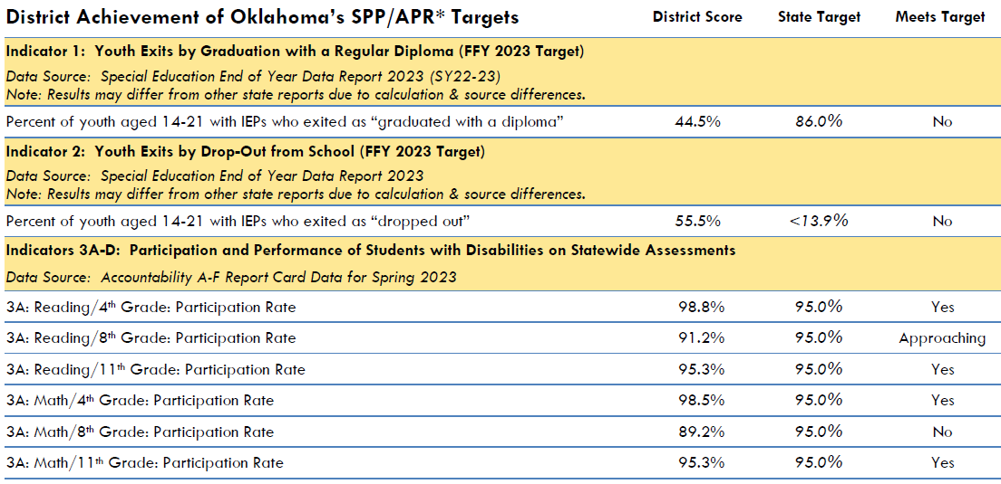
Notes:
In this example:
These are the Indicators the OSDE reports to the Office of Special Education Programs (OSEP). IDEA requires each State to gather the data from all LEAs and to provide you with a report of your data. Our office also pulls all LEAs data together to analyze the State level data to gauge where we need to focus improvements. We also submit the State data to OSEP.
Each yellow row is a different Indicator.
Within the yellow row, you will find the Data Source. This will guide you to your data should you wish to compare. Please remember that some of the Indicators take your data and then are processed through a calculation formula.

Slide 10

Notes:
At the top, you will find the District score or percentage, the State target, and the Meets Target is a quick information to inform the LEA of their progress towards each Indicator.

Slide 11
NA: Indicates that the calculation does not apply to the district.
NC: Indicates that student counts were too small to complete the calculation
NR: Indicates that the district did not report the Indicator Data.
***: Indicates that a significant discrepancy was found, and OSDE-SES will review policies, procedures, and practices before the final “meets Target” can be determined.
Notes:
Some LEAs will see NA, NC, NR, or ***. There is a key on the last page of your DDP to help you understand these.
NA – means this Indicator does not apply to the LEA. EX: This could happen if the district is a K-8 therefore we would not expect to see data for specific indicators. (e.g., 11th grade participation and assessment)
NC – means the student counts were too small to complete the calculation.
NR – means the district did not report or provide the information/data (End-Of-Year)
*** - you will only see on Indicators 4, 9, and 10. This means your data is higher than the State Target and the OSDE will require you to provide policy, procedures, and practices for review to determine if any of these are a cause. The district will be notified if the PPP are problematic. Regardless if the PPP is problematic, the district must still determine the root cause and develop a plan to improve the data.
This document is the longest document included in the November data packets.

Slide 12
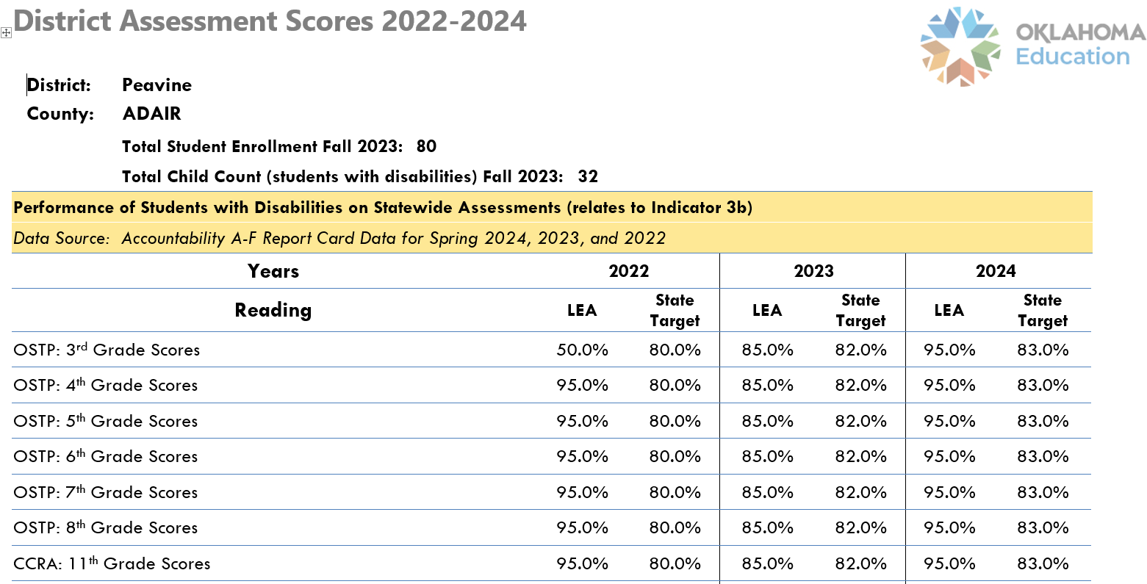
Notes:
This is a sample of a new Improved Student Outcomes document that will be included in your data packet. This document will provide three consecutive years of assessment data for students with disabilities. The document will include reading and math for all tested grades, including Alternate Assessments.
We created this as a tool to assist you in reviewing your assessment data to help drive improvement for Indicator 3.
LEAs will find indicator 3 breakdowns for each age and subject area assessed.

Slide 13
Determination Letter

Slide 14
Differentiated Monitoring Results (DMR) Letter
This letter summarizes the DMR result and compliance indicator results. The LEA’s DMR identified level of support is identified:
1. Meets Requirements
2. Needs Assistance
3. Needs Intervention
4. Needs Substantial Intervention.
Pay particularly close attention to the information in bold print, and to the mandatory webinar link if provided.

Slide 15
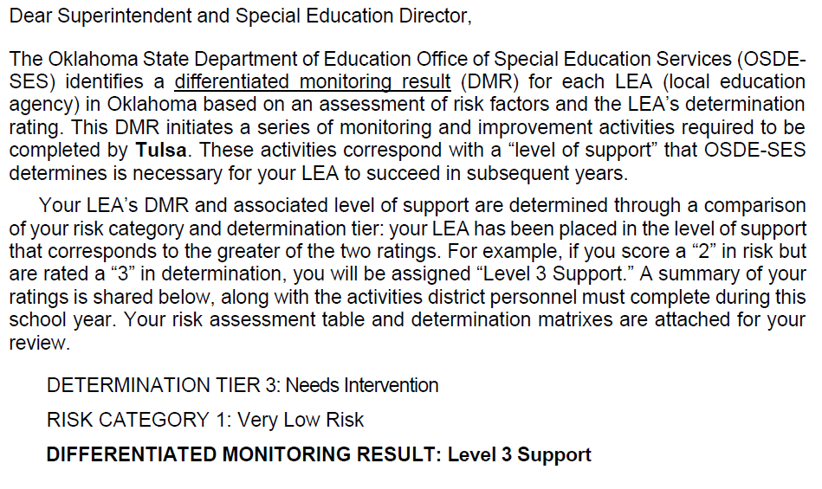

Notes:
This is a sample of the cover letter. The purpose of the cover letter is to provide you with quick information before you dig into the DDP and your determination data.
Here you see the results for Determination Table, Risk Table, and the final DMR Level assigned as a result of the Determination and Result Tables.

Slide 16
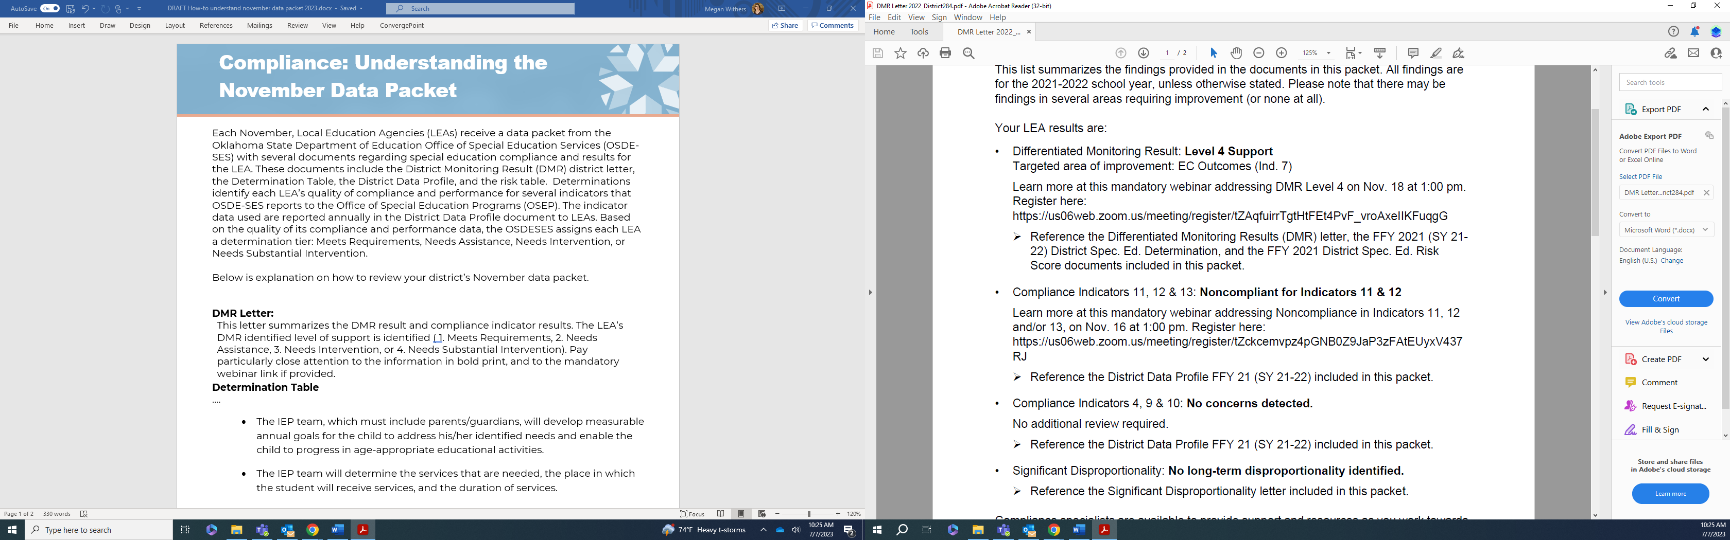
Notes:
This is the page following the cover page. Here is the breakdown of the information. Again, this is a quick reference before you look at your reports.
PLEASE note that some LEAs would look only at the DMR Level and if they fell in a level 1 or 2, they stopped. Please DO NOT stop. Even if you are a Level 1 or 2, you still have indicators that require your attention.
As you look at the letter, you’ll see the Differentiate Monitoring Result (DMR) in bold, and the targeted area of improvement listed below. This is the results indicator that is furthest from meeting the state goal. In this example, it is Indicator 7, early childhood outcomes. Beside each section, an arrow notes which document(s) in the packet provide additional information about the district’s performance.

Slide 17
Notes:
The next item below gives the registration link required for the district’s DMR level. Attendance is expected. This will provide you with the information and knowledge for your next steps and timelines.
The second arrow provides you with information on where to look at the data.

Slide 18
Notes:
Next are two sets of compliance indicators: 11,12, & 13 as well as 4,9, & 10. In this case, this district was not 100% compliant for indicators 11 & 12. This means the district will be addressing these indicators. A weblink to register for the mandator webinar is provided, as are the date and time.
Finally, no significant findings were noted for this district for indicators 4,9, & 10. If they had been, the webinar would have been listed here as well.

Slide 19
Differentiated Monitoring Results

Slide 20
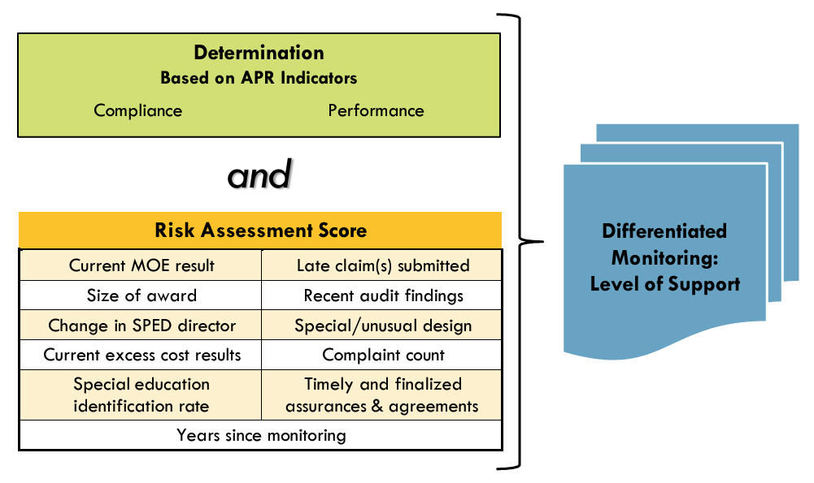


Slide 22
Determination Table
Notes:
Most of the processes we currently utilize mirror what OSEP has implemented for each state. OSEP reviews Oklahoma’s data related to compliance and also reviews student outcomes, very similar to our processes to support each LEA.

Slide 23
Determination Table
LEA’s DMR level is indicated at the top of this document as well.
This document is three tables:
  Table 1 is the LEA’s table for compliance indicators
  Table 2 is the LEA’s table documenting the results matrix
  Table 3 combines the totals for the first two tables and averages them. This last table is what determines the LEA’s DMR level.
Notes:
Next, we’ll talk about the District determination table
For Table 1 and 2: The rows are divided by indicators/indicator areas and other elements included in the determination (timely completion of monitoring requirements, PD bonus, etc), while the columns show the district’s results, if the target was met, and the score the district received.

Slide 24
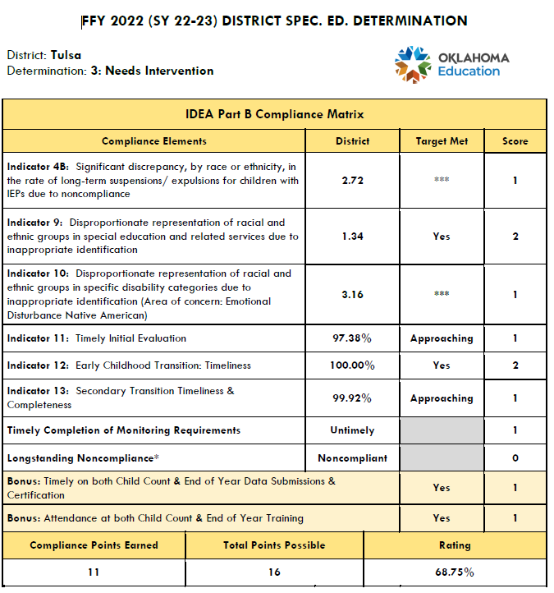


Compliance Matrix (table 1)
Notes:
This is a sample of the Determination Table
The top has the District data, if you met the State Target, and the point value added based on your data.
The Indicators in this table are considered our Compliance Indicators which include Indicators 4B, 9, 10, 11, 12, and 13.

Slide 25
Compliance Matrix (table 1)
Notes:
This is a sample of the Determination Table. In this sample, you see the *** for Indicators 4 and 10. If you see this, you will be required to submit your PPP before we can determine if you are in compliance. Please know that regardless if the OSDE-SES finds that your PPP is not the cause of the district data, you MUST still identify the root cause and develop a plan to improve this data. Indicators 4, 9, and 10, if not addressed, place the district at a higher risk of becoming significantly disproportionate.
To know where the district data falls compared to the State Target, you will need to refer back to your DDP.

Slide 26
Compliance Matrix (table 1)
Notes:
This table also documents a district’s timely completion of monitoring requirements. This means all toolkits for indicators (root cause, plans, PD, and progress reviews are timely), and if you are a DMR Level 3 or 4, this will include all activities required for the student file review, corrections for the report, and continuous compliance also known as Prong II.
There are opportunities for districts to earn bonus points. The purpose of the bonus points is to encourage all districts to participate in the data training. You must attend the entire training for both Child Count and End-Of-Year. You must also ensure your data is submitted and certified timely.
Last you will find the district total points earned, possible and the rating or percentage the district earned. This information in one part of the final DMR Level assigned a district.

Slide 27
Results Table

Slide 28
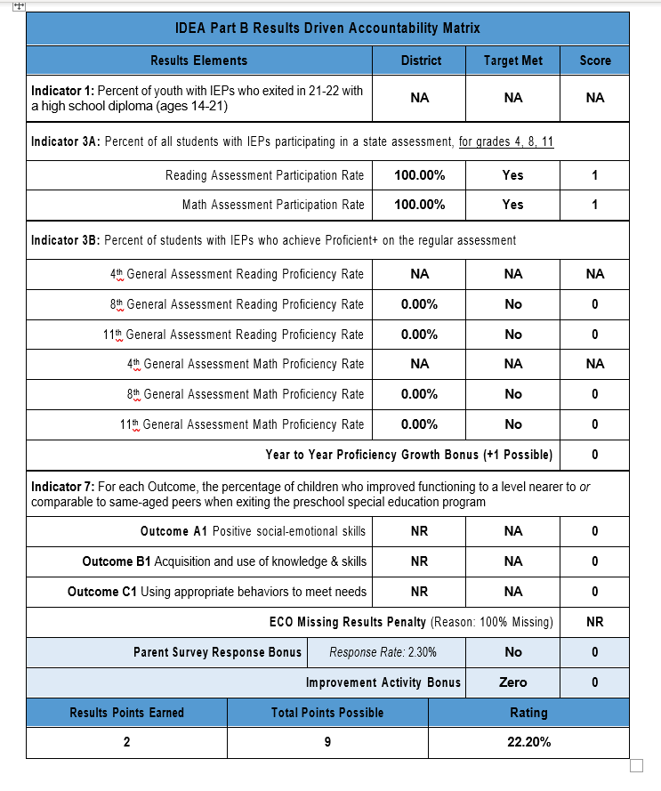

Results Data Matrix (table 2)
Notes:
The rows and columns as well as the point totals and ratings are set up the same way as the Compliance Matrix. Only the indicators have changed.
The Results table displays Indicators 1, 2, 3A, and 3B, as well as Indicator 7 Outcomes A-C.
In this sample, Indicator 1 has NA. This means this district does not have a high school program. You also see NA for Indicator 3B which means this district did not have any students with disabilities in that grade.
You also see the opportunity to earn a point for any growth. It does not have to be growth in all grades.

Slide 29
Results Data Matrix (table 2)
Notes:
In this sample, the district did not complete and save the required outcomes for all required preschoolers and received none of the points available (shown as NR).

Slide 30
Results Data Matrix (table 2)
Notes:
Last, there is once again, an opportunity to earn Bonus Points. The first opportunity is to increase the parent survey response rate by 5% or 50% response rate. On the parent survey brochure, you will find an email address and phone number. You can reach out to know how many have been submitted so far this school year then you can calculate if you have increased 5% from the previous year.
The improvement activities are the PD. If you are a DMR Level 3 or 4 you will automatically be given the two points as long as you have submitted your PD documentation for all indicators and required PD from the student file monitoring report. If you are a DMR level 1 or 2, you are required to submit the PD documentation. The information explaining the approved PD is located in the General Supervision System Manual (GSS) The process to submit your documentation is sent out on the ListServ beginning around April through to about mid-September.
Last is the district’s points earned for the Results Table, the points possible and the district’s percentage earned.

Slide 31
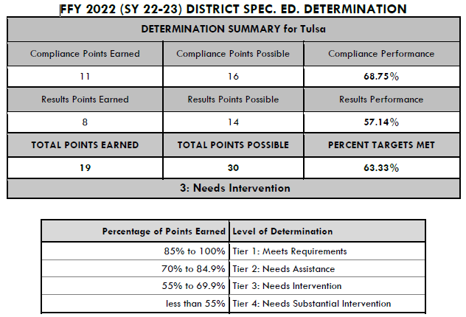

Determination Summary
(table 3)
Notes:
The summary table is on the final page of the Determination Packet.
In this example, the district has earned 11 points out of 16 available for Compliance (Indicators 4, 9, 10, 11, 12, 13)

Slide 32
Determination Summary
(table 3)
Notes:
The summary table is on the final page of the Determination Packet.
In this example, the district has earned 8 points out of 14 available for Results (Indicators 1, 3, and 7)

Slide 33
Determination Summary
(table 3)
Notes:
The summary table is on the final page of the Determination Packet.
In this example, the district has earned a total of 19 out of the 30 points available with a total percentage of 63.33 earned.
The table below will provide the DMR Leve assigned based on the total percentage. In this sample, this district is a DMR Level 3 Needs Intervention.

Slide 34
Risk Table

Slide 35
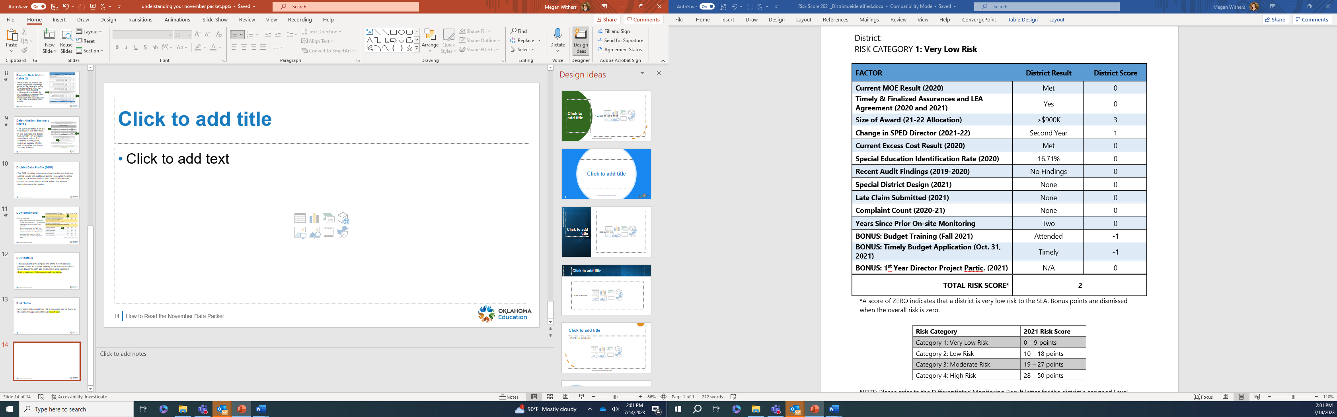
Risk Table
Notes:
Risk is assessed across numerous factors, and district result and score listed.
In this instance, lower numbers = less risk, and negative numbers subtract from the total.
This district’s score of 2 places them in the Category 1 Very Low risk.

Slide 37
Significant Disproportionate

Slide 38
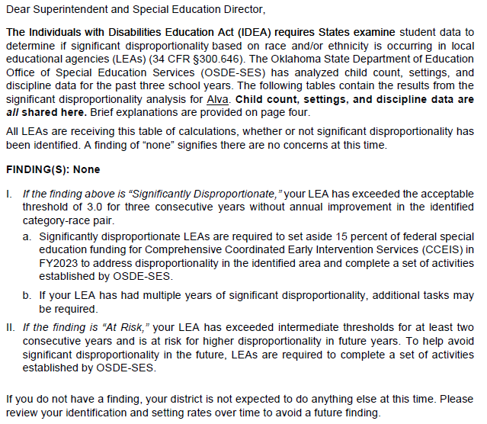

Notes:
This is the cover letter you will receive for Significantly Disproportionate.
You will first want to look at the Findings. This is a summary of all the pages of data.

Slide 39
Notes:
Below the Findings, are the explanations for a district if there were findings of significant disproportionate or At Risk.
Oklahoma has At Risk. Our goal is to help the district reduce the chance of becoming Significantly disproportionate.
For districts that are significantly disproportionate, they have to complete a tool to help identify the cause, develop a plan to improve, and identify the budget to support the plan. The plan has to either expand on an existing program or a new program.

Slide 40
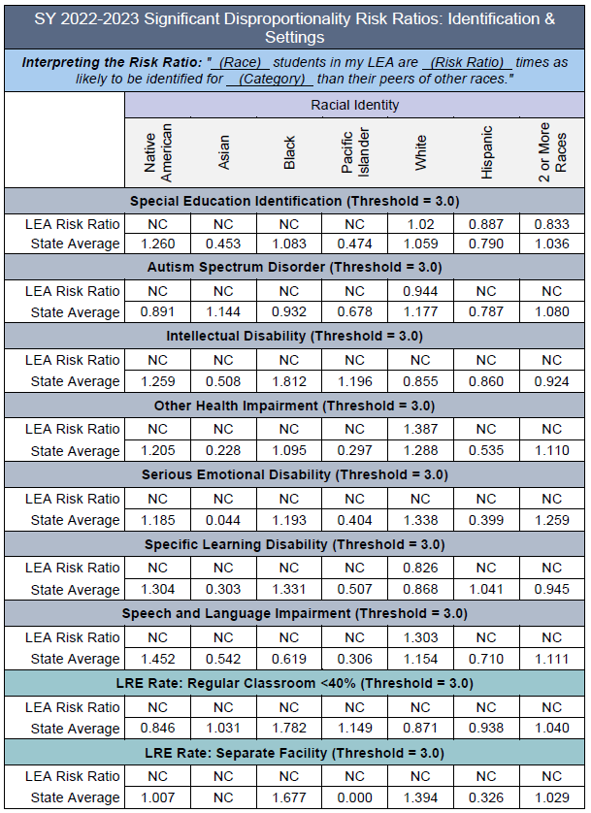
Notes:
Here you will find the calculation for each of the areas below.

Slide 41
Notes:
Here are the ethnic groups each area was calculated.

Slide 42
Notes:
Each blue line is a different area. (Total special ed identification, Autism, ID, OHI, SLD, SLI, then LRE in the general education setting and separate facility).
Below each you will see the LEA Risk Ration and below that is the State Average. This will enable you to see for each ethnic group and disability category and LRE where your district is compared to the State Average.
The NC means that the district did not have the group minimum cell or n-size to calculate a group risk.

Slide 43
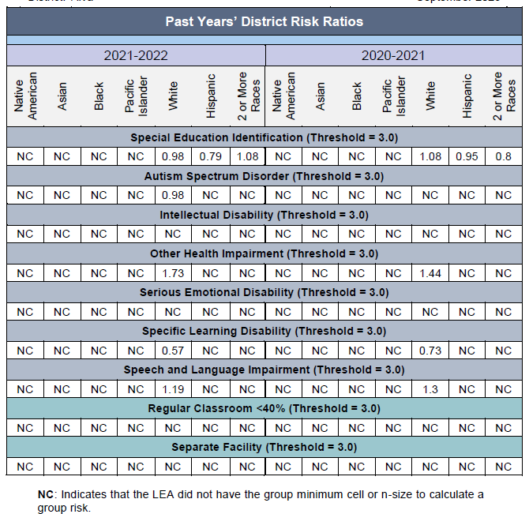
Notes:
This page shows the trend data for two consecutive years. You will find the school years, the ethnic groups again, and below are the same areas but now you only see the district data for the two years.
Remember, the NC means that the district did not have the group minimum cell or n-size to calculate a group risk.

Slide 44
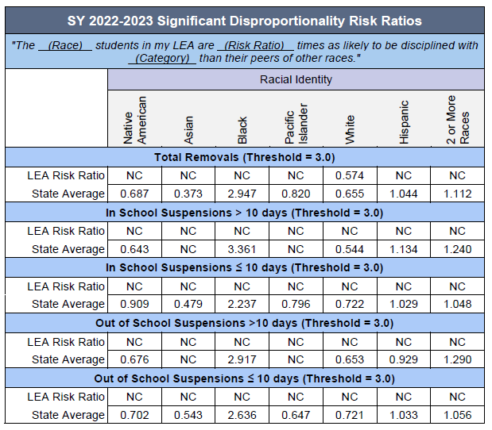
Notes:
This is the next page in the data packet for significantly disproportionate. This page shows the same information as the other page. It shows the calculation formula and the ethnic groups, however, this data relates to the district's removals/discipline.
Again, it shows the specific areas in blue and below is the LEA Risk Ratio and then the State Average.

Slide 45
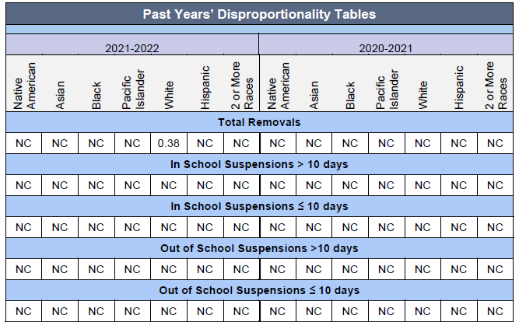
Notes:
This page displays the past year’s data which allows you to monitor your progress from one year to the next. Again, this is related to the discipline data.

Slide 46
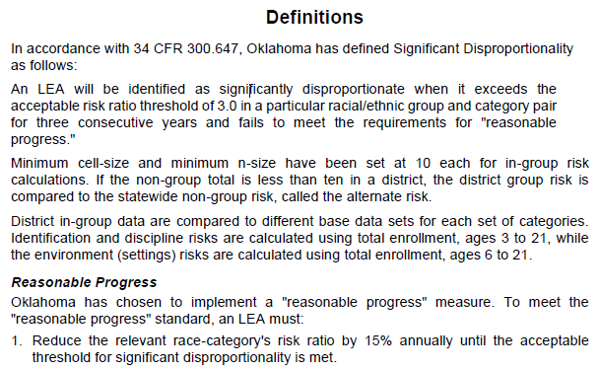
Notes:
The last part of the significantly disproportionate data is the definitions. This will help guide you in managing your data and improvement.
This paragraph provides the information that will result in significant disproportionate identification. For a district to reach this level, the data in a single area and ethnic group (the same area and ethnic group for three consecutive years) must be at or exceeding 3.0
The next paragraph explains how the calculations are made if a district’s cell or n-size are below the threshold. For small districts with a cell or n-size below 10, the group risk is compared to the Statewide non-group risk.

Slide 47
Notes:
Last is reasonable progress. Our goal is to provide credit for districts have are working on improvement and making gains where they are not yet at or below the State Average. Here we are looking for a least a 15 % increase in their data.

Slide 48
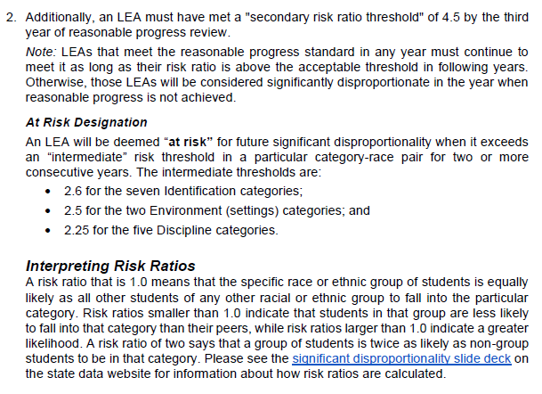
Notes:
On this page of the packet, you will find information related to the At Risk for Significant Disproportionality. It breaks down the threshold for the seven identification categories, the two environments, and the five discipline categories.
At Risk is applied if a district is at the At Risk threshold for two consecutive years.

Slide 49
Next Steps

Slide 50
Next steps
Who should be included in reviewing data and developing plans for improvement?
  Multiple people in the district (superintendent, special education director and special education staff, and others, as appropriate in your district).
If the LEA has been found noncompliant for any indicator(s), a plan for improvement is required
DMR 3, or 4, additional steps are required to be completed by the district.
Notes:
After reviewing data packet, please reach out to your monitoring coordinator with any questions.

Slide 51
Dates to Remember
November 15th – District Data Packets
November 19th (9 am to 11 am) – Required Training for DMR Level 1 & 2
November 19th (1 pm to 3 pm) – Required Training for DMR Level 3 & 4
Notes:
Remember, on November 15th all districts will be emailed the data packets that will include the DDP, Determinations, and significant Disproportionate data. These will be emailed to the Superintendent and Special Education Director. IF you are a new director or if you have a new superintendent, please reach out to our office and provide the correct email address.
As you can see, every district will participate in one of the two trainings scheduled for November 19th. If your data places you as DMR Level 1 or 2 your will need to participate in the training in the morning. If your data places you as a DMR Level 3 or 4 you will need to participate in the training in the afternoon.

Slide 52
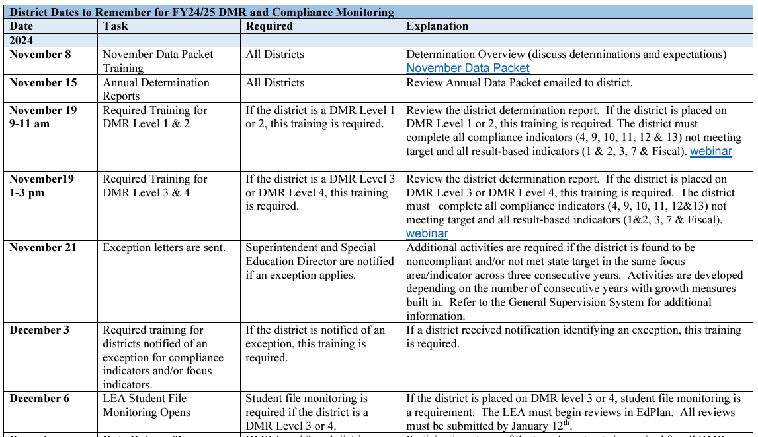
Dates to Remember
Notes:
All of the dates you will need to know are provided on a “Dates to Remember” tool. The heading is linked to this document. It is also located on our website under the compliance tab, then DMR tab. Everyone should locate and keep this document as the Compliance Team has scheduled the entire year so you know now all of the due dates and expectations.
Each district has an assigned specialist that will reach out to you via email shortly after the November 15th Data Packet has been sent. Their goal is to introduce themselves to you and provide you specific information, required trainings, and the dates to remember document specific to your district.

Slide 53
Other Information

Slide 54
Professional Development Funds
Project 613
  Specific list of PD activities for reimbursement
  The Approved PD list is under the PD tab on our website
Project 615
  PD reimbursement opportunities to address unique needs related to students with disabilities.
  MUST Budget no later than December 31st
Notes:
Here are two opportunities for PD funds to support your district initiatives.
613 – the PD activities must be on the approved list to be reimbursed. OSDE-SES has allocated a limited amount of funds to this PD activity.
615 – This is provided for your PD needs. This project is not limited except there needs to be a connection to supporting students with disabilities. If you do not budget the funds, even if it is a placeholder, we will remove the funds after December 31st.

Slide 55

General Supervision System Manual
More information about how risk is assessed can be found in the General Supervision System at https://sde.ok.gov/special-education
Notes:
Here is our current General Supervision System Manual. This manual will explain in more detail Oklahoma’s Differentiated Monitoring Process. This manual is located on the Special Education Homepage along with the Policy & Procedures Manual and other Manuals. We have placed all manuals together on the home page for quick reference.

Slide 56
Other Resources
Special Education Data Reporting Guidance for End-of-Year
Child Count Training
Significantly Disproportionate
Compliance Webpage

Slide 57
Data Team
Travis Thompson
Project Manager, Data Travis.Tompson@sde.ok.gov (405)522-5203
Tanis Thompson
Specialist, Data Tanis.Thompson@sde.ok.gov (405)521-4871

Slide 58
Compliance Team
Kristen Coleman
Program Manager, Differentiated Monitoring
Kristen.Coleman@sde.ok.gov
(405) 522-1463
Felica Denton
Fiscal Monitoring Coordinator Felica.Denton@sde.ok.gov (405)522-9562
Megan Withers
Early Childhood Project Manager Megan.Withers@sde.ok.gov (405)522-5168
Notes:
This is your compliance team. Remember you will receive an email after the data packet is sent. Please pay attention to their email. They are charged with ensuring you meet all timelines. Please know, the most important, is communication with your assigned specialist. We all have unexpected events that cause us stress. When these events happen, COMMUNICATE. They will work with you.

