Slide 2
Financial Management of Special Education Programs Federal IDEA Part B Funds
Special Education Services

Slide 3
Federal IDEA Part B Funds
IDEA Part B funds are Federal funds the Local Education Agency (LEA) receives to help support the special education program and implement IDEA.

Slide 4
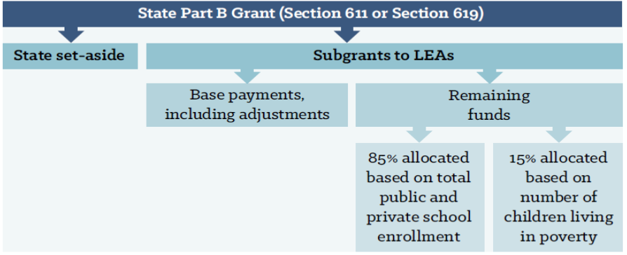
Federal IDEA Part B Funds

Slide 5
Allowable Use of Federal Funds
IDEA Part B Federal Funds may be used for:
Special Education & Related Services
Appropriate Technology for Special Education
Coordinated Early Intervening Services

Slide 6
Use of IDEA Part B Funds
Funds must be used to:
Pay the excess costs of special education and related services.
Supplement State and Local funds.
Funds must NOT be used to:
Supplant or replace State and Local funds.

Slide 7
Use of IDEA Part B Funds
IDEA Part B Federal funds must be budgeted in the Grants Management System (GMS).
All expenditures must be submitted through the GMS.
Expenditures must be necessary and reasonable.

Slide 8
Excess Cost/Maintenance of Effort

Slide 9
Excess Cost / Maintenance of Effort
IDEA contains two separate requirements for LEAs to ensure sufficient funding for special education programs:
Maintenance of Effort
Excess Cost
While these requirements have some similarities, there are separate requirements requiring separate calculations.

Slide 10
Excess Cost

Slide 11
Excess Cost
Excess costs are costs that are over and above what the LEA spends on average for students enrolled at the elementary or secondary level.
Every student enrolled in a public school receives educational support, including students with disabilities. Because a student with a disability is a student entitled to an education first, the concept of excess costs establishes that:
Students with disabilities receive educational support like non-disabled students, and
IDEA Part B funds only pay for the excess cost of educating students with disabilities.

Slide 12
Excess Cost
Districts can view their Excess Cost online through the Oklahoma Cost Accounting System.
If an LEA has not met excess cost in both elementary and secondary, the district will be issued a citation, and a reduction in State Aid funding will be imposed.

Slide 13
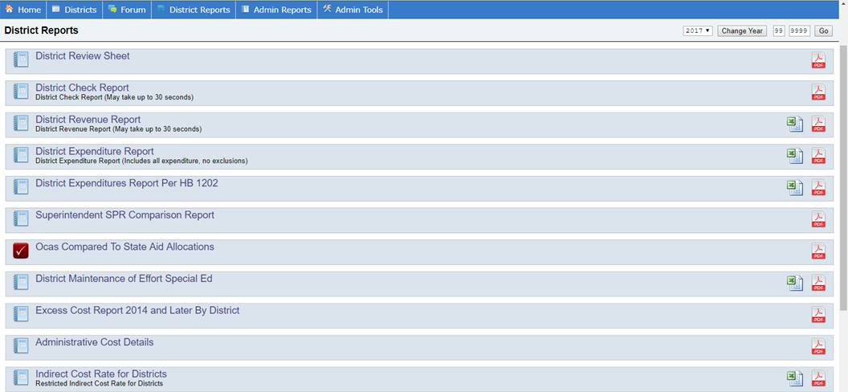

Slide 14
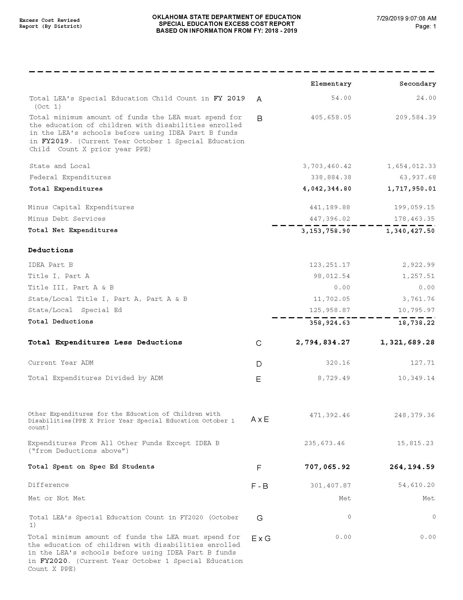

Slide 15
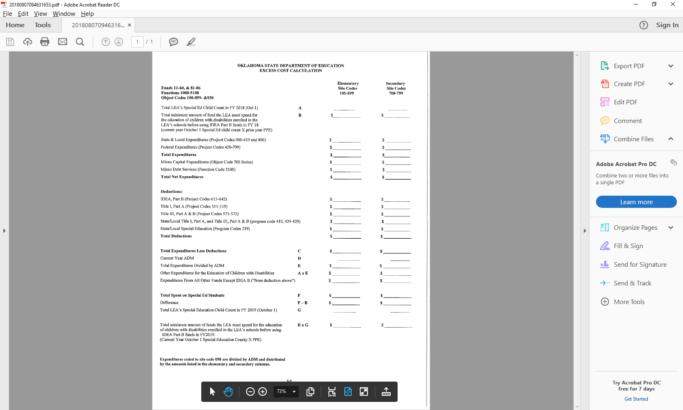

Slide 16
Maintenance of Effort

Slide 17
Maintenance of Effort
Must maintain 100% the level of expenditures from State and/or Local funds spent on special education and related services.

Slide 18
Maintenance of Effort
An LEA may use one of four methods to demonstrate they have met MOE requirements under IDEA.
local total expenditures
local per capita
state and local total expenditures
state and local per capita

Slide 19
Maintenance of Effort
Oklahoma Cost Accounting System (OCAS) calculates using just 2 ways:
The total expenditures of the LEA for special education and related services (state and local).
Per capita amount spent on children receiving special education services (state and local).
If both, the total amount of expenditures and the per capita amount decreased in the second (i.e., subsequent) year, the LEA has failed to meet the MOE requirement.

Slide 20
Maintenance of Effort
Districts are required to input MOE data information when completing their new fiscal year LEA Agreement.
All data information must match data submitted through Oklahoma Cost Accounting Services (OCAS)
IDEA Part B budgets cannot be approved unless the MOE tab has been completed and the district has demonstrated compliance.

Slide 21
Miscoding is not an EXCEPTION

Slide 22
Maintenance of Effort
If an LEA receives notification that the MOE requirement has not been met, an opportunity will be provided for the LEA to submit documentation of allowable exceptions.

Slide 23
Maintenance of Effort
Exceptions:
Voluntary departure, by retirement or otherwise, or departure for just cause, of special education or related services personnel.
A decrease in the enrollment of children with disabilities.

Slide 24
Maintenance of Effort
Exceptions:
The termination of the obligation of the agency, consistent with this part, to provide a program of special education to a particular child with a disability that is an exceptionally costly program, as determined by the SEA, because the child
has left the jurisdiction of the agency;
has reached the age at which the obligation of the agency to provide Free Appropriate Public Education to the child has terminated; or
no longer need the program of special education.

Slide 25
Maintenance of Effort
Exceptions:
The termination of costly expenditures for long-term purchases, such as the acquisition of equipment or the construction of school facilities; or
The assumption of cost by the high cost fund operated by the SEA.

Slide 26
Maintenance of Effort
Special Education Services can assist your district
OSDE-SES will receive a list of LEAs failing to meet MOE.
Working with LEAs, SES will contact and request specific documentation.

Slide 27
Maintenance of Effort
LEAs failing to then meet MOE, will be issued a citation, and a reduction to their State Aid funding.
Everyone loses when MOE is not met, funds leave your district and our State.
Paying the penalty does not reduce your base. You must maintain the MOE base set prior to the penalty.

Slide 28
Coordinated Early Intervening Services (CEIS)

Slide 29
Coordinated Early Intervening Services (CEIS)
CEIS are services provided to children who are not currently identified as needing special education or related services, but who need additional academic or behavioral support to succeed in general education.
LEAs may now voluntarily reserve up to 15 percent of their Part B funds for CEIS.
Starting in 2018-2019, LEAs identified as having significant disproportionality will be required to set aside 15 percent of their Part B funds to provide comprehensive CEIS to children in the LEA, particularly, but not exclusively, to children in those groups that were significantly over identified.

Slide 30
Coordinated Early Intervening Services
CEIS is important for identifying and addressing learning difficulties early.
Research indicates that the earlier the intervention, the more effective the support and the less severe the learning difficulties will be.
Delays in providing support may increase the intensity, and the cost of the services needed to address learning difficulties.

Slide 31
Coordinated Early Intervening Services
CEIS activities that may be funded under Part B include:
Provide professional development for teachers and other school staff to enable such personnel to deliver scientifically based academic and behavioral interventions based literacy instruction and where appropriate, instruction on the use of adaptive and instructional software and;
Provide educational and behavioral evaluations, services, and supports, including based literacy instruction.

Slide 32
Comprehensive Coordinated Early Intervening Services (CCEIS): Significant Disproportionality

Slide 33
CCEIS / Significant Disproportionality
Revised regulations on significant disproportionality (34 CFR §300.636) have been finalized by the Office of Special Education Programs (OSEP). These regulations enforce the use of IDEA funds to be used on mandatory Comprehensive Coordinated Early Intervening Services (CCEIS).

Slide 34
CCEIS / Significant Disproportionality
LEAs found to be significantly disproportionate are required to set aside 15 percent of their total allocation. This will include any re-allocations.
The LEA must serve children age 3 through grade 12 who are and are not currently identified as needing special education or related services but are in need of additional academic and behavioral support.
Funds must be used to identify and address the factors which contributed to the significant disproportionality for the identified category.

Slide 35
CCEIS / Significant Disproportionality
LEAs may use CCEIS funds for training, professional development, behavioral evaluations, and supports such as:
-Functional Behavioral Assessments
-Behavioral Intervention plans
But only to the extent to address the factors identified as contributing to the significant disproportionality identified by the State.

Slide 36
CCEIS / Significant Disproportionality
LEAs required to set aside funds for CCEIS cannot reduce the districts MOE.
Funds must supplement not supplant.
Funds cannot be used to provide services already required by law.
Funds cannot be used to provide services that were paid for with other funds in a previous year.

Slide 37
CCEIS / Significant Disproportionality
Example of an LEA with Significant Disproportionality regarding MOE:
An LEA has a 621 allocation of $2,166,666
The next year it received a $1,000,000 increase and it’s allocation is now $3,166,666
Amount available for up to 50 percent reduction = $500,000
Amount available for up to 15 percent for CEIS = $475,000

Slide 38
CCEIS / Significant Disproportionality
If the LEA has been identified as having significant disproportionality:
Amount available for 50 percent reduction = 0
Reason: any amount reserved for CCEIS must reflect subtraction of any amount by which MOE will be reduced and since the LEA is required to use the full 15 percent, it cannot reduce its MOE by any amount. The amount the LEA must reserve for CCEIS = $475,000

Slide 39
Time and Effort

Slide 40
Time and Effort
In general, salaries and wages of employees who work on federally funded programs may be paid with federal funds as long as they are working on the grant objectives and appropriate time and effort records are maintained.

Slide 41
Time and Effort
All employees must maintain documentation showing that their salaries are allocable to a federal program.
That documentation must be based on records that accurately reflect the work performed.

Slide 42
Time and Effort
Federal regulation requires that any salaries and benefits charged to a federal award(s) must be documented in writing.
Reflect actual time spent on activities to which federal program(s) are being charged.
It is recommended documentation is to be signed by the employee and the employee’s supervisor.

Slide 43
Time and Effort
Time and effort reports should be prepared for any staff with salary and benefits that are charged:
Directly to a federal award.
Directly to multiple federal awards.
Directly to any combination of federal awards and other State or Local fund sources.
Keep time and effort reports on file at the district.

Slide 44
Time and Effort
Single Cost Objective
A single work activity that may be funded by one or more fund sources.
Semi-annual time and effort documentation is made in arrears.

Slide 45
Time and Effort
Remember:
A time and effort report of an actual employee must be uploaded during the district’s closeout.

Slide 46
Time and Effort

Slide 47
Time and Effort
Multiple Cost Objectives
For employees who have different jobs or are paid with different funds;
Must reflect an after-the-fact distribution of the actual activity of each employee;
Must account for the total activity for which each employee is compensated;
Must be prepared at least monthly and coincide with one or more pay periods; and
Must be signed by the employee and supervisor.

Slide 48
Time and Effort

Slide 49
COOP / Interlocal co-op

Slide 50
COOP / Interlocal co-op
LEAs that select to pool their funds must sign a letter of intent to participate in a special education cooperative arrangement (this is an arrangement that exists under federal law) or an interlocal cooperative (this is a cooperative entity that is created through a specific process under Oklahoma statute 70 O.S. 5-117b. also known as an “interlocal co-op”). Participating cooperative LEAs other than interlocal co-ops should elect one LEA to act as the fiscal agent for funds.

Slide 51
COOP / Interlocal co-op
LEAs participating in a cooperative arrangement or an interlocal co-op must receive goods or services from the cooperative entity. The special education cooperative cannot act as a flow-through agent, but must provide a program consisting of the provision of goods and/or services (70 O.S. § 5-117).

Slide 52
COOP / Interlocal co-op
An LEA Agreement for Special Education in Oklahoma and Assurances must be submitted for each LEA participating in the cooperative or interlocal co-op. In addition, each participating LEA is still responsible for the compliance with IDEA Part B of the cooperative or interlocal as it relates to each child of the LEA served by the cooperative or interlocal.

Slide 53
COOP / Interlocal co-op
Each LEA participating in a cooperative arrangement for the provision of special education services retains the responsibility to ensure that each of its students receives a Free Appropriate Public Education (FAPE), so LEAs participating in such arrangements should monitor service provision as necessary to ensure each student is receiving a FAPE.

Slide 54
Assurances, LEA Agreement, Closeout, and Consolidated Application

Slide 55
Assurances and LEA Agreement
Superintendents must complete Assurances and LEA Agreements each year prior to the start of the new fiscal year.
Assurances and LEA Agreements are required by law to be completed prior to July 1st.
Assurances and LEA Agreements must be completed before the IDEA Consolidated Application will be available.

Slide 56
Assurances and LEA Agreement
You will be required to upload specific documentation on your LEA Agreement:
District policies and procedures regarding Child Find or the identification process.
Policies/Procedures on Discipline/Expulsion.

Slide 57
Year End Closeout
Districts must perform a closeout at the end of the fiscal year.
Special Education Services (SES) requires closeout completion by September 1.
The closeout informs the SDE that the district has concluded expenditure reporting for the year.
Closeouts also move all unspent funds to the next fiscal year for budgeting.
The closeout process is a simple procedure that closely resembles the creation of an expenditure report.

Slide 58
Year End Closeout
When completing the closeout report, a district must upload a Time and Effort Report and a Vendor Performance Review, if applicable.
A Time and Effort report is required if IDEA Part B funds are used to pay any salary.
A Vendor Performance Review is required for each vendor if IDEA Part B funds are used to pay any Contract Service.

Slide 59
IDEA Consolidated Application
Once the Assurances and LEA Agreement are completed, approved, and the Special Education allocation has been awarded, a district will be able to complete the Consolidated Application.

Slide 60
Submitting Expenditure Reports for Reimbursement of Funds

Slide 61
Expenditure Reporting
You must budget your funds and receive approval from the Oklahoma State Department of Education-Special Education Services (OSDE-SES) before you can apply for reimbursement.
All special education expenditures must be necessary and reasonable.

Slide 62
Expenditure Reporting
Reimbursement claims are submitted online through the Single Sign On, Grants Management and Expenditure Reporting.
NO claim will be paid without a valid DUNs number and current expiration date.
Attach supporting documents which must include the Summary Expenditure Report, the Detailed Expenditure Report and all required invoices and receipts.

Slide 63
Expenditure Reporting
Supporting documentation includes:
Requisition
Receipt(s)
Invoice Payment
Without supporting documentation, LEAs cannot prove compliance with IDEA Part B federal grant requirements.

Slide 64
Expenditure Reporting
Summary and Detail Expenditure Report must be signed by the Superintendent or a representative authorized by the local board of education.
Do NOT use special characters in your PDF title. (#, @, &, etc.)

Slide 65
Expenditure Reporting
If an authorized representative has signed the report, the district must have completed the Board Authorization tab located in their Federal Programs Consolidated Application.
The district must also upload the authorization on school letterhead indicating the appointment.

Slide 66
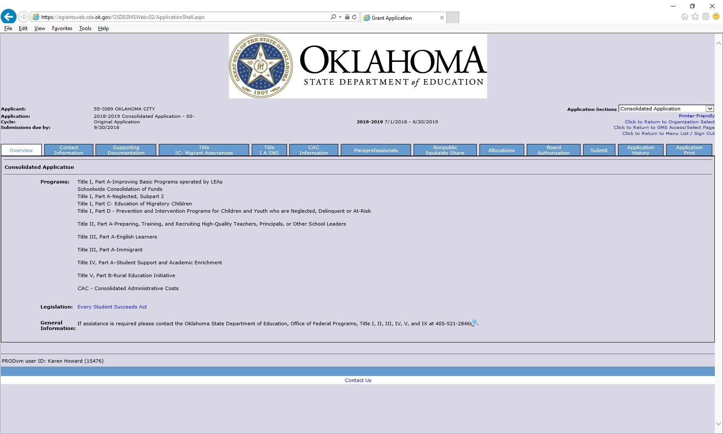

Slide 67
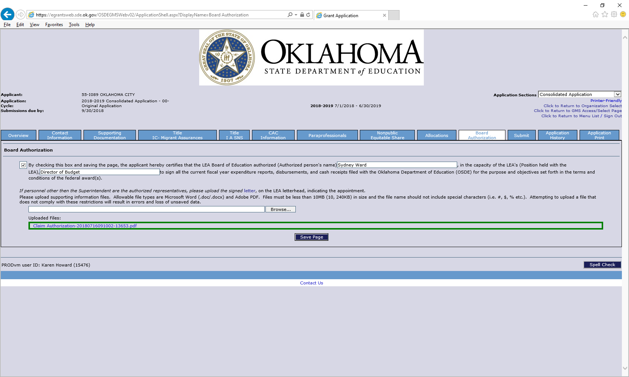

Slide 68
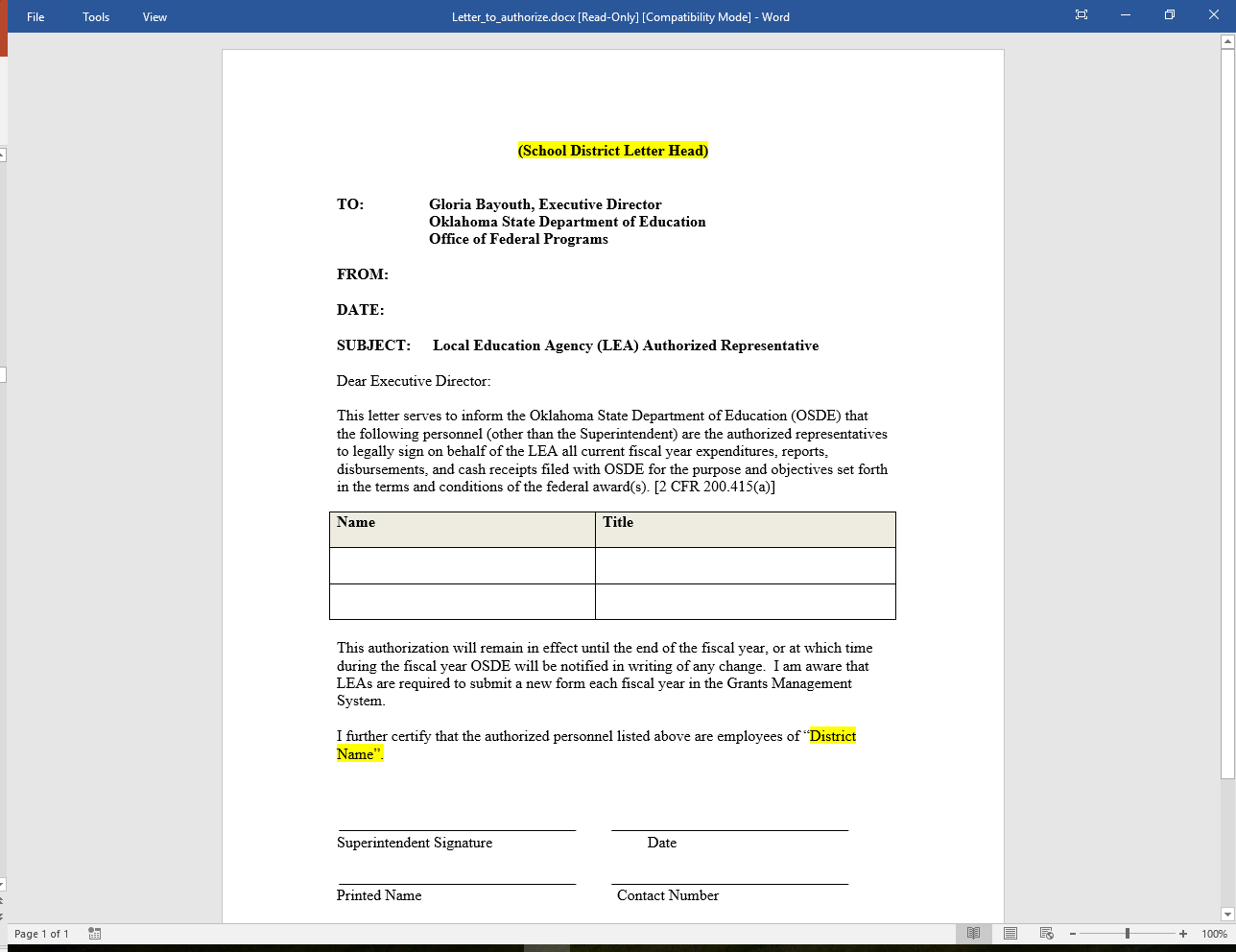

Slide 69
Expenditure Reporting
As stated in the Joint Federal Programs Claims Procedures, all districts should file at least one claim by the end of November. Districts that have not filed a claim by November will be contacted.

Slide 70
Proper Use of Codes
For a list of proper use of codes in Special Education please see the State Department of Education website, listed under Oklahoma Cost Accounting.
http://sde.ok.gov

Slide 71
Project 613
Special Education Professional Development Grant

Slide 72
Project 613
The intent of this grant is to encourage district involvement in Professional Development opportunities.

Slide 73
Project 613
The application is located on the Grant Management System. This project is to reimburse districts the costs of travel, substitute teachers, registration, and hotel for eligible events/training.
Funds for this project are limited and based on availability.
Required information:
Names and title of staff members attending the event/training
Event/training title and date
Estimated cost breakdown

Slide 74
Project 613
Reimbursement will include:
Mileage
Substitute cost
Registration
Hotel

Slide 75
Project 613
Reimbursement will not include:
Individual Reimbursement
Per Diem / Food

Slide 76
Project 615
Special Education Professional Development/District

Slide 77
Project 615
The purpose of this project is to provide additional funds to districts, based on their most recent child count, and are used only for professional development activities that increase the ability of teachers to ensure positive outcomes for students with disabilities.

Slide 78
Project 615
Examples of usage are:
Inviting Speakers
Purchasing Books for Staff
Attending Conferences
Conducting Trainings
Attending Webinars

Slide 79
Project 615
The application will be completed online through the Grant Management System.
The application will ask for an explanation of the activity and must be completed for the entire allocation funds.
Districts not completing a budget by December 1 will forfeit their allocation and funds will be returned back to Special Education Services.

Slide 80
Project 616
Certification Examination Reimbursement

Slide 81
Project 616
The purpose of this project is to reimburse districts for assisting teachers that need to take and pass additional subject area certification examinations.
It is limited to one exam per individual and districts must provide justification for the necessity of each individual to take and pass the subject area examination.

Slide 82
Project 616
Funds for this project are limited and based on availability.
The district will be required to upload a copy of the Board Policy.

Slide 83
High Need Students

Slide 84
High Need Students
Tier 1
Out-of-State residential placements (prior OSDE approval required).
Must be written in the students IEP.
Must have acceptance letter from the Out-of-State resident facility.

Slide 85
High Need Students
Tier 2
Applicants must meet the following qualifications:
At least three times the average per pupil expenditure in Oklahoma.
At least 10% of the LEA’s previous year’s Flow-Through allocation (for all high need children).
Funds will be awarded based on availability.

Slide 86
High Need Students
Applications for Tier 1 and Tier 2 programs will be available on the SDE Special Education web site.
Applications for Tier 1 and Tier 2 programs will be due on the Fourth Friday of July.

Slide 87
Lindsey Nicole Henry Scholarship for Children with Disabilities

Slide 88
Lindsey Nicole Henry Scholarship for Students with Disabilities
The Lindsey Nicole Henry (LNH) Scholarship Act (70 O.S. § 13-101.2) is a law which became effective August 26, 2011.
The Act created a scholarship for use at a private school accredited by the State Board of Education or another accrediting association approved by the State Board of Education for students with IEPs.

Slide 89
Lindsey Nicole Henry Scholarship for Students with Disabilities
The parent or legal guardian of a public school student with a disability may exercise their parental option and request to the OSDE-SES to have an LNH scholarship awarded for the child to enroll in and attend a private school if specific conditions are met.
The parent must revocate their right for FAPE.

Slide 90
Lindsey Nicole Henry Scholarship for Students with Disabilities
Students who were enrolled in a public school the preceding year with an IEP and were counted at the public school for funding purposes are eligible.

Slide 91
Lindsey Nicole Henry Scholarship for Students with Disabilities
Parents must complete the application process with the OSDE-SES by December 1 of the school year considered.
Public Schools must notify parents annually of this option.
The public school must continue with child find obligation.

Slide 92
Lindsey Nicole Henry Scholarship for Students with Disabilities
LNHS began in 2010-2011
The student enrollment count was 53
The current student enrollment count is 827

Slide 93
Finance Resources

Slide 94
Finance Resources
http://ok.gov/sde/finance
Due date for financial activities
Maintenance of Effort
Time and Effort
High Need Student Application
COOP/Interlocal Coop
Lindsey Nicole Henry Scholarship

Slide 95
Finance Due Dates
GMS opens first Friday in May
Due by the last Friday in June
Assurances
LEA Agreement
Due by the fourth Friday of July
Tier 1 Out-of-State Residential Application
Tier 2 High Needs Application

Slide 96
Finance Due Dates
June 1
Last day to file a payable claim to be guaranteed payment by June 30
June 30
No budget revisions can be made

Slide 97
Finance Due Dates
August 1
Expenditure Reports Due, (all expenditure reports submitted after August 1 are subject to the approval of the State Board of Education)
September 1
District Closeout
December 1
Submission of completed Lindsey Nicole Henry Scholarship Application

Slide 98
Finance Team
Ashlee Henson, Finance Specialist – (405) 521-4857
Carole Tomlin, Finance Specialist – (405) 521-2335
Janet Felton, Finance Specialist – (405) 522-1578
Nathan Goad, Special Project – (405) 521-4867
Stacy Eden, LNHS Specialist – (405) 521-4876
Karen Howard, Finance Director – (405) 521-3587

