Slide 1
Financial Management of Special Education Programs Federal IDEA Part B Funds
Special Education Services

Slide 2
Federal IDEA Part B Funds
IDEA Part B funds are Federal funds the Local Education Agency (LEA) receives to help support the special education program and implement IDEA.
All federal funds are to be used on a reimbursement basis only.

Slide 3
Allowable Use of Federal Funds
IDEA Part B Federal Funds may be used for:
Special Education & Related Services
Appropriate Technology for Special Education
Coordinated Early Intervening Services

Slide 4
Use of IDEA Part B Funds
Funds must be used to:
Pay the excess costs of special education and related services.
Supplement State and Local funds.
Funds must NOT be used to:
Supplant or replace State and Local funds.
(supplement is to provide or make a supplement to something while supplant is to take the place of; to replace, to supersede).

Slide 5
Excess Cost/Maintenance of Effort
Excess Cost / Maintenance of Effort

Slide 6
Excess Cost / Maintenance of Effort
IDEA contains two separate requirements for LEAs to ensure sufficient funding for special education programs:
Excess Cost
Maintenance of Effort (MOE)
While these requirements have some similarities, there are separate requirements requiring separate calculations.

Slide 7
Excess Cost
Excess costs are costs that are over and above what the LEA spends on average for students enrolled at the elementary and secondary level.
Every student enrolled in a public school receives educational support, including students with disabilities. Because a student with a disability is a student entitled to an education first, the concept of excess costs establishes that:
Students with disabilities receive educational support like non-disabled students, and
IDEA Part B funds only pay for the excess cost of educating students with disabilities.

Slide 8
Excess Cost
Districts can view their Excess Cost online through the Oklahoma Cost Accounting System.
If an LEA has not met excess cost in both elementary and secondary, the district will be issued a citation, and a reduction in State Aid funding will be imposed.

Slide 9
There are no exceptions for Excess Cost

Slide 10
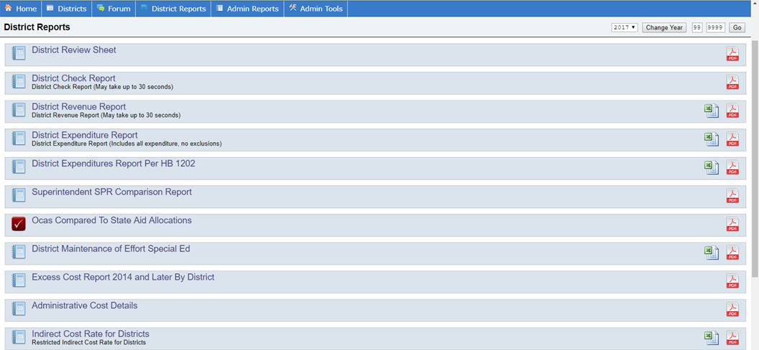

Slide 11
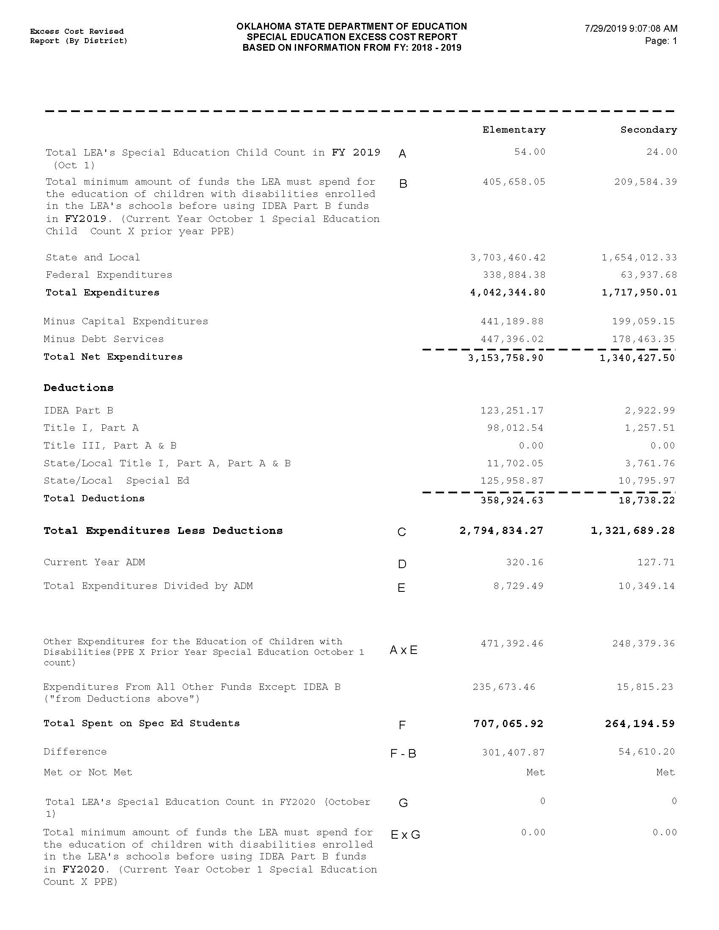

Slide 12
Maintenance of Effort
LEAs must maintain 100% level of expenditures from State and/or Local funds spent on special education and related services.

Slide 13
Maintenance of Effort
An LEA may use one of four methods to demonstrate they have met MOE requirements under IDEA.
local total expenditures
local per capita
state and local total expenditures
state and local per capita

Slide 14
Maintenance of Effort
Oklahoma Cost Accounting System (OCAS) calculates using just 2 ways:
The total expenditures of the LEA for special education and related services (state and local).
Per capita amount spent on children receiving special education services (state and local).
If both, the total amount of expenditures and the per capita amount decreased in the second (i.e., subsequent) year, the LEA has failed to meet the MOE requirement.

Slide 15
Maintenance of Effort
Districts are required to input MOE data information when completing their new fiscal year LEA Agreement.
IDEA Part B budgets cannot be approved unless the MOE tab has been completed and the district has demonstrated compliance.
All MOE data information must match data submitted through Oklahoma Cost Accounting Services (OCAS).
LEAs must update the MOE data in their LEA Agreement once their data has been certified through OCAS.

Slide 16
Maintenance of Effort
If an LEA receives notification that the MOE requirement has not been met, an opportunity will be provided for the LEA to submit documentation of allowable exceptions.

Slide 17
Maintenance of Effort
Exceptions:
Voluntary departure, by retirement or otherwise, or departure for just cause, of special education or related services personnel.
A decrease in the enrollment of children with disabilities.

Slide 18
Maintenance of Effort
Exceptions:
The termination of the obligation of the agency, consistent with this part, to provide a program of special education to a particular child with a disability that is an exceptionally costly program, as determined by the SEA, because the child
has left the jurisdiction of the agency;
has reached the age at which the obligation of the agency to provide Free Appropriate Public Education to the child has terminated; or
no longer need the program of special education.

Slide 19
Maintenance of Effort
Exceptions:
The termination of costly expenditures for long-term purchases, such as the acquisition of equipment or the construction of school facilities; or
The assumption of cost by the high cost fund operated by the SEA.

Slide 20
Miscoding is not an Exception

Slide 21
There are no exceptions under IDEA for Covid 19

Slide 22
Maintenance of Effort
Oklahoma State Department of Education-Special Education Services (OSDE-SES) can assist your district
SES will receive a list of LEAs failing to meet MOE.
Working with LEAs, SES will contact and request specific documentation.

Slide 23
Maintenance of Effort
LEAs failing to then meet MOE, will be issued a citation, and a reduction to their State Aid funding.
Everyone loses when MOE is not met, funds leave your district and our State.
Paying the penalty does not reduce your base. You must maintain the MOE base set prior to the penalty.

Slide 24
Assurances, LEA Agreement, and Consolidated Application

Slide 25
Assurances and LEA Agreement
Superintendents must complete Assurances and LEA Agreements each year prior to the start of the new fiscal year.
Assurances and LEA Agreements are required by law to be completed prior to July 1st.
Assurances and LEA Agreements must be completed before the IDEA Consolidated Application will be available.

Slide 26
Assurances and LEA Agreement
You will be required to upload specific documentation on your LEA Agreement:
District policies and procedures regarding Child Find or the identification process.
Policies/Procedures on Discipline/Expulsion.

Slide 27
IDEA Consolidated Application
Once the Assurances and LEA Agreement are completed, approved, and the Special Education allocation has been awarded, a district will be able to complete the Consolidated Application.

Slide 28
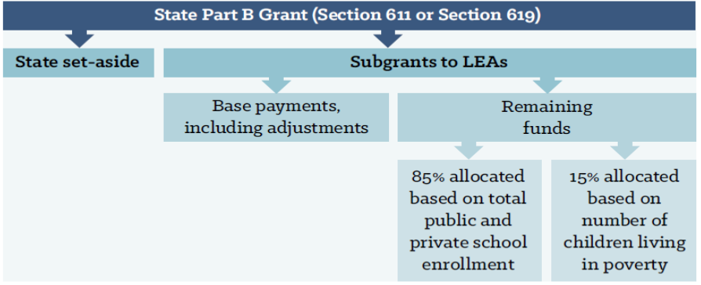
Federal IDEA Part B Funds

Slide 29
Use of IDEA Part B Funds
IDEA Part B Federal funds must be budgeted in the Grants Management System (GMS).
All expenditures must be submitted through the GMS.
Expenditures must be necessary and reasonable.

Slide 30
American Rescue Plan
The American Rescue Plan (ARP) was signed into law on March 11, 2021, offering the first COVID-19 related targeted IDEA resources to address the challenges faced in ensuring services for children with disabilities. These ARP IDEA supplemental funds are intended to support early intervention and special education services for infants, toddlers, children and youth with disabilities and their families. The guidelines and requirements for the ARP IDEA funds are subject to the same requirements under IDEA and Uniform and Grant Guidance (UGG) as all IDEA funds.

Slide 31
American Rescue Plan
LEAs will operate separate budgets for both traditional and ARP IDEA allocations. LEAs are encouraged to budget these supplemental funds for non-recurring activities.
ARP IDEA is a one-time funding opportunity that will not be available to sustain ongoing activities such as permanent employees.
All IDEA allocations must be combined when addressing Proportionate Share, CEIS/CCEIS, MOE 50% Rule, and COOP/Interlocal transfer.

Slide 32
American Rescue Plan
ARP IDEA projects will be as follows:
APR-IDEA Flow Through – Project 628
APR-IDEA Flow Through Private – Project 629
APR-IDEA PreSchool – Project 643
APR-IDEA PreSchool Private – Project 644
APR-IDEA Early Intervening (CEIS/CCEIS) – Project 624

Slide 33
Coordinated Early Intervening Services (CEIS)

Slide 34
Coordinated Early Intervening Services (CEIS)
CEIS are services provided to children who are not currently identified as needing special education or related services, but who need additional academic or behavioral support to succeed in general education.
LEAs may voluntarily reserve up to 15 percent of their IDEA funds for CEIS.
Starting in 2018-2019, LEAs identified as having significant disproportionality will be required to set aside 15 percent of their IDEA funds to provide comprehensive CEIS to children in the LEA, particularly, but not exclusively, to children in those groups that were significantly over identified.

Slide 35
Coordinated Early Intervening Services
CEIS is important for identifying and addressing learning difficulties early.
Research indicates that the earlier the intervention, the more effective the support and the less severe the learning difficulties will be.
Delays in providing support may increase the intensity, and the cost of the services needed to address learning difficulties.

Slide 36
Coordinated Early Intervening Services
CEIS activities that may be funded under IDEA include:
Provide professional development for teachers and other school staff to enable such personnel to deliver scientifically based academic and behavioral interventions based literacy instruction and where appropriate, instruction on the use of adaptive and instructional software and;
Provide educational and behavioral evaluations, services, and supports, including based literacy instruction.

Slide 37
Comprehensive Coordinated Early Intervening Services (CCEIS): Significant Disproportionality

Slide 38
CCEIS / Significant Disproportionality
Revised regulations on significant disproportionality (34 CFR §300.636) have been finalized by the Office of Special Education Programs (OSEP). These regulations enforce the use of IDEA funds to be used on mandatory Comprehensive Coordinated Early Intervening Services (CCEIS).

Slide 39
CCEIS / Significant Disproportionality
LEAs found to be significantly disproportionate are required to set aside 15 percent of their total allocations (IDEA FlowThrough, IDEA PreSchool, and IDEA ARP FlowThrough and IDEA ARP PreSchool). This would also include allocation adjustments.
The LEA must serve children age 3 through grade 12 who are and are not currently identified as needing special education or related services but are in need of additional academic and behavioral support.
Funds must be used to identify and address the factors which contributed to the significant disproportionality for the identified category.

Slide 40
CCEIS / Significant Disproportionality
LEAs may use CCEIS funds for training, professional development, behavioral evaluations, and supports such as:
-Functional Behavioral Assessments
-Behavioral Intervention plans
But only to the extent to address the factors identified as contributing to the significant disproportionality identified by the State.

Slide 41
CCEIS / Significant Disproportionality
LEAs are required to submit a Summary Analysis within their CCEIS application. The summary must be approved through the SES Data Manager prior to any claim approvals.

Slide 42
CCEIS / Significant Disproportionality
LEAs required to set aside funds for CCEIS cannot reduce the districts MOE.
Funds must supplement not supplant.
Funds cannot be used to provide services already required by law.
Funds cannot be used to provide services that were paid for with other funds in a previous year.

Slide 43
COOP / co-op
COOP / Interlocal co-op

Slide 44
COOP / Interlocal co-op
LEAs that select to pool their funds must sign a letter of intent to participate in a special education cooperative arrangement (this is an arrangement that exists under federal law) or an interlocal cooperative (this is a cooperative entity that is created through a specific process under Oklahoma statute 70 O.S. 5-117b. also known as an “interlocal co-op”). Participating cooperative LEAs other than interlocal co-ops should elect one LEA to act as the fiscal agent for funds.

Slide 45
COOP / Interlocal co-op
All LEA’s participating in a COOP/Interlocal coop must complete a COOP/Interlocal Arrangement For Consolidated Funding Application and return to OSDE-SES Finance. This application must be signed by all LEAs participating in a COOP/Interlocal and will instruct OSDE-SES Finance the amount of funding to be transferred to the lead LEA.
The transfer of funds must address IDEA B Flow Through and PreSchool funding and ARP Flow Through and ARP PreSchool funding.

Slide 47
COOP / Interlocal co-op
LEAs participating in a cooperative arrangement or an interlocal co-op must receive goods or services from the cooperative entity. The special education cooperative cannot act as a flow-through agent, but must provide a program consisting of the provision of goods and/or services (70 O.S. § 5-117).

Slide 48
COOP / Interlocal co-op
Assurances and LEA Agreement for Special Education must be submitted for each LEA participating in the cooperative or interlocal co-op. In addition, each participating LEA is still responsible for the compliance with IDEA Part B of the cooperative or interlocal as it relates to each child of the LEA served by the cooperative or interlocal.

Slide 49
COOP / Interlocal co-op
Each LEA participating in a cooperative arrangement for the provision of special education services retains the responsibility to ensure that each of its students receives a Free Appropriate Public Education (FAPE), so LEAs participating in such arrangements should monitor service provision as necessary to ensure each student is receiving a FAPE.

Slide 50
Submitting Expenditure Reports for Reimbursement of Funds

Slide 51
Expenditure Reporting
LEAs must complete a budget for funds and receive approval from OSDE-SES before you can apply for reimbursement. This will include a separate budget for ARP funding.
All special education expenditures must be necessary and reasonable.

Slide 52
Expenditure Reporting
Reimbursement claims are submitted online through the Single Sign On, Grants Management and Expenditure Reporting.
NO claim will be paid without a valid DUNs number and current expiration date.
Attach supporting documents which must include the Summary Expenditure Report, the Detailed Expenditure Report and all required invoices and receipts.

Slide 53
Expenditure Reporting
Supporting documentation includes:
Requisition
Receipt(s)
Invoice Payment
Without supporting documentation, LEAs cannot prove compliance with IDEA Part B federal grant requirements.

Slide 54
Expenditure Reporting
Summary and Detail Expenditure Report must be signed by the Superintendent or a representative authorized by the local board of education.
Do NOT use special characters in your PDF title. (#, @, &, etc.)

Slide 55
Expenditure Reporting
If an authorized representative has signed the report, the district must have completed the Board Authorization tab located in their Federal Programs Consolidated Application.
The district must also upload the authorization on school letterhead indicating the appointment.

Slide 56
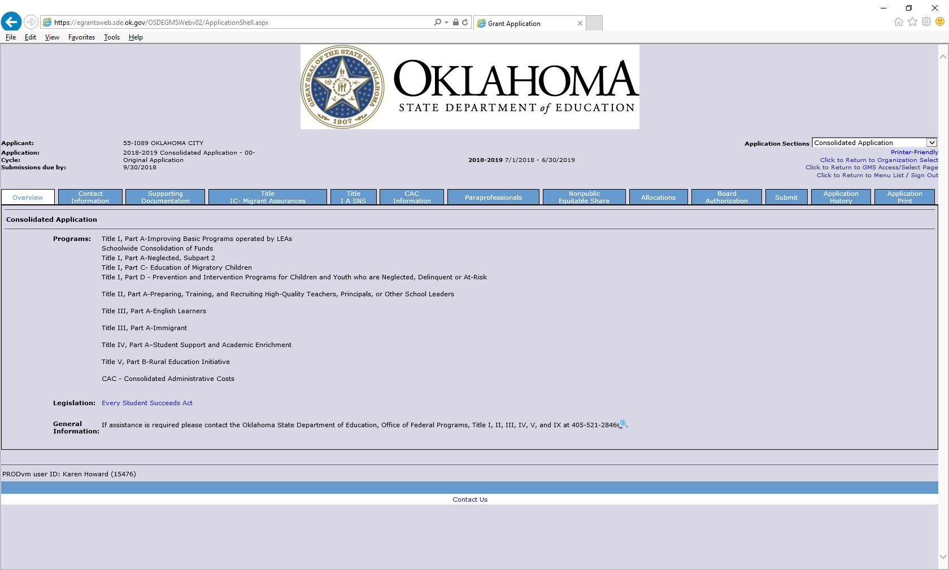

Slide 57
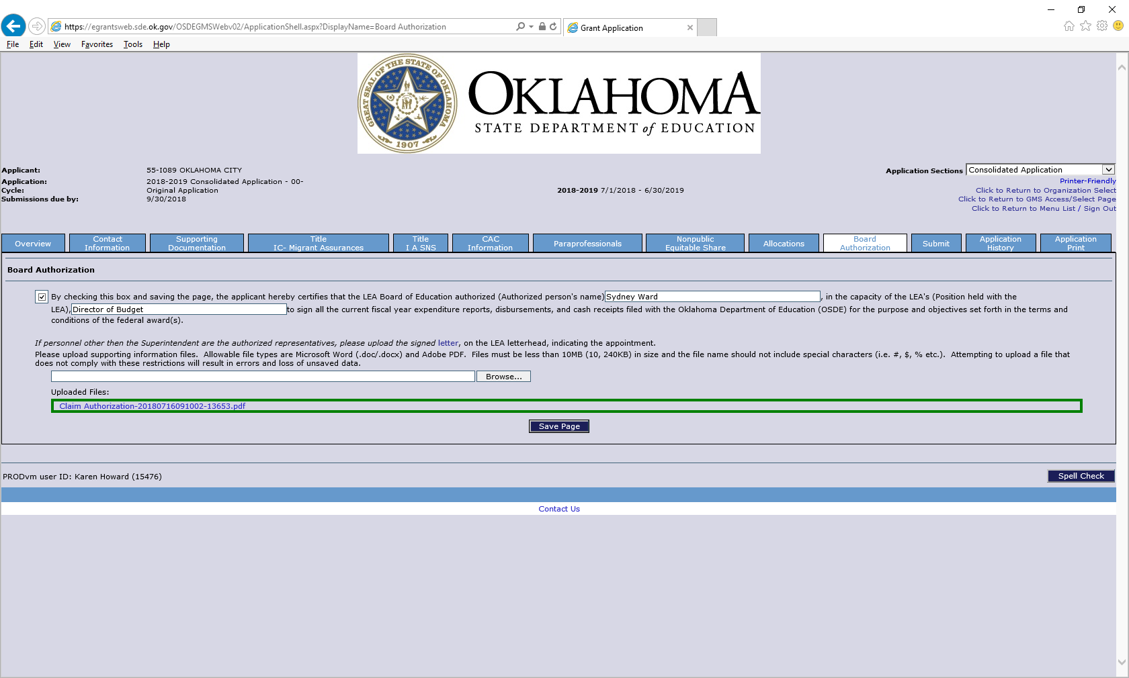

Slide 58
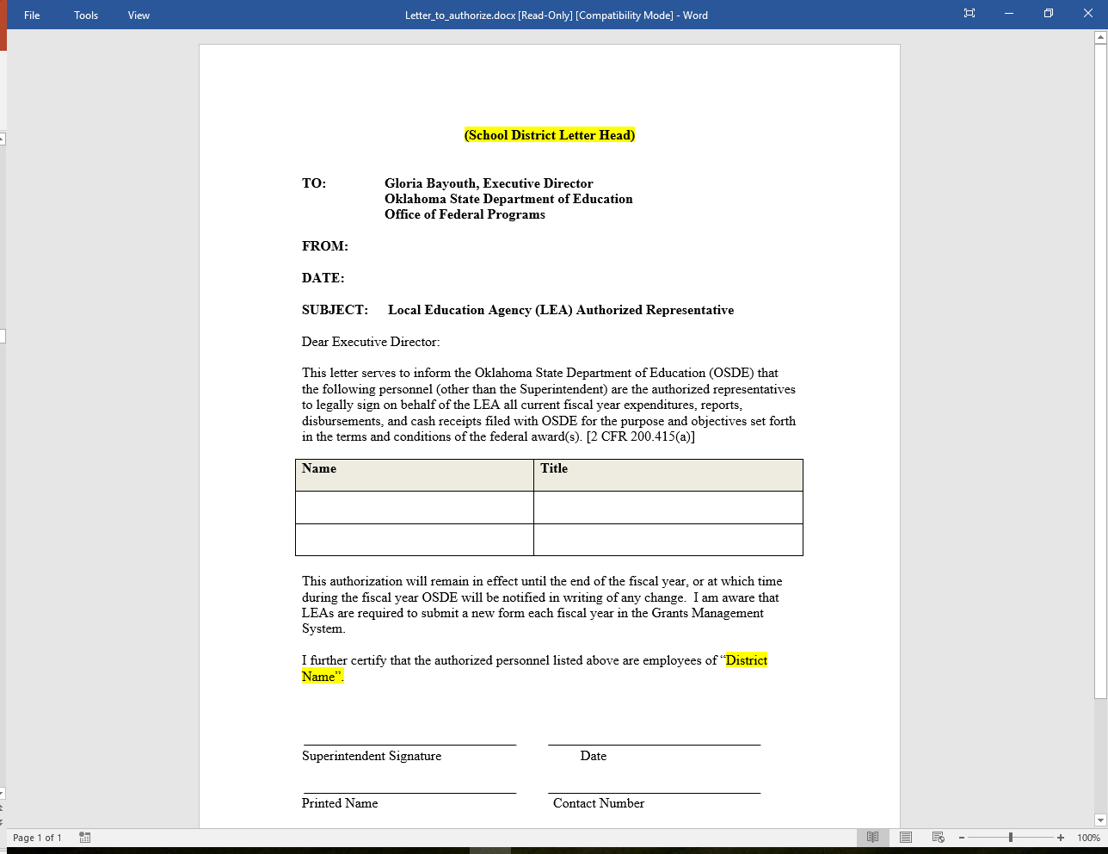

Slide 59
Expenditure Reporting
As stated in the Joint Federal Programs Claims Procedures, all districts should file at least one claim by the end of November. Districts that have not filed a claim by November will be contacted.

Slide 60
Expenditure Reporting
If a claim is returned, you can review the reason by going onto the Summary Expenditure Report Menu, select which report has been returned, then click the Review Summary button.

Slide 61
Expenditure Reporting
Select which program review, then click on the Review Checklist button. Once the checklist appears, you will be able to review the message informing why the claim has been returned.

Slide 62
Expenditure Reporting
If you do not see the below screen, check to see if your pop up blockers are on.

Slide 63
Proper Use of Codes
For a list of proper use of codes in Special Education please see the State Department of Education website, listed under Oklahoma Cost Accounting.
http://sde.ok.gov

Slide 64
Time and Effort
Year End CloseOut

Slide 65
Year End Closeout
Districts must perform a closeout at the end of the fiscal year.
SES requires closeout completion by September 1.
The closeout informs the SDE that the district has concluded expenditure reporting for the year.
Closeouts also move all unspent funds to the next fiscal year for budgeting.
The closeout process is a simple procedure that closely resembles the creation of an expenditure report.

Slide 66
Year End Closeout
When completing the closeout report, a district must upload a Time and Effort Report and a Vendor Performance Review, if applicable.
A Time and Effort report is required if IDEA Part B funds and/or ARP funds are used to pay any salary (object code 100).
A Vendor Performance Review is required for each vendor if IDEA Part B and/or ARP funds are used to pay any Contract Service (object code 300).

Slide 67
Time and Effort
Time and Effort

Slide 68
Time and Effort
In general, salaries and wages of employees who work on federally funded programs may be paid with federal funds as long as they are working on the grant objectives and appropriate time and effort records are maintained.

Slide 69
Time and Effort
All employees must maintain documentation showing that their salaries are allocable to a federal program.
That documentation must be based on records that accurately reflect the work performed.

Slide 70
Time and Effort
Federal regulation requires that any salaries and benefits charged to a federal award(s) must be documented in writing.
Reflect actual time spent on activities to which federal program(s) are being charged.
It is recommended documentation is to be signed by the employee and the employee’s supervisor.

Slide 71
Time and Effort
Time and effort reports should be prepared for any staff with salary and benefits that are charged:
Directly to a federal award.
Directly to multiple federal awards.
Directly to any combination of federal awards and other State or Local fund sources.
Keep time and effort reports on file at the district.

Slide 72
Time and Effort
Single Cost Objective
A single work activity that may be funded by one or more fund sources.
Semi-annual time and effort documentation is made in arrears.
(Arrears is a financial and legal term that refers to the status of payments in relation to their due dates. The word is most commonly used to describe an obligation or liability that has not received payment by its due date.)

Slide 73
Time and Effort
Remember:
One time and effort report of an actual employee must be uploaded during the district’s closeout.

Slide 74
Time and Effort

Slide 75
Time and Effort
Multiple Cost Objectives
For employees who have different jobs or are paid with different funds;
Must reflect an after-the-fact distribution of the actual activity of each employee;
Must account for the total activity for which each employee is compensated;
Must be prepared at least monthly and coincide with one or more pay periods; and
Must be signed by the employee and supervisor.

Slide 76
Time and Effort

Slide 77
Special Education Professional Development
Project 613

Slide 78
Project 613
The intent of this grant is to encourage district involvement in Professional Development opportunities.

Slide 79
Project 613
The application is located on the Grant Management System. This project is to reimburse districts the costs of travel, substitute teachers, registration, and hotel for eligible events/training.
Funds for this project are limited and based on availability.
Required information:
Names and title of staff members attending the event/training
Event/training title and date
Estimated cost breakdown

Slide 80
Project 613
Reimbursement will include:
Mileage
Substitute cost
Registration
Hotel

Slide 81
Project 613
Reimbursement will not include:
Individual Reimbursement
Per Diem / Food

Slide 82
Special Education Professional Development/District
Project 615

Slide 83
Project 615
The purpose of this project is to provide additional funds to districts, based on their most recent child count, and are used only for professional development activities that increase the ability of teachers to ensure positive outcomes for students with disabilities.

Slide 84
Project 615
Examples of usage are:
Inviting Speakers
Purchasing Books for Staff
Attending Conferences
Conducting Trainings
Attending Webinars

Slide 85
Project 615
The application will be completed online through the Grant Management System.
The application will ask for an explanation of the activity and must be completed for the entire allocation funds.
Districts not completing a budget by December 1 will forfeit their allocation and funds will be returned back to Special Education Services.

Slide 86
Certification Examination Reimbursement
Project 616

Slide 87
Project 616
The purpose of this project is to reimburse districts for assisting teachers that need to take and pass additional subject area certification examinations.
It is limited to one exam per individual and districts must provide justification for the necessity of each individual to take and pass the subject area examination.

Slide 88
Project 616
Funds for this project are limited and based on availability.
The district will be required to upload a copy of the Board Policy.

Slide 89
High Needs
Tier I and Tier II

Slide 90
High Need Students
Tier I
Out-of-State residential placements (prior OSDE approval required).
Must be written in the students IEP.
Must have acceptance letter from the Out-of-State resident facility.

Slide 91
High Need Students
Tier II
Applicants must meet the following qualifications:
At least three times the average per pupil expenditure in Oklahoma.
At least 10% of the LEA’s previous year’s Flow-Through allocation (for all high need children).
Funds will be awarded based on availability.

Slide 92
High Need Students
Applications for Tier I and Tier II programs will be available on the SDE Special Education web site.
Applications for Tier I and Tier II programs will be due on the Fourth Friday of July.

Slide 93
Lindsey Nicole Henry Scholarship for Children with Disabilities
Lindsey Nicole Henry Scholarship

Slide 94
Lindsey Nicole Henry Scholarship for Students with Disabilities
The Lindsey Nicole Henry (LNH) Scholarship Act (70 O.S. § 13-101.2) is a law which became effective August 26, 2011.
The Act created a scholarship for use at a private school accredited by the State Board of Education or another accrediting association approved by the State Board of Education for students with IEPs.

Slide 95
Lindsey Nicole Henry Scholarship for Students with Disabilities
The parent or legal guardian of a public school student with a disability may exercise their parental option and request to the OSDE-SES to have an LNH scholarship awarded for the child to enroll in and attend a private school if specific conditions are met.
The parent must revocate their right for FAPE.

Slide 96
Lindsey Nicole Henry Scholarship for Students with Disabilities
Students who were enrolled in a public school the preceding year with an IEP and were counted at the public school for funding purposes are eligible.

Slide 97
Lindsey Nicole Henry Scholarship for Students with Disabilities
Parents must complete the application process with the OSDE-SES by December 1 of the school year considered.
Public Schools must notify parents annually of this option.
The public school must continue with child find obligation.

Slide 98
Lindsey Nicole Henry Scholarship for Students with Disabilities
LNHS began in 2010-2011
The student enrollment count was 53
The current enrollment count is 1197

Slide 99
Finance Resources
Finance Resources

Slide 100
Finance Resources
http://ok.gov/sde/finance
Due date for financial activities
Frequently asked questions-Maintenance of Effort
Time and Effort Samples and FAQ
Board Policy Sample
High Need Student Application
COOP/Interlocal Coop Application
Lindsey Nicole Henry Scholarship
ARP Guidance
CloseOut Power Point
Finance Funding Manual
Joint Federal Programs Claims Procedures

Slide 101
Finance Due Dates
For the new fiscal year ;
GMS opens first Friday in May
Due prior to July 1
Assurances
LEA Agreement
Due by the fourth Friday of July
Tier I Out-of-State Residential Application
Tier II High Needs Application

Slide 102
Finance Due Dates
October 31, 2021
IDEA and ARP Consolidated Applications
June 3, 2022
Last day to file a payable claim to be guaranteed payment by June 30
June 30, 2022
Last day to submit a budget amendment

Slide 103
Finance Due Dates
August 1
Expenditure Reports Due, (all expenditure reports submitted after August 1 are subject to the approval of the State Board of Education)
September 1
District Closeout

Slide 104
Finance Due Dates
December 1
Submission of completed Lindsey Nicole Henry Scholarship Application
Project 615 Application. LEAs not submitting an application by December 1 will forfeit their allocation. These funds will be re-allocated to LEAs with a submitted application.

Slide 105
Finance Team
Ashlee Henson, Finance Specialist (405) 521-4857
Carole Tomlin, Finance Specialist (405) 521-2335
Janet Felton, Finance Specialist (405) 522-1578
Nathan Goad, Project 613 Specialist (405) 521-4867
Stacy Eden, LNHS Specialist (405) 521-4876
Crystal Royalty, LNHS Specialist (405) 521-2372
Karen Howard, Finance Director (405) 521-3587
Email address
first name.last name@sde.ok.gov

