Slide 1
Office of English Language Proficiency FY23 Monitoring

Slide 2
Office of English Language Proficiency FY23 Monitoring
Thomas Kirk
Director of English Language Identification and Monitoring
Office of English Language Proficiency

Slide 3
Overview
What is Monitoring?
Who gets monitored?
Desk Monitoring or Site Monitoring
The Monitoring Process and Timeline
The Toolkit and Checklist
The English Language Proficiency Monitoring Tool
Outcomes
Question Time

Slide 4
What is English Language Proficiency Monitoring?
The United States Department of Education (USDE) requires that all Local Education Agency (LEA) sub-recipients of federal funds participate in a monitoring process to ensure accountability.
Through the monitoring process the Oklahoma State Department of Education’s Office of English Language Proficiency (OELP) verifies that state and federal requirements are being met by the state’s schools and LEAs.
The monitoring process also gives OELP the opportunity to provide technical assistance and guidance to LEAs in order to strengthen their English language programs and improve the quality of services provided.

Slide 5
Who gets monitored?
All LEAs that receive federal funds are monitored at least once during a three-year cycle. Fiscal Year 2023 (FY23) is the second year of the current cycle.
OELP follows the same three-year cycle as the Office of Federal Programs.
Through a risk-assessment process all LEAs are scored on several factors indicating potential risk in the identification of English Learners and/or meeting state and federal requirements.
LEAs identified as representing an elevated risk in the management of funds are then added to the current rotation.

Slide 6
Desk Monitoring or Site Monitoring
All LEAs to be monitored this year will receive notification by July 31, 2022 whether they would be Desk Monitored or Site Monitored.
Desk monitored LEAs are required to submit the monitoring tool and supporting documentation no later than December 9, 2022.
Any LEA that fails to submit documentation by the December 9, 2022 deadline will be considered non-compliant for the year and federal funds will be withheld. When the LEA has submitted acceptable documentation for all relevant points, federal funding will be released. The LEA, however, will still be considered non-compliant for the year.
All LEAs being site monitored will submit the same documentation as those being desk monitored.

Slide 7
Site Visits
Site monitored LEAs will also be contacted individually in order arrange a site visit by OELP staff, who will conduct a series of interviews with local personnel.
The LEA will be notified informally of potential compliance issues at the conclusion of the site visit.
Formal notification of compliance or non-compliance will follow the complete review of the Monitoring Tool.
A summary of the site visit conclusions will be sent to the LEA together with a compliance or non-compliance letter and the Monitoring Tool.

Slide 8
The Monitoring Process and Timeline
As mentioned above, all monitored LEAs are required to submit the English Language Proficiency Monitoring Tool and supporting documentation to the Office of English Language Proficiency no later than December 9, 2022.
The reviewer assigned to the LEA will evaluate the documentation and add explanatory comments on the monitoring tool. When a first review is completed, the reviewer will return the monitoring tool to the LEA along with any requests for further or alternative documentation.

Slide 9
The Monitoring Process (cont.)
The reviewer will complete an initial review of all documents and return the monitoring tool to the LEA, allowing sufficient time for the LEA to gather any further documentation.
The LEA will then return the monitoring tool with the requested documentation. Depending on the quality of the documentation, there could be several such exchanges between reviewer and LEA.
This process closes on April 19, 2023. In other words, the Office of English Language Proficiency must have received satisfactory documentation for all relevant points on the Monitoring Tool by this date for the LEA to be considered compliant.

Slide 10
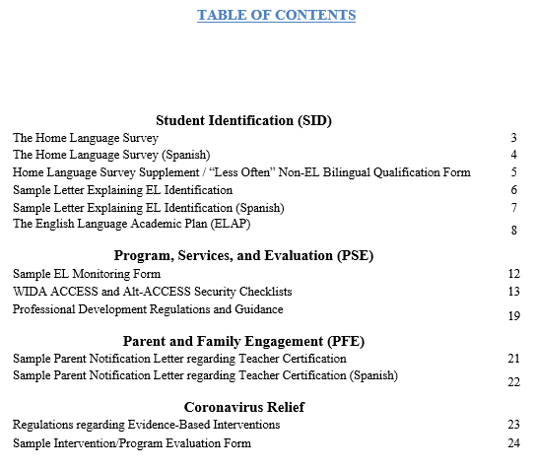
The English Language Proficiency Monitoring Toolkit available at: https://sde.ok.gov/el-and-title-iii-state-monitoring-resources

Slide 11
The OELP Monitoring Tool
https://sde.ok.gov/el-and-title-iii-state-monitoring-resources

Slide 12
The Monitoring Tool (cont.)

Slide 13
The Monitoring Tool (cont.)

Slide 14
The Monitoring Tool (cont.)

Slide 15
The Monitoring Tool (cont.)

Slide 16
Outcomes
Compliance
The desired outcome. When the Office of English Language Proficiency has received and approved all relevant documentation (before April 19, 2023) a compliance letter will be sent to the LEA together with the final version of the Monitoring Tool.

Slide 17
The Other Outcome
Non-compliance
If the Office of English Language Proficiency has not received all relevant documentation by April 19, 2023 the LEA will be found non-compliant and will receive a non-compliance letter.
If an LEA is deemed non-compliant, reimbursement of all federal funds may be withheld for the remainder of the current fiscal year.

Slide 18
The Other Outcome (cont.)
Non-compliant LEAs will have thirty (30) calendar days to submit a Corrective Action Plan for each missing or unacceptable item.
Once the Corrective Action Plans have been received and approved by OELP, that LEA’s federal funds for the remainder of the current fiscal year will be released.
A failure to submit Corrective Action Plans within thirty (30) days could result in the withholding of federal funds both for the current and the following fiscal year, at OSDE discretion.

Slide 19
Questions?

Slide 20
In Closing
If you have any further questions about the OELP monitoring process or about any individual items on the OELP Monitoring Tool, please do not hesitate to contact me or your assigned reviewer.
Thomas Kirk
Director of English Language Identification and Monitoring
405-522-5073
Thomas.Kirk@sde.ok.gov

