Slide 2
Gearing Up for ACCESS
Preparation and Resources for
Spring 2019 ACCESS Testing

Slide 3
What Do I Need To Get Started with ACCESS?
All staff who will be involved in ACCESS testing need a WIDA account and a WIDA AMS account.
To learn how to obtain your accounts, please refer to our Instructions for Obtaining WIDA and WIDA AMS Accounts flyer.

Slide 4
What Is the Difference Between WIDA and WIDA AMS?
WIDA is the consortium to which OK belongs; WIDA creates the ACCESS assessments (and EL screeners).
Your WIDA account will allow you to get trained and certified to screen or proficiency test ELs.
The WIDA website also provides our English language development (ELD) standards, training webinars, and other resources for serving ELs.

Slide 5
What Is the Difference Between WIDA and WIDA AMS?
WIDA AMS is the Assessment Management System for the tests created by WIDA.
WIDA AMS is run by DRC for WIDA.
DRC INSIGHT is the test platform through which students take ACCESS for ELLs 2.0 Online*.
WIDA AMS is where you order tests, schedule test sessions, print test tickets, and more.
Notes:
DRC INSIGHT is also the test platform for WIDA Screener Online.

Slide 6
What’s New With ACCESS This Year?
Review ACCESS for ELLs: What’s New for 2018-19? flyer.
This resource flyer covers:
Test Preparation and Training
Getting Students Ready for Testing
Test Materials and Ordering
Technology Updates
Accessibility and Accommodations

Slide 7
How Do I Keep Up With Important ACCESS Information?
If you are the DTC, make sure you belong to the Office of Assessment’s EL/WIDA listserv.
Regularly refer to:
EL/WIDA listserv messages
Oklahoma’s WIDA member page
OSDE’s ELPA/WIDA page and EL/WIDA FAQ
ACCESS training courses and support webinars
Your WIDA Secure Portal page
Notes:
NOTE: Contact Elizabeth Warren to be added to the listserv.

Slide 8
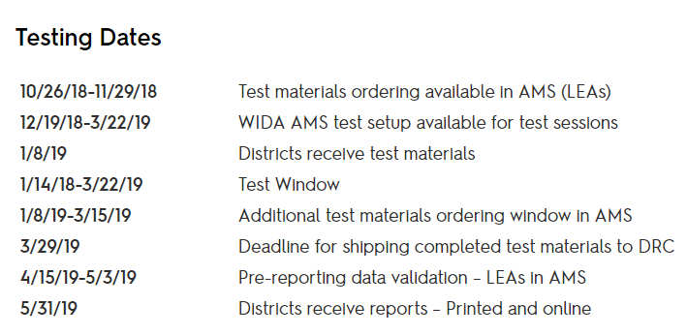
Where Can I Find the ACCESS 2018-2019 Testing Calendar?
Visit Oklahoma’s WIDA page to view our 2018-2019 ACCESS testing calendar:
Notes:
https://wida.wisc.edu/memberships/consortium/ok

Slide 9
How Do I Learn to Navigate My Secure Portal Page?
Consult the Secure Portal User Guide for step-by-step instructions on:
Managing your WIDA Secure Portal Account
Access WIDA Screener and ACCESS training courses
Viewing your training history and certificates (and others’ history and certificates if you are the DTC)
Navigating the District Administrator account features

Slide 10
How Do I Identify Which Students Need ACCESS Testing?
Review Oklahoma’s Identification and Placement Guidance on our member page of the WIDA website.
Further EL identification and placement testing info can be found in OSDE’s 2018-2019 EL/WIDA FAQ.

Slide 11
Which ELs Still Need to Take ACCESS?
Students who have been identified as EL via the EL screening process must take the appropriate ACCESS test each spring until they either:
Hit the automatic exit criteria of 4.8 or above on Overall/Composite*, or
Score within the ELP band on ACCESS, are found to be eligible for an ELP band committee, and are exited by the committee.
Notes:
*NOTE: For students with disabilities who cannot take all test domains, an Overall/Composite score will be factored by the Office of Accountability using a formula provided by WIDA. Exit decisions should be made using this factored Overall/Composite score.

Slide 12
How Do I Find Out About My ACCESS Responsibilities?
Read Oklahoma’s ACCESS for ELLs Online Checklist for a list of duties for serving in any/all of these roles:
District Testing Coordinator
District Technology Coordinator
School Testing Coordinator
Test Administrator
Checklist also contains resource links.

Slide 13
What Are Important References for District and School Testing Coordinators?
For District and School Testing Coordinators:
Oklahoma’s ACCESS Checklist
District and School Test Coordinator Manual
Accessibility and Accommodations Supplement
Facilitator Toolkit
Test Administrator and Technology Coordinator training materials

Slide 14
What Are Important References for Test Administrators?
For test administrators:
Oklahoma’s ACCESS Checklist
Test Administrator Manuals (all manuals for all versions of ACCESS administered)
Accessibility and Accommodations Supplement
Training courses tutorials and quizzes for all versions of ACCESS administered

Slide 15
What Are Important References for Technology Coordinators/All Roles?
For Technology Coordinators:
The Technology Readiness Guide
Technology User Guide
Additional references located in WIDA Secure Portal
For All Roles:
WIDA Assessment Management (AMS) User Guide
ACCESS Webinars on WIDA website
Practice test items located in WIDA AMS

Slide 16
Who Can Administer ACCESS?
Anyone who will administer an ACCESS test must be a certified staff member.
Districts may hire retired teachers who are still OK certified to help with ACCESS testing.
Non-certified staff may help with logistics of testing, but may not administer/score* ACCESS.
Notes:
NOTE: Only Kindergarten ACCESS and Alternate ACCESS require TAs to score student responses.

Slide 17
How Do I Prepare to Administer ACCESS?
All test administrators must take the applicable ACCESS training courses and certification quizzes for any assessment they will administer:
Kindergarten ACCESS for ELLs
ACCESS for ELLs 2.0 Online
Alternate ACCESS for ELLs

Slide 18
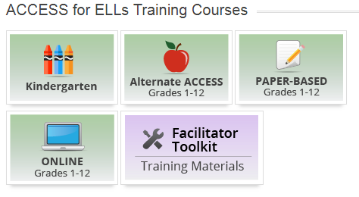
Where Do I Find the ACCESS Training Courses?
ACCESS training courses are located on your WIDA My Account and Secure Portal and can be accessed by clicking the tiles below:
Notes:
NOTE: No one will need to take the ACCESS Paper-Based Grades 1-12 training course, as Oklahoma is an ACCESS 2.0 Online-Only state.

Slide 19
What if I Certified to Give ACCESS Last Year?
OSDE strongly recommends that staff revisit training courses and certification quizzes yearly.
However, for 2018-19, it is not mandatory for certified test administers to recertify, provided it has not been more than one full academic year since they administered a given ACCESS test.

Slide 20
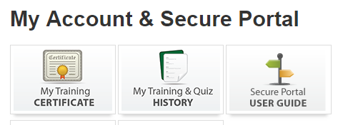
Where Do I Find My ACCESS Training History?
Staff members may view their ACCESS training course history by clicking the applicable tiles on their My Account and Secure Portal pages:

Slide 21
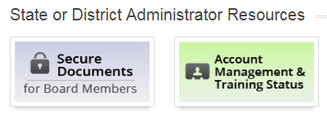
Where Do I Find My Staff’s ACCESS Training Histories?
If you are the DTC, log into My Account and Secure Portal and click the yellow Account Management & Training Status tile to view others’ trainings and certifications:

Slide 22
Where Do I Find District Technology Resources for ACCESS?
From WIDA AMS Website: Log in and select Device Toolkit from the All Applications menu:

Slide 23
Where Do I Find District Technology Resources for ACCESS?
From WIDA Website: Log into My Account and Secure Portal and click the Technology Coordinators tile:
Notes:
NOTE: All of the Technology Coordinator documents can also be found in the Download Library.

Slide 24
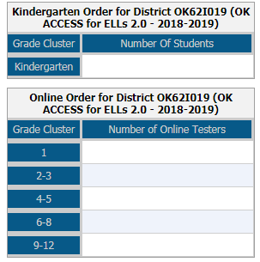
How Do I Order ACCESS Materials?
Materials are ordered in WIDA AMS via the Material Ordering screen shown below:

Slide 25
Important Material Ordering Reminder
As of 2018-2019, Oklahoma only uses ACCESS for ELLs 2.0 Online.
All districts must order ACCESS Online, as use of ACCESS Paper is no longer permitted.
Districts may request a paper Writing test or ACCESS Paper test for individual ELs using Form U-A: Unique Accommodations Request Form for ACCESS.
Notes:
Requests must be submitted to the Office of Assessment by December 1, 2018. They should be emailed to both Elizabeth Warren and Yuseli Freire. Responses will be provided on a case-by-case basis by March 1, 2019.

Slide 26
How Does Student Information Get Into WIDA AMS?
On Thursday, November 29, 2018, OSDE will perform the PreID upload for districts.
Any student coded as EL in a district’s student information system on 11/29/18 will be loaded into WIDA AMS.
ELs that enter a district after 11/29/18 will need to be manually entered into WIDA AMS.

Slide 27
How Do We Create ACCESS Test Sessions?
ELs that are included in the PreID upload will be placed into prepopulated test sessions arranged by site/grade cluster by DRC.
Districts do not need to use the preset test sessions, and may delete or create sessions in WIDA AMS, as well as move ELs into or out of test sessions, on an as-needed basis.

Slide 28
What If a Student Moves Away/Enrolls During ACCESS Testing?
Please refer to the instructions for handling Student Transfers located in:
WIDA AMS User Guide (this will be the primary resource for this process)
District and School Testing Coordinator Manual
Test Administrator manuals for all ACCESS tests
Instructions for handling these situations vary depending upon the ACCESS test being taken and how many domains have been completed.

Slide 29
Who Needs to Sign a Non-Disclosure Agreement (NDA)?
Districts must maintain a signed NDA for every individual involved in administering ACCESS.
NDAs should be signed or electronically signed at the completion of ACCESS training courses.
The NDA can be found under the Key Resources menu of each ACCESS training course.

Slide 30
How Do We Store Our NDAs?
Copies of the NDA can be stored in hard copy and/or electronic format.
NDAs should be stored locally and do not need to be submitted to WIDA or DRC.
Districts monitored by OSDE may be asked to provide copies of their signed ACCESS NDAs.

Slide 31
How Do I Learn About ACCESS Accommodations?
Review the Accessibility and Accommodations Supplement when preparing to implement ACCESS testing for ELs with disabilities.
View sample IEP checklists for Kindergarten ACCESS, ACCESS Online, and Alternate ACCESS for further guidance when making accommodations decisions.

Slide 32
When Do I Add ACCESS Accommodations into WIDA AMS?
While OSDE strongly suggests adding accommodations prior to testing, only three accommodations must be added prior to a student testing:
Manual control of item audio (MC)
Extended Speaking test response time (ES)
Repeat audio item (RA)
All other accommodations can be added at any time during the testing process.

Slide 33
ACCESS Online Vs. Alternate ACCESS: Who Takes Which Test?
The majority of ELs who are also served on an IEP will take ACCESS Online with accommodations.
Only ELs who have significant cognitive disabilities and take an alternate state content test (DLM) should take Alternate ACCESS.

Slide 34
What Live Trainings Are Available for ACCESS Online?
December 4, 2018, Oliver Hodge Building-Room 215, 2500 N. Lincoln Blvd., OKC, OK 73105:
Test Coordinator Training, 8:30-11:30 a.m.
Test Administrator Training, 12:30-3:30 p.m.
December 5, 2018, Varsity Club at Tiger Stadium-220 N. 23rd St., Broken Arrow, OK 74102:
Test Coordinator Training, 8:30-11:30 a.m.
Test Administrator Training, 12:30-3:30 p.m.

Slide 35
ACCESS Online Live Trainings: Registration Info
Participants need to register for live trainings; spots are limited.
Registration links were sent out via EL/WIDA listserv message on 11/1/18.*
Participants must bring laptop or tablet to trainings.
Participants need WIDA and WIDA AMS logins.
Notes:
*NOTE: Anyone who is not subscribed to the listserv and wishes to be, and/or wishes to get the message with the registration links can email Elizabeth Warren and Yuseli Freire. Contact info will be provided at the end of the webinar, and is available on the ELPA/WIDA page of the OSDE website.

Slide 36
What If I Can’t Attend Live Trainings?
Consult the 2018-19 ACCESS and Screener Webinar Calendar.
View ACCESS Pre-Testing webinars:
Welcome Back! What’s New in 2018?
ACCESS for ELLs Training
Software Updates and Technology Readiness Checklist
ACCESS for ELLs for New District Test Coordinators
Test Scheduling

Slide 37
How Do I Prepare Students for ACCESS?
Review Getting Students Ready for Testing and ACCESS Writing Test Tips.
Visit Preparing Students for ACCESS for ELLs:
Online Speaking test guidance for Grades 1-3, Grades 4-5, and Grades 6-12
Test demo
Interactive sample items
Practice test

Slide 38
What If Parents Have Questions?
If parents have questions about how their child was identified, what it means to be EL, and/or how their child may qualify to exit services, please consider sharing:
My Child is an ELL: A Parent’s Guide (English)
Mi Hijo(a)es un(a) Aprendiz del Ingles: Una Guia para Padres de Familia (Spanish)
Each guide contains links to three Family webinars, all available in English and Spanish.

Slide 39
What Do I Need to Know About Kindergarten ACCESS?
Paper-based and individually administered.
Can take up to 60 minutes per student.
Test administrator scores all domains; scored tests sent to DRC to process for score reporting.
Not split into difficulty tiers; students test until they hit ceiling for a given domain.

Slide 40
Do All Kindergartners Take All Kindergarten ACCESS Domains?
Districts are strongly encouraged to administer all domains, but may choose to administer only the Oral (Speaking/Listening) domains to certain kindergartners on a case-by-case basis.
Students who only take the Oral domains will have an Overall score calculated by the Office of Accountability to be used for district accountability calculations.

Slide 41
How Do I Decide Which Kindergartners Should Take the Entire Test?
Each domain has “Winding Down” activities, with scripting provided in the “Moving On” sections. This allows TAs to wrap up activities while allowing students to feel successful.
When in doubt, TAs should always opt to try to administer all four domains, and may use the “Winding Down” activities for students unable to perform in Reading and Writing.

Slide 42
How Long Does ACCESS Online Take To Administer?
Reading:
Up to 35 Minutes
Listening:
Up to 40 Minutes
Speaking:
Up to 30 Minutes
Writing:
Up to 65 Minutes
Complete Test:
Up to 170 Minutes
Notes:
NOTE: Alternate ACCESS takes a variable amount of time to administer based on domain, grade level, and student ability.

Slide 43
How Do I Handle, Store, and Ship ACCESS Test Materials?
Refer to Oklahoma’s State Specific Directions for instructions on:
Materials management prior to, during, and immediately following administration
Properly using Pre-ID labels, District/School labels, and Do Not Process labels
Preparing test materials for return to DRC
Avoiding common errors and handling unique situations when preparing materials for return
State-Specific Guidelines for test bubbling

Slide 44
Thank You for Your Time Today!
Please feel reach out to us with any questions you may have:
Elizabeth Warren, Director of ELPA, elizabeth.warren@sde.ok.gov, (405) 522-5073
Yuseli Freire, EL Proficiency and Monitoring Specialist, yuseli.freire@sde.ok.gov, (405) 522-0862

