Slide 1
Intervention Library

Slide 2
Access

Slide 3
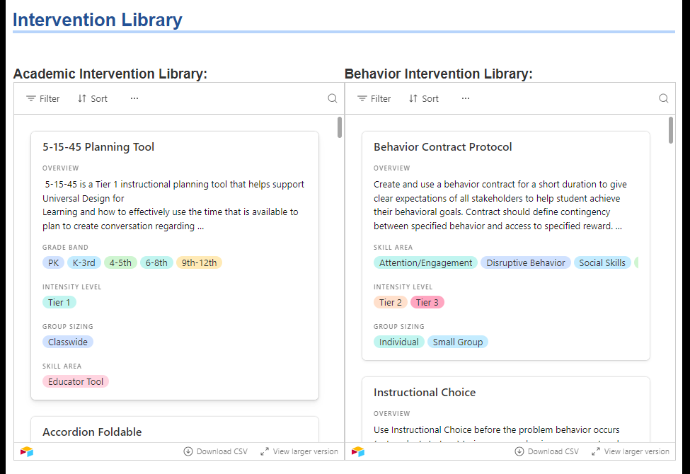
Accessing the Intervention Library
www.sde.ok.gov/okmtss
Or www.sde.ok.gov > search site > OKMTSS

Slide 4
Academic and Behavior Intervention
View larger version opens a new window

Slide 5
Filter Feature
+ Add condition
Where “Field” contains “value”
Resource | Title of Intervention
Overview | Description of the intervention
Grade Band | PK, K-3rd, 4-5th, 6-8th, 9-12th
Intensity Level | Tier 1, Tier 2, Tier 3
Group Sizing | Classwide, Small Group, Individual
Skill Area | *See other slide*
Lesson Plan | Intervention protocol
Fidelity Check | Fidelity checklist
Template/ Resources | Additional links if provided
Resources/Research | Linked in the protocol, but also provided here for some cards

Slide 6
Grade Band
The grade band provided on the intervention protocol considers the following:
The Oklahoma Academic Standards grade level for that skill.
The protocol’s task and how that relates developmentally for student’s ages in expected grades.
Behavior grade bands are not provided because the selection should consider the protocol’s skill area and task more than the age/grade of the skill.
Grade Band Code | Considerations | Grade Band Code | Considerations
PK | Preschool or Early Skill | 6-8th | Early Secondary Literacy, Early Secondary Math
K-3rd | Early Literacy, Early Math
4-5th | Intermediate Literacy, Intermediate Math | 9-12th | Secondary Literacy, Secondary Math

Slide 7
Intensity Level
The Tiered recommendations are provided as guidance. It is up to the team to determine the intensity choices best for the student’s needs.
The National Center for Intensive Intervention defines intervention intensity with a framework of seven components:
1. Strength
2. Dosage
3. Alignment
4. Attention to transfer
5. Comprehensiveness
6. Academic/Behavioral Support
7. Individualization
Tier 1 | Tier 2 | Tier 3
Universal support | Targeted Support | Intensive Support

Slide 8
Group Size
The group sizes indicated are:
Whole group
Small group
Individual
It is up to the team to determine what the group size is needed to ensure effective dosage.
Some protocols lend themselves to need to be done in a small group, but others are able to be done with the whole class and with individual students.
When considering group size, consider the targeted skill and the students that can/need to participate in the intervention.

Slide 9
Skill Areas
Literacy Areas
Educator Tool
Comprehension
Fluency
Phonemic Awareness
Phonics
Vocabulary
Spelling
Written Expression
Math Areas
Algebra and Algebraic Thinking
Computation Fluency
Early Numeracy
Geometry
Measurement
Numbers and Operations
Data
Behavior Areas
Disruptive Behavior
Social Skills
Attention/Engagement
Executive Function
Self-Regulation
Compliance

Slide 10
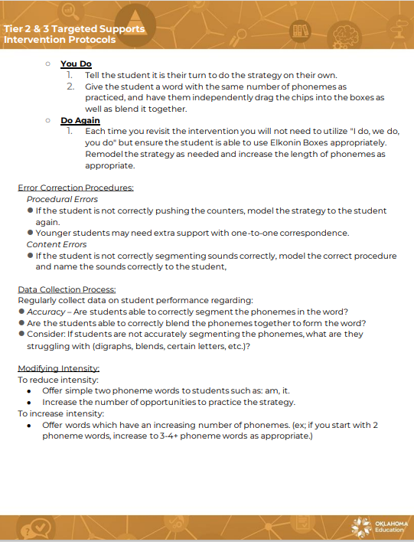
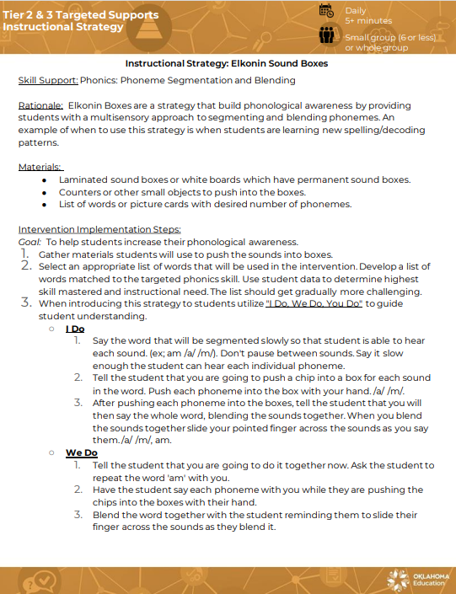
Lesson Plan
The protocol contains:
Skill support- the target skill the protocol is designed to target.
Rationale- the support for this protocol’s actions to target the skill defined.
Materials- anything needed for the intervention.
Intervention implementation steps- protocol steps in order.
Error correction procedures- how to correct the student’s errors.
Data collection- data needed to determine if the protocol is effective.
Modifying intensity- some suggestion for intensity adjustments

Slide 11
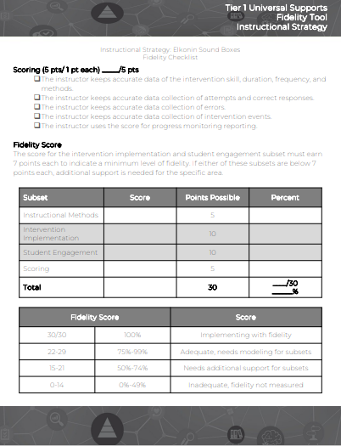
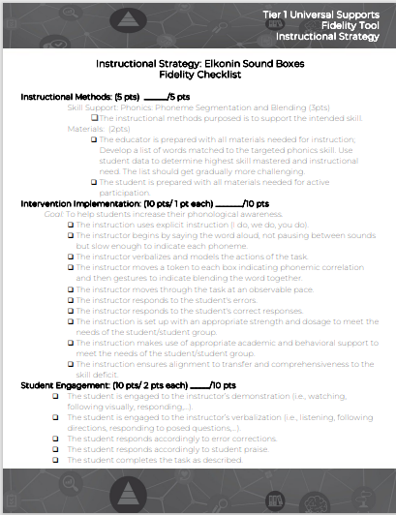
Fidelity Check
The fidelity check supports calculation of the attention to the protocol:
Instructional methods
Intervention implementation
Student engagement
Scoring/Data collection
The team can then use the fidelity score to support additional next steps.
It is up to the team to determine if ‘cusp’ scores are valid and reliable or if the intervention will need adjustment.

Slide 12
District Usage
This tool is available for anyone to use at anytime. However, districts can streamline their decision rules with this tool to support them.
The district could select a series of 3-5 protocols for each skill area and determine the process for the usage of those protocols.
For example, the LEA would determine which skills would be used intentionally at Tier 1 for any Tier 1+ needs to differentiate for students. Then, they would determine which series of interventions are in the ‘targeted’ or Tier 2 set. Intensity determinations will be based on the student need and the team’s determination. If a student needs a more intense intervention, then they will move to the Tier 3 set.
Skill Area | Tier 1 | Tier 2 | Tier 3
Comprehension | Explicit Instruction Text-to-Self Graphic Organizers | Repeated Practice Accordion Foldable Activating Prior Knowledge | Think aloud Graphic Organizers-Student

Slide 13
Site Usage
Perhaps an LEA has multiple sites that need different levels of support. The district may pull together a list of what resources are in each Tier, but sites may need to adjust based on their data.
This determination must be in alignment with the district, as a student moves from school to school it may be important to note that areas were adjusted.
Usage | Skill Area | Tier 1 | Tier 2 | Tier 3
District Plan | Comprehension | Explicit Instruction Text-to-Self Graphic Organizers | Repeated Practice Accordion Foldable Activating Prior Knowledge | Think aloud Graphic Organizers-Student
Site Plan | Comprehension | Explicit Instruction Activating Prior Knowledge Text-To-Self | Repeated Practice Accordion Foldable Graphic Organizers | Think aloud Graphic Organizers-Student

Slide 14
Educator Usage
If an LEA or site has not made procedures on how to use these protocols, an educator can still use these to support the following:
Tier 1, class-wide instructional practice
Tier 1, small group instructional practice
Literacy and math center instructional methods
Tier 2 and 3, intervention practice with consideration of district/site requirements for intervention provision

Slide 15
Frequently Asked Questions
The list is so long, our teachers will get overwhelmed. How can we use this tool when our teachers will have a hard time selecting the intervention?
The filter tool helps to narrow the list to the targeted grade and skill.
The site and LEA should consider determining the specific Tiered placements for the protocols the team wishes to use.
What level of training is required for these protocols?
Some protocols can be taught to an educator through reading the steps, watching the linked videos (when possible), and using the resources (linked where possible).
However, others may require more specialized training.

