Slide 1
OK Alternate Assessment Program (Dynamic Learning Maps® Alternate Assessment)
OK State Department of Education
©️2020 Accessible Teaching, Learning, and Assessment Systems (ATLAS)
Notes:
Welcome! This presentation will provide an overview of the Dynamic Learning Maps® (DLM®) Alternate Assessment, which Oklahoma uses as its alternate assessment program.

Slide 2
Topics Covered
student uploads and tasks in Kite® Educator Portal
instructionally embedded assessments
the Instruction and Assessment Planner
released testlet examples
the spring assessment window
Notes:
This presentation will cover
student uploads and other tasks in Kite® Educator Portal
the benefits of using instructionally embedded assessments
how to use the Instruction and Assessment Planner
demonstrations of released testlets and
a review of the spring assessment window

Slide 3
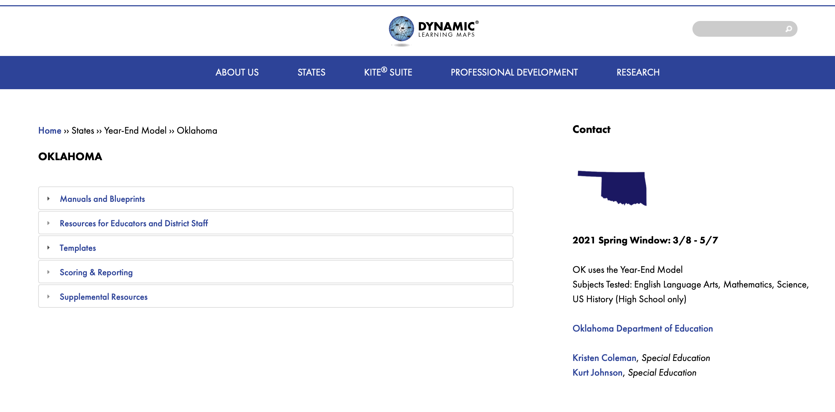
OK’s Page of the DLM Website
Notes:
First, know that each member state of the DLM Consortium has its own page on the DLM website at dynamiclearningmaps.org. Select the state from the list under the States tab on the Home page of the site. Resources accessed from the state’s page will be referenced throughout this presentation.

Slide 4
Tasks in Educator portal
Notes:
The next two slides address a few of the basic tasks to be completed in Educator Portal. Educator Portal is the website educators log into to view and manage student data.

Slide 5
Verify Student Data and Create Rosters
District data managers
Upload enrollment files for test administrators.
Test administrators
Check rosters and student information.
Notify the data manager if student information is inaccurate.
Notes:
State or district data managers must upload student information to Educator Portal. Then the test administrator must verify the information is accurate. The test administrator needs to make sure every student to be tested is listed and that no extra students appear on the roster. Then the test administrator must check each student’s state ID, first and last name, grade, and other profile information. The test administrator should contact the district data manager if corrections or additions are needed.

Slide 6
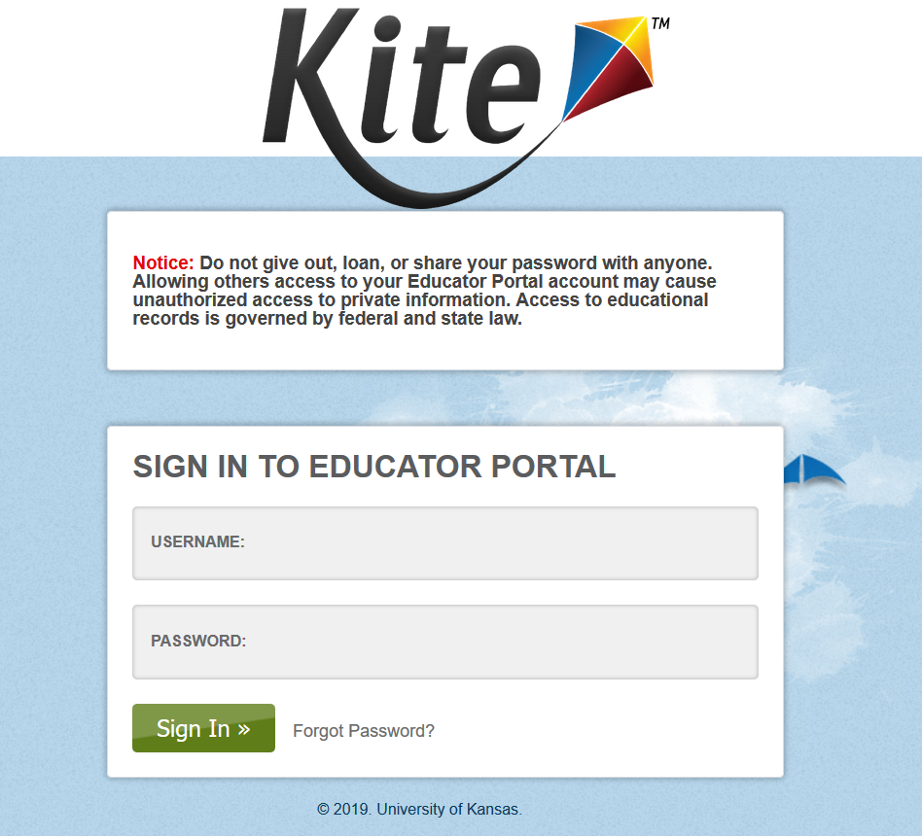
Tasks in Educator Portal
Teacher/Test Administrators
Complete Required Test Administrator Training in Moodle.
Electronically sign the Test Security Agreement.
Verify roster and student information.
Complete the PNP and First Contact survey for each student.
Notes:
Every test administrator must complete the Required Test Administrator training course in Moodle.
The Test Security Agreement must be completed once each school year. The Test Security Agreement pops up automatically in Educator Portal when it needs to be completed, but the agreement can be accessed any time in the user’s profile.
As mentioned on the previous slide, test administrators are responsible for checking available rosters to make sure all students to be assessed are listed and that each student’s information is accurate. Then, test administrators must customize each student’s Personal Needs and Preferences Profile (PNP) settings as needed and complete each student’s First Contact survey.
Please note that on Oklahoma’s page of the DLM website, an Educator Portal User Guide is provided under the Manuals and Blueprints tab. Helplet videos regarding Getting Started in Educator Portal, completing the Personal Needs and Preferences Profile, and completing the First Contact survey are provided under the Resources for Educators and District Staff tab, following the Educator Resource Videos link. These resources provide step-by-step instructions, often with screenshots, for completing tasks and accessing student information in Educator Portal.

Slide 7
using Instructionally Embedded Assessments
Notes:
The following section describes the use of instructionally embedded assessments.

Slide 8
What Are They?
Instructionally embedded assessments are…
testlets administered during the fall/winter months
intended to be administered after instruction has occurred
a means of helping guide instruction
risk-free since their results do not affect end-of-year scoring
Sept 14, 2020 — Feb. 24, 2021
Notes:
So, what exactly are instructionally embedded assessments? They are testlets that are administered during a special window in the fall and winter months. Testlets are mini-assessments, a series of which comprises the assessment for each subject as a whole. Instructionally embedded testlets are intended to be administered after instruction has been provided, and since assessment results are immediately available, instructionally embedded assessments can help inform instructional planning. Since using instructionally embedded assessments is optional, they provide a risk-free opportunity for teachers and students to gain experience with the DLM system without affecting end-of-year score reports.

Slide 9
What Aren’t They?
Instructionally embedded assessments are NOT…
baseline assessments
progress monitoring events
benchmarks or interim assessments
intended predictors of spring performance
Notes:
However, please understand that instructionally embedded assessments are not intended to be baseline assessments, progress monitoring events, or benchmark or interim assessments. Results on instructionally embedded assessments do not necessarily predict how well a student will do on the spring assessments.

Slide 10
How Are They Like the Spring Assessment?
are secure
(test security guidelines apply)
are administered in Kite® Student Portal
are based on the Essential Elements and linkage levels
have the same item and testlet types
have Testlet Information Pages (TIPs)
involve the same administration procedures
assess a single Essential Element per testlet
(with the exception of writing)
use the same kinds of materials
Both instructionally embedded assessments and spring assessments…
Notes:
Instructionally embedded testlets are very similar to the testlets student take during the spring assessment window. They are both secure, meaning test security guidelines apply. They are both administered in Kite® Student Portal. They are written to the DLM alternate achievement standards, called Essential Elements, and the Essential Elements’ linkage levels. Testlets are written based on the linkage levels. Linkage levels provide a gradation of complexity and/or difficulty so that the wide range of students who participate in the alternate assessment can access the academics of the Essential Elements and show what they have learned and can do. Essential Elements for ELA and mathematics each have five linkage levels, and Essential Elements for science have three linkage levels. Each testlet assesses a single Essential Element and linkage level with the exception of writing testlets. Both instructionally embedded assessments and spring assessments involve the same administration procedures, have the same item and testlet types, have Testlet Information Pages, and use the same kinds of materials.

Slide 11
How Are They Like the Spring Assessment?
individual assessment
group assessment
Notes:
Another important aspect of both instructionally embedded assessments and spring assessments is the fact that the DLM alternate assessment is an individual assessment, not a group assessment. All testlets are administered one-on-one between the test administrator and the student. Even among a class of students of the same grade being assessed on the same set of Essential Elements, students will take testlets at varying linkage levels and are not likely to all have the same testlet or need the same directions. Students who participate in the alternate assessment often have support needs that require one-on-one interaction not conducive for group administration.

Slide 12
How Do They Differ From the Spring Assessment?
Instructionally Embedded Testlets | Spring Testlets
optional | required
no set number to complete | 6-8 testlets to be completed for mathematics, 9 testlets for ELA and for science
do not impact end-of-year results | used to determine end-of-year results
can choose the Essential Elements and linkage levels to assess | system adaptively determines linkage levels for each testlet
taken one at a time but more than one can be planned and queued for each subject | delivered one after another until all taken
Notes:
Instructionally embedded assessments are optional. Therefore, no set number of testlets to complete is necessary. Results from instructionally embedded assessments do not impact a student’s end-of-year score report. Another important aspect of instructionally embedded assessments is the amount of freedom and choice they provide teachers. Teachers are able to choose the Essential Elements and linkage levels they want to assess for each student, and more than one testlet can be planned and queued for each subject, whereas for the spring assessment window the system adaptively determines the linkage levels and delivers each testlet one after another until the assessment as a whole is complete.

Slide 13
How Do They Differ From Released Testlets?
Instructionally embedded assessments are…
accessed with the student’s own credentials rather than demo accounts
specific to the student’s academic and accessibility needs
available for all Essential Elements and linkage levels
Notes:
Released testlets and practice activities are offered via the DLM website. However, they are accessed using demo student accounts and are intended mainly to orient teachers and students to the content, accessibility, and navigation features of the assessment system. Instructionally embedded assessments, on the other hand, are accessed with the student’s own credentials and are specific to the student’s academic and accessibility needs. Also, instructionally embedded assessments are available for every Essential Element and linkage level, which is not the case for released testlets.

Slide 14
How Do They Benefit Teachers?
Instructionally embedded assessments give teachers…
context for instructional planning
experience administering testlets
immediate feedback on student performance
increased familiarity of the assessment system and its resources
Notes:
Instructionally embedded assessments give teachers a context for which to plan and build their instruction targeting the Essential Elements. They also provide teachers with experience administering testlets. They give teachers immediate feedback on student performance, and they improve a teacher’s familiarity of the assessment system as a whole and its tools and resources.

Slide 15
How Do They Benefit Students?
Instructionally embedded assessments can help students…
gain experience taking DLM assessments
show what they have learned and can do
reduce assessment anxiety
Notes:
Instructionally embedded assessments help students gain familiarity and comfortability taking DLM assessments, and they give students more opportunities to show what they have learned and can do.

Slide 16
Overview of The Process
Choose
Instruct
Assess
Determine Next Steps
• The teacher chooses one or more Essential Elements in the Instruction and Assessment Planner (tool inside Kite® Educator Portal).
• The teacher uses the information provided in the Instruction and Assessment Planner and on the DLM website to plan and implement instruction.
• When the teacher determines adequate instruction has been provided, the teacher confirms the Essential Element assignment in the Instruction and Assessment Planner, which makes a testlet available for the student in Student Portal.
• Each time the student completes a testlet in Student Portal, the teacher accesses the results in Educator Portal and makes a decision.
— Is more instruction needed?
— Should a different linkage level be chosen?
Notes:
The process for using instructionally embedded assessments involves these steps: choose, instruct, assess, and determine the next steps.
First, the teacher chooses one or more Essential Elements in the Instruction and Assessment Planner, which is a special tool available in Educator Portal. Then, the teacher uses the information provided in the Instruction and Assessment Planner and on the DLM website to plan and implement instruction. When the teacher determines adequate instruction has been provided, the teacher confirms the Essential Element assignment in the Instruction and Assessment Planner, which then and only then makes a testlet available for the student to take in Student Portal.
Each time the student completes a testlet in Student Portal, the teacher accesses the results in Educator Portal and makes a decision: Is more instruction needed, and should the student be reassessed later on the same Essential Element and linkage level? Or, should a different linkage level be chosen? If instruction continues, might the student achieve a higher level?
This process emphasizes the connection between instruction and assessment.

Slide 17
Training Videos
DLM Website > States tab > Oklahoma > Resources for Educators and District Staff Tab > Educator Resource Videos
Notes:
Two training videos pertaining to instructionally embedded assessments are available on DLM’s website. They are located on the Educator Resource Videos page under the Resources for Educators and District Staff tab. The first is a helplet called Using the Instruction and Assessment Planner. It provides onscreen guidance through the process of using the Instruction and Assessment Planner. The second video is longer and is an Overview of the Instructionally Embedded Assessments. Teachers are the target audience for both videos. Be advised that these videos are geared toward teachers in states using the Instructionally Embedded Model of the DLM assessment. However, most of the information is applicable to teachers in Year-End Model states like Oklahoma who want to take advantage of the instructionally embedded assessments window because the process is essentially the same for both models.

Slide 18
First Steps—Instructionally Embedded Window
Sept 14, 2020 — Feb. 24, 2021
Note: These steps are not repeated for the spring assessment window.
The student must be enrolled.
The student must be rostered.
The student’s First Contact survey must be completed*.
The Test Security Agreement must be completed.
Required Test Administrator Training must be completed.
*First Contact survey can be accessed directly in the Instruction and Assessment Planner OR in the student’s record.
Notes:
In order to use the instructionally embedded assessments, a few steps must be completed first. However, once completed these steps are not repeated for the spring assessment window. First, the teacher must complete the Required Test Administrator Training and accept the Test Security Agreement. Then, the student must be enrolled and rostered to the teacher. Finally, the student’s First Contact survey must be completed. The First Contact survey is conveniently accessible directly in the Instruction and Assessment Planner as well as in the student’s record.

Slide 19
First Contact Survey
must be completed for each student each year
if completed for the instructionally embedded window, does not need to be completed a second time for the spring assessment window
Notes:
As mentioned on the previous slide, a First Contact survey must be completed for each student each year. However, again, if the First Contact survey is completed in order to use the instructionally embedded assessments window, it does not need to be completed a second time for the spring assessment window.

Slide 20
First Contact Survey
sensory and motor
computer access
attention
communication
academic skills
Notes:
The First Contact survey includes questions about the student’s sensory and motor characteristics, computer access, attention, communication skills, and academic skills. Even if the student participated in the DLM alternate assessment last year, the student’s First Contact survey must be completed for the current school year in case any changes are needed.

Slide 21
First Contact Survey
instructionally embedded assessments
system recommends linkage levels, but test administrator ultimately chooses
spring assessment window
system determines the linkage level for the student’s first testlet in each subject then adapts for subsequent testlets based on student performance
Note: Results from any instructionally embedded assessments taken do not affect the system’s assignment of a student’s first testlet for the spring assessment window.
Notes:
For the instructionally embedded assessments, the system uses the test administrator’s responses on the student’s First Contact survey to recommend a linkage level for each Essential Element. However, as mentioned earlier, the test administrator can override the system’s recommendation and ultimately choose a different level if desired. Such is not the case for the spring assessment window. For the spring assessment window, the system uses the student’s First Contact survey to determine the linkage level for the student’s first testlet in each subject then adapts for each subsequent testlet based on student performance. From one testlet to another, the linkage level may be the same, one level higher, or one level lower.
Results from instructionally embedded assessments taken do not affect the system’s assignment of a student’s first testlet for the spring assessment window.

Slide 22
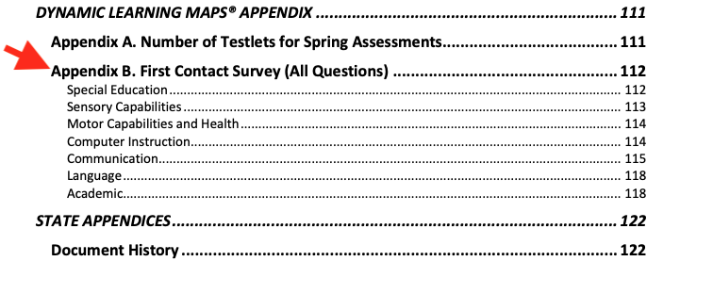
First Contact Survey
Excerpt from the Test Administration Manual table of contents
Notes:
The full list of questions for the First Contact survey are provided in the appendix of the Test Administration Manual. Only one First Contact survey is completed per student per year. This list may be helpful for situations where a student is assessed by one teacher for ELA but another for mathematics and another for science. The test administrators involved can consult the list of questions and confer as to how they should be answered, particularly for the section about the student’s academics.

Slide 23
The instruction and assessment planner
Notes:
The next section provides an overview of the Instruction and Assessment Planner.

Slide 24
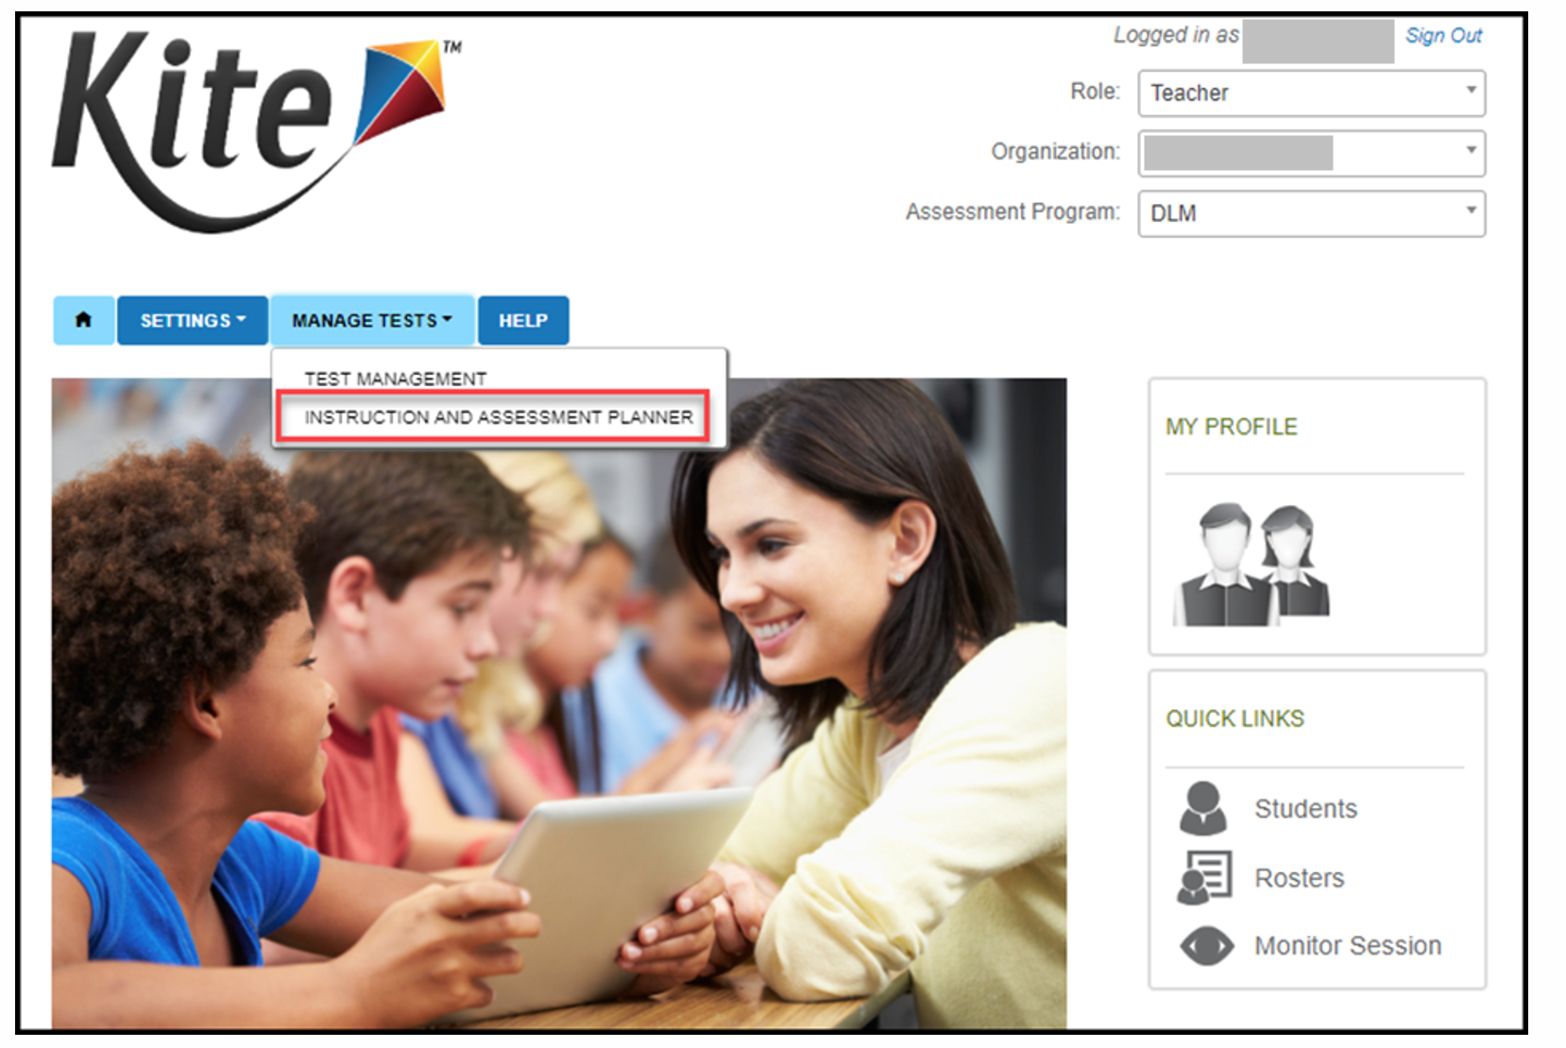
Instruction and Assessment Planner
Note: The Instruction and Assessment Planner is only available during the instructionally embedded assessments window.
Sept 14, 2020 — Feb. 24, 2021
Notes:
The Instruction and Assessment Planner is only accessible during the instructionally embedded assessments window. It is found under the Manage Tests tab in Educator Portal. Therefore, this section of the presentation applies only to the optional instructionally embedded assessment window for the fall and winter months. The Instruction and Assessment Planner is not used for the required spring assessment window.

Slide 25
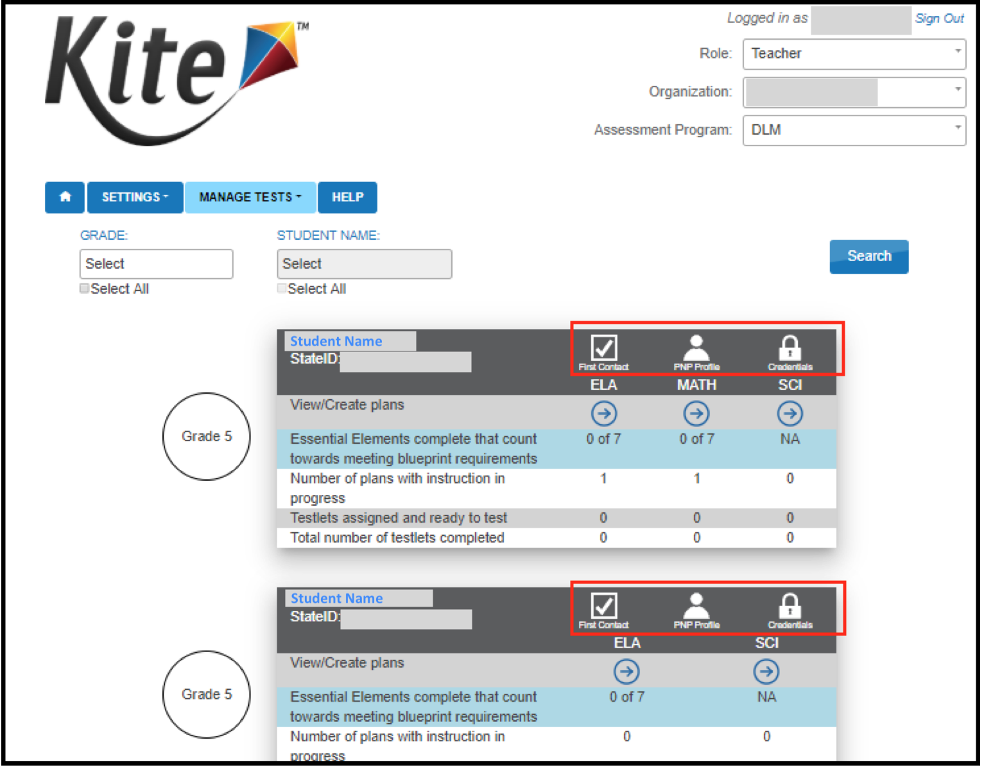
inside the Instruction and Assessment Planner in Educator Portal
Notes:
Inside the Instruction and Assessment Planner, all students rostered to the teacher are listed by grade and can be filtered. Shown here is information for two students in grade 5.
At the top of the table for each student are buttons for the student’s First Contact survey, Personal Needs and Preferences (PNP) Profile, and login credentials for Student Portal. The checkmark above First Contact indicates the student’s First Contact survey has been completed. When not completed, a caution icon appears instead, and the arrows for each subject are inaccessible. The arrows are used to access the Essential Elements and their linkage levels for each subject.

Slide 26
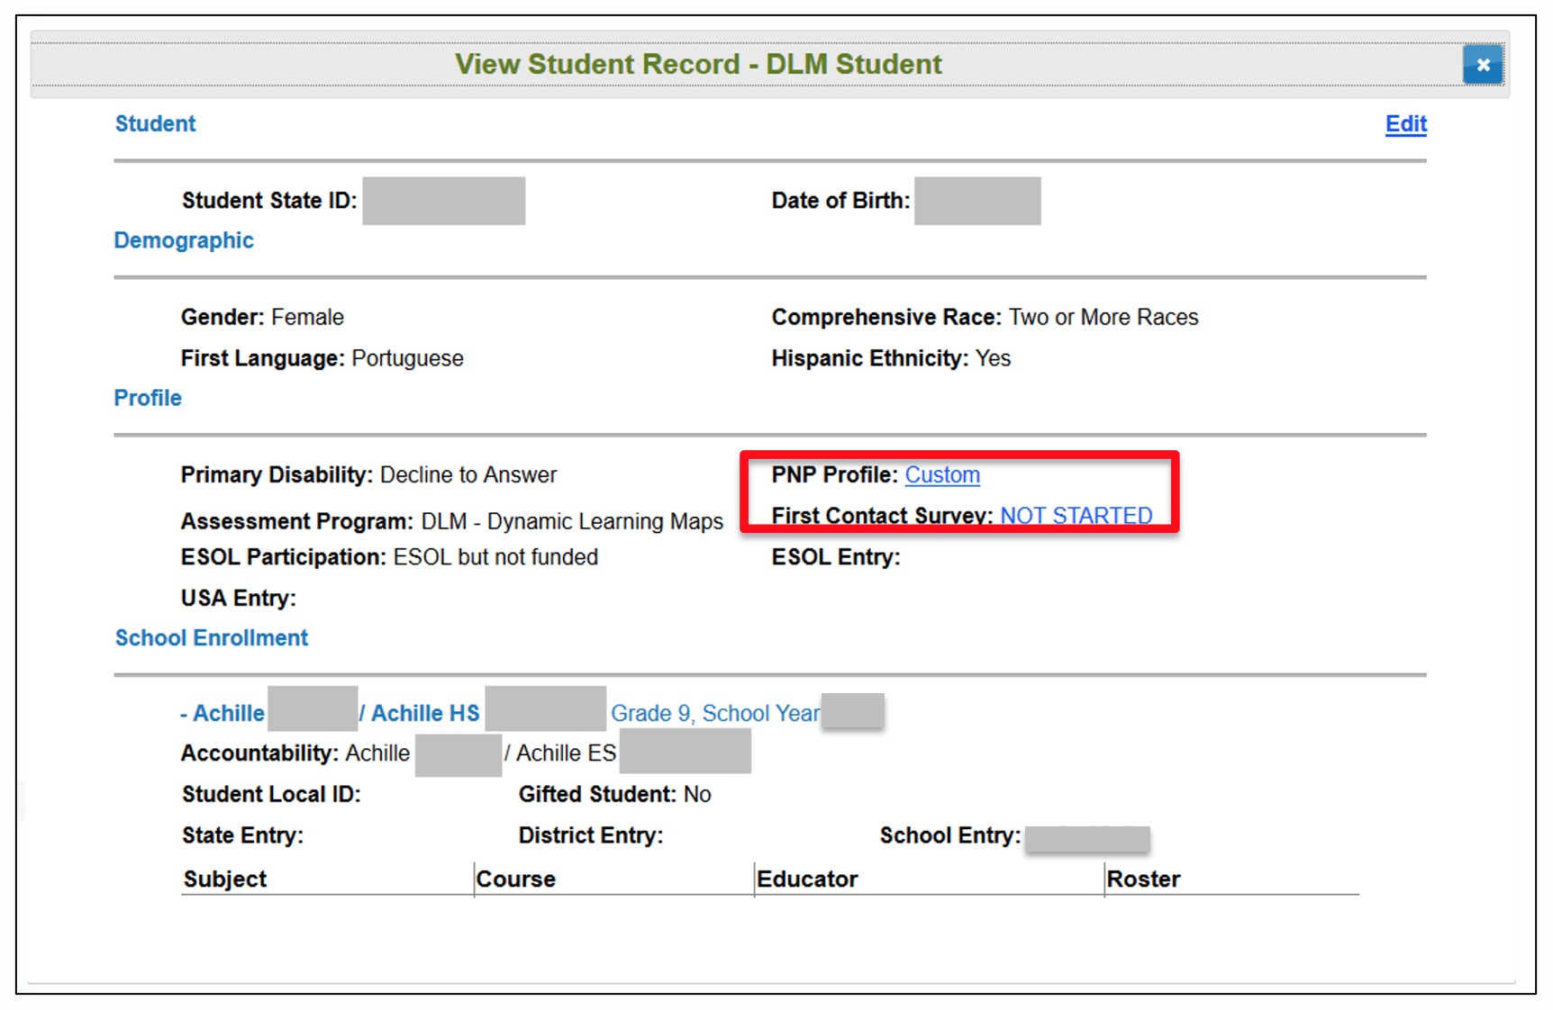
inside the student’s record in Educator Portal
other location if not completed in the Instruction and Assessment Planner
Notes:
The student’s Personal Needs and Preference Profile and First Contact survey can also be accessed from the student’s record in Educator Portal apart from the Instruction and Assessment Planner. However, the Instruction and Assessment Planner is a convenient place to complete and review them when making selections for the instructionally embedded assessments.

Slide 27
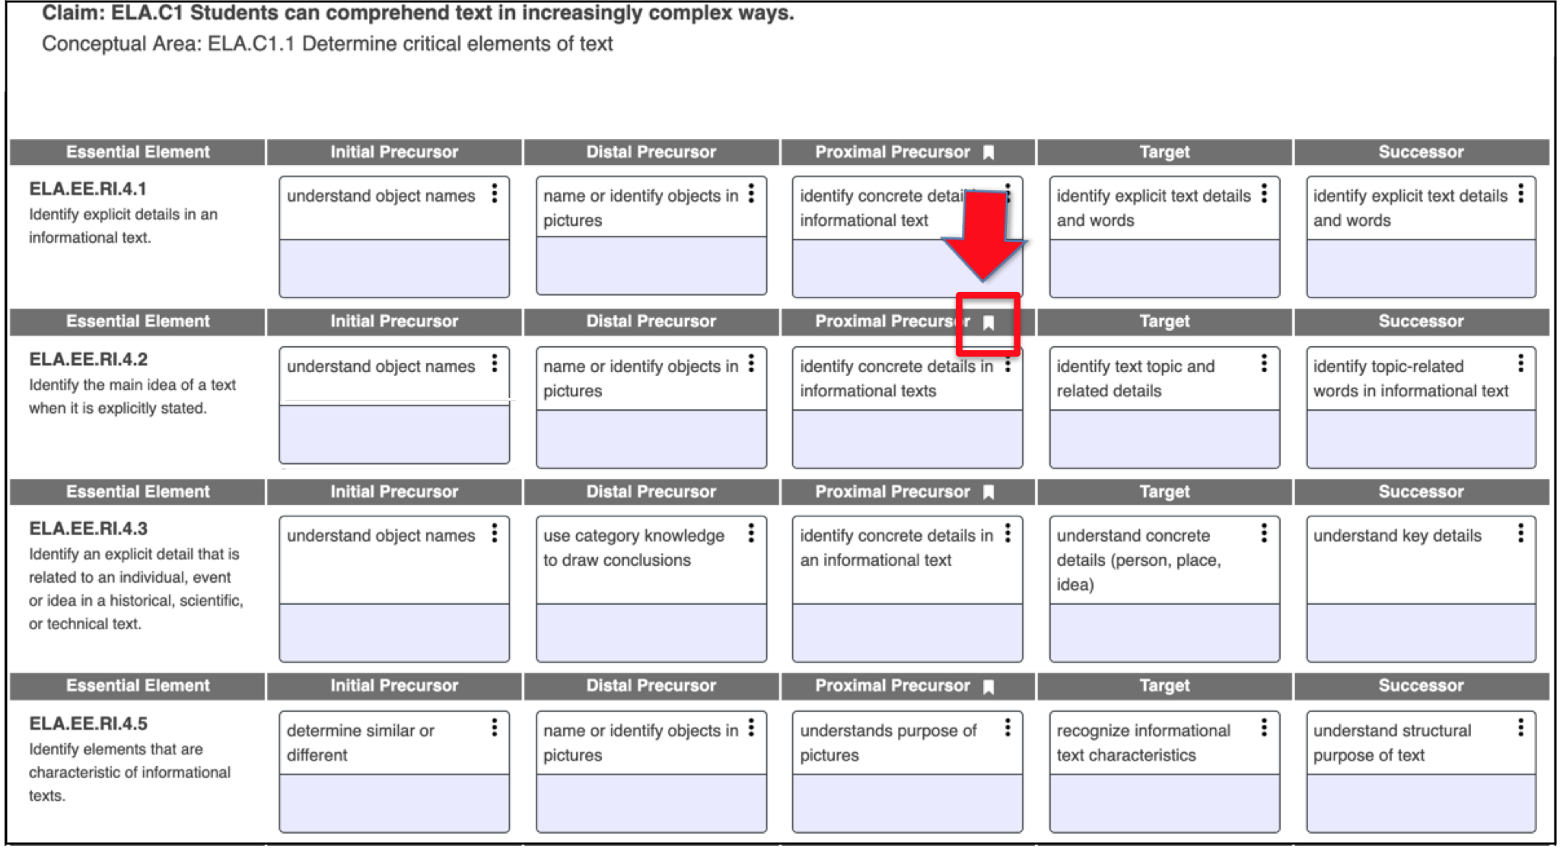
Instruction and Assessment Planner
inside the Instruction and Assessment Planner
Continue scrolling the page for Essential Elements in other conceptual areas
Notes:
Once a subject has been selected in the Instruction and Assessment Planner, the Essential Elements and their linkage levels are displayed by conceptual area for ELA and mathematics or domains for science. A ribbon icon indicates the linkage level the system recommends based on the teacher’s responses to the student’s First Contact survey, but remember a significant feature of the Instruction and Assessment Planner is that the teacher has the flexibility of choosing a different linkage level if desired, and there are many reasons a teacher may choose to do so, especially when reassessing a student after continued instruction.

Slide 28
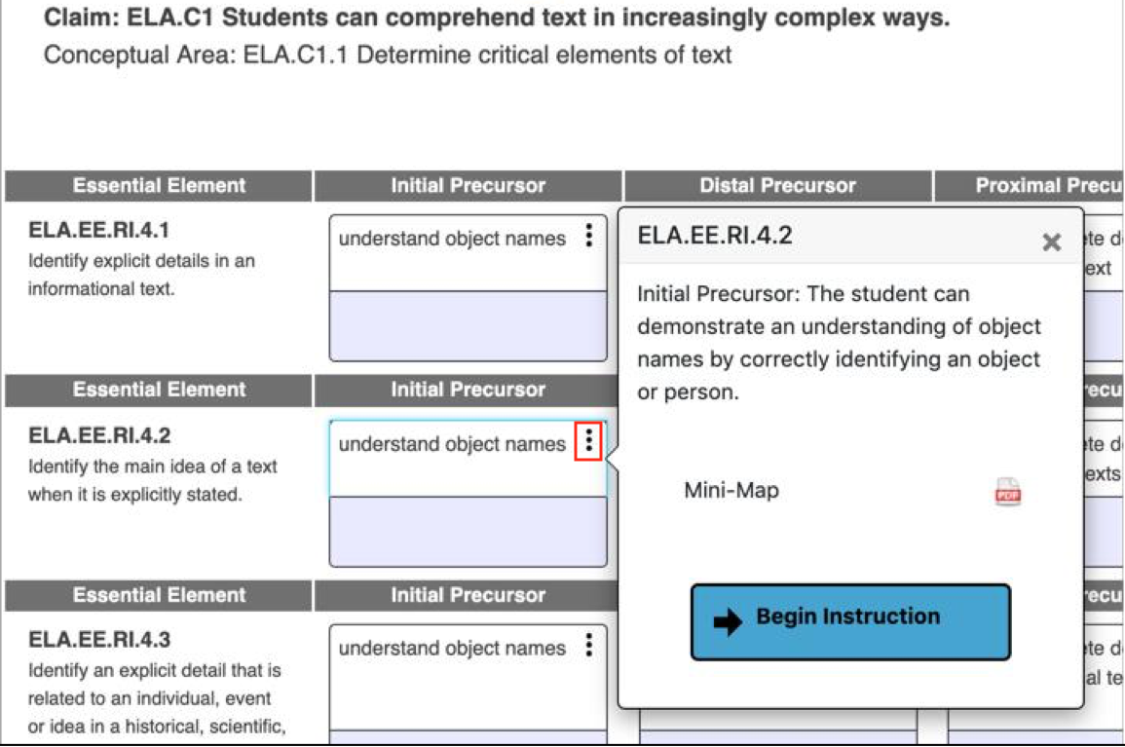
Using the Process
1. Choose
Key Considerations
What are the skills and knowledge that will be assessed at the chosen linkage level?
Is the chosen linkage level appropriate for the student? (It should be not too hard and not too easy.)
What type of activities and instruction might be used prior to assessing the student on the Essential Element?
Notes:
The three stacked dots that appear to the right of each linkage level description for each Essential Element are called a kabob. Selecting a kabob reveals a longer description of the chosen linkage level and a link to a PDF of the mini-map that shows where the linkage level is along the path of skills that lead to the Essential Element.
Key questions to consider when selecting a linkage level include
What are the skills and knowledge that will be assessed at the chosen linkage level?
Is the chosen linkage level appropriate for the student? (It should not be too hard and not too easy.)
What type of activities and instruction might be used prior to assessing the student on the Essential Element?

Slide 29
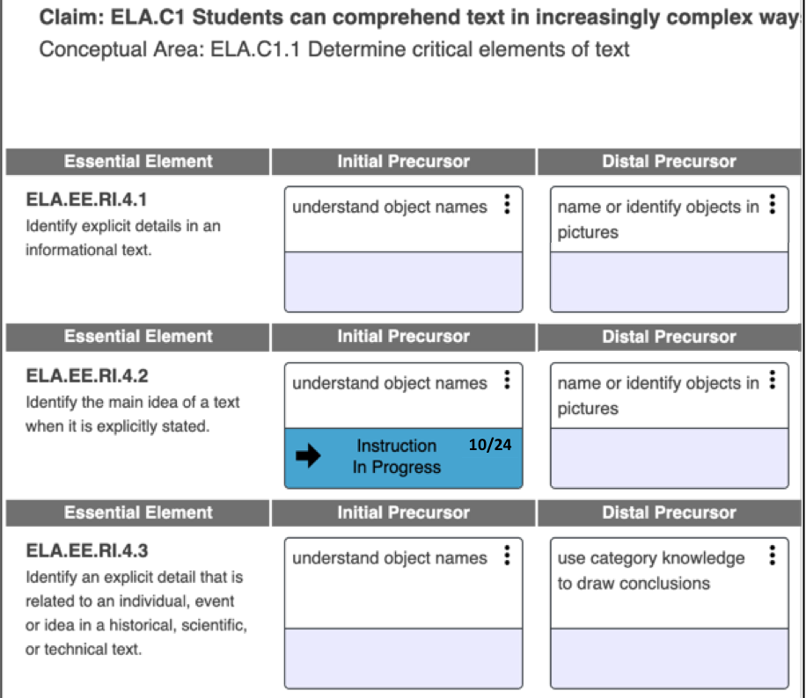
Using the Process
1. Choose
2. Instruct
Notes:
Selecting Begin Instruction places the linkage level in the In Progress status with the date it was chosen indicated. Return to the kabob menu for this updated status. A different choice can be made later if needed. Once the linkage level is placed in this status, provide instruction. More information about how to approach instruction is provided later in the presentation.

Slide 30
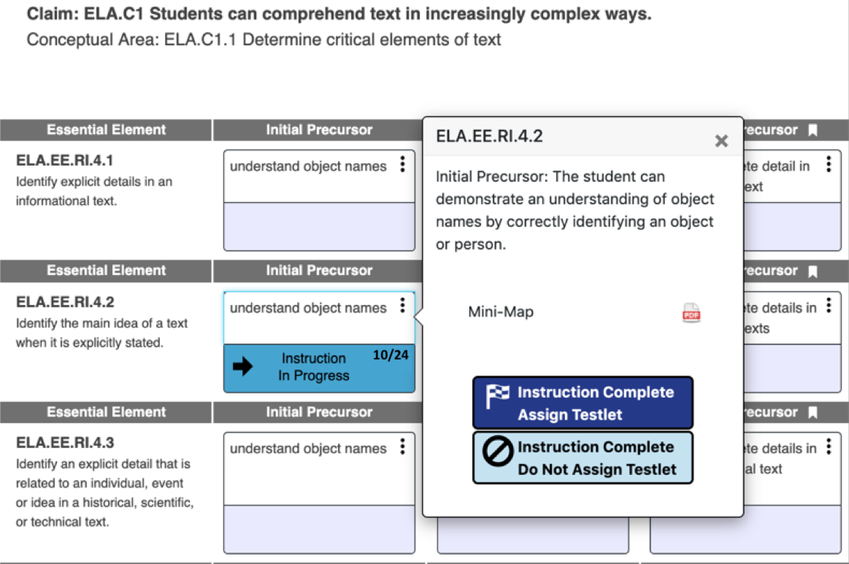
Using the Process
3. Assess
Notes:
When ready to assess the student, the teacher returns to the Instruction and Assessment Planner, selects the kabob again, and selects either Instruction Complete Assign Testlet or Instruction Complete Do Not Assign Testlet. Assigning a testlet means a testlet for the chosen Essential Element and linkage level will be available for the student in Student Portal and cannot be canceled at this point. Not assigning a testlet is selected when the teacher has decided to forego the chosen linkage level for another option.

Slide 31
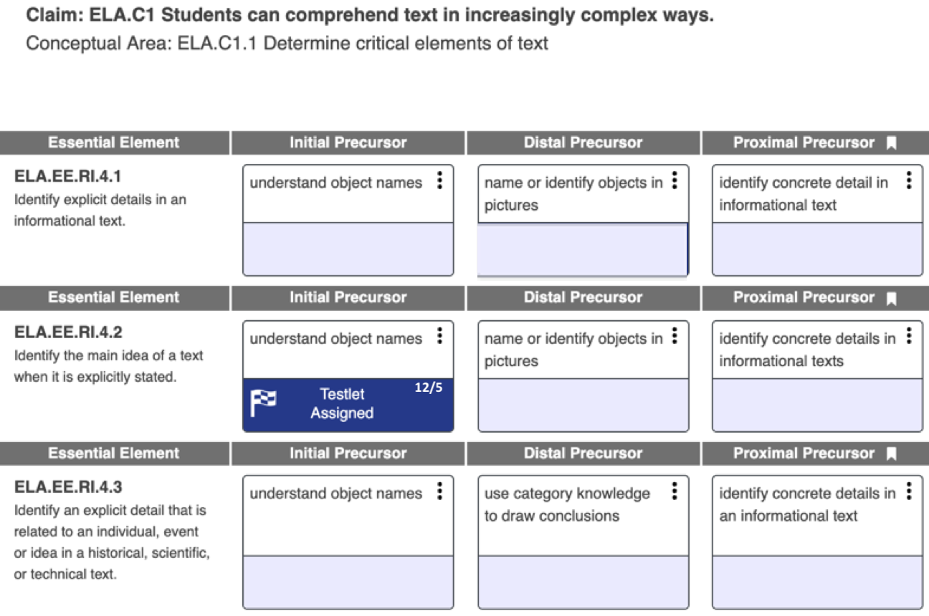
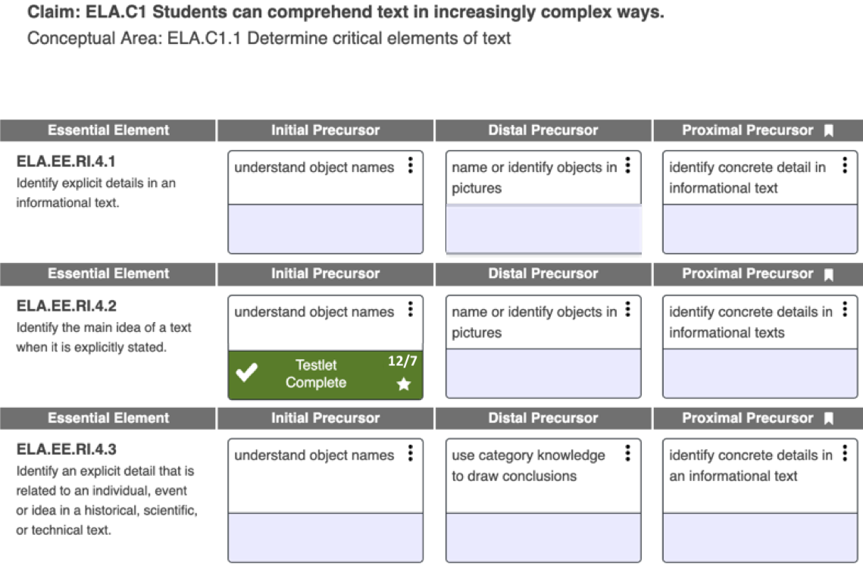
Using the Process
3. Assess
once the testlet has been assigned
once the testlet has been taken
Notes:
When a testlet is assigned, the kabob menu indicates the Testlet Assigned status in the Instruction and Assessment Planner along with the date the action took place. Then after the student takes the testlet in Student Portal, the Instruction and Assessment Planner indicates the testlet has been completed along with the date it was completed.

Slide 32
Using the Process
3. Assess
Retrieve the Testlet Information Page from Educator Portal!
available in the Instruction and Assessment Planner for the instructionally embedded assessments after Instruction Complete Assign Testlet has been selected
Testlet Information Pages are secure testing materials and must be destroyed after use.
Notes:
Each time a testlet is assigned to Student Portal, a corresponding Testlet Information Page becomes available in Educator Portal, which helps the teacher prepare to administer the testlet. The Testlet Information Page provides information about any materials needed to administer the testlet so that the teacher is not surprised and inconvenienced when sitting down with a student to administer the testlet in Student Portal.
A Testlet Information Page is only available once Instruction Complete Assign Testlet is selected in the Instruction and Assessment Planner, because a Testlet Information Page is testlet-specific. Remember Testlet Information Pages are considered secure testing materials and must therefore be destroyed after use.

Slide 33
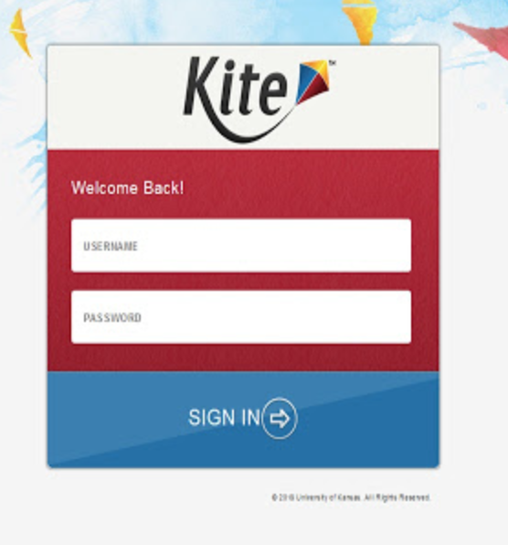
Using the Process
3. Assess
in Student Portal…
Log in using the student’s credentials.
Remember, the credentials are accessible in the Instruction and Assessment Planner.
Select Take A Test.
Select the desired testlet if more than one testlet is in the queue.
Notes:
Student Portal must be downloaded and installed from the DLM website on the computer or tablet being used to administer testlets to a student. Either have the student log in to Student Portal or do so for the student. Remember, the student’s credentials are accessible in the Instruction and Assessment Planner. Once logged in, the Take a Test option should be selected and then the desired testlet to be taken if more than one testlet is in the queue.

Slide 34
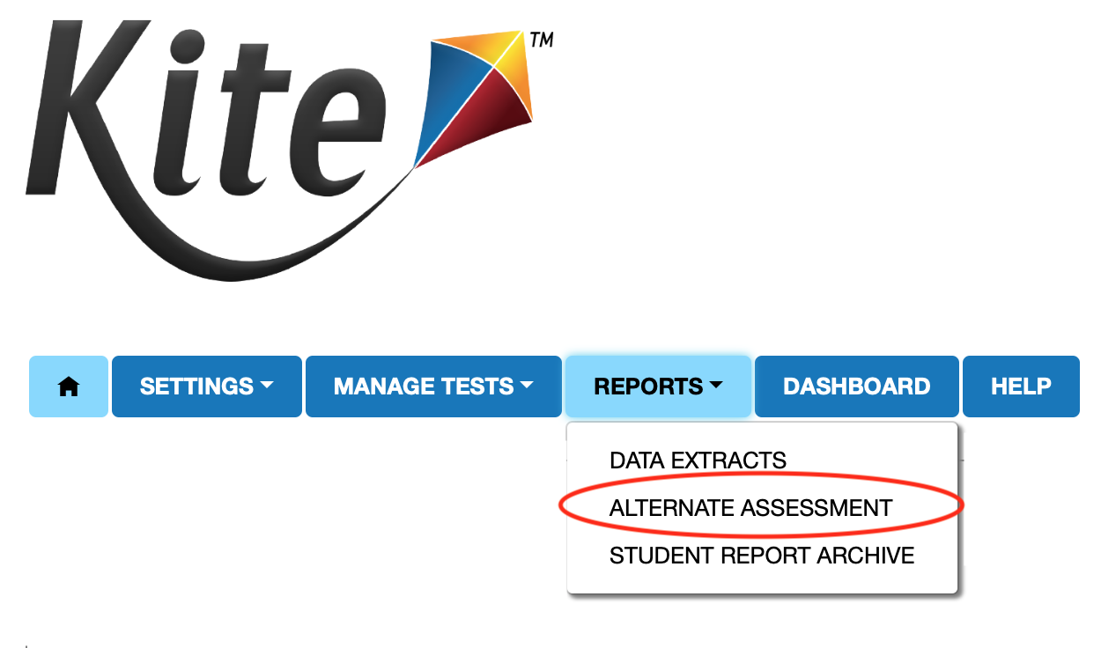
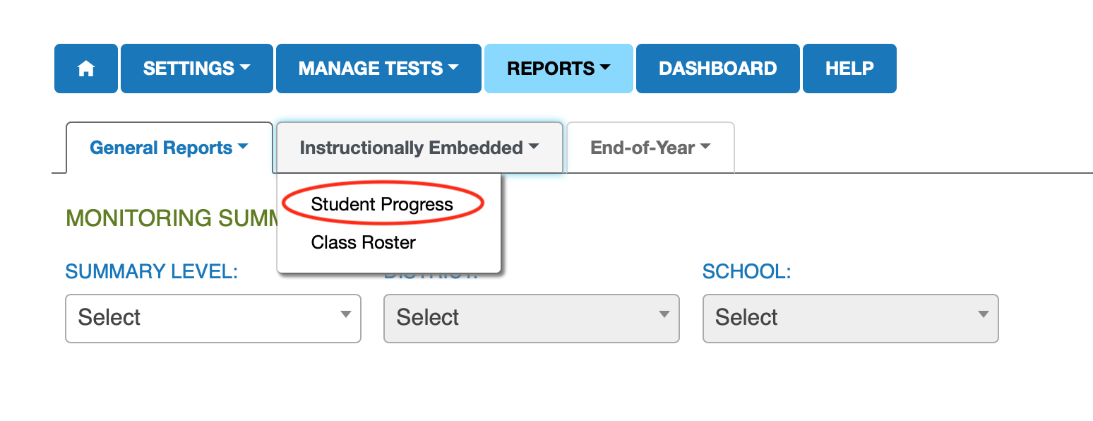
On-Demand Progress Reports
4. Determine Next Steps
Notes:
On-demand progress reports are available in Educator Portal for instructionally embedded assessments taken. They are accessed by selecting Alternate Assessment under the Reports tab then Student Progress under the Instructionally Embedded tab. Notice a class roster report is also available.
Results from instructionally embedded assessments taken can help the teacher determine the next steps for the student. Perhaps the student would benefit from continued instruction on the assessed Essential Element and linkage level. Perhaps the student is ready for instruction on a higher linkage level. Or, maybe the student should be reassessed at a lower linkage level. These options are decisions for the teacher to make using the data from the instructionally embedded assessment results.

Slide 35
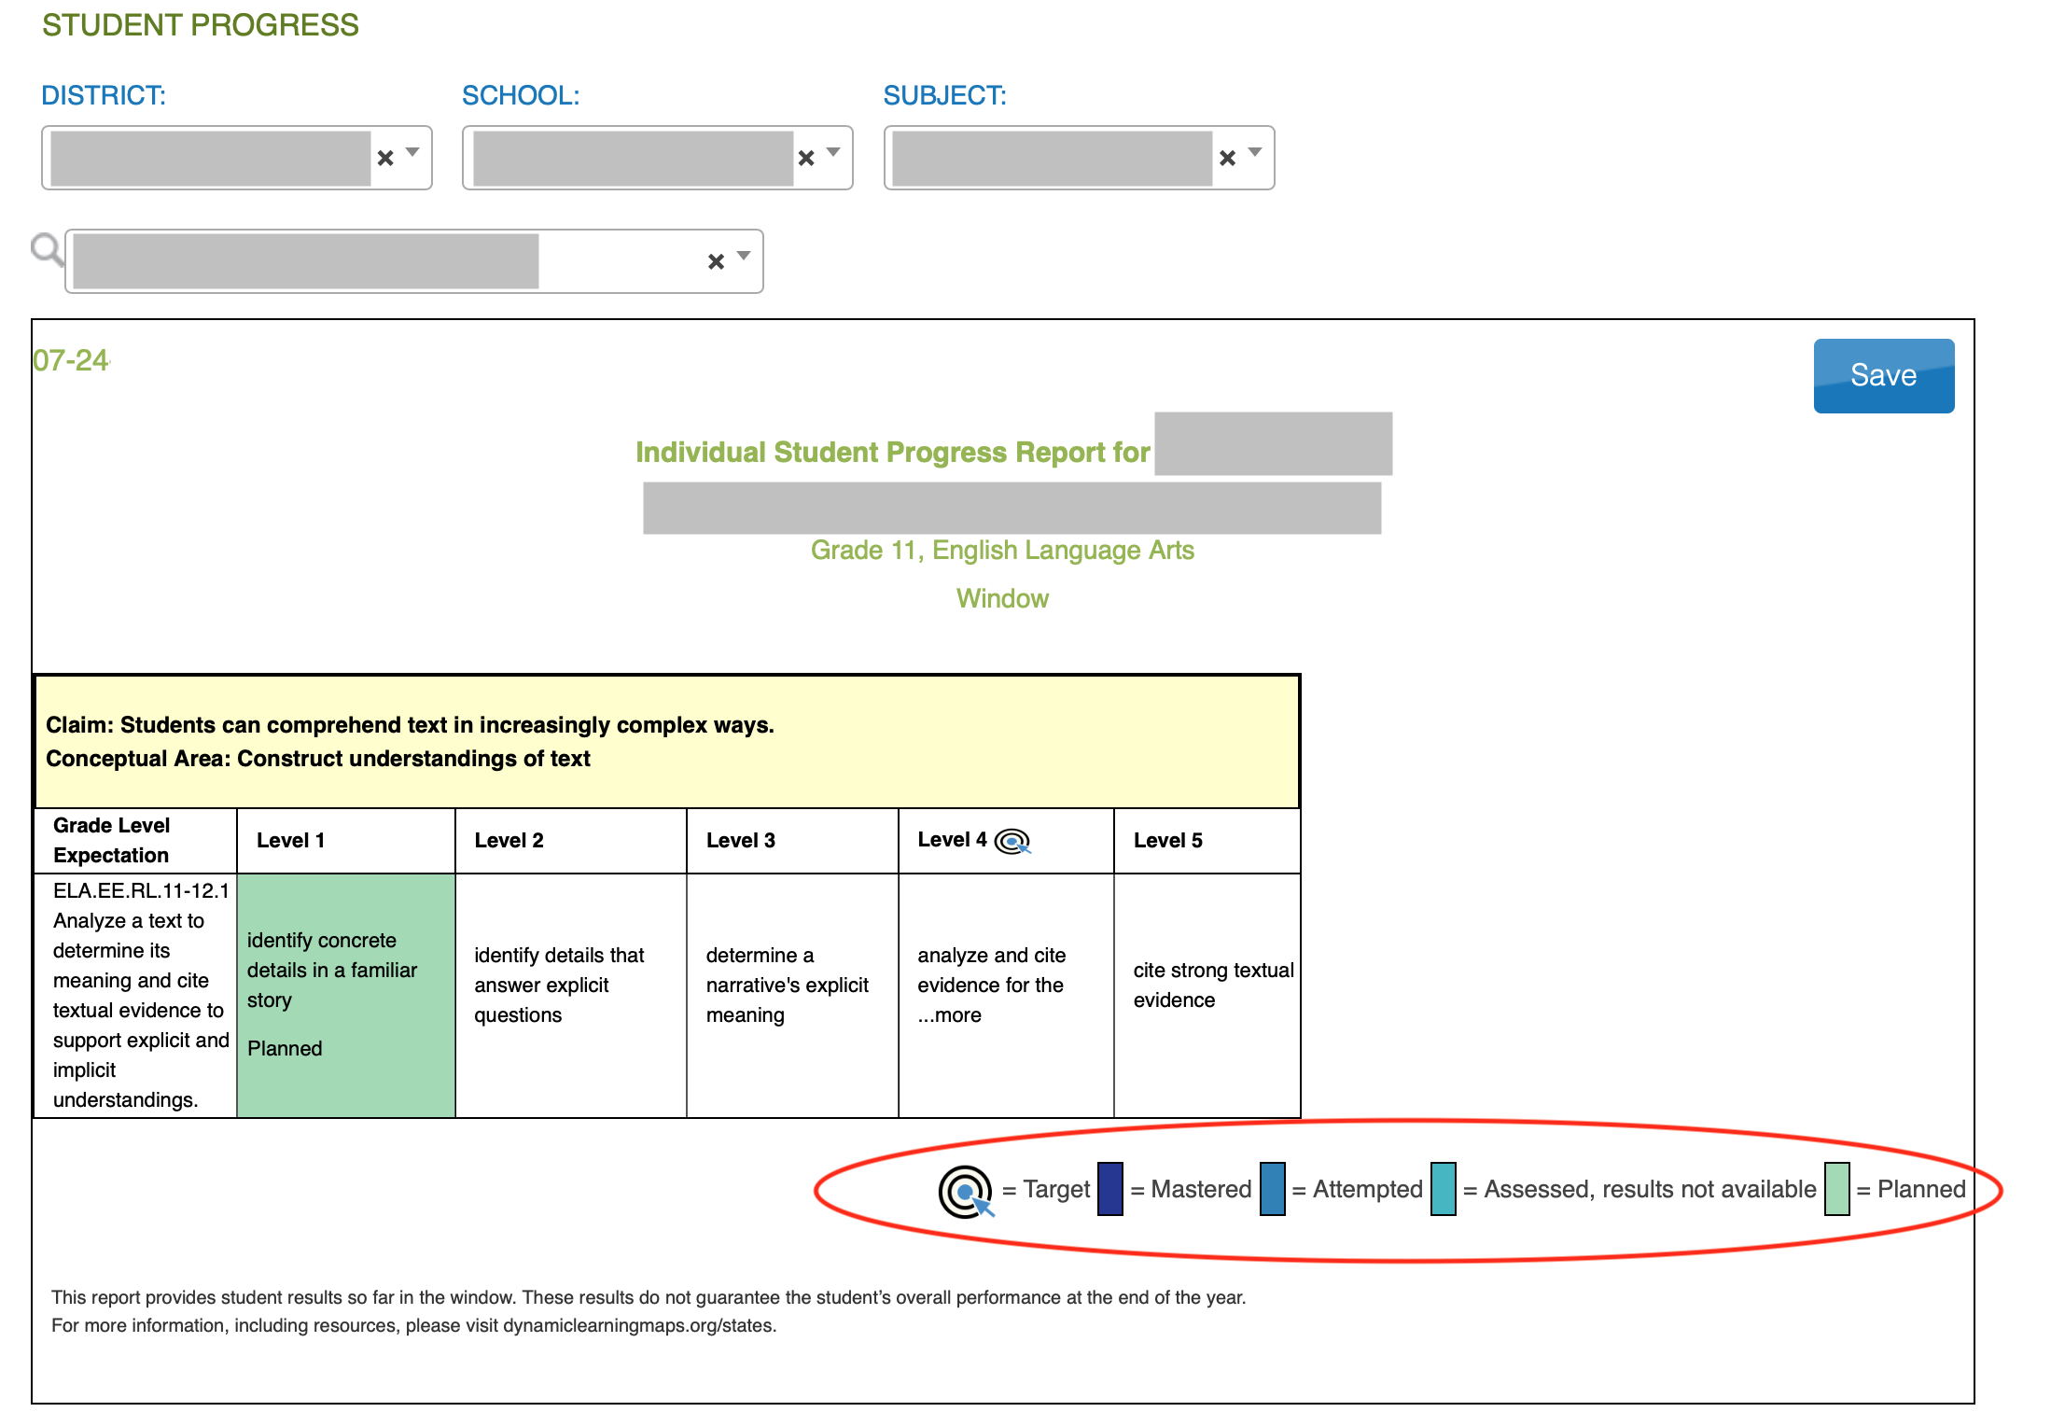
On-Demand Progress Reports
Can select one or more students at a time.
Student progress reports will display results from any/all instructionally embedded testlets taken per student by grade and subject.
Notes:
The on-demand student progress report shows any/all linkage levels planned, assessed, and mastered. In the reports, level 1 is the Initial Precursor linkage level. Level 2 is the Distal Precursor linkage level. Level 3 is the Proximal Precursor linkage level. Level 4 is the Target linkage level. Level 5 is the Successor linkage level.
Shown here is a snippet of an English language arts report for a student in grade 11. This report indicates the student has not completed any testlets but that a plan is in place for the Initial Precursor linkage level for Essential Element RL.11-12.1. In the Instruction and Assessment Planner, the linkage level would be in the In Progress status.

Slide 36
The Teacher Is In The Driver’s Seat!
The teacher has the opportunity to
choose the Essential Elements and linkage levels for each student
decide when the student is ready to be assessed
cancel plans in the Instruction and Assessment Planner or proceed to assigning a testlet
determine next steps for instruction
make assessment a normal part of the classroom experience
Notes:
In summary, instructionally embedded assessments put teachers in the driver’s seat and provide them with the opportunity to choose Essential Elements and linkage levels, decide when each student is ready to be assessed, cancel and change plans at will, determine the next steps for instruction, and ultimately make assessment a normal part of the classroom experience.

Slide 37
Review
Having a student complete instructionally embedded assessments will
provide the student and test administrator experience in the system
allow for an assessment experience following instruction on an Essential Element
Having a student complete instructionally embedded assessments will not
impact testlets delivered in the spring assessment window
impact a student’s score report
Notes:
Having a student complete instructionally embedded assessments will provide the student and test administrator with experience in the DLM system and allow for an assessment experience following instruction on an Essential Element. Having a student complete instructionally embedded assessments will not impact testlets delivered in the spring assessment window or impact a student’s end-of-year score report.

Slide 38
Making choices for instruction and assessment
Notes:
In light of the information provided thus far about instructionally embedded assessments, the next several slides will address considerations when making choices for instruction and assessment. This section will also highlight some of the instructional materials provided.

Slide 39
self-contained, single grade?
self-contained, multi-grade?
inclusion?
one student?
several students?
one subject?
multiple subjects?
Notes:
A teacher’s approach to instruction often depends on the size of the school or district and the type of classroom set-up. Teachers may have self-contained single grade classes, self-contained multiple grade classes, or perhaps even teach in an inclusive setting. Some teachers only have one student who participates in the alternate assessment, while others may have several students. Some teachers, especially elementary teachers, may be responsible for teaching multiple subjects, whereas other teachers are departmentalized. All of these circumstances are important to consider.

Slide 40
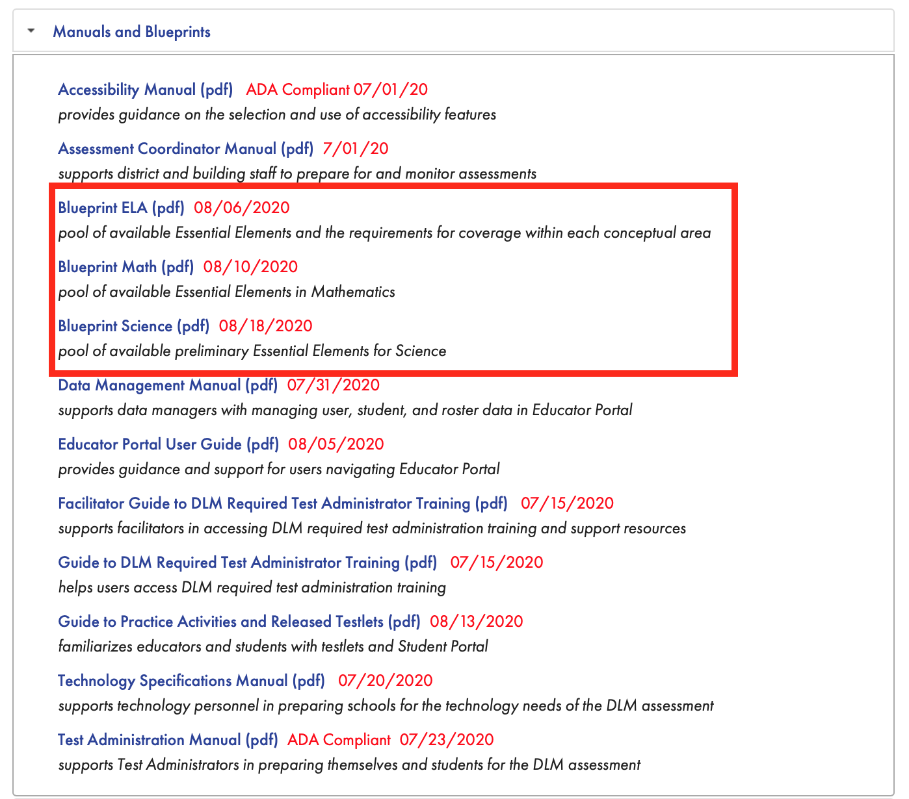
Blueprints
Notes:
To begin the discussion about making choices for instruction and assessment, consider the test blueprints. A DLM blueprint is a list of the Essential Elements to be assessed. Each subject has its own blueprint, and the Essential Elements are listed by grade. The blueprints can be accessed on the state’s page of the DLM website under the Manuals and Blueprints tab.

Slide 41
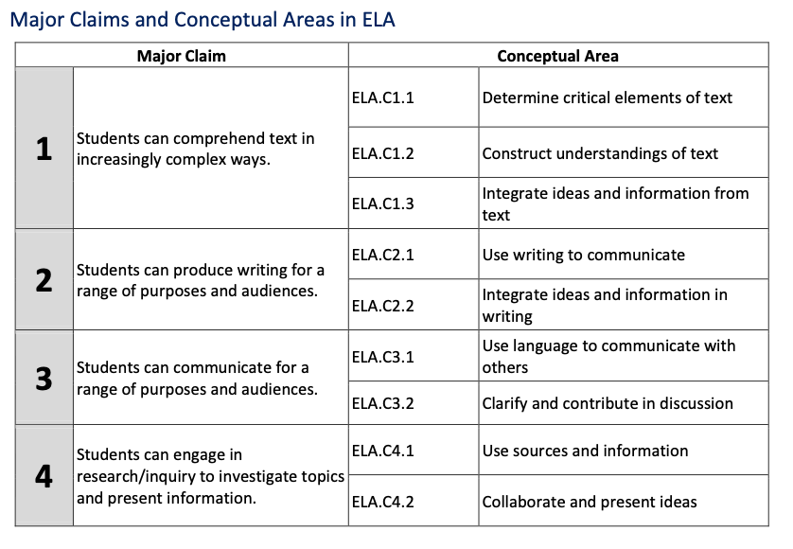
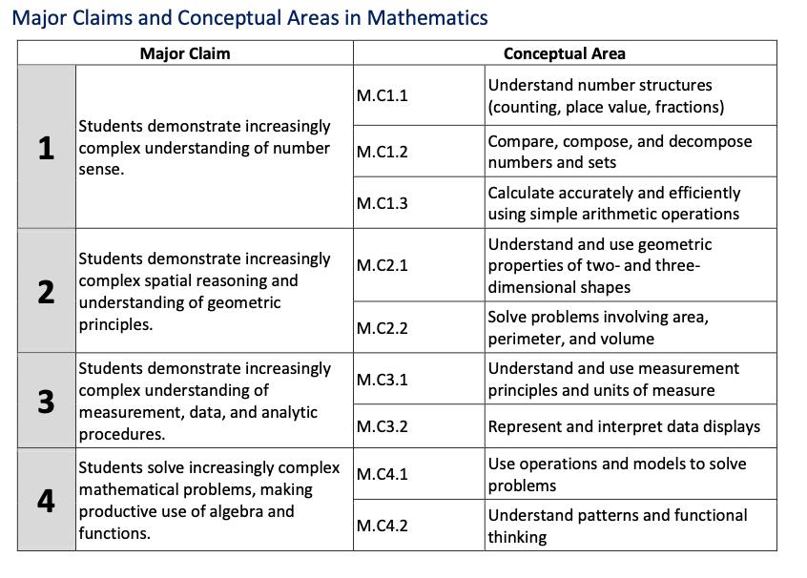
Conceptual Areas for ELA and Mathematics
Notes:
The blueprints for ELA and mathematics are organized into claims and conceptual areas. Claims are broad groups of related Essential Elements. ELA and mathematics each have four claims. Claims are further organized into conceptual areas, which are groups of Essential Elements that are more closely related to one another than to those in the broader claim.
For each grade level, Essential Elements from conceptual areas within claims 1 and 2 for ELA are assessed. However, Essential Elements within claims 3 and 4 for ELA are not currently assessed. Essential Elements for claims 1 and 2 were prioritized for the assessment because claim 1 pertains to reading comprehension and claim 2 pertains to writing.
For mathematics, Essential Elements from conceptual areas across all four claims are assessed.
Keep this in mind when planning units of instruction, as conceptual areas may provide opportunities to build instruction targeting multiple Essential Elements instead of approaching each Essential Element in isolation.

Slide 42
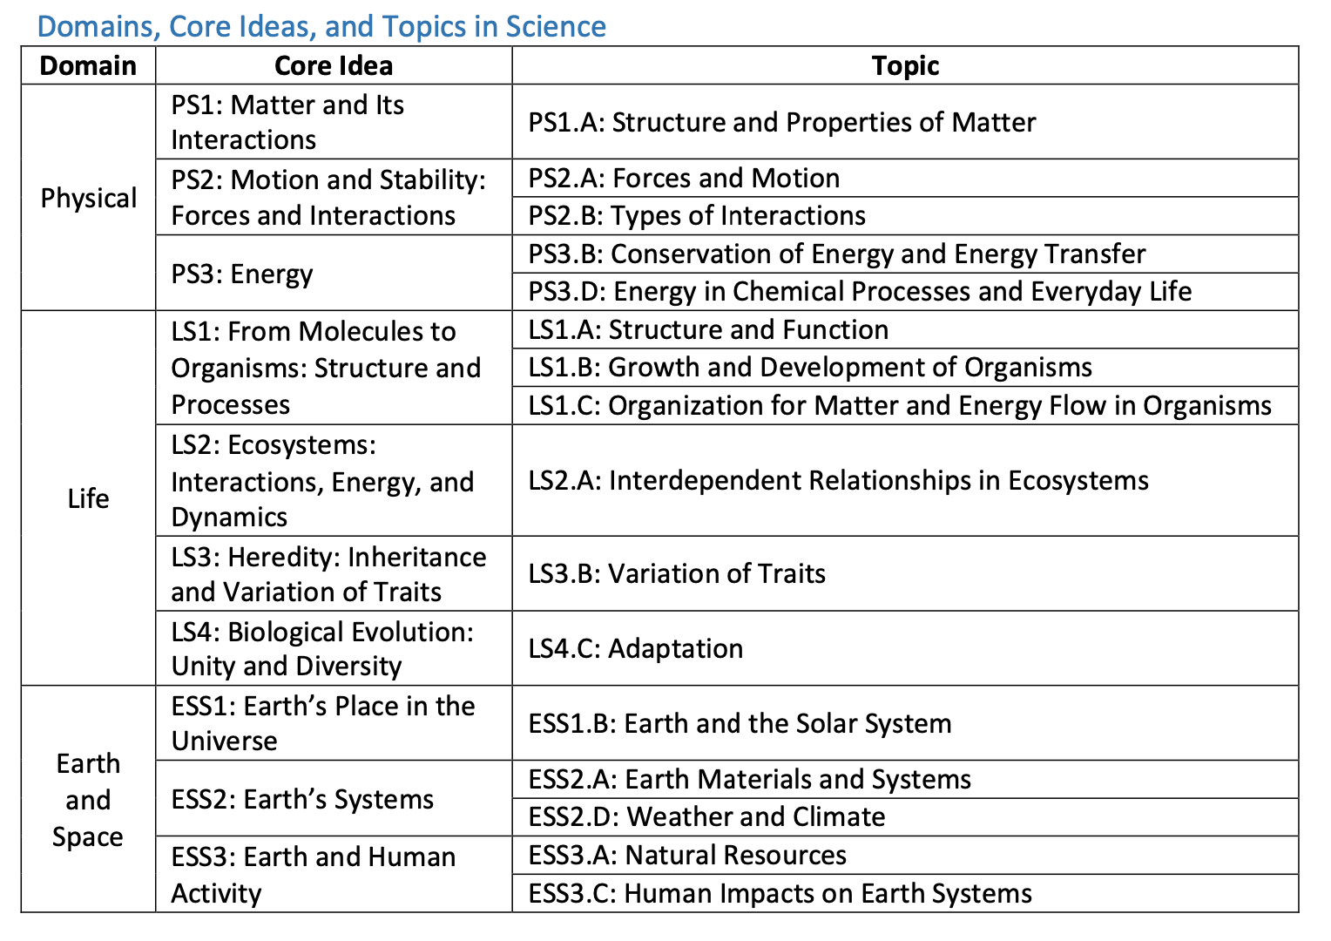
Domains, Core Ideas, and Topics for Science
Notes:
Science Essential Elements are organized into domains, core ideas, and topics rather than claims and conceptual areas. For all grade bands (elementary, middle, and high) three domains are assessed: physical science, life science, and Earth and space science. Physical science has three core ideas, and each has one or two topics. Life science has four core ideas with one to three topics in each. Earth and space science has three core ideas with one or two topics in each. Like ELA and mathematics, keep these domains, core ideas, and topics in mind when planning units of instruction, as they may provide opportunities to build instruction targeting multiple Essential Elements instead of approaching each Essential Element in isolation.

Slide 43
Currently Tested Essential Elements
Resources for Educators and District Staff tab > Educator Resource Page (for the desired subject)
Notes:
The blueprints are also available on the Educator Resource Page for each subject under the Resources for Educators and District Staff tab of the state’s page of the DLM website. The Currently Tested Essential Elements are also provided on the Educator Resource Page and include links to the mini-maps documents used for instructional planning. Select the Educator Resource Page for ELA and mathematics or the one for science. Shown here is an excerpt from the Educator Resource Page for ELA and mathematics. The ELA icon has been selected, and the Currently Tested Essential Elements for ELA are found under the Essential Elements heading.

Slide 44
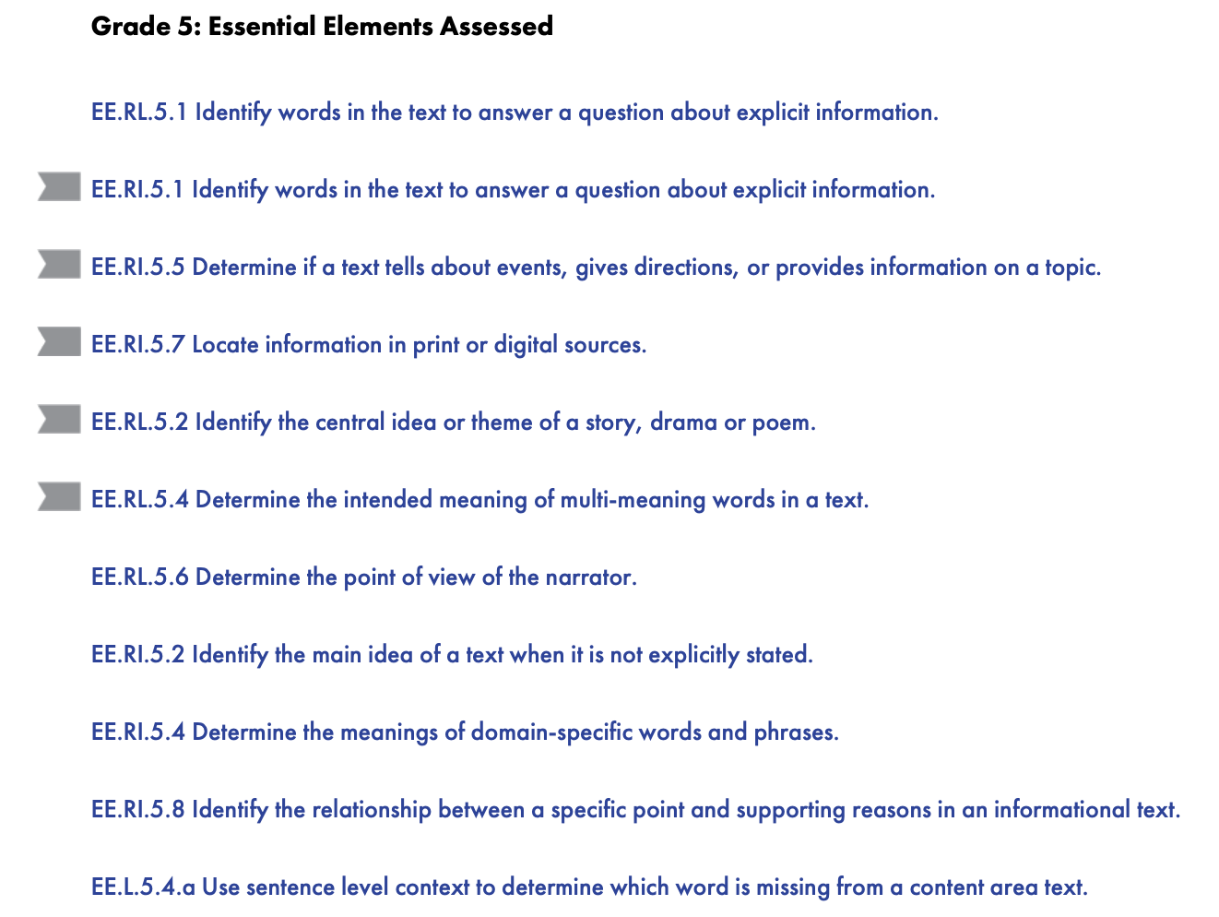
Currently Tested Essential Elements
ELA
Resources for Educators and District Staff tab > Educator Resource Page (for the desired subject)
scroll for other grades
EXCERPT
Notes:
Within the Currently Tested Essential Elements document, all currently assessed Essential Elements are listed by grade. Shown here is an excerpt with the Essential Elements for Grade 5. Gray flags indicate Essential Elements that are not currently a part of the Year-End model blueprint but may still be useful in instruction. All Essential Elements are available in the Instruction and Assessment Planner, so consult the Currently Tested Essential Elements to prioritize which Essential Elements to select in the Instruction and Assessment Planner. Notice at the end of the list of Essential Elements is a link to a PDF that contains all of the grade 5 ELA Essential Elements in one PDF.
Click an Essential Element to learn more about it and its linkage levels. For the purpose of this presentation, EE.RI.5.2 “Identify the main idea of a text when it is not explicitly stated” will be used as an example.

Slide 45
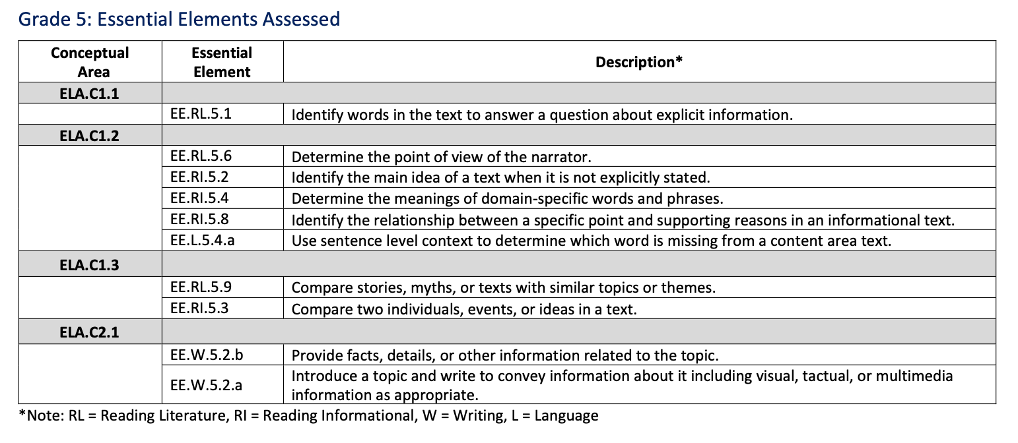
ELA Blueprint
EXCERPT
Notes:
Going back to the blueprint for ELA, EE.RI.5.2 falls within Conceptual Area 1.2.

Slide 46
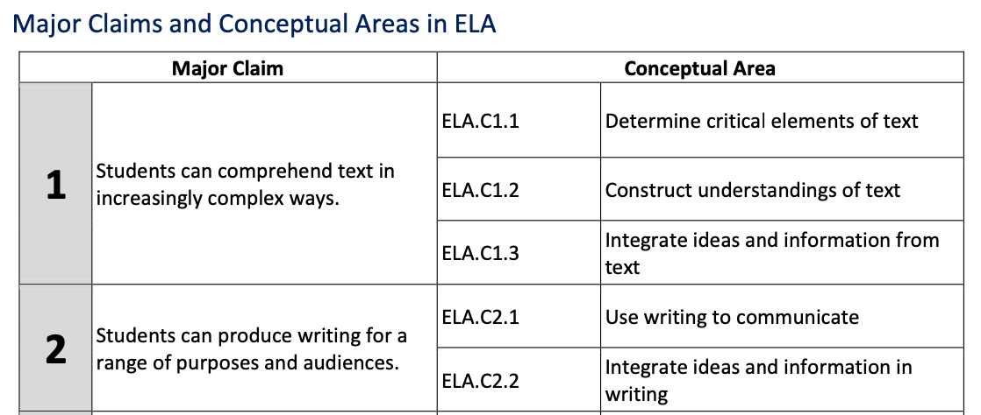
ELA Blueprint
EXCERPT
Notes:
Essential Elements for conceptual area 1.2 all pertain to constructing understandings of text.

Slide 47
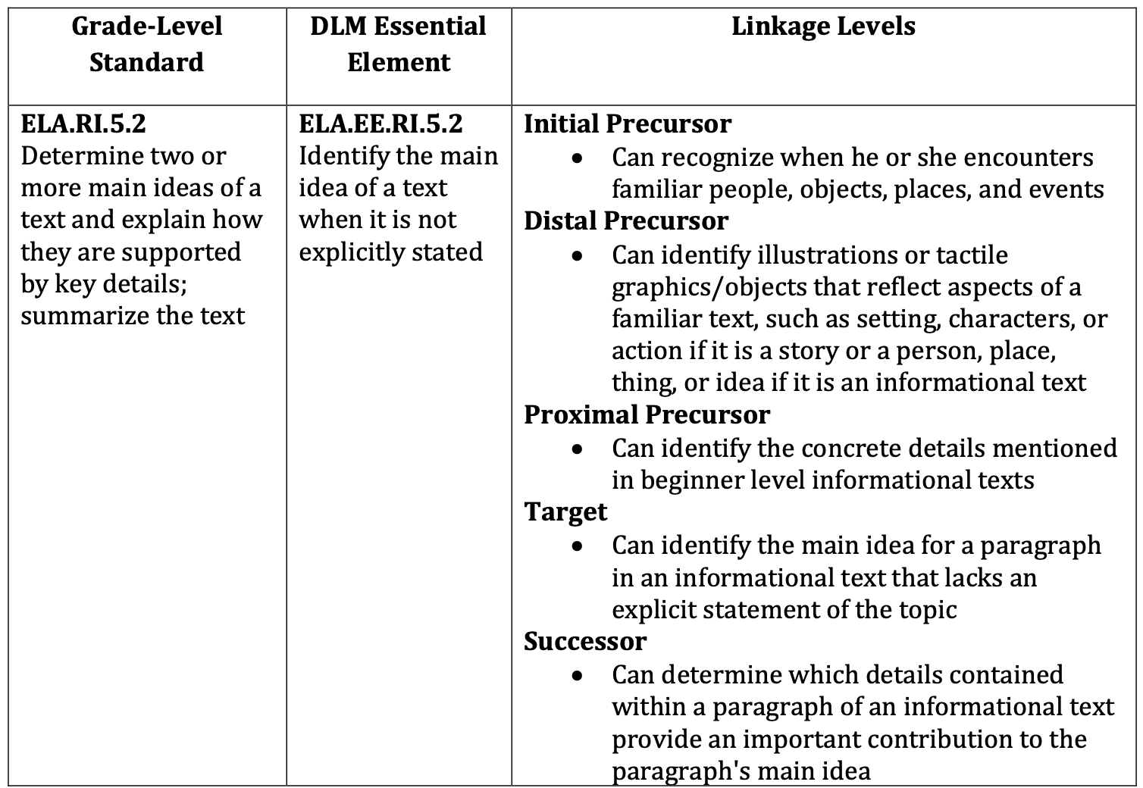
Currently Assessed Essential Elements
EXAMPLE
Notes:
When the Essential Element is selected in the Currently Tested Essential Elements for ELA, the first page of the resulting PDF lists the general education grade-level standard, the Essential Element, and the linkage levels for the Essential Element.

Slide 48
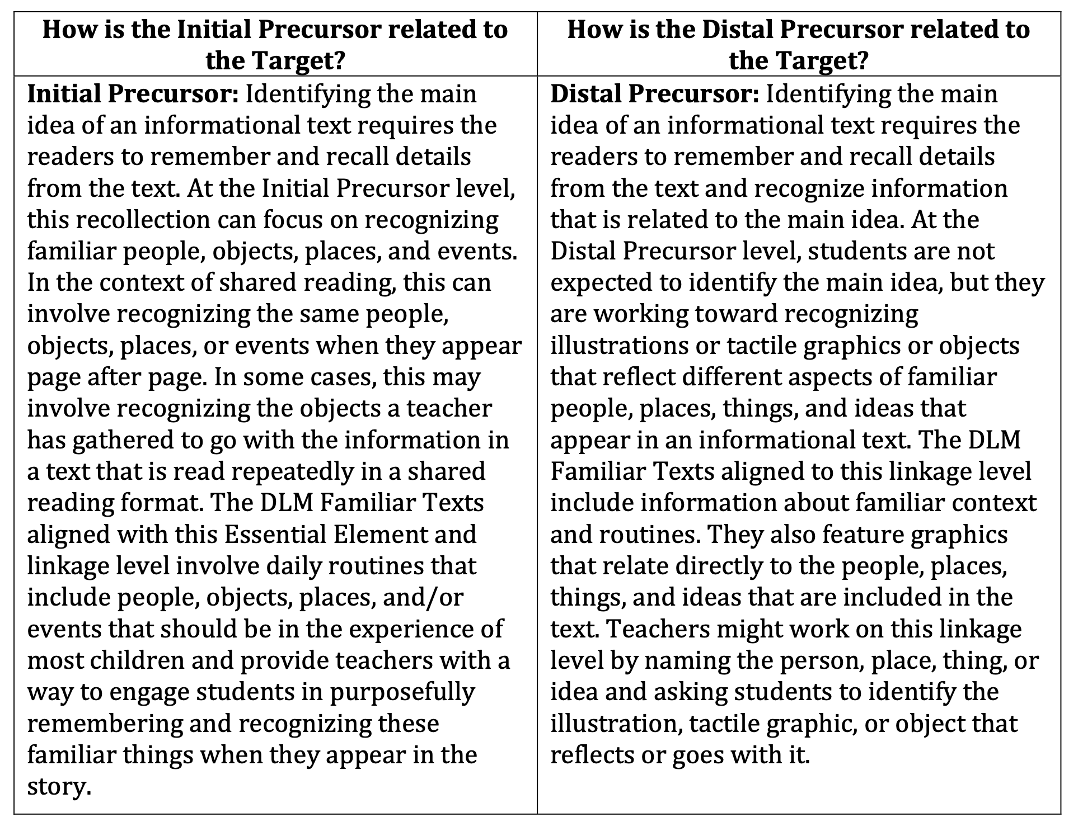
Currently Assessed Essential Elements
EXAMPLE
Notes:
The next page of the PDF provides more information about how the Initial Precursor and Distal Precursor linkage levels relate to the Target. Initial Precursor and Distal Precursor skills are often foundational skills, and so the connection to the Target level may not be obvious. This page helps explain how those skills are indeed related to the Target.

Slide 49
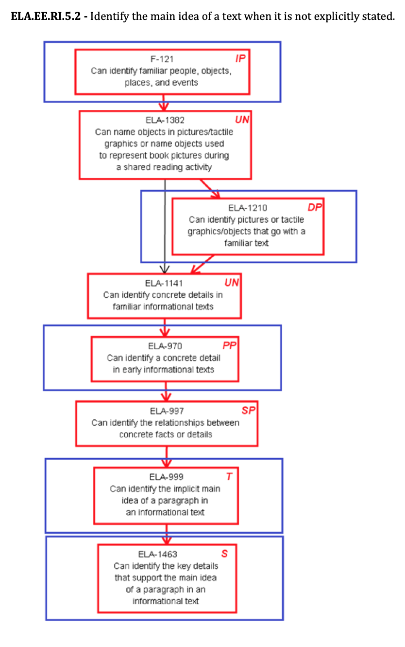
Mini-Map
EXAMPLE
Notes:
The last page of the Currently Tested Essential Elements PDF for ELA.EE.RI.5.2 is the mini-map. A mini-map is a diagram that shows the possible learning routes from one linkage level to another for a particular Essential Element. The arrows in a mini-map are called connections because they route from one skill to another. The mini-map for ELA.EE.RI.5.2 is rather linear. Other mini-maps, particularly those for mathematics, show multiple pathways of learning from skill to skill. The linkage levels increase in complexity moving down the mini-map. In the case of this mini-map, if a student can identify familiar people, objects, places and events, as stated for the Initial Precursor skill, perhaps they can then be taught the next skill, which is untested but still important to the route. UN in the box stands for untested. The untested skill here is, “Can name objects in pictures/tactile graphics or name objects used to represent book pictures during a shared reading activity.” If after instruction the student can do that, then perhaps the student is ready for instruction aimed at the Distal Precursor skill, which is, “Can identify pictures or tactile graphics/objects that go with a familiar text.” Some students will be able to bypass the Distal Precursor skill and move on to the next skill in the map, which is another untested skill but moves the student on down the mini-map. The goal, of course, is to get to the Target skill, and with enough time and repeated instruction, many students are able to achieve higher levels of learning, often surprising their teachers.

Slide 50
Mini-maps provide teachers with a better understanding of how to help a student progress and give students more opportunities to learn.
Notes:
Mini-maps provide teachers with a better understanding of how to help a student progress and give students more opportunities to learn. In the past, many teachers struggled with where to start instruction or what to do once a student achieved a certain skill. And, in the past, many teachers fell into the trap of teaching skills that didn’t lead anywhere. While the linkage levels that comprise mini-maps are the basis of the DLM testlet writing approach, mini-maps are important instructional guides.

Slide 51
At which linkage level is a student currently?
How much time might be needed for the student to learn this skill?
What kinds of lessons and materials might be effective in teaching this skill?
Are there other skills that we could work on in the process?
How can instructional units meet the needs of multiple students?
Notes:
Becoming familiar with the Essential Elements and their linkage levels brings up several key questions for teachers to consider as they start to think about how to approach instruction. First, the linkage levels can be used to figure out at which level a student is currently and how much time might be needed to learn the skill and be ready for the next higher skill. Teachers must think about the curriculum and the lessons and materials likely to be most effective in the student’s instruction. Considering other skills that might be taught in conjunction is also important. Finally, teachers must think about how to provide instruction that fits all of the students they are teaching. These are the kinds of questions that the next section will address.

Slide 52
Review
Test blueprints
Claims and Conceptual Areas for ELA and mathematics
Domains, core ideas, topics for science
Currently Tested Essential Elements
Linkage levels
Mini-maps
Notes:
As a review, when approaching instruction targeting the Essential Elements and their linkage levels, the test blueprints for each subject list the assessed Essential Elements for each grade or grade band and organize them into groups of related Essential Elements by claims and conceptual areas for ELA and mathematics and domains, core ideas, and topics for science. Then, on the Educator Resource Page for each subject is a link to the Currently Tested Essential Elements for each subject. The Currently Tested Essential Elements list the Essential Elements to be assessed and their linkage levels, showing their interconnectedness in diagrams called mini-maps. Understanding how to use the test blueprints and Essential Elements documents is an important first step to approaching standards-based instruction for students who participate in the DLM alternate assessments.

Slide 53
Strategies for approaching instruction
Notes:
The next set of slides focus on strategies for approaching instruction using the Essential Elements and linkage levels.

Slide 54
self-contained, single grade?
self-contained, multi-grade?
inclusion?
one student?
several students?
one subject?
multiple subjects?
Notes:
As stated earlier, a teacher’s approach to instruction often depends on the size of the school or district and the type of classroom set-up. Teachers may have self-contained single grade classes, self-contained multiple grade classes, or perhaps even teach in an inclusive setting. Some teachers only have one student who participates in the alternate assessment, while others may have several students. Some teachers, especially elementary teachers, may be responsible for teaching multiple subjects, whereas other teachers are departmentalized. All of these circumstances are important to consider.

Slide 55
How Many Standards and Testlets?
Scope of Instruction
ELA—9 testlets total, each a single Essential Element except 1 that is a writing testlet that combines all writing Essential Elements for the grade
Mathematics—6-8 testlets depending on the grade
Science—9 testlets regardless of the grade band
Notes:
Consider the scope of Essential Elements to be taught and assessed. With the exception of writing testlets, each testlet a student takes assesses a single Essential Element. So, ELA has 8 assessed Essential Elements for reading literature, reading informational, and language, plus 2 to 5 writing Essential Elements that are combined into a single writing testlet. Mathematics has 6 to 8 testlets depending on the grade, and science has 9 testlets regardless of the grade band. Considering the scope of Essential Elements to be taught for the grade or grades of the students in the class is an important consideration when approaching instructional planning.

Slide 56
one Essential Element and linkage level at a time?
Notes:
Given the scope of Essential Elements to be taught, is teaching them one at a time an efficient way to approach instruction? Probably not. Building instructional units of multiple lessons targeting sets of Essential Elements may be challenging for special education teachers who are used to working on discrete skills and tasks. However, approaching instruction from a conceptual angle is recommended to make instruction efficient, effective, and authentic.

Slide 57
Suggestion
Compare Essential Elements by
claims/conceptual areas, domains/core ideas/topics
linkage levels
grade/grade band
Notes:
One suggestion that may prove helpful is to use the test blueprint to compare the Essential Elements by claims and conceptual areas or by domains, core ideas, and topics for science. Also compare the linkage levels for multiple Essential Elements, as many skills could be combined into lessons and units of lessons. And, compare Essential Elements across grades, particularly for multi-grade teaching situations.

Slide 58
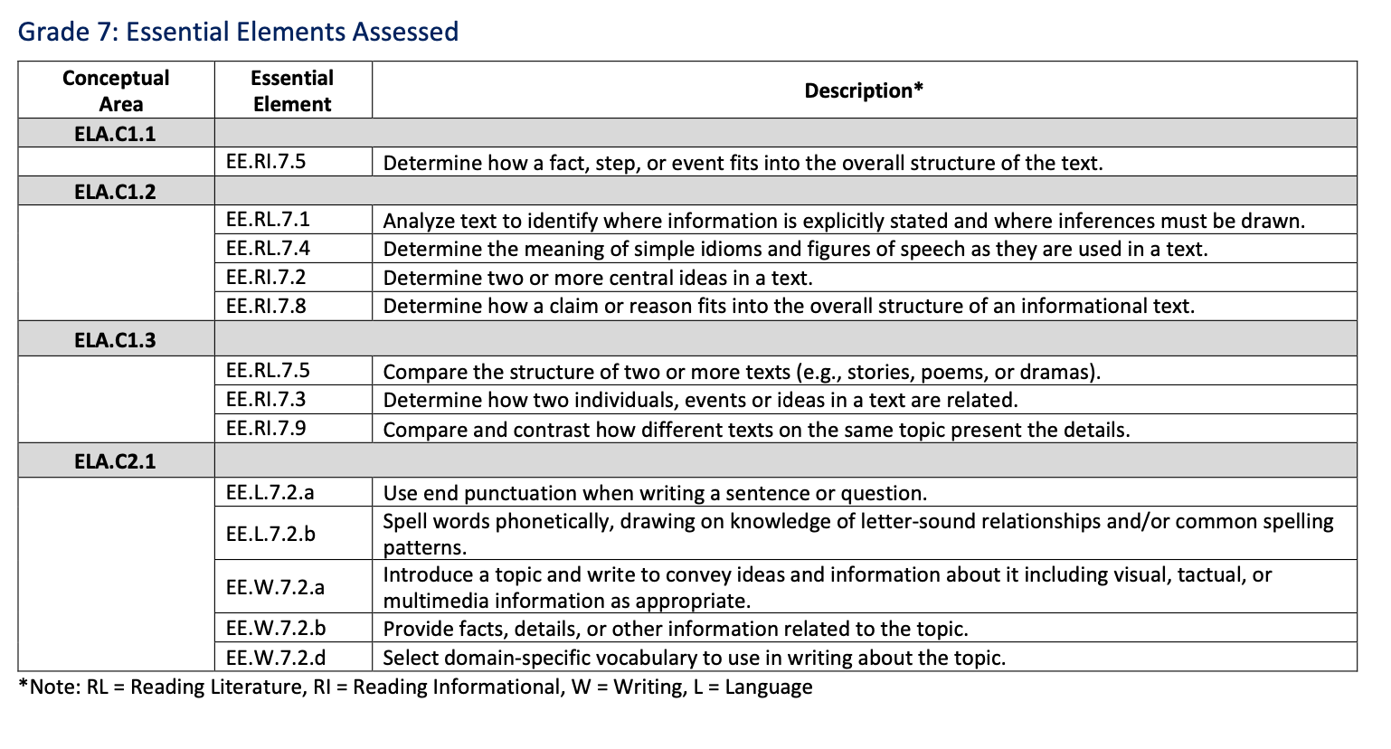
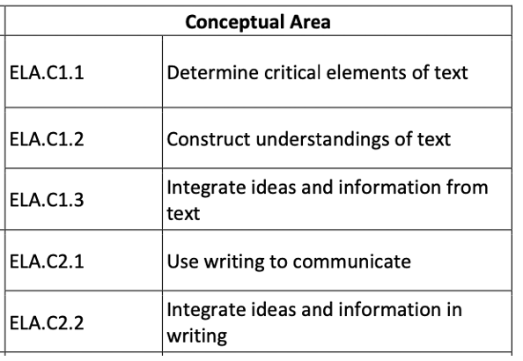
ELA Blueprint
EXAMPLE
Notes:
For example, shown here is the ELA blueprint for grade 7 with a reminder of the conceptual areas. Essential Elements in conceptual area 1.1 all pertain to determining critical elements of text. Essential Elements in conceptual area 1.2 all pertain to constructing understandings of text. Essential Elements in conceptual area 1.3 all pertain to integrating ideas and information from text. Essential Elements in conceptual areas 2.1 and 2.2 pertain to writing skills. Conceptual area 2.1 is “Use writing to communicate,” and 2.2 is “Integrate ideas and information in writing.” Being mindful of the conceptual areas helps better understand the groups of Essential Elements listed on the blueprint. The conceptual areas do not change from grade to grade. Only the Essential Elements listed for each conceptual area change from one grade to the next.
For grade 7, the Essential Elements can be combined into units of instruction rather than approaching each one in isolation. Designing instruction targeting multiple Essential Elements is up to the teacher’s discretion and professional judgment.

Slide 59
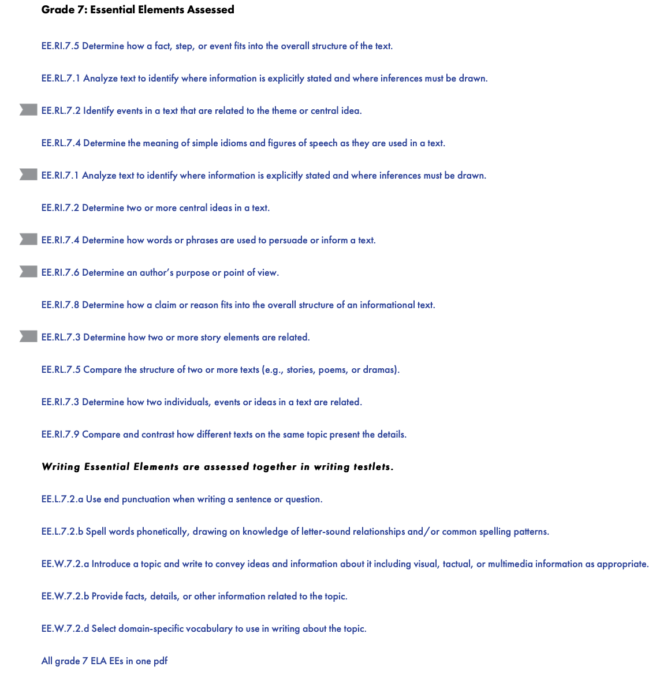
Don’t Forget the Mini-Maps!
EXAMPLE
Resources for Educators and District Staff tab
Educator Resource Page (for the desired subject)
Essential Elements heading >
Currently Tested Essential Elements (scroll for the desired grade inside the document)
Notes:
Many times, comparing the linkage levels across the Essential Elements for the grade is helpful because the same or similar linkage level skills may appear for multiple Essential Elements. To that point, while clicking each Essential Element individually within the Currently Tested Essential Elements resource is certainly an option, all of the Essential Elements and their mini-maps can be accessed in a single PDF listed at the end of the grade in the Currently Tested Essential Elements resource.

Slide 60
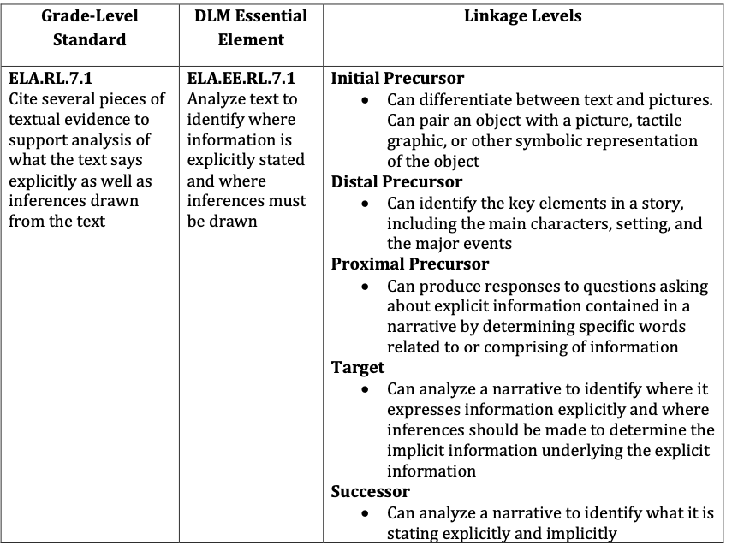
Don’t Forget the Mini-Maps!
Resources for Educators and District Staff tab
Educator Resource Page (for the desired subject)
Essential Elements heading >
Currently Tested Essential Elements (scroll for the desired grade inside the document)
EXAMPLE
Notes:
The linkage levels are not shown in the test blueprints. Only the Essential Elements themselves are named in the blueprints. Shown here is the first page of the mini-maps document for ELA.EE.RL.7.1. The Essential Element is listed along with its linkage level statements.

Slide 61
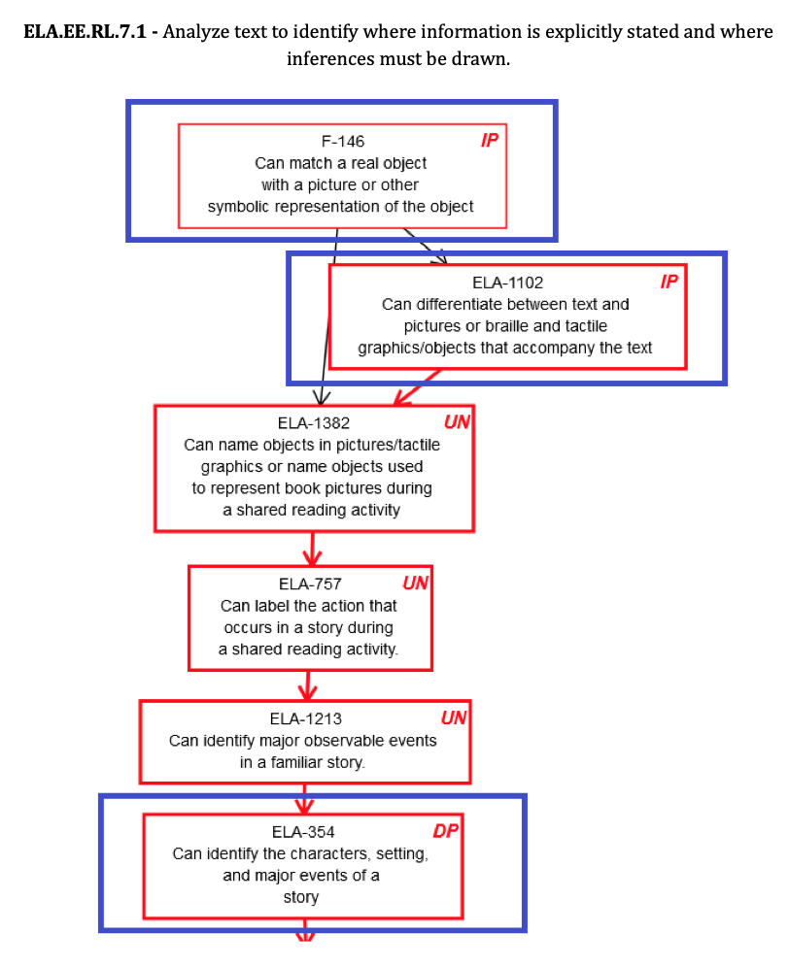
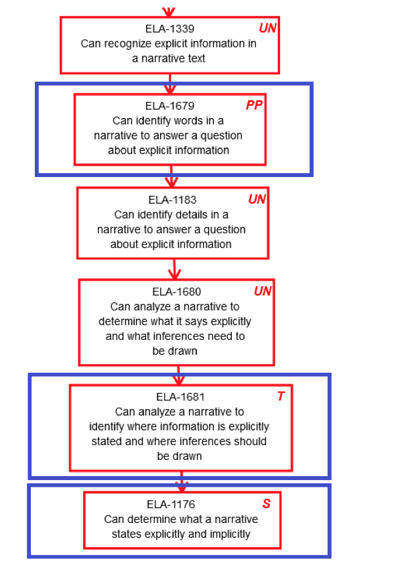
Don’t Forget the Mini-Maps!
EXAMPLE
Notes:
Continuing in the document, the mini-map is shown, which includes the arrowed connections that show the possible pathways of learning students may take from student to student. This particular mini-map spans two pages.

Slide 62
Don’t Forget About the Familiar Texts!
State’s page > Resources for Educators and District Staff tab > Educator Resource Page for ELA and Mathematics > ELA icon > Familiar Texts heading
EXAMPLE
Notes:
The DLM familiar texts are a great place to start when building a unit of instruction for ELA. The familiar texts are found under the Resources for Educators and District Staff tab on a state’s page of the DLM website. Select the Educator Resource Page for ELA and Mathematics, then the ELA icon, and then the Familiar Texts heading. Each grade has three main titles, and then each main title is broken down into multiple stories for reading literature and informational texts. In the case of the example shown here, the three main titles for grade 7 are based on Rosemary Sutcliff’s Black Ships Before Troy: The Story of the Iliad, Gary Paulsen’s Hatchet, and Jacqueline Kelly’s The Evolution of Calpurnia Tate. For the purpose of this presentation, Black Ships Before Troy: The Story of the Iliad was selected, revealing two stories for reading literature and three related informational texts.

Slide 63
Don’t Forget About the Familiar Texts!
State’s page > Resources for Educators and District Staff tab > Educator Resource Page for ELA and Mathematics > ELA icon > Familiar Texts heading
EXAMPLE
Notes:
At the top of the list of familiar texts for each grade, a link to an “about” document is provided.

Slide 64
Don’t Forget About the Familiar Texts!
State’s page > Resources for Educators and District Staff tab > Educator Resource Page for ELA and Mathematics > ELA icon > Familiar Texts heading
EXAMPLE
EXAMPLE
Notes:
Familiar texts are often used in ELA testlets at the Initial Precursor and Distal Precursor linkage levels. They are called “familiar texts” because they are intended to be used in classroom instruction so that if a student receives a testlet that uses a familiar text, the text will indeed be familiar to the student. The “about” document takes the familiar texts one step further in that it actually lists the Essential Elements and linkage levels for which the familiar texts are used. In the example shown here, again for grade 7, the texts are listed for the Initial Precursor linkage level for ELA.EE.RL.7.1.
The familiar texts are selections from the University of North Carolina’s Tar Heel Reader.

Slide 65
Don’t Forget About the Familiar Texts!
State’s page > Resources for Educators and District Staff tab > Educator Resource Page for ELA and Mathematics > ELA icon > Familiar Texts heading
EXAMPLE
Notes:
Different familiar texts related to the same source books are also used for the Distal Precursor linkage level for ELA.EE.RL.7.1.

Slide 66
Don’t Forget About the Familiar Texts!
State’s page > Resources for Educators and District Staff tab > Educator Resource Page for ELA and Mathematics > ELA icon > Familiar Texts heading
EXAMPLE
Notes:
The familiar texts show up again for other Essential Elements for the grade, such as shown here for ELA.EE.RL.7.5.

Slide 67
Don’t Forget About the Familiar Texts!
from The Golden Apple
EXAMPLE
Notes:
For anyone not familiar with Tarheel Reader, the texts appear across several screens with navigation buttons at the bottom of each screen, very similar to the way they are displayed in a student’s testlet. A sentence or two is presented at a time, each screen with an accompanying picture. Printing the texts for a student who needs or prefers a hardcopy is perfectly fine.

Slide 68
Don’t Forget About Familiar Texts!
Are familiar texts only useful in instruction for the Initial Precursor and Distal Precursor linkage levels?
Are other grade-level texts that are not listed as familiar texts acceptable to use?
No! They can be used in instruction for all linkage levels; it’s just that they will only be used in testlets for the lower linkage levels.
Of course! The DLM consortium does not limit or dictate what texts may be used for instruction on the Essential Elements.
Notes:
Familiar texts are usually only used in testlets at the lower linkage levels, but that does not mean they aren’t useful for instruction for students who are working toward higher linkage levels. The texts serve as a basis for teaching the concepts of the Essential Elements. Many other texts may also be used, as the DLM consortium does not limit or dictate what texts may be used for instruction based on the Essential Elements.

Slide 69
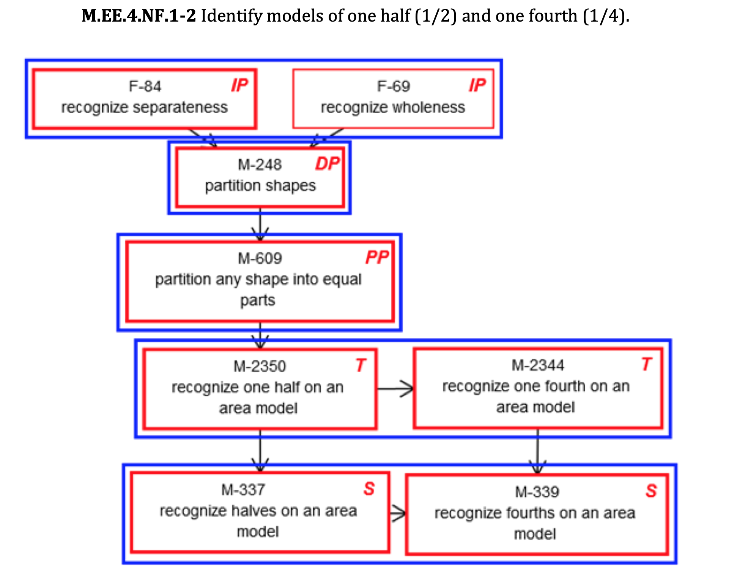
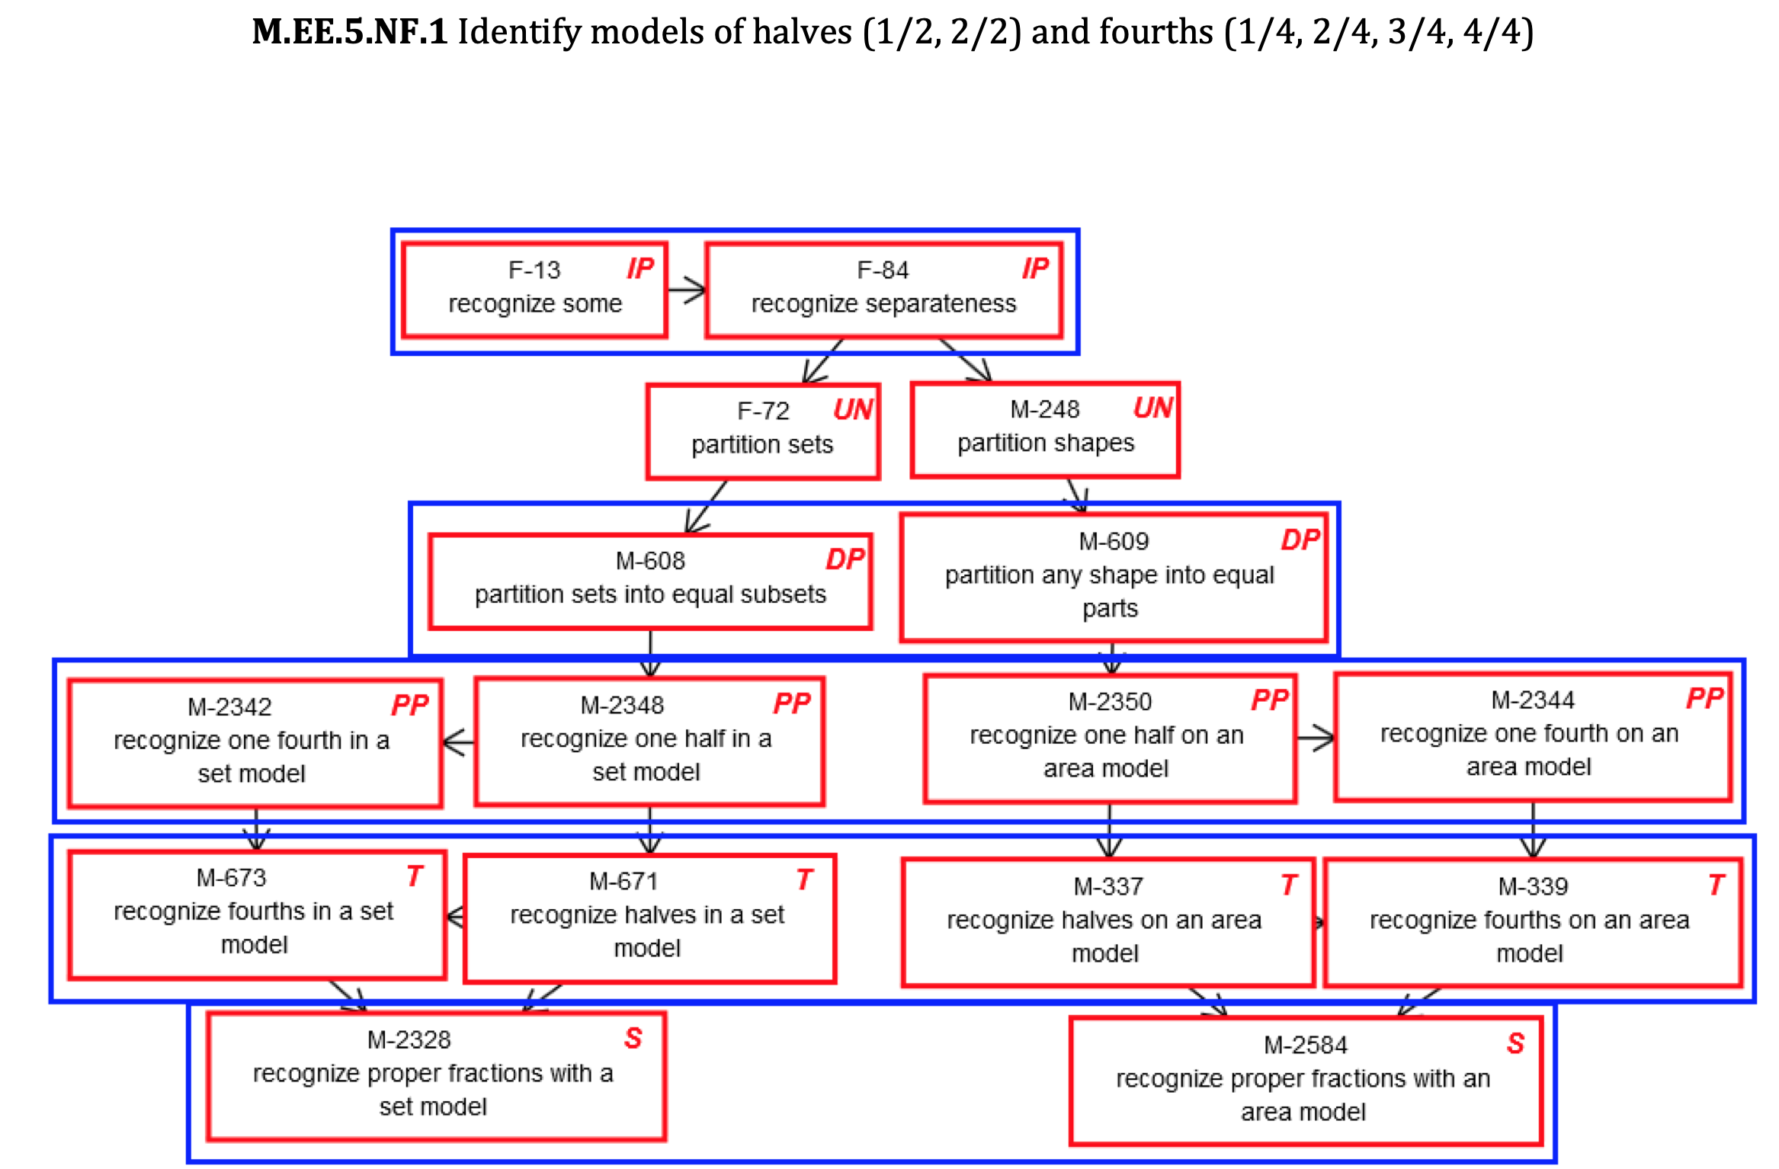
Same/Similar Skills Across Grades
Grade 4
Grade 5
EXAMPLES
Notes:
Earlier in the presentation the point was made that sometimes the same or similar linkage level skills appear for multiple Essential Elements. This is true not only among Essential Elements for the same grade but across grades as well.
Shown here in these examples for grades 4 and 5, seven of the linkage level skills appear on both mini-maps since both the grade 4 and grade 5 Essential Elements pertain to fractions. For example, notice how “recognize separateness” is an Initial Precursor skill for both Essential Elements, and then “recognize one half on an area model” is a Target level skill for grade 4 but a Proximal Precursor skill for grade 5.

Slide 70
Science
State’s tab > Resources for Educators and District Staff tab > Educator Resource Page for Science
Notes:
The following example for science can be found on the Educator Resource Page for Science. Select the Essential Elements for Science PDF.

Slide 71
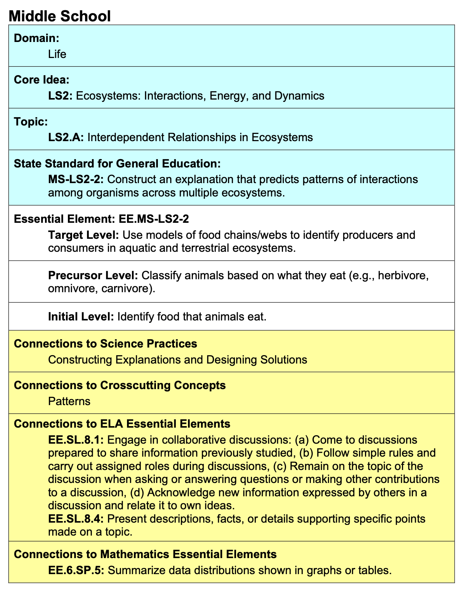
Cross-Curricular Opportunities
EXAMPLE
Notes:
Science Essential Elements often present opportunities to build cross-curricular instruction. Within the Essential Elements for Science document found on the Educator Resource Page for Science, each Essential Element has a table like the one shown here. This example is for a middle school physical science Essential Element. In addition to the domain, core idea, topic, general education standard, linkage levels, and connections to science practices and crosscutting concepts, the table often lists related Essential Elements for ELA and/or mathematics that might be useful in instructional unit planning. In the case of this example, the table lists two related Essential Elements for ELA and one related Essential Element for mathematics.

Slide 72
Don’t Forget About Sample Instructional Activities for Science
State’s tab > Resources for Educators and District Staff tab > Educator Resource Page for Science
Notes:
The Educator Resource Page for Science also features a tab for sample instructional activities. These activities are ideas for how to teach the science concepts for select Essential Elements.

Slide 73
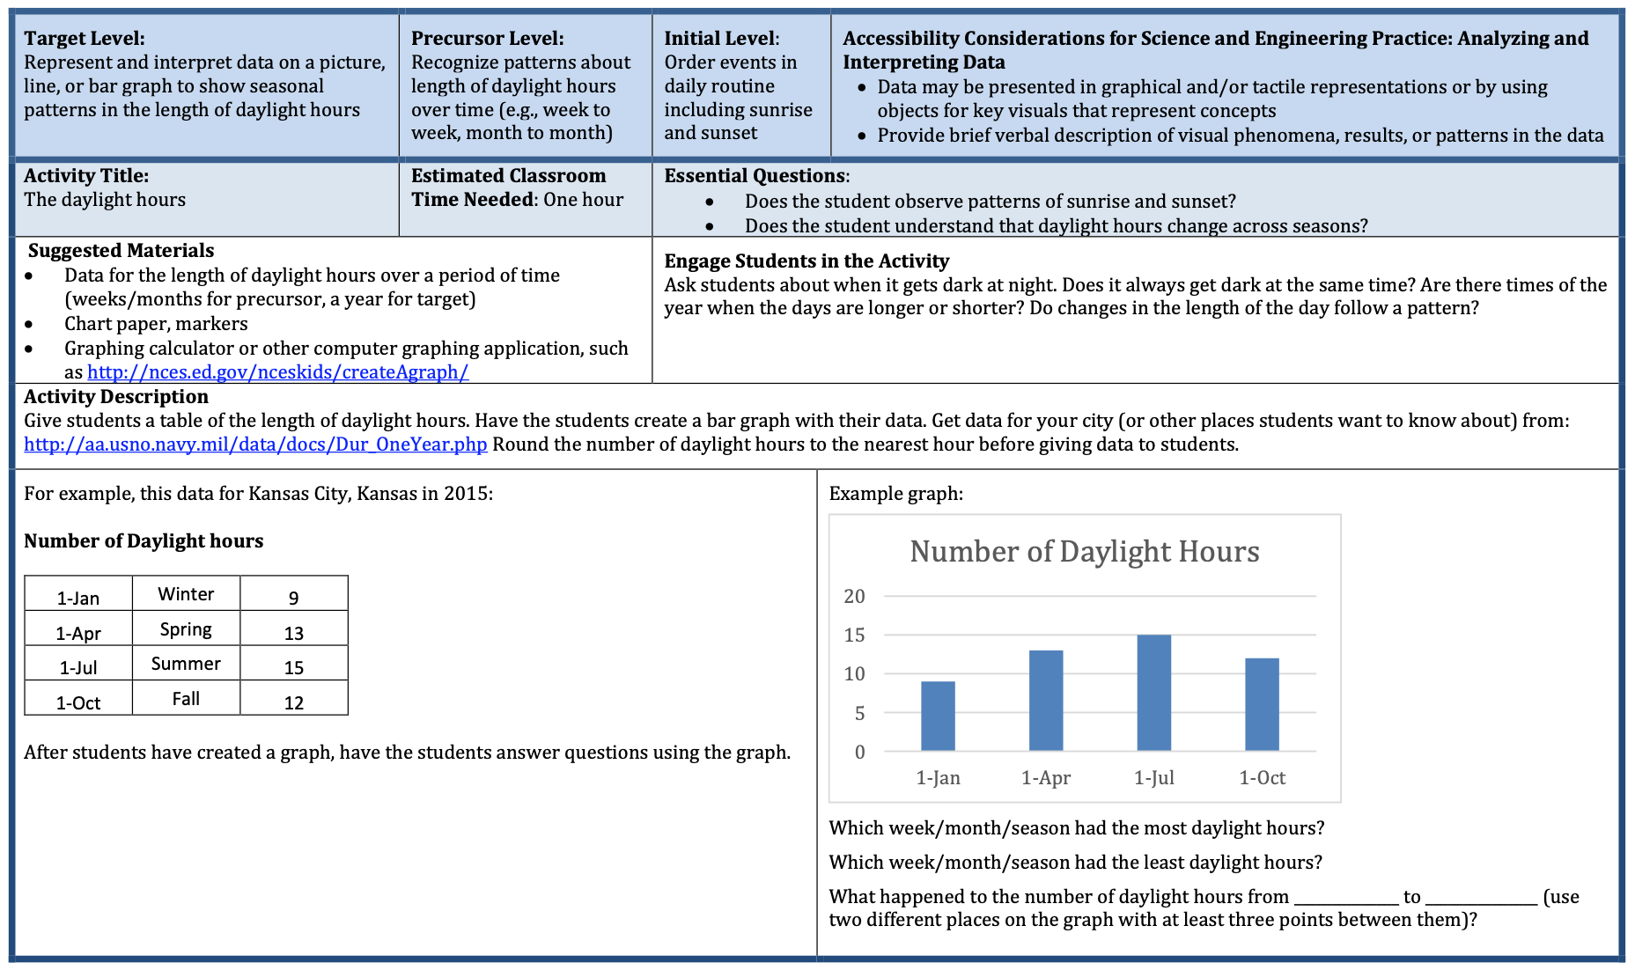
Don’t Forget About Sample Instructional Activities for Science
State’s tab > Resources for Educators and District Staff tab > Educator Resource Page for Science
EXAMPLE
EE.5.ESS1-2
Notes:
For example, this sample instructional activity is for Essential Element 5.ESS1-2. This Essential Element is for the elementary grade band and pertains to the Earth and space science domain. This activity provides the linkage levels at the top of the first page along with accessibility considerations. (Remember science Essential Elements have three linkage levels, whereas ELA and mathematics have five linkage levels.) Essential questions and suggested materials are listed along with ideas for how to engage and guide students through the activity. Then the second page provides ideas for differentiating the activity at the different linkage levels.
The science instructional activities can be used as models for designing lessons and units for other science Essential Elements.

Slide 74
Don’t Forget About Collections Lists!
Educator Resource Pages for each subject
Collections Lists heading
Common Materials Used in Administer Testlets by grade
Notes:
The collections lists provided for each subject on the Educator Resource Pages of the DLM website are also great references for understanding the kinds of materials that, yes, might be called out for use in administering a particular testlet with a student, but would also be useful in classroom instruction. In fact, using materials in classroom instruction that may also be used on the assessment is a great way to ensure students are already familiar and comfortable with those materials.

Slide 75
Don’t Forget About Collections Lists!
NOT NECESSARY TO COLLECT ALL ITEMS ON THIS LIST, AS NOT ALL WILL BE NEEDED AND SUBSTITUTIONS ARE USUALLY ALLOWED!
EXCERPT
Notes:
Collecting all of the items on a collections list is not necessary. A single student doesn’t typically have testlets that utilize all of the materials listed. In fact, even among students in the same class who take a variety of testlets at a variety of linkage levels, all of the materials listed on the collections list are not likely to actually be needed to administer those students’ testlets. Plus, remember that substitutions for materials that are not readily available or appropriate for a student is usually allowed. So, stressing over collecting items is not necessary, but the lists may certainly be helpful when planning instruction and thinking about ways to teach the concepts of the Essential Elements.

Slide 76
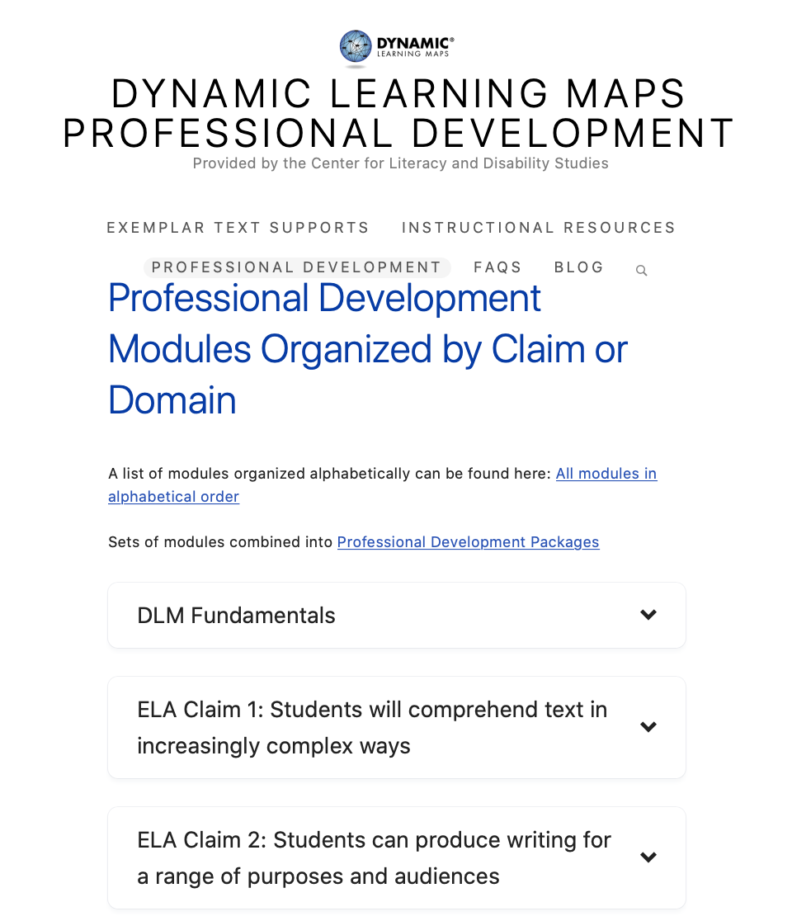
Don’t Forget About Professional Development!
Keep scrolling for more…
EXCERPT
Notes:
DLM partners at the University of North Carolina at Chapel Hill host DLM’s professional development site located at dlmpd.com. Professional development modules are organized by claims and domains, relating back to the blueprints for ELA, mathematics, and science. These modules are free and presented in a self-directed format, although materials to use when facilitating a module for a group are also offered.

Slide 77
Don’t Forget About Professional Development!
State’s page > Resources for Educators and District Staff tab > Educator Resource Page for ELA and Mathematics > Essential Elements heading
Notes:
Back on dynamiclearningmaps.org, an Excel spreadsheet is offered that cross-references the professional development modules on dlmpd.com with the Essential Elements. The spreadsheet is found on the Educator Resource Page for ELA and mathematics under the Essential Elements heading for either ELA or for mathematics. The same spreadsheet is included for both subjects. The spreadsheet does not include cross-references for the science modules.

Slide 78
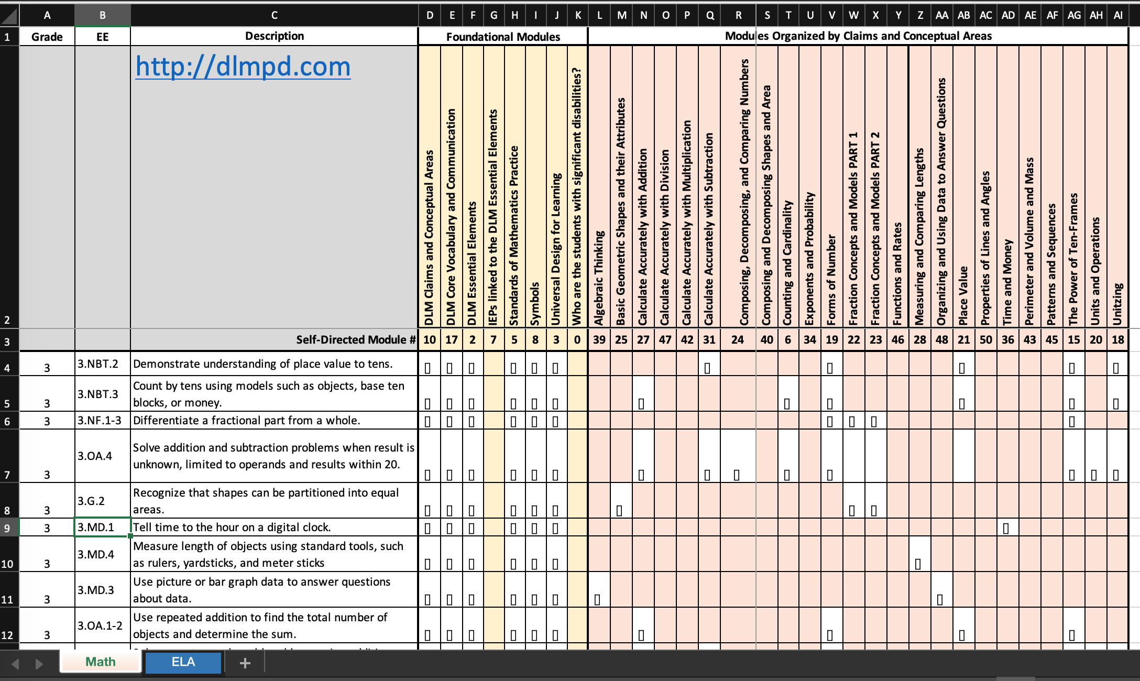
Don’t Forget About Professional Development!
Notes:
The spreadsheet includes separate tabs for ELA and for mathematics and lists the Essential Elements by grade cross-referenced with their applicable professional development modules. Notice the link to dlmpd.com directly in the spreadsheet.

Slide 79
What’s the Point of All This?
The same texts and materials can be used to address multiple Essential Elements and linkage levels.
Essential Elements can be taught conceptually with individual student practice focusing on the linkage level that meets their instructional needs.
Notes:
So, what’s the point of using all of these resources? Aside from the fact that resources like familiar texts are used in actual DLM testlets students may encounter when taking the operational assessment, the resources make the point that the same texts and materials can be used to address multiple Essential Elements. Furthermore, teachers can teach conceptually then use the linkage levels for student practice based on each student’s instructional needs. This is true even when students from more than one grade level are in the same class.

Slide 80
Review: Instructional Resources
blueprints
currently tested Essential Elements
mini-maps
familiar texts
collections lists
professional development modules
Instruction and Assessment Planner
instructional activities for science
Notes:
To review the instructional resources mentioned so far in this presentation, the test blueprints list and organize the Essential Elements to be assessed by grade and subject. The Currently Tested Essential Elements resource provides individual links to the assessed Essential Elements, and the PDFs for each Essential Element include a mini-map that shows the possible routes of learning students may take from linkage level to linkage level en route to the Essential Element’s Target linkage level. Familiar texts are provided to use in instruction for ELA, and sample instructional activities are provided for science. Collections lists are provided for ELA, mathematics, and science to give a better idea of the kinds of materials used to administer testlets, although the point was made that not all materials listed will be needed and that substituting materials for those more readily available is often allowed. Professional development modules were also discussed. Finally, the Instruction and Assessment Planner was explained as a tool that can help test administrators better make the connection between instruction and assessment, thereby maximizing the use of the DLM alternate assessment and its resources.

Slide 81
Take-Aways
Spend some time becoming familiar with the Essential Elements for your student’s grade(s).
1
Think conceptually and look for ways to combine Essential Elements to build instructional units.
2
Use the linkage levels to help students practice the skills included in your lessons.
3
Use the mini-maps to determine possible routes a student might take from one skill level to the next.
4
Notes:
The first recommended next step when reflecting on this presentation is to take some time to become familiar with the Essential Elements for your student’s grade(s) and the subjects you teach. Everything is provided on the DLM website but can certainly be printed if desired. Think conceptually and look for ways to combine Essential Elements to build instructional units comprised of multiple lessons and opportunities to learn. Use the linkage levels to help students practice the skills included in your lessons and use the mini-maps to determine possible routes a student might take from one skill level to the next.

Slide 82
Apply The Process
Choose
Instruct
Assess
Determine Next Steps
During the OPTIONAL instructionally embedded assessments window, use the Instruction and Assessment Planner to…
• The teacher chooses one or more Essential Elements in the Instruction and Assessment Planner (tool inside Kite® Educator Portal).
• The teacher uses the information provided in the Instruction and Assessment Planner and on the DLM website to plan and implement instruction.
• When the teacher determines adequate instruction has been provided, the teacher confirms the Essential Element assignment in the Instruction and Assessment Planner, which makes a testlet available for the student in Student Portal.
• Each time the student completes a testlet in Student Portal, the teacher accesses the results in Educator Portal and makes a decision.
— Is more instruction needed?
— Should a different linkage level be chosen?
Notes:
During the optional instructionally embedded assessments window, apply the process discussed earlier in the presentation. Use the Instruction and Assessment Planner to select Essential Elements and linkage levels from the test blueprints and list of currently tested Essential Elements. The Essential Elements and their linkage levels are chosen directly in the Instruction and Assessment Planner. When an Essential Element and linkage level are chosen, a PDF of the mini-map for the Essential Element is provided in the Instruction and Assessment Planner. Use the mini-map to plan then implement instruction, providing students with opportunities to practice the linkage level skills. Determine when each student is ready to be assessed on the selected Essential Element and use the Instruction and Assessment Planner in Educator Portal to assign a testlet at the desired linkage level for the student in Student Portal. Retrieve the testlet’s Testlet Information Page in Educator Portal in order to make the necessary preparations ahead of sitting down with the student to administer the testlet.

Slide 83
How Do They Differ From the Spring Assessment?
Instructionally Embedded Testlets | Spring Testlets
optional | required
no set number to complete | 6-8 testlets to be completed for mathematics, 9 testlets for ELA and for science
do not impact end-of-year results | used to determine end-of-year results
can choose the Essential Elements and linkage levels to assess | system adaptively determines linkage levels for each testlet
taken one at a time but more than one can be planned and queued for each subject | delivered one after another until all taken
Notes:
Remember the differences between the instructionally embedded testlets and the spring testlets. The use of instructionally embedded testlets is optional, but the process is certainly helpful in approaching instruction on the Essential Elements ahead of the spring assessment window. The Instruction and Assessment Planner is the tool test administrators use to choose Essential Elements and linkage levels during the instructionally embedded window, and it allows more than one testlet to be planned and queued for each subject for each student, whereas testlets during the spring assessment window are delivered one after another until all have been completed.

Slide 84
Notes:
Remember that students with the most significant disabilities often require repeated instruction, which is different from skill and drill and rote memorization. Students with significant cognitive disabilities often have limited working memory and therefore benefit from repeated instruction over time to reinforce the concepts taught, continually practice the skills learned, and apply those skills to additional contexts so that the learning is truly theirs to own. This takes time, which is why teaching to the Essential Elements throughout the year is necessary and one reason why the spring assessment window is long. This is also why the optional instructionally embedded window is so helpful, giving teachers and students ample opportunities to interact with the assessment system and maximize the benefits of its resources.

Slide 85
Testlet demonstrations
Notes:
The next section includes demonstrations of two released DLM testlets.

Slide 86
Types of Testlets
computer-delivered
teacher-administered
Notes:
DLM testlets are either computer-delivered or teacher-administered.

Slide 87
Computer-Delivered Testlets
maximize student interaction
items written to the student
3-9 items follow an engagement activity
maximize student independence
student selects response choices independently
supports allowed for
entering the student’s responses
navigating screen to screen
Notes:
Most testlets are computer-delivered. Computer-delivered testlets have items written to the student. Computer-delivered testlets begin with an engagement activity followed by 3-to-9 conceptually related items. Computer-delivered testlets are intended for the student to interact with the testing device independently as much as possible. However, supports are allowed as needed. For example, the test administrator may enter the student’s chosen responses and navigate across screens for the students.

Slide 88
Teacher-Administered Testlets
directions written to the test administrator in Student Portal
scripted statements/interactions for the test administrator to follow
items for the test administrator to complete based on observation of behavior
used for lower linkage levels and for all writing testlets
Notes:
Teacher-administered testlets are written to the test administrator. Still, like computer-delivered testlets, teacher-administered testlets are accessed in Student Portal. The test administrator is given a script to follow, step by step. The script tells the test administrator what to say and do throughout the testlet, and the test administrator observes what the student does in response to the script, and then enters the student’s responses based on those observations.
Teacher-administered testlets are predominantly at the lower linkage levels because students with the most complex needs may still be developing symbolic understandings. Teacher-administered testlets are also used when the content cannot be assessed with information presented on the computer screen.
Also, no matter what grade or linkage level, one of the student’s ELA testlets will be a writing testlet. All writing testlets are teacher-administered.

Slide 89
Writing Testlets
The engagement activity requires the student to select a topic.
The test administrator
follows Educator Directions
interacts with student
observes and records observations of student writing
Writing product is not submitted.
Notes:
Again, all writing testlets are teacher-administered. The test administrator delivers a structured writing activity to the student. The testlet begins with an engagement activity that requires the student to select a writing topic. Then, step-by-step scripted directions are provided which ask the student to engage in writing tasks. After each step, the test administrator records the student’s response in Student Portal. Some writing testlets also require the test administrator to evaluate the written product. In all cases, selections are made from the onscreen options that best reflect the test administrator’s observations. The student’s writing product is not submitted.
A separate video that provides more information about the writing testlets is available on the Educator Resource Page for ELA under the Resources for Educators and District Staff tab of the state’s page of the DLM website.

Slide 90
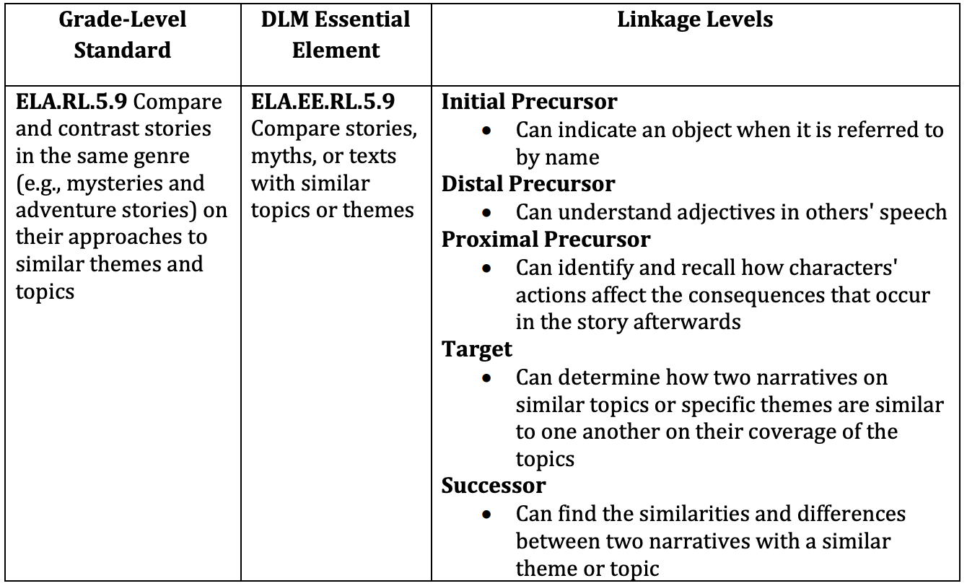
ELA Testlet Demonstration
See the mini-maps PDF for ELA.EE.RL.5.9 via the link to the Currently Tested Essential Elements on the Educator Resource Page for ELA on the DLM website.
Grade 5
Reading Literature
Notes:
The first demonstrated testlet is a computer-delivered testlet that assesses a grade 5 ELA Essential Element. Specifically, the testlet assesses ELA.EE.RL.5.9 at the Proximal Precursor linkage level, which states, “Can identify and recall how characters’ actions affect the consequences that occur in the story afterwards.”

Slide 91
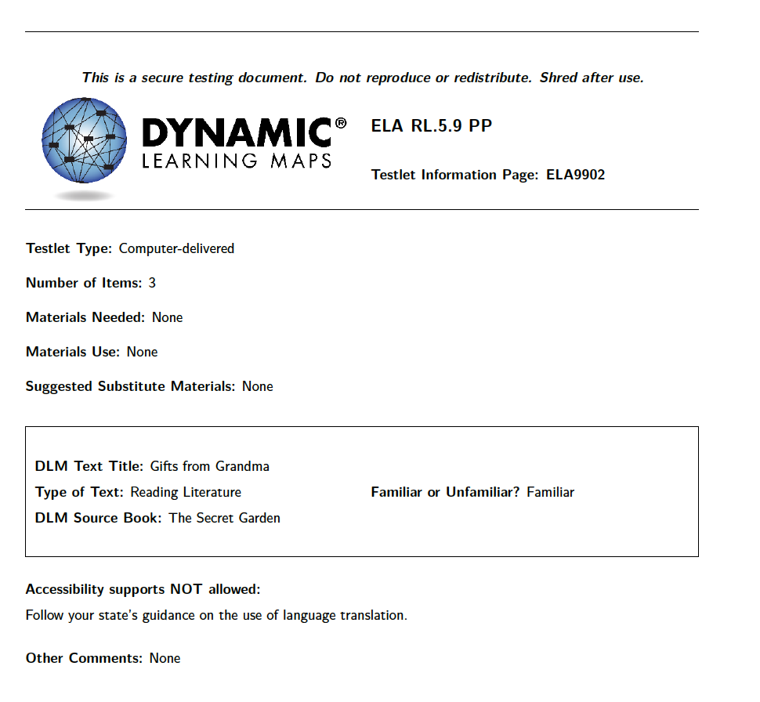
Testlet Information Page (TIP)
Notes:
As was mentioned previously, before administering a testlet with a student in Student Portal, the testlet’s corresponding Testlet Information Page should be accessed in Educator Portal because it contains important preparatory information.
The Testlet Information Page for the following released testlet indicates the testlet will assess RL.5.9 at the Proximal Precursor linkage level, will be computer-delivered, and will have three items. However, no materials will be needed.
The Testlet Information Page also indicates the testlet will use the familiar text Gifts from Grandma, which is a literary text based on the source book The Secret Garden. Again, as a reminder, familiar texts are provided by grade under the Familiar Texts heading on the Educator Resource Page for English Language Arts of the DLM website and are intended to be used in instruction so that if a student encounters a testlet that uses a familiar text, the text will, indeed, be familiar to the student.
This Testlet Information Page does not include any other information about accessibility supports NOT allowed or any comments.

Slide 92
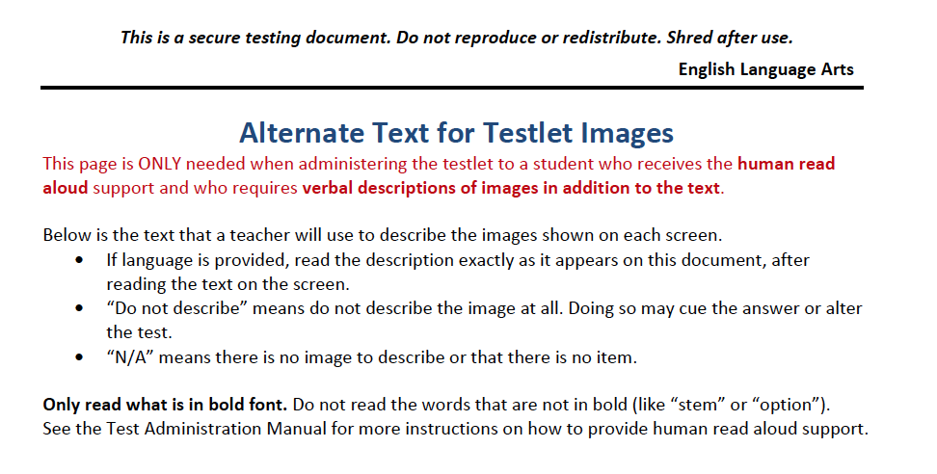
Alternate Text
EXAMPLE
Notes:
However, subsequent pages of the Testlet Information Page include alternate text for students who need human read aloud and descriptions of images in addition to the text. An example of alternate text for a testlet image is shown on this slide. The test administrator would read the text on the screen, which in this case is the title, “Gifts from Grandma,” then describe the picture by saying, “a smiling older woman,” exactly as written. Although not shown here, alternate text is provided for all other images in the testlet as well.

Slide 93
Ela.ee.rl.5.9 proximal precursor
computer-delivered
Notes:
Having considered the Testlet Information Page for this released testlet, the testlet will now be demonstrated.
For the purpose of this demonstration, each screen will be read as it appears. Remember, since this testlet is computer-delivered, the directions and items are written for the student, although the student may require assistance navigating across screens and entering chosen responses.
The testlet will be shown without any accessibility supports. Only correct response options will be chosen.

Slide 94
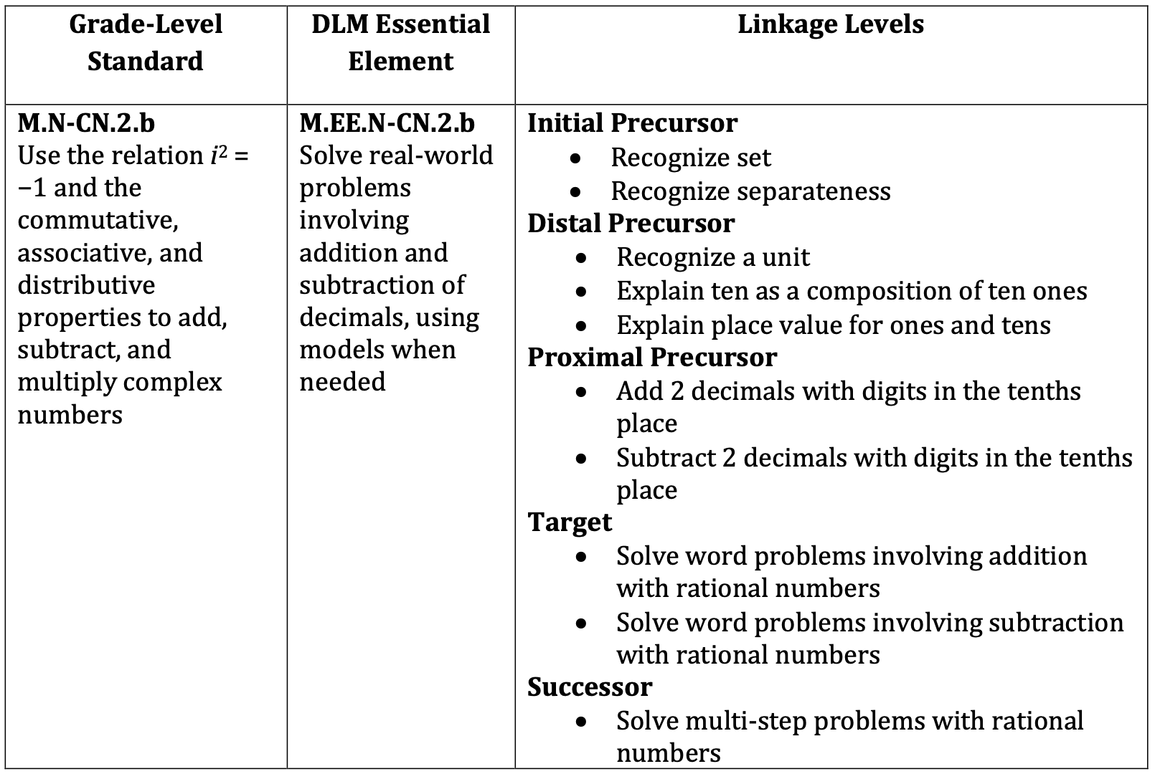
Mathematics Testlet Demonstration
See the mini-maps PDF for M.EE.N-CN.2.b via the link to the Currently Tested Essential Elements on the Educator Resource Page for Mathematics on the DLM website.
High School
Number and Quantity—The Complex Number System
Notes:
The second demonstrated testlet is teacher-administered. It assesses the high school mathematics Essential Element M.EE.N-CN.2.b at the Initial Precursor linkage level. The Initial Precursor linkage level for this Essential Element includes two skills: “recognize set” and “recognize separateness.”

Slide 95
Testlet Information Page (TIP)
Notes:
The Testlet Information Page for the following released testlet indicates the testlet will assess M.EE.N-CN.2.b at the Initial Precursor linkage level, will be teacher-administered, and will have five items.
The materials needed to administer this testlet include 5 erasers, 5 pencils, and 1 rubber band. The materials will be used for the student to recognize set and separateness. However, if those materials are not readily available or appropriate for the student, suggested substitutions include 2 sets of 5 or more objects that can be bundled, stacked, or grouped, such as 7 cups. A piece of string can be used in place of the rubber band for bundling.
Calculator use is not applicable for this testlet.
The mathematics vocabulary used in this testlet are together and set, and the test administrator should not define the words separate or group for the student.
As a reminder, Testlet Information Pages are considered secure testing documents. They are not to be reproduced or redistributed and should be shredded after use.

Slide 96
M.EE.N-CN.2.b INITIAL precursor
teacher-administered
Notes:
Having considered the Testlet Information Page for this released testlet, the testlet will now be demonstrated.
For the purpose of this demonstration, each screen will be read as it appears. Remember, since this testlet is teacher-administered, the educator directions and items are written for the test administrator.
The testlet will be shown without any accessibility supports. Only correct response options will be chosen.

Slide 97
Spring assessment window
March 8, 2021—May 7, 2021
Notes:
The final section of this presentation will address the spring assessment window. The dates for Oklahoma’s spring assessment window are March 8 through May 7, 2021.

Slide 98
Spring Assessment Window
Number of Testlets Per Subject | Testlet Items | Assessment Scheduling
9 for ELA, regardless of the grade (1 of the 9 is a writing testlet) 6-8 for mathematics, depending on the grade | 3–9 conceptually-related items | 5–15 minutes to complete a testlet
9 for science, regardless of grade 6 for high school US history | all items within a testlet are the same linkage level (with the exception of writing) | each testlet administered one-on-one (test admin to student)
Notes:
As mentioned previously, unlike the optional instructionally embedded assessments window, assessing students during the spring assessment window is required. Nine testlets total make up the ELA assessment, regardless of the grade, and one of those testlets is a writing testlet. For mathematics, each student completes 6 to 8 testlets, depending on the grade. For science, each student completes 9 testlets, regardless of the grade, and 6 testlets comprise the high school US history assessment. Every testlet has 3-to-9 conceptually-related items, and all items within a testlet are the same linkage level, with the exception of writing testlets. Testlets are intentionally short to help prevent fatiguing the student and are administered across multiple assessment sessions rather than in one sitting. A student typically takes 5-to-15 minutes to complete a single testlet, and as mentioned earlier in the presentation, each testlet is administered one-on-one between the test administrator and the student. All testlets must be completed within the state’s spring assessment window.

Slide 99
View Student Username and Password
in Educator Portal
Notes:
For the spring assessment window, use the Manage Tests tab in Educator Portal to access the student’s username and password. However, be advised that if the student participated in the instructionally embedded assessments, the student will use the same credentials for the spring assessments.

Slide 100
View Student Username and Password
Notes:
The Test Management option will display under the Manage Tests heading for users with a teacher role in Educator Portal.

Slide 101
View Student Username and Password
Notes:
Rostered students will be listed under the View Test Sessions tab. If no students appear, work with the local assessment coordinator or data manager to confirm students are rostered correctly.

Slide 102
View Student Username and Password
Notes:
The PDF in the Tickets column includes the student’s credentials for Student Portal.

Slide 103
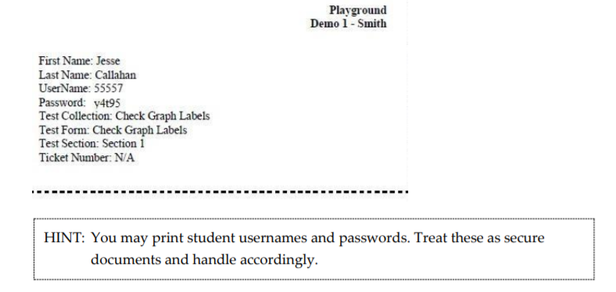
View Username and Password
5. Click Open with and choose Adobe Acrobat.
6. Click OK.
7. View the student username and password.
Notes:
The PDF test ticket includes the student’s name, username, and password. Student credentials may be printed but should be treated as secure documents.

Slide 104
Testlet Information Page (TIP)
Download/print ahead of testing
Spring assessment window
accessed from the Test Management section of Educator Portal
Securely destroy each TIP after use.
Notes:
For the instructionally embedded assessments, each Testlet Information Page is available in the Instruction and Assessment Planner after Instruction Complete Assign Testlet is selected. However, since the Instruction and Assessment Planner is not used for the spring assessment window, Testlet Information Pages are accessed under the Test Management tab in Educator Portal for the spring assessments.
Again, the Testlet Information Page provides information the test administrator will need in order to administer the testlet to the student as shown with the testlet demonstrations earlier in the presentation. Test administrators may download or print the Testlet Information Page if desired; however, after the testlet is administered, the downloaded or printed Testlet Information Page must be destroyed, because Testlet Information Pages are considered secure testing materials.

Slide 105
Testing Progress
Notes:
The Test Progress column shows the number of testlets a student has completed for a content area. The number of testlets remaining to be completed also displays in Student Portal each time a student completes a testlet. If a student wishes to keep track of the number of completed testlets and the number that remain, consider making a testing progress chart for the student with checkmarks or stickers for each completed testlet.

Slide 106
Spring Assessment Window
All testlets must be completed between March 8, 2021 and May 7, 2021.
Notes:
As a final reminder, all testlets for each subject must be completed within the state’s spring assessment window.

Slide 107
Final Review: Topics Covered
student uploads and tasks in Kite® Educator Portal
instructionally embedded assessments
the Instruction and Assessment Planner
released testlet examples
the spring assessment window
Notes:
This presentation covered
student uploads and other tasks in Kite® Educator Portal
the benefits of using instructionally embedded assessments
how to use the Instruction and Assessment Planner
demonstrations of released testlets and
a review of the spring assessment window

Slide 108
Thank you!
Notes:
Thank you for your attention to this presentation.

