Slide 1
Chapter 11 Dispute Resolution
Oklahoma Special Education
Policies and Procedures
July 2022

Slide 2
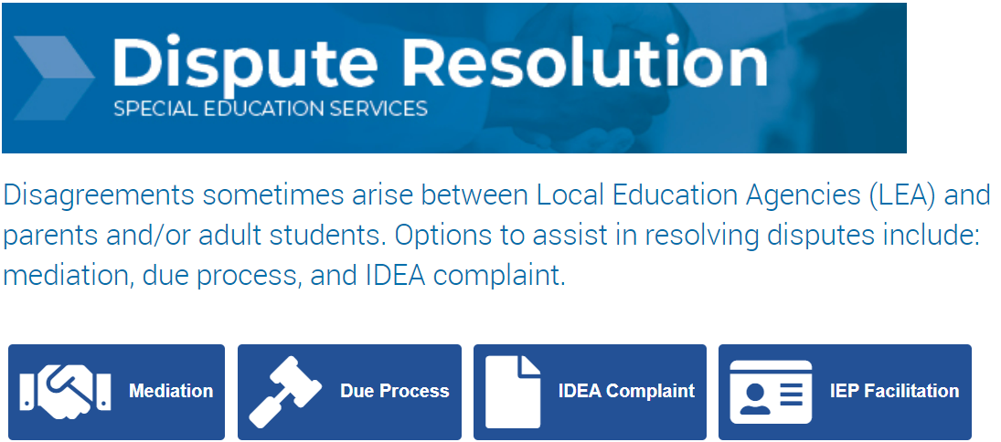
Dispute Resolution
Notes:
On occasion, conflicts arise between Local Education Agencies (LEA) and parents and/or adult students. Several mechanisms are available through the Oklahoma State Department of Education (OSDE) to assist in resolving disputes. The processes are individualized education program (IEP) facilitation, mediation, formal state complaints, due process hearings, facilitated resolution sessions, and expedited due process hearings. This chapter contains information on each of these processes.
The OSDE accepts formal state complaints and requests for due process hearings via fax, mail, and personal delivery. Additionally, requests for IEP facilitation and mediation may be requested through the resolution center.

Slide 3
IEP Facilitation
Voluntary for parents and school personnel
Offered when disputes arise
Confidential, thus encouraging all participants to speak freely
A No-Cost Service to parents and LEAs
An Alternative that does not delay the status of a due process hearing or formal complaint
Notes:
A request for IEP facilitation may be made by the parent and/or adult student or by an LEA representative, such as the director of special education. Requests may be made in writing or by phone to SERC. IEP facilitation is a voluntary process for which a facilitator is appointed to facilitate an IEP team meeting. Both parties must agree to the use of IEP facilitation. The role of the facilitator is to help team members communicate more effectively and efficiently. IEP facilitation supports early dispute resolution, providing assistance to the IEP team before a potential conflict develops into a more serious dispute. The facilitator is an impartial third party, not a member of the IEP team, and has no stake in decisions made by the team.

Slide 4
Mediation
Voluntary for parents and school personnel
Offered when disputes arise, including, but not limited to, formal complaints and due process hearing requests Confidential, thus encouraging all participants to speak freely
A No-Cost Service to parents and LEAs
An Alternative that does not delay the status of a due process hearing or formal complaint
Notes:
Mediation is a structured, voluntary process in which an impartial third party (a mediator) assists parents and/or adult students and LEA personnel resolve disputes. Mediation builds positive working relationships, encourages mutual understanding, and helps the parties focus on their common interest—the student. For the parties to enter into mediation, both parties must agree to the use of mediation.

Slide 5
Formal State Complaint
A formal state complaint may be filed with the OSDE by any individual or organization who believes the LEA or other education agency has violated a requirement of the Individuals with Disabilities Education Act (IDEA).
The alleged violation occurred not more than one year prior to the date that the complaint is received.
The complaint must be in writing and include the required information.
Notes:
A formal state complaint may be filed with the OSDE by any individual or organization who believes the LEA or other education agency has violated a requirement of Individuals with Disabilities Education Act (IDEA). The complaint must allege a violation that occurred not more than one year prior to the date that the complaint is received. The compliant must be in writing and OSDE has a form available that may be used. The OSDE will accept a complaint received by email, mail, fax or hand delivery.

Slide 6
OSDE Complaint Procedures
Determine whether the complaint meets the required criteria.
Notify the complainant if their submission is insufficient.
Notify the LEA that a complaint has been received and the timeline to submit documentation.
Give the complainant the opportunity to provide additional information about the allegations, either orally or in writing.
Investigate and resolve the complaint and issue a Final Report within 60 calendar days of receipt of the complaint.
Notes:
Upon receipt of a written complaint, the OSDE will do the following: • Determine whether the complaint meets all of the required criteria. The OSDE will notify the complainant if their submission is insufficient. • Notify the LEA that a complaint has been received and the timeline to submit documentation. • Give the complainant the opportunity to provide additional information about the allegations, either orally or in writing. • Investigate and resolve the complaint and issue a Final Report that includes the findings of fact, conclusions, and resolution for each violation within 60 calendar days of receipt of the complaint. This time period may be extended, but only under exceptional circumstances, which must be documented by the OSDE. The report will state: How to remedy any denial of services, which may include the award of compensatory services, or other corrective action as appropriate to the needs of the student; and o The future provision of services for a student with a disability, if such clarification is needed. • Ensure the LEA takes corrective action if it is determined that the LEA was out of compliance. All corrective actions must be completed no later than one year from issuance of the finding of violation. The OSDE may require a timeline for correction at a date earlier than one year.

Slide 7
OSDE Complaint Procedures - 2
The report will state:
How to remedy any denial of services, which may include the award of compensatory services, or other corrective action as appropriate to the needs of the student
The future provision of services for a student with a disability, if such clarification is needed.
OSDE must ensure the LEA takes corrective action (if applicable).
All corrective actions must be completed no later than one year from the issuance of the finding of violation.
The OSDE may require a timeline for correction at a date earlier than one year.
Notes:
The report will state: o How to remedy any denial of services, which may include the award of compensatory services, or other corrective action as appropriate to the needs of the student; and o The future provision of services for a student with a disability, if such clarification is needed.
Ensure the LEA takes corrective action if it is determined that the LEA was out of compliance. All corrective actions must be completed no later than one year from issuance of the finding of violation. The OSDE may require a timeline for correction at a date earlier than one year.

Slide 8
Due Process
A request for a due process hearing may be made by:
Parent, adult student, attorney representing the parent/adult student or
LEA
The request must be mailed, emailed, faxed, or hand-delivered.
All applicable timelines for due process hearings and resolution sessions will start when the request has been filed with the other party and the OSDE.
Notes:
A request for a due process hearing may be made by a parent, adult student, attorney representing the parent/adult student, or the LEA. A parent and/or adult student or LEA may file a request for hearing with the other party. The request must be mailed, emailed, faxed, or hand-delivered.
When the request is filed, the requesting party must send copies to the Dispute Resolution Director at the OSDE. All applicable timelines for due process hearing and resolution sessions will start when the request has been filed with the other party and the OSDE.

Slide 9
Regular and Expedited Due Process
Two types of hearings when a parent, adult student, or attorney files a due process:
Regular due process
Expedited due process
A manifestation determination or an interim education placement during a long-term suspension
Removing a student to an Interim Alternative Education Setting (IAES) for 45 school days when there is substantial evidence that maintaining the current educational placement is likely to result in injury to the student or others.
Notes:
There are 2 types of hearings when a parent, adult student or attorney files a due process: a regular due process hearing and an expedited due process hearing: • A regular due process hearing is an administrative hearing to resolve disputes on any matter related to the identification, evaluation, educational placement, and the provision of a FAPE.
An expedited due process hearing is an administrative hearing to resolve disputes concerning:
o A manifestation determination or an interim education placement during a long-term suspension.
o Removing a student to an Interim Alternative Education Setting (IAES) for 45 school days when there is substantial evidence that maintaining the current educational placement is likely to result in injury to the student or others.

Slide 10
Dispute Resolution Contact & Resources
Colin Raley
Director of Dispute Resolution
Colin.Raley@sde.ok.gov
405-521-3351
OSDE-SES Dispute Resolution Webpage
Special Education Resolution Center (SERC)

