Slide 1
Virtual Arts Ideas
Alternative Education Webinar
Elizabeth Maughan
Director of Fine Arts
Maria Krey-Gibson
Putnam City Dance Educator
Morgan Brown
Jenks Visual Art Educator
Jennifer Allen-Barron
Oklahoma Arts Council

Slide 2
Session Overview
Best Practices of Online Fine Arts Teaching
Online Teaching Successes and Challenges
Grant Opportunities for Alternative Education Arts Classes

Slide 3
Best Practices of Online Fine Arts Teaching
Create a climate and culture based on trust
Students want to know…
Empathy and trust
A Focus on Empathy in Distance Learning
Positive, trusting class culture

Slide 4
Best Practices of Online Fine Arts Teaching
Curriculum and Assignments
Social and Emotional Learning (SEL)
Arts Education and Social Emotional Learning
Culturally Responsive Instruction
Culturally Responsive Teaching and the Brain
Project-Based Learning
PBL For Remote Learning
Place-Based Learning
What is Place-Based learning and why does it matter?

Slide 5
Best Practices of Online Fine Arts Teaching
Strategies for Curriculum and Assignment Success
Get to know your students.
Consider their interests and needs, especially in regards to SEL and culture.
Involve students as you build projects and ask for their input.
Think outside the box and give students agency in projects. Incorporate PBE as much as possible.

Slide 6
Best Practices of Online Fine Arts Teaching
Lesson Planning and Creation
Backwards Planning
Sample Lesson Structure
Lesson Content
Discussions
Formative Assessment
Summative Assessment
Reflection

Slide 7
ARTech Grant
Grant for PK-12 Oklahoma schools
Hybrid arts classes offered throughout the year
Hands on arts experiences with a teaching artist
Online assignments
2021-22 - Dance & Visual Art
2022-23 - Music & Drama/Theatre
Grant will extend through the 2024-25 school year
ARTech Website

Slide 8
Online Teaching Successes & Challenges
Maria Krey-Gibson, Putnam City Dance Educator
Curriculum & Assignments
History of Ballet, Jazz, & Hip Hop
Four 8s of movement - Ballet & Jazz
Hip Hop Creative Project
Reflection in Ballet, Jazz & Hip Hop

Slide 9
Online Teaching Successes & Challenges
Challenges
Video Assessments
Building trust/community
Equity - internet access
Unable to collaborate
Successes
Reflections
Hip Hop Creative Project

Slide 10
Online Teaching Successes & Challenges
Take Away
Dance is an empowering experience for students.
Students may not gain physical skills through an online class in the same way that they would in person. However, experiencing a shift in awareness is just as important as learning perfect physical technique.
Consider the challenges of a new program in a year like 2020.

Slide 11
Online Teaching Successes & Challenges
Morgan Brown, Jenks Visual Art Educator
Supplies
Providing a list vs. assessing a fee
Pick up/drop off days
Platforms utilized
Canvas
Google Meet
Calendar

Slide 12
Online Teaching Successes & Challenges
Successes & Challenges
Document camera
Uploading large videos
Small group and Q&A sessions
Time management
Student engagement & accountability

Slide 13
Online Teaching Successes & Challenges
Take Away
Visual arts is uniquely suited to adapt and adapt well to virtual learning due to its personal nature. While certainly challenging at times, when students are given the proper tools and demonstrations, they rise to the occasion and take advantage of their isolation to take creative risks they might not have in a large group setting.

Slide 15
Oklahoma Arts Council
Jennifer Allen-Barron, Oklahoma Arts Council Arts Education Director

Slide 16
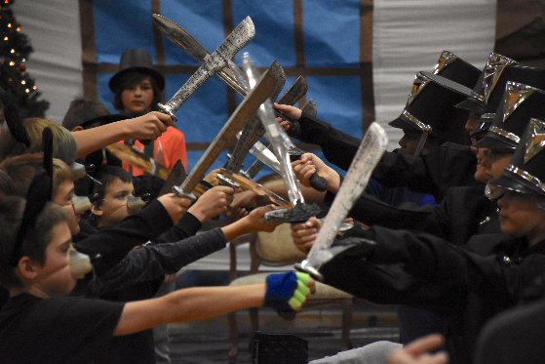
Grant Programs for Alternative Schools
How We Fund Alternative Schools
Classroom Supply Grants
Arts in Alternative Education
Notes:
We have two grants available for Alt-Ed schools, and they are each used in different ways.
Classroom Supply Grants are used for the costs of consumable supplies, and
Arts in Alternative Education are the grants that pay for artist residencies. Several of our teaching artists have been able to lead residencies virtually, so this could be a great way to get

Slide 17
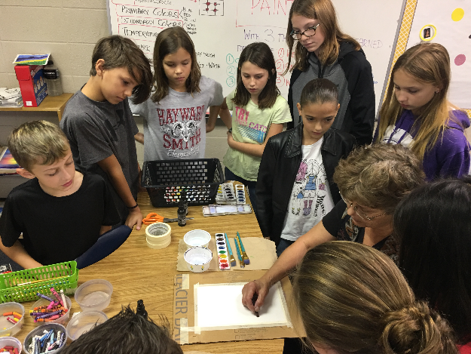
About Classroom Supply Grants
$500 maximum award per school
For consumable art supplies only
Any discipline is eligible – dance, drama, music, visual arts – as long as your school has at least a part-time instructor in the discipline
Notes:
JENNIFER
What do we mean by consumable? For visual arts, think of items that are used up or fundamentally changed through the course of instruction. Paintbrushes, paper, ceramic, ink, but not easels, pottery wheels or permanent equipment.
For music, we can pay for instrument repair or rental, sheet music, and other items but not the purchase of instruments, music stands, or repairs to a building.
A longer list of examples is on our website, but I’d be happy to answer questions if you have something in mind. My contact information is at the end.

Slide 18
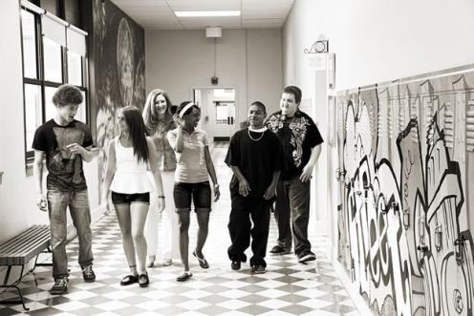
About Arts in Alternative Education
$2500 maximum award per application; up to 3 applications per school per year. 5% match required.
Can pay for artists’ time, travel, related student supplies, and select other costs.
First time applicants: Please contact me to discuss your project ideas.

Slide 19
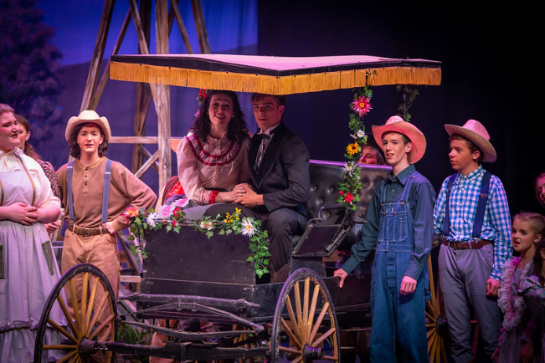
Step 1: Submit a Login Request arts.ok.gov

Slide 20
Additional Resources
Teaching Artist Roster

Slide 21
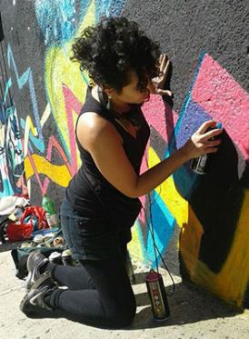
Additional Resources
Drama - Diana Haslett “Intro to Screenwriting”
Music - Benjamin Krumwiede “Molding Music: A Young Beginner’s Guide to Composition”
Visual Arts –
Nicole Emmons “Let’s Animate! Learn to Create a Short Animated Film”
Ghazal Ghazi “Exploring Street Art and Public Art: The Site-Specificity and Stories of Murals, Sculptures, and Public Installations”
Oklahoma Online Fine Arts Curriculum

Slide 22
Additional Resources
Arts Council OKC - All Access Arts
https://www.artscouncilokc.com/allaccessarts/
Arts and Humanities Council of Tulsa - Social Distance Studio
https://ahhatulsa.org/social-distance-studio/
Metropolitan Museum of Art
https://www.metmuseum.org/learn/educators/lesson-plans
Kennedy Center
https://www.kennedy-center.org/education/resources-for-educators/classroom-resources/lessons-and-activities/activities/kennedy-center-teaching-artists-present/
Other Arts Organizations

Slide 23
Contact Information
Jennifer Allen-Barron
Arts Education Director
(405) 521-2036
jennifer.allen-barron@arts.ok.gov
Heidi Costello
Grants/Programs Assistant
(405) 521-2040
heidi.costello@arts.ok.gov
Thomas Tran
Grants Director
(405) 521-2041
thomas.tran@arts.ok.gov
arts.ok.gov
Notes:
JENNIFER
Please bookmark our website: arts.ok.gov – you can find more information about this grant, our other school grants, and other programs and services of the OAC.
We are here to help however we can. Heidi is the best person to talk to about your login request, contact Thomas with questions about our grant system or managing your grant award, and you can contact me, Jennifer, with questions about your project and writing and submitting your grant application.

Slide 24
Questions?
Elizabeth Maughan, Ph.D.
Director of Fine Arts
Elizabeth.Maughan@sde.ok.gov
@ElizMaughan
OK Fine Arts
Maria Krey-Gibson
Dance Educator, Putnam City Schools
mkreygibson@putnamcityschools.org
Morgan Brown
Visual Art Educator, Jenks Public Schools
morgan.brown@jenksps.org
Thank you!
Virtual Arts Ideas

