Slide 1
Charter School Training
Oklahoma School Testing Program
Maria Harris
Assistant Executive Director of State Assessments

Slide 2
Oklahoma School Testing Program in ESSA
“The system should provide a strong summative assessment program that fits as a component within a multifaceted state, district and school accountability system.” ESSA Plan p. 48
OSTP Assessments
Notes:
In our approved essa plan we recognize that a system of assessments and the roles and values of each type of assessment, but the OSTP focuses on the summative

Slide 3
ESSA – Goals for States
95% participation on assessments
Required for Title I funding
Only 1% may take alternate tests
States may assess other subjects
Notes:
Federal requirements

Slide 4
ESSA – Goals for States
Must adopt challenging academic standards
Math & reading/ELA assessed in grades
3-8 & once in grades 9-12
Science assessed at least once in grades
3-5, 6-9, and once 10-12

Slide 5
Oklahoma School Testing Program
Assessment of the Oklahoma Academic Standards
Criterion-referenced test
Fulfills the Federal and Oklahoma’s state testing requirements
Provides scores used for the Report Card

Slide 6
Oklahoma School Testing Program
Oklahoma School Testing Program (OSTP)
Grades 3-8
College- and Career-Readiness Assessments
Grade 11
Oklahoma Alternate Assessment Program (OAAP)
Grades 3-8 and Grade 11

Slide 7
OSTP General Assessments for Grades 3-8
Grade | Math | English Language Arts (ELA) | Science
Grade 3
Grade 4
Grade 5
Grade 6
Grade 7
Grade 8
Federal and State Mandated tests

Slide 8
College- and Career- Readiness Assessments (Grade 11 CCRA)
Math (SAT/ACT) | ELA (SAT/ACT) | Grade 11 Science Content | U.S. History
Federal and State Mandated tests
State Mandated tests

Slide 9
Oklahoma School Testing Program
Every student enrolled in a tested grade level in an Oklahoma public school must participate in testing.
All students will be administered either an
OSTP general assessment with or without accommodations or
Alternate assessment.

Slide 10
College- and Career-Ready High School Assessments
For 2018-19, Students in Grade 11 will take the following assessments:
ACT/SAT + writing (ELA/Math)
Grade 11 Science Content
Grade 11 U.S. History (HB 3311)

Slide 11
HB 3311 U.S. History Requirements
The subject matter standards for United States Government shall include an emphasis on civics. For the purposes of this section, "civics" means the study of the rights and duties of Oklahoma and United States citizens and of how those governments work.
United States History assessment, with an emphasis on civics, not less than once during the grade span of nine through twelve.

Slide 12
College- and Career-Ready
Grade 11 U.S. History Assessment
50%
50%
FIELD TEST 2019

Slide 14
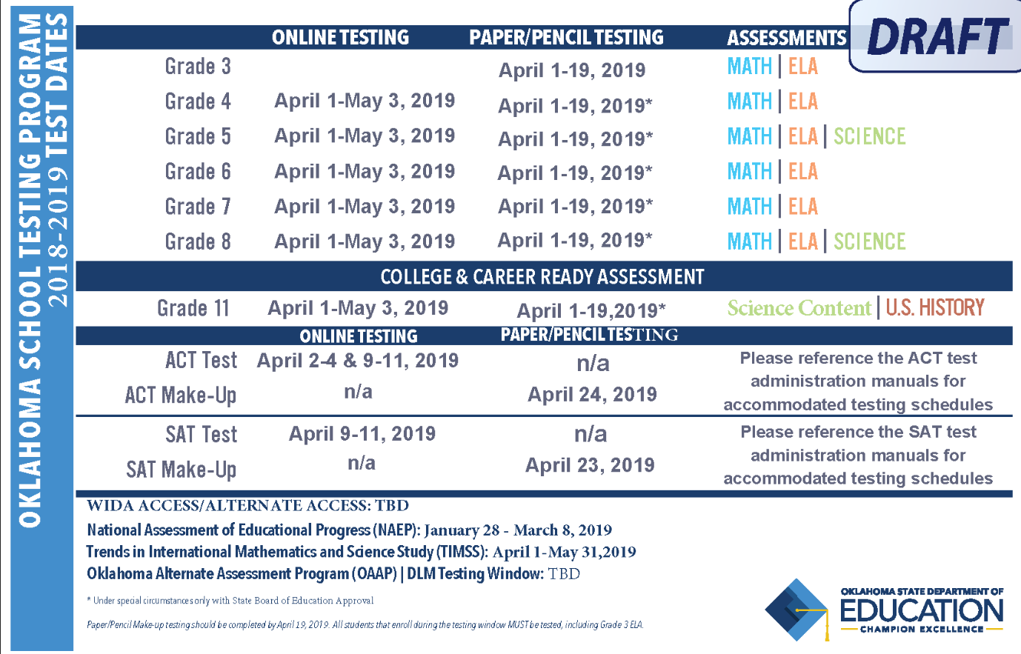

Slide 15
OK Educators Connections to the OSTP

Slide 16
Shifting Perspectives in ESSA
Focus on Growth along a continuum of learning
Role of state assessment as part of a system of assessment
Use of multiple measures for accountability
Belief that All students can grow and All schools can improve

Slide 17
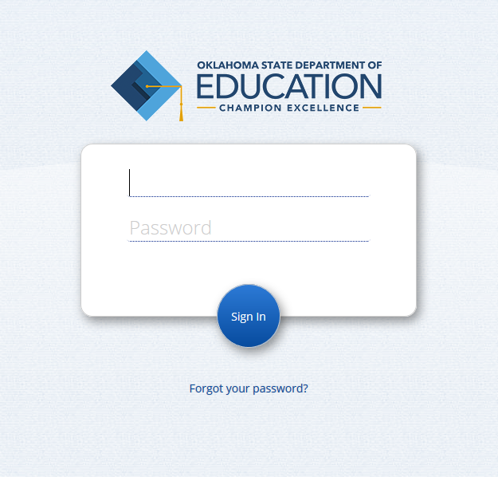
Measured Progress Portal

Slide 18
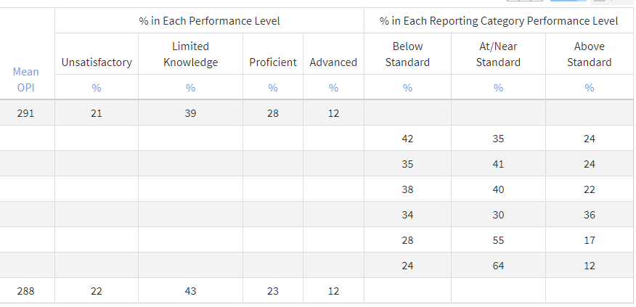
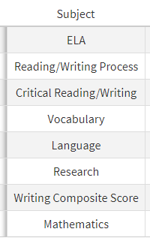
What OSTP data will you receive?

Slide 19
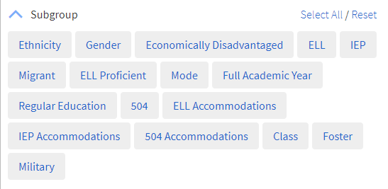
Ability to Aggregate Data by Student Group

Slide 20
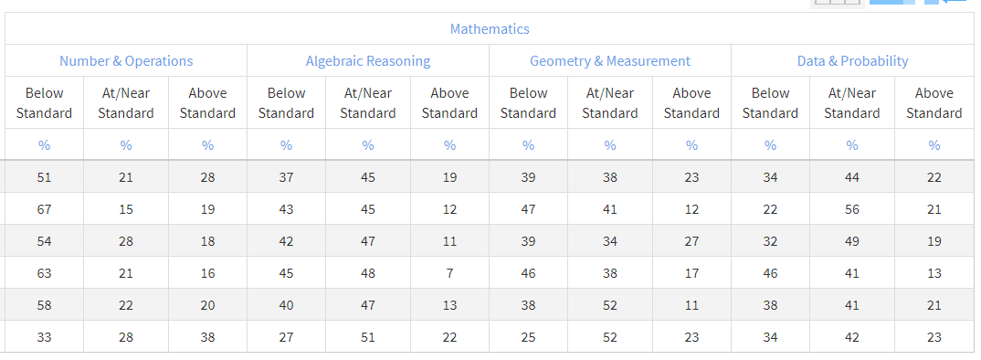
Ability to Aggregate by Grade and Class

Slide 21
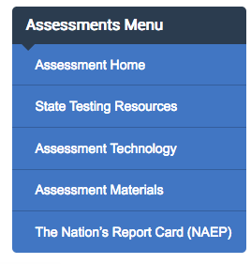
OSTP Support Tools
Assessment Materials- Where you find Blueprints, Test and Item Specs, Parent Guides, and Performance Level Descriptors
State Testing Resources- Where you find practice tests, summary reports, general information, and link to Measured Progress resources
Measured Progress Resources- Where you find training resources and DTC forms and information
Assessment Guidance- Where you find assessment and data literacy links, tools, and supports
OSTP Data Portal- Where you find data from the OSTP suite of assessments. Requires a username and password to access.

Slide 22
Survey to Districts: DTC/CCRA/ELPA
Sent to superintendents in early August

Slide 23
Oklahoma School Testing Program
District Test Coordinator (DTC)
Responsible for making arrangements for testing
Handles and maintains the secure distribution and collection of test materials
Security of all testing information and material is crucial.
Must be trained by State Department during Test-Preparation In-Service
Training must be validated each school year.

Slide 24
Oklahoma School Testing Program
District Test Coordinator (DTC)
Trains Building Test Coordinators, Test Administrators, Test Proctors and other key staff
Test administrators are required to be Oklahoma certified teachers employed by the district.
Proctors are required for every 25-35 students.

Slide 25
Contact Information
Office of Assessments
(405) 521-3341

Slide 26
Office of Assessment
Dr. Maridyth McBee, Interim Deputy Superintendent of Assessment & Accountability
Craig Walker, Executive Director of State Assessments
Maria Harris, Assistant Executive Director of State Assessments
Elizabeth Warren, Director of English Language Proficiency Assessments
Yuseli Freire, English Language Proficiency & Monitoring Specialist
Lesa Rohrer, Director of Assessment and Data Literacy
Christy McCreary, ELA & Social Studies Assessment Specialist
Cora James, Science Assessment Specialist
Sarah Owens, Mathematics Assessment Specialist
Rebecca Logan, Executive Director of NAEP & International Assessments
Dionne Jordan-Mock, Coordinator II
Molly Brown, Coordinator I
Samantha Sheppard, Coordinator I

