Slide 1
2017 NAEP Mapping Study
Mapping State Proficiency Standards
Onto the NAEP Scales

Slide 2
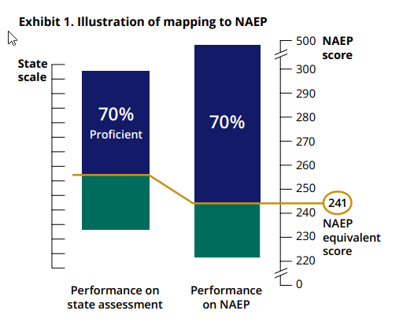
The Method
The mapping report displays the NAEP equivalent score for each state.
Analysis are based on NAEP and state assessment results for public schools that participated in NAEP in 2017.
Reading & Mathematics
Grades 4 & 8

Slide 3
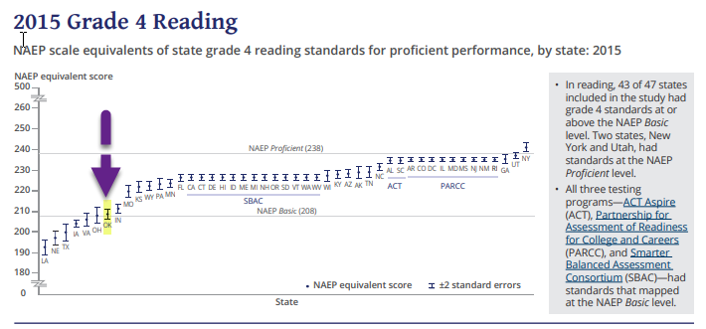

Slide 4
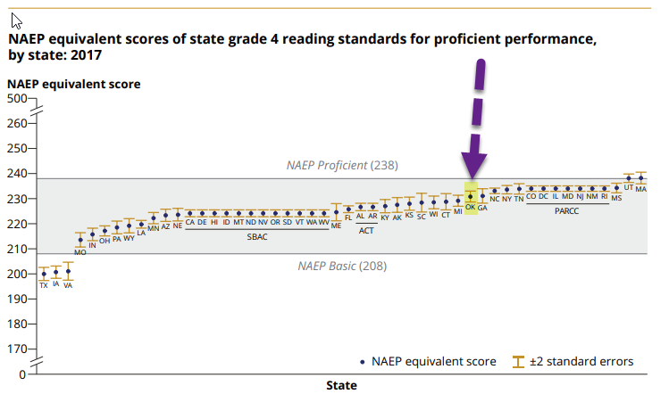

Slide 5
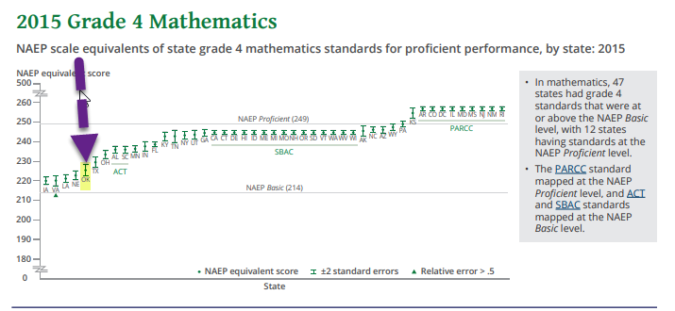

Slide 6
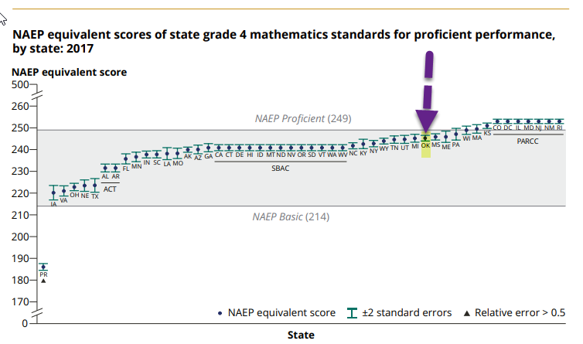

Slide 7
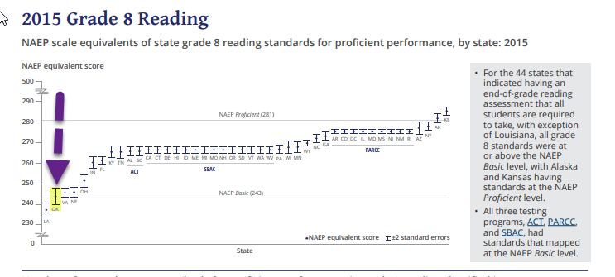

Slide 8
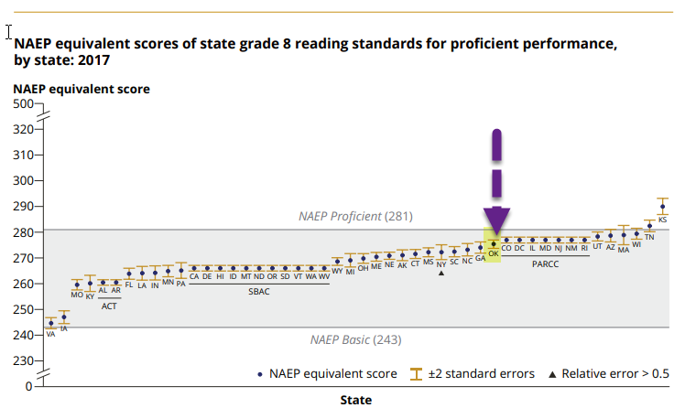

Slide 9
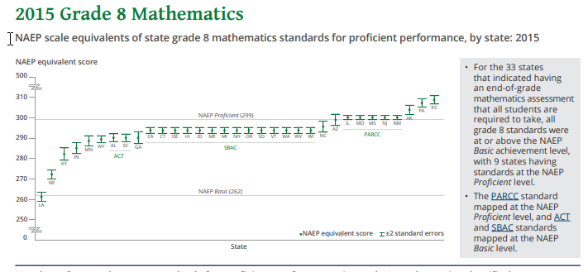

Slide 10
