Slide 1
OKLAHOMA ADVISORY COUNCIL
ON INDIAN EDUCATION (OACIE)
2018 Annual Report to the
Oklahoma State Board of Education
08 / 22 / 2019

Slide 2
OACIE Priorities
Improve collaboration and communication among all Oklahoma educational entities
Encourage the inclusion of more American Indian history in state curricula and educational leadership
Identify and disseminate measurable, research-based criteria to assist American Indian/Alaska Native children
Analyze data to ensure we are meeting the needs of American Indian/Alaska Native students
Make recommendations to the Oklahoma State Department of Education (OSDE)

Slide 3
Title VI Count & Funding
131,029 American Indian students in Oklahoma Public Schools
$25.4 million Title VI federal formula dollars from the Office of Indian Education, FY 2018
406 schools, SY 2018-19

Slide 4
Indian Education in Oklahoma
Bureau of Indian Education (BIE)
Johnson O’Malley Programs
FY 2014 – 57 contracts serving 92,589 students
One BIE-Operated School
Riverside Indian School, Anadarko
Four Tribally-Operated BIE Schools
Chickasaw Children’s Village, Kingston - Chickasaw Nation
Eufaula Dormitory, Eufaula - Muscogee Nation
Jones Academy, Hartshorne - Choctaw Nation
Sequoyah High School, Tahlequah - Cherokee Nation

Slide 5
Oklahoma & the 39 Tribal Nations
Validation of American Indian students
Integrate more culturally responsive Native curriculum
Encourage and cultivate a greater understanding of Native culture
Teach all students about Oklahoma’s Tribal Nations
Teach all students the impact of Tribal Nations in Oklahoma
Encourage schools to provide teachers professional development on Oklahoma’s Tribal nations

Slide 6
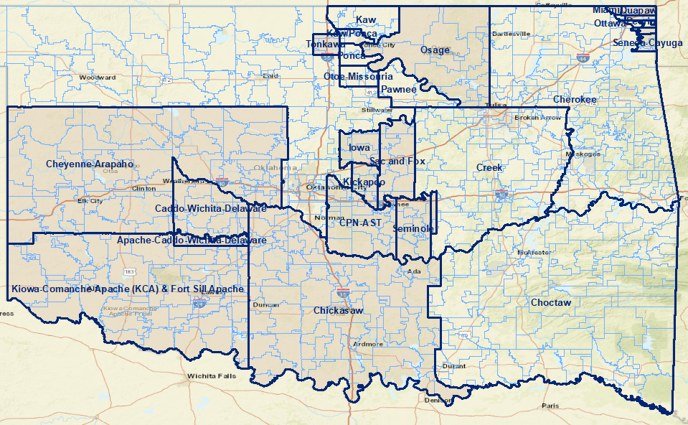
Tribal and School Jurisdictions

Slide 7
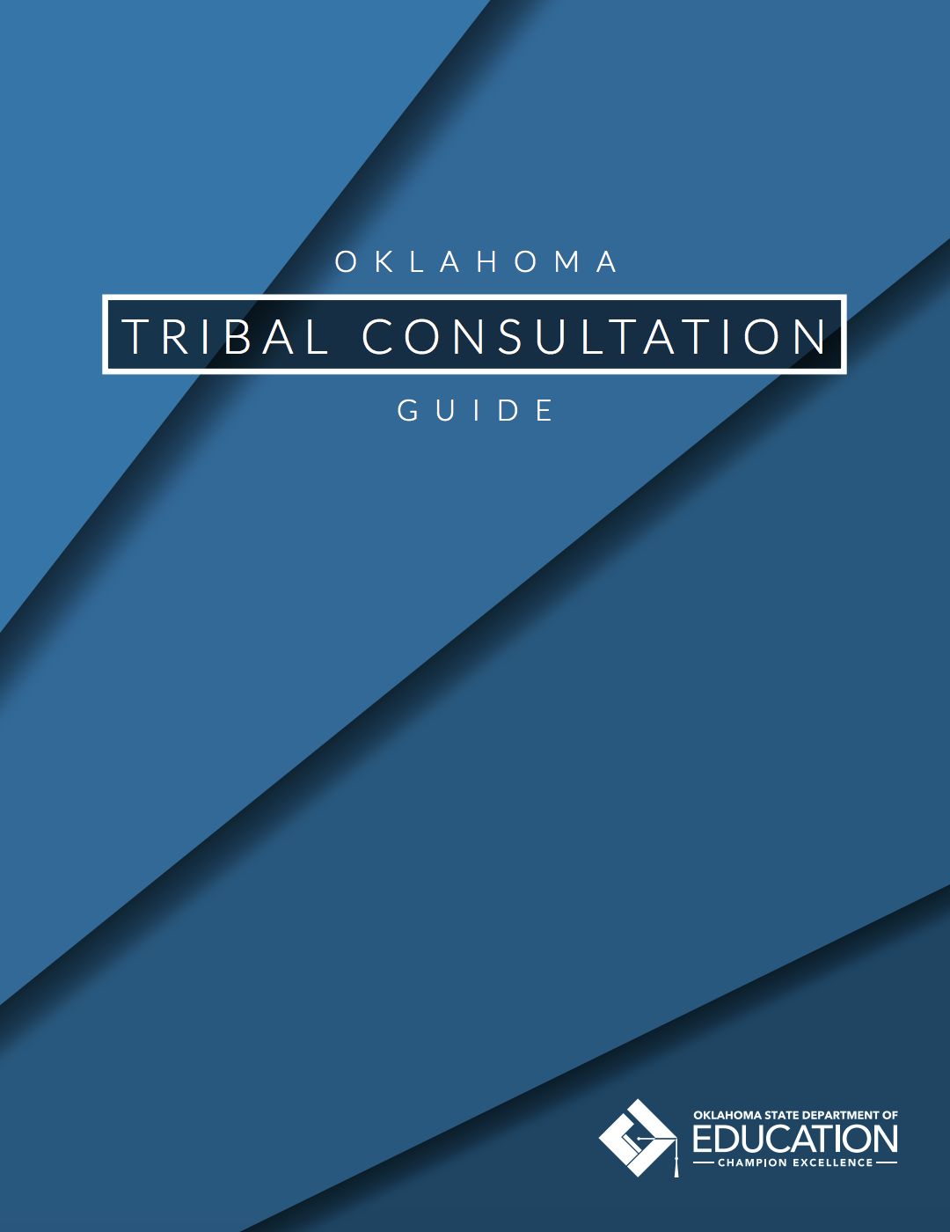
Tribal Consultation in Oklahoma
178 school districts required to have Tribal Consultation
Every Student Succeeds Act (ESSA) Sec. 8538(c)(1)(A) & (B)
Tribal Consultation is required when a school district:
Receives greater than $40,000 in Title VI funds
Has 50% AI/AN enrollment

Slide 8
Tribal Consultation in Oklahoma
Qualified Districts must consult on the following ESSA Titles:
Part A of Title I
Part C of Title I
Part D of Title I
Part A of Title II, III, IV
Part B of Title IV
Subpart 2 of Part B of Title V
Title VI

Slide 9
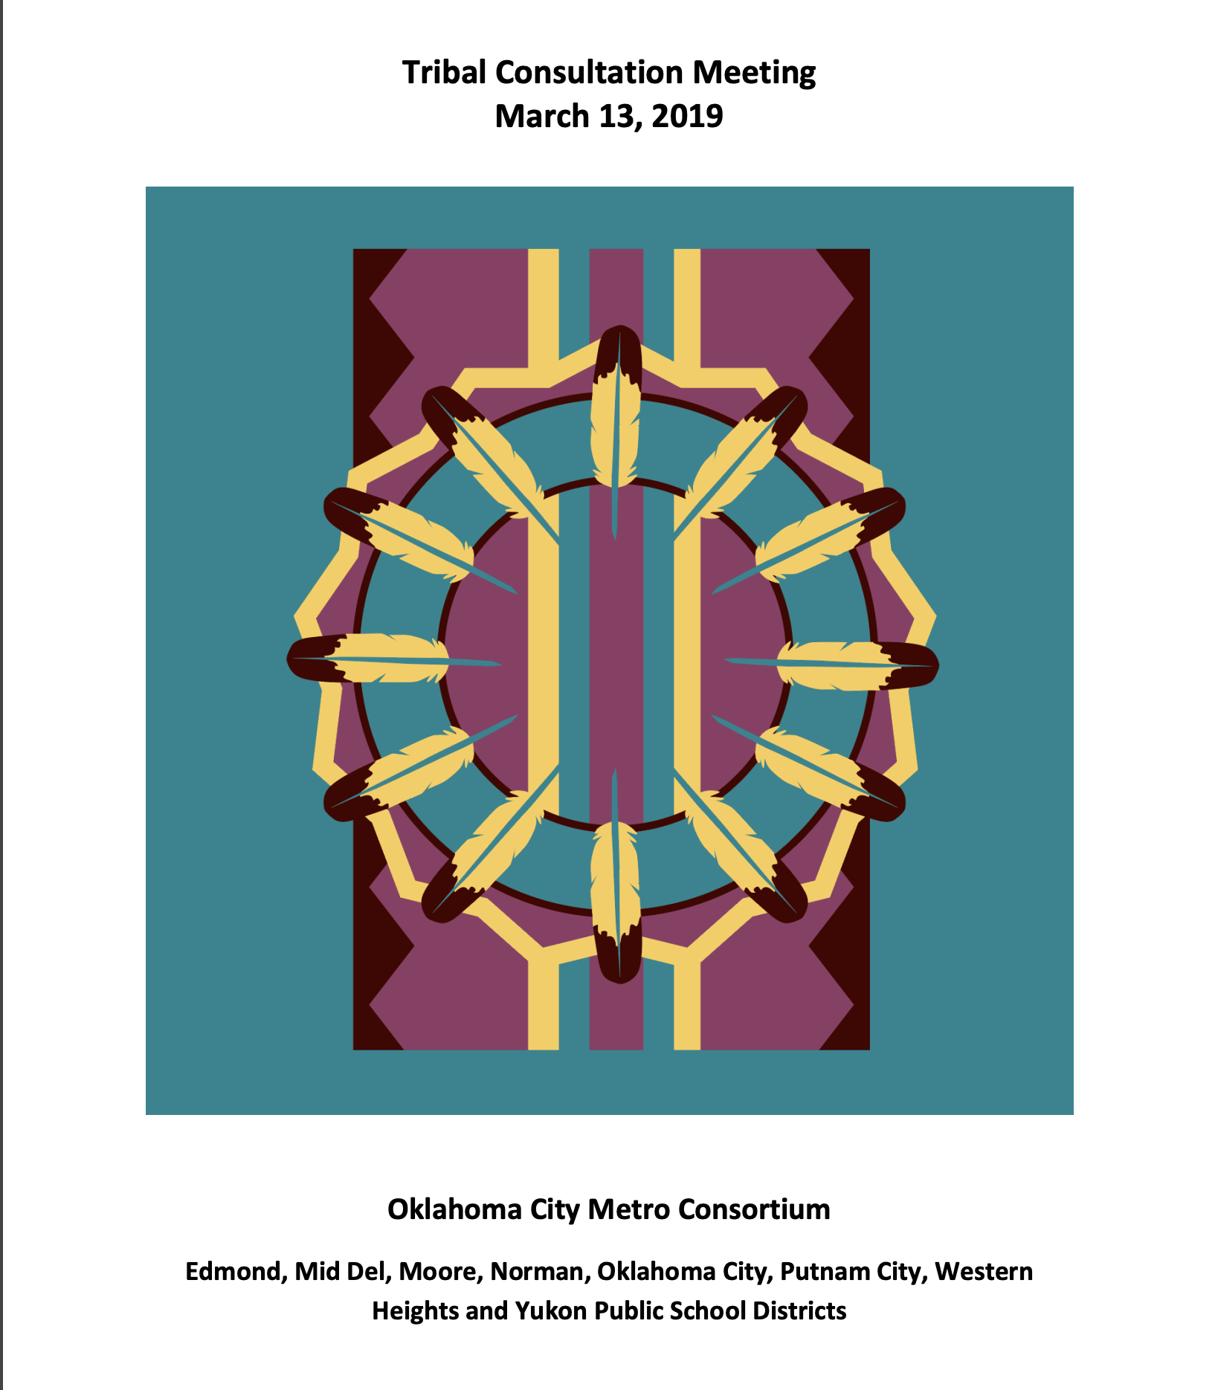
ESSA Tribal Engagement Workshop
Tribal Consultation Meeting
March 13, 2019
Oklahoma City Title VI
Metro Consortium

Slide 10
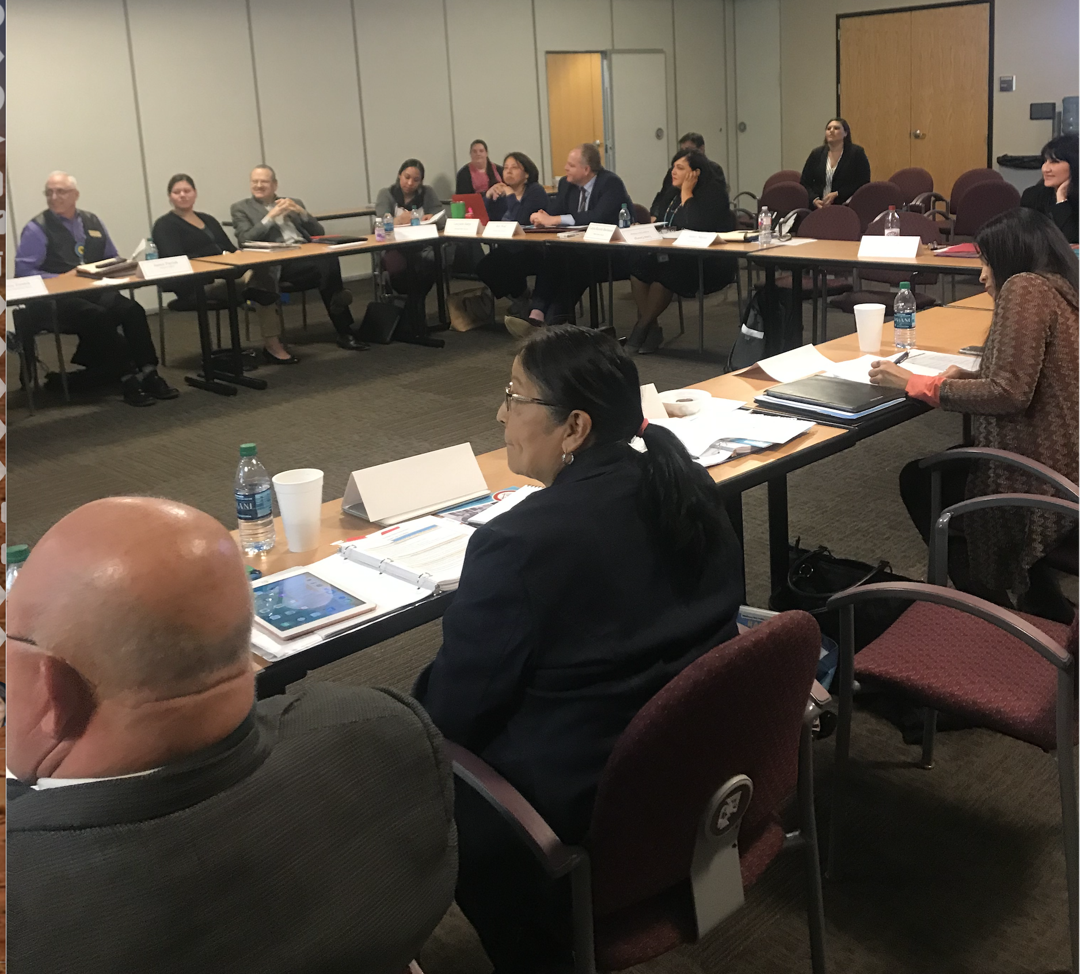
Tribal Consultation

Slide 11
Collaboration Between
Tribal Nations and Public Schools
Conduct collaborative engagement meetings
Nurture partnerships, strengthen ties
Educate and promote effective communication
Promote engagement between Tribal Nations and school leaders
Strengthen the quality and effectiveness of instructional programs
Improve the educational environment for all

Slide 12
OSDE Partnerships
Oklahoma Tribal Education Departments from multiple Tribal Nations
State-Tribal Education Partnership (STEP) Grant Partners: Muscogee (Creek) Nation, Cheyenne and Arapaho Tribes, and Chickasaw Nation
National Indian Education Association
Oklahoma Council for Indian Education
Tribal Education Departments National Assembly
Inter-Tribal Council of the Five Civilized Tribes

Slide 13
Professional Development
March 19-20, 2018 - Oklahoma Johnson O’Malley Conference
July 31-August 1, 2018 - Indian Education Summit
December 4-5, 2018 - OCIE 39th Annual Conference
July 2018, Office of American Indian Education at EngageOK
Culturally Responsive American Indian Curriculum for All
Building Sustainable Partnerships with Tribal Education Agencies

Slide 14
Social Studies Standards
Revised Oklahoma Academic Standards (OAS) for social studies went into effect May 1, 2019 and increased references to tribal sovereignty.
Tribal perspectives included on all three committee levels: Drafting, Writing, and Executive
Additional input solicited from Focus Group and considered perspectives from Elected Tribal Leaders, Title VI Directors, and Johnson O’Malley staff

Slide 15
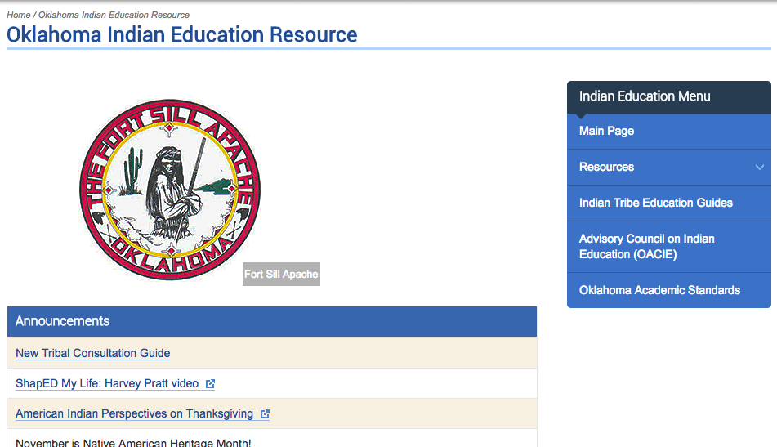
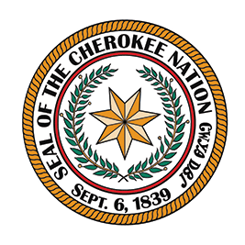
Oklahoma Indian Education Resource
URL: http://sde.ok.gov/sde/indian-education

Slide 16
Federal Demonstration Grants
In 2018, the U.S. Department of Education awarded four college and career readiness demonstration grants in Oklahoma for American Indian students.
FY 2018 Grantees | Award Amounts:
American Indian Resource Center | $824,371
Cheyenne and Arapaho Tribes | $663,017
Choctaw Nation | $731,463
Oklahoma State Department of Education | $998,743
Total | $3,217,324

Slide 17
Native Youth Community Project (NYCP) Objectives
Objectives:
Increase the academic achievement of participating Indian students
Collaboration between Tribes and Schools for Individual Career Academic Planning (ICAP)
Improve college and career planning with American Indian students
Build a college and career readiness culture

Slide 18
Native Language Revitalization

Slide 19
Native Languages in Our Schools
Key Figures
13 Tribal Nations have language programs in Oklahoma public schools. Ten (10) have course codes.
1,471 enrolled K-12 students

Slide 20
Native Languages in Our Schools
10 Classes course-coded:
Cherokee I-IV
Chickasaw I-IV
Choctaw I-IV
Comanche I-IV
Maskoke-Seminole I-IV
Mvskoke I-IV
Osage I-IV
Pawnee I-IV
Potawatomi I-II
Sauk I-IV
Cherokee Nation
Immersion Charter School

Slide 21
Recommendations
Produce a sustainability plan by FY 2021 to maintain staffing capacity of Office of American Indian Education, post-grant.
Provide additional staff development for teachers and administrators via an “Indian Education Curriculum Frameworks”.

Slide 22
Recommendations
Produce an updated tribal consultation guide.
Encourage/mandate the inclusion of more American Indian history and contemporary information in all state standards.
Build effective partnerships with all 39 Tribal Nations

Slide 23
Upcoming OACIE Meeting
October 23, 2019 (Wednesday)
10 a.m. - 2 p.m.
Oklahoma State Department of Education
Board Room

Slide 24
OACIE Statutory Appointments
Per 70 O.S. § 3-173 Oklahoma Advisory Council on Indian Education Act
Council Member | Organization | Appointed by/Designee | Represents
Greg Anderson | Muscogee (Creek) Nation | Governor | Tribal Nation
Lori Hamilton | Chickasaw Nation | Governor | Tribal Nation
Lisa John | Chickasaw Nation | Governor | Tribal Nation

Slide 25
OACIE Statutory Appointments
Per 70 O.S. § 3-173 Oklahoma Advisory Council on Indian Education Act
Council Member | Organization | Appointed by/Designee | Represents
Jana Roth | Delaware Tribe | Governor | Tribal Nation
David Walkingstick | Cherokee Nation | Governor | Tribal Nation
Judy Davis | Miami Tribe | Governor | Tribal Education Department

Slide 26
OACIE Statutory Appointments
Per 70 O.S. § 3-173 Oklahoma Advisory Council on Indian Education Act
Council Member | Organization | Appointed by/Designee | Represents
Rhonda Hayworth | Ottawa Tribe | Governor | Tribal Education Department
Mary McCormick | Sac and Fox Nation | Governor | Tribal Education Department
James Parrish (Vice-Chairperson) | Choctaw Nation | Governor | Tribal Education Department

Slide 27
OACIE Statutory Appointments
Per 70 O.S. § 3-173 Oklahoma Advisory Council on Indian Education Act
Council Member | Organization | Appointed by/Designee | Represents
Lucyann Harjo (Chairperson) | Norman Public Schools | Governor | OK Council Indian Education
Esther Bell | Professional Oklahoma Educators, Shawnee, OK | President Pro Tempore Senate | Statewide Teacher Organization

Slide 28
OACIE Statutory Appointments
Per 70 O.S. § 3-173 Oklahoma Advisory Council on Indian Education Act
Council Member | Organization | Appointed by/Designee | Represents
Paul Pinkerton | Oklahoma Education Association, Stilwell, OK | President Pro Tempore Senate | Statewide Teacher Organization
Todd Crabtree | Oklahoma Association of School Administrators | Speaker of the House | School Superintendents

Slide 29
OACIE Statutory Appointments
Per 70 O.S. § 3-173 Oklahoma Advisory Council on Indian Education Act
Council Member | Organization | Appointed by/Designee | Represents
Robert Bible | College of the Muscogee Nation | Chancellor | Tribal College
Shoshana Wasserman | American Indian Cultural Center and Museum (AICCM) | Director of AICCM | Native American Cultural Authority

Slide 30
OACIE Statutory Appointments
Per 70 O.S. § 3-173 Oklahoma Advisory Council on Indian Education Act
Council Member | Organization | Appointed by/Designee | Represents
Cori Gray | Oklahoma Department of Career Technology Education (CTE) | State Director Designee | Oklahoma Department of Career Technology Education
Annette Long | Oklahoma State Regents for Higher Education (OSRHE) | Chancellor Designee | Oklahoma State Regents for Higher Education

Slide 31
OACIE Statutory Appointments
Per 70 O.S. § 3-173 Oklahoma Advisory Council on Indian Education Act
Council Member | Organization | Appointed by/Designee | Represents
Julian Guerrero, Jr. | Oklahoma State Department of Education (OSDE) | State Superintendent Designee | State Department of Education

