Slide 1

2020 OSTP/CCRA
Building Test Coordinator Training

Slide 2
Contact Information
Oklahoma State Department of Education (SDE)
For questions relating to policy or the OSTP in general:
Office of Assessments
(405) 521-3341 assessments@sde.ok.gov
Cognia Oklahoma Service Desk
For questions relating to the OSTP online or paper/pencil testing (i.e. iTester software, technical issues, test materials, UPS pickup, etc.)
Monday – Friday, 7AM – 7PM Central during the testing window
Monday – Friday, 7:30 AM – 4:30 PM Central outside the testing window
(866) 629-0220 oktechsupport@cognia.org

Slide 3

1
General testing information

Slide 4
Important Dates
 | CCRA | Grades 3-8
Manuals arrive in districts | LP and Braille PSTGs only: 2/19/2020 | 3/09/2020
Test materials in districts | 3/11/2020 | 3/30/2020
Tests available for scheduling | 3/25/2020 | 4/13/2020
Grade 3 ELA tests must be completed in order to receive early RSA reporting | n/a | 4/24/2020
Grade 4-8 ELA online tests must be submitted in order to receive preliminary reports | n/a | 5/08/2020
Last day for scoreable testing material pick-up | 4/21/2020 | 5/05/2020
Notes:
Practice tests, PSTGs, TAMs, TPM were available starting in January. Manuals in districts: Carefully calculated numbers, if you need more, please print from site. CCRA this is only Braille and LP, all others are online only.

Slide 5
Testing Window 2019-2020
 | Paper Dates | Online Dates
CCRA Science & U.S. History CBT with PBT accommodations | 4/1/2020 – 4/17/2020 | 4/1/2020 – 4/24/2020
OSTP G3 math & Grades 4-8 all contents CBT with PBT accommodations | 4/20/2020 – 5/01/2020 | 4/20/2020 – 5/15/2020
Recommended Testing Window for OSTP Grade 3 ELA in order to receive early RSA reporting. PBT integrated books only | 4/20/20 - 4/24/20
Recommended Testing Window for OSTP Grades 4 through 8 ELA online in order to receive preliminary reports. |  | 4/20/20 - 5/08/20
Notes:
Manuals in districts: Carefully calculated numbers, if you need more, please print from site. CCRA this is only Braille and LP, all others are online only.

Slide 6

2
OSTP Overview

Slide 7
OSTP Testing Overview
Grades 3 – 8 & 11

Slide 8
Testing Overview
English Language Arts, Mathematics, and Science assessments are required by the federal legislation Every Student Succeeds Act (ESSA) for accountability.
Oklahoma public schools must administer an OSTP general assessment with or without accommodations, or an Oklahoma Alternate Assessment Program (OAAP) test to all students enrolled in a tested grade level.

Slide 9
Testing Overview
In order to meet federal ESSA requirements, students must test:
  English Language Arts and Mathematics
    annually in Grades 3 – 8
    once in Grades 9 – 12
  Science
    once in Grades 3 – 5
    once in Grades 6 – 9
    once in Grades 10 – 12

Slide 10
Testing Contractors
Cognia will serve as Oklahoma’s testing vendor for all OSTP Grades 3-8
  English Language Arts,
  Mathematics, and
  Science
Grade 11 CCRA
  District choice of SAT or ACT
  Science and U.S. History Content – Cognia
Oklahoma Alternate Assessment Program (OAAP): All subject areas will be assessed through Dynamic Learning Maps for
  English Language Arts (Grades 3-8 & 11)
  Mathematics (Grades 3-8 & 11)
  Science (Grades 5, 8 & 11)
  US History (11th or 12th graders if needed for participation)

Slide 11
Demographic Information & Demographic Overlay Report

Slide 12
Demographic Overlay File & Report
Demographic information should be correct in the WAVE at all times:
  Gender, IEP/504, EL, EL 1st/2nd year proficient, Migrant, Title X (homeless)
  Economically Disadvantaged
  Ethnicity/Race
  Military
  Foster
  Most Recent Exit Date
  OCAS codes for students assigned to a particular teacher for the class reports

Slide 13
Demographic Overlay File & Report
Districts must certify the Demographic Overlay report by May 8, 2020.
  The demographic overlay pulls from the WAVE's course code assigned to a student, and it only populates one teacher. However, districts may input multiple teacher names into the demographic overlay manually.
Additional information about the Demographic Overlay Report will be provided in the future by the Office of Accountability.

Slide 14
Demographic Information
All students must be accounted for at the time of testing.
Ultimately, all student demographic information will be pulled from the Demographic Overlay Report. Please ensure information in the local SIS is accurate.
Incorrect or incomplete information will result in inaccurate student data and may have a negative impact on the final reports.
Notes:
Information being incorrect in your Student Information System will cause the Preliminary Reports to be incorrect. This will requires cause additional clean-up during the correction window.

Slide 15
OSTP
Testing All Eligible Students

Slide 16
Testing All Students
OAC 210:10-3-2(b)
“All public school districts shall administer the state mandated academic achievement tests of the OSTP to all students enrolled in designated grades.”

Slide 17
Participation in Grade 3-8 Tests
If a student is enrolled in the same district during precode and the testing window, the grade the student is at the close of precode will determine what grade level tests they take.
If a student transfers to a new district between precode and the testing window, the demographic overlay will determine grade level that should have been assessed.

Slide 18
Participation in CCRA
Students who were enrolled in grade 11 on January 17th will be expected to participate.
Districts will need to add students to the Cognia, SAT or ACT system manually if:
  the student(s) were promoted before precode or
  need to take one of the CCRAs for graduation purposes, including alternative education students.
If a student transfers districts and is erroneously enrolled in the wrong grade, do not exit and re-enroll, correct in local SIS.

Slide 19
Absent Students
Any student absent during the scheduled test session must be administered the assessment upon their return.
The make-up session must be scheduled within the existing testing window.
Students must take sections in proper order.

Slide 20
Suspended Students
OAC 210:10-1-5
It is no longer appropriate to “drop” or “exit” a student who is suspended out of school for any length of time.
  Students who are suspended will be expected to participate in the OSTP.
  Guidance for Attendance and Suspension

Slide 21
Students Who Receive Instruction Away from Sites of Official Enrollment
Students Testing at Alternative Sites
This includes:
  Special education consortiums;
  Alternative education cooperatives and interlocals;
  Hospital placement;
  Homebound placement; and
  Technology Centers.
No less than thirty days prior to the testing window, request permission in writing from the Office of Assessment at assessments@sde.ok.gov to test certain students at the site of instruction, rather than at the site of enrollment.

Slide 22
Students Who Receive Instruction Away from Sites of Official Enrollment
Paper/pencil test materials will be ordered by and sent to the district where the students are officially enrolled.
Online assessments should be set up by the district of official enrollment. The site of enrollment:
  Submits the student data through the WAVE or manual upload,
  Places students in a testing session,
  Prints test tickets and delivers the test tickets to the site of instruction or transfers test tickets through a secure online platform.
When testing students at their sites of instruction, follow the procedures outlined in the Test Preparation Manual.
Notes:
A district plan for the security and transport of materials should be written out. This documentation is requested for monitoring purposes, but every district should have a plan and procedure in place.

Slide 23
Students Who Receive Instruction Away from Sites of Official Enrollment
Students Testing at Alternative Sites
Score reports will be sent to the districts where the students are officially enrolled.
The Test Administrator (TA) at the site of instruction signs a Test Security Form.
TAs must be certified employees of the school district or site of instruction.
TAs and TPs cannot be related, nor can they be related to any student in the testing session.
All test books, answer documents, and test tickets, are returned to the site of residence.
All security forms have been signed electronically through DocuSign using “ALT” for the site code.

Slide 24
Distance Learners
Schools must account for all students. This includes Distance Learners who are taking classes via the Internet.
School districts offering online courses or programs will provide at least one onsite location for these students to test.

Slide 25
OSTP
IEP & 504 Plan Students

Slide 26
IEP/504 Accommodations
Accommodations for IEP and Section 504 students must be:
Specified in an IEP or Section 504 Plan
  Any accommodation received on the OSTP must be provided frequently and on a regular basis in the classroom.
Selected from the list of state approved accommodations; and
Indicated for each student by choosing either with or without accommodations
  For paper testers this must be bubbled on the back of a paper answer document.
  For online testers the “with accommodations” must be checked under the Delivered Locally section in the testing platform.

Slide 27
IEP/504 Accommodation Updates
Minor revisions
  Kiosk Accessibility Mode
    For example: Voice-to-Text, Braille Readers.
  Paper Testing Checklist
  Updated Chart for SAT/ACT Accommodations
IEP/504 Accommodations Manual

Slide 28
Emergency Accommodations
Form EA (Emergency Accommodations):
  If prior to or during testing, the school principal (or designee) determines that a student requires an emergency accommodation (e.g., broken hand), Form EA must be completed and submitted to the DTC for approval.
  Form EA must be retained at the district level for five (5) years for monitoring purposes.
Notes:
Districts should have a written plan in place for when an Emergency Accommodation is necessary. Decide who determines the accommodation is needed and who completes the paperwork. This plan must be submitted during monitoring, but all districts should have a plan in place prior to the beginning of testing.

Slide 29
OSTP
English Learner (EL) Students

Slide 30
EL Testing Accommodations
EL accommodations must be:
  Selected from the approved list of state-approved accommodations
  Indicated for each student by choosing either with or without accommodations
    For paper testers this must be bubbled on the back of a paper answer document.
    For online testers the “with accommodations” must be checked under the Delivered Locally section in the testing platform.

Slide 31
EL Accommodation Updates
Spanish PSTGs only available electronically
EL8: Spanish 3-8 Math/Science online forms with Spanish Text-to-Speech.
EL10: Districts may request to order Spanish audio files and English paper test forms for students who are not literate in Spanish, but would benefit from listening to the Spanish audio files.
EL Accommodations Manual & Test Form Resource

Slide 32
Spanish Translation
Spanish translated test forms are available for:
Online Test Forms
  Math grades 3 - 8
  Science grades 5, 8, and 11
  U.S. History
Spanish audio files are available to accompany English paper forms for math, science, and U.S. History.

Slide 33
Important Scheduling Info
Ensure that text-to-speech (TTS) accommodations are selected in the portal before scheduling the student’s test.
If the test is scheduled before TTS is selected, these accommodations will not be available to the student.
This applies to both English and Spanish TTS.

Slide 34
OSTP
Test Irregularities and Invalidations

Slide 35
Test Irregularity Vs. Test Invalidations
A testing irregularity is an out-of-the-ordinary situation which does not affect the outcome of testing and does not require students to retest.
  Requires DTC or BTC to submit a Test Irregularity Form through SDE-provided Google Form.
A testing invalidation is caused by a situation where the test or test security has been compromised and students must retake the test.
  Requires DTC to submit a Test Invalidation Request through the Testing Status Application in the SDE Single Sign On.

Slide 36
Testing Irregularities
Document testing irregularity.
Re-administer same test form, if possible:
  Student may need a new answer document or booklet depending on circumstances.
Complete the Testing Irregularity Form provided by the Office of Assessment. This will be on the SDE website.
  Take extra precaution when entering student’s STN
DTC must be contacted to obtain a Proctor Password for online testing.
Proctor Passwords must be manually reset by DTC periodically throughout testing.

Slide 37
Testing Irregularities
Sickness
TA/TP is distracting to students
Student received read aloud for Math/Science and should not have
Misread script
Parent picked up student during testing session
Wrong accommodation
Sections not given on consecutive instructional days
Sections not given in the correct order
Technical issues during online testing
Notes:
Districts must have plans and procedures in place for handling testing irregularities. This plan should be written and provided to test administrators prior to testing. The plan is required documentation for monitoring, but all districts need to have a plan in place before testing begins.

Slide 38
Test Invalidation
Reasons for possible test invalidations include, but are not limited to:
Cheating;
Large-scale security violation;
Presence of a cell phone (or other smart technology including smart watches) in the testing environment;
Testing outside the test window;
TA/TP/Student are related in the testing room;
Student received read aloud on ELA and was not supposed to;
ELA writing section was started and didn’t finish until days after;
TP not employee of district for Human Reader.
If the SDE approves the invalidation, the student will be considered a nonparticipant unless a Breach Assessment is administered.
Notes:
Districts must have plans and procedures in place for handling testing invalidations. This plan should be written and provided to test administrators prior to testing. The plan is required documentation for monitoring, but all districts need to have a plan in place before testing begins.

Slide 39
Breach Tests
In situations when a test must be invalidated, the DTC must enter the invalidation request on the Testing Status Application on the SDE Single Sign-On.
Check the status through the Testing Status Application.
Once the invalidation is approved, the SDE will order the Breach Test.
  The Breach Test must be administered to the student within the remainder of the testing window.
  In the case of a paper/pencil test, all answer documents for Breach Tests, as well as the invalidated operational tests, must be returned with the scoreable answer documents.
  In the case of online tests, Breach Tests may not be scheduled on the same day as the invalidated operational tests. Please follow the directions carefully and select the Breach Test form when scheduling the test.

Slide 40
OSTP
Test Security

Slide 41
Test Security
Who must be trained on test security and administration procedures?
District Test Coordinators (DTCs)
Building Test Coordinators (BTCs)
Test Administrators (TAs)
Test Proctors (TPs)

Slide 42
Test Security
Additional important information regarding test security and validity is included throughout the Test Preparation Manual and its appendices.
Test materials must be kept secure at all times and should not be left in open or unattended areas.
Test books are not to be opened prior to or after any test sessions. Only the students testing are allowed to view the contents of a test book or an online test and only at the time of testing.
All secure test materials must be returned to the vendor after the completion of testing.
Notes:
Each site must have plans and procedures for maintaining the security of test materials before, during, and after testing. These plans are required documentation for monitoring, but each site should have a documented plan in place prior to receiving testing materials.

Slide 43

Test Security
Nondisclosure Agreements (NDA) are included on the TA Security Form
  All TAs must sign via DocuSign and list their TPs
  TPs will submit NDA via training certificate
Revealing information about test items or the overall test, either implicitly or explicitly, is a violation of test security protocols. This includes discussions:
  with students – individually or as a class
  with teachers
  on social media

Slide 44
Test Security
Violations in test administration and test security may result in an invalidation of the test and/or test results and could impact school accountability.

Slide 45
Test Security
Paper-based Testing
Classroom Security Checklists must be completed, signed, and dated by the TA and the BTC. Please retain a copy of the checklist for your records.
District and School Checklists provide a list of all materials’ barcodes and have blank columns to record information regarding the location (school or classroom) of the test books.

Slide 46
Test Security
DTC, BTC and TA Security forms will be provided and signed electronically using DocuSign. :
  District Level Test Security Form,
  Building Level Test Security Form, and
  Test Administrator Security Forms.
Test Proctors will complete and sign an Observation Log which must be returned to the BTC.
Keep an electronic copy or print a hard copy for your district records.

Slide 47
Staffing Standard OSTP 3-8 and Science and U.S. History Content Assessments
Each testing room is required to have one Test Administrator.
  Certified employee of the district.
A proctor is required for each testing session.
  Additional proctors are required for every 35 students for paper testing.
  Additional proctors are required for every 50 students for online testing.
Administrator and Proctor cannot be related to anyone in the room – including each other.

Slide 48
Grades 3-8 and CCRA Science & U.S. History Content Assessments
Paper Testing
Online Testing
# of Testers | Staff Requirements
1-35 | 1TA & 1 TP
35-69 | 1 TA & 2 TPs
70+ | 1 TA & 3+ TPs (1 additional proctor for each additional 35 students
# of Testers | Staff Requirements
1-50 | 1 TA & 1 TP
51-100 | 1 TA & 2 TPs
101+ | 1 TA & 3 TPs+ (1 additional proctor for each additional 50 students
The DTC cannot act as a Testing Administrator or Proctor when more than one room is testing.

Slide 49
SAT and ACT Assessments
 | SAT | ACT
Roving Proctor |  | X*
Hall Proctors | X
Proctor for Accommodated Rooms | X* | X*
Cannot be related to an 11th grader taking the same assessment | X | X
*Minimum 1 Required by OSDE

Slide 50
Data Forensics
SDE conducts data forensics on all assessments and may conduct investigations as deemed necessary when test security and testing violations are suspected.

Slide 51
OSTP
DTC Instructions and Information
DTCs serve as the SDE’s contact for all testing activities.

Slide 52
OSTP
BTC Instructions and Information

Slide 53
BTC Instructions and Information
General Responsibilities:
Serve as the site contact for the DTC, direct the entire testing procedure at the specified building site.
Ensure all TAs and TPs are trained using the TA/TP Modules and maintain documentation.
  Note: Module training certificates required for all TAs/TPs.
Identify students who need special accommodations and/or alternate assessments and make the appropriate testing arrangements for these students.

Slide 54
BTC Instructions and Information
General Responsibilities:
Inventory all paper test materials upon receipt from the DTC.
Distribute or provide access to the PSTGs and Test Administration Manuals.
Check testing materials out to TAs the day of testing using the Security Checklist.
Verify the presence of a TP in every testing session before testing begins. Ensure that there is a TP present the entire testing session.
Notes:
Districts will receive a paper copy of the PSTG for each paper/pencil tester. For students testing online, districts should provide parents with the links to the PSTG or districts may elect to print the guides for parents.

Slide 55

BTC Instructions and Information
General Responsibilities:
Collect all test materials from the TAs upon completion of testing each day.
Ensure all Test Security Forms and Classroom Security Checklists are signed. (Print or save copies for your records.)
All materials must be accounted for and returned to the DTC.
Complete Schedule of Testing (under ”Other Forms”)
  fficial Schedule Template

Slide 56
BTC Instructions and Information
The BTC needs to be available at all times when testing is occurring within the building.
  The BTC must not act as a TA or TP when more than one test session is in progress within the building.

Slide 57
OSTP
Test Administrator (TA) and Test Proctor (TP) Training Records

Slide 58
TA and TP Training Records
  The BTC must ensure TAs and TPs are trained using the TA/TP Training Modules provided on Cognia’s Help and Support Site.
  The BTC must keep the training module certificate for each TA and TP.
    TAs and TPs must earn an 80% on the quiz to receive their certification of training.
    Note: The training module certificate must be saved or printed before closing, as no record of the training is kept beyond this certificate.
  The BTC may provide additional training for TAs and TPs.
Notes:
During monitoring, the Office of Assessment staff must match each TA/TP security document signature with the record of training. When sign-in sheets do not have a legibly printed name (or the signatures are not valid) results in SDE contacting you

Slide 59






Printing TA and TP Training Records
Press Ctrl P or select Print in the menu bar in the upper right-hand corner
Firefox Internet Explorer/ Google Chrome
Microsoft Edge
For Firefox, select Print in the upper left-hand corner
Select the printer, and press OK (Firefox) or Print (for IE or Chrome)

Slide 60
Saving TA and TP Training Records
Documents will not automatically be saved or stored on a server. Once the browser window is closed, training records cannot be retrieved, unless manually saved
Press Ctrl P or select Print in the menu bar in the upper right-hand corner
Firefox Internet Explorer Google Chrome
For Firefox, select Print in the upper left-hand corner
Select “Adobe PDF” in the printer drop-down, and press OK (Firefox) or Print (for IE or Chrome)
Save the PDF to your computer/drive

Slide 61
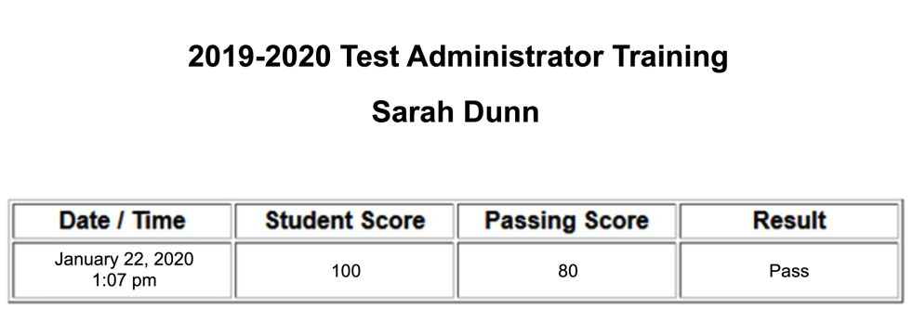
TA and TP Training Records
The names of Test Administrators and Test Proctors used on the training documentation must match the name used for signing the TA/TP Security Forms and must be printed on the training certificate.
Certificates with handwritten or altered names will not be accepted.
Notes:
The name on the training record must be the same as the name used to sign the TA/TP security forms

Slide 62
OSTP
Test Administrator (TA) Instructions and Information

Slide 63
TA Instructions and Information
General Responsibilities:
TAs must be a certified employee of the district.
TAs must be trained via the SDE-provided TA training module.
Review the Test Administration Manual (TAM) for directions several days prior to testing.
Ensure all visual aids are removed or covered during testing.
Confirm arrangements for students who require special accommodations or alternate tests.

Slide 64
TA Instructions and Information
General Responsibilities:
Follow the scripts in the TAMs exactly or play the TAM recorded script that will be available on the Cognia Help and Support Site.
Make sure students use No. 2 pencils, scratch paper/unmarked grid paper, appropriate calculator, and if your district chooses: Reference Sheets for grades 6-8 math, Writer’s Checklist for grade 5 & 8 ELA, or Periodic Table for CCRA Science Content.
Administer tests with a TP present the entire testing session.
Ensure that the TA and TP are not related to each other nor to any student in the testing session.

Slide 65
TA Instructions and Information
General Responsibilities:
Keep a log of unusual student behavior or circumstances.
Report any testing irregularities directly to the BTC.
Keep records of students who missed the test on the original test date.
Keep a record of who proctored tests with you and the dates.
Administer make-up tests within the testing window, if needed.
TA must sign the Test Security Form via DocuSign and enter the TP names of all TPs serving with them.

Slide 66
OSTP
Test Proctor (TP) Instructions and Information

Slide 67
TP Instructions and Information
General Responsibilities:
Must be at least 18 years old, approved by the building principal, and cannot be related to the TA or any student in the testing session.
TPs must be training via the SDE-provided TP training module.
May NOT administer tests.
May assist the TA with certain duties (e.g., inventory test materials).
Maintain the security of all test materials.
The TA training module meets TP training requirements, so I it is unnecessary for TAs to complete both modules, even if t they serve as TPs.

Slide 68
TP Instructions and Information
General Responsibilities:
A proctor must be present for the ENTIRE testing session.
A TP that monitors a read-aloud session must be an employee of the school district.
Monitor the TA’s transcribing of tests and checking of answer documents or test books for stray marks.
Complete Test Proctor Observation Log, sign, and return to the Building Test Coordinator.
  Test Proctor Observation Log Form (under “Other Forms”)
Notes:
Test Proctor Log can be printed from the Cognia Help and Support Site.

Slide 69
OSTP
English Language Arts, Mathematics, Science, and U.S. History

Slide 70
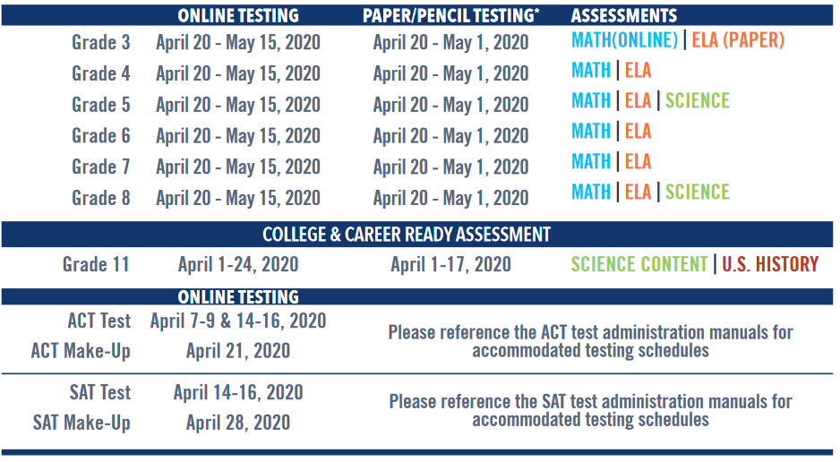
2019-20 Testing Window
Notes:
Grades 4 and 5 will be administered online. This results in a single testing window for paper/pencil testers and the elimination of returning grade 3 early.

Slide 71
Testing Schedules
Estimated testing times for each test include distributing books, filling in student demographic information, and reading directions aloud to students/playing recorded script. These can be found in the TPM.
The tests are not timed. Students should be given additional time if needed as an immediate extension of the current session. A TA and TP are required for the duration of testing.
  Additional time must be an immediate extension of the testing session not to exceed double the amount of recommended time per section/session.

Slide 72
Testing Schedules
Ideally, each content assessment should be administered on a separate day.
If more than one content assessment is administered on the same day, students should be given a rest break between sessions.
Under no circumstances should a test be started unless there is enough time to complete it.

Slide 73
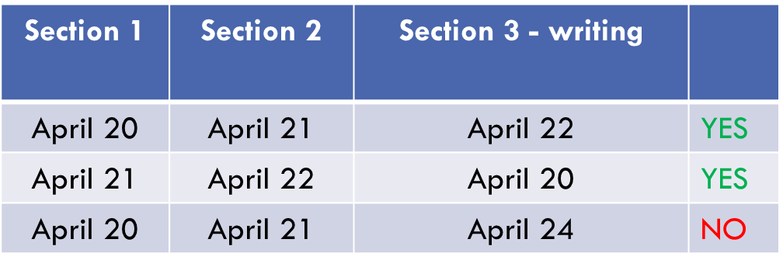
Testing Schedules
Students may only be given breaks between sections/sessions.
Sections must be given in sequential order on consecutive instructional days.
Grades 5 & 8 ELA Section 3 (writing prompt) may be administered BEFORE Section 1 or AFTER Section 2.
  Ex Grade 5 ELA:
Notes:
For last row: Monday April 20, Tuesday April 21, Friday April 24

Slide 74
Testing Schedules
It is highly recommended, but not required, that all ELA assessments take priority in scheduling.
  In order to receive early RSA reporting, Grade 3 ELA tests must be completed no later than Friday, April 24, 2020.
  In order to receive preliminary score reports, Grades 4 - 8 online ELA tests must be completed no later than Friday, May 08, 2020.
  Otherwise, these students’ scores will not be available until Final Reporting.

Slide 75
Test Results – Grades 3-8 and CCRA Science
Preliminary results:
  Must take advantage of early testing window
  Available in the OSTP Portal 6/05/2020
  Available on the Parent Portal 6/10/2020
  Preliminary Results will not be available for CCRA: U.S. History Content due to standard setting, which will be held in June.
Final results:
  Final reporting dates are based on correction window dates
  Available in the OSTP Portal (tentative) 8/10/2020
  Available on the Parent Portal (tentative) 8/10/2020
Materials returned late or incorrectly will impact reporting dates.

Slide 76
Online Testing
Online practice tests are available for students to become familiar with the online tools and formatting of questions.
  https://okpracticetest.measuredprogress.org
Only a basic calculator will be available in the online sample sections for Grade 6-8 Math due to the allowability of mixed group test administration.
The operational portion of the Grade 6-8 online tests will provide:
  Grades 6-7: Basic Calculator
  Grade 8: Scientific Calculator

Slide 77
Scratch Paper & Unmarked Grid Paper
Students are allowed scratch paper for all assessments.
  Blank copy paper
  Lined notebook paper
  Unmarked grid paper
Ensure students are writing their essays on the lined pages in the test booklet or in the online platform’s text box.
BTCs MUST collect all scratch paper and unmarked grid paper after testing.
All scratch and unmarked grid paper is to be DESTROYED by the BTC immediately after testing.

Slide 78
Reference Sheets
Reference Sheets will be provided in the tools section for online tests and paper copies for paper/pencil testers:
  Formula sheet: Math grades 6 – 8 (available in English or Spanish)
  Periodic Table: Science grade 11 (available in English or Spanish)
  Writer’s Checklist: ELA grades 5 and 8 writing section (CBT and PBT)
Your district may elect to provide paper copies of these documents to online testers. They can be printed from Cognia’s Help and Support Site and must be DESTROYED by the BTC immediately after testing.

Slide 79
OSTP
English Language Arts Assessment

Slide 80
Grades 5 and 8 ELA Assessments
Writing sections will be a paired passage-based prompt.
Paper Tests – Students will write on the five (5) lined pages in their test books.
  Planning pages are included.
Online Tests – Students will write their essays in the online platform.
  Planning can be done on the scratch paper.
  Remind BTCs that students should not hit "Turn In" until they are done.
Notes:
Word limit increased to 1500. This is not an expectation of how much students should write, but did not want to restrict those who had more to say.
Students must actively type in the online platform to prevent timing out. Moving the curser does not register as activity.

Slide 81
OSTP
Mathematics and Science

Slide 82
Calculators
Grades 3-5 Math
  IEP or 504 Plan students with a documented accommodation may use a basic four-function calculator.
  Any student with this accommodation will need a handheld calculator for both PBT and CBT testing.
Grades 6-7 Math
  All students may use a handheld four-function calculator with square root and percentage, excluding the +/- key.
  Online calculator will be provided: TI-108 (disabled +/- key).

Slide 83
Calculators
Grade 8 Math & Science
  Handheld scientific calculator
  Online calculator will be provided: TI-30XS Multiview
Grade 11 Science
  Handheld graphing or scientific calculator
  Online calculator will be provided: TI-84 Plus
Please review the published Calculator Policy.

Slide 84
College & Career Readiness Assessments (CCRA)
SAT/ACT and Science and U.S. History Content Tests

Slide 85
CCRA (Grade 11)
Each district has selected to administer the SAT or ACT.
  This assessment fulfills the federal requirement for assessing students in grades 9-12 for math and ELA, including students with disabilities and English Learners.
  This assessment will be used in accountability for math and ELA.
  Students must also take the writing section.
Grade 11 Science Content Test will fulfill the federal requirement for assessing students in science in grades 10-12.

Slide 86
CCRA: U.S. History Content
Required by Oklahoma HB 3311
  Students MUST be assessed in U.S. History once in grades 9 - 12.
All grade 11 students will participate
Any 12th grade students who have not been assessed may be manually added to the testing portal and assigned a test.

Slide 87
OSTP
Reading Sufficiency Act

Slide 88
Reading Sufficiency Act
http://sde.ok.gov/sde/reading-sufficiency
Melissa Ahlgrim, Director of RSA
  Melissa.Ahlgrim@sde.ok.gov
  405-522-1591

Slide 89
Requirements for Driver’s License
Scoring BASIC on the 8th grade OSTP ELA assessment (2017 and beyond) is considered satisfactory for the driver’s licensing.
Public schools must provide an approved alternative reading proficiency test at least four times per year to students who have not met satisfactory reading proficiency who attend the public schools in the respective districts as well as nonpublic school students who reside in that district.
For further guidance contact assessments@sde.ok.gov

Slide 90

3
OSTP
Online System

Slide 91
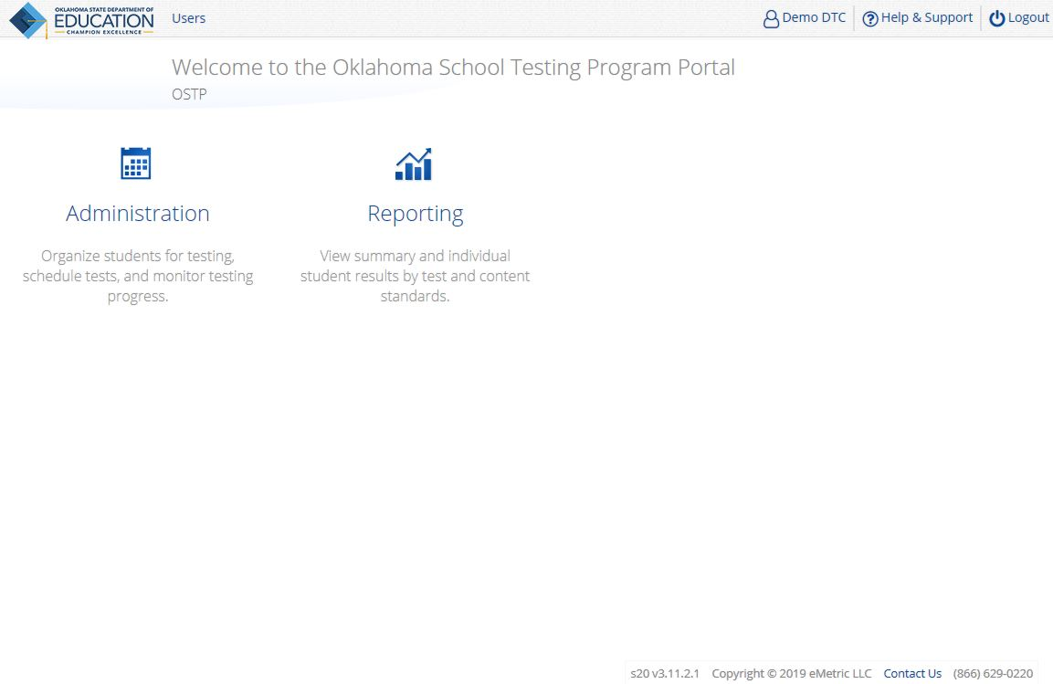
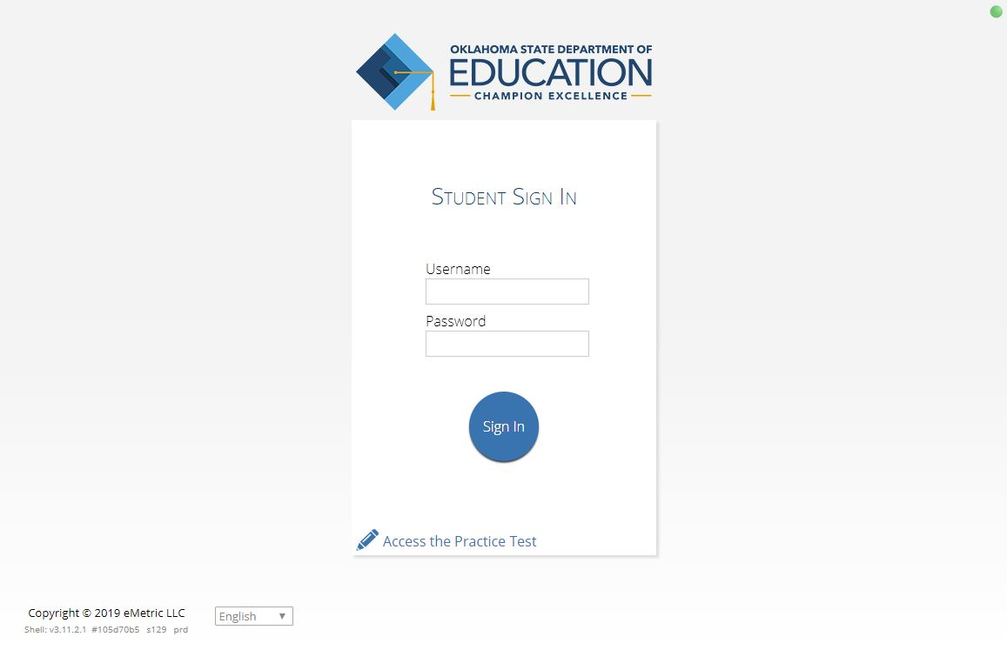
OSTP Online System Components
OSTP Portal
Manage portal users
Manage student data and online test sessions
Available via a browser
OSTP Kiosk
Student test delivery platform
Technology staff will install OSTP Kiosks or Apps on student testing devices

Slide 92

OSTP Portal Access
Available via a browser at https://oklahoma.measuredprogress.org
Already have a user account? Continue to use it!
Don’t have an account yet?
  District Test Coordinators must create all other portal users within the OSTP Portal.
  Users will receive automated email with username and temporary password from OSTPProgramManagementTeam@cognia.org.
    Add “Trusted” Email Sender
    No email? Check Spam folder
    Contact Technical Support if no email received.
      (866) 629-0220
      oktechsupport@cognia.org

Slide 93
OSTP Portal Landing Page
1
2

Slide 94

OSTP Portal User Roles
Role | Responsibilities
District Test Coordinator (DTC) | Manage portal users Enrollment transfer requests & approvals Edit student data Create classes Schedule tests Manage & monitor student testing Track shipments and order additional materials View Dashboard Create & review online reports Access Proctor Passwords from Administration home page
Building Test Coordinator (BTC) | Manage portal users Edit student data Create classes Schedule tests Manage & monitor student testing View Dashboard Create & review online reports

Slide 95
OSTP Portal User Roles
Role | Responsibilities
Assessment Technology Coordinator (ATC) | Download and install Kiosk Perform Site Readiness Testing Certify Site Ready for Testing
District Level User (DU) | Edit student data Create classes Schedule tests Manage & monitor student testing View Dashboard View online reports
Building Level User (BU) | Verify student data Create classes Schedule tests View Dashboard View online reports
Reports Access Only (District or Building) | View online reports

Slide 96


Administration - Students
Student Information, Accommodations, and Enrollment
  Available on February 17, 2020
  Review Student Information & Enrollment Data
  Assign Accommodations
    DTCs and STCs are responsible for assigning all embedded and non-embedded student accommodations.
  Accommodations Upload & Export
The accommodations export will no longer be blacked out during peak operational testing hours and will be available throughout the operational administration.

Slide 97
Administration – Classes
Class Creation
  Pre-created classes
  Optional manual class creation
  Class bulk upload

Slide 98
Administration – Test Sessions
Scheduling Tests
  Schedule classes to tests
  Print student test logins with students' usernames and passwords
  Manage & monitor test sessions
    Test Status Export
Generate an export of students not scheduled to a specific test at a school.
Date/Time Created column added to Test Session Details.

Slide 99
Note About Spanish Test Scheduling...
Scheduling Spanish Tests:
All students to be scheduled for a Spanish test need to be placed into a separate class.
The new class must be scheduled to take the Spanish version test.
  Select the test with SPANISH in the test name.

Slide 100
Note About Breach Test Scheduling...
Scheduling Breach Tests:
All students to be scheduled for a Breach test need to be placed into a new class.
The new class must be scheduled to take the Breach test.

Slide 101
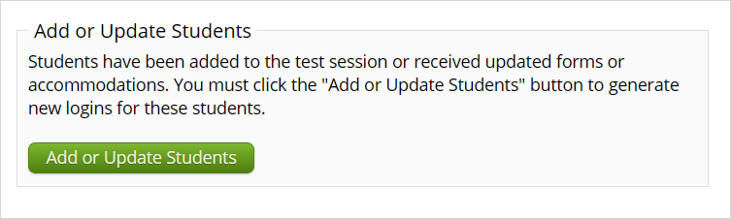
Text-to-Speech Accommodations
Assign all student text-to-speech accommodations PRIOR to scheduling tests.
  If a class is already scheduled, assign accommodation, return to test session, and click Add/Update Students button to generate new test logins.
  Check Date/Time Created for the most recent students added.
  If a student logs in to the test and the text-to-speech accommodation has not already been assigned, the student must continue testing with a human reader.

Slide 102
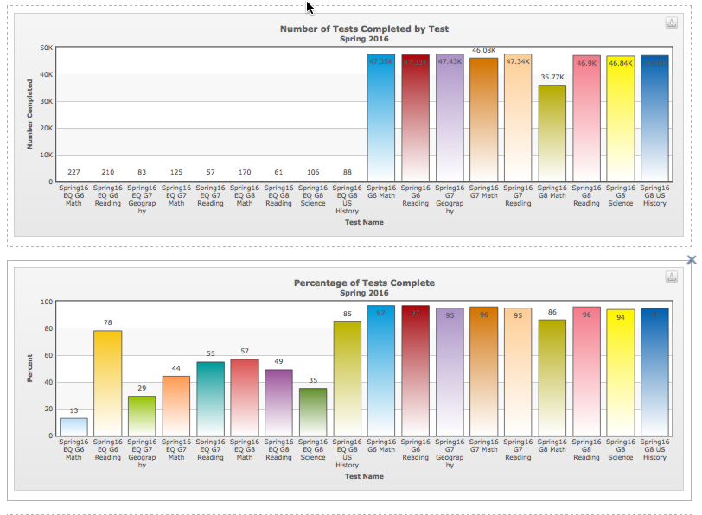
Administration – Dashboard
State Users, DTCs, BTCs, DUs, BUs
  State level data
  District level data
  School level data
During Operational Testing
  Portal User Activity
  Daily & Cumulative Test Summaries
    Number of active testers
    Number of tests scheduled
    Number of tests completed
    Percent of tests completed
  Number of operating systems by OS type
  By Hour Summaries
    Number of tests paused
    Number of tests completed
    Number of tests in progress

Slide 103

OSTP Portal: File Upload
File Upload | Data | Dates Available | Record Limit
Portal Users | Add or edit portal user accounts for your organization | January 21 – May 15 | 30
Student Accommodations Data | Student accommodations only | February 17 – May 15 | 1,000
Class Data | Mapping students to classes or proctoring groups | February 17 – May 15 | 1,000
During the operational testing window, the bulk upload functionality is available from 7:00 PM CST to 7:00 AM CST.
Users can still manually add students, edit students, create/edit classes, and create/edit portal users any time.

Slide 104
OSTP Portal: File Exports
Export | Data | Dates Available | Record Limit
Portal Users | List of portal user accounts for your organization | January 21 - May 15 | 30
Student Accommodations Data | Student accommodations only | February 17 - May 15 | -
Students Test Status | List of students with their test completion status by school/test | April 1 - May 15 | -
Students Not Scheduled for a Test | List of student within a school that are not schedule for the selected test | March 25 - May 15 | -

Slide 105
OSTP Online System Components
OSTP Portal
Manage portal users
Manager student data and online test sessions
Available via a browser
OSTP Kiosk
Student test delivery platform
Technology staff will install OSTP Kiosks or Apps on student testing devices
Notes:
Manage portal users
Manager student data and online test sessions
Available via a browser

Slide 106

OSTP Kiosks
Desktop Kiosk
    Available for Windows, macOS and Linux
Mobile App Kiosk
    Available for iPadOS and Chrome OS
New kiosks ARE required for Spring 2020!

Slide 107
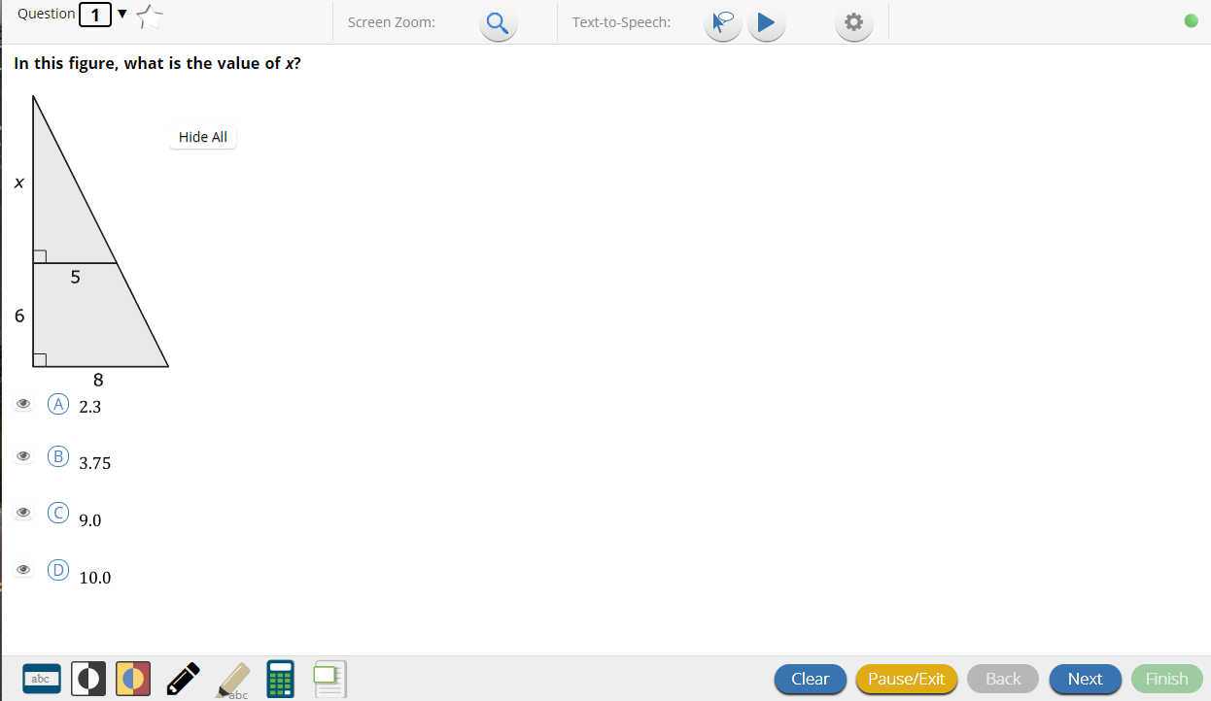

OSTP Kiosk: Checking Internet Connectivity
Internet Connectivity is ON
Internet Connectivity is OFF

Slide 108
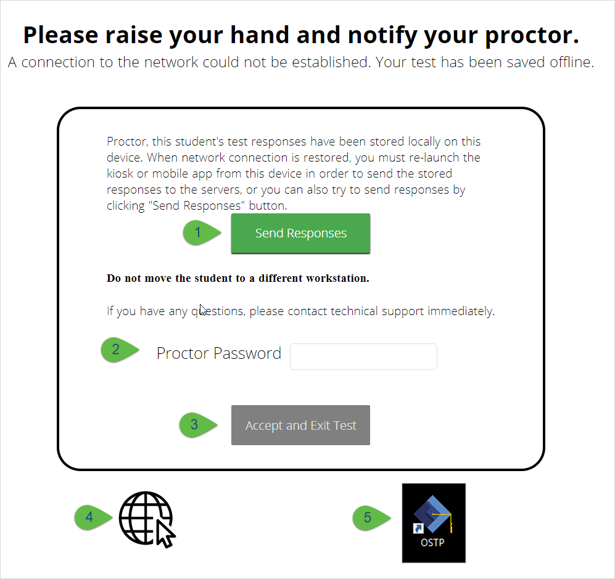
What’s new for 2019-2020 in OSTP Kiosk?
For cases where a student turns in his/her test offline and there are responses that are stored locally, the current offline warning message has been updated with a new message.
The new message will alert the student to notify his/her proctor that there are locally stored responses.
The proctor will be prompted to click a button to try and send the student responses before closing the kiosk.

Slide 109
What’s new for 2019-2020 in OSTP Kiosk?
Removal of username and password from the practice tests
Display of magnification buttons while taking practice tests on a browser, but the functionality is grayed out
Enhancements to the Text-to-Speech buttons
Display of informative text on to the feedback page of practice tests (This is to indicate that the student can click on the question or score to see the correct answer.)
Addition of exit button to the Sign In page on the Chrome OS app
Spanish Text-to-Speech available on Chrome OS
New iPadOS app called “iTester”

Slide 110
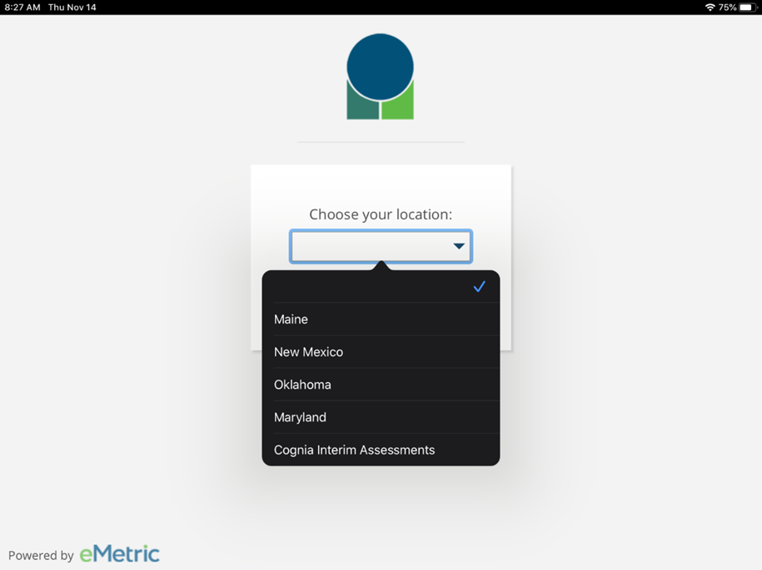
What’s new for 2019-2020 in OSTP Kiosk?

Slide 111

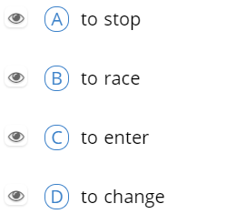


Universal Tools
Universal Tools are available to all students for online testing:
Name | Assessment / Content Area | Tool Icon | Supported Devices
Guideline | All |  | All
Answer Masking | All |  | All
Sketch | All |  | All
Highlighter | All |  | All

Slide 112

Accommodations
Text-to-Speech accommodations ordered for specific students:
Name | Assessment/Content Area | Tool Icon | Supported Devices
Text-to-Speech Mathematics | Grades 3-8 Math |  | Not supported on Linux
Text-to-Speech ELA Grades 4, 6, & 7 NS1 (State approval is required); Grades 5 & 8 Writing Sections Only | Grades 4-8 ELA |  | Not supported on Linux
Text-to-Speech Science | Grades 5 & 8 Science |  | Not supported on Linux
Text-to-Speech US History | Grade 11 US History |  | Not supported on Linux

Slide 113
Accommodations
Text-to-Speech Accommodations ordered for specific students:
Name | Assessment / Content Area | Tool Icon | Supported Devices
Spanish Text-to-Speech Mathematics | Grades 3-8 Math |  | Windows, macOS, and Chrome OS
Spanish Text-to-Speech Science | Grade 5 & 8 Science |  | Windows, macOS, and Chrome OS
Spanish Text-to-Speech US History | Grade 11 US History |  | Windows, macOS, and Chrome OS

Slide 114
Text-to-Speech Voices
Spanish voice is available on Windows, macOS, and Chrome OS.
Windows & macOS
  A Cepstral Spanish language pack must be installed on the student’s device where Spanish version of the test will be taken using Text-to-Speech.
  The Spanish language pack must be requested from Cognia.
Chrome OS:
  There are no changes that need to be made to the device configuration; you just need to ensure the Spanish TTS accommodation has been selected in the portal.
OSTP Kiosk uses the default voice set on the student’s device.
  See Kiosk Installation Guide for specific steps on how to change the default voice.
Use the practice test to let the students hear the voice.
  If the student does not like the voice, change the default voice setting on the device or try a device with a different operating system/voice pack.

Slide 115


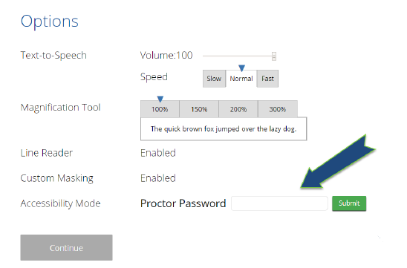
Accommodations
Accommodations ordered for specific students:
Name | Assessment / Content Area | Tool Icon | Supported Devices
Screen Zoom | All | 100%, 150%, 200%, 300% | All
Color Contrast | All |  | All
Reverse Contrast | All |  | All
General Masking | All |  | All
Turn Off All Universal Tools | All | Guideline, Answer Masking, Sketch and Highlighter not available | All
Allow Accessibility Mode Testing | All |  | All

Slide 116
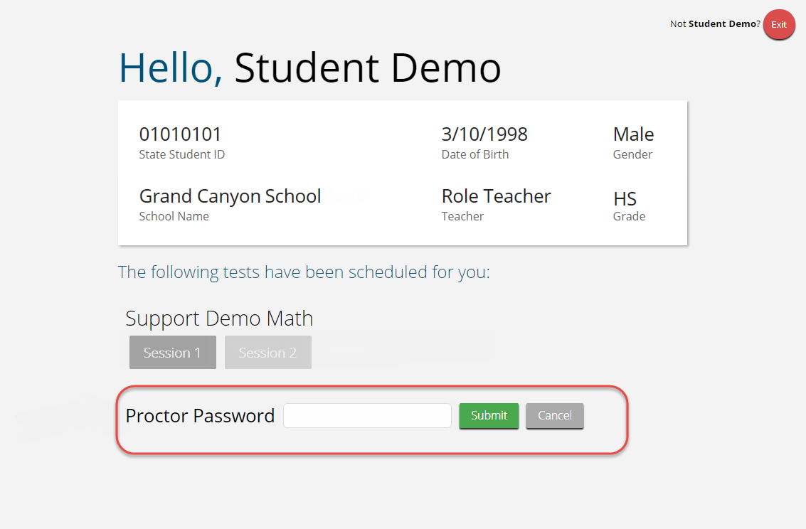
Proctor Password
When is a proctor password required?
Student pauses for longer than 20 minutes
Student is inactive longer than 60 minutes
On an abrupt closure of the OSTP Kiosk
When a student submits a test offline
DTC users can access the Proctor Password on the Home page within the Administration component of the portal.

Slide 117
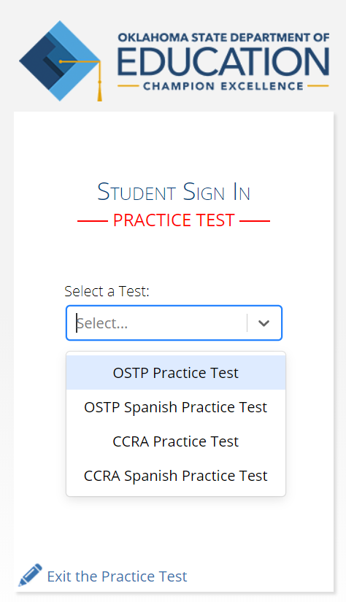
Online Practice Tests
https://okpracticetest.measuredprogress.org/student
The Practice Test can be taken on a browser or with the OSTP Kiosk or mobile apps.
If a student needs screen zoom, they must use the Kiosk.
Students should take the practice tests on the devices to be used for testing.
Students will no longer need a username and password to access the practice tests.

Slide 118
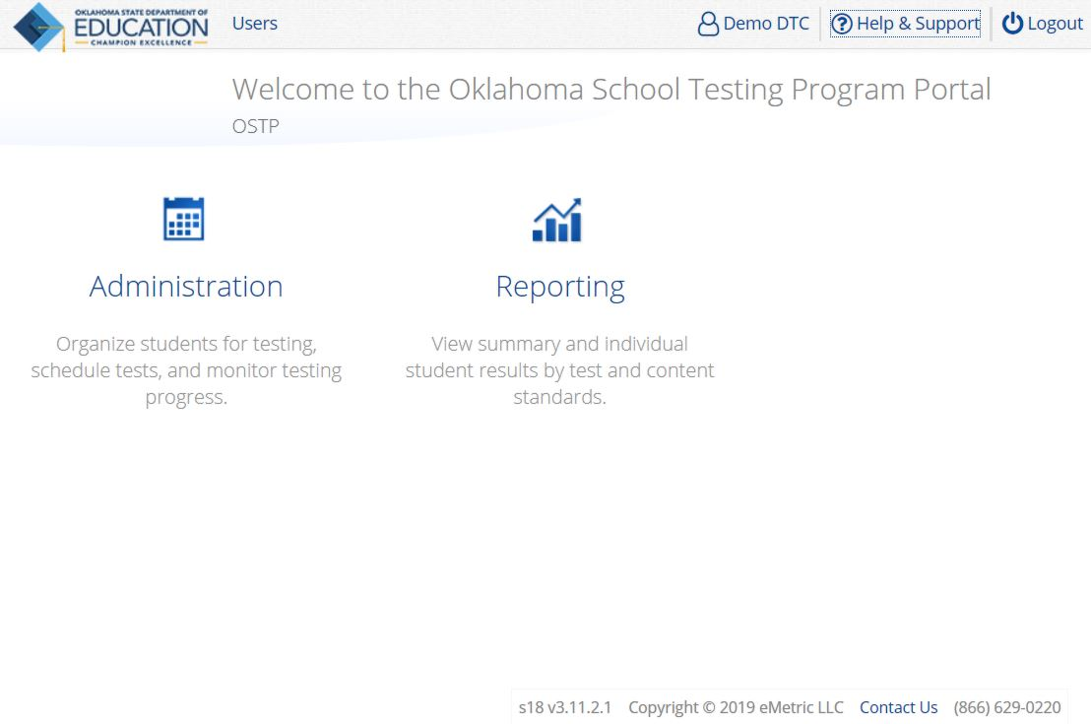
Training Resources

Slide 119
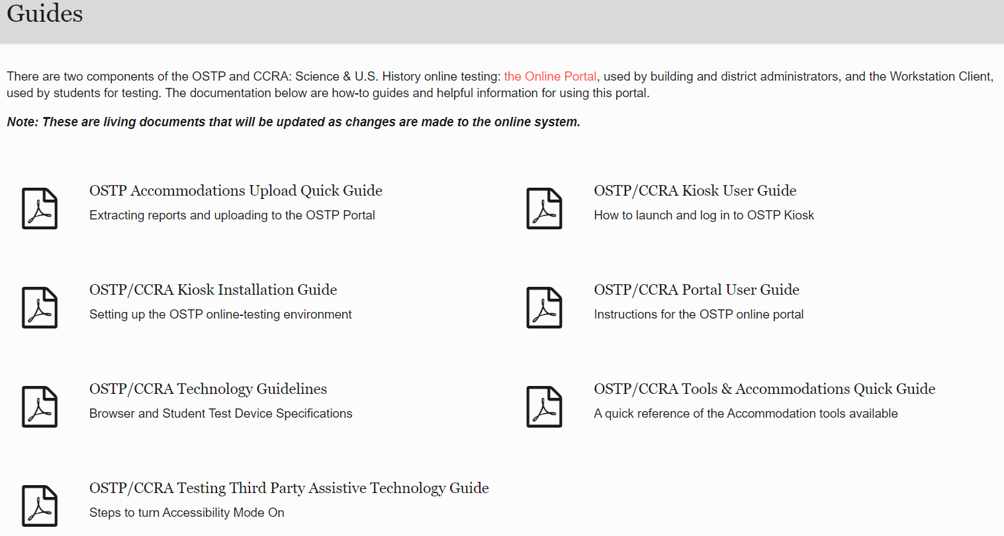
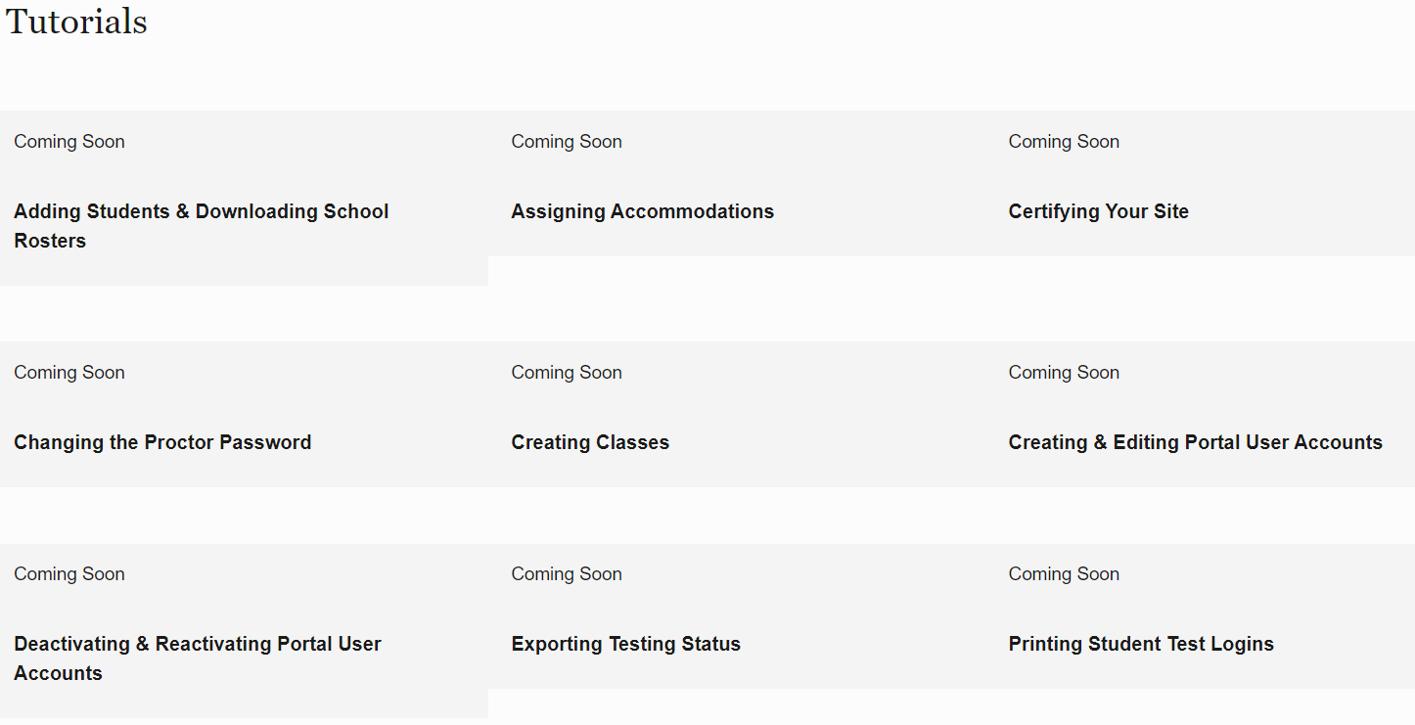
Training Resources
Help & Support Site
User Guides
Tutorials
https://oklahoma.onlinehelp.cognia.org/

Slide 120

4
Paper/pencil material

Slide 121

Spanish Translation Options
Grades 3-8 Math and Science:
Online testing (grade 3-8)
  Online testing (grades 3-8)
    A Spanish version of the test will be available online and Requires installation of Cepstral Spanish Voice Pack
    Spanish audio files are available to accompany English paper forms for grades 3-8 Math and Grades 5 and 8 Science
    Cepstral Spanish Voice Pack and Spanish Audio file request forms are available on the Help and Support Site
CCRA Science and U.S. History Content:
  A Spanish version of the test will be available online
  Requires installation of Cepstral Spanish Voice Pack
  Spanish audio files available to accompany English paper forms
  Cepstral Spanish Voice Pack and Spanish Audio file request forms are available on the Help and Support Site

Slide 122
Cepstral Spanish Voice Pack
Who
  The school or district will only need to install a Cepstral Spanish language voice pack if student(s) meet the following requirements for read-aloud accommodations:
    Student(s) must have been using the Spanish read-aloud accommodation throughout the year.
    Student(s) must have the read-aloud accommodation specified as required on the ELAP.
How
  The Spanish version of the test uses the read-aloud accommodation, which requires a Cepstral Spanish language pack on the machine where the test is run.
  Licensing of this language pack is limited. Please stagger student testing through the same machine(s) in order to use a few computers as possible.
  Request form on the Help and Support Site

Slide 123
Manuals
Test Preparation Manual (3-8 and CCRA)
Test Administration Manual (3-5, 6-8, CCRA Science and U.S. History Content)
PSTGs
Spanish PSTGs
Spanish TAM scripts
Electronic versions
  Approved devices: Desktop Computer, Laptop Computer, Tablet, iPad
  Not approved devices: Any cell phone device
Controlled number of printed manuals
http://oklahoma.onlinehelp.Cognia.org/
Notes:
Predetermined number printed therefore limited inventory
TPMs (All districts/sites) Print 10% overage on hand for additional orders
Each district receives 1 TPM and each site receives 1 TPM.
The top 20 districts in student enrollment receive an additional 10 TPMs. Oklahoma City
Tulsa
Moore
Edmond
Putnam City
Broken Arrow
Union
Norman
Lawton
Midwest City – Del City
Jenks
Mustang
Owasso
Yukon
Enid
Muskogee
Stillwater
Bartlesville
Bixby
Choctaw/Nicoma Park
Approximately 2,500 TPMs (MP Please confirm)
TAMs (Middle School/High School/Charter) Print 10% overage on hand for additional orders
Each district receives 2 TAMs and each site receive 5 TAMs
The top 20 districts in student enrollment receive an additional 25 TAMs.
Approximately G6-8: 5,000 TAMs (MP Please confirm numbers and whether G6-8 TAM is separate from G10)
Approximately G10: 5,000 TAMs (MP Please confirm number)

Slide 124
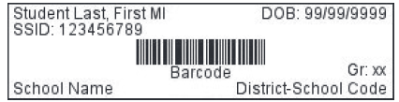
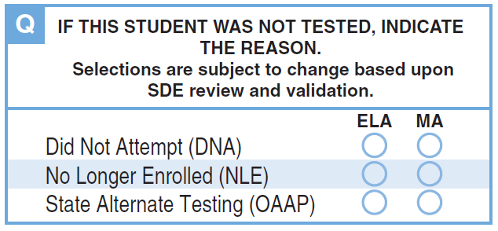
Student Labels and Rosters
Student labels will be provided for every student needing paper forms indicated through the Wave.
Students with Labels: Verify Student Information
  If any student demographic details are incorrect on the student label, still use the label unless there is a mistake in the main identifiers – first name, last name, DOB, or State Student ID (SSID).
  If one or more of these identifiers is incorrect, do not use the label and bubble the student information on the demographic page of the answer document.
  If a school receives labels for students who are no longer enrolled, adhere the label to a blank student answer document and mark the reason in box Q.
Notes:
For Grade 03 ELA and Math, 05 ELA, and 08 ELA the content will be added to the CPI label. The CPI label is applied to the outside of the Student Label envelope. This will apply to these grade and content are only as these are the only answer documents that are not combined.

Slide 125
Student Labels and Rosters
Students without Labels:
  If a student does not have a label for any reason (e.g., label is missing, lost or damaged), bubble the student information carefully on the student demographic page of the answer document.
  If student ID labels for an entire class are missing, students may bubble their own demographic information.
Notes:
For Grade 03 ELA and Math, 05 ELA, and 08 ELA the content will be added to the CPI label. The CPI label is applied to the outside of the Student Label envelope. This will apply to these grade and content are only as these are the only answer documents that are not combined.

Slide 126

Void Bubble
Voids are applicable when an answer document is damaged and/or not scoreable or a breach has been administered.
Indicate void using box V.
Testing Irregularity also submitted using Office of Assessment Google Form.
  A testing irregularity does not mean an answer document needs to be voided.
Opportunity to review during clean-up window.

Slide 127
Return Shipping Grades 3-8
Last Day for Materials Pick-up | Grade 3-8 Phase 1: Grade 3 ELA If utilizing the self-schedule option that must be done by 4/24/20 Cognia scheduled a 1-day pickup on 4/28/20* Phase 2: All scorable materials If utilizing the self-schedule option that must be done by 5/1/20 Cognia scheduled a 1-day pickup on 5/5/20* Phase 3: All non-scorable materials If utilizing the self-schedule option that must be done by 5/5/20 Cognia scheduled a 1-day pick-up on 5/8/20*
* Districts are encouraged to schedule their own UPS pickup per the directions in the Test Preparation Manual. If you schedule your own UPS pickup, please contact Cognia to cancel the automatic pick up.

Slide 128
Return Shipping CCRA
Last Day for Materials Pick-up | CCRA Phase 1: All scorable materials only If utilizing the self-schedule option that must be done by 4/17/2020 Cognia scheduled 1-day pick-up is on 4/21/2020* Phase 2: All non-scorable and unused material If utilizing the self-schedule option that must be done by 4/21/2020 Cognia scheduled 1-day pick-up is on 4/24/2010*
* Districts are encouraged to schedule their own UPS pickup per the directions in the Test Preparation Manual. If you schedule your own UPS pickup, please contact Cognia to cancel the automatic pick up.

Slide 129
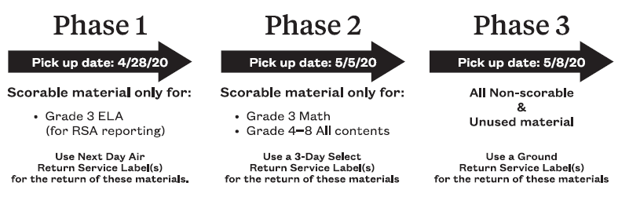
Returning
Materials
OSTP
Three phased approach:
NEW!
Notes:
Show poster
Will be included in your test material shipment.

Slide 130
Security Checklists
Grades 3-8 and CCRA Science & U.S. History
  School boxes will contain a paper version.
  Districts will receive electronic versions via the SFTP site.
  Additional materials orders will only receive paper versions.
Notes:
Electronic security checklists will be available the week that materials arrive in districts.

Slide 131


Security Forms
Three forms for electronic signature
  District Level Test Security Form
  Building Level Test Security Form
  Test Administrator Test Security Form and Non-disclosure Agreement
DocuSign
Step by step instructions will be on the Help and Support Site
Notes:
Will look slightly different than the ones in the manuals as we just added in a spot to fill in the district and school name. We need those to make the forms PDF searchable. That is the only difference.

Slide 132
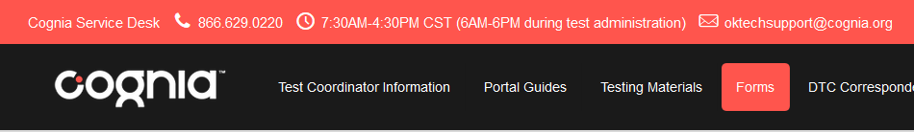
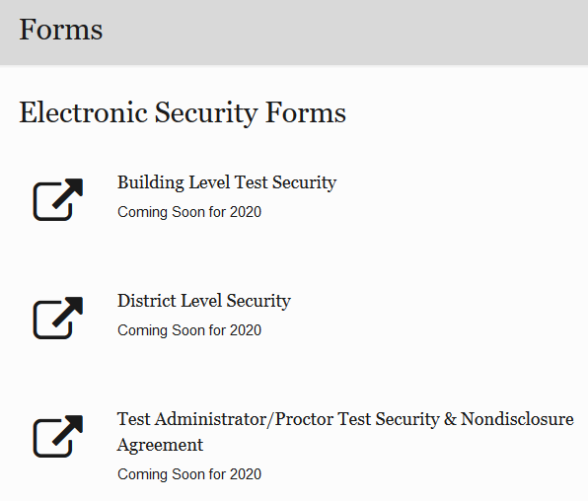
DocuSign
Where:
Oklahoma Help & Support Page
Forms tab
Links for every form!
How:
Click the link for the form you need. Type in the name and email information of those who need to sign the form.
When:
When someone sends you a DocuSign document for your electronic signature, you’ll receive an email from DocuSign to either resume or review the document depending on your role.
Notes:
If you are not sure if a form is complete you it will be easy to check – did you get it back? If not bug people. If you need to check you can call us, we just need to know the name of the person you are checking on.

Slide 133

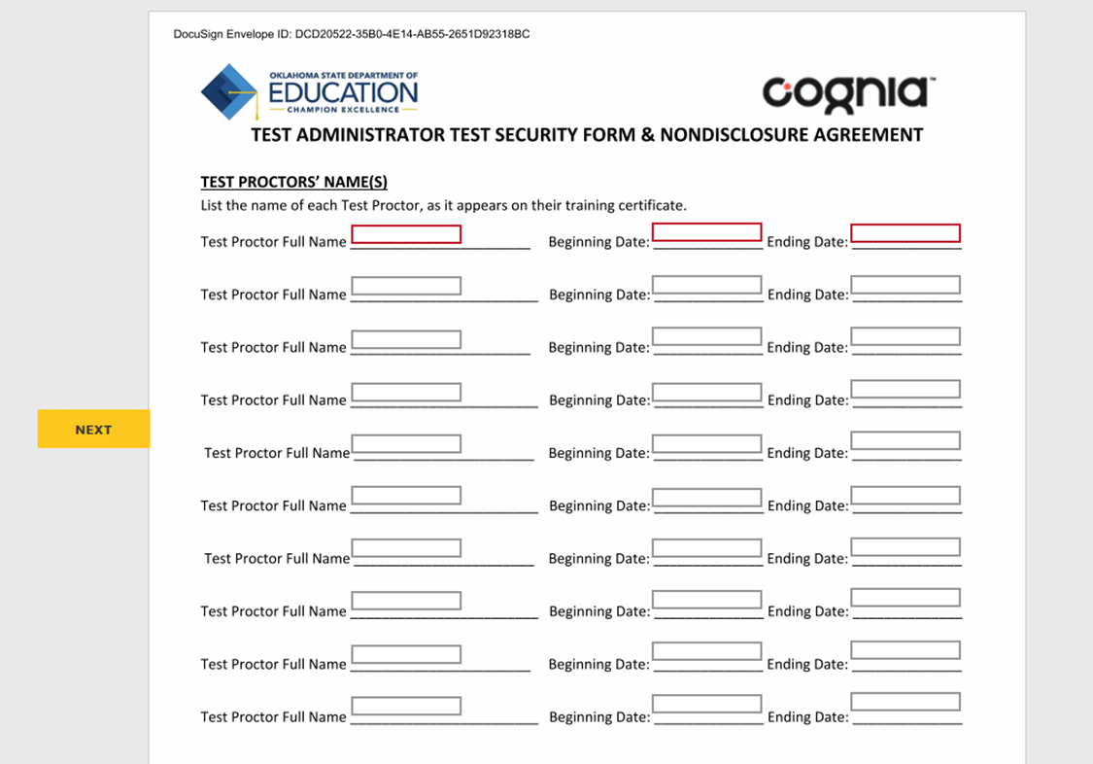
DocuSign Improvements for 2020
Redesigned TA Form
  One Test Administrator will sign and fill in the names of all the Test Proctors they worked with and the dates they worked with them.
  Spaces for up to 10 Test Proctor names and dates on one form.
  Test Proctors no longer need to sign forms using DocuSign
Notes:
If you are not sure if a form is complete you it will be easy to check – did you get it back? If not bug people. If you need to check you can call us, we just need to know the name of the person you are checking on.

Slide 134
DocuSign Reminders for 2020
DocuSign Form Email Subject Lines
  The name of person who needs to sign the form will be visible in the email subject line.
    Quickly find the right form for the right person to sign.
Enter the official district codes and district names
  List of official district codes with district names is now posted on the OK Help & Support site.
You will not receive a completed copy of a form until ALL people sign it. So it you don’t receive a form, contact all signors and ask them to check again in the email box for the notification.
Notes:
If you are not sure if a form is complete you it will be easy to check – did you get it back? If not bug people. If you need to check you can call us, we just need to know the name of the person you are checking on.

Slide 135
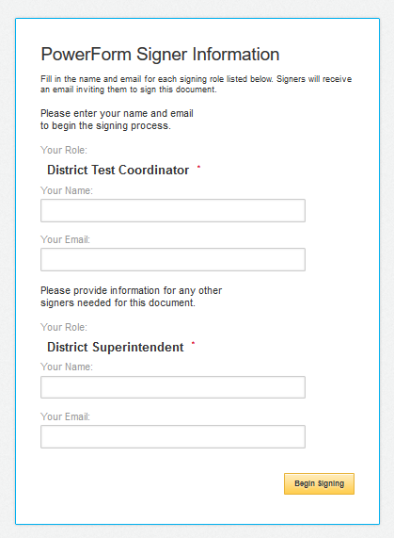
Building Test Security Form
The person starting the form clicks the link and fills in the information.
Note:
If you use one email address on the forms, but enter different names, take notice if the names in the form change after being sent for signature!
This means you have an open
DocuSign account using that email address and a registered name. Contact DocuSign to close the account if you want to use this email address for all forms.
Tip: You can use the same email address but must have different names.

Slide 136
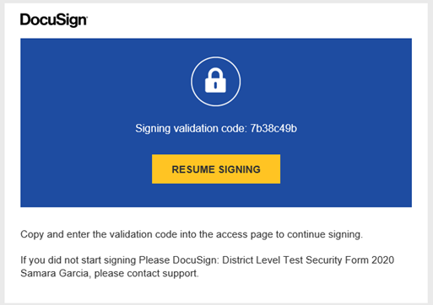
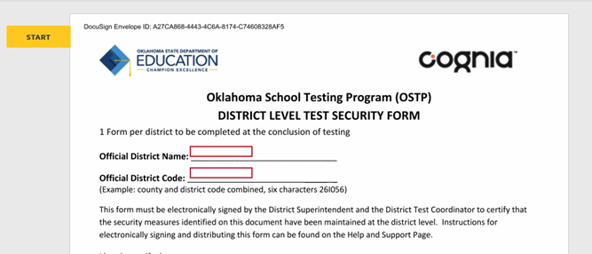
First person on
List gets this email
notification
First person starts signing the form.

Slide 137
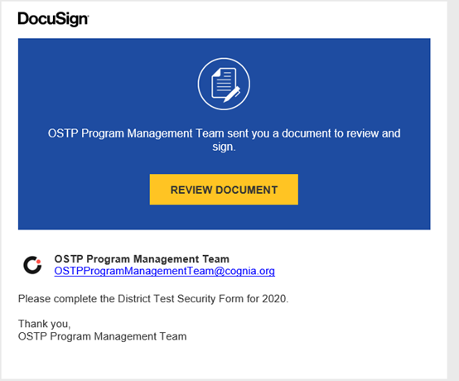

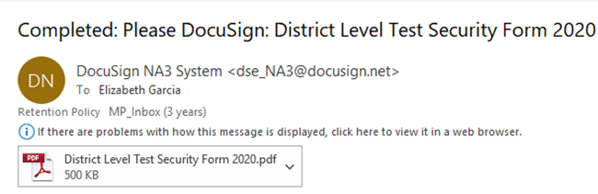
The next person in the list gets this email.
Once completed, each person receives a signed copy via email.

