Slide 1
Weekly Wave
Data & Information Systems

Slide 2
Wave Rollover
Not sending a specific object
OR
Not communicating with the Wave
DIS has contacted SIS vendors and superintendents

Slide 3
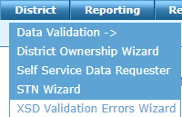
XSD Errors
What: When sent data doesn’t meet minimum validation requirements
Bad data will not enter the state’s system for reporting
How to correct: Reach out to your SIS vendor
Where to find:

Slide 4
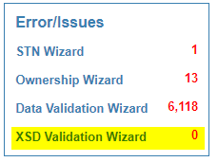
XSD Errors
Who can access this?: District level users
How do you know if you have these errors?

Slide 5
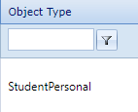
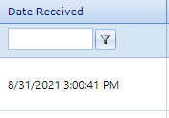
XSD Errors
What can you send to your vendor or correct?
The error description
Object that failed
XML
Date of error

Slide 6
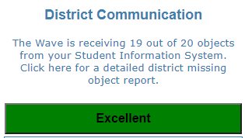
Corrected Issues: District Communication
Clickable link now be visible to check your districts status
Will save an excel spreadsheet to your computer
Notes:
https://content.govdelivery.com/attachments/OKSDE/2021/02/23/file_attachments/1702563/SIS-Wave-EDPlan%20Integration%20Guidance%20v1.pdf

Slide 7
Corrected Issues: EdPlan Sync
PCG, OSDE, and OMES are still working on a resolution on issues with data syncing in real time
Currently using daily uploads
Data might take 24-72 hours to become visible
Notes:
https://content.govdelivery.com/attachments/OKSDE/2021/02/23/file_attachments/1702563/SIS-Wave-EDPlan%20Integration%20Guidance%20v1.pdf

Slide 8
Wave State Certification Reports
OPEN NOW:
3rd Grade Promotion & Retention (July-October)
Closes 10/31/2021 @ 11:59PM
OPENING SOON:
First Quarter Statistical Report (FQSR)
Opens 9/7/2021
October 1 Consolidated Report
Tentative Opening: 9/13/2021

Slide 9
High Contact Volume
24-48 hours turn around time to respond while we look into your specific issue

Slide 10
New Wave Accounts
While OMES is working on the methods to automate this…
If you have a new SSO user getting access to the Wave
OR
You do not have an @affiliates.ok.gov email
You must contact OMES: servicedesk@omes.ok.gov

Slide 11
Questions
StudentDataInfo@sde.ok.gov
https://sde.ok.gov/student-information-documents-and-guides

