Slide 1
Weekly Wave
Data & Information Systems

Slide 2
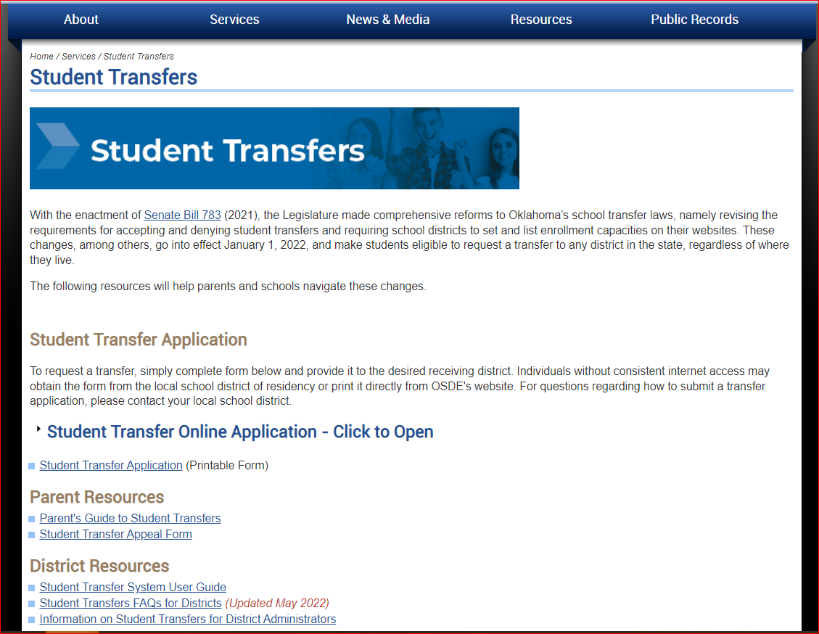
Transfers
The Online tool is now up and working. Parents will click on the Student Transfer Online Application link and complete the application.

Slide 3
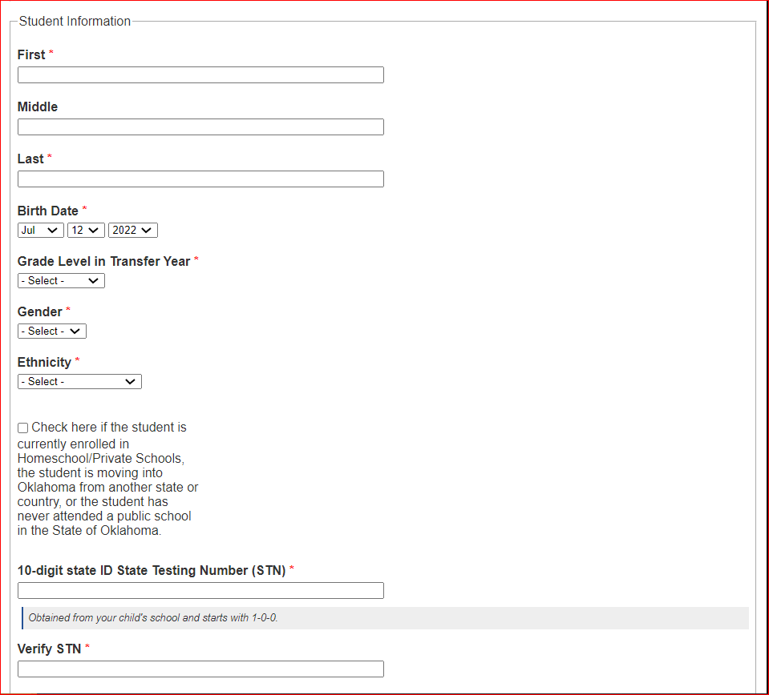
Transfers
Parents will populate their student’s First Name, Middle Name, Last Name, DOB, Grade Level, Gender, and Ethnicity. The checkbox is for students that have been enrolled in Homeschool/Private Schools or if the student is moving to Oklahoma from another state or country, or if the student has never attended a public school in the State of Oklahoma.
Checking this box will send for a new STN creation. If the student has an existing STN the parent will populate the STN fields.

Slide 4
Transfers
Report capacity numbers between 15 days prior to any quarter and 15 days after the start of the quarter. Quarter dates are July 1st, October 1st, January 1st, and April 1st.

Slide 5
Rollover to 2022/2023
The Wave rollover has begun, and the Wave will be down until July 22nd.
Prior to doing a SIF agent rollover put your zone to sleep. If you are having issues putting your zone to sleep, you can reach out to your vendor or contact studentdatainfo@sde.ok.gov for assistance.

Slide 6
P-EBT
The training modules are almost complete. That training will show how to make changes in the Accounting Reporting application.
The Accountability Reporting DVR process will be available to make changes at the same time of the release of the training modules.

Slide 7
Wave Consolidated Training

Slide 8
Questions
StudentDataInfo@sde.ok.gov
https://sde.ok.gov/student-information-documents-and-guides

