Slide 1
Weekly Wave
Data & Information Systems

Slide 2
Accountability Reporting
Currently Open
  Chronic Absentee Medical Exemption – Now Open Closes 6/30/23
    Open through the end of the school year
    Webinar training will be provided by the Office of Accountability throughout the year

Slide 3
Accountability Reporting
  Dropout Report - Conflicts have been turned on and when we announce the window opening there will be a DVR function for the dropout
  Report Card CVR-Open - Closes on 12/07/2022
  A webinar for Report Card calculations was done on 11-30-22 and can be viewed at https://www.youtube.com/watch?v=fiaxOFbMX90
  Please check your data to ensure it is correct
Reporting Windows Announced through GovDelivery
        Email Accountability@sde.ok.gov

Slide 4
Accountability Reporting
Resolving Enrollment Conflicts for SY 21-22 is located on the Dropout Tab
Students coded as transferring to another public school in Oklahoma (1907,1908, and 3508) will display as having an enrollment conflict and show as a dropout unless OSDE’s data systems display subsequent enrollment, or the exit code is updated. Record conflict can be updated using the Data Verification (DVR) process

Slide 5
Accountability Reporting
Reminder, if a student exited your district before October 1, 2022, and is still showing as a dropout, means the student has yet to enroll in another Oklahoma school district and may be included in the Dropout Report. Guidance on how to resolve conflicts can be found at: https://sde.ok.gov/sites/default/files/Resolving%20Enrollment%20Conflicts_KJ_RB.pdf

Slide 6
Accountability Reporting
Postsecondary Data Collection Review
Please continue to evaluate courses and sections in your local SIS for the 2022-23 Postsecondary Data collection. Administrators should plan to review Accountability > Coursework in January to ensure grades are displaying as expected for postsecondary credit. Please note that OSDE is not using coursework grades for any grade level under 9th grade. If your district is not currently sending section marks for PK-8th grade, no action is required.

Slide 7
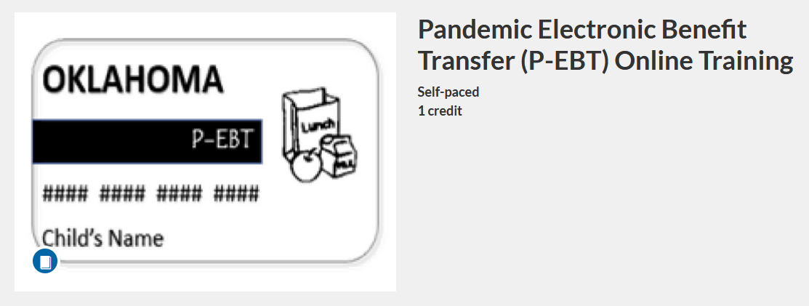
P-EBT Training
Below is the link for the PEBT training
https://osdeconnect.pdx.catalog.canvaslms.com/courses/pandemic-electronic-benefit-transfer-p-ebt-online-training
If you don't have an account for SDE Canvas, you will need to create an account when you use the link. Your email will have to be validated and you will set up your login credentials and be enrolled in the P-EBT course.

Slide 8
P-EBT
The training is broken into modules and is very nicely done.
There is in-depth training for understanding P-EBT and various scenarios to learn how to evaluate if a student qualifies
There are modules for the DVR process located towards the end. PDF documentation is in the last module
You will be able to start and stop and return at any time. When you return to the link, access Canvas from the menu to locate your enrolled training.

Slide 9
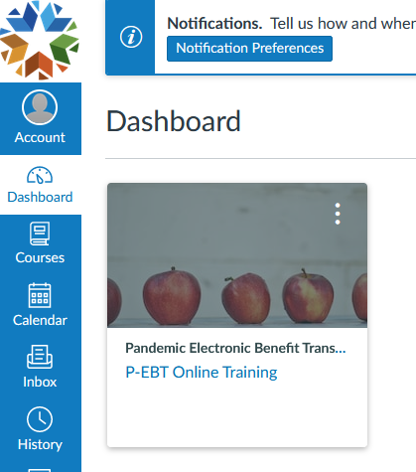
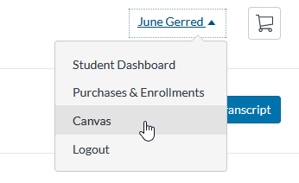
P-EBT

Slide 10
Requesting State Assistance
Please include your name and phone number on your request
Provide the student STN or Local ID only
Do Not provide any personal information for the student
This includes emails sent to the studentdatainfo@sde.ok.gov, team group chats, or any of our personal email boxes

Slide 11
New Wave Accounts
Superintendents must provide Wave access in the SSO
Employees will need to request an affiliates log-on from OMES
Please make sure they assign the ticket to the following group: AppData-Modernization and assign it to User: Matthew Johnston
If you are giving new Wave access to new employees, it may take at least 72 hours for all your access to show up
Please contact OMES: servicedesk@omes.ok.gov or 405-521-2444

Slide 12
Issues Accessing the Wave
Go to the SSO page
Click on Open the Wave
Login with your user id (ssousername)@affiliates.ok.gov
When you get to the page asking for Microsoft page use the same login information as above
When you get to the password click on forgot password
The system will email you a temporary password, you will have to change the password
If this does not work, you will need to reach out to servicedesk@omes.ok.gov

Slide 13
Questions and Resources
StudentDataInfo@sde.ok.gov
https://sde.ok.gov/student-information-documents-and-guides

Slide 14
Questions??

