Slide 1
Accreditation
Ryan Pieper
Executive Director of Accreditation

Slide 2
Purpose of the RAO’s
Educate!
Act as liaison between the SDE and the schools.
Resource for information.
Provide guidance and make recommendations.
Conduct audits & gather information for other departments.
We are here to help you by the best leader you can be!
Do not hesitate to call your RAO!

Slide 3
Resources You can find multiple resources on the SDE Accreditation Webpage with a simple search
Professional Development
Deregulations & Waivers
Teacher Certification Guide
Days to Hours Worksheet
Standards of Accreditation Guide
Much More!
Subject Codes
RAO Information
Student Transfers
Education Law Book
Board Member Report

Slide 4
OSDE Reporting Requirements
https://sde.ok.gov/reporting-requirements-calendar
View in traditional “calendar” format.
Filter by division, report name or date.
Can even download to Outlook calendar!

Slide 7
Site Code & Grade Span Changes
Site code and grade span change requests must be turned into the accreditation office by Sept. 1 of each new school year. Appropriate documentation to provide to the Accreditation Office includes:
1) Board memo written on school letterhead stating their local Board of Education voted to change/expand a site’s grade formation & must be signed by the superintendent.
2) Board minutes of meeting during which their Board of Education approved to change a site’s grade set-up.
3) IF expansion is not in original application approved by sponsor, include letter from sponsor showing approval for grade expansion or addition of new site.

Slide 8
Accreditation
YOUR GOAL AS AN EFFECTIVE LEADER
Every Site Accredited With…
NO DEFICIENCIES
Accredited schools are meeting state requirements
State aid is paid ONLY to accredited schools
A deficiency indicates the school is not in compliance with one or more requirements, but is still accredited
Repeated same deficiencies can lead to being non-accredited. The steps typically move from one deficiency, deficiency with warning, probation, followed by non-accredited

Slide 9
Preparing For Your Audits
Organize your supporting evidence in the order requested.
Try to provide all listed documentation to avoid rescheduling.
Check over paperwork before the RAO arrives making sure it’s correct and complete.
Use a binder or file box to organize materials.
Do NOT use plastic sleeves.
Use this opportunity to demonstrate the great things going on in your school district!

Slide 10
Online Accreditation App
Administrators can delegate job tasks
but cannot delegate responsibility!
Each year the application can reflect a few changes, so be sure to watch for those—Don’t skip questions & answer all questions correctly.
Application opens on Oct. 1 and closes in approx. 2-3 weeks except for the upload section, which is open all year.
Some information will be uploaded for viewing instead of being required during Accreditation visit. Upload exactly what is requested & be sure the uploaded information is current for the school year.
Once the district & all site tabs are accurate & complete, the superintendent must certify the reports. If an error is found before the closing deadline, you may contact the Office of Accreditation to reopen your application.
If you have questions, call for clarification–405-521-3335

Slide 12
Accreditation Application-Cont.
District/Site Tabs:
Many of the items from this tab will be uploaded or checked in the spring
Calendar Tab: Accuracy is very important – check calendar dates and times. Be sure all sites have the correct calendar. Changes may occur as the school year progresses, but you will not be able to get into this application to change data. Instead, you will upload changes as needed
School Day Tab: Times should match times shown on the Days to Hours Worksheet. Changes may occur as the school year progresses.

Slide 13
Accreditation Audits - UPLOADS
PLEASE—Before uploading, be sure to save your district, site and document name in the title. Please be sure documents are readable & not upside down! The Upload link is open all year to update documents as needed.
Calendar Change Notifications
Class Schedules
CPR/Heimlich Cards
Safe School & Healthy & Fit School Advisory Committee
Treasurer/Encumbrance Clerk trainings
Bonds for Superintendent, Treasurer & Clerks

Slide 14
District Treasurers/Encumbrance Clerks
70 O.S. § 5-190: The school district treasurer/encumbrance clerk(s) shall be required within nine months after employment in the position, to complete 12 hours of training in the required instruction in school finance laws, accounting, ethics, and the duties/responsibilities of the position. Any instruction as described & completed by the treasurer or encumbrance clerk within 3 years prior to employment in the position shall count toward satisfying these requirements.
Every school district treasurer & encumbrance clerk must complete 12 hours of continuing education every 3 years. Upload ONLY those most recent 12 hours.
The superintendent cannot be treasurer or encumbrance clerk.
Encumbrance clerk(s) must be listed in SPR & be properly coded.
All trainings applying to 12 hours must have the OCAS stamp.
Required Bonding documentation: $100,000 for superintendent & treasurer and $1,000 for encumbrance clerk(s).
Please put the most recent training in front of the file.

Slide 15
Security/Safety Drills
Conducting drills serves as documentation you have done everything possible to keep your students and staff members safe from any unexpected occurrences.
Multiple drills should NOT be conducted during the same time frame-Each drill should be conducted as a stand-alone drill.
Routinely change the type of additional drills, so that your district has documentation they are well prepared for all types of emergencies.
Report drills to Homeland Security on www.schoolsecurity.ok.gov

Slide 16
Security/Safety Drills-Cont.
School Wide Drills for ALL students & faculty
2 Tornado Drills: One in September and one in March
2 Fire Drills: One within first 15 days of the start of each semester
4 Security Drills: One within first 15 days of the start of each semester & one additional security drill anytime during each semester
2 Drills of Choice: Do not keep repeating the same mandated drills above as the additional drills. The school safety committee should evaluate dangers that exist in/near your community & provide input that helps determine what drills are most beneficial to your grade level, specific area or needs. Additional drill examples include: earthquake, missing student, site bus evacuation, prison break, grass fires, truck, train/airplane crash, factory explosions, drug houses, etc….
Transportation Drills for all students riding daily Bus Routes
2 Bus Evacuation Drills: One within first 15 days of the start
of each semester is recommended

Slide 17
Annual Audits—Spring
Checks done prior to coming on-site:
Online Accreditation Application: Calendar, Schedule, etc.
Uploads: CPR/Heimlich Cards, Healthy & Fit School Advisory Committee, Safe School Committee, Annual College Remediation & Dropout Report to board, Career Tech course approval board minutes, Treasurer/Encumbrance Clerk trainings, Bonds for Superintendent, Treasurer & Clerks, etc.
Fall Audit Compliance Items
Spring Audit Compliance Items

Slide 18
Additional Annual Audits
October: FBA (Flex Benefit Audit)
October-November: FQSR (First Quarter Statistical Report)
December-March: Bilingual Audit
January-February: FBA (Flex Benefit Audit)
March-April: Spring Accreditation Visits

Slide 19
Spring Compliance Checks Below are other SDE Departments that can recommend a Deficiency
Special Education
Child Nutrition
Federal Programs
Accountability
OCAS
Alt. Ed
Reading Sufficiency

Slide 20
FLEX BENEFIT AUDIT

Slide 21
General Information
Flexible Benefit Allowance will be referred to as FBA
RAO’s will conduct audits by either onsite visit or via email
Schools will use October 1st Payroll to validate employee count
FBA is a state paid statutory benefit covering the cost of health insurance for state public school employees and is not dependent upon funding from the state
Qualifying employees opting to not take insurance, may take the “In Lieu of FBA” benefit as taxable compensation
FBA extends over a twelve (12) month period
The FBA audit is for the collection of the current fiscal year’s data
Corrections/Adjustments may be made to the computer employee printout as needed

Slide 22
General Information-Cont.
FBA employment numbers are reported two times a year based on the counts on October 1 and January 1
Initial FBA Allocations are based upon the previous year’s January audited FBA count. Adjustments to the district’s allocation will be made after the October audit
The January audit will identify any personnel that have made changes in their benefits during the open option period in October. This will then be reflected by another allocation adjustment
New hires pending board action no later than the October meeting should be added in and counted on the FBA. If a position is not filled by the October board meeting, the position can not be counted

Slide 23
FBA Application in SSO

Slide 24
Office of State Aid
Renee McWaters,
Executive Director
Kim Ivester,
Assistant Director
QUESTIONS
405.521.3460
state.aid@sde.ok.gov

Slide 25
STATISTICAL REPORTING
FQSR/ASR

Slide 26
FQSR/ASR
First Quarter Statistical Report will be referred to as FQSR
Annual Statistical Report will be referred to as ASR
Student Information System will be referred to as SIS
Average Daily Membership will be referred to as ADM
Average Daily Attendance will be referred to as ADA
The FQSR/ASR audits result in the majority of the school district’s state funding
RAO’s are available to work with your district prior to your audit

Slide 27
Student Information System
The first and most important step is making sure all student information is put in the system correctly. Provide training to your staff to make sure they understand the BIG picture. It may cost your district money if you do not take steps to make sure all information is correct. All district personnel need to understand the importance of entering and maintaining current and accurate data
Accuracy is extremely important!
Garbage In = Garbage Out
Much is pulled from the School’s SIS and ALL should be accurate and current. The data you enter that is directly related to FQSR/ASR is student Membership, Attendance, Transportation & Age

Slide 28
Student Information Systems
List of Oklahoma Approved Student Information System (SIS) Vendors
Wen-Gage (Municipal Accounting Systems-MAS)
PowerSchool
Infinite Campus
SchoolInsight/TeacherEase/Common Goals
Sunguard- Mizuni Agent
Tyler Technologies
InformationNow
Legacy-Wengage

Slide 29
Student Information System
Membership: this number will be the number of days a student is counted on roll from the first date of entry to the day the report is run. Entry dates, by law, are the first day the student is present for the school year. If a student is rolled over from the end of the previous year and does not attend the first day, they should be dropped. Students can be re-enrolled when they actually show up
Attendance: this number should reflect the absences of students. For better accuracy, this should be kept on a daily basis, with good documenting notes. Once the reports are run, any changes made to a student’s attendance will result in having to start all over. For this reason, some SIS have made available a “lock down” function

Slide 30
Calendar(s) Setup
One of the first steps to maintaining accurate data is a correct school calendar put into the SIS. If applicable, make sure that every site has input the same calendar dates. Because different people input data at different sites, it might be beneficial for each site to print calendars, compare and make any adjustments before there is a problem
Remember to include parent teacher conferences as days taught in the student information calendar
If any changes were made to the calendars throughout the year, verify the calendars in the SIS was updated at all sites and that they match
Verify the calendars for any CO-OP students including special education and alternative education programs
Verify that the calendars in your SIS matches the WAVE Student Level Data calendars as early in the year as possible! NOW!

Slide 31
Initial Preparations
Before you run state reports from your SIS, there are some maintenance items to check to ensure your data is accurate
Check & clear the STN Wizard
Clear all Validation Errors and warnings
Check & clear all District Ownership Conflicts with other districts
Check for Missing Students in the Wave
Make sure the transportation & attendance data is populating in the WAVE
Make sure all attendance issues are resolved
Again, verify your SIS calendar(s) with the other sites in your district. THEN compare SIS calendar(s) against the WAVE Student Level Data calendar. These MUST match!

Slide 32
FINAL CERTIFICATION & AFFIDAVITS
As the Superintendent, the click of the “Certify” button assures that the data has again been verified BY YOU and the report is current and accurate.
Principals can delegate assignments, but they can not delegate responsibility. The affidavit is the principal’s assurance that he or she has verified the data on the reports is current and accurate and the information on the FQSR/ASR report matches the data on the reports
The principal should include a printed signed & notarized site affidavit with the documentation. The original copy should be kept with the site’s attendance register.

Slide 33
Check for Accuracy & Compare Data
Accuracy is crucial- so carefully review this year’s information to ensure that it is correct
It is helpful to compare to previous year’s Statistical Reports
No changes should be made to the data in your SIS once you begin to run the reports
If the numbers do not match, find out why and make corrections. Do not hesitate to call State Aid or your RAO for assistance
Remember, you can delegate job tasks, but you can not delegate responsibility. If someone else enters your student information, you MUST verify that it is correct before it is submitted!

Slide 34
Preparing for your audit
Check It Again!
Organize your supporting evidence in the order requested
Two Audit formats:
Desktop Audit: All audit materials will be scanned and emailed in an organized method to the RAO
On Site Audit: Use a binder or file box to organize audit materials for the onsite visit. Do NOT use plastic sleeves

Slide 35
Audit Concerns
Below are some Red Flags that will be noticed by your RAO!
Are students off roll for a random day that does not match the school calendar?
Are there any patterns of irregularity in the attendance?
Are students entered (rolled over) on the first day, but followed by absences?
Are students all added on the first day and not added and dropped throughout the school year?
Are students dropped from roll after ten days of consecutive absences?
Do the Session days match the FQSR/ASR days?

Slide 36
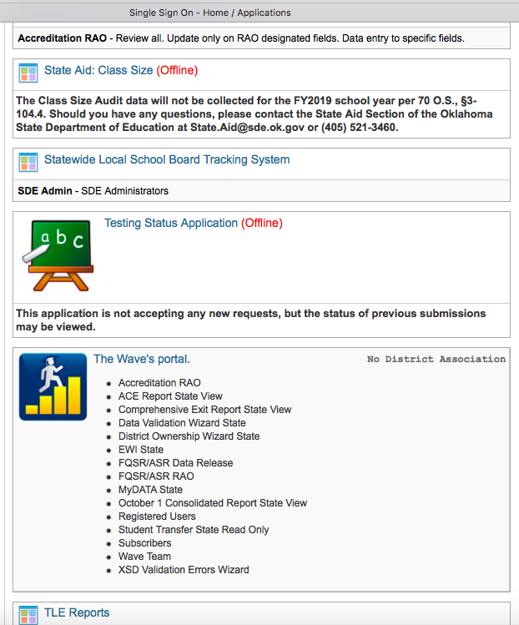

Slide 37
Office of State Aid
Renee McWaters,
Executive Director
Lori Kimbrough
Mitzi Perry
QUESTIONS
405.521.3460
state.aid@sde.ok.gov

Slide 38
Ryan Pieper
Executive Director
Office of Accreditation
405.521.3335
QUESTIONS ?

