Slide 1
Creating K-12 Standards that Work

Slide 2
My name is Larry Gray. I’m a mathematician.
Veteran of the Minnesota Math Wars, 2000-2003
Negotiated a cease-fire so new Minnesota math standards could be written in 2003
Testified frequently at legislature, both as a critic and an advocate
Co-chaired Minnesota Math Standards Revision Committee 2006-7
“Revision” became a thorough re-write, producing a successful set of standards that are still used today and for the foreseeable future
4th graders first in nation, 8th graders third in nation in both “Percent Proficient” and “Percent Advanced” on 2013 NAEP math tests

Slide 3
Great standards, poor results
Parent Confusion
Teacher Frustration
Political Pressures
Public Opinion
Great Standards

Slide 4
Successful standards are like a gourmet dish
A great recipe is worthless without:
Quality Ingredients
Expert Preparation
Carefully Planned Presentation
Knowledgeable Appreciation

Slide 5
Quality ingredients
Committee
Definitions and Expectations
Resources

Slide 6
Quality ingredients
Committee (see Standards Revision Process handout)
Chairs
Content Experts
Writers
Consultants
Other Stakeholders (e.g. parents, business/industry)
Definitions and Expectations
Resources

Slide 7
Quality ingredients
Committee
Chairs:
Minnesota uses Co-chairs, one from Higher Ed and one from K-12
Provides both content expertise and links to K-12 community
Look for people who will likely collaborate, appear publicly
Content Experts
Writers
Consultants
Other stakeholders (e.g. parents, business/industry)

Slide 8
Quality ingredients
Committee
Chairs:
Content Experts:
Must agree to prescribed content and expectations
Look for those who cover many grade levels
Representatives of urban and rural areas in state
Minnesota has an online application system (see handout)
Writers
Consultants
Other stakeholders (e.g. parents, business/industry)

Slide 9
Quality ingredients
Committee
Chairs:
Content Experts:
Writers:
Subset of larger committee, possibly including co-chairs
Broad and deep content knowledge
Passionate about Vertical and Horizontal Integration
Work closely with rest of committee on regular basis
Consultants
Other stakeholders (e.g. parents, business/industry)

Slide 10
Quality ingredients
Committee
Chairs:
Content Experts:
Writers:
Consultants:
Include experts who can’t commit as much time
Higher ed from both content and education sides
Representatives of industry, teacher associations
STATE ASSESSMENT staff – regularly involved – IMPORTANT!
Other stakeholders (e.g. parents, business/industry)

Slide 11
Quality ingredients
Committee
Definitions and Expectations (see FAQ handout)
College and/or Career Readiness
Purposes and Audiences for Standards
Beginning, Middle, End
Structure of Standards Document
Criteria for Standards Quality
Resources

Slide 12
Quality ingredients
Definitions and Expectations
College and/or Career Readiness in Minnesota Math Standards:
Ready to take Precalculus I (College Algebra) at the U of M
This created buy-in from Higher Ed, and a pathway to STEM majors at U of M
We could not define Career Readiness in meaningful way
Purposes and Audiences
Beginning, Middle, End
Structure of Standards Document
Criteria for Standards Quality

Slide 13
Quality ingredients
Definitions and Expectations
College and/or Career Readiness
Purposes and Audiences for Standards in Minnesota:
Expectations for achievement of K-12 students (teachers, parents)
Graduation Requirements (teachers, higher ed, parents)
State Tests must be aligned with Standards (test makers, teachers)
Guide for designing Curricula (teachers)
Beginning, Middle, End
Flexibility in High School Curriculum
Structure of Standards Document
Criteria for Standards Quality

Slide 14
Quality ingredients
Definitions and Expectations
College and/or Career Readiness
Purposes and Audiences
Beginning, Middle, End of Math Standards in Minnesota:
“Beginning” is K, with flexibility in K-2 (no state tests at that level)
“Middle” is 8th grade, where legislature mandated Algebra I
“End” is 9-11 combined for curriculum flexibility
Flexibility in High School Curriculum
Structure of Standards Document
Criteria for Standards Quality

Slide 15
Quality ingredients
Definitions and Expectations
College and/or Career Readiness
Purposes and Audiences
Beginning, Middle, End
Flexibility in High School Curriculum in Minnesota Math:
Standards combined for Grades 9-11, tested near end of 11th grade
Three main subject areas: Algebra, Geometry, Probability & Data
Based on Algebra I in 8th grade
Topics in Standards limited to those for which Mastery is expected (see FAQ)
Students on track should take 4th high school math class (U of M requirement)
Structure of Standards Document
Criteria for Standards Quality

Slide 16
Quality ingredients
Definitions and Expectations
College and/or Career Readiness
Purposes and Audiences
Beginning, Middle, End
Flexibility in High School Curriculum
Structure of Standards Document in Minnesota Math Standards:
Standards (main concepts) and Benchmarks (detailed skills and concepts)
In Grades 3-8 and 11, all Standards must be tested each year
Most, but not all, Benchmarks tested each year
Strands: Number & Operation (through 8th), Algebra (K-11), Geometry and Measurement (K-11), Data Analysis (3-5) or Data Analysis & Probability (6-11)
Strands in a Grade Level Connect to a few Focused Concepts (Horizontal Integration)
Many Substrands apparent in structure and wording of document (Vertical Integration)
Criteria for Standards Quality

Slide 17
Quality ingredients
Definitions and Expectations
College and/or Career Readiness
Purposes and Audiences
Beginning, Middle, End
Flexibility in High School Curriculum
Structure of Standards Document
Criteria for Standards Quality in Minnesota:
Do they work for Teachers and Test Makers? (clear, complete, consistent, checkable)
Are they Grade-level Appropriate?
Do the colleges and universities endorse w.r.t. College Readiness?
Is the content sound, accurate, correct, up-to-date?
Do they connect to the world around us?
Do they promote literacy (technology, media, reading/writing)?
Do they satisfy legislative requirements?
Do they reflect a consistent feedback process from all stakeholders?
Can student progress be monitored by school districts?

Slide 18
Grade | CCSS |  | Minnesota
 | Domains | Clusters | Standards | Benchmarks
K | 9 | 30 | 5 | 13
1 | 11 | 30 | 6 | 20
2 | 10 | 34 | 7 | 20
3 | 11 | 40 | 9 | 26
4 | 12 | 43 | 8 | 27
5 | 11 | 43 | 9 | 27
6 | 9 | 50 | 10 | 33
7 | 9 | 45 | 11 | 34
8 | 10 | 42 | 8 | 35
9 to 11 | 47 | 127 | 11 | 71
Totals | 139 | 484 | 84 | 306
One simple way to compare sets of standards

Slide 19
Quality ingredients
Committee
Definitions and Expectations
Resources considered authoritative by Minnesota for Math:
Curriculum Focal Points (NCTM)
American Diploma Project Standards (Achieve)
Principles and Standards (NCTM)
Legislative Requirements
Previous Minnesota Standards

Slide 20
Quality ingredients
Committee
Definitions and Expectations
Resources to be considered for Oklahoma Math Standards:
Curriculum Focal Points (NCTM)
American Diploma Project Standards (Achieve)
Principles and Standards (NCTM)
Legislative Requirements (including comparison to PASS)
Previous Oklahoma Standards (PASS, Common Core)
ACT Standards (all of them)
Standards of one or two other states

Slide 21
Expert preparation
Ongoing feedback from many directions
Appropriate Timelines
In Minnesota, we only had 10 weeks from first math committee meeting until first expert reviews ☹
In Minnesota, 2007 Standards first tested in Spring 2011☺
Constant interaction with State Assessment, leading to clear, appropriate Test Specs – missing in Minnesota in 2003 ☹, did not happen with Common Core Math ☹☹
Vertical and Horizontal Integration

Slide 22
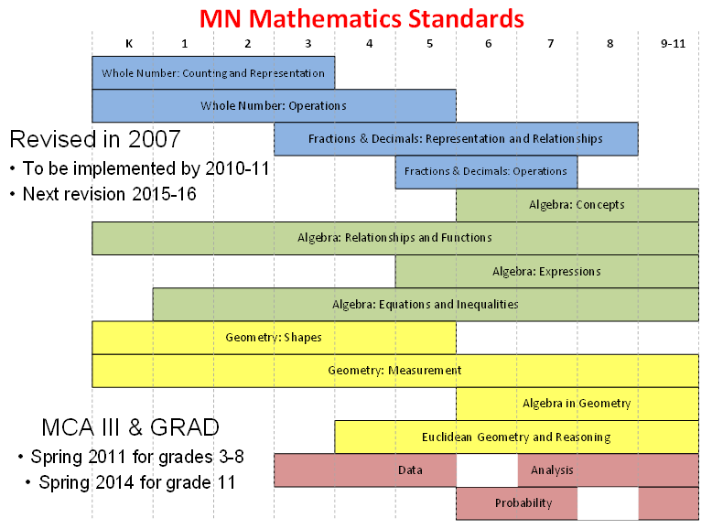
VERTICAL INTEGRATION (shown horizontally)

Slide 23
TRACKING VERTICAL INTEGRATION of a SMALL SUB-STRAND

Slide 24
Carefully planned presentation
Public Comment Online
Town Halls
Expert Review
Review by Higher Ed
Legislature
Teacher Conventions
FAQ Document and Standards Webpage
Bottom line: Get Buy-in!

Slide 25
Knowledgeable appreciation
Frameworks (see Minnesota Frameworks handout)
Data systems
Professional Learning Communities
Time and Patience
It’s all about the Teachers

Slide 26
Who is The chef?
The State Education Commissioner
Aided by the State Department of Education
For details, see Standards Revision Process handout

Slide 27
What Oklahoma has going for it
Previous experience with PASS, Common Core
Good people in charge who want to find out how to do it right
Workable legislation

Slide 28
What are the challenges for Oklahoma?
Several changes in recent years
Some political turmoil
Starting all over, with a tight adoption date (Aug 1, 2016)
Student achievement seems to be relatively low
Lots of decisions to be made before starting
Good Luck!

