Slide 1
Data Reporting: APR/DDP Indicators 11 & 12
Erik Friend & Ginger Elliott-Teague
Directors of Data Analysis
April/May 2016

Slide 2
Data Collection Notes
Indicators 11 & 12 have federally-set targets of 100%.
For summer 2016, Indicators 11 and 12 are calculated using data sourced from the District Summary Data page in OK EdPlan*.
Reminders:
Only EdPlan Administrators have access to this summary page.
It must be completed by June 30 to count.
*Except for the 11’s total evaluation count which is calculated from background data in EdPlan (see the next slide).
Notes:
This brief presentation discusses the data sources and calculations for APR/DDP indicators 11 and 12.
NOTES:
To access the District Summary Data page, go to the Administrator drop-list on OK EdPlan.
Data not entered by June 30 will not count for your district. You will receive a “Not Reported/NR” on your DDP as a result.

Slide 3
Indicator 11: Child Find (45-day Timeline)
Question addressed: What percentage of initial evaluations were completed within the 45-day timeline?
Calculated as:
# of initial evaluations completed in 45 days
(# of all initial evaluations completed - # of initial
evaluations over 45 days due to parent exceptions)
This box—located on the RED—gives day 1 of the 45-day timeline.
Notes:
The calculation of child find is determined by the total number of evaluations completed in 45 days divided by the total number of all evaluations completed including evaluations over 45 days due to parent exceptions. Parent exceptions are recorded this year as a total count (of each exception) on the District Summary Data page. At this time there is no way in the IEP process to document why a district exceeds the 45 day time. This will be updated over the summer to allow districts to document reasons for delay. See the next slide for the parent exception options.
Day one of the timeline is the date that is entered on the REDs document as the date of consent for evaluation. If a parent revoked consent prior to holding the eligibility event, the OK EdPlan administrator will need to go to the student’s document page and delete the event.
This indicator does not calculate Reevaluations, Evaluations, or Response to Intervention. This indicator will only identify initial evaluations.
The Consent to Eligibility report in OK EdPlan will show the number of students who have exceeded the 45 day timeline. The report will not differentiate between reevaluation and initial eligibility event. You can filter to identify the data of exceeding 45 days. Once this is filtered you can look line by line at the students to determine whether it was an initial or re-evaluation.

Slide 4
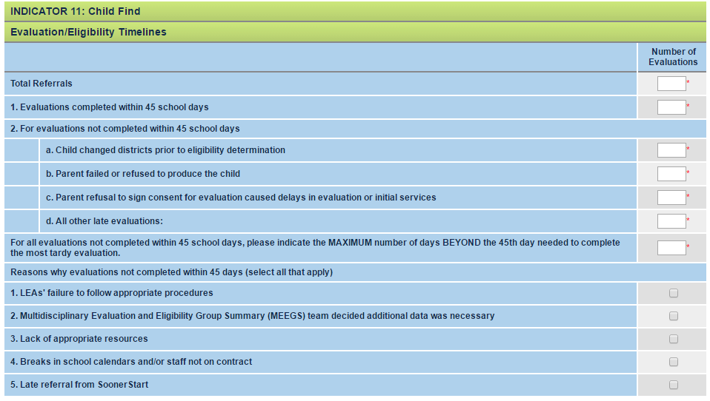
Indicator 11, cont’d.
Notes:
The data collected on the District Summary Data page for Indicator 11 tells us and OSEP why delays in evaluation occurred. OSEP does not count against us delays caused by parents. Be sure to record parent causes accurately in the top section of the Indicator 11 table. The bottom section records the reasons for delays other than parent cause. Please mark each box if a delay was caused one or more times as described. For example, if the MEEGS team decided additional data was necessary for even one evaluation during the school year, check the corresponding box.
Be sure to include the total number of children served through the referral process.
Circled count: Evaluations completed within 45 days will be generated automatically through OK EdPlan. This row will not require a summary total calculated by the district. You may put a zero for this field.

Slide 5
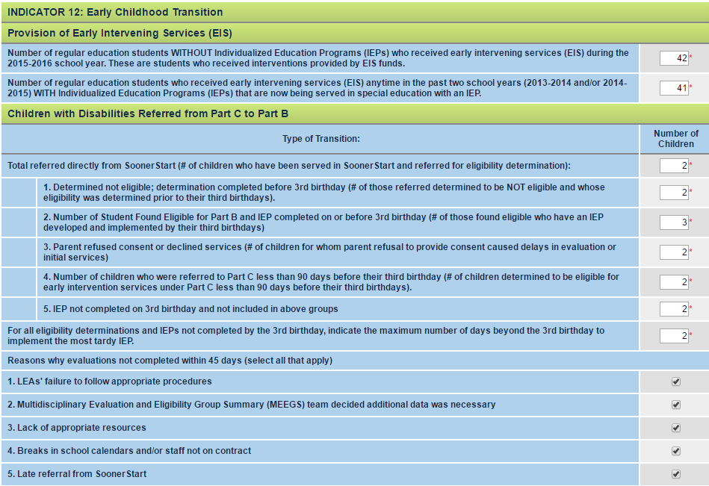
Indicator 12: Effective EC Transition
Notes:
Indicator 12 data is collected in OK EdPlan on the District Summary Data page in a manner similar to that used in Single Sign-On in the past. Please refer to the Indicator 12 table on the summary page.
The data collected on the District Summary Data page for Indicator 12 tells us and OSEP why delays in transition evaluations occurred. OSEP does not count against us delays caused by parents. Be sure to record parent causes accurately in the top section of the Indicator 12 table. The bottom section records the reasons for delays other than parent cause. Please mark each box if a delay was caused one or more times as described. For example, if the MEEGS team decided additional data was necessary for even one evaluation during the school year, check the corresponding box.
Be sure to include the total number of children referred.
NOTES:
1. The very top section (red boxed here) listed under Indicator 12 collects data related to CEIS rather than Indicator 12 (it is mislabeled in the section). Enter the data requested here, as it is required for other data collections outside of the DDP process. If you do not provide EIS to any children in your district, you can enter zero in both of these boxes.
--The provision of Early Intervening Services section is for all students of all ages. Don’t get confused by the heading.
--Do we have to include EIS funds (619 funds)? No, you do not have to report.
2. This data may be able to be self-reported in the future with the development of IFSPs in OK EdPlan for SoonerStart/Part C children. This is in the initial stages of development.

Slide 6
OSDE Contact
Need more detail?
Contact:
Erik Friend
405-521-2198
erik.friend@sde.ok.gov
Ginger Elliott-Teague
405-521-4871
ginger.elliott-teague@sde.ok.gov

