Slide 1
Data Reporting: APR/DDP Indicators 1 & 2
Erik Friend & Ginger Elliott-Teague
Directors of Data Analysis
April/May 2016
Notes:
This presentation covers Indicators 1 & 2: the rates of graduation and dropout among special education students.

Slide 2
Data Collection Notes
Sources:
Graduation Rate (Ind. 1) – Superintendent-certified reports from LEAs to OSDE
Dropout Rate (Ind. 2) – June 30 EOY Collection through OK EdPlan
Questions addressed:
Ind. 1: At what rate are special education secondary students graduating (per 4-yr cohort)?
Ind. 2: At what rate are special education students (14-21) dropping out of school?
Notes:
Information compiled for a district’s graduation rate is generated from the WAVE. The graduation data comes from several certified reports submitted by LEA superintendents at various times during the year. See the next slide for notes on these reports.
The dropout rate data comes straight from OK EdPlan. This data is submitted by users when they inactivate a student within a district’s OK EdPlan system for whatever reason.

Slide 3
Indicator 1: Graduation Rate
The rate is required to use a 4-year cohort basis
How the cohort system works
Reported a year in arrears
Common Questions
How do I know what Cohort each student is in?
What if a student moves before scheduled graduation?
Can I calculate my own graduation rate?
Notes:
District superintendents can view graduation information from their login through the WAVE. The superintendent validates this information 3 times before it is submitted to OSDE-SES. Once a graduation rate has been certified by a superintendent it cannot be changed. Even though the information cannot be changed, if a district has not met target for this indicator, a special education director can identify the calculation of the specific names of students who did not meet the graduation requirements for their cohort.
We always report this a year in arrears to allow our Accountability Department adequate time to obtain the cleanest and most complete data possible. (FFY 2015 represents the year the school year started.) They collect this data from 4 reports (Data: SMART Report, October 1st Child Count Report, Comprehensive Exit Report, Historical Cohort Graduation Report) and do exhaustive cross checks between all of them before compiling and issuing a count of students for each district. OSDE-SES then take the data and filters for SPED students only. Then the percentage of graduates among SPED students in that year’s cohort is calculated.
The Cohort system is designed to work like this: The first day that a student enters 9th grade for the first time, they are assigned to a cohort of students who are intended to graduate 4 years later. He/she will have the same start year of entering 9th grade no matter where the student goes during high school or which district the student attends.
If the student moves out of your district to another district in the state (or elsewhere), the acquiring district assumes the responsibility of graduation. If the student drops out (or “moves, not known”) then the last known district of record (even if it was 2 year ago) will assume the responsibility of the student as a drop out. The student will remain with their original cohort, meaning that a district will only be docked for non-graduates in the cohort year (not multiple years over time as the student stays in school, for example).
Remember: don’t just think of your seniors who didn’t graduate. There may be other students who dropped out 3 years ago who still count in this year’s cohort. Those students will still count against you. IDEA requires districts to serve students until they are age 22. You should provide services to address the student’s needs regardless of whether the student will not graduate their cohort year. They will only be counted as a non-graduate the one year that they were assigned to that cohort…and will not count toward the graduation rate later.
There are only 4 reasons that a student would not count towards your graduation rate. If he or she…
Moves to another diploma-issuing school,
Emigrates to another country,
Passes away, or
Never actually enrolls in your district.
So, if a student leaves school and receives a GED, is retained past the fourth year, or reaches the maximum age for services, then that student will count towards your total number of students in the cohort.
However, students exited to general education (by beginning homeschooling or completing an IEP, for example) will not count because they are no longer special education students.
If a student is promoted and graduates early, then they will have a code of graduate with diploma and will count for the original cohort year as “graduated with a diploma.”
**Changing in the future? Due to the Reauthorization of ESSA, we may have an opportunity to change our cohort system. Dr. Cindy Koss, Deputy Supt for Academic Affairs, is working to determine if the state will move to a 5-6 year cohort for special education.

Slide 4
Indicator 1: cont’d.
All Students with an IEP in the cohort, who graduated with a diploma (coded 01)
(All Students with an IEP in the cohort minus Students with Report Category codes 02, 04, 05 &13)
Notes:
Report Category codes:
02- transfer to another diploma issuing school
04- Emigrated
05- Died
13- Never Enrolled

Slide 5
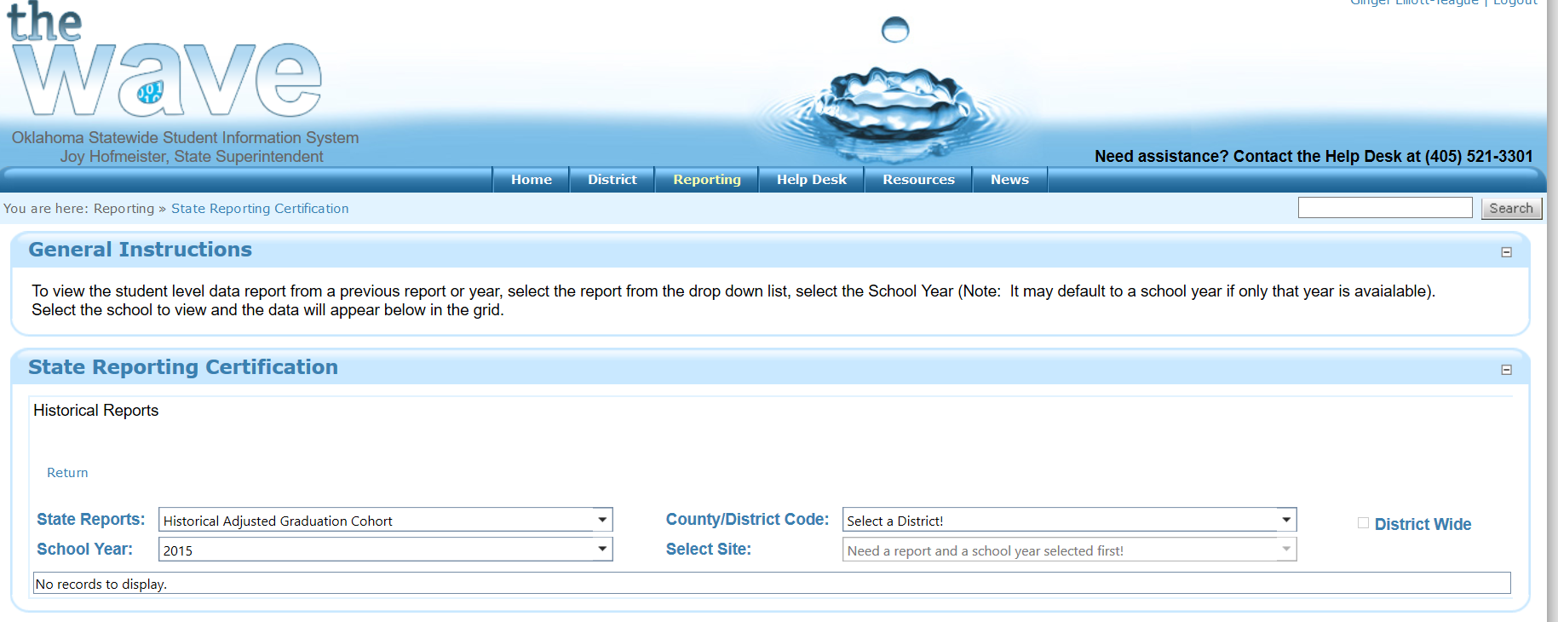
Graduation Report Information in the WAVE
Notes:
A report is available to superintendents in the WAVE: the Historical Adjusted Graduation Cohort Report. Your superintendent can grant you viewing access if they choose. Otherwise, request a print-out.
Superintendents are required to validate the report, but it may be helpful to you to know that it is there to help confirm the accuracy of the data.
If you are granted access, you can get to the report via the following steps:
Choose “Reporting” at the top menu bar.
Choose “State reporting certification” from the drop down list.
Scroll down the page and click on the blue oval button titled “Historical Reports.”
In first drop down list select this report: “Historical Adjusted Graduation Cohort.”
Under the county/district code drop down select “district view.”
Select the school year: “2015” to get current data.
Check the district wide icon if there is more than 1 high school in your district.
The report with student specific information will appear.
You need to select students based on information in three columns: IEP (yes or no), Cohort Class of, & Report Category.
Filter:
Type at the top of the “IEP” column: Type in “Yes,” filter “Equal to”
“Cohort class of” column: Type in “2015,” filter “Equal to”
Results will show a list of all students with an IEP for cohort class of 2015.
Filter again by “Report Category”: Type in “02,” filter “Does Not Contain” (this removes students who moved away).
The report will now show all relevant students, with a few exceptions. You may ignore (for the purpose of this report) students with the following 3 categories in “Report Category”:
04: Emigrated
05: Deceased
13: Never enrolled
Graduation Rate is calculated by putting total number of students that Report Category = “01” divided by all students for whom the Report Category does not equal “02”, “04”, “05”, or “13”.
Note, at the bottom right corner of your screen is the total number of kids in the district/school set for that school year.

Slide 6
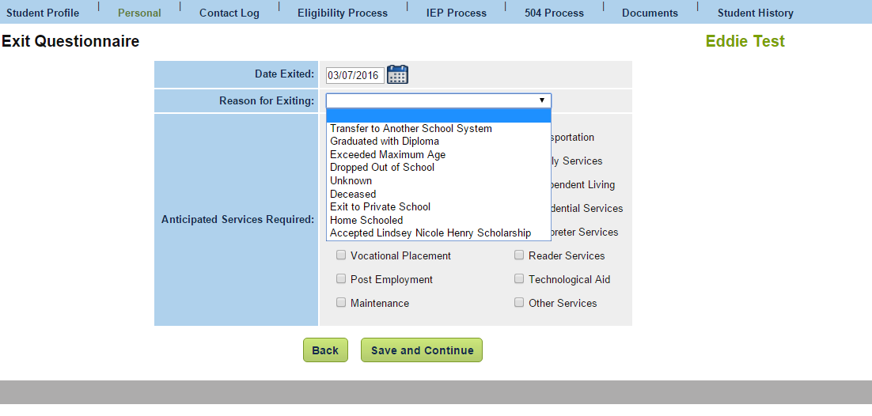
Indicator 2: Dropout Rate
OK EdPlan Exit Questionnaire page
Difference between Dismissing & Inactivating
Difference between Unknown & Transfer to another school system
Notes:
The data for indicator 2 comes from the reasons for exiting provided via the Exit Questionnaire in OK EdPlan.
There are 9 options available to select for exit: Transfer to another school system, graduated with a diploma, exceeded maximum age, dropped out, unknown, deceased, exit to private school, home schooled, accepted LNH Scholarship. One exit option no longer exists on this list: “Return to regular education”.
If you have a student who is no longer eligible for any reason (i.e. met IEP goals, parent withdrawal, etc.), then you must return to general education by finalizing an eligibility event. This is called “dismissing” a student. This student will never be inactivated in OK EdPlan as long as the student is still enrolled in the district. If you have inactivated students who is still in your school district—regular education or not—you will have to reactivate them AND do an eligibility event to determine them not eligible for special education services. Take the students off the teachers’ caseload; the students are no longer in special education and will have a clear checkmark next to their names in OK EdPlan.
You may have to run the dropout report or “All student export file (sped only)” in OK EdPlan and filter on the column of “Exit Reasons” for “return to regular education” to determine the names of students who have been dismissed. Determine which students are still enrolled in your SIS, then proceed with the advise above: reactivate and create an eligibility event.
If the child leaves your school district for whatever reason—such as enrolling in private school (LNH or otherwise) or home school—you should exit the child with an exit reason, provide the date the student exited and inactivate the child…even if they remain eligible for services.
NOTES:
If the student dropped out to get a GED to seek support through Job Corp, it would be considered as a drop out.
If you do not know that a student is continuing their education at another public school system, mark “Unknown.”
If you selected an exit reason moved not known to be continuing, you can change the exit reason if records are requested at a later date. The exit reason would be exit known to be continuing. You would want to address this step so the exit not known to be continuing doesn’t count against your district.
If a student drops out multiple years, then every single year that the student drops out will count against the district.
Are the dropouts generated from the WAVE? No. It is not a required element at this point, so the information is not gathered through the WAVE, but it may be an available component for the future). Another concern is that principals may not understand about the exit reason, especially as it relates to special education students.
3 year olds are not effected because dropouts are calculated for students age 14-21. (Some schools will have dropouts for 14 year old students who are in 8th grade).
If you are an independent school district and the student is an 8th grader the exit reason should be transferred to another school system. This will translate as exit known to be continuing.
You will not want to exit the student (the date will be the date the student graduated) until the student has left the school district (walked across the stage). If the IEP is due prior to the graduation date, the team must have a new IEP meeting to continue to provide services prior to the time of graduation.
If the student met the IEP requirements prior to graduation you can dismiss the student through an eligibility event. If the student completed the program and you don’t want to write an IEP, understand that if a graduate is returned to general education, the dropout rate will increase. Graduating seniors help with reduce the dropout rate.

Slide 7
Indicator 2: cont’d.
Calculation*:
Count of Students with Exit Reason “Dropped Out”
Count of Students with Exit Reasons “Dropped out” + “Exceeded Maximum Age” + “Graduated with a Diploma” + “Deceased”
*Using the codes on the OK EdPlan Dropout Report.

Slide 8
OSDE Contact
Questions about graduation or dropout rate?
Contact:
Erik Friend
405-521-2198
erik.friend@sde.ok.gov

