Slide 1
Data Reporting: APR/DDP Indicator 5
Erik Friend & Ginger Elliott-Teague
Directors of Data Analysis
April/May 2016
Notes:
This brief presentation discusses Indicator 5, which reports on the location of services provided to students to ensure that students are served in the “Least Restrictive Environment” possible.

Slide 2
Data Collection Notes
Source: Oct 1 Child Count through OK EdPlan
Question addressed:
What percentage of the time do students with IEPs receive services in regular education settings?

Slide 3
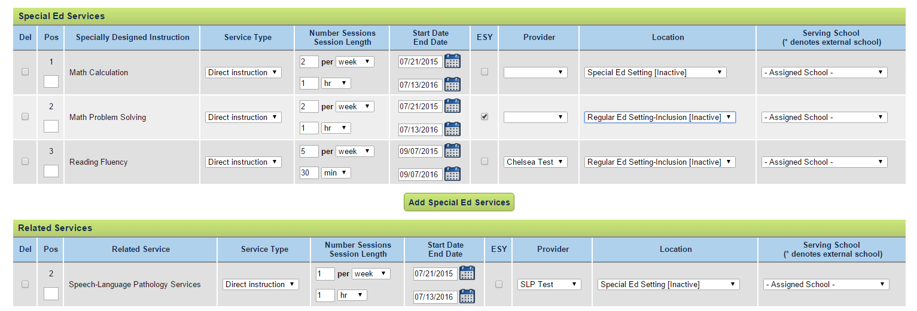
Indicator 5: Least Restrictive Environment 6-21
LRE is calculated from a child’s OK EdPlan Services page.
Notes:
The LRE rating for each student is calculated as the number of hours of services provided in a general education setting divided by the length of the school week. To get this number, do the following:
First, on the services page of a student’s IEP, count of the number of hours of services (special ed and related) provided per week in the special education setting.
Look at the service type. The only area that will count towards LRE is Direct Instruction. Anything other the Direct Instruction is ignored because it does not count towards LRE.
Look at the location to determine where the service is provided.
Count up the number of sessions per week, multiplied by the time services are provided each week.
On this slide, the math calculation service in special education will count for 2 hours per week, and the SLP services (under related services) will count for 1 hour per week. Thus, this child is being provided services outside the regular education setting for 3 hours per week.
Next, determine the length of the student’s school week (see the next slide).
NOTES:
OK EdPlan Admin users can view each student’s LRE by going to the student’s personal page.
Within OK EdPlan a period is set at 60 minutes, an hour is 60 minutes and a block is set at 90 mins. If IEPs were finalized with a significant difference in this definition, the IEPs will have to be refinalized using minutes to define the amount of services received.
Fields that attribute to the calculations:
Service type
Location
Number of Sessions/Session Length
Start Date/End Date
Length of School Week
Students aged 3-5 are excluded from the LRE calculation on the services page for data purposes. IEP teams will continue to use the services page to address the services provided for all students. The information entered is generated from the EC environment tab.

Slide 4
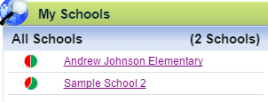
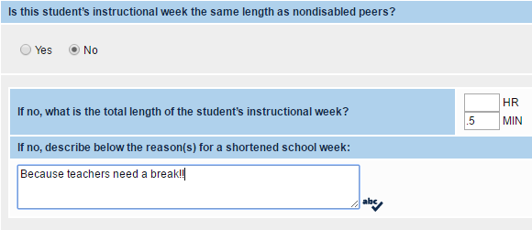
Indicator 5, cont’d.
Choose Site -> Review Length of School Week
If the student’s instructional week is not the same as peers’, be sure to notate that on the Services page, as shown on the box to the left.
Notes:
You find the Length of School Week on the Site Profile page, on the student’s personal page (which reflects the Site Profile data), or on the Services page (if the length of school week differs from the student’s nondisabled peers).
Do not edit a school site to adjust one student’s length of school week, but record the reduction of a length of school week on the Services page of the student’s IEP. The answer to the question of “Is this student’s instructional week the same length as nondisabled peers?” would be ”no”…and enter the number of hours of the student’s week.
NOTES:
Check the length of school week for every site in your district. We have seen some sites with a “Length of School Week” of just 6 periods. In OK EdPlan, 6 periods equates to 6 hours or 360 minutes, thus these sites had set their length of week to 360 minutes long…which is clearly wrong.
Once all student services data is entered, we calculate Indicator 5 by counting the students who fit into each category of LRE we are required to report (>80%, <40%).

Slide 5
OSDE Contact
Need more detail?
Contact:
Erik Friend
405-521-2198
erik.friend@sde.ok.gov
Ginger Elliott-Teague
405-521-4871
ginger.elliott-teague@sde.ok.gov

