Slide 1
Data Reporting: APR/DDP Indicators 6 & 7
Erik Friend & Ginger Elliott-Teague
Directors of Data Analysis
April/May 2016
Notes:
This presentation discusses Indicator 6 & 7. These reports focus on Early Childhood aspects, specifically EC Environments and EC outcomes. These indicators ensure that students are served in a “Regular Early Childhood Program” when applicable and that students are making progress between ages 3-6.

Slide 2
Data Collection Notes
Sources:
Ind. 6: Oct. 1 Child Count in OK EdPlan
Ind. 7: June 30 EOY Collection in OK EdPlan
Questions addressed:
Ind. 6: What percentage of students receive the majority of SPED services in a regular early childhood program?
Ind. 7: Are children progressing toward peer-level performance on various early childhood outcomes?

Slide 3
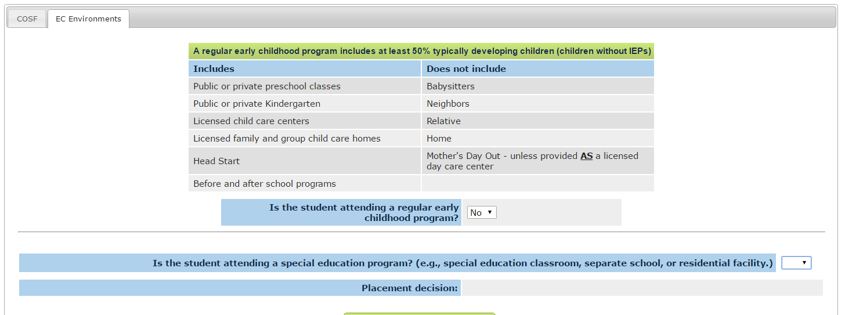
Indicator 6: Early Childhood Environments 3-5
Notes:
If a student does not attend any of the regular EC programs listed, then chances are they stay at home with a babysitter or parents or grandparents. In these cases, when you answer no to “Is the student attending a regular early childhood program?”, the next question addresses the service location: a special ed classroom, separate school, or residential facility. Those listed correspond directly with C1, C2, and C3 respectively. Otherwise, you are providing services at the students home or in another location which correspond with D1 and D2 respectively.

Slide 4
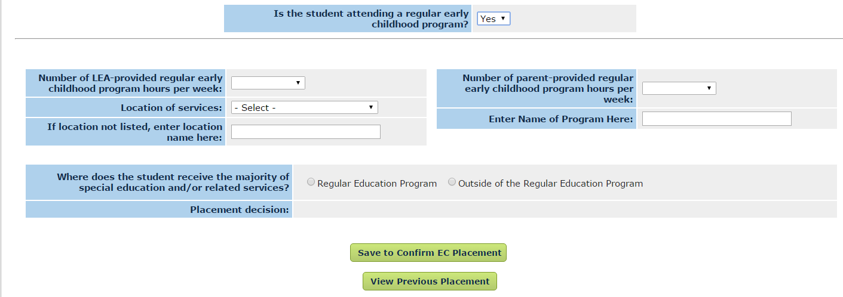
Indicator 6: cont’d.
Notes:
An EC environment is required for ALL students regardless of the length of time they have received services or been determined eligible prior to his/her 6th birthday. It is not like EC Outcomes that are not reported in certain circumstances.
Entering EC environments in OK EdPlan does not require a team meeting to refinalize.
Line 1 on the DDP for Indicator 6 only counts the percentage of students who receive most services in a regular early childhood program (A1, which reflects >10 hours per week and B1, which reflects <10 hours per week in a regular education program). A2 and B2 are coded when children receive the majority of their services in a special education setting, even though they attend a regular education program (for more (A) or less (B) than 10 hours a week).
If a student only goes to you for special education services the answer to the first question on this slide is “No.” They are not attending a regular early childhood program. Example: The student only leaves home to attend school for speech and is pulled out to a separate area for speech services. These students are coded C or D.
If the answer is “Yes” to the first question, you must record the number of hours the child was in a regular early childhood program, whether LEA-provided or parent-provided (such as daycare, a private preschool, HeadStart, etc.). The two numbers are added together to determine the length of week spent is a regular EC program. The list of approved regular EC programs is on the previous slide.
Where are the majority of special education services received?
If children receive services in the regular EC classroom, then mark that. If a child receives most or all services outside the classroom, mark that. We understand that most speech-only students receive the majority, if not all, of their special education services in a 1 on 1 setting with a speech pathologist outside the classroom. In this case, the question must be answered with “Outside of the Regular Education Program.” This has been defined at a federal level. If your district has a lot of speech only students in the 3-5 year old age range, removed from their general education classroom, your Indicator 6 data will appear to be very low and not reflect positively for the district. However, this is the correct way to report service environment for these children.
Right now, please make sure your district is reflecting the data accurately. For now, some things that you could discuss with your personnel and IEP team is the possibility of bringing the Speech Path into the classroom with all of the children and incorporating speech therapy in the classroom at least half the time. (Example: If a student receives special education services 1 hour per week, the SLP would have to go into the student’s classroom at least 30 minutes.) At this time, to meet indicator 6, the SLP will need to be in the general education classroom the majority of service time. However, this may not meet the specific needs of the child. Therefore, do not provide services in the classroom just to meet the Indicator target. The IEP needs to reflect whatever is best for the child. For some schools, this might work better than others.
This indicator does not count towards a determination at this time. There is a placeholder on your DDP, but it is not counted. The priority for Oklahoma right now is to make this area is consistent across the state. Everyone is providing services similarly, but service is reported differently statewide. Accurately reported data will most likely decrease the outcome data. If that happens, the targets could possible be reset to make them more realistic. OSDE is having ongoing conversations to address this area of concern for Oklahoma.

Slide 5
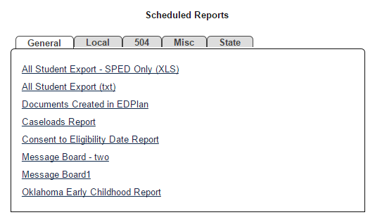
Indicator 7: Early Childhood Outcomes
OK EdPlan ECO page
For each outcome, if the rating is the same at entry and exit, then the student has gained skills.
You can pull the Oklahoma Early Childhood Report for your district.
Notes:
All special education directors need to ensure that all students age 3-6 have entry dates and entry ratings entered before you leave for summer or June 30th, whichever is sooner. If students do not have their ECO entry data in OK EdPlan, they will not counted toward your Indicator data. There were some students that slipped through early in the year and have completed IEPs but do not have ECOs entered. You can look at the Oklahoma Early Childhood Report in OK EdPlan to see the data currently available for the district.
Exit dates and ratings must only be entered for children who are exiting the program appropriately (when they finish an IEP or age out).
ALL students age 3-6 MUST have an entry date, unless a student has not received services or is initially identified within 180 days of services prior to their 6th birthday. If a student exits out of the state a district would have to enter an exit date.
NOTES:
1. If a student enters with a 3 rating and exits with a 3 at age 6, the student HAS made progress. Yes! The expectations for a 3 year old and a 6 year old are different. The student would have had to learn something to maintain their level of a 3. If you have not had this practice, use this moving forward. If you reported this wrong last year, the data was corrected on your behalf.
2. If you have an out of state student who did not have the entry data with them, contact the previous school district to find out the information. Ask the previous district to fax you the document, get the EC Environment information and the EC entry date. Do your best to track down the data if at all possible. If you don’t have the information you will have to use the date the student entered your school district and do the best you can with the information available. The entry date is the date student started receiving services, not when they entered the school district as a general education student.
3. In Oklahoma there is only one entry date and one exit date. It is no longer the practice to rate children multiple times when they move between multiple districts. Enter ECO once; exit ECO once during a child’s EC education.
4. The date of exit is the date of the student’s 6th birthday or the date that the team determined the student is no longer eligible for special education services. The final ECO could be done 90 days before their 6th birthday. If the student will turn 6 over the summer and no services will be offered over the summer, the exit date can be the last day of school.
5. OK EdPlan now has a custom compliance symbol to instantly indicate for teachers/directors that the EC Outcomes need to be completed. It will go to a red x if they have exceeded the student’s 6th birthday. OK EdPlan administrators can go in and enter an exit date for students who have exceeded 6 years, 6 months. Editing the field is an available feature for all age students (including 9 year olds).

Slide 6
OSDE Contact
Need more detail?
Contact:
Erik Friend
405-521-2198
erik.friend@sde.ok.gov
Ginger Elliott-Teague
405-521-4871
ginger.elliott-teague@sde.ok.gov

