Slide 1
Charter school training
accreditation
Lynn Jones
March 3, 2015

Slide 2
Charter school training accreditation
WHAT IS ACCREDITATION?
Accredited Schools are meeting State Requirements.
State Aid is paid ONLY to Accredited Schools
Each district has a Regional Accreditation Officer that monitors compliance with Oklahoma statutes and State Board rules
Regional Accreditation Officers are a valuable resource

Slide 3
Charter school training accreditation
Regional Accreditation Officers conduct periodic reviews and audits to determine compliance
Audit Employee Flexible Benefits (Oct, Jan)
Audit Attendance/Membership (Nov, June)
Accreditation Visit (Feb-May)
Summer School (July)
There are 12 Regional Accreditation Officers that cover 517 districts plus 35 charter school sites and 27 career techs or approximately 45 districts each.

Slide 4
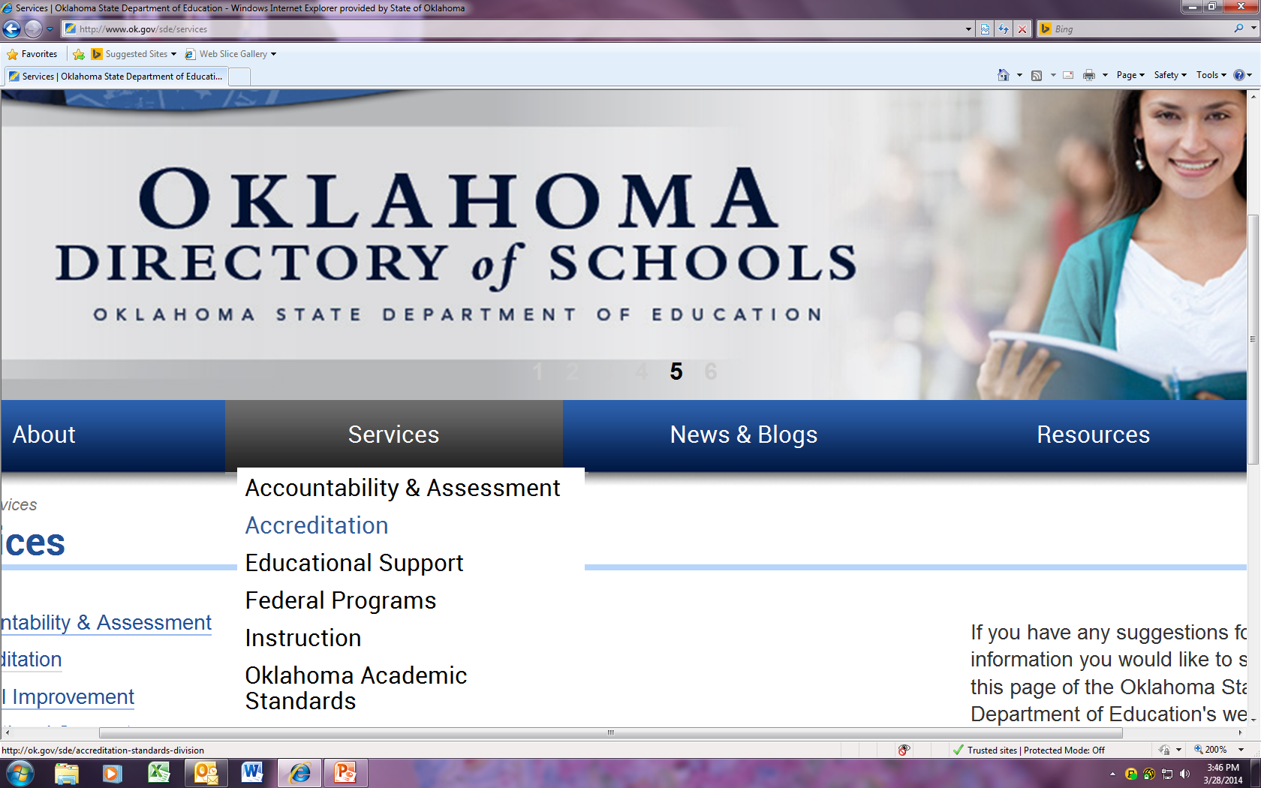
Charter school training accreditation

Slide 5
Charter school training accreditation

Slide 6
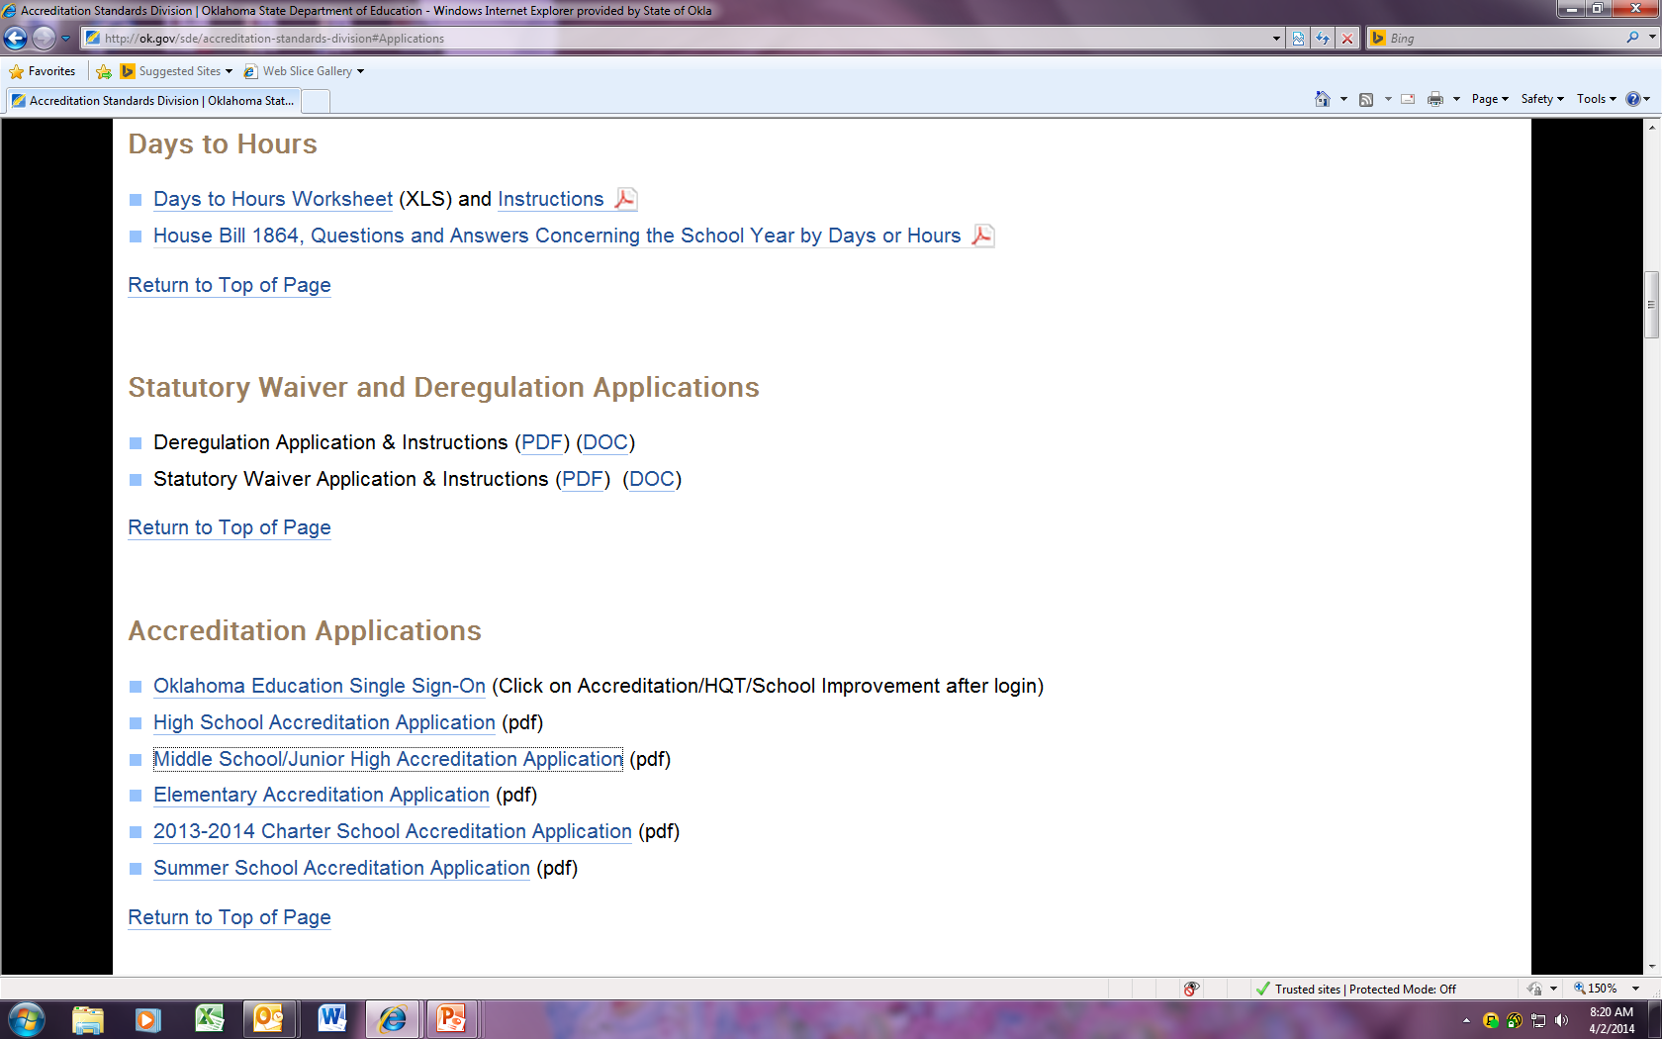
Charter school training accreditation

Slide 7
Charter school training accreditation

Slide 8
Charter school training accreditation
Oct 1 Information is entered—a snapshot of that day
Two sections of data are pre-populated:
*the statistical information or demographic grid (number of students in each grade and their ethnicity, for example) from the student information system
*teachers-from the personnel report

Slide 9
Charter school training accreditation
Other Information that Must be Entered:
Calendar and School Day
Library Media
CPR Provider
Curriculum
Paraprofessional Information
Early Childhood
Counseling
AP/Pre AP Classes

Slide 10
Charter school training
accountability
at
a glance
Lynn Jones
March 3, 2015

Slide 11
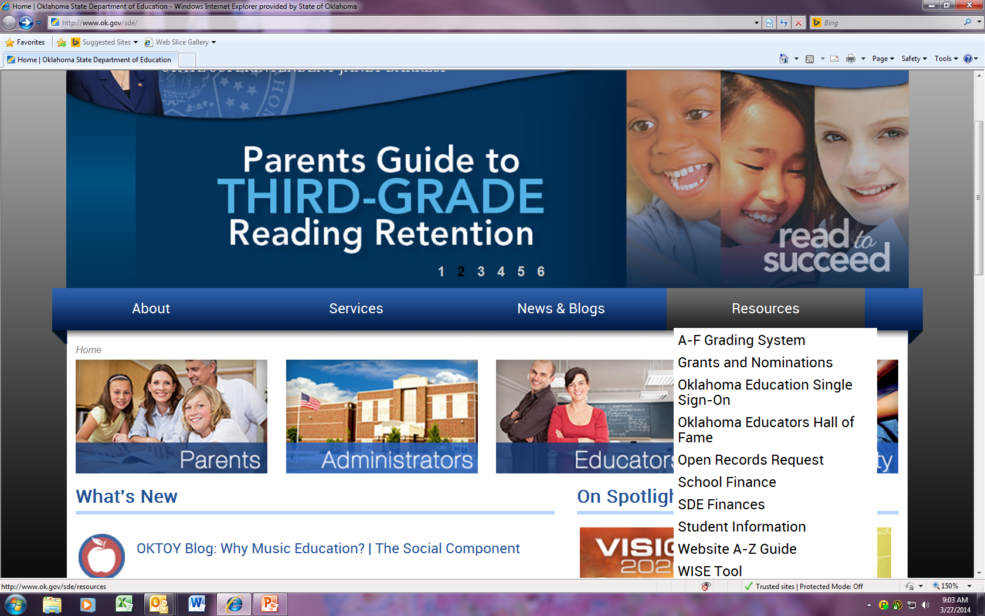
Charter School Training Accountability at a glance

Slide 12
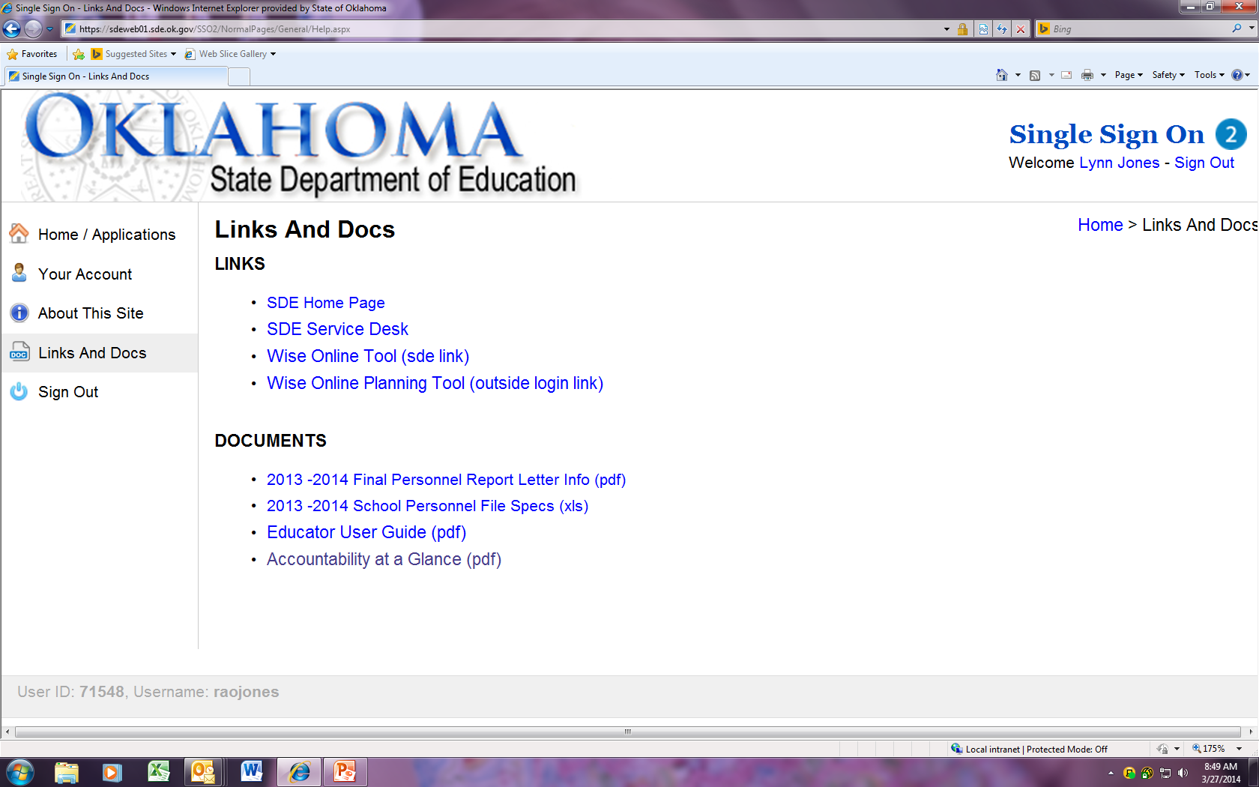
Charter School Training Accountability At A Glance

Slide 13
Charter School Training Accountability At A Glance

Slide 14
Charter School Training Accountability At A Glance

Slide 15
Charter School Training Accountability At A Glance
Helpful Hints
Dates and items are submitted for the next year by early summer.
If you print it, check to Make Certain the copy you have is the most current.
Glossary of terms S-State, F-Federal
Contact information

Slide 16
Charter School Training Accountability At A Glance

Slide 17
Charter School Training Accountability At A Glance

Slide 18
Charter School Training Accountability At A Glance

Slide 19
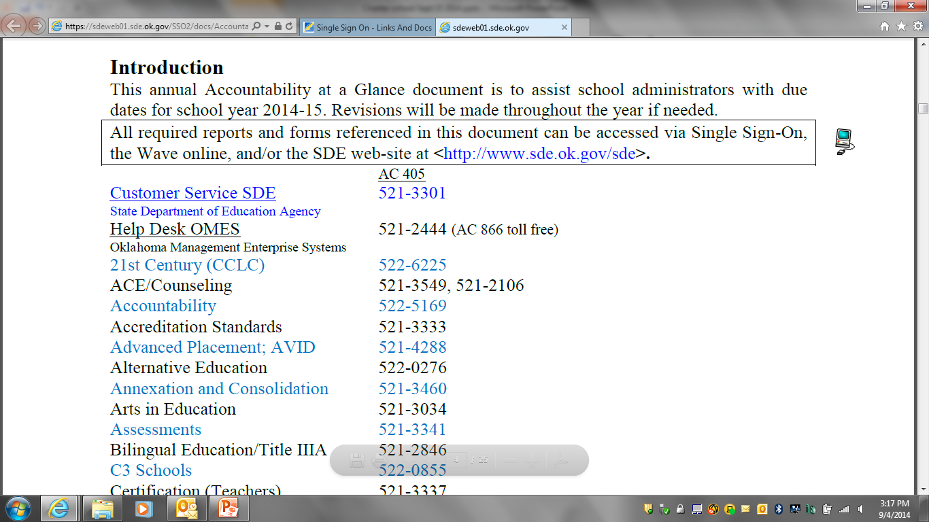
DURING THE YEAR S Each school site must conduct two (2) lockdown drills; ACE/Counseling (405) 521-2106. [70 O.S. § 5-148] F Gun-free Schools Weapon Report is due within two weeks of any incident; ACE/Counseling (405) 521-2106. [H.R. 1 § 4141; NCLB § 4112] S School Emergency Plan is to be reviewed and updated annually. [63 O.S. § 2001] S Annual School Board Membership Report (provided on the SDE web site) is due after district elections in February, or run-off elections in April; Accreditation (405) 521-3333. [70 O.S. § 5-110.2] S First time Oklahoma superintendents (a first year superintendent) upon employment must enroll in the required training program (66 hours) provided by the SDE; Accreditation (405) 521-3335 or 522-2692. [OAC 210:20-21-1] Note: If a due date falls on Saturday or Sunday, the following Monday is acceptable. 1 Legend:

Slide 20
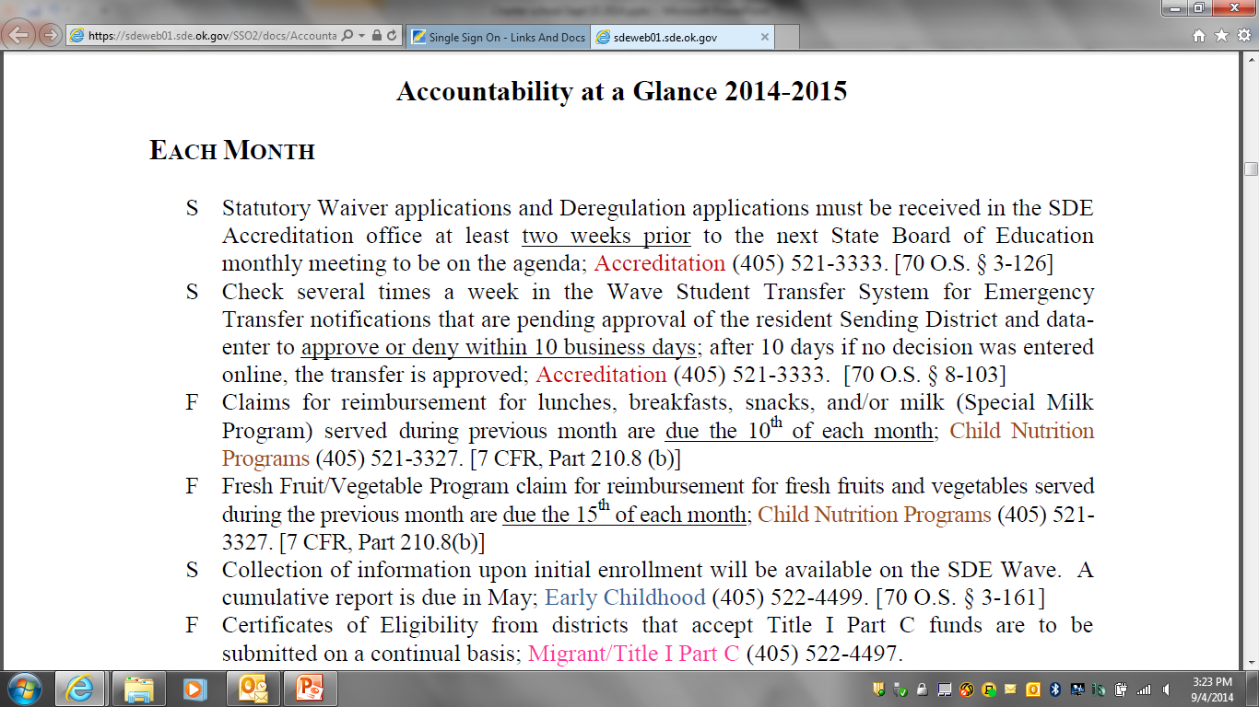
Charter School Training Accountability At A Glance

Slide 21
Charter School Training Accountability At A Glance

Slide 22
Charter School Training Accountability At A Glance
Important Accreditation Dates
Transfers-Open transfer deadline with data entered is May 31, as of legislation that takes effect November, 2014.
Days to Hours Notification-Intent to calculate the instructional calendar by hours instead of minutes is due to the Accreditation office prior to September 15.
Accreditation Applications-Applications are open for data entering on October 1st and are to be certified online no later than October 15th.

Slide 23
Charter School Training Accountability At A Glance
Contact Information
Lynn Jones 405-522-2692
Executive Director
Accreditation, School Personnel Records
Christy Hanshew 405-521-3335
Division Support Coordinator
Email addresses: first name.last name@sde.ok.gov

