Slide 1
Expectation
Matrix
Activity

Slide 2
Expectations Matrix Activity
Guidelines
State rules positively
Keep to 3 to 5 per setting
Use common and few words (easy remember)
Rules should tell what the behaviors “looks like”
Example: What does respect look like in the classroom
What does being safe look like when using technology
Tell students what TO DO rather than what NOT to do.
Example: Instead of “no vaping the restroom”
Report inappropriate activity immediately
Return to class quickly

Slide 3
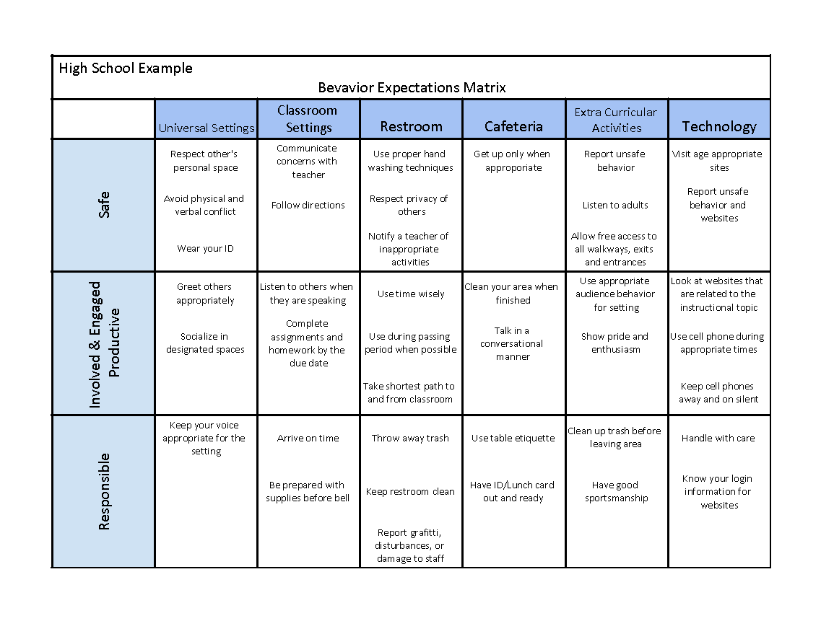
Example of an Expectation Matrix

Slide 4
Instructions
Grab a sticky note.
Select an expectation (left side of matrix, in red).
Select a location (top of matrix, in black).
Write down one behavior specific rule.
Shows how the expectation looks in the given location.
Place sticky note on the behavior matrix.
At the end of the activity, sticky notes will be collected to assist with the creation of the schoolwide behavior/expectation matrix.

Slide 5
 | Classroom | Hallway | Restrooms | Cafeteria | Technology | Extracurricular Activities
Insert Expectation
Insert Expectation
Insert Expectation

