Slide 1
2018-19 Oklahoma School Testing Program (OSTP) Statewide Results

Slide 2
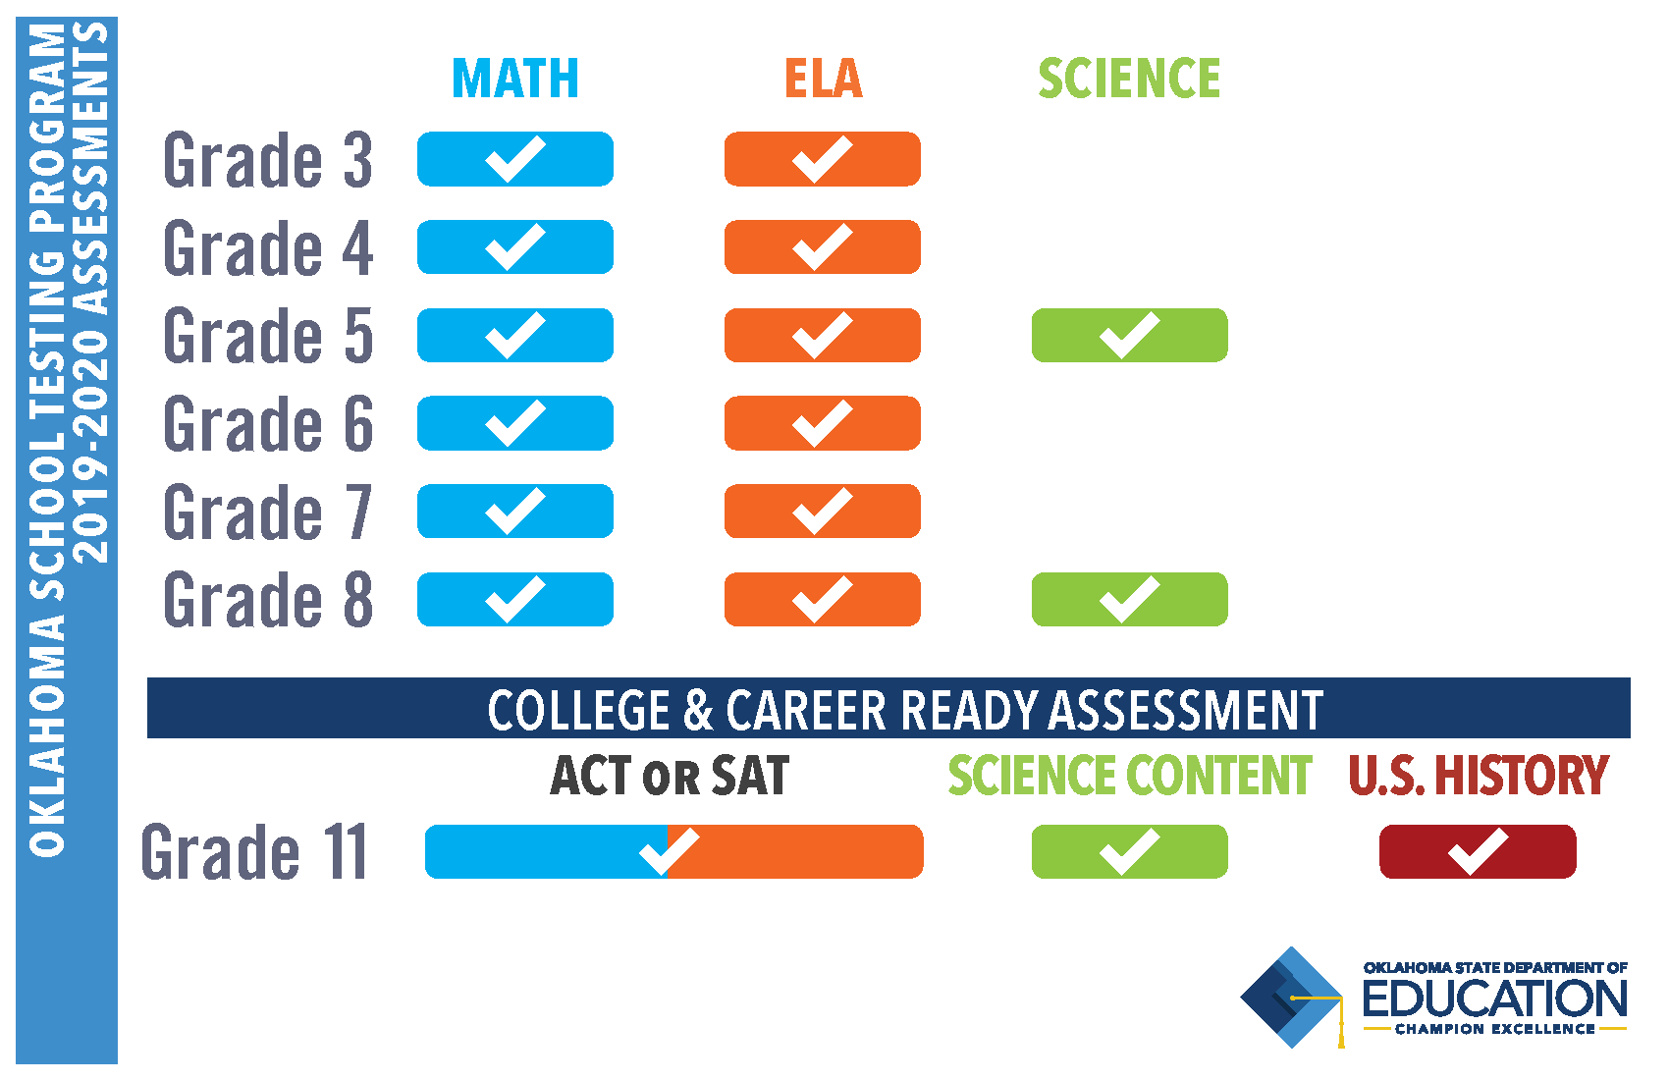
Oklahoma School Testing Program 2019-2020 Assessments
FIELD TEST ‘19

Slide 3
Grades 3-8 Math Results
 | Proficient & Advanced | Average OPI
Grade 3 | 43% | 294
Grade 4 | 38% | 289
Grade 5 | 31% | 285
Grade 6 | 30% | 284
Grade 7 | 33% | 286
Grade 8 | 23% | 276

Slide 4
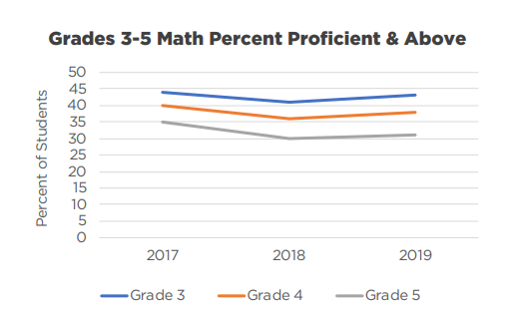

Slide 5
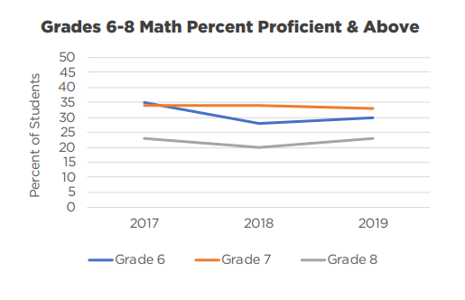

Slide 6
Grades 3-8 English Language Arts Results
 | Proficient & Advanced | Average OPI
Grade 3 | 39% | 289
Grade 4 | 30% | 284
Grade 5 | 35% | 287
Grade 6 | 36% | 290
Grade 7 | 29% | 284
Grade 8 | 30% | 283

Slide 7
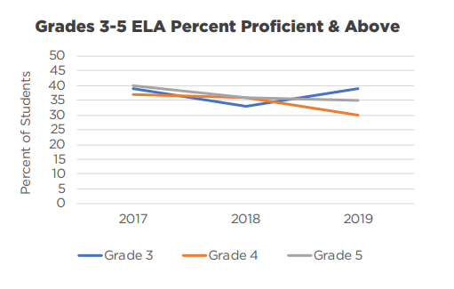

Slide 8
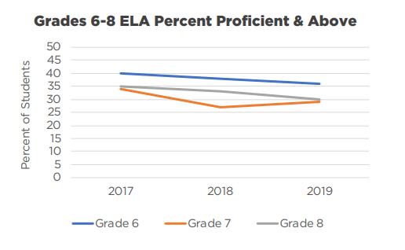

Slide 9
Grade 3 RSA Students Meeting Requirements

Slide 10
2018-19 Science Results
 | Proficient & Advanced | Average OPI
Grade 5 | 39% | 291
Grade 8 | 40% | 291

Slide 11
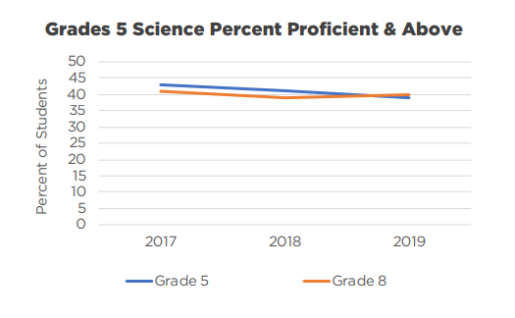

Slide 12
Grade 11 College- and Career-Readiness Assessment Results
Proficient & Advanced | 2018 | 2019
English Language Arts | 38% | 33%
Math | 22% | 24%
Science | Field Test | 24%

