Slide 1
Charter Schools
Brad Clark
General Counsel
Brad.Clark@sde.ok.gov
Office: 405-522-3274
Notes:
Megan & Shannon

Slide 2
Disclaimer
Everything you are about to hear are the personal opinions of the speaker and not necessarily the policies or opinions of the State of Oklahoma. Information provided should not be construed as legal advice or opinion.
Humor?

Slide 3
What is a Charter School?
Public School
Contract
Specific curriculum?
Exempt from certain regulations
Teacher Due Process; TLE; collective bargaining; credentialing
Flexibility in exchange for accountability

Slide 4
What is a Charter School?
Charter Sponsor (Authorizer): Allows the school to exist. Receives up to 5% of all state aid from the school in return for services.
Governing Board: Typically incorporated as a 501(c)3, this body is the applicant to the sponsor and serves as the school board. They are subject to Open Meetings/Records Act.
School Leadership: This person or team runs the day-to-day operations of the school and is hired and fired by the “Board of Governance.”

Slide 5
Purpose – 70 O.S. §3-131
Improve student learning
Increase learning opportunities for students
Different and innovative teaching
Additional choices
Require measurement of student learning and create innovative forms of measuring student learning
Establish new forms of accountability; and
New professional development opportunities

Slide 6
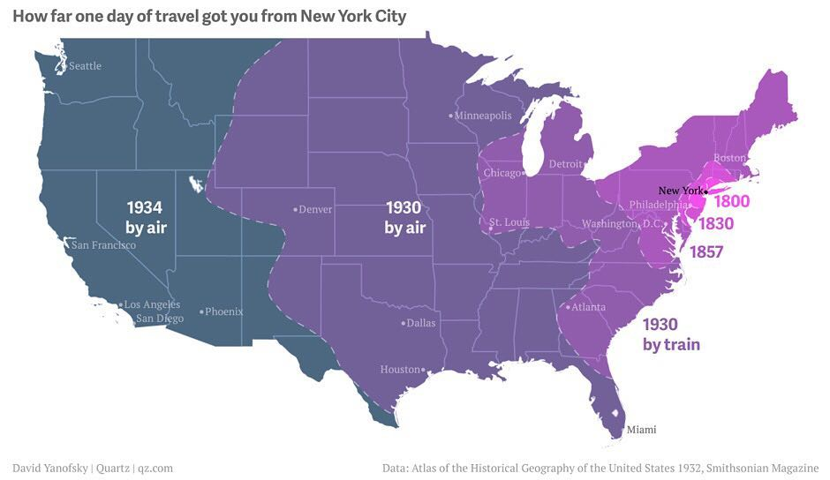

Slide 7
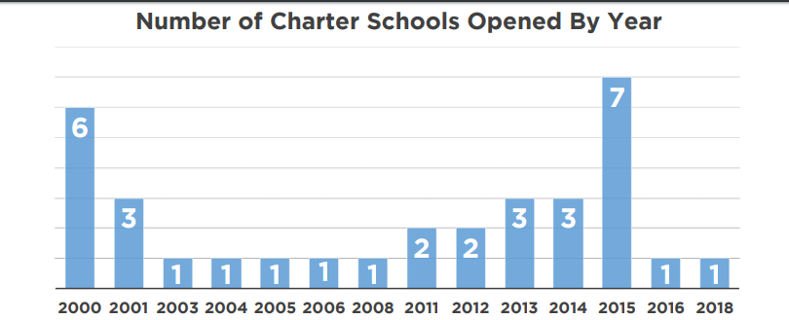
History/Background
Trends - 1999, 2011 and through 2015

Slide 8
Establishment
Charter school training
Application
Contract

Slide 9
Application – 70 O.S. §3-134
Submission: time limitations?
Sponsor* has 90 days
Must accept or reject
30 days to submit revised application
30 additional days…
Upon approval/rejection
Approval: negotiate 5 year contract
Rejection: appeal to the State Board of Education (school district only)
Non-school district: mediation or binding arbitration

Slide 10
Application – 70 O.S. §3-134
Application to a sponsor must include 35 elements:
Financial plans, financial controls and audit requirements
Start-up and 5-year budget including cash flow projections
Facilities plan, including contingency plan
Description of minimum and maximum enrollment (caveat)
Description of academic program aligned with state standards
Instructional framework (class size and structure, teaching methods, etc)
Plan for assessments
Plan for serving students with disabilities, ELL, and struggling students
Demonstration of community support

Slide 11
Application…70 O.S. §3-134
Application…
Plan for student recruitment
Discipline policies
Organizational structure and responsibilities
Plans for transportation and food service
Governing board meets at least quarterly
Counties with 500,000 - a majority of board members residents within the boundary of the sponsor
Requirement that the school follow Open Meeting and Open Records Acts

Slide 12
Sponsors – 70 O.S. §3-132
ANY school district
Technology center school district
Accredited institution of higher education*
Federally-recognized Indian tribe*
Former reservation or treaty area on property held in trust
State Board of Education*
Statewide Virtual Charter School Board

Slide 13
Sponsor Powers and Duties
Oversight through annual performance review
Decline weak or inadequate applications
Monitor performance and legal compliance
Renewal/non-renewal
Develop policies
5% of state allocation for administrative services
Provide OSDE with financial records documenting any state funds retained

Slide 14
Contract – 70 O.S. §3-135
Charter incorporation
Admission policies and procedures
“Equally free and open”
Shall not discriminate or limit enrollment
Tiered enrollment?
Lottery?
Management & Administration
Audit procedures
Compliance with Act
Term
Funding
Performance framework?

Slide 15
Performance Framework 70 O.S. §3-135
Academic proficiency
Academic growth
Attendance
Graduation rate
Postsecondary readiness
Financial
Governing board performance

Slide 16
Sponsorship – 70 O.S. §3-134
Upon approval, sponsor charter to provide:
Charter
Charter contract
Minutes
Physical location, grades, and opening date

Slide 17
Startup - 70 O.S. §3-135
No hiring or operations until contract is signed
Sponsor “reasonable” preopening requirements
Health, building, safety, insurance, other requirements
Employment Agreement
Professional development
Certification
Leave policy
Suspension/dismissal
Rights if closed/terminated

Slide 18
Compliance - 70 O.S. §3-136
Except as provided for in the Charter Schools Act…exempt from statutes, rules, and regulations

Slide 19
Compliance
Nonsectarian
Oklahoma School Testing Program (OSTP)
Financial audits, audit procedures, reporting requirements
Use Oklahoma Cost Account System (OCAS) to report financial transactions
Individuals with Disabilities Education Act (IDEA)

Slide 20
More Compliance - 70 O.S. §3-136
Board member conflict of interest statutes
No tuition or fees
No home school generation of revenue
Days of instruction (180 days/1080 hours)
Student suspension
School district for Governmental Tort Claims Act
Teachers retirement?
No taxes or issuing bonds, but…
Quarterly board meetings
Open Meeting Act
Open Records Act

Slide 21
To Further Comply
Federal regulations, state law, rules relating to health, safety, civil rights and insurance.
What??

Slide 22
Health, Safety, Civil Rights
Examples, include:
Drug Free Schools Act
Administration of medication
Family Medical Leave Act (FMLA)
Smoking in Public Places
Background check / Sex Offender / Felony
Child abuse
Safe School Committee / Bullying Prevention
Fire / Lockdown / Tornado drills
Title IX, Americans with Disabilities Act (ADA), Family Education Rights and Privacy Act (FERPA)

Slide 23
Open Meeting Act – 25 O.S. §301
Encourage and facilitate informed citizenry
Meetings of public bodies at place, time and location convenient and open to public
Does not include informal gatherings
Advance notice of meeting
Executive session – do not do unless specifically authorized by 25 O.S. 307(b)
Violations?

Slide 24
Open Records - 51O.S. §24A.1
Front page of the paper theory
Things created by or in the custody of public body
E-mail?
Confidential
Student records
Attorney-client
Executive session
Personnel records?
Violations?

Slide 25
Renewal - 70 O.S. §3-137
4th year of operation
Summary of performance to date
Consideration of at-risk population
Weaknesses/concerns?
Opportunity to respond
5th year of operation
Renewal application
Improvements planned and/or undertaken
Plan for next term

Slide 26
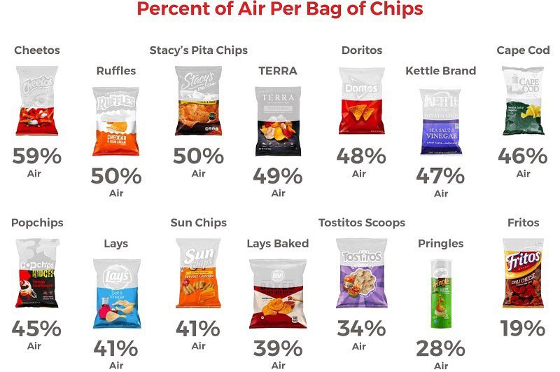

Slide 27
Non-Renewal
Intent to not renew– 8 months prior to expiration
Decisions are transparent based on:
Performance evidence
Achievement of standards and targets
Data used in decision are transparent and available
Public report
Binding arbitration?

Slide 28
Termination - 70 O.S. §3-137
Failure to meet performance targets
Fiscal (mis)management
Violation of law, other good cause
90 days written notice
Informal hearing
14 days
Binding arbitration?

Slide 29
Accountability - 70 O.S. §3-137
Senate Bill 782
Bottom 5% at time of renewal
Average of current year and two prior years
What if accountability system changes?
What if the Sponsor does not close the school?

Slide 30
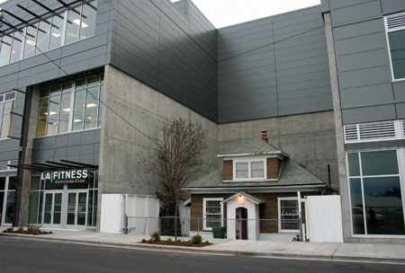
Refusal to Close Shop

Slide 31
Accountability - 70 O.S. § 3-137
If not closed, sponsor appears before State Board of Education
State Board may:
Transfer sponsorship
Order closure
Reduce administrative fee
Due Process?
Other Factors?

Slide 32
Enrollment - 70 O.S. § 3-140
Students who reside within the boundaries or who transfer
Capacity insufficient?
Academic Enterprise Zone – 60% free and reduced
Nondiscrimination
Enrollment caps?
Shall not discriminate/as free and open as traditional school

Slide 33
Attendance – Brick/Mortar
“[a]ll student attendance, absence and transportation information is compiled on a half-day basis with the exception of attendance, absence and transportation information for half-day early childhood or kindergarten programs which are recorded on a full-day basis.” OAC 210:10-1-5(f)(2)

Slide 34
Virtual Attendance
Traditional charter or non-charter
Local policy
Examples:
Hours/day measured across a week by login
Completion of assignments

Slide 35
Attendance – Statewide Virtual Only
Local policy
Quarterly analysis; in attendance if:
Assignments completed on no less than 90% of days within the quarter;
On pace for on-time completion of course (defined by local board); or
Complete no less than 40 instructional activities within quarter
Instructional activity: logins, offline activities, assignments, testing, face-to-face communication or meetings via email, text or phone.

Slide 36
House Bill 1395 (2019)
Virtual Charter School
Board members subject to continuing education requirements
Education Management Organization (EMO)
Report amount paid to EMO, itemized expenditures of and for EMO, and compensation of superintendent
Owner to disclose ownership in business that contracts with school
Suspension of teaching certificate

