Slide 1
OKLAHOMA CHARTER SCHOOLS ACT
Brad Clark
General Counsel
Oklahoma State Board of Education
Brad.Clark@sde.ok.gov
405-420-4318

Slide 2
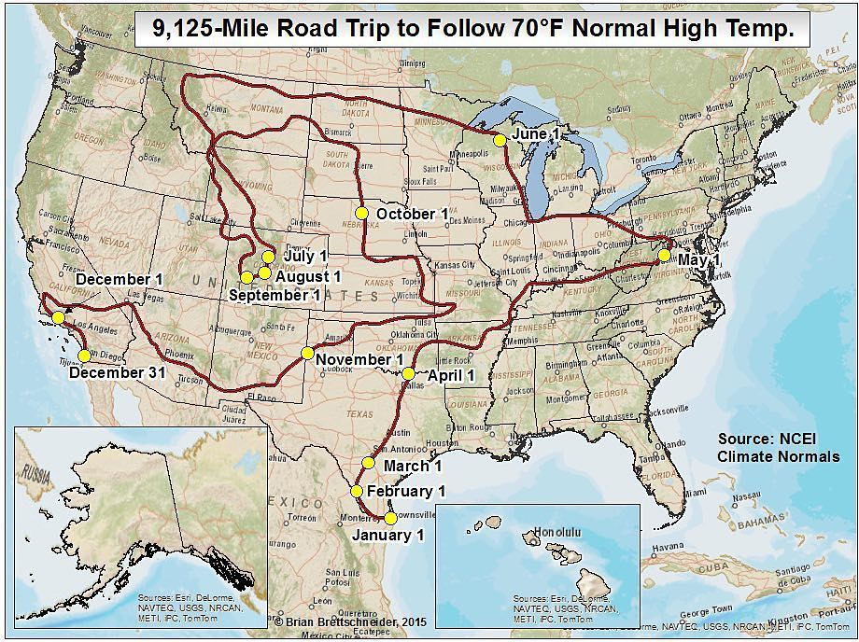

Slide 3
What is a Charter School?
Public School
Contract
Specific curriculum?
Exempt from certain regulations
Teacher Due Process; TLE; collective bargaining; credentialing
Flexibility in exchange for accountability

Slide 4
What is a Charter School?
Charter Sponsor (Authorizer): Allows the school to exist. Receives up to 5% of all state aid from the school in return for services.
Governing Board: Typically incorporated as a 501(c)3, this body is the applicant to the sponsor and manages the school’s function like a school board. They are subject to Open Meetings/Records Act.
School Leadership: This person or team runs the day-to-day operations of the school and is hired and fired by the “Board of Governance.”

Slide 5
Purpose – 70 O.S. §3-131
Improve student learning
Increase learning opportunities for students
Different and innovative teaching
Additional choices
Require measurement of student learning and create innovative forms of measuring student learning
Establish new forms of accountability; and
New professional development opportunities

Slide 6
Sponsors – 70 O.S. §3-132
ANY school district
Technology center school district (29)
Accredited institution of higher education, so long as…
Federally-recognized Indian tribe
Former reservation or treaty area on property held in trust
State Board of Education
Office of Juvenile Affairs (2)
On appeal (5 per year…)
High quality application
Clear demonstration of community support
Decision not supported by greater weight of the evidence
Statewide Virtual Charter School Board

Slide 7
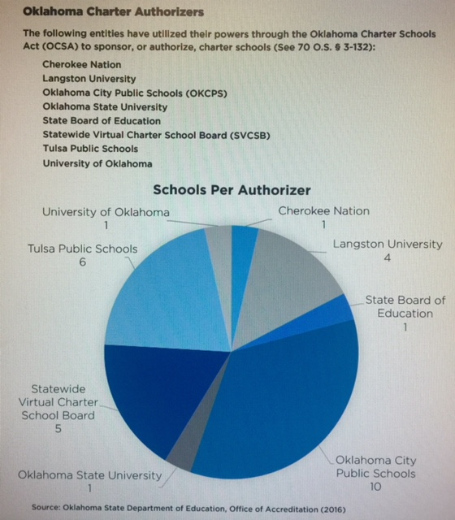

Slide 8
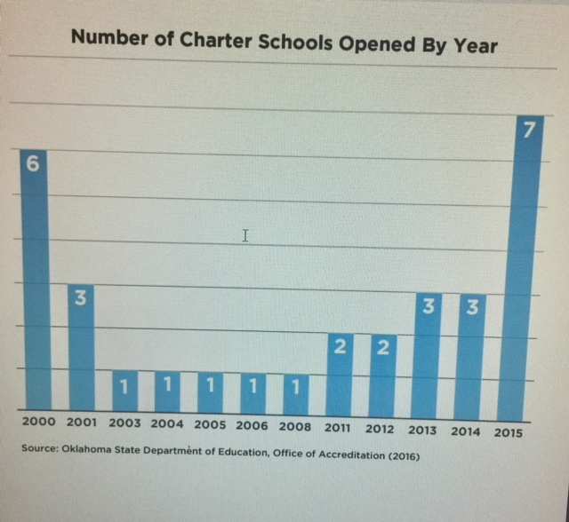
History/Background
1999 – Original enactment
2015 – Senate Bill 782

Slide 9
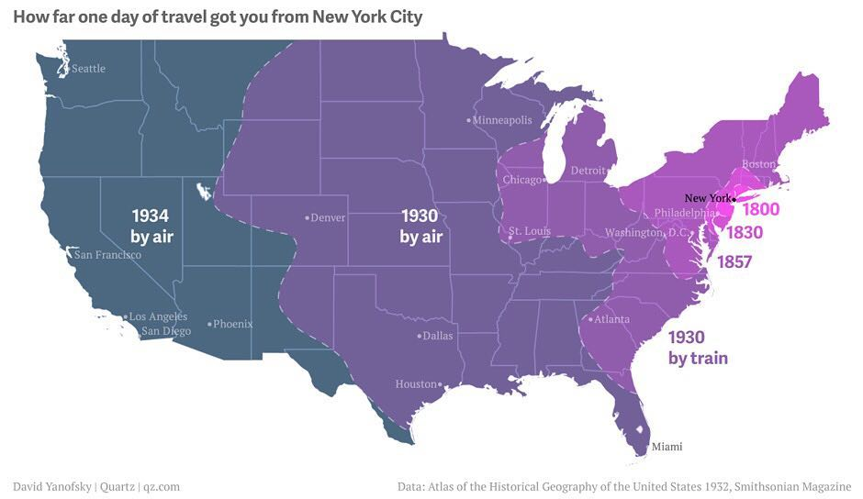

Slide 10
Establishment
Charter school training
Application
Contract

Slide 11
Application Process – 70 O.S. §3-134
Submission: time limitations?
Sponsor has 90 days
Must accept or reject
30 days to submit revised application
30 additional days…
Upon approval/rejection
Approval: negotiate 5 year contract
Rejection: appeal to the State Board of Education (school district only)
Non-school district: proceed to mediation or binding arbitration

Slide 12
Application – 70 O.S. §3-134
10 to 35
Application to a sponsor must include 35 elements:
Financial plans, financial controls and audit requirements
Start-up and 5-year budget including cash flow projections
Facilities plan, including contingency plan
Description of minimum and maximum enrollment (caveat)
Description of academic program aligned with state standards
Instructional framework (class size and structure, teaching methods, etc)
Plan for assessments
Plan for serving students with disabilities, ELL, and struggling students
Demonstration of community support

Slide 13
Application…70 O.S. §3-134
Application…:
Plan for student recruitment
Discipline policies
Organizational structure and responsibilities
Plans for transportation and food service
Governing board must meet at least quarterly within the state
For counties with 500,000- people, a majority of board members must be residents within the geographic boundary of the sponsor
Requirement that the school follow Open Meeting and Open Records Acts

Slide 14
Sponsorship – 70 O.S. §3-134
Upon approval, sponsor charter to provide:
Charter
Charter contract
Minutes
Physical location, grades, and opening date
Powers and duties
Oversight through annual performance reviews
Decline weak or inadequate applications
Monitor performance and legal compliance
Renewal/non-renewal
Develop policies

Slide 15
Contract – 70 O.S. §3-135
Charter incorporation
Admission policies and procedures
“Equally free and open”
Shall not discriminate or limit enrollment
Tiered enrollment?
Lottery?
Management & Administration
Audit procedures
Compliance with Act
Term
Funding

Slide 16
Startup - 70 O.S. §3-135
No hiring or operations until contract is signed
Sponsor “reasonable” preopening requirements
Health, building, safety, insurance, other legal requirements
Employment Agreement
Professional development
Certification
Leave policy
Suspension/dismissal
Rights if closed/terminated

Slide 17
Performance Framework – 70 O.S. §3-135
Annual review
Academic proficiency
Academic growth
Attendance
Graduation rate
Postsecondary readiness
Financial
Governing board performance

Slide 18
Renewal - 70 O.S. §3-137
4th year of operation
Summary of performance to date
Consideration of at-risk population
Weakness/concerns?
Opportunity to respond
5th year of operation
Renewal application
Improvements planned and/or undertaken
Plan for next term
Intent to not renew– 8 months prior to expiration
Decisions are transparent based on:
Performance evidence
Achievement of standards and targets
Public report
Binding arbitration

Slide 19
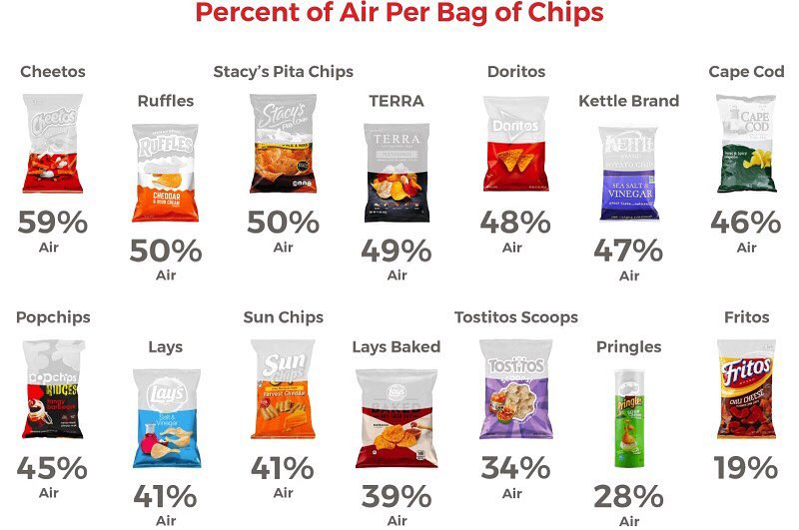

Slide 20
Termination - 70 O.S. §3-137
Failure to meet performance targets
Fiscal (mis)management
Violation of law, other good cause
90 days written notice
Informal hearing
14 days
Binding arbitration?

Slide 21
Compliance - 70 O.S. §3-136
Except as provided for in the Charter Schools Act…exempt from statutes, rules, and regulations
Federal regulations, state law, rules relating to health, safety, civil rights and insurance
Nonsectarian
Oklahoma School Testing Program
Financial audits, audit procedures, reporting requirements
Use Oklahoma Cost Account System (OCAS) to report financial transactions
Individuals with Disabilities Education Act (IDEA)

Slide 22
Compliance - 70 O.S. §3-136
Board member conflict of interest statutes
No tuition or fees
No home school generation of revenue
Days of instruction (180 days/1080 hours)
Student suspension
School district for Governmental Tort Claims Act
Teachers retirement?
No taxes or issuing bonds, but…
Quarterly board meetings
Open Meetings Act
Open Records Act

Slide 23
Open Meetings Act – 25 O.S. §301
Encourage and facilitate informed citizenry
Meetings of public bodies at place, time and location convenient and open to public
Does not include informal gatherings
Advance notice of meeting
Executive session – do not do unless specifically authorized by 25 O.S. 307(b)
Penalties

Slide 24
Open Records - 51O.S. §24A.1
Front page of the paper theory
Things created by or in the custody of public body
E-mail?
Confidential
Student records
Attorney-client
Executive session
Personnel records?
Violations?

Slide 25
Accountability - 70 O.S. §3-137
Senate Bill 782
Bottom 5% at time of renewal
Average of current year and two prior years
What if A-F changes?
What if the Sponsor does not close the school?

Slide 26
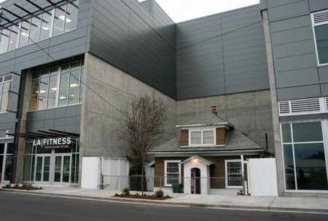
Refusal to Close Shop

Slide 27
Accountability - 70 O.S. §3-137
If not closed, sponsor appears before State Board of Education
State Board may:
Transfer sponsorship
Order closure
Reduce administrative fee
Due Process?
Other Factors?

Slide 28
Enrollment - 70 O.S. §3-140
Students who reside within the boundaries or who transfer
Capacity insufficient?
Academic Enterprise Zone – 60% free and reduced
Nondiscrimination
Enrollment caps?
Shall not discriminate/as free and open as traditional school

Slide 29
Disclaimer
General Counsel to the State Department/State Board of Education represents the Oklahoma State Department/Board of Education
This document provides general information regarding the Oklahoma Charter Schools Act and should not be construed as professional advice or opinion on specific facts or circumstances
Charter school applicants should consult with their own independent legal counsel for advice in matters regarding the Oklahoma Charter Schools Act.

