Slide 1
Academic Assessment Monitoring Program (Narrated Version)
Desk Monitoring

Slide 2
Purpose
To meet federal requirements, Oklahoma’s AAMP evaluates school district implementation of both federal- and state-required academic assessments.
All public school districts will be monitored at least once during the established five-year cycle.
An electronic version of the five-year monitoring cycle is updated on an annual basis and posted to the Test Security and Assessment Monitoring page
The Desk and On-site Monitoring Checklists has been revised
All monitoring types require districts/sites to submit information contained in the desk monitoring checklist
Districts will be notified of on-site monitoring at least 10 working days before the opening of the testing window.

Slide 3
Required Documentation

Slide 4
Desk Monitoring
2 types on documentation
District/site provided documentation
Line items 1 – 12
State collected documentation
Line items 13 – 17

Slide 5
District and Site Provided Documentation

Slide 6
Line Item 1 - Training
Provide evidence of training for Building Test Coordinators, Test Administrators, and Test Proctors.
BTCs were trained by either their OSDE-trained DTC or via an OSDE Test Prep In-service training.
Certificate of training from TA/TP modules

Slide 7
Provide evidence of training for Building Test Coordinators BTCs were trained by either their OSDE-trained DTC or via an OSDE Test Prep In-service training.
Certificate from attendance to the OSDE provided DTC training
Sign-in sheet from attendance to an in-service training
Training must be provided by an OSDE-trained DTC
Record of training must include:
Date training occurred
Agenda of training
Printed names and signature of BTCs in attendance

Slide 8
Provide evidence of training for Test Administrators/Test Proctors Record of training from TA/TP modules
Only training certificates for the TA/TP modules will be accepted as a record of training
Name on the certificate must match the name used to sign security documentation.
Date of training on the certificate must be prior to administering/proctoring tests
Altered certificates will not be accepted

Slide 9
Line Item 2 – Testing Schedule
Provide the site Official Schedule of Testing.
Schedule must include all testing sessions conducted at the site
Official Schedule of Testing

Slide 10
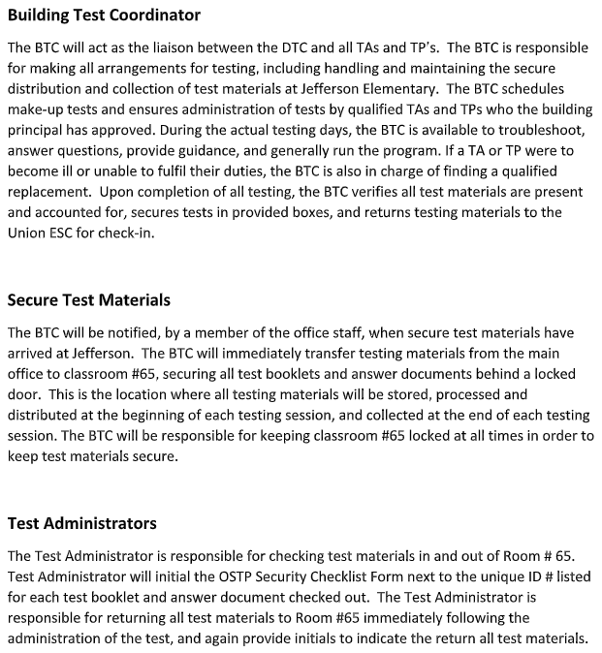
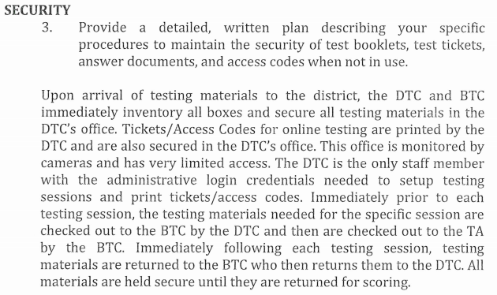
Line Item 3 – Test Security Provide a detailed, written plan describing your district’s specific procedures to maintain the security of test booklets, test tickets, answer documents, and access codes.

Slide 11
Line Item 4 – Test Security
Provide your district’s detailed, written plan for the transfer of secure testing documents to and from an Alternate Site of Instruction (e.g., hospital, juvenile detention center, homebound, etc.). Required, even if your site did not use and alternate testing site.

Slide 12
Line Item 5 – Calculator Use
Provide your plan for implementing the state calculator policy, including who will implement the plan. Plan must include how it is used, which faculty member is in charge of implementation, and how students have access.

Slide 13
Line Item 6 – Emergency Plan
Provide your detailed, written communication plan in case of emergencies including: student illness, power failure, fire/tornado alarm, and evacuation of building. This must include:
what will be done with secure test materials,
how this will affect students,
what will be done to handle the testing environment, and
who will complete the Test Irregularity form.

Slide 14
Line Item 7 - Accommodations
Provide your detailed, written school plan and procedures for providing testing accommodations. This must include:
who is responsible for verifying the accommodation received is documented on the students IEP, 504 Plan, or ELAP.

Slide 15
Line item 8 – Students Needing Additional Time
Provide your detailed, written school plan for unaccommodated students who need additional time. This must include:
the location where students will continue testing,
how materials will be handled, and
how a secure testing environment will be ensured.

Slide 16
Line Item 9 – Security Breaches
Provide your detailed, written school plan and procedures for handling test security breaches. Plan must include:
Who determines a breach has occurred
Who requests a test invalidation in the Testing Status Application
How will testing be completed

Slide 17
Line Item 9 – Security Breaches Provide your detailed, written school plan and procedures for handling test security breaches in the Testing Status Application

Slide 18
Line Item 10 – Test Irregularities
Provide your detailed, written school plan and procedures for self reporting test irregularities. Plan must include:
Who completes the Test Irregularity Form
How (if applicable) will testing be completed

Slide 19
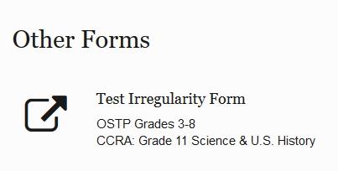
Line Item 10 – Test Irregularities Provide your detailed, written school plan and procedures for handling self-reporting test irregularities using the Test Irregularity Form

Slide 20
Line Item 11 – Emergency Accommodations
Provide your plan for implementation of Emergency Accommodations (EA Form). Required, even if your site did not use an Emergency Accommodation.

Slide 21
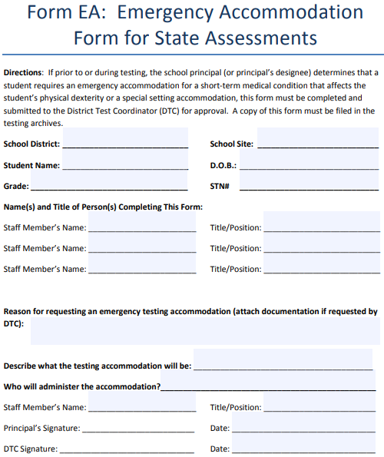
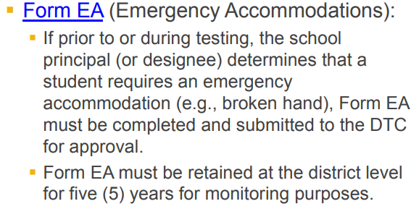
Line Item 11 –Emergency Accommodations

Slide 22
Line Item 12 – Nonstandard Accommodations
Provide your plan proper implementation of Nonstandard Accommodations (ELA Test Read-Aloud & Unique). Required, even if your site did not use these accommodation types.

Slide 23
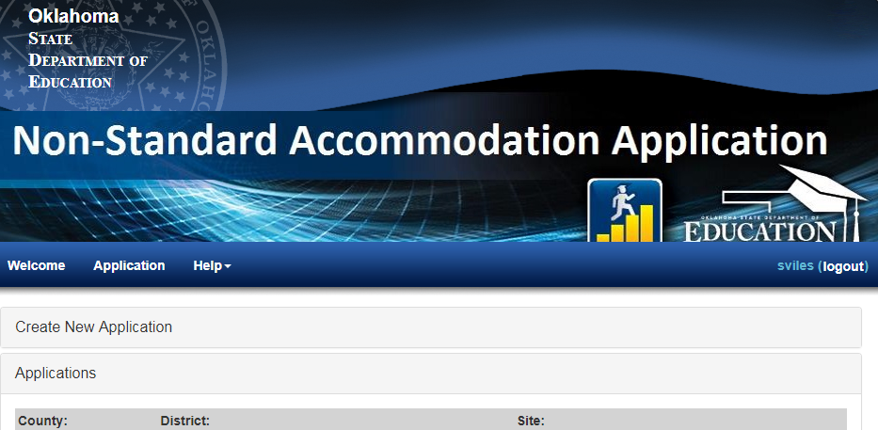
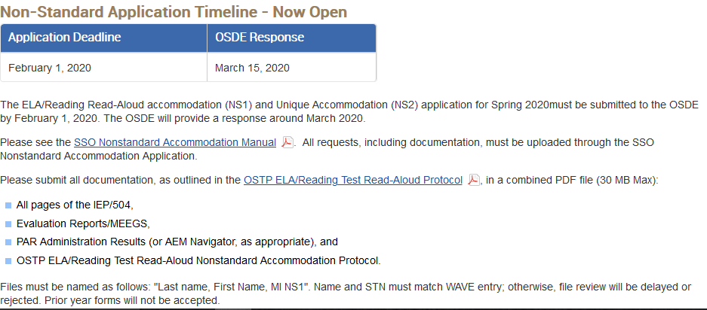
Line Item 12 – Nonstandard Accommodations proper implementation of Nonstandard Accommodations(ELA Test Read-Aloud & Unique)

Slide 24
State Collected Documentation

Slide 25
Line Items 13-16 – Vendor Supplied Information
District Test Coordinator (DTC) attended Test Preparation In-service Training provided by the OSDE.
District and Building Security forms, and TA Security forms completed via DocuSign with the correct County-District-Site (CDS) codes.
Test Security forms and seating charts completed and returned to ACT/SAT (HS Only)
All test booklets and materials accounted for, from current administration. (missing test books reported to the OSDE by the testing vendor).

Slide 26
Line Item 17 – IEP/504 Plans
Students designated as Special Education or 504 must have valid eligibility documentation and have an IEP or 504 Plan in effect for the current school year. The OSTP approved accommodations used by students must be documented on an IEP or 504 Plan and they must be routinely used as part of classroom instruction and assessments. The OSDE may sample a selection of IEPs for review through EdPlan.

Slide 27
Submitting Documentation
Monitoring documentation received at SDE by June 5, 2020. Failure to submit documentation by this date may result in an automatic non-compliance status.
Submitting Documentation
Email to Assessments@sde.ok.gov with subject line: Desk Monitoring
Mail flash-drive to:
Office of Assessments
2500 N Lincoln Blvd, Suite 214
Oklahoma City, OK 73105-4599

